Slide 1

Comparison of Flare Forecasting Methods

Slide 2
Focus of the workshop
Workshop was in 2009
Focus of workshop was on “all-clear” forecasts
  Predicting time intervals during which no flares occur
Results presented focus on comparing flare predictions
  Most forecasting methods focus on predicting probability a flare will occur
  Not specific to all-clear forecasts

Slide 3
Data
From Solar and Heliospheric Observatory / Michelson Doppler Imager
  (SOHO/ MDI)
  Contains sub-areas extracted from full-disk magnetogram and continuum images
  FITS format
Data was for particular time and particular active region
  ”single snapshots” and do not include evolution of active region
  Data was not ideal for many methods
Line-of-sight magnetic field data for years 2000-2005 inclusive
Participants use their own methods to make predictions from the data

Slide 4
Data extraction
Daily magnetogram + continuum images near ~12:45–13:00 UT.
Active region coordinates taken from NOAA daily reports.
  National Oceanic and Atmospheric Administration
Regions extracted as rectangular patches, size scaled by region area and disk position.
Overlapping extracted boxes merged into a single cluster if overlap >95% of combined area.
Merging restricted to same hemisphere.
Manual intervention used in rare cases to avoid “full-Sun” clusters.
  In practice, fewer than 10 cases of this
In total, 12,965 data points (daily extracted magnetograms) between 2000-2005

Slide 5
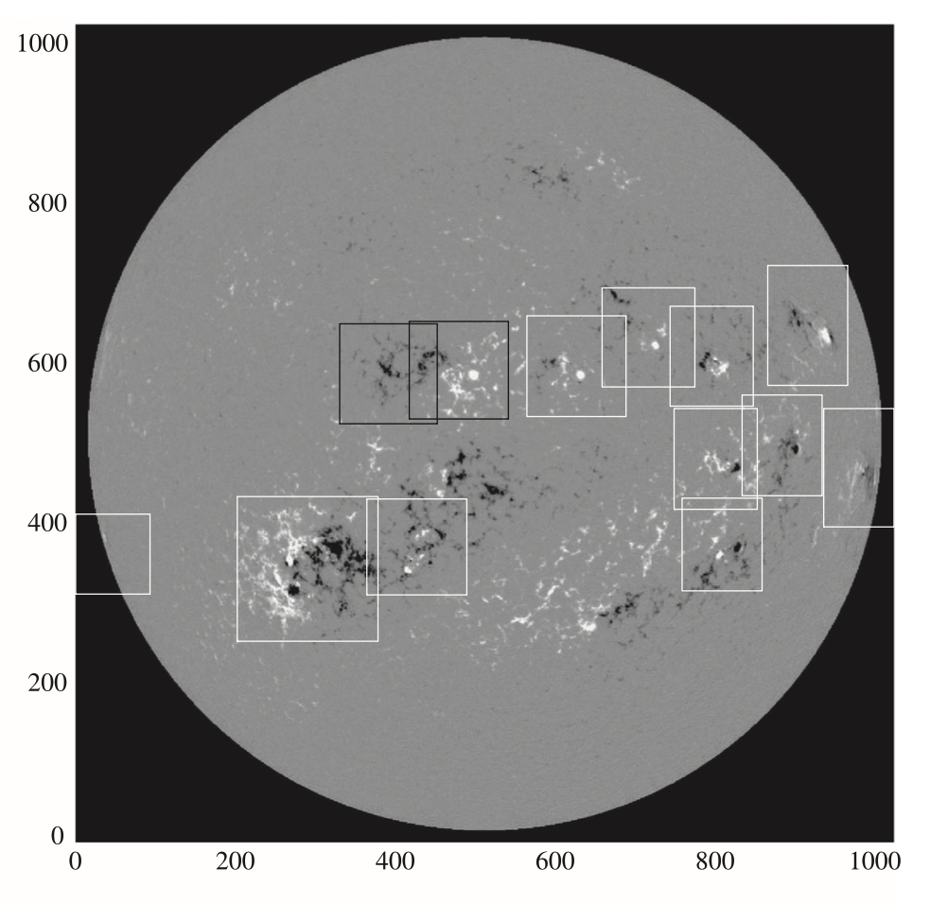
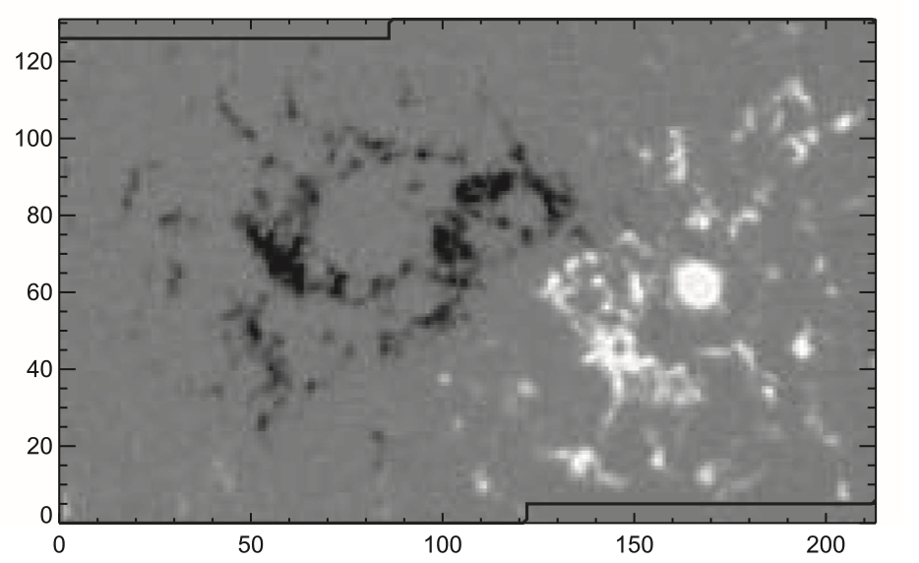
Data extraction
Notes:
A / sqrt (area box 1 x area box 2) > 0.95
A is area of overlap of two boxes
If above then ”merged cluster”

Slide 6
Event sample definitions
Three event thresholds:
  C1.0+ (24 hr window)
  M1.0+ (12 hr window)
  M5.0+ (12 hr window)
Constructed from flares recorded in NCEI archives
  National Center for Environmental Information
Multiple flares in window count as a single event.
Event timing can cause rare double-counting when daily images are slightly offset.
Substantial fraction of small flares not associated with active region (~38% for all C)

Slide 7
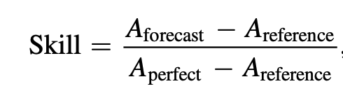
Evaluation Methods – generalized skill score
Compare forecasts to a reference forecast.
Normalize relative to:
  A_perfect → accuracy of a perfect system
  A_reference → accuracy of reference method
  A_forecast → accuracy of method under consideration

Slide 8

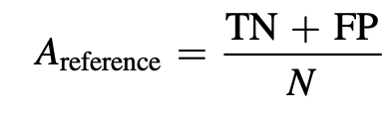
Evaluation methods – ApSS, HSS, TSS
For binary, categorical forecasts –
A_perfect = 1
Appleman’s Skill Score (ApSS) –
  Used when TP + FN < TN + FP
HSS
TSS

Slide 9


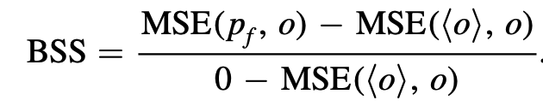
Measure of accuracy
Flare forecasting methods discussed here generally predict probability of flare of given class occurring, rather than binary, categorical forecast.
A_perfect = 0 (MSE of 0)
Notes:
P_f – forecast probability
O – observed outcome

Slide 10
Probability thresholds
Due to probabilistic forecasts, need probability threshold to convert
Any forecast > P_th = event
Poisson
  threshold that depends on ratio FN / FP with FN / FP ~ 1 for HSS
  FN / FP = N_event / N_no_event for TSS
Similar method for each combination of method, skill score, and event definition

Slide 11
Prediction methods
Generally consists of two parts
  Parameterization of observational solar data to characterize target active region
    Calculating total magnetic flux, length of strong neutral lines, etc.,
  Statistical method by which prior params or flaring activity was used
One end of the spectrum are methods based on McIntosh-like classification
  Historical flaring rate used as look-up table
Machine learning techniques that do not employ a priori classifications
No attempt was explicitly made to combine parameterization by one group with predictions algorithm of another

Slide 12
Data subsets
AD — All Data
  Uses climatology when a method provides no forecast.
  Ensures full coverage but penalizes methods that only forecast on small subsets.
MCD#1 — Max Common Dataset (all methods except event-statistics)
  Largest subset where all included methods provide forecasts.
  Restrictions mostly geometric (e.g., disk-center distance).
  Event rates similar to AD → similar underlying population.
MCD#2 — Max Common + Event-Statistics Requirements
  Adds requirement of ≥10 prior events.
  Produces very different population (event rates change up to ×10).

Slide 13
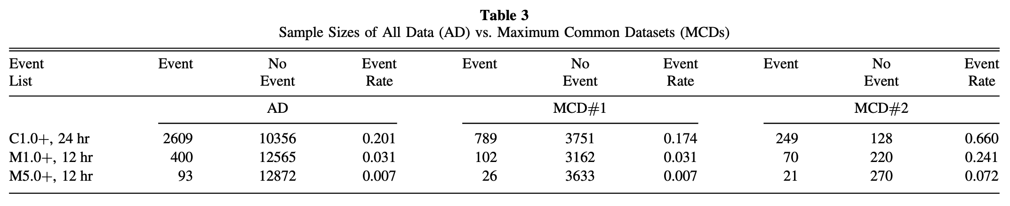
Data subsets - impact
Methods trained on AD may suffer when evaluated on MCDs.
MCD#1 is relatively consistent with AD → minimal population shift.
MCD#2 introduces major sampling bias, especially for small events.
Despite population differences, performance is shown for all three to illustrate these effects.
Notes:
- notes: FITS take note

Slide 14
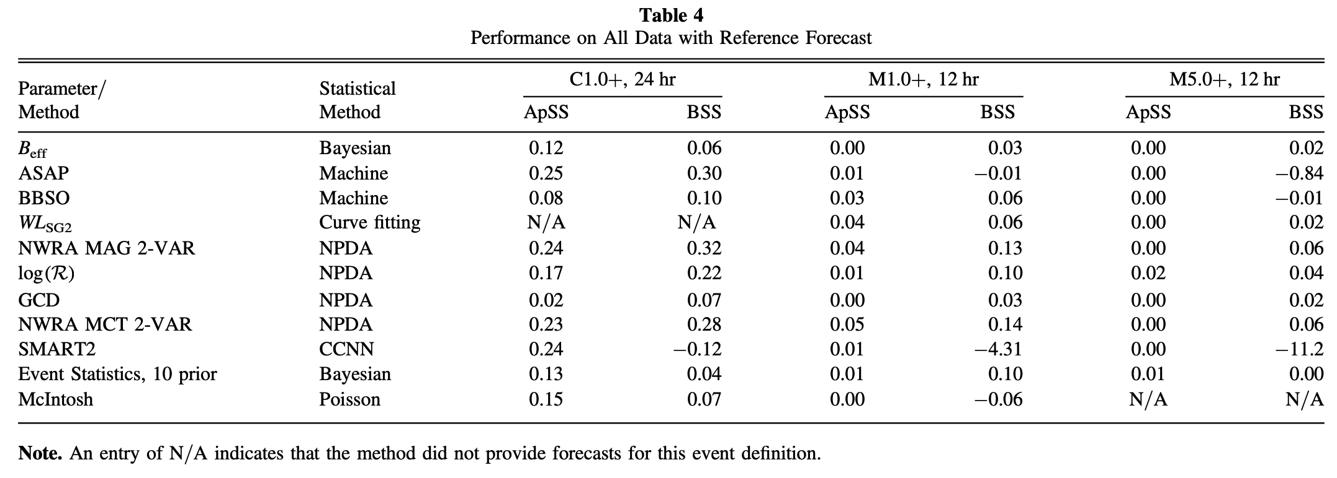
Model performance comparison
Notes:
- NPDA – nonparametric discriminant analysis

Slide 15
Model performance comparison
Tendency for ML algorithms to produce best categorical forecasts (high ApSS)
Nonparametric discriminant analysis (NPDA) produced best probability forecasts (BSS)
BSS penalizes ML algorithms that overpredict or underpredict

Slide 16
Approach evaluation
Many groups computed same parameters, implementations differ significantly
  Values for same parameter are substantially different
A major one is total unsigned magnetic flux of a region
  Direct measure of region size
Main conclusions
  Implementation details greatly influence resulting parameters values
    Although surprisingly little difference in forecasting ability of quantities considered
    Many parameters used are correlated with each other, bringing no independent information to forecasts
  May be a limited amount of information available only using line-of-sight magnetic field without additional modeling

Slide 17
Second meeting
New data from Helioseismic and Magnetic Imager (HMI) on Solar Dynamics Observatory (SDO)
  Significantly improved data
This research comparison limited to those running in operational manner, providing forecast on routine, consistent basis
Not required to be automatic – “forecaster in the loop” (FITL)
Not Providing forecast on daily basis again penalized by eval metrics
Testing interval of 2016 Jan 1 – 2017 Dec 31
Event definitions – “C1.0+/0/24”
  Thresholds, latency in hours, validity period in hours

Slide 18
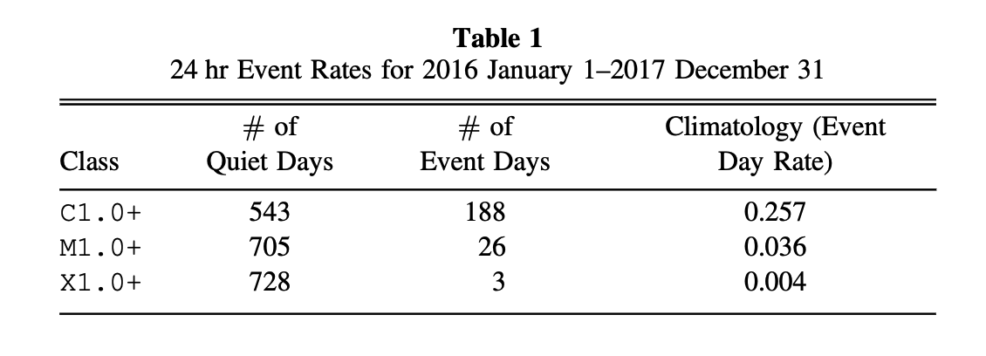
Data

Slide 19
Change in metric / skill score P_threshold
These methods not explicitly optimized for particular probability threshold
p_th = 0.5
All methods missing forecasts were assigned p = 0
  The penalty for not forecasting
The no-skill forecasts calculation
  t = day
  N = 120 days up to and including t -1
  Used as reference forecast’s predicted probability for date t

Slide 20
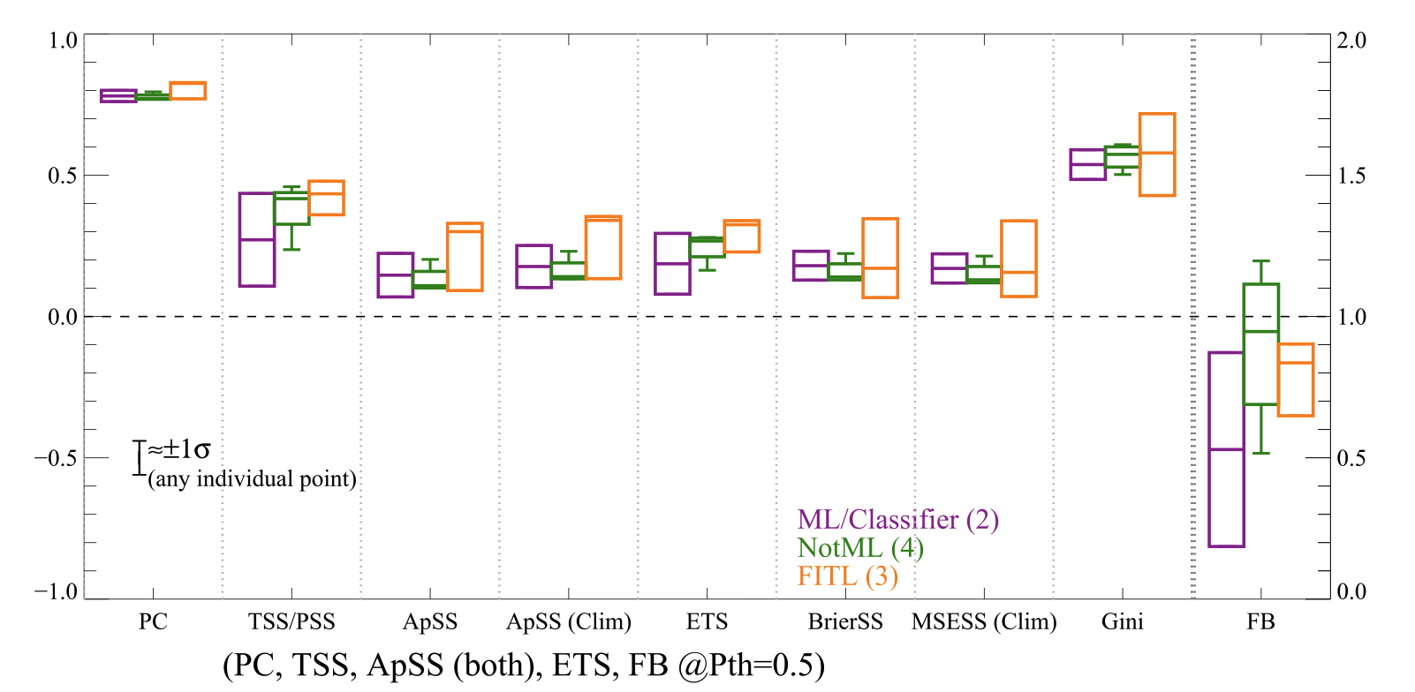
Comparison of ML – Not ML - FITL

Slide 21
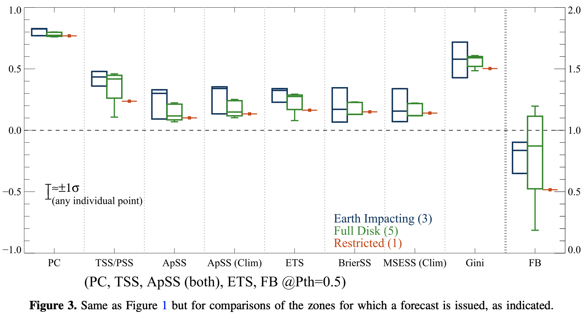
Comparison of observational limits
Notes:
- Restricted means close to central meridian
– full disk – most popular
- Earth impacting – not yet visible but expected regions (new or returning) - forecasting for anything impactful even from regions that are not yet or no longer visible

Slide 22
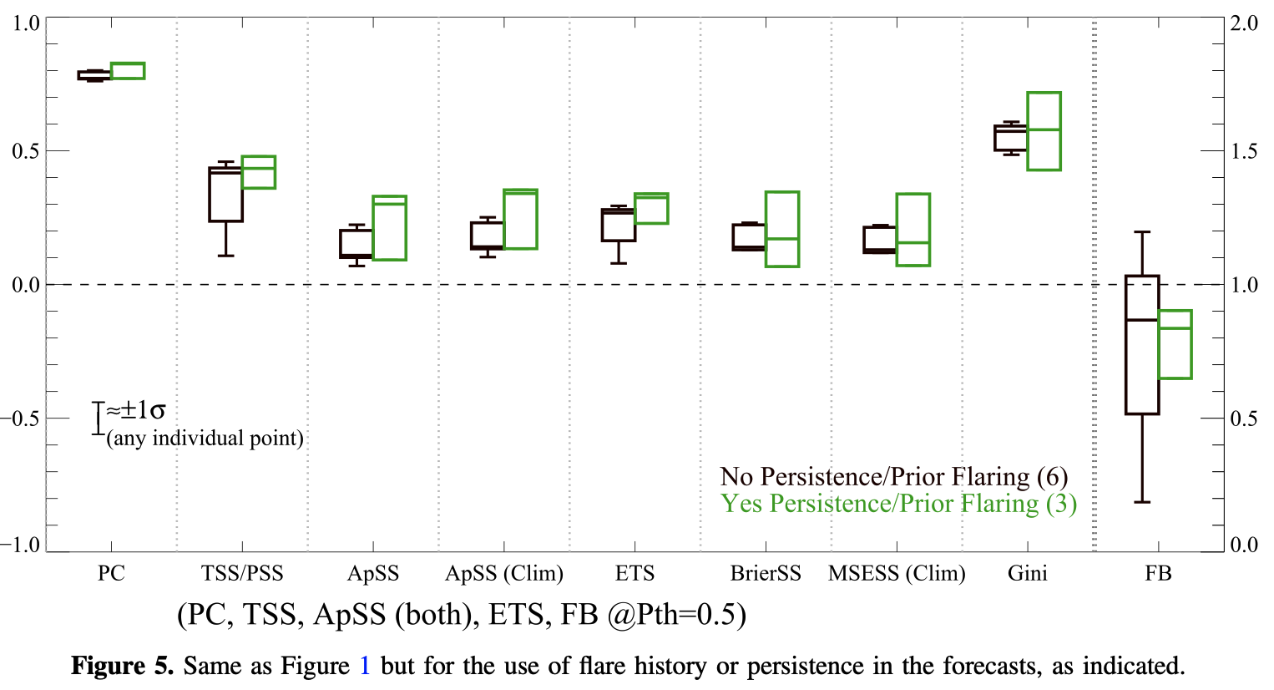
Comparison of persistence
Notes:
- Restricted means close to central meridian
– full disk – most popular
- Earth impacting – not yet visible but expected regions (new or returning) - forecasting for anything impactful even from regions that are not yet or no longer visible

Slide 23
Conclusion
No trend present significantly outperforms others
Slight advantage to ML
Including FITL does appear to be better
  Did not distinguish between ML / Non ML that use FITL
Disadvantage to using restricted
Advantage to using persistence / prior flare activity
  They say they are different but did not differentiate
Use of modern data no significant impact
Not enough ML in operation and limit of sample sizes leads to no comment on any advantages or disadvantages of ML in operational flare forecasting

