Slide 1

A Dive Into React

Slide 2
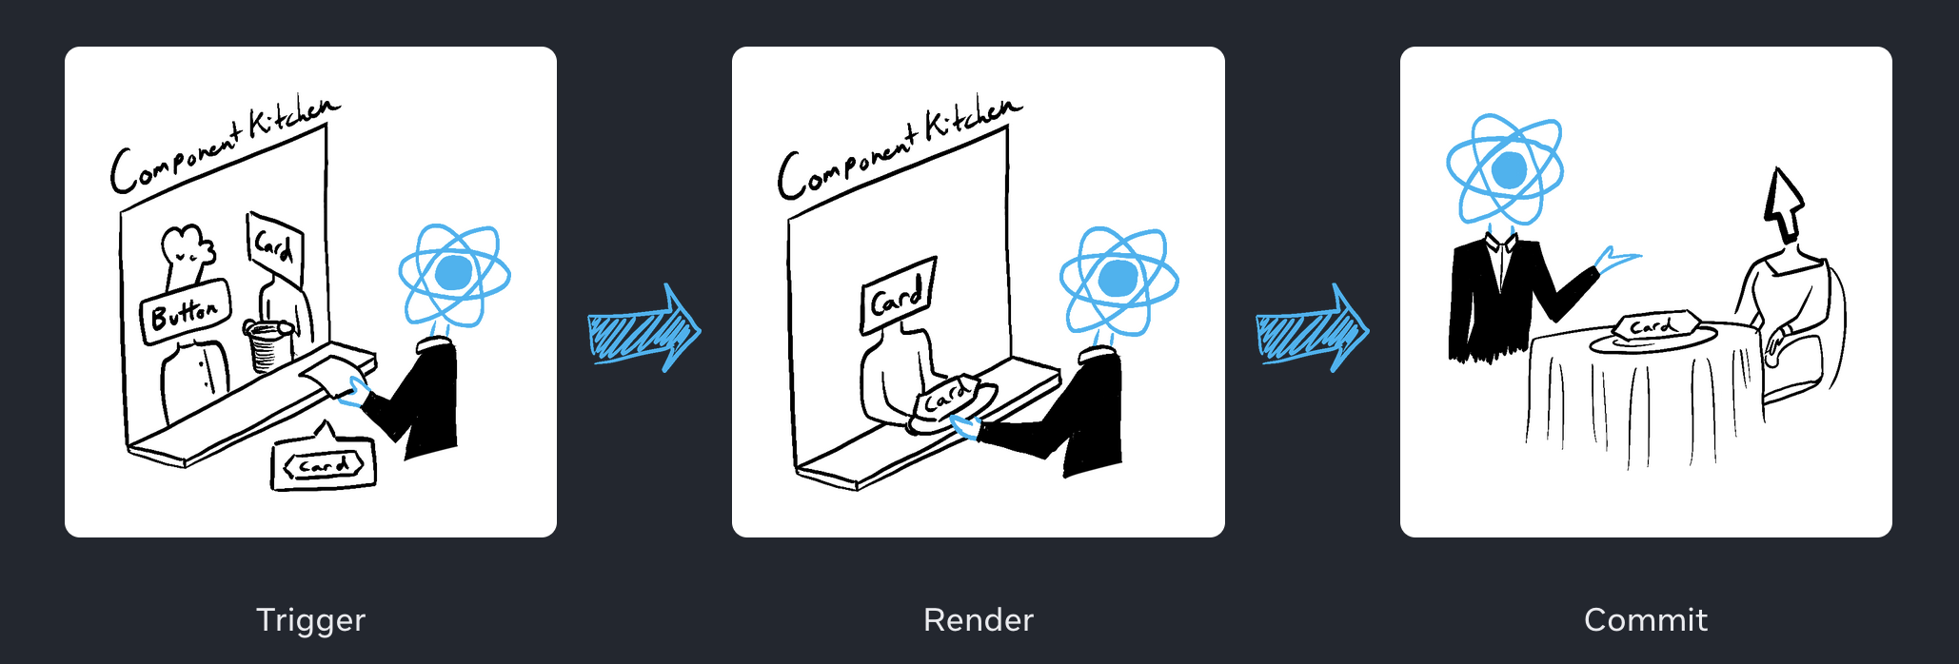
The Two Phases of React
Render phase (includes reconciliation)
  “Rendering” is React calling your components
  Call component function and build virtual DOM
  Compute the diff
  Synchronous
Commit phase
  Applies necessary changes to real DOM
  Paint the screen
  Run previous effect cleanup functions
  Run new effect callbacks
react.dev

Slide 3
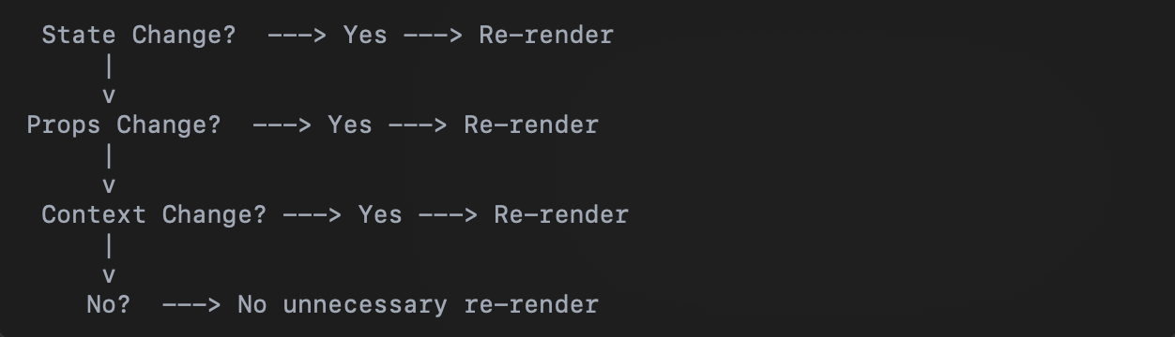
What Triggers a Re-Render?
3 main triggers
  State
  Props (Parent -> child components)
  Context
Re-render != repainting
Which operation costs more?
Img from ChatGPT

Slide 4
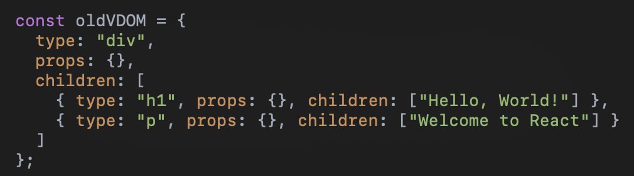
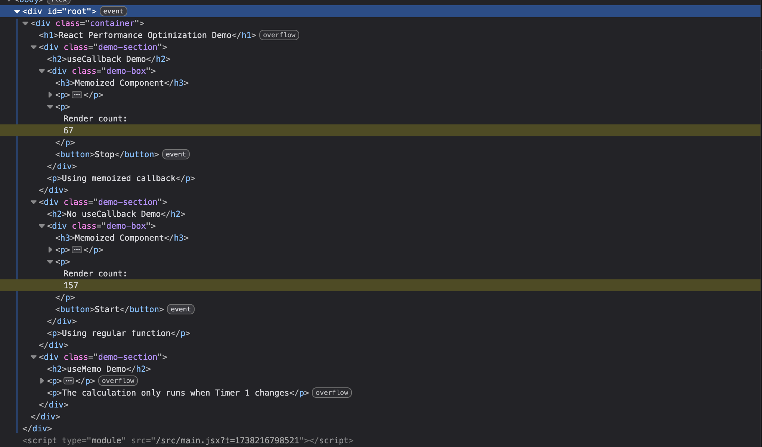
React’s Reconciliation Process (Render Phase)
React creates a new Virtual Dom tree (just JS objects!)
Compares the new Virtual DOM with previous one (diffing)
Updates only the changed parts in real DOM

Slide 5
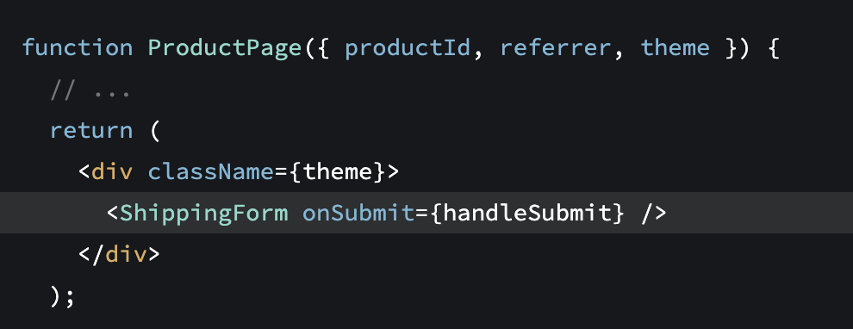
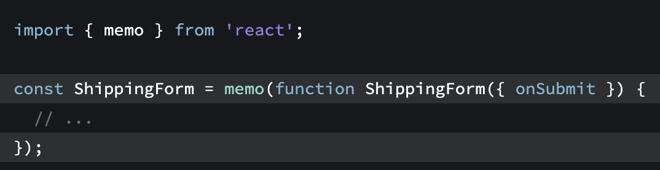
Optimization Techniques
useMemo - cache result of calculation between re-renders
useCallback – cache a function definition
memo – allows skipping of a re-render when props are unchanged
Typically used in combination
Define static things in module scope
There are many other ways, but these are some of the most common and can apply to many use cases
Note! React Compiler is coming
Images from react docs

Slide 6
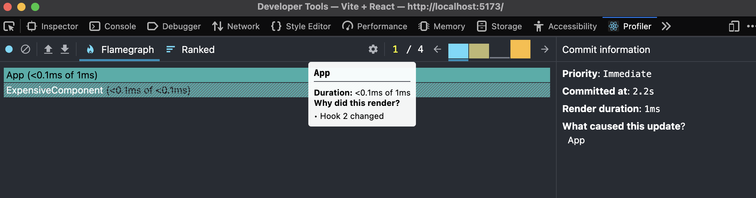
When to use these techniques?
Profiler (React dev tools ext)
<Profiler> for programmatically
Technically there is nothing wrong with overuse. React even addresses that here
One negative impact may be readability
Make sure the techniques you implement are doing what you expect. Verify in Profiler

Slide 7
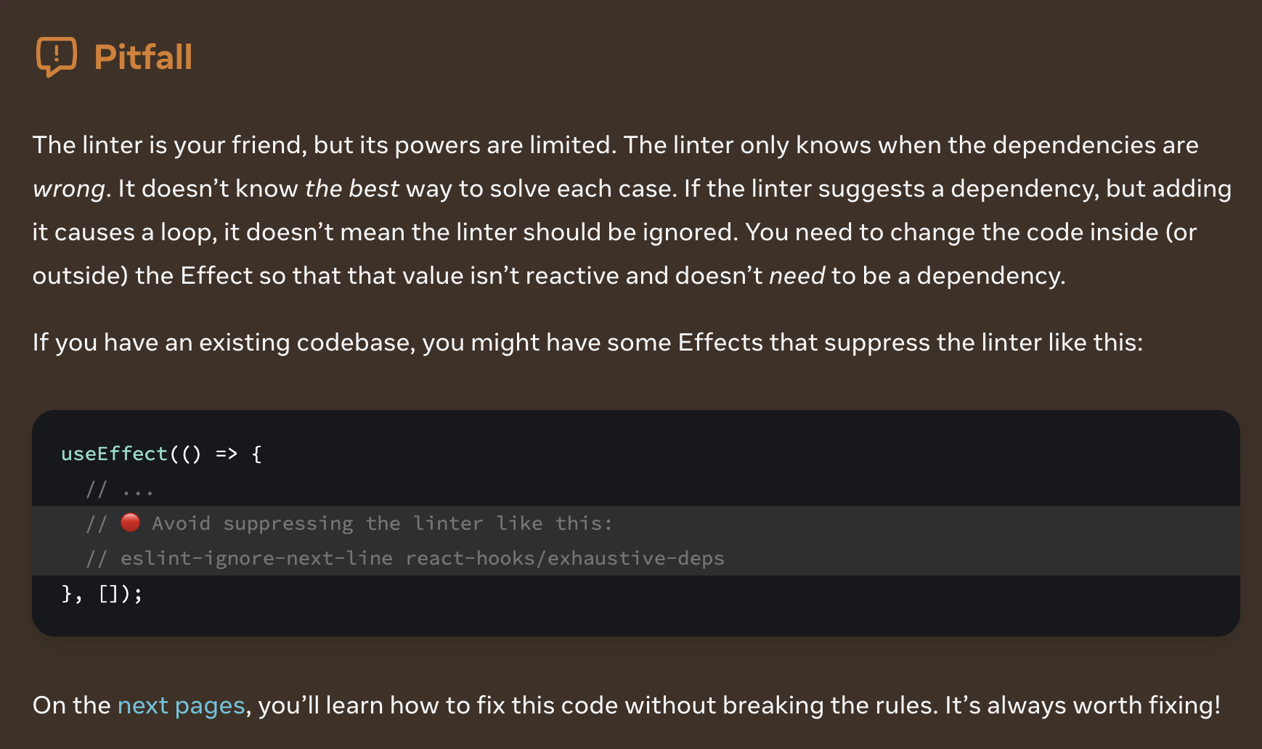
To be… or not to be… an Effect
Data fetching is common in useEffect but has issues
  Effect runs AFTER commit
  Specific libraries and frameworks to handle this, react-query, react router, etc..
Handles side effects outside rendering calculation
Runs after EVERY render unless dep array provided.
  Refs and set functions have stable identity
  Caveat – refs passed from a parent
  Reactive values include props and all variables and functions declared directly inside of your component
Logic that should only run once when application starts can be outside your components (module initialization level) but don’t overuse

Slide 8
Sources:
Images and code snippets courtesy of ChatGPT
https://react.dev/reference/react/useMemo#memoizing-a-function
https://react.dev/reference/react/hooks#performance-hooks
https://react.dev/learn/synchronizing-with-effects

