Slide 1


Sink or Swim?
Titanic survivor prediction

Slide 2
Problem definition
The goal of this project is to build a model that could predict whether a passenger survived or not. It is a binary classification problem
891 samples, 12 attributes, 7 predictors, and 1 target variable. The predictor variables are Sex, Age, Pclass, SibSp, Parch, Fare, and Embarked. The target variable is Survived
Data source - Kaggle Titanic Dataset
Machine learning algorithm – Logistic Regression since it is a supervised algorithm
Metric of assessment – Accuracy and F1 Score compared with the model run here which also used Logistic Regression. Target for test accuracy is 81% with an F1 score of 80%

Slide 3
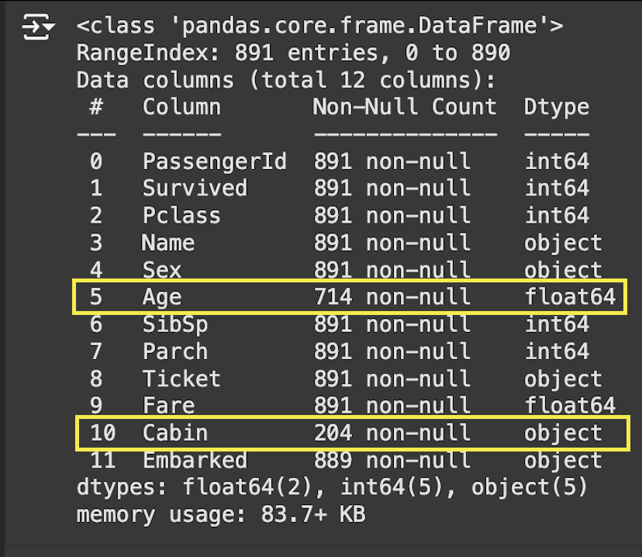
Exploring the data
Notice Age, Cabin, and Embarked have null values
Name, Sex, Ticket, Cabin, and Embarked are not integer values
Name, PassengerId, Ticket, and Cabin can be dropped

Slide 4
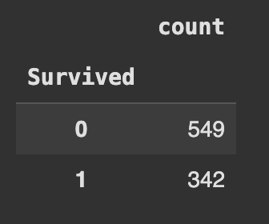
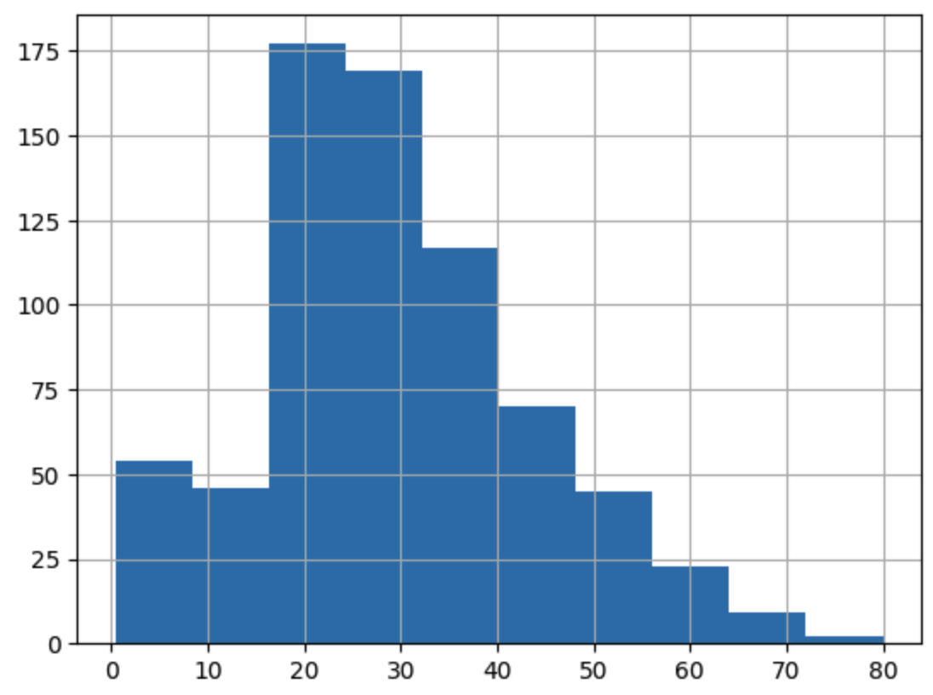
Exploring the data
Imbalanced data will need to be handled using SMOTE (Synthetic Minority Over-sampling Technique)
Age is skewed so use median to fill in values as median is less affected by outliers

Slide 5
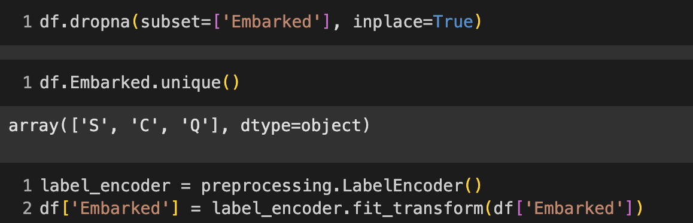
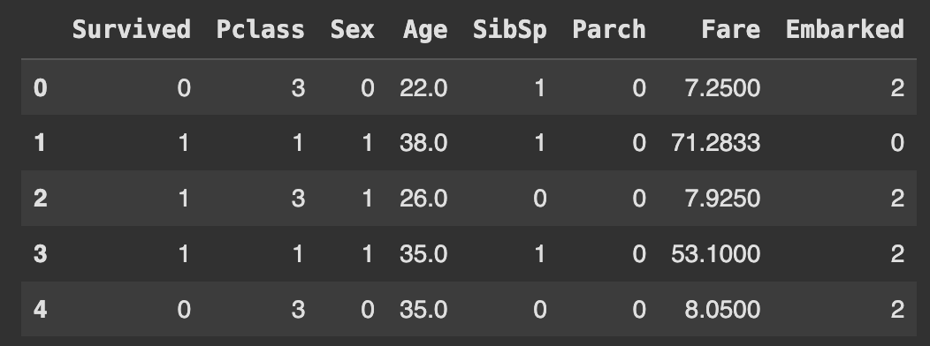
Handle missing values
Age and Embarked are the remaining features with missing values
Fill null age values with the median age
Drop the two null rows then encode Embarked.
All predictors are now numerical and missing values have been handled
Notes:
Embarked ports were Southampton, U.K, Cherbourg, France, Queenstown, Ireland

Slide 6
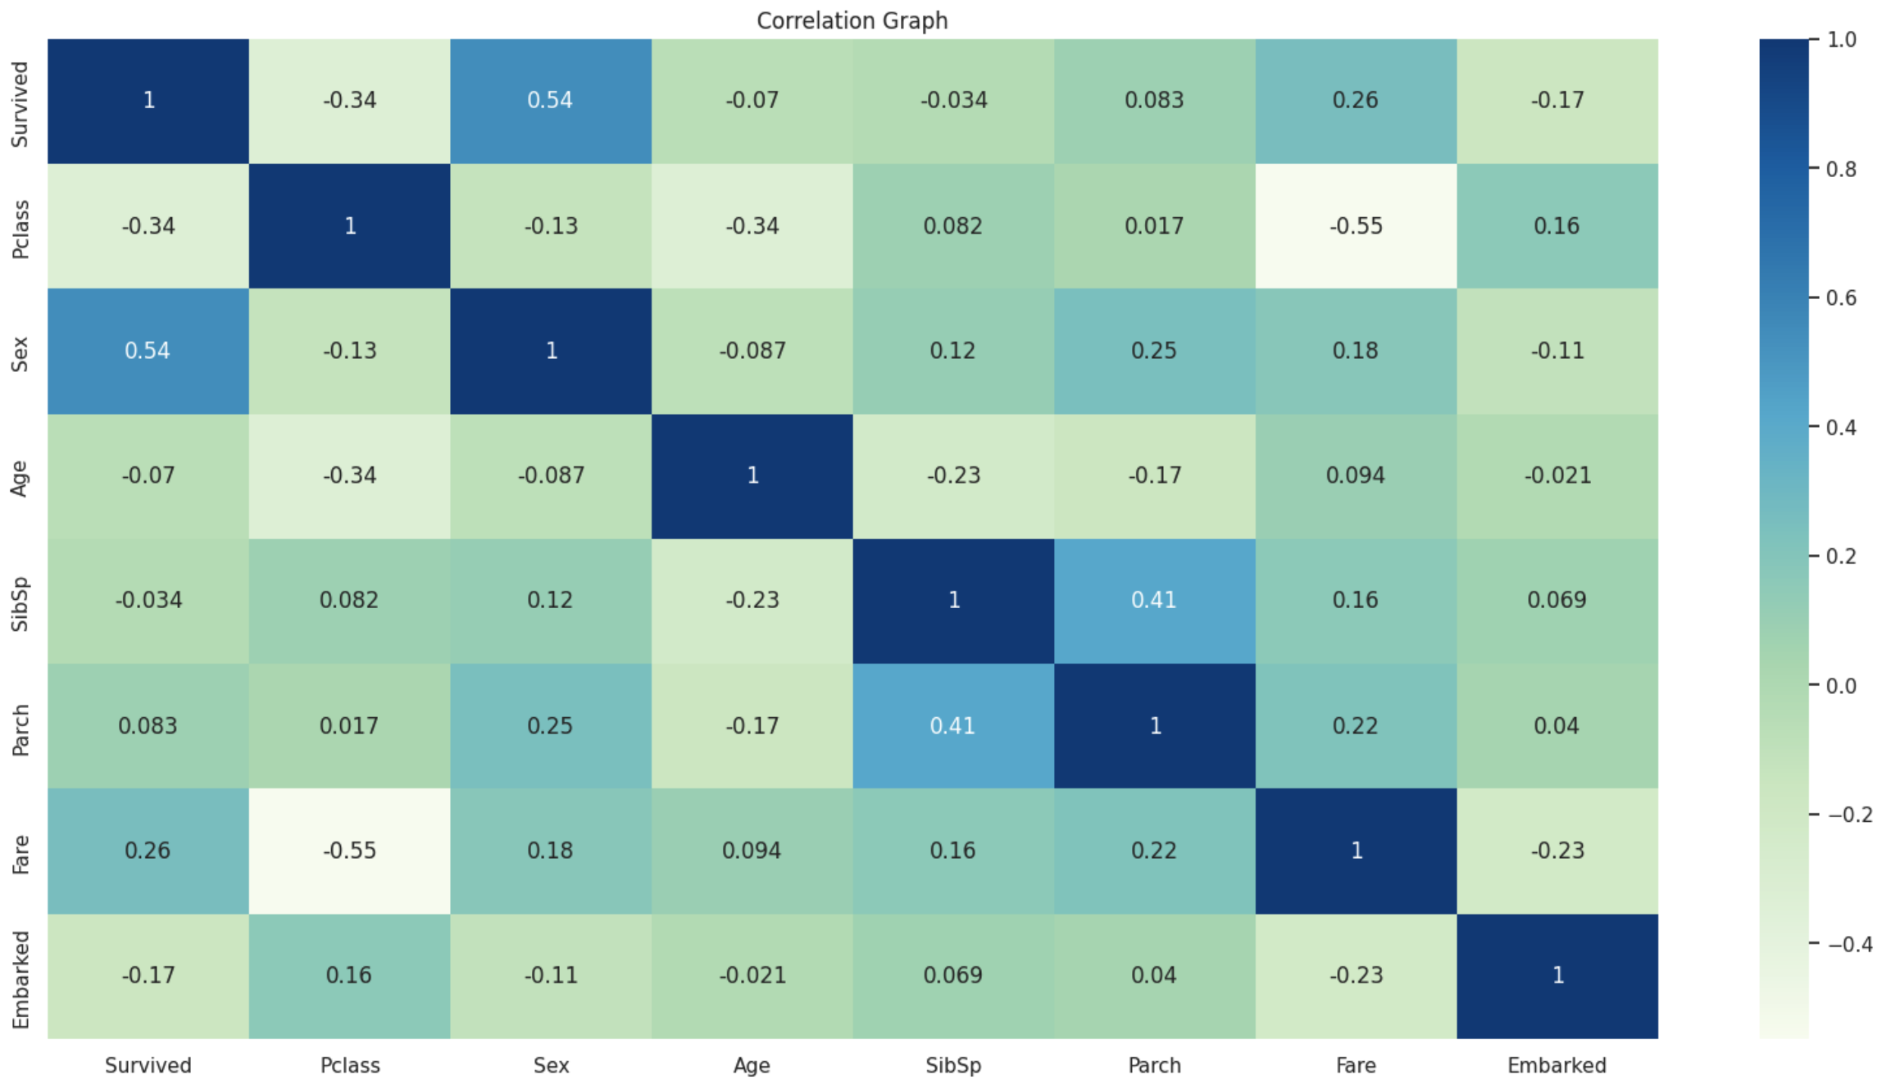
correlations
Sex and Survival highly correlated
Embarked has a slight correlation
Age surprisingly does not have a strong correlation
The passengers class also has effects

Slide 7
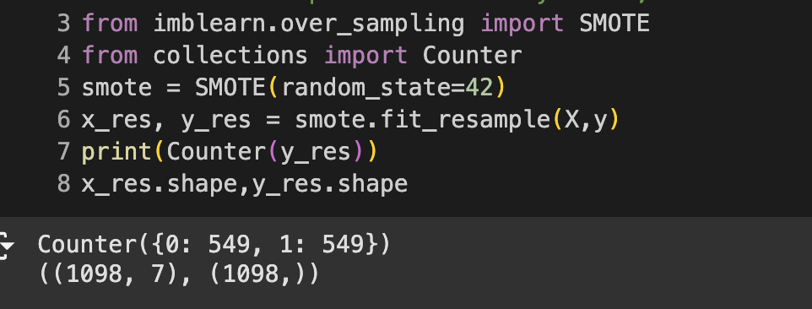
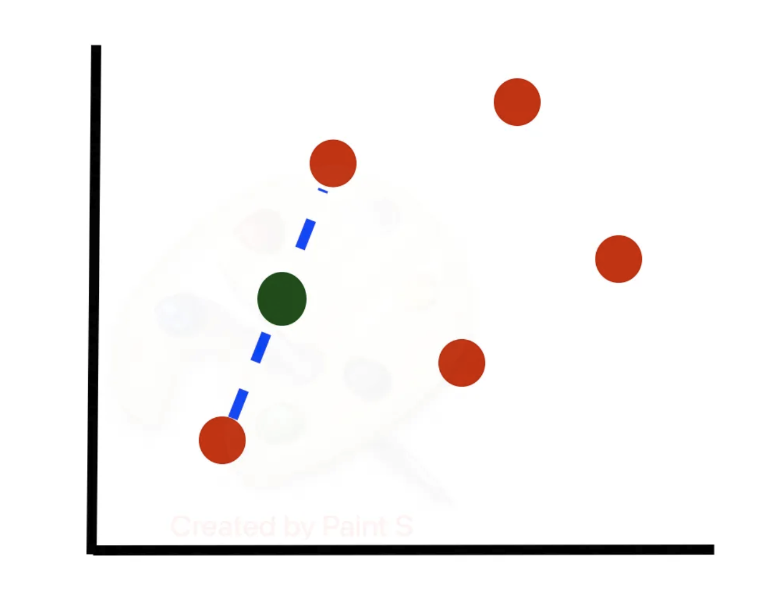
SMOTE
Synthetic Minority Over-sampling Technique
Utilizes K nearest neighbors to generate a synthetic sample [2]
Notice the samples has now increased from 891 to 1098
Source: [2]
Notes:
Image source: https://medium.com/@corymaklin/synthetic-minority-over-sampling-technique-smote-7d419696b88c

Slide 8
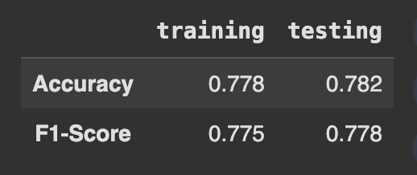
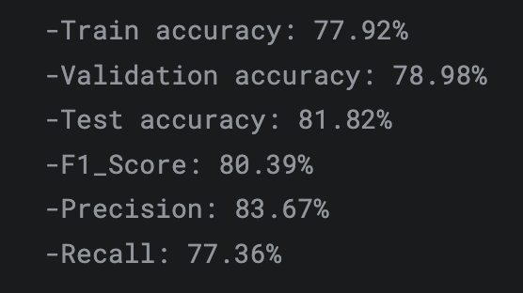
Training and results
Training accuracy is on point
F1 score of comparison model is only done on testing data [3]
Testing accuracy is not quite as close (off by 3%)
Possible reason for difference is GridSearchCV used by comparison model
GridSearch performs hyperparameter tuning
Source: [3]

Slide 9


Thanks! Questions?

Slide 10
References
[1] https://medium.com/@corymaklin/synthetic-minority-over-sampling-technique-smote-7d419696b88c
[2] https://imbalanced-learn.org/stable/references/generated/imblearn.over_sampling.SMOTE.html [3] https://www.kaggle.com/code/walidabdelhameed/apply-10-models-to-titanic-dataset?scriptVersionId=196557170&cellId=43

