Slide 1
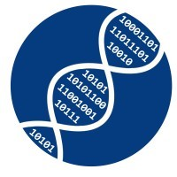
Algorithms in Bioinformatics using Python

Slide 2

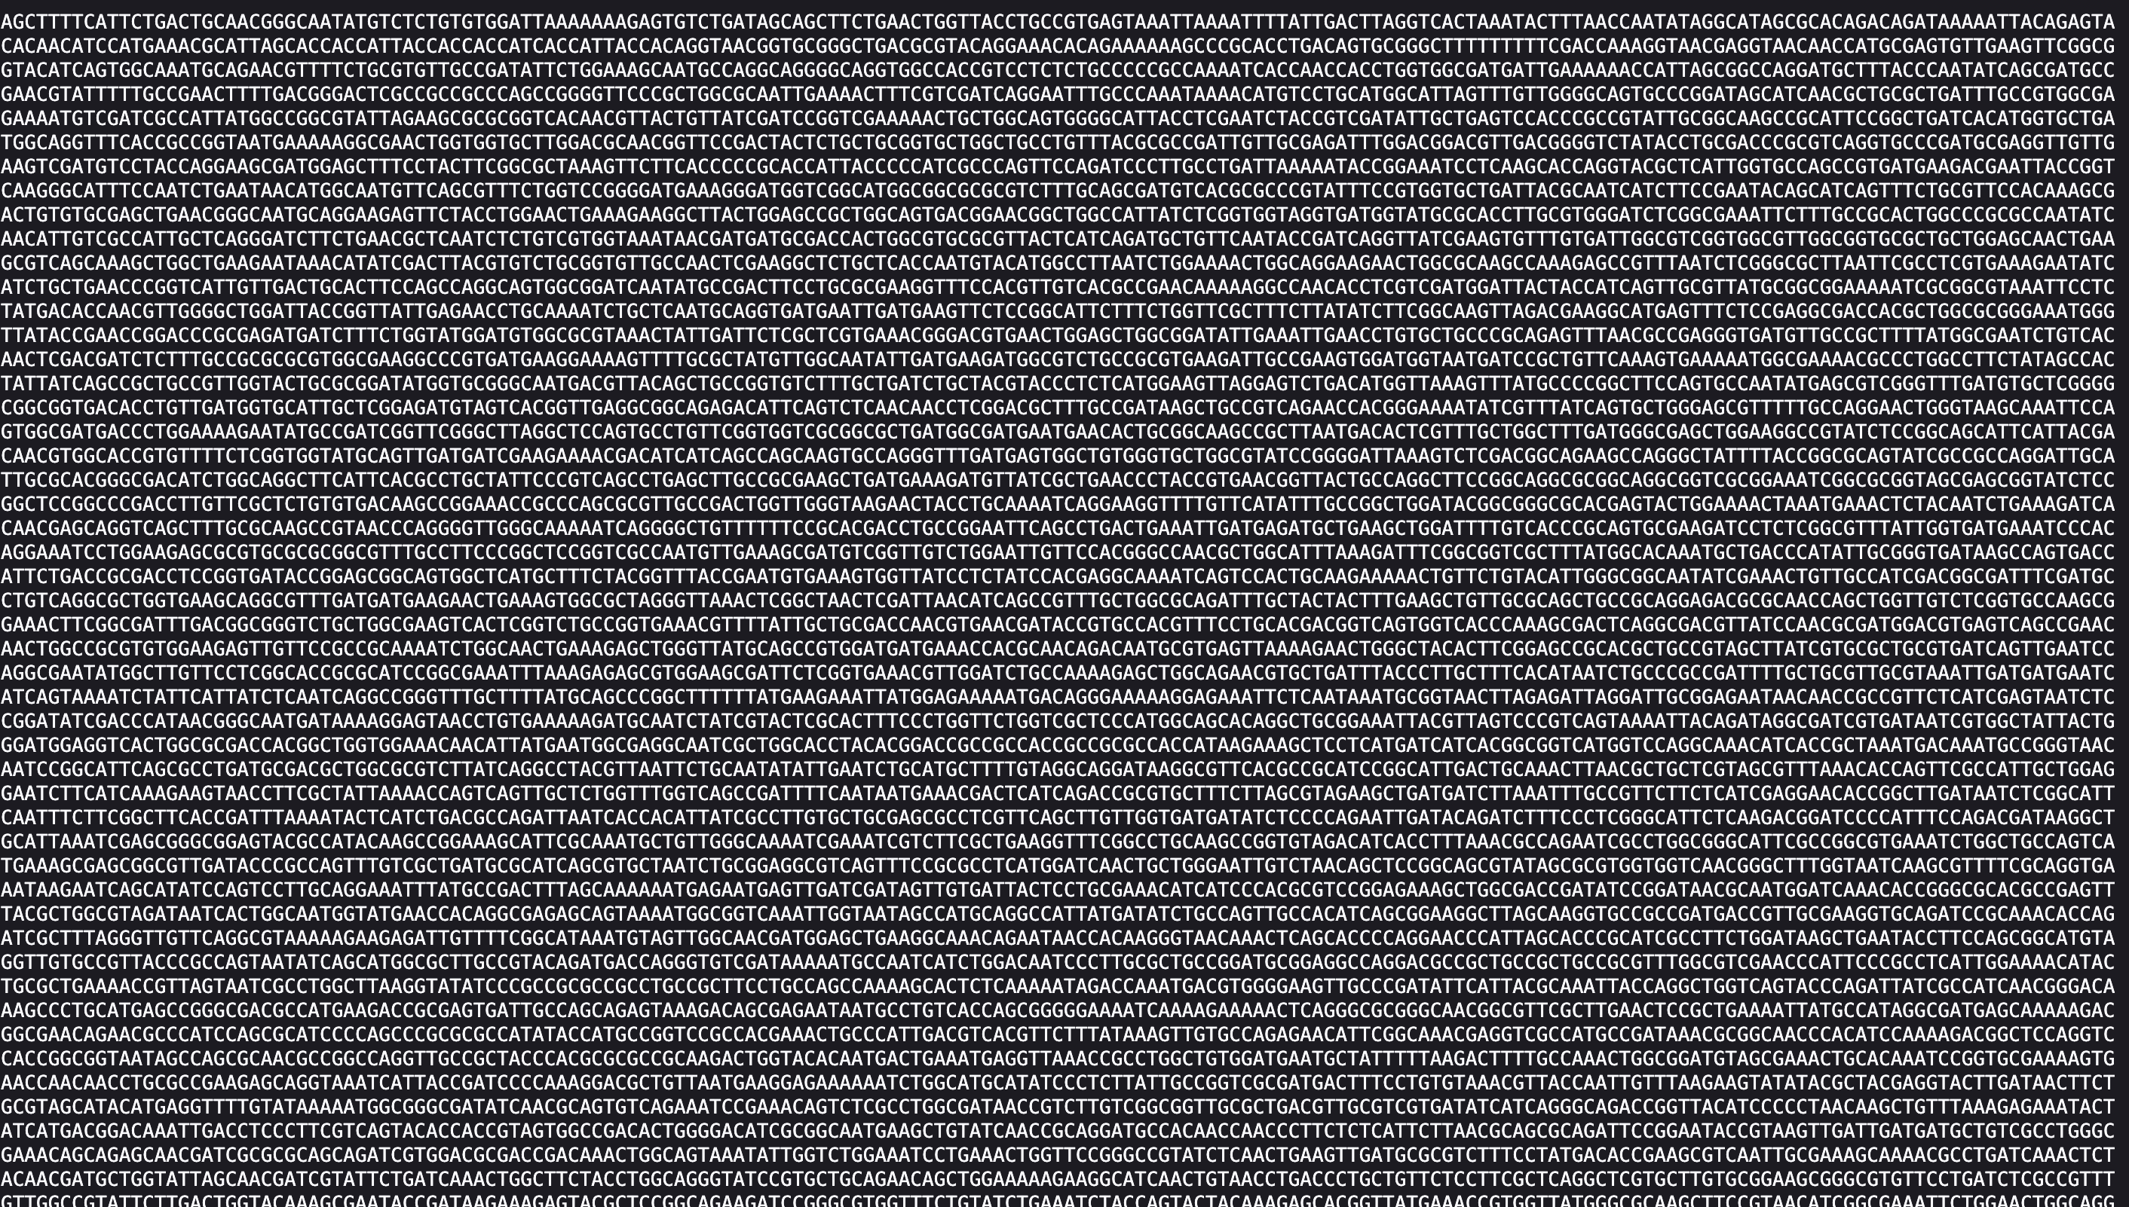
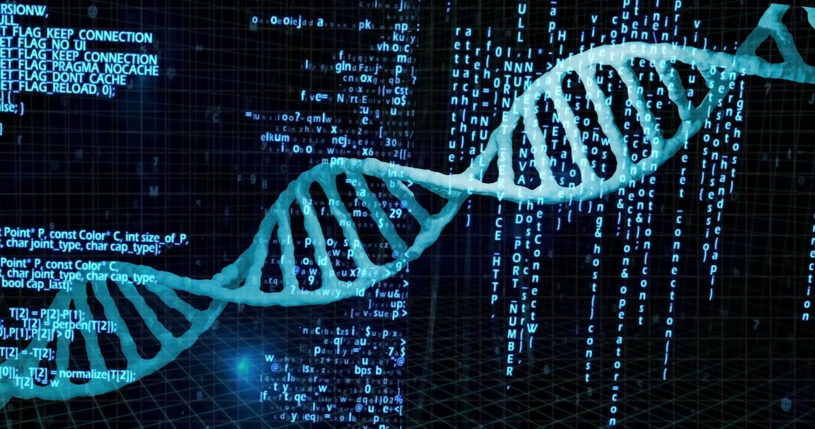
What is bioinformatics?

Slide 3
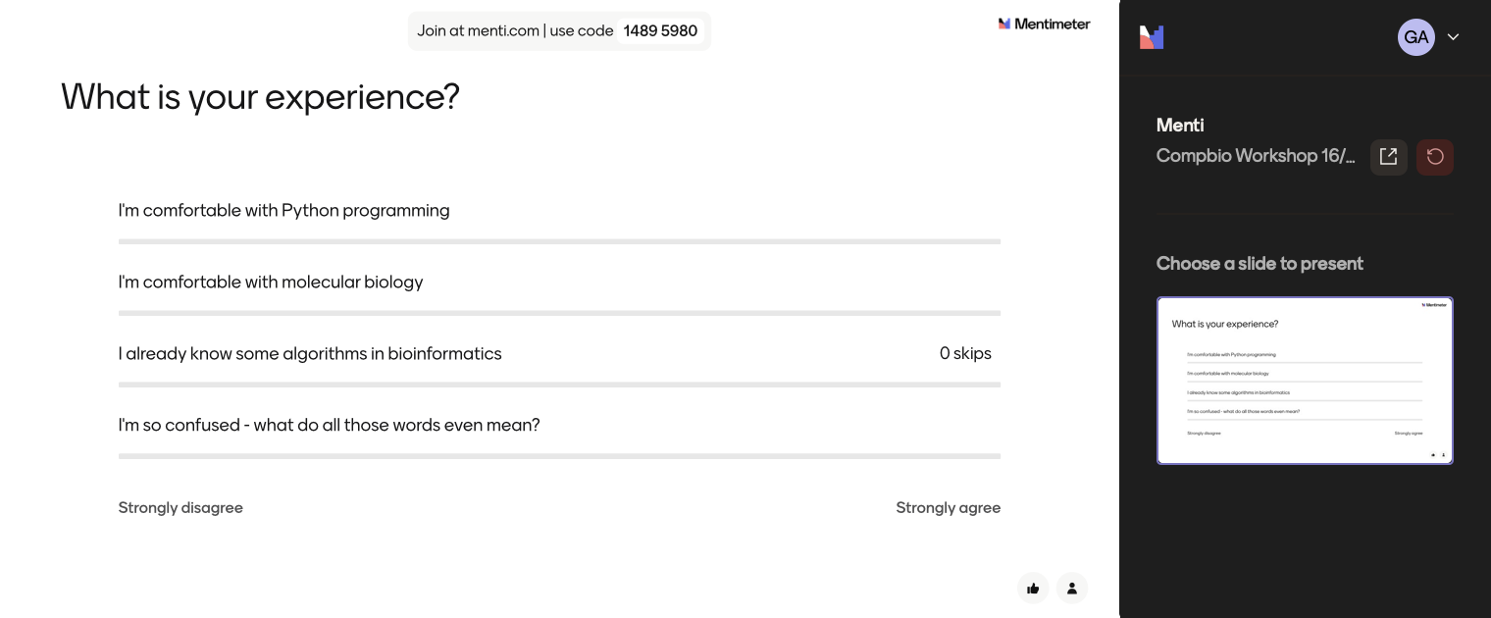
Let’s meet

Slide 4
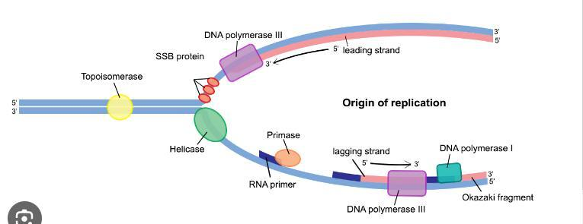
DNA Replication in Bacteria

Slide 5
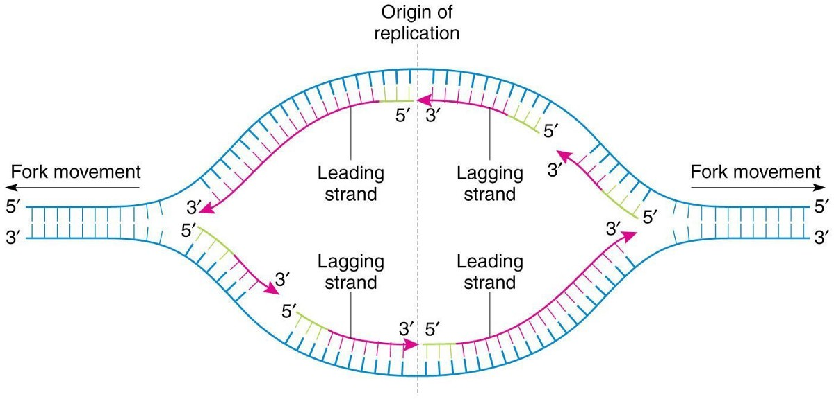
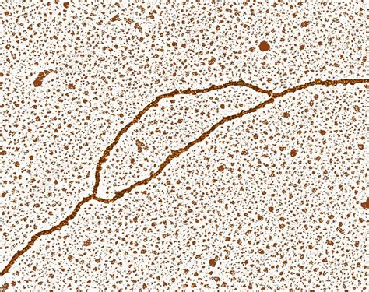
How does it look?
OriC – origin of replication!
Replication Fork

Slide 6
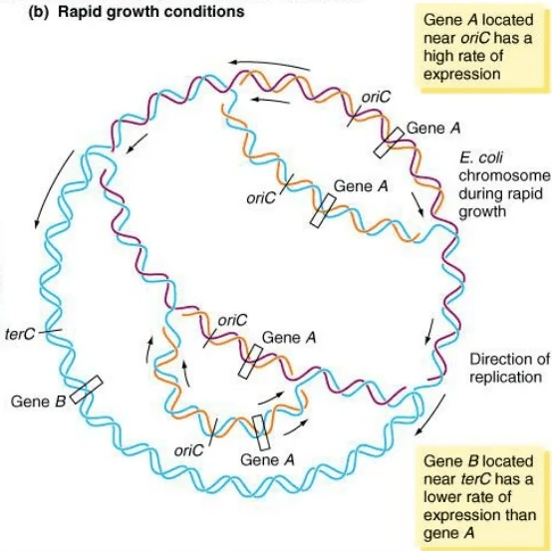
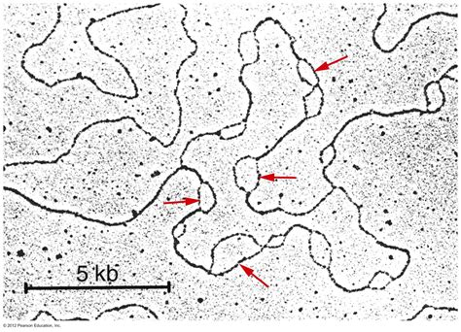
How Many Forks? How many oriC?

Slide 7
Where is oriC?
Finding the Origin of Replication Problem:
Input: a DNA string Genome
Output: The location of ori in Genome

Slide 8
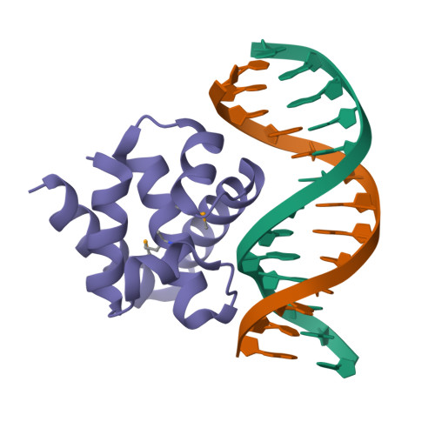
Is that even possible?
DnaA – protein that initiates replication in bacteria
Has to bind some specific sequence in oriC - DnaA box
Many DnaA boxes -> high concentration of DnaA -> initiation of replication
DnaA protein
DnaA box
Notes:
How does the bacterial cell know to begin replication exactly in this short region within the much larger Vibrio cholerae chromosome, which consists of 1,108,250 nucleotides?There must be some “hidden message” in the ori region ordering the cell to begin replication here. Indeed, we know that the initiation of replication is mediated by DnaA, a protein that binds to a short segment within the ori known as a DnaA box.

Slide 9
What the workshop is about
Working with DNA sequences – sequence bioinformatics
Session 1 – Intro to Problem and learning basics
Session 2 – Going further into algorithms
Getting accustomed with basic algorithms such as:
Pattern matching
Clump finding for genome-scale computations
Approximate pattern matching, skew diagrams
Local and global alignment
Session 1
Session 2

Slide 10
Let's find oriC together!
Beginner track:
If you feel like you’re not that comfortable with Python, no worries at all! We’ll implement our first function together, step-by-step
You can switch to Experienced track at any point, it’s all in the same notebook
Experienced track:
Solve an exercise – get a letter (or two) from a scrambled 10-letter word on the topic
Submit the word using the form at the end if you want to get a certificate later
Don’t worry if you can’t solve everything – you can submit individual letters as well!

Slide 11
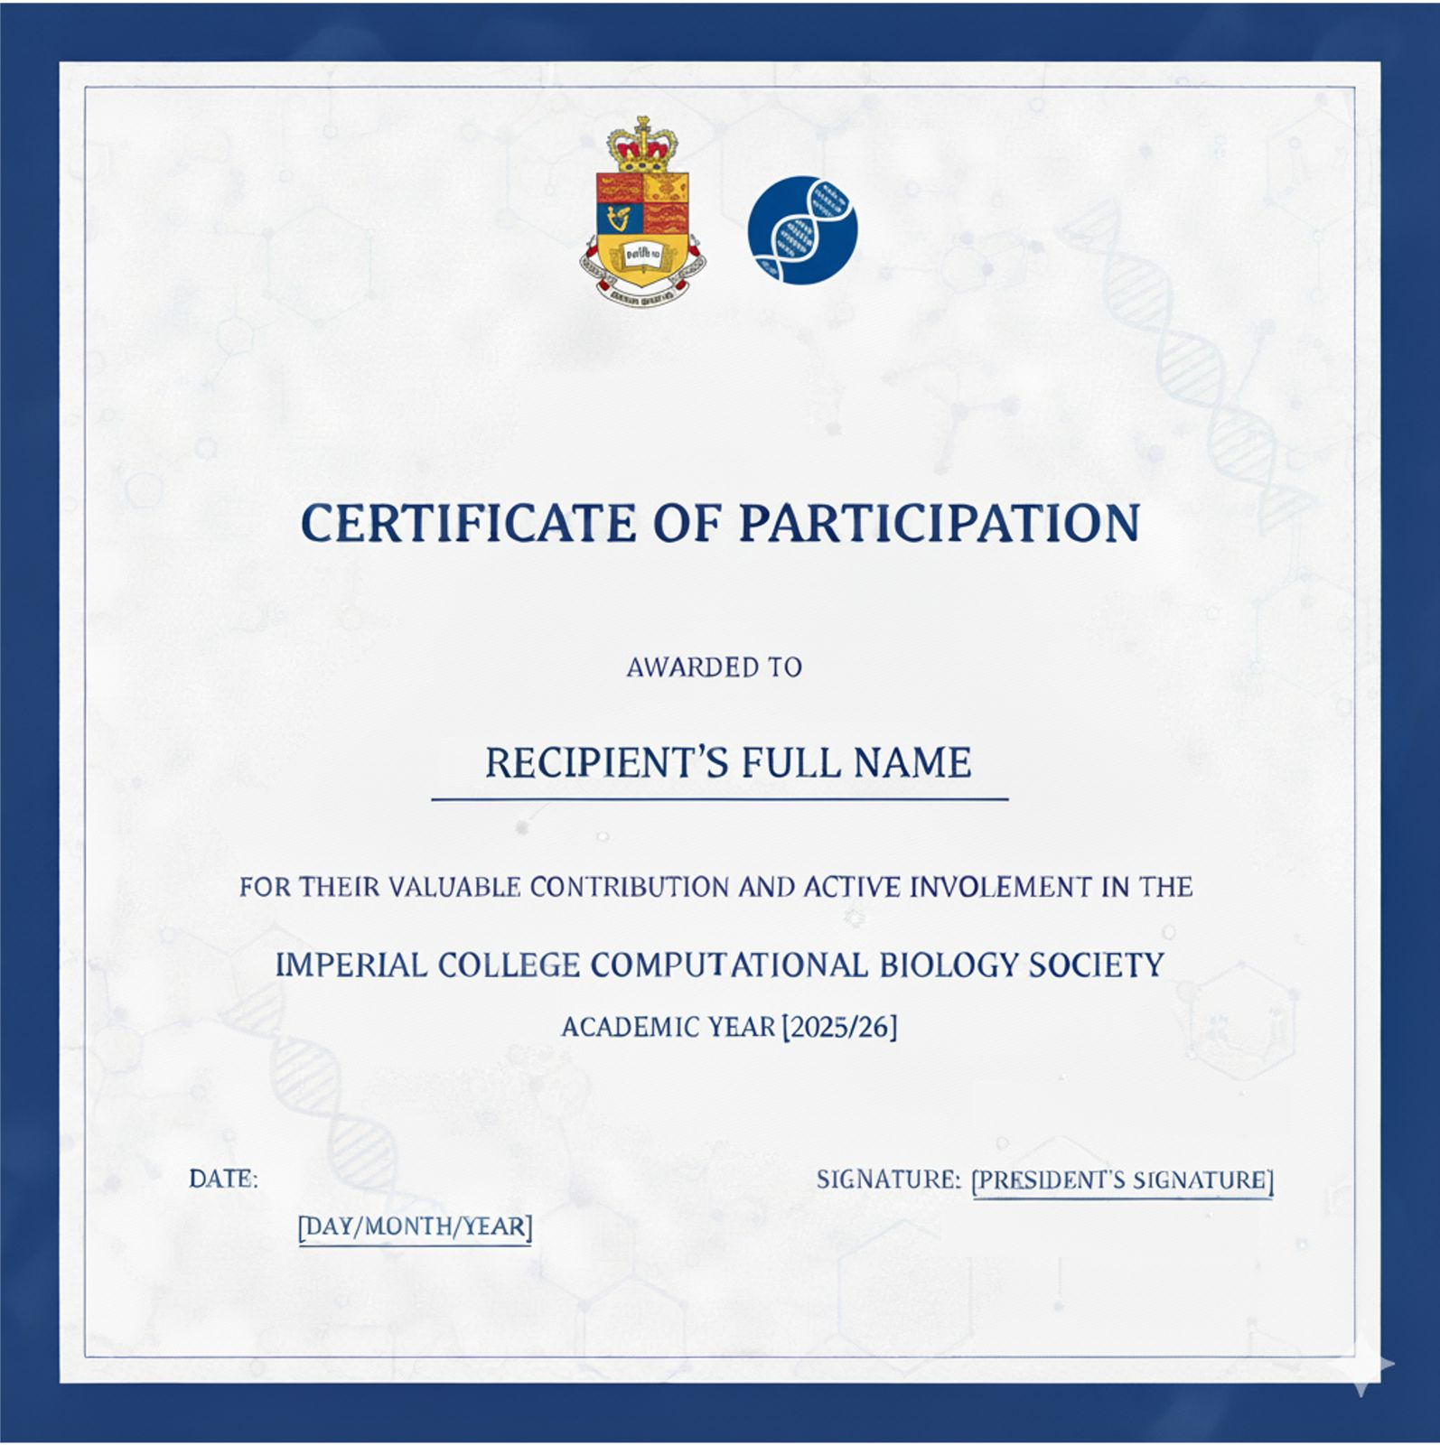
Imperial Compbio Ceritificate

Slide 12
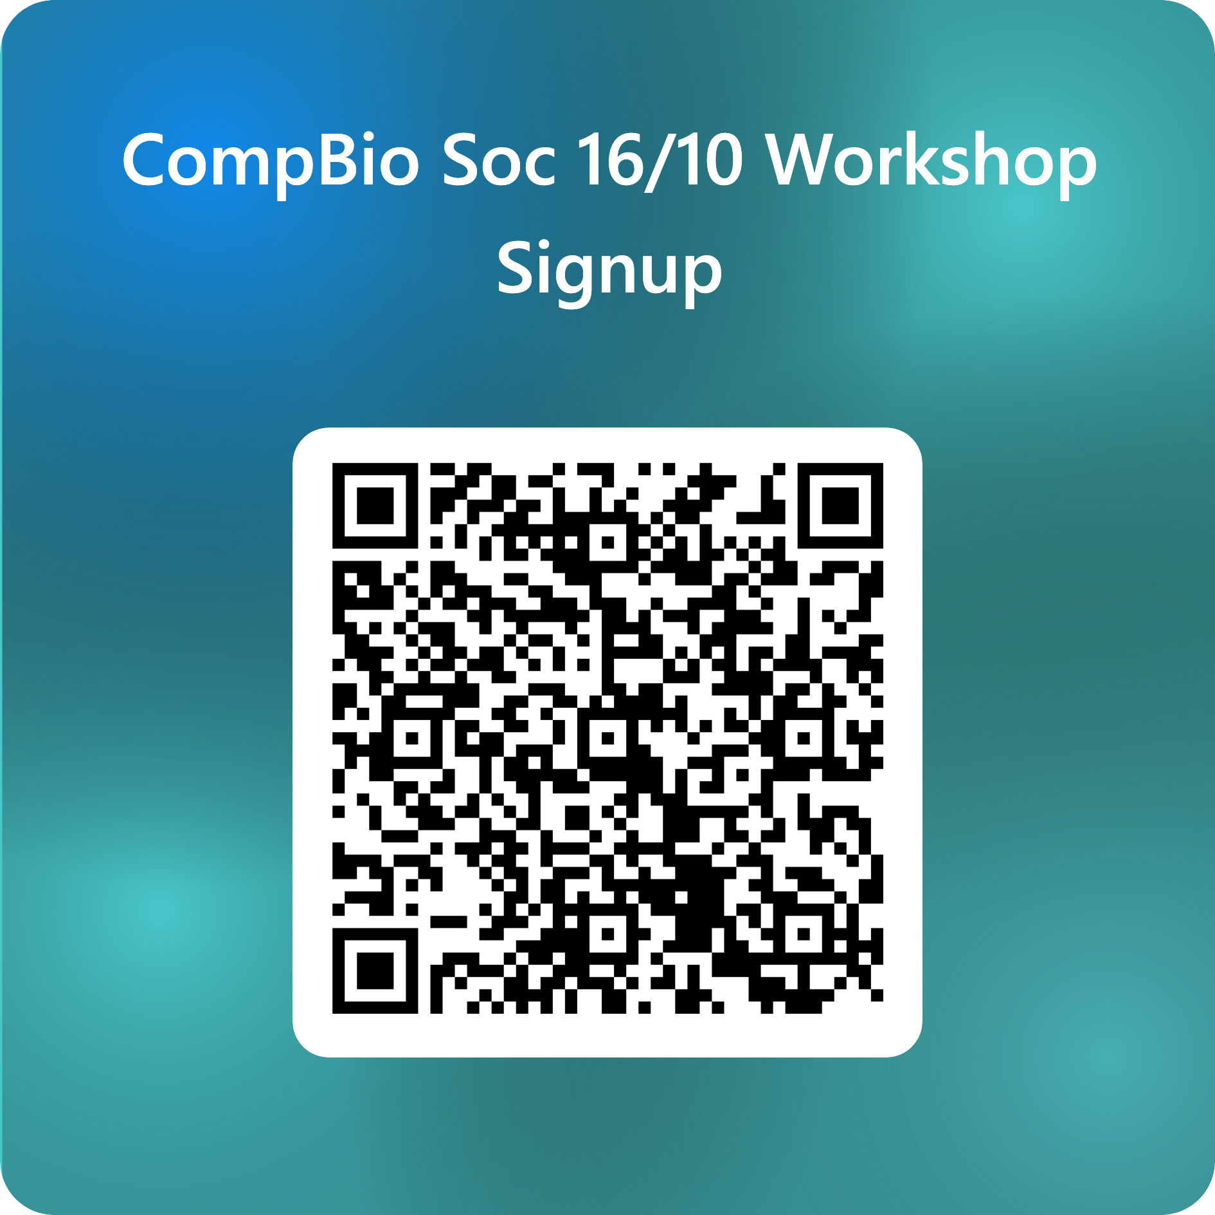
Let's find oriC together!
If you completed the signup form, you should have been added to the Teams channel already.
In the files/announcements, you can find a link to Github with all the materials. Go to that link ->Algorithms In Bioinformatics Channel -> Algorithms_in_Bioinformatics_Session_1.ipynb -> press Open in Colab button on top
When you’re done, you can save the notebook to Google Drive or download it for future use
If you haven't completed the signup form, submit your shortcode using the form on the QR code.

