Slide 1

Deep Language Model Representation of Document Clustering
Presenter – Bhuvaneshwari Basquarane (bh563857@dal.ca)

Slide 2
P-08 Presentation Road Map
Our Project – Bhuvaneshwari
Problem statement
Traditional and Deep Language models
Methodology
Transformers - Noah
BERT Model - Shakhboz
SBERT Model - Rakshit

Slide 3
Content
Motivation
Dataset and its challenges
Methodology
Language Models
Clustering
Hyper-parameter tuning
Future Research

Slide 4
Motivation
Bucketing the documents based on their content
Testing out state-of-the-art Transformer Models to produce embeddings
Comparing performance of clustering algorithms with contextual embeddings given by BERT

Slide 5
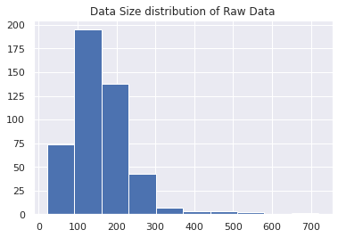
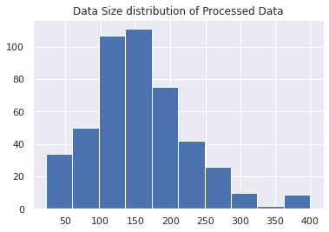
Dataset and Challenges
We are using research papers from MALNIS lab
Clustering only on the Abstract part of the paper
Paper are majorly from the field of ML, NLP
Average length of the data is 200-250 words (figure-1)
It’s an unlabeled data, hence difficult to evaluate quantitively
Truncated few documents to 400 in order to meet BERT requirement of 512 words (figure - 2)
Figure - 1
Figure - 2

Slide 6
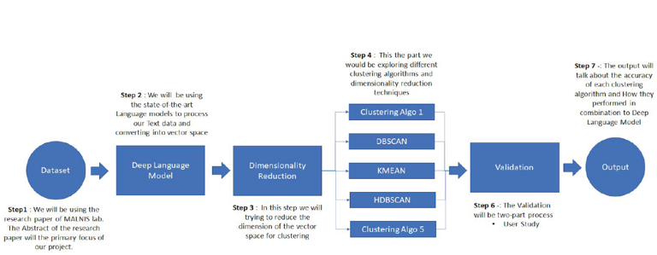
Methodology Pipeline

Slide 7
Basic Research Strategies
Traditional Method
Bag of words
Tf-Idf to cluster document corpus
Sophisticated Language Model
N-gram
Continuous embedding like Bert
Exponential type of statistical model evaluates text by using an equation which is a combination of n-grams and feature functions.

Slide 8
Dimensionality Reduction
Principal Component Analysis is a dimensionality-reduction method that is often used to reduce the dimensionality of large data sets
Transforming a large set of variables into a smaller one that still contains most of the information in the large set.

Slide 9
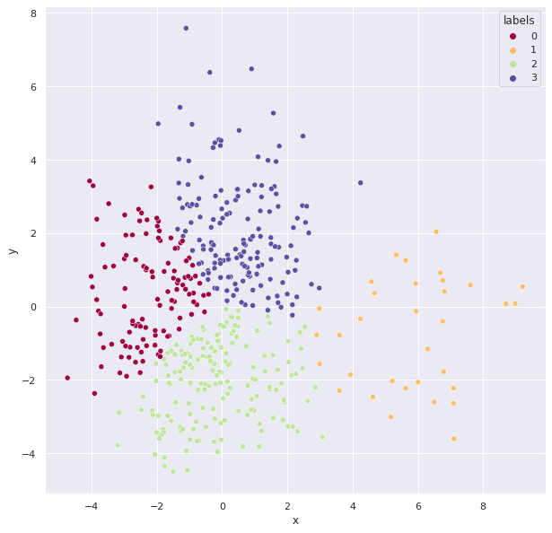
Clustering K-MEANS
K-means
Fast & easy to understand
Rather partitioning algorithm
Cluster number is needed
Elbow method
PCA

Slide 10
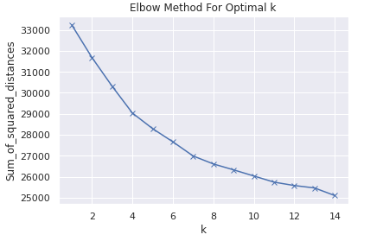
Hyper-Parameter Tuning K-means
K-means
K is a hyper-parameter that specifies the number of clusters.
K must be a positive integer that is less than the number of instances in the training set.
The Elbow method is used to estimate an optimal number of clusters on the complete dataset which will be the hyper parameter that minimizes a predefined loss function to give better results.
.

Slide 11
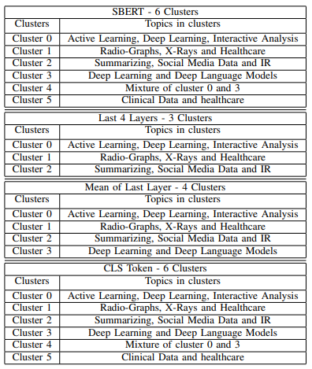
Result and Analysis
To evaluate the clusters based on the titles that gives a clear look of how the embedding's from each type of BERT
K-Means clustering to bucket the documents together
The number of clusters in each variant came out to be low since the data-set contains homogeneous papers from the field of ML, DL and NLP.

Slide 12
Future Research
We will try to implement other deep language models XLNET, Infer-sent.
Fine-tuning our applications for better embedding's using variance BERT.
Implementing Interactive clustering and Topic modelling, where the user objective to use this tool for transforming cluster using his domain knowledge.

Slide 13
Question ?
Thank You !

