Slide 1
Sentence-BERT: Sentence Embeddings using Siamese BERT-Networks - 2019
By Nils Reimers, Iryna Gurevych
Presenter : Rakshit Makan
Reference : https://arxiv.org/pdf/1908.10084.pdf

Slide 2
P-08 Presentation Road Map
Transformers – Noah
BERT Model – Shakhboz
SBERT Model – Rakshit
Problems With Bert
SBERT Model
Overview
Pooling Strategies
Model Training
Results from Experiment
Our Project - Bhuvaneshwari

Slide 3
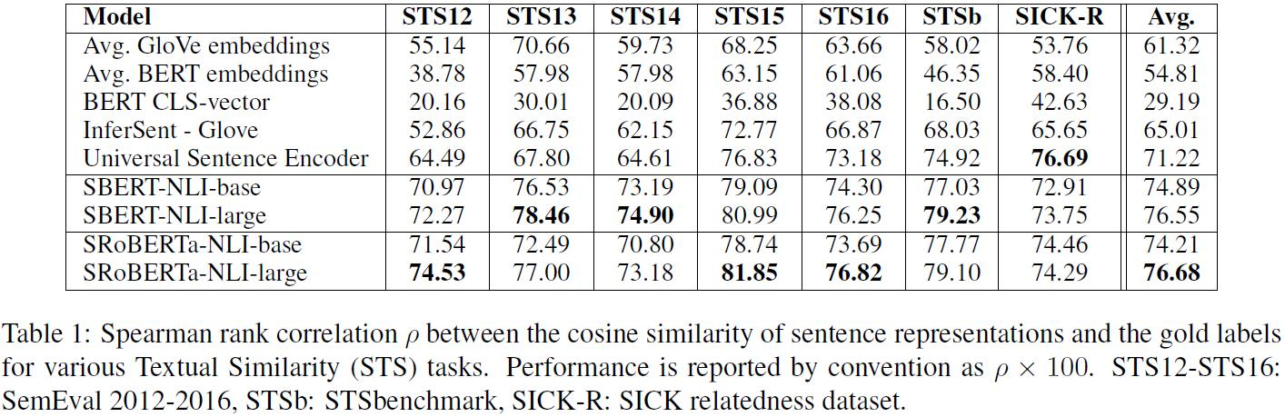
Problem with BERT
output
BERT
For 10,000 sentences the pair with the highest similarity requires approx. 50M inference computations which require about 65 hours, where as with SBERT it will be 5 Seconds
On textual similarity (STS) tasks, using either the averaging or [CLS] method for sentence embeddings using BERT gives poor results. Even GloVe vectors significantly outperform naive BERT sentence embeddings..
Sentence 1
Sentence 2

Slide 4
SBERT Model - Overview
Sentence-BERT (SBERT), a modification of the BERT network using Siamese (twin) and triplet networks that can derive semantically meaningful sentence embeddings.
Its fine tuned on combination of SNLI and MNLI dataset.
When the cosine similarity of the pair of sentence embeddings is computed, we want it to represent accurately the semantic similarity of the two sentences.

Slide 5
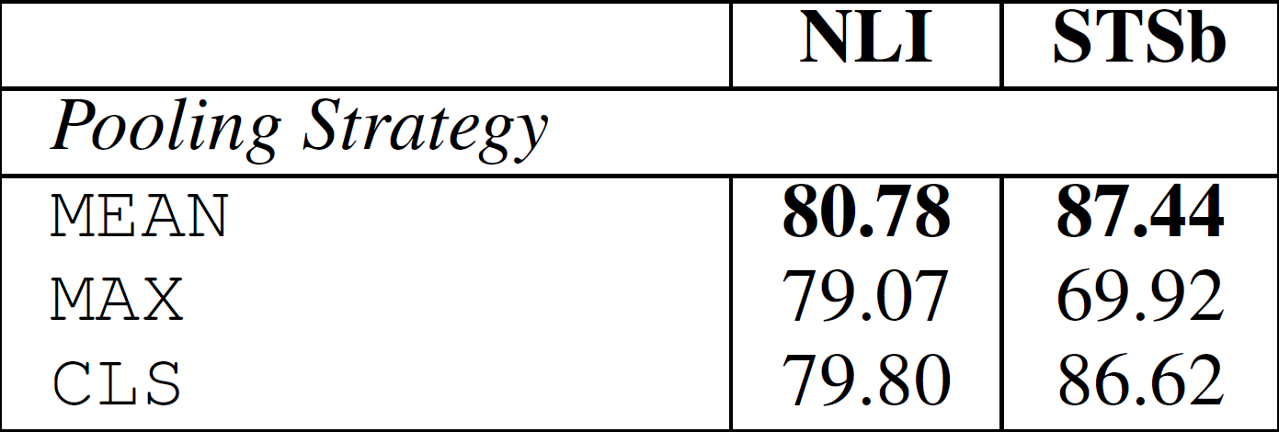
Pooling Strategies
SBERT adds a Pooling operation to the output of BERT to generate a fixed-dimensional sentence Embedding. Three Pooling strategies were adopted in the experiment for comparison:
CLS: directly use the output vector of the CLS position as the entire sentence vector
MEAN: Calculate the average of all Token output vectors as the entire sentence vector
MAX
It can be seen from the results that the effect of MEAN is the best, so the following experiments also use the MEAN strategy by default.

Slide 6
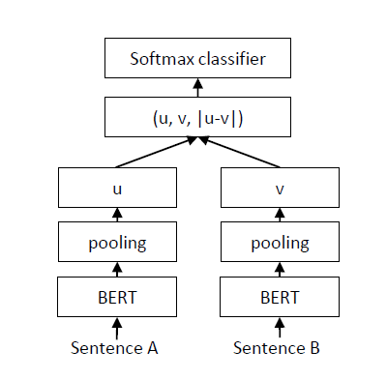
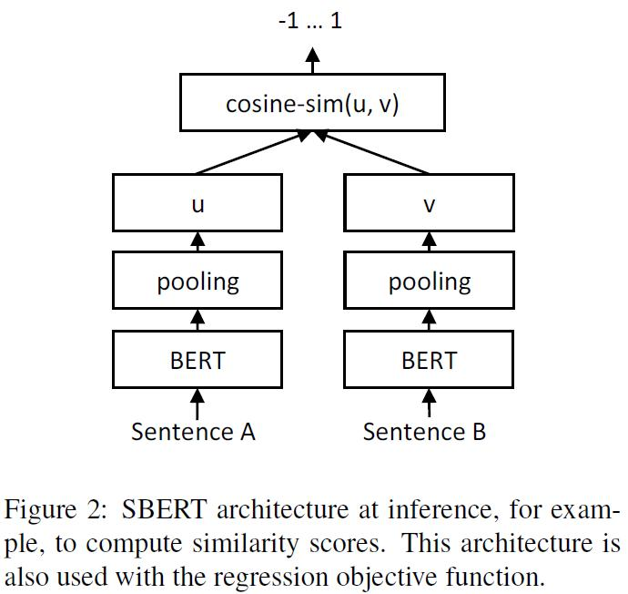

Model Training
Classification Objective Function
Regression Objective Function
The loss function is Cross-Entropy Loss
The loss function is MSE

Slide 7
Results from Experiment
 | Similarity B/w Paper 1 and Paper 2 | Similarity B/w Paper 1 and Paper 3
BERT CLS token | 96 | 97
Concat Last 4 layers | 92 | 92
Mean Last Layer | 91 | 93
SBERT- Mean Pooling | 80 | 37
Example:
Paper 1 : DocBERT: BERT for Document Classification
Paper 2 : Publicly Available Clinical BERT Embeddings
Paper 3 : Studying the Wikipedia Hyperlink Graph for Relatedness and Disambiguation

Slide 8
References
Reimers, Nils and Iryna Gurevych. “Sentence-BERT: Sentence Embeddings using Siamese BERT Networks.” EMNLP/IJCNLP (2019). https://arxiv.org/pdf/1908.10084.pdf

Slide 9
Thank You

