Slide 1
P-08 Presentation Road Map
Transformers – Noah
BERT Model – Shakhboz
Discussing related paper
Used for feature extraction
SBERT Model – Rakshit
Our Project - Bhuvaneshwari

Slide 2
BERT: Pre-training of Deep Bidirectional Transformers for Language Understanding
By Jacob Devlin, Ming-Wei Chang, Kenton Lee, Kristina Toutanova Google AI Language

Slide 3
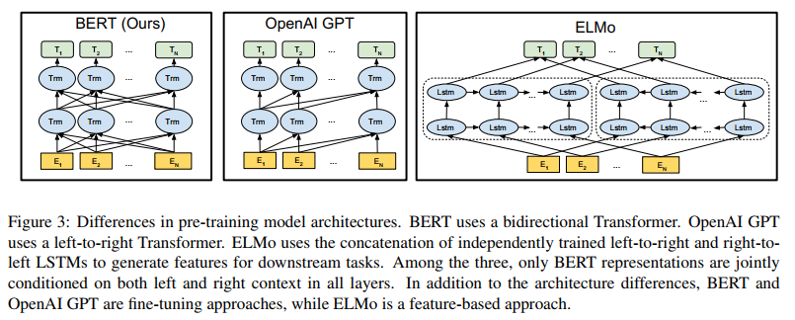
Introduction
BERT - the first deeply bidirectional, unsupervised language representation model, pretrained by fine tuning approach
Pretrained Representations:
Context-free (word2vec, Clove)
Contextual:
Unidirectional (OpenAI GPT)
Bidirectional (ELMO, shallow)

Slide 4
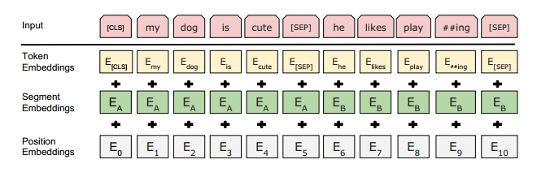
Model Architecture
Multi-layer bidirectional Transformer encoder based (L- number of layers, H-hidden unit size, A – number of self-attention heads):
BERT_{BASE} = (L=12, H=768, A=12, Total Parameters=110M)
BERT_{LARGE} = BERTLARGE (L=24, H=1024, A=16, Total Parameters=340M)
Input representaion:
WordPiece embeddings with 30,000 token
positional embedding with up to 512 tokens

Slide 5
Pretraining BERT
Masked Language Model for 15% of input sequence:
80% of the time: Replace the word with the [MASK] token
10% of the time: Replace the word with a random word
10% of the time: Keep the word un- changed
Next Sentence Prediction:
50% of the time: Real sentence pairs
50% of the time: 2nd sentence is randomly chosen from corpus

Slide 6
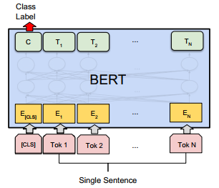
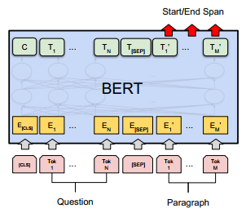
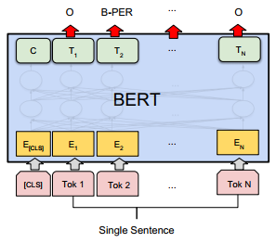
Using BERT (Fine-tuning)
Classification tasks Question Answering tasks Named Entity Recognition

Slide 7
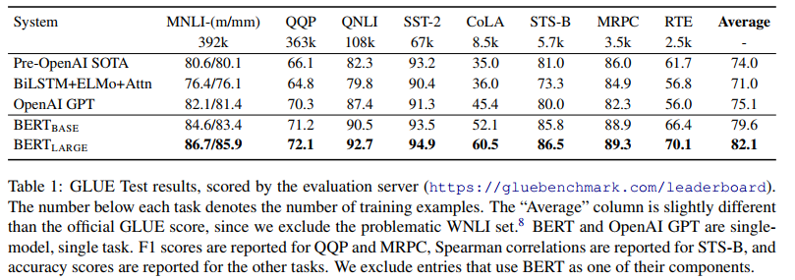
Results & Takeaways
Model size matters, even at huge scale
With enough training data, more training steps == higher accuracy
BERT’s bidirectional approach (MLM) converges slower than left-to-right approaches

Slide 8
Conclusion
BERT is undoubtedly a breakthrough in the use of Machine Learning for Natural Language Processing. The fact that it’s approachable and allows fast fine-tuning enables a wide range of practical applications.

Slide 9
References:
J. Devlin, M. Chang, K. Lee, K. Toutanova et al.(2018). BERT: Pre-training of Deep Bidirectional Transformers for Language Understanding. Retrieved from: https://arxiv.org/abs/1810.04805.
Alammar, Jay. (2018) The Illustrated BERT, ELMo, and co. (How NLP Cracked Transfer Learning). [Blog post]. Retrieved from http://jalammar.github.io/illustrated-bert/.
Rani Horev. (2018). BERT Explained: State of the art language model for NLP. [Blog post]. Retrieved from : https://towardsdatascience.com/bert-explained-state-of-the-art-language-model-for-nlp-f8b21a9b6270.

Slide 10
Thank you for your attention!

