Slide 1
Augmenting COVID-19 CT Dataset with Generative Models
Luke Strgar, Menna Nawar, Alexander Kahanek, Wen Jian
Project TA: Rutvi Prajapati
Mega Pod Name: Kale Juniper Group Name: Adventure Networx

Slide 2
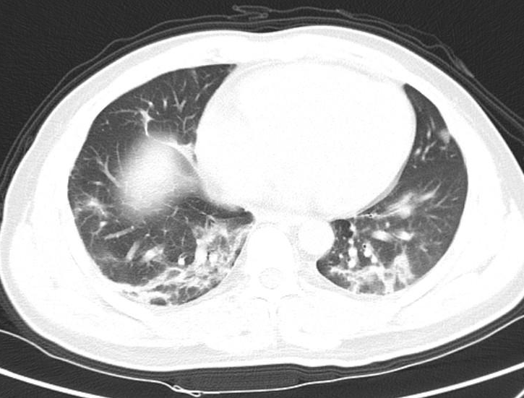
Introduction
Augmenting COVID-19 CT Dataset with Generative Models
The Adventure Networx
Motivated to explore deep learning based approaches to automate (or improve efficiency) of disease diagnosis given evidence (e.g. CT or fMRI image)
COVID-19 CT Dataset:
742 chest CT images with corresponding COVID-19 positive / negative label
Split over train, validation, test
github.com/UCSD-AI4H/COVID-CT
Our contribution:
Reproduce baseline classification results with this dataset
Beginnings of enlarged dataset via generative methods

Slide 3
Classification
Augmenting COVID-19 CT Dataset with Generative Models
The Adventure Networx
Applied transfer learning to COVID-19 positive / negative classification task
Reproducible, scalable pipeline built with PyTorch Lightning
Tested with ResNet50, VGG-16, DenseNet169, and others with and without classical data augmentation
Original dataset contains ~400 training samples
Augmented dataset contains ~5000 training samples
Random application of affine transformations + noisy perturbations
Best (test set) results with DenseNet169:
No dataset augmentation: 82% Accuracy
Augmented dataset: 84% Accuracy

Slide 4
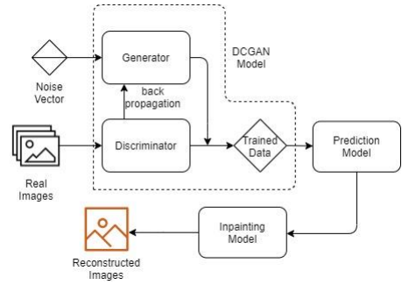

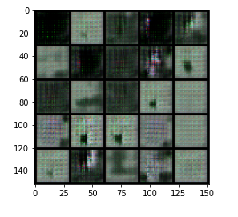
DCGAN model
Augmenting COVID-19 CT Dataset with Generative Models
The Adventure Networx
The deep convolutional generative adversarial network, or DCGAN for short, is an extension of the GAN architecture for using deep convolutional layers in both the generator and discriminator models.
Image credit: National College of Ireland
Basic Model Implementation

Slide 5
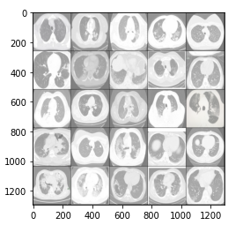
DCGAN model
Augmenting COVID-19 CT Dataset with Generative Models
The Adventure Networx
Final output
Desired output
How to improve this output?

Slide 6
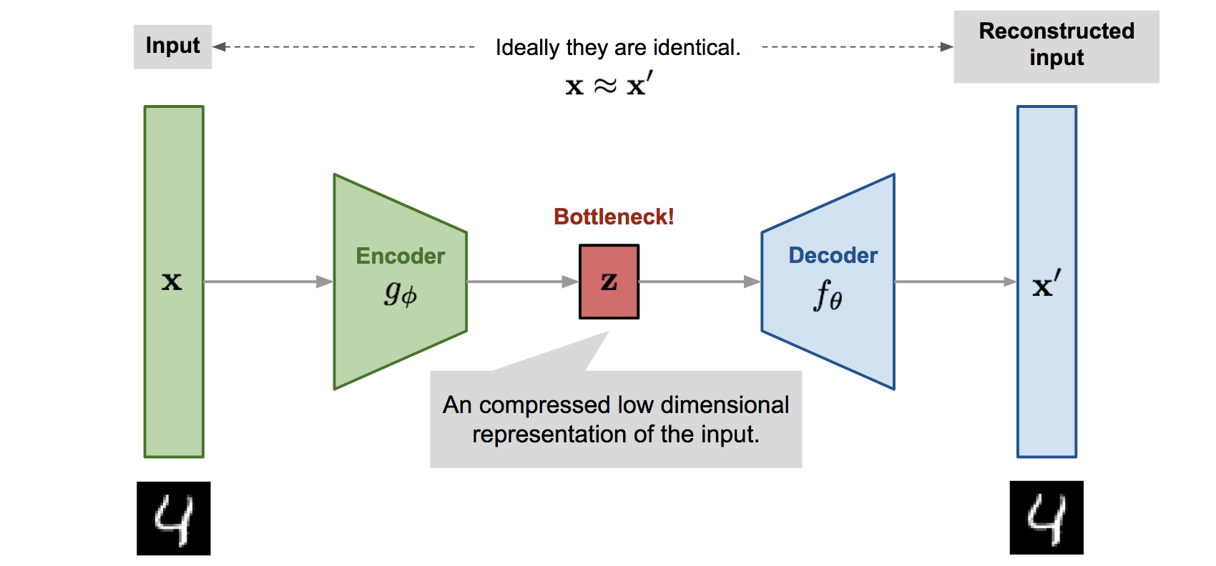
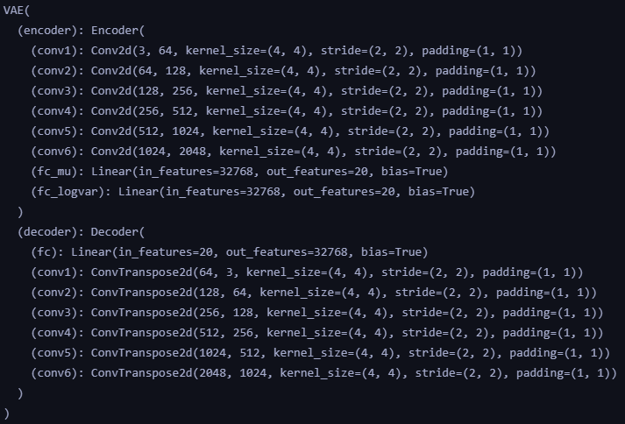

Variational Autoencoder (VAE) Architecture
Augmenting COVID-19 CT Dataset with Generative Models
The Adventure Networx
A VAE attempts to encode an image down to a small latent space distribution, which can then be resampled from to reconstruct new images.
Image credit:
https://lilianweng.github.io/lil-log/2018/08/12/from-autoencoder-to-beta-vae.html
Notes:
I.

Slide 7
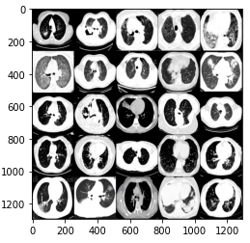
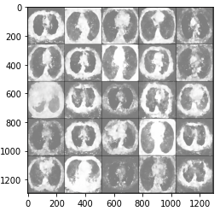
Variational Autoencoder
Augmenting COVID-19 CT Dataset with Generative Models
The Adventure Networx
After reconstructing our original images we see the model has learned the general shape of the chest CT scan
However, the reconstructed pixel values are not as contrasted.
Overall, a decent job, but needs more work.
Original images
Reconstructed images

Slide 8
Discussion and Future Work
Augmenting COVID-19 CT Dataset with Generative Models
The Adventure Networx
What did we accomplish overall?
Used transfer learning to achieve positive/negative classification of COVID-19 CT images with a highest accuracy of 82%.
Implemented GAN & VAE to augment the CT dataset.
Future Work
GAN and VAE can be used to generate new CT images, although quality needs improvement.
Generated images need to be used for training and (hopefully) improve classification results.

Slide 9
References
Augmenting COVID-19 CT Dataset with Generative Models
The Adventure Networx
kaggle.com/mloey1/covid19-chest-ct-image-augmentation-gan-dataset
github.com/UCSD-ai4h/COVID-ct
link.springer.com/article/10.1007%2Fs00521-020-05437-x
http://norma.ncirl.ie/4387/1/sahilbhujbal.pdf
https://machinelearningmastery.com/tour-of-generative-adversarial-network-models/

Slide 10
Thank You

