Slide 1

Clustering Litter during events.
3/13/2021
Alexander Kahanek

Slide 2
Data Summary
The purpose of this analysis is to look at the clustering of litter for the cleanup done during the Startup Grind 2020 event, by the Rubbish, co. team.
The data was collected by Rubbish during the four-day event. They collected the litter at the end of each day's events.
Sunday – baseline cleanup
Found 392 pieces of litter
Monday – Opening Night Event
Found 613 pieces of litter
Tuesday – Event day 1
Found 868 pieces of litter
Wednesday – Event day 2
Found 564 pieces of litter

Slide 3
Research Questions
Can use clustering to evaluate the placement of collection objects (i.e, trash cans, etc.) to possibly improve on the cleanup policies?
What insights can we gain from the habits of littering, during events or in general?

Slide 4
The pre-processing done
Data originally had aggregated items tagged in one row, which seemed to have been a server update issue with the Rubbish application.
Items were separated into single rows, i.e, they were changed from having counts for objects to one object per row.
The weekdays had a mistake for one of the dates, so the day was directly re-pulled from the system timestamp column.
I separated the system timestamp to two columns:
date - changed to Year-month-date
time - changed to Year-month-day 24hour:min:sec.
I combined the “unknown” and “uncategorized” rubbishType categories to instead be “other”.
I added the column “is_litter” to signify if the tagged item is a litter object, (and a resulting opposite of a collection object).

Slide 5
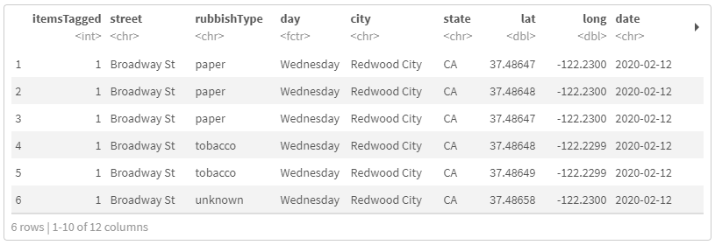
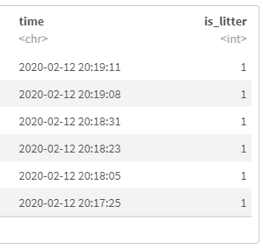
What the data looked like

Slide 6
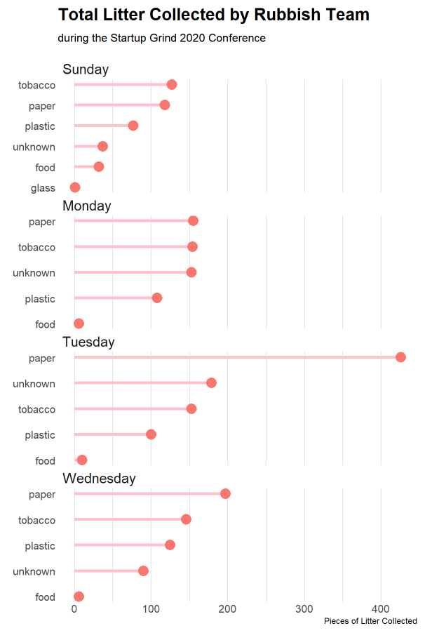
Timeline of litter types
Here we can see the distribution of litter types throughout each of our four days.
We see a clear increase in litter during our two event days, Tuesday and Wednesday.
Paper and Tobacco products are the clear winners.

Slide 7
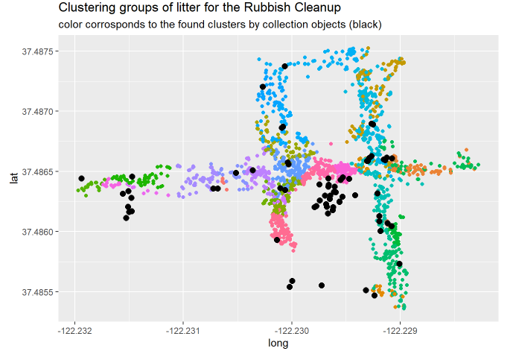
Clustering
The black dots represent the collection objects.
The colored dots represent the specific cluster attached to the litter object.
We see good groupings here; however, it is clear the placements of the collection objects could be improved.

Slide 8
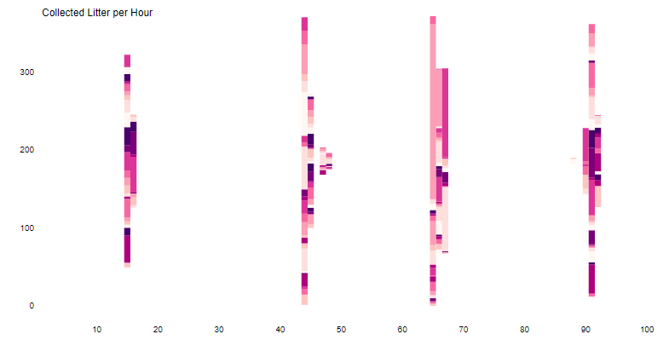
Timeline of collection
This represents the timeline of litter collection, per hour, done by the Rubbish team.
The color represents the cluster grouping with it, colors are repeated.
We can see large groupings of clusters during certain time periods.

Slide 9
Collection in time
The black dots represent the collection objects.
The colored dots represent the specific cluster attached to the litter object.
We see a good timeline of litter collection. There does not appear to be much purposeful collection of the clumping of the team.

Slide 10
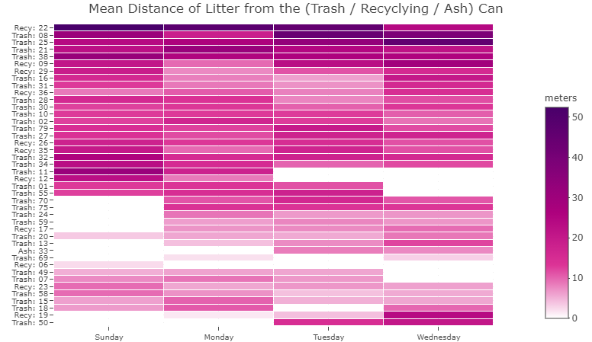
Average distance of litter
A distance of 0 means there are no objects around the collection object.
We see consistent patterns in the average distance of litter to collection objects.
Some collection objects only had litter near them during the event, and some only had litter near them before the event.

Slide 11
Interpretation
Distance of Litter to Collection Objects
Placement of Collection Objects
From our 42 total collection objects, only 14% of them had an aggregated average distance of more than 20 meters of its litter.
The average person drops their trash on the ground, when the nearest collection object is 12 meters away.
These results can be skewed as we do not know how full the collection objects were at the time.
Which would heavily affect the reasons why one might drop their trash.
We see good clustering around the event space.
Although these could be improved by moving collection objects to the centers of their clusters.
We also see a large increase in paper-based litter being collected.
This could be reduced by smart collection object placement.

Slide 12
Conclusion
My recommendations for litter data collection, during events.
Collect litter while the event is happening.
This will help decrease time bias and allow an analysis on litter patterns throughout the timeline of the event.
Decrease bias in collection areas, trying to spread out the collection team.
This will help decrease bias on identifying high-volume areas of litter.
Collect data 2 days prior, and 2 days after.
This will give a good baseline, as the initial baseline collection is most likely litter from multiple days prior.
Give metrics for how full a collection object is.
This will help give great feedback on collection object placement.
This will help validate the results of an analysis, or collection object placement scheme.

Slide 13
Tools Used
R
Python
I used a R script for the data cleaning portion of this analysis. The script can be found at:
https://github.com/Alexander-Kahanek/Rubbish_Clustering/blob/master/clean_script.R
R was also used for the entire analysis and data visualization portions.
I used a Python script to cluster each litter object to the closest collection object, which can be found here:
https://github.com/Alexander-Kahanek/Rubbish_Clustering/blob/master/euclidean_script.py

Slide 14
Thank you!
Alexander Kahanek
More in-depth report:
https://alexander-kahanek.github.io/project/rubbish_analysis.html
GitHub for the analysis:
https://github.com/Alexander-Kahanek/Rubbish_Clustering
Data source:
Rubbish, co
https://www.rubbish.love/

