Slide 1


Slide 2
NWD1x1 – Group Virtual C
Members –
James Bartel , Nathan Taylor , Alexander Kruger, Travis Roy Hanekom, Kiara Herbst

Slide 3
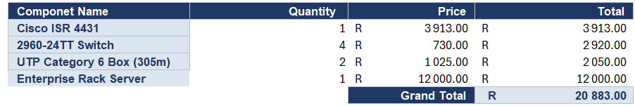

Bill of Materials for Network
Notes:
What to discuss:
Physical Scope: Briefly frame the infrastructure around the core requirements—supporting 3 classrooms (11 devices each), a central server, and high-speed internet.
The Server Inclusion: Explicitly defend why a physical "Enterprise Rack Server" is in the budget. Explain that while DNS, DHCP, and file-sharing are software roles, they require dedicated host hardware to prevent overloading student PCs.
Cabling Justification: Explain the choice of UTP Category 6 copper cable over fiber optics, highlighting the massive cost disparity that would violate the project's "cost-effective" mandate.
Good day. As the Hardware Architect for this project, I will present the Bill of Materials and design justification for the new Belgium Campus branch network.
To meet our physical requirements—which consist of three classrooms with eleven devices each, a shared central server, and a high-speed internet connection—we engineered a cost-effective, scalable infrastructure.
As seen in our Bill of Materials, the total projected capital expenditure is R20,883.00. This includes one central gateway router, four Cisco 2960 switches, two boxes of UTP Category 6 bulk cable, and one Enterprise Rack Server. Crucially, the server has been budgeted because while DNS, DHCP, and file-sharing are software roles, they require dedicated physical host hardware to ensure high availability without overloading individual classroom workstations.

Slide 4
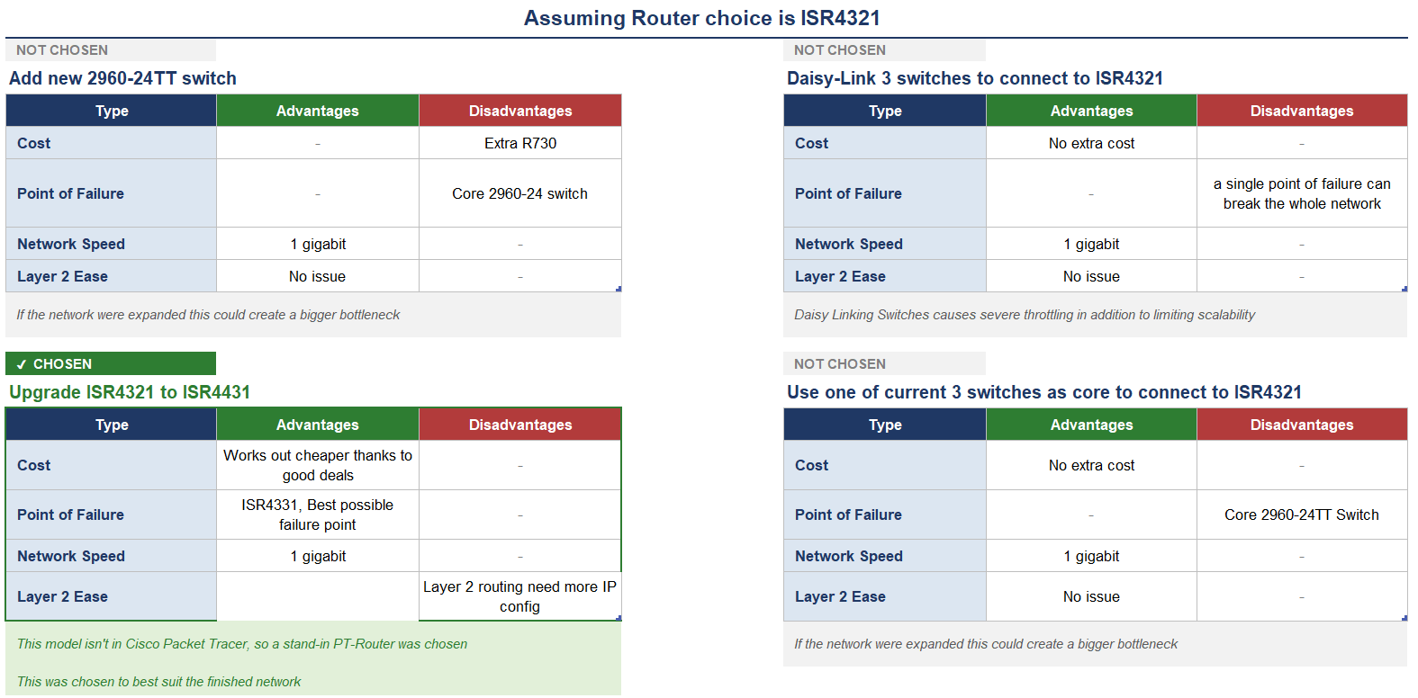
Network and Hardware Chosen and Explanation
Notes:
What to discuss:
Rejection of Alternative Topologies: Discuss why linear "Daisy-chaining" was evaluated and discarded. Explain the networking risks involved: a single point of failure and critical data bottlenecks.
Subnetting and Port Density: Explain the decision to use four dedicated Gigabit interfaces on the router (three for the classrooms, one for the ISP). Explain that this provides strict physical isolation of the three subnets, keeping the design clean and avoiding the immediate need for complex Layer 2 VLAN configurations.
When designing the physical topology, we evaluated several structural alternatives.
First, Daisy-chaining switches was explicitly discarded. While it has zero extra cost, it introduces a single point of failure and severe data bottlenecks if a middle switch fails.
Second, our IP addressing scheme required three strictly isolated subnets to ensure maximum security between the classrooms. To facilitate this without introducing the administrative complexity of Layer 2 VLAN routing at this preliminary stage, our design required four dedicated Gigabit interfaces—three for the classrooms and one for the ISP uplink.

Slide 5
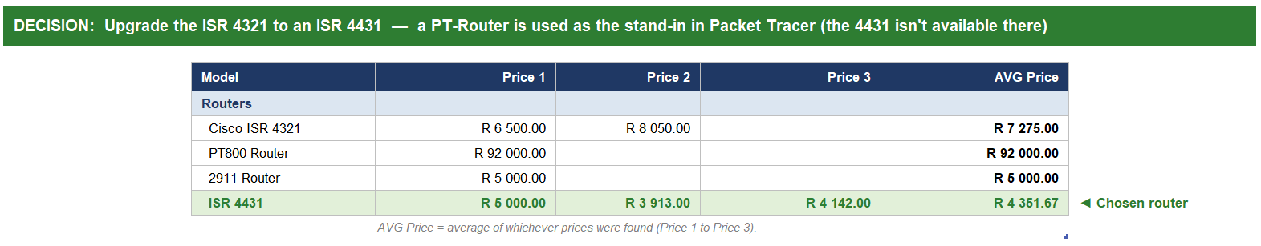
Cost table
+
Chosen Hardware
Notes:
What to discuss:
Budgetary Constraint Analysis: Discuss the financial evaluation process. Mention that enterprise alternatives like the Cisco Catalyst 8200 were researched but quickly rejected due to prohibitive costs (exceeding R90,000), which would break the branch budget.
The Selected Hardware: Explain how the team landed on the Cisco ISR 4431 through refurbished market research, balancing high-speed throughput with fiscal responsibility.
The Simulation Caveat: Address the technical reality of the software. Clearly inform the marker that because the specific ISR 4431 model is not natively rendered in this version of Cisco Packet Tracer, a modular PT-Router is being used as a functional simulation stand-in.
Our hardware selection process involved rigorous cost analysis. We initially evaluated the Cisco ISR 4321 and reviewed high-end alternatives like the Cisco Catalyst 8200, which priced out at an unfeasible R92,000—a figure that would completely break the branch budget.
We also analyzed legacy routers such as the 2911, but found they lacked native multi-port gigabit scalability. Ultimately, we selected the Cisco ISR 4431. Through careful sourcing of refurbished enterprise hardware, we secured it at an average price of roughly R4,351, making it the most cost-effective, high-throughput solution available.
Furthermore, in terms of cabling, we selected standard UTP Category 6 copper cable over fiber optic alternatives because fiber costs are excessively prohibitive for a standard classroom environment.
Finally, please note for our simulation: because the exact Cisco ISR 4431 model is not natively rendered in this version of Cisco Packet Tracer, a modular PT-Router has been deployed in the workspace as a direct functional equivalent to execute and test our configuration.

Slide 6
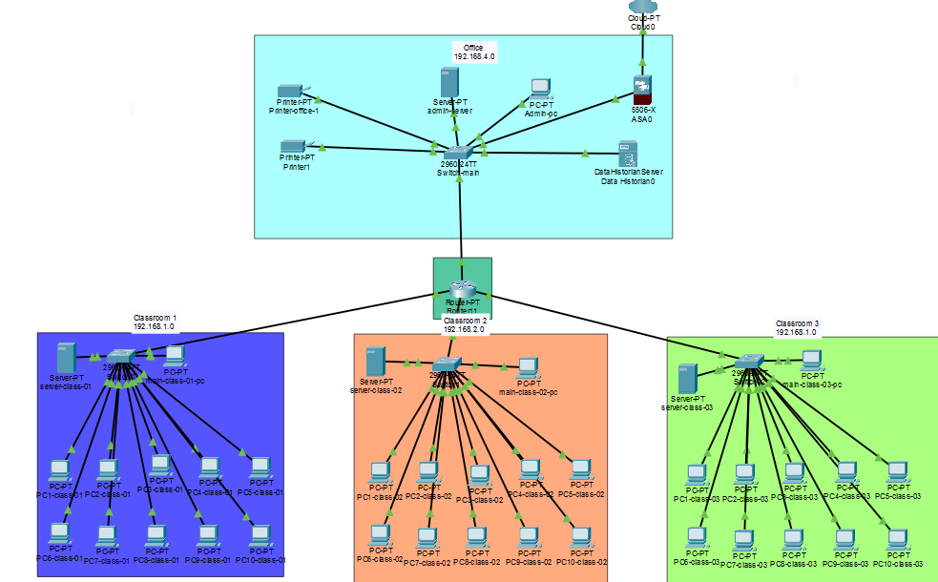
Network Topology
Notes:
Star tree topology:
We used a Star Tree topology, meaning that this entire network is built around one central router that connects the four segments, i.e. the three classrooms and the admin segment. Since only one router that can accommodate communication between all four segments is needed, the network remains cost-effective.
Each classroom is built around its own switch that connects the 10 student PCs and the one lecturer PC.
The admin segment handles all the shared devices such as the printers.
By dividing the network into 4 subnets, we create a more efficient and secure network.
Devices and connections:
Main Router
Printers
Security server in the office block connects to the internet to help give the network some protection.
Servers
PCs
UTP 6 cable: uses copper to transmit electrical signals
Advantages:
Lower Cost: UTP is generally less expensive than other similar shielded cabling because it does not require additional metallic shielding.
Ease of Installation: The absence of shielding usually makes UTP simpler to handle and route and is commonly installed in many office and / or classroom environments without needing to worry about the additional grounding and shielding considerations associated with shielded cable systems. This being one of the factors that led to us using this cable type.
Flexibility: UTP cables are generally lighter and more flexible than their counterparts containing additional shielding. This can make them easier to route through walls, cable trays and equipment cabinets.
Compatibility with Common Network Equipment: UTP is commonly supported by Ethernet network devices, including computers, switches, routers and network printers, making it a suitable choice for this scenario.
Suitable Performance for Typical Networks: When the category of cable, the equipment that is connected and the installation are appropriate, UTP can support the data rates required by many modern local area networks.
Limitations:
Greater Susceptibility to External Interference
UTP cables can potentially be affected by nearby power cables, electrical equipment or other sources of electromagnetic interference.
Transmission Distance Limitations
Like other copper cables, UTP cables will experience signal attenuation as transmission distance increases.
Sensitivity to Installation Quality
Improper installation can reduce the performance of a UTP connection.
Potential problems include:
Routing the cable too close to electrical power cables.
Untwisting wire pairs excessively near connectors.
Bending or crushing the cable.
Using unsuitable connectors.
Installing the cable in an environment for which it is not designed.
Data movement:
(The router acts like a GPS telling data where to go. Most data will originate from a device like one of the Pc’s or printers)
Access to communication:
All the Switches and routers support full duplex communication when transmitting data, meaning that the devices can communicate with each other simultaneously.
Advantage:
All the classes can communicate with each other and the office because of the router and switches
If the connection to one computer breaks in a class the rest are not affected.
If the connection to one of the classrooms breaks, the office and other classes won’t be affected.
Disadvantage:
If the central router is damaged or removed the network cannot function.
Adding devices
With the addition of devices, we can add more computers to the classrooms since not all of the 24 ports of the switch is used up , only eleven , however expanding horizontally by addinllg more classes won't be as efficient since the router doesn't have spare gigabit ports for new switches . But regardless adding more devices shouldn't disrupt communication as long as existing connections aren't severed

Slide 7
NWD1x1 – Group Virtual C
Thank You

