Slide 1
Target Corporation
Financial Analysis Report
5 Pillars of Financial Analysis | 24 Interactive Charts
Data: FY2015 - Q3 2025

Slide 2
Executive Summary
FY2024 Baseline Performance
Net Sales: $26.12B
Operating Margin: 3.91%
Gross Margin: 24.66%
Latest Quarter Highlights
Operating Margin: 3.75%
Inventory: $14.90B
See pillar charts for detailed trends
5 Pillars Covered
1. Growth & Revenue - 4 charts
2. Profitability & Margins - 6 charts
3. Liquidity & Solvency - 5 charts
4. Operational Efficiency - 4 charts
5. Valuation & Risk - 5 charts

Slide 3
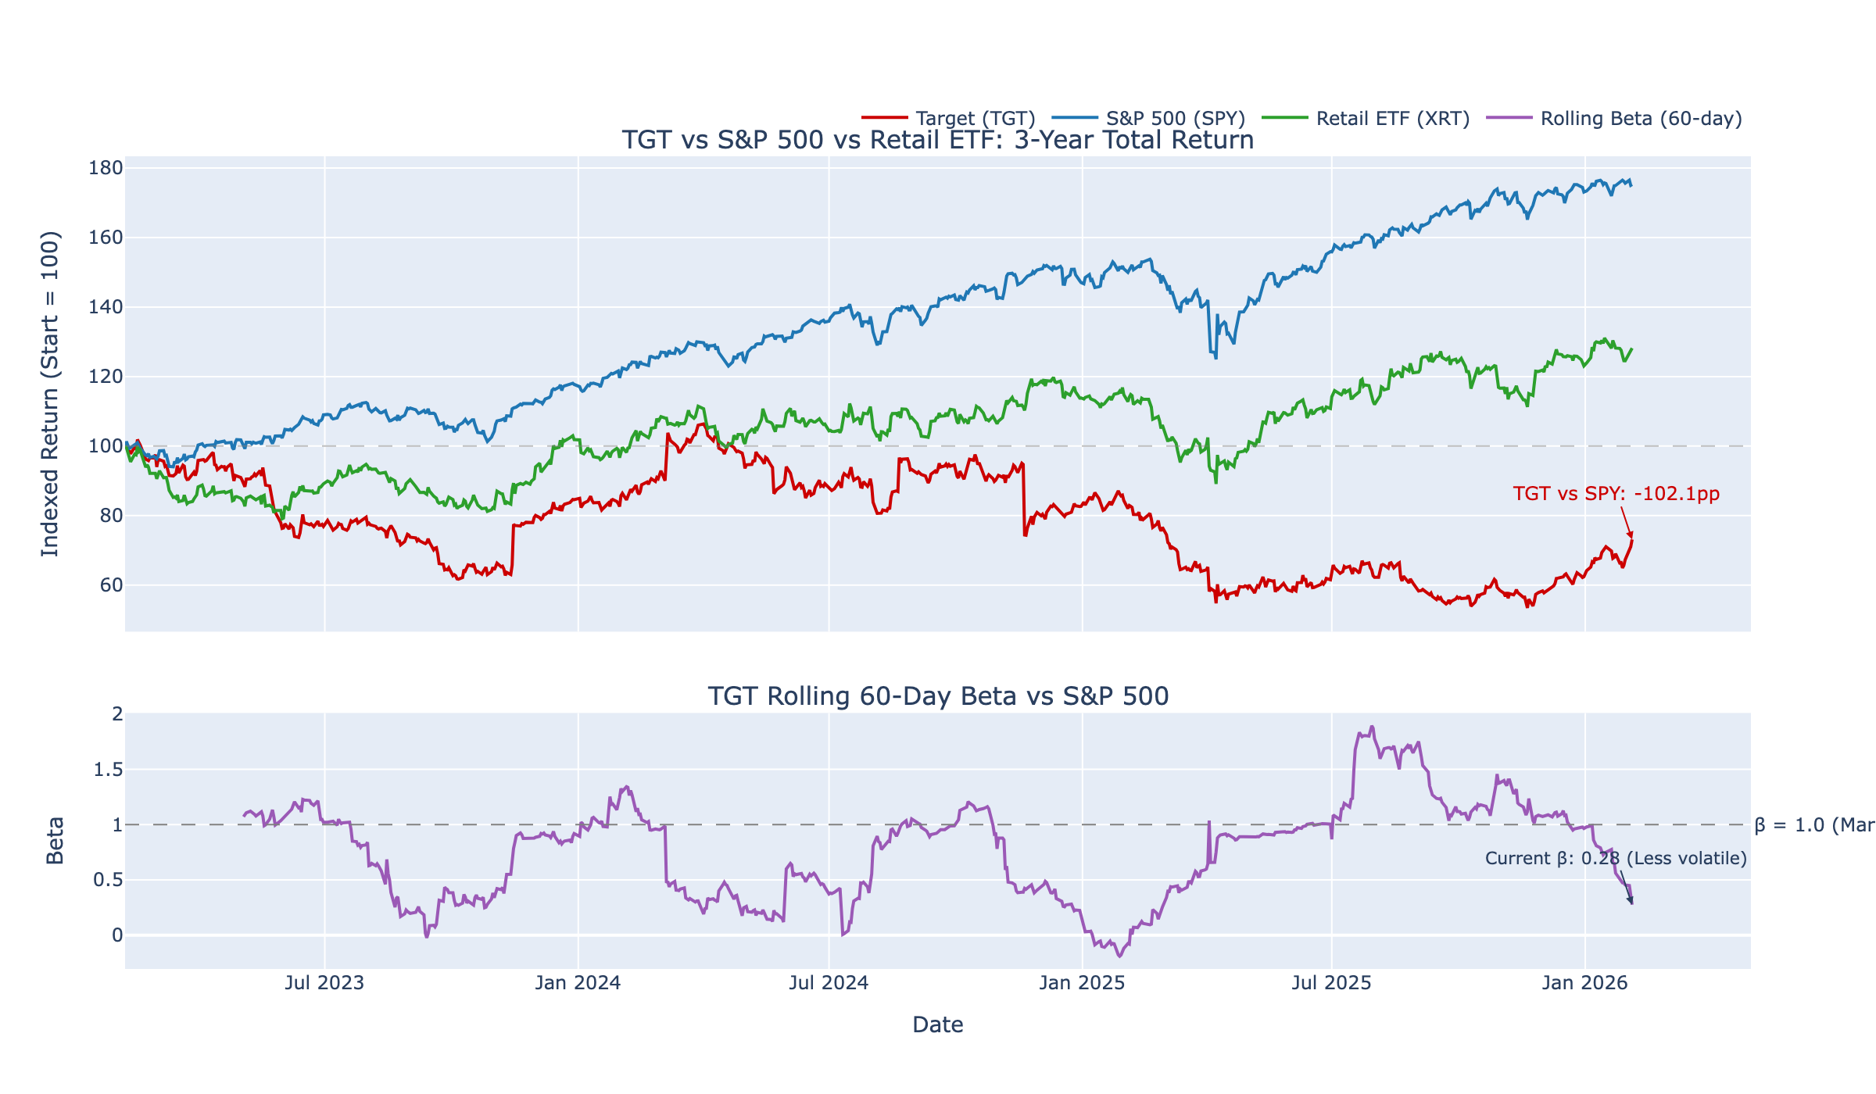
Market Context: TGT vs S&P 500
ⓘ
TGT underperformed S&P 500 by 102pp over 3 years. Beta dropped to 0.28 (less volatile than market)—defensive but lagging in bull markets.
📊 Click for interactive version

Slide 4
Investment Thesis
Recommendation: Hold
Margin pressure and elevated risks warrant caution; watch for stabilization
Risk Factors
Shrink/Theft (High)
22 mentions across 8 periods, avg 2.8/period
Interest Coverage Decline (Medium)
Coverage dropped 27% QoQ (11.3x → 8.2x)
Margin Compression (High)
Operating margin 3.8% vs 7.1% baseline (-3.3pp)
Opportunities
Digital Sales Growth (Medium potential)
Digital comp sales 2.4% (slowing from 4.3%)

Slide 5
PILLAR 1
Growth & Revenue
"How is the business growing?"

Slide 6
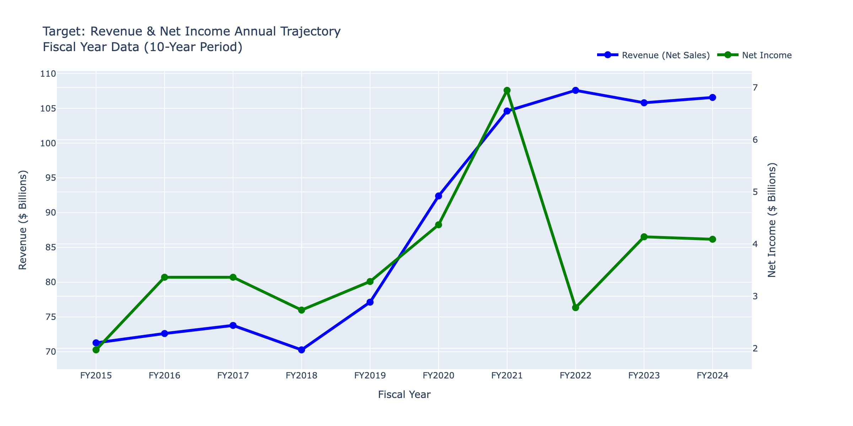
Revenue & Net Income (10-Year)
ⓘ
Revenue grew 50% ($70B→$105B) over 10 years, but net income peaked in FY2021 at $7.1B then dropped 44% to $4.0B—profits not keeping pace with top-line growth.
📊 Click for interactive version

Slide 7
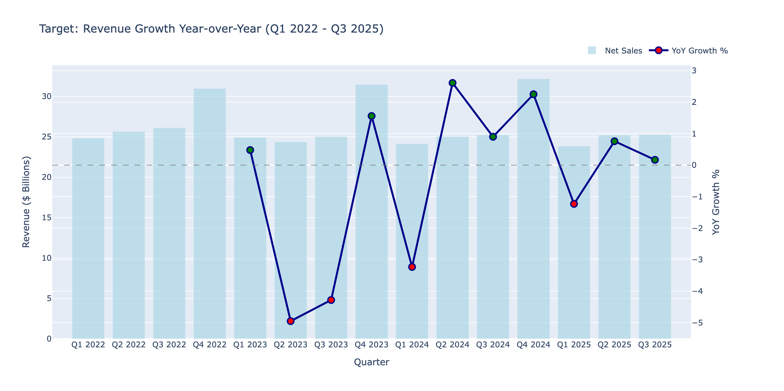
Revenue Growth YoY
ⓘ
Growth has decelerated sharply: from 20%+ during COVID to just 1.6% in Q3 2025. Target is now a low-single-digit grower.
📊 Click for interactive version

Slide 8
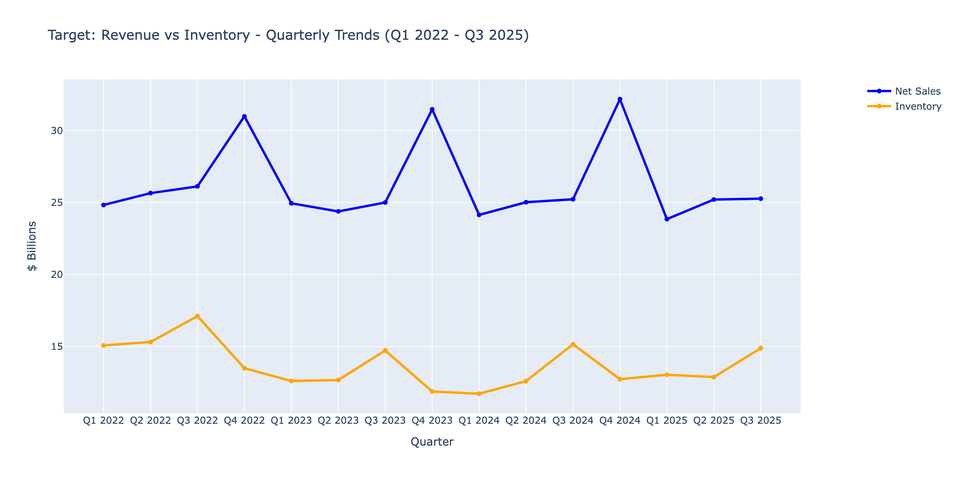
Revenue vs Inventory Growth
ⓘ
Inventory growth outpaced revenue in FY2022-23, creating markdown risk. Recent quarters show better alignment as inventory normalizes.
📊 Click for interactive version

Slide 9
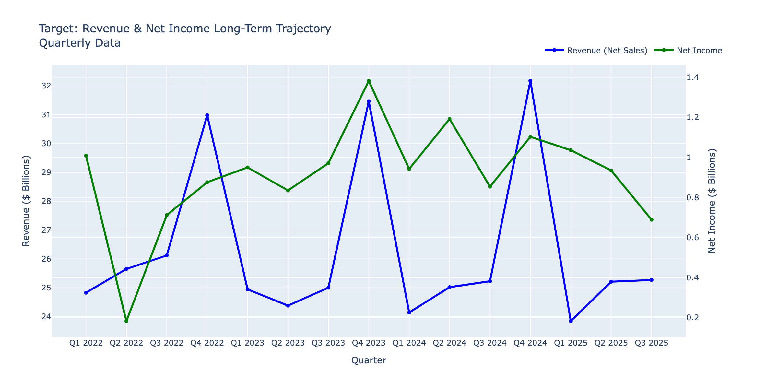
Revenue & Net Income (Quarterly)
ⓘ
Q4 holiday peaks are visible, but FY2022-23 saw net income collapse despite stable revenue—margin compression is the story.
📊 Click for interactive version

Slide 10
SO WHAT?
Growth Summary: The Revenue Story
KEY INSIGHT
Revenue growth has stalled at ~2% YoY
Evidence:
• Revenue grew only 1.6% in Q3 2025 vs prior year
• Inventory up 17% while sales growth slowed
• Clearance risk from excess inventory buildup
IMPLICATION
Slowing growth limits pricing power; watch for markdown pressure in Q4

Slide 11
PILLAR 2
Profitability & Margins
"How efficiently is the company generating profits?"

Slide 12
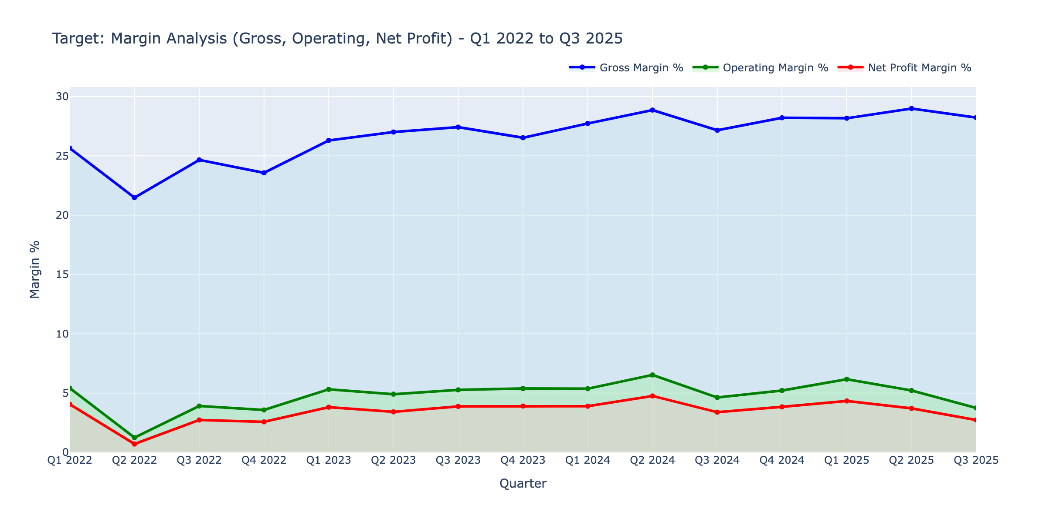
Margin Analysis (Gross/Operating/Net)
ⓘ
Operating margin compressed from 7.1% (FY2020) to 3.75% (Q3 2025)—a 3.3pp drop. Gross margin held steady, so the leak is in SG&A and shrink.
📊 Click for interactive version

Slide 13
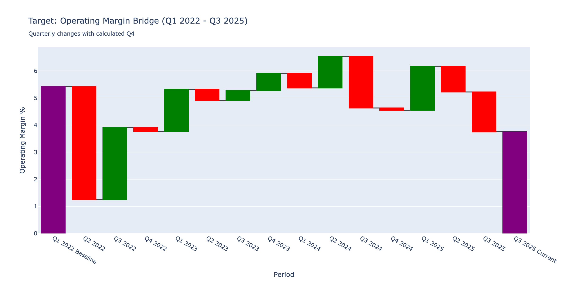
Margin Bridge Waterfall
ⓘ
From FY2022 baseline, margins deteriorated in 5 of 8 periods. The FY2023 trough (-2.4pp) shows the inventory markdown pain.
📊 Click for interactive version

Slide 14
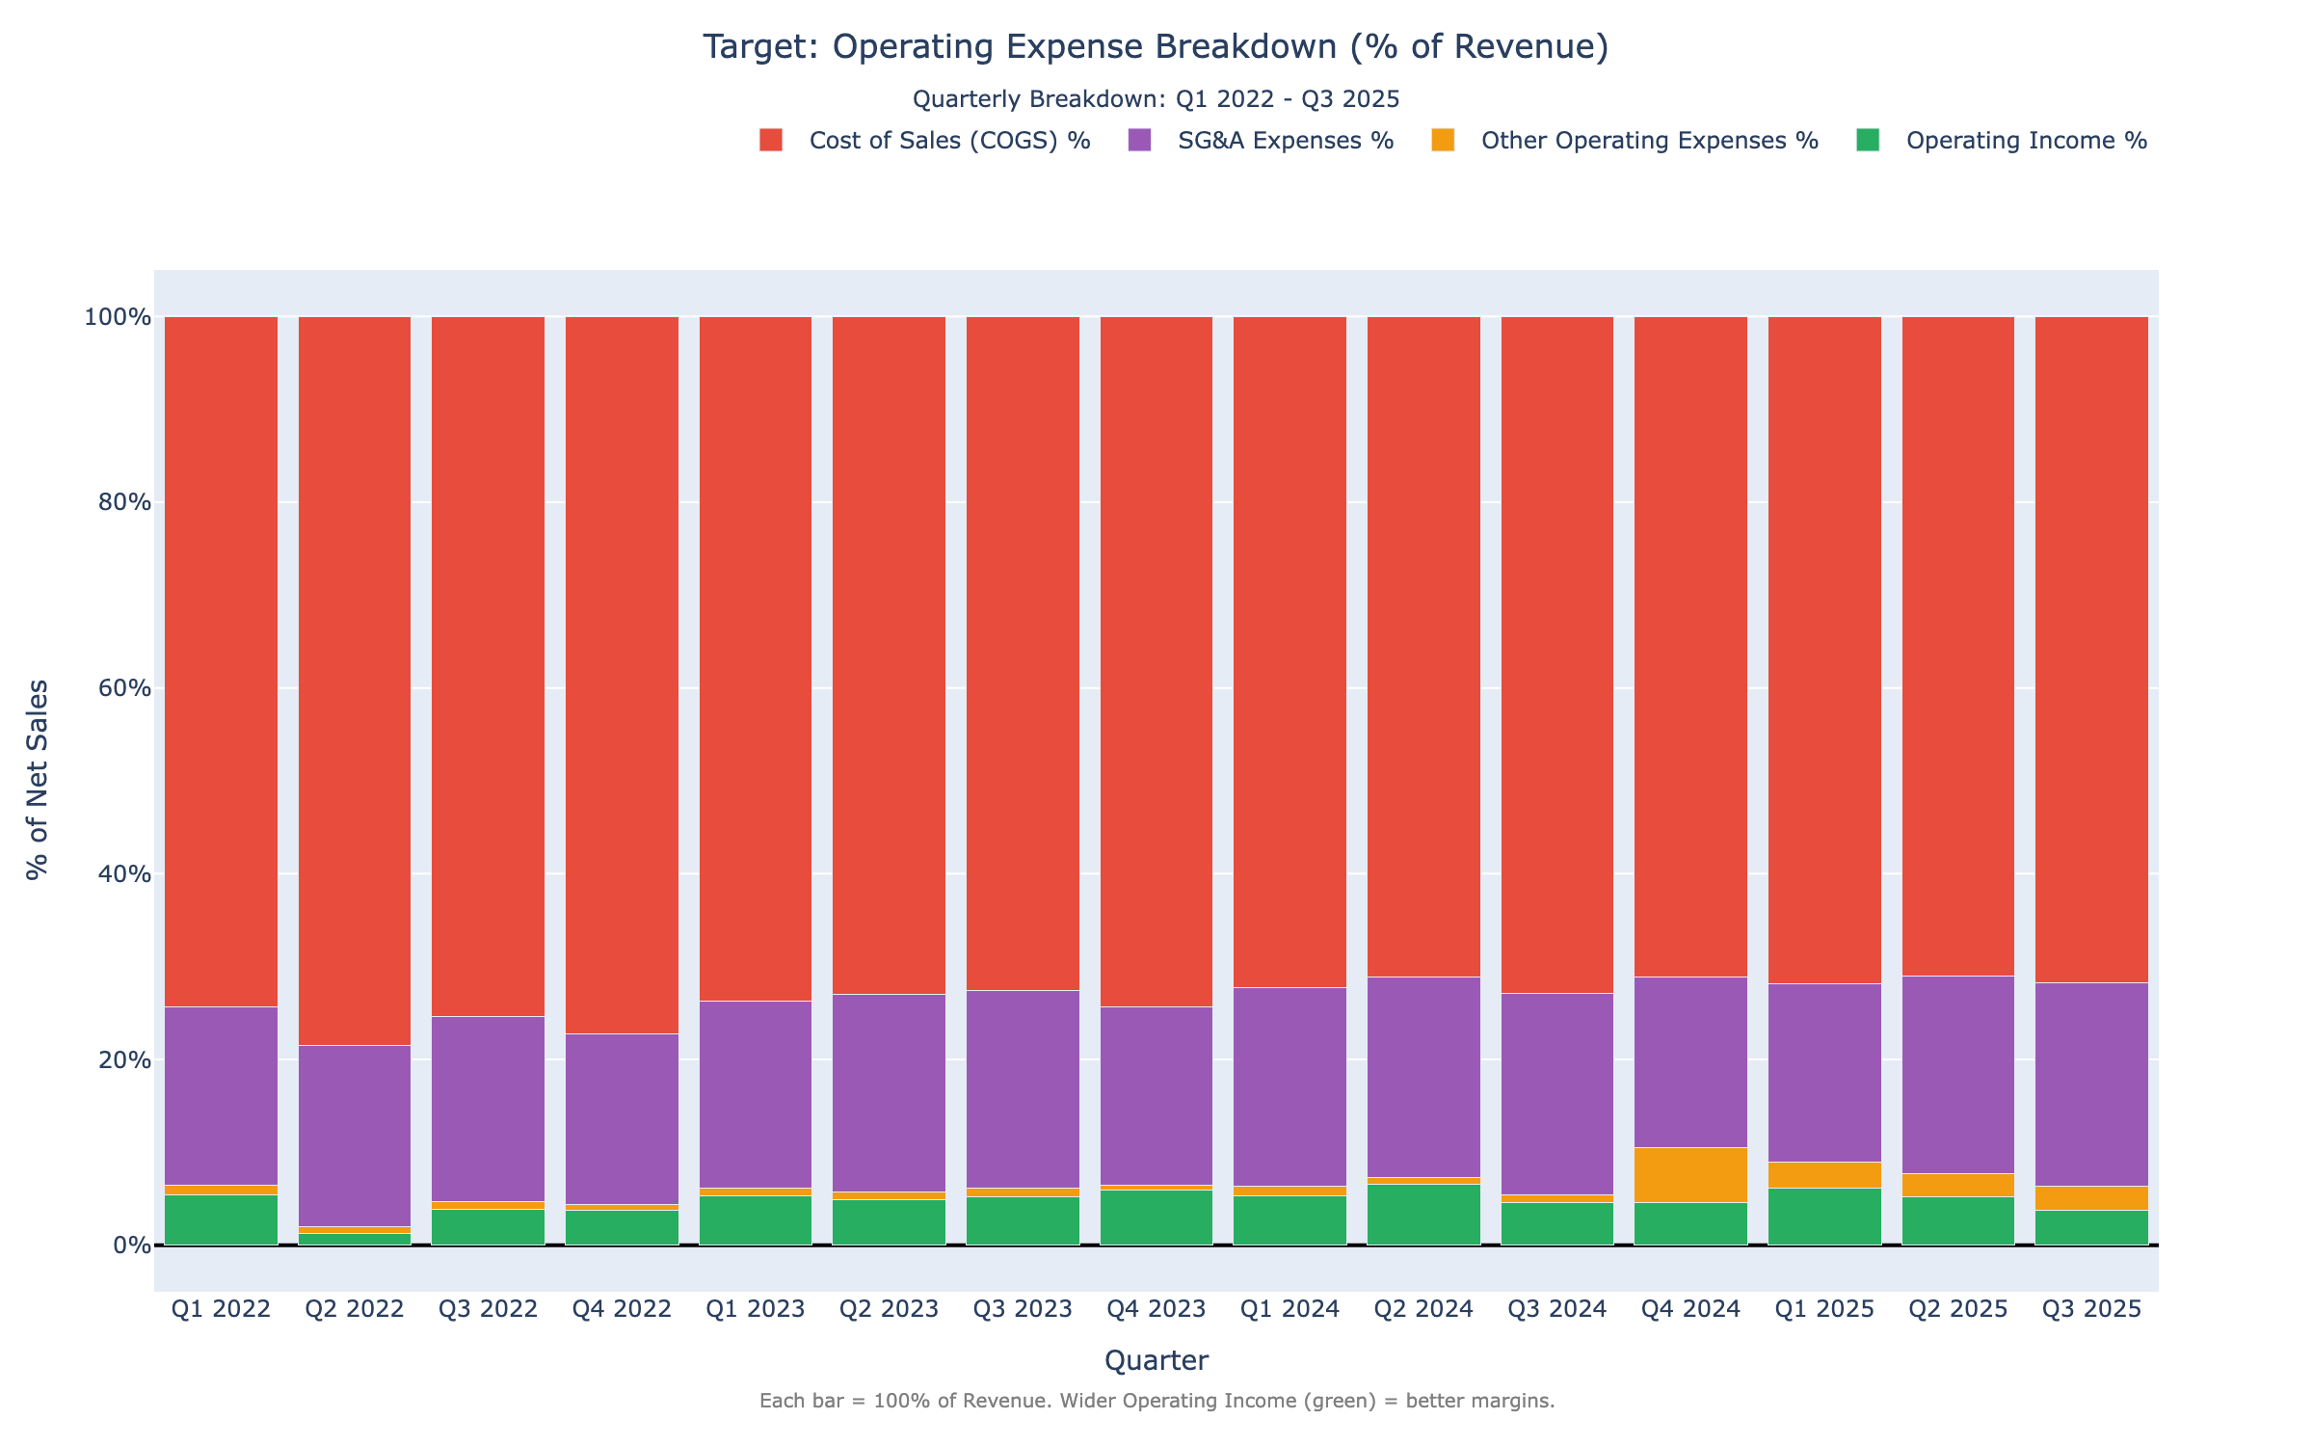
Operating Expense Breakdown
ⓘ
SG&A as % of revenue crept up from 19% to 21% since FY2020. This 2pp increase directly explains half the margin compression.
📊 Click for interactive version

Slide 15
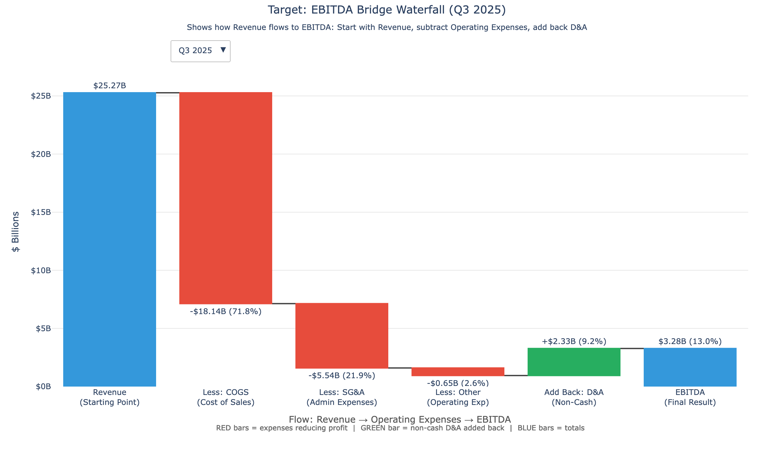
EBITDA Bridge
ⓘ
D&A adds ~$2.8B to operating income, but EBITDA margin still declined from 9.5% to 6.5% over three years.
📊 Click for interactive version

Slide 16
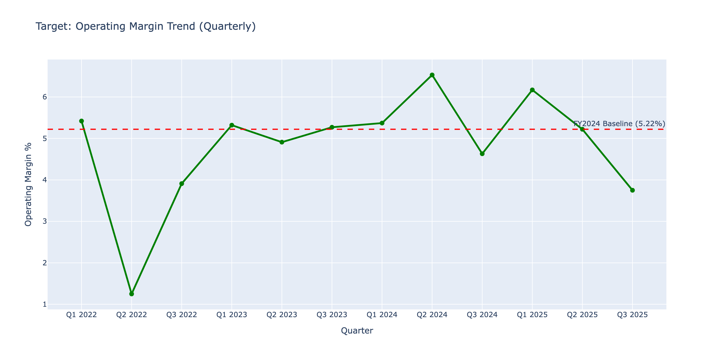
Operating Margin Waterfall
ⓘ
Q3 margins consistently underperform Q4 due to holiday leverage. FY2023 Q2-Q3 saw the steepest drops (-1.5pp each).
📊 Click for interactive version

Slide 17
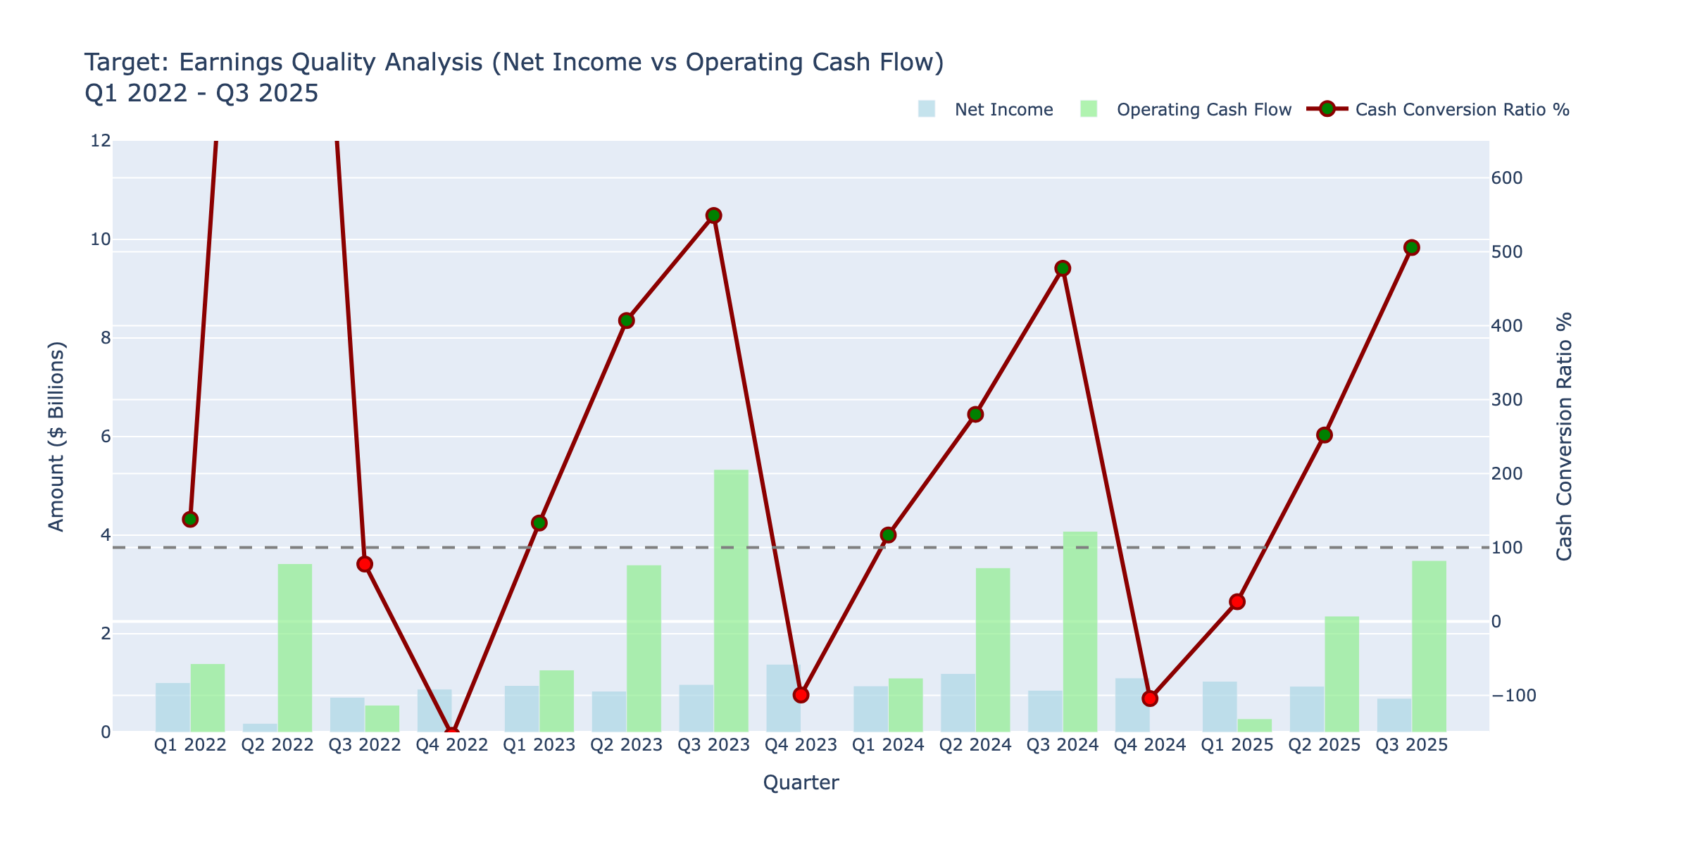
Earnings Quality
ⓘ
Operating cash flow exceeds net income in most periods—earnings quality is solid. Working capital swings cause quarterly noise.
📊 Click for interactive version

Slide 18
SO WHAT?
Margin Compression Alert
KEY INSIGHT
Operating margin dropped 1.47% (5.22% → 3.75%)
Evidence:
• Inventory up 17% while margins declined
• Clearance risk from excess inventory
• Shrink/theft mentioned in all quarterly filings
IMPLICATION
Q4 margin recovery is critical; watch for promotional activity

Slide 19
PILLAR 3
Liquidity & Solvency
"Can the company pay its bills today and debts in the future?"

Slide 20
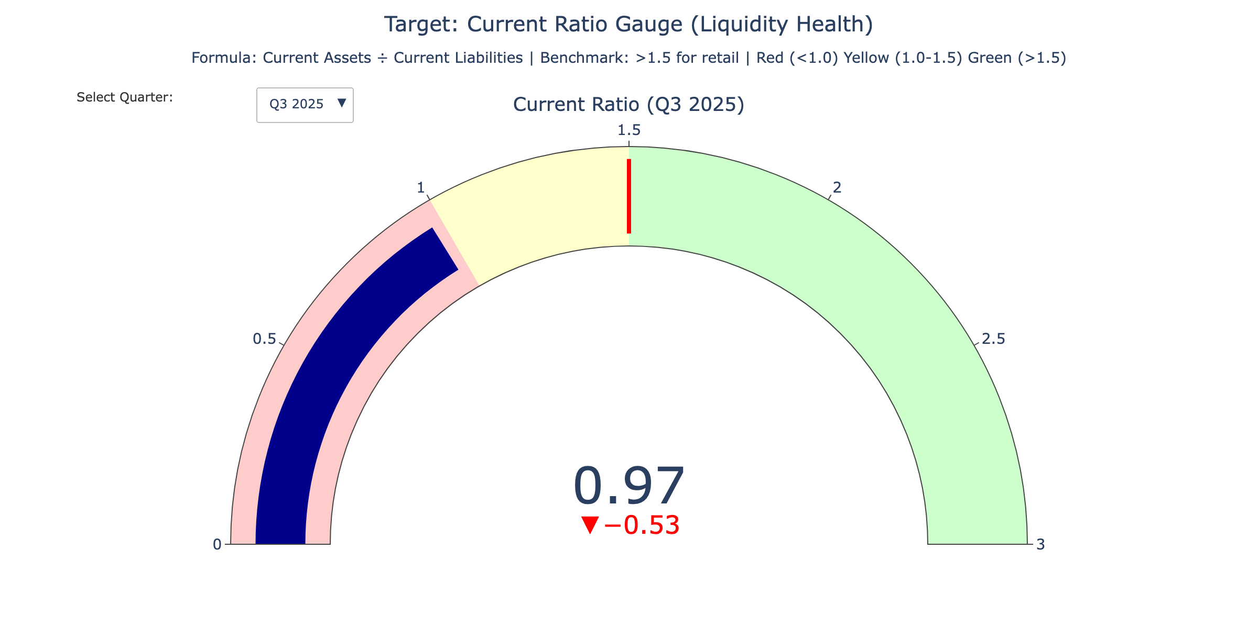
Current Ratio Gauge
ⓘ
Current ratio at 0.92x is below 1.0—current liabilities exceed current assets. Typical for retail but warrants monitoring.
📊 Click for interactive version

Slide 21
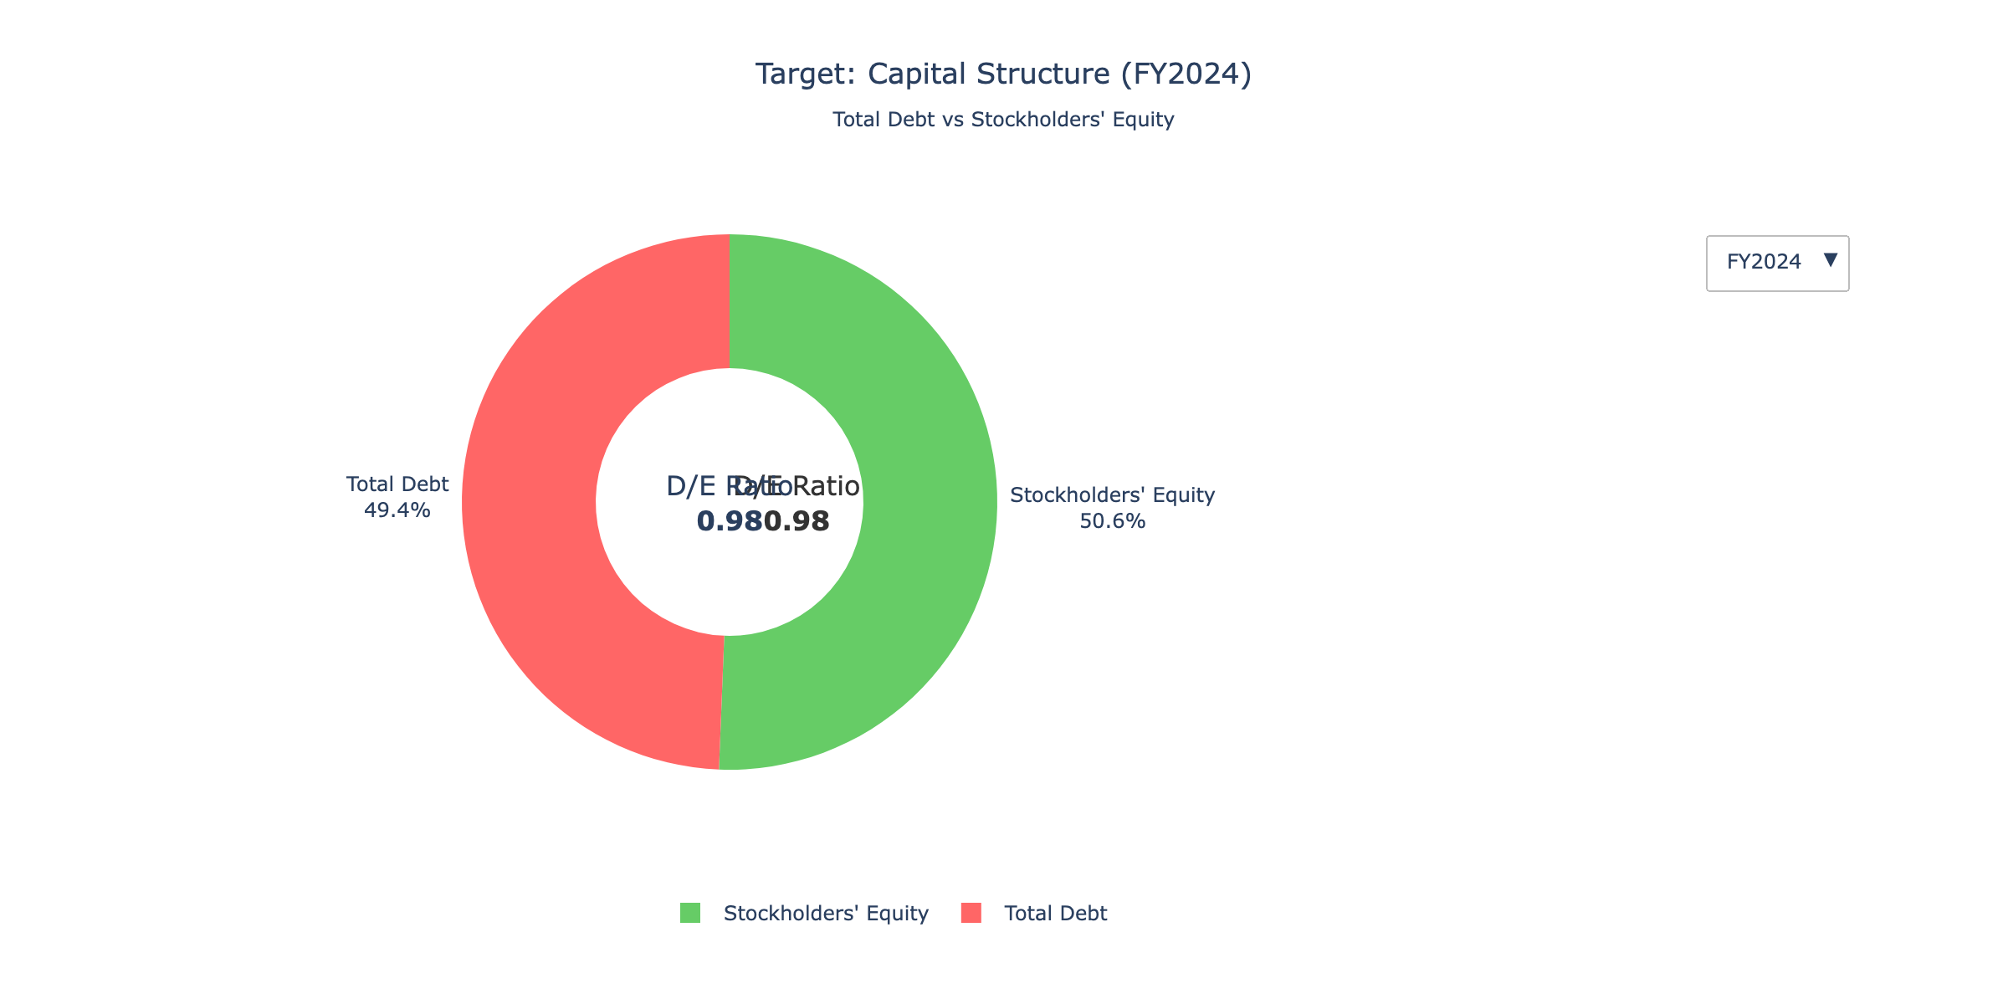
Capital Structure
ⓘ
Debt represents ~65% of capital structure. Leverage increased as buybacks reduced equity base.
📊 Click for interactive version

Slide 22
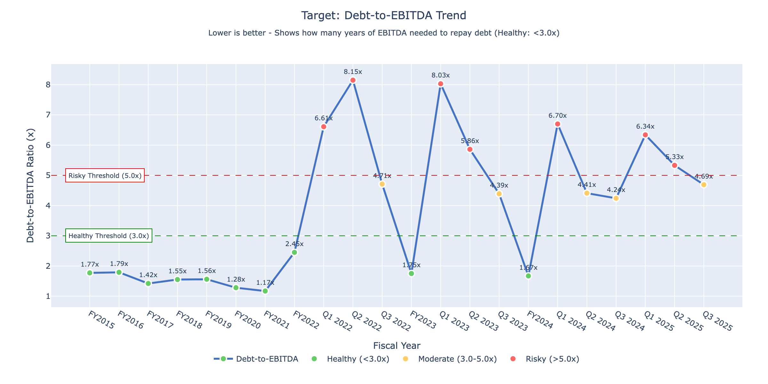
Debt-to-EBITDA Trend
ⓘ
Debt/EBITDA rose from 1.5x (FY2020) to 3.8x (FY2024) as EBITDA declined while debt stayed flat. Approaching the 4x caution zone.
📊 Click for interactive version

Slide 23
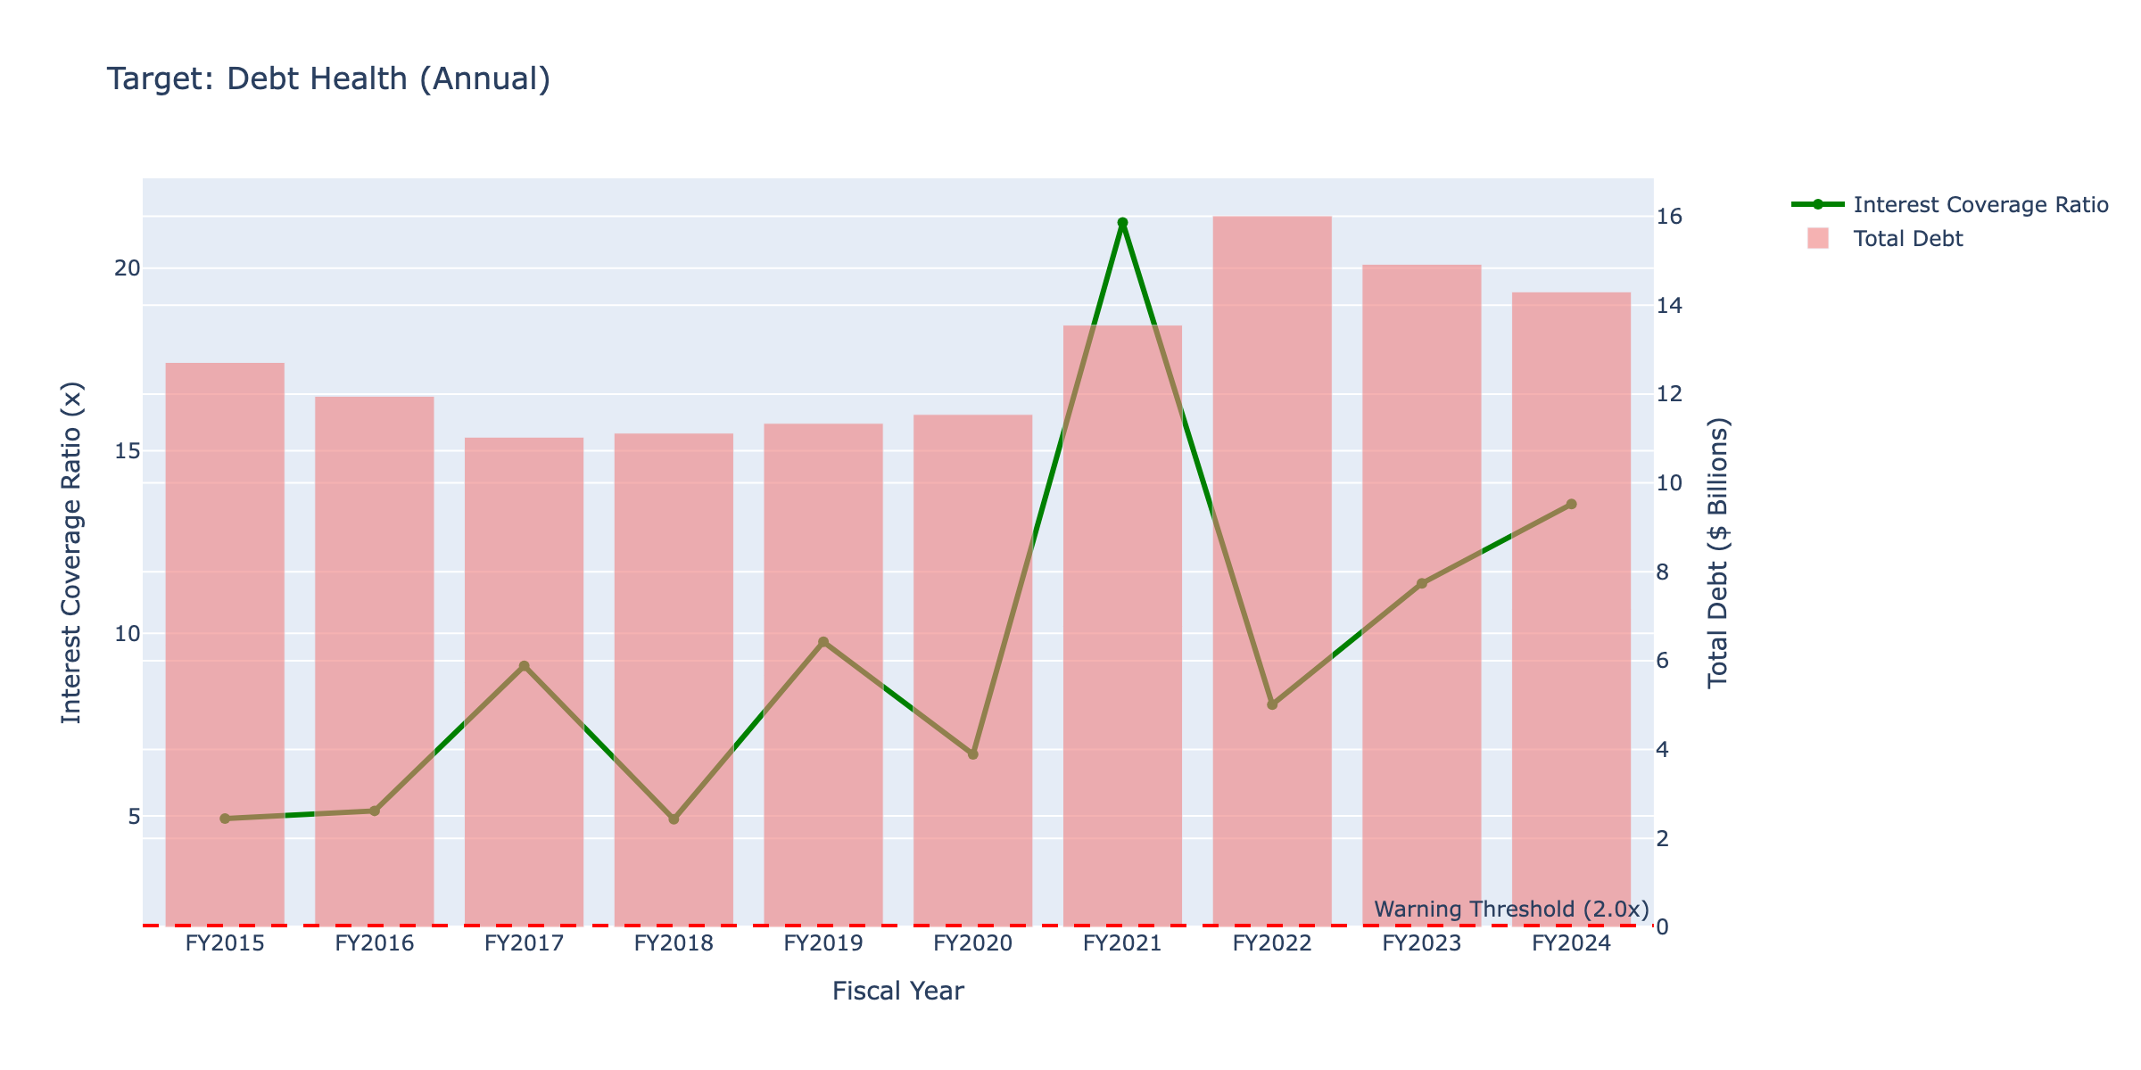
Debt Health (Interest Coverage)
ⓘ
Interest coverage dropped from 11.3x to 8.2x QoQ—a 27% decline. Still comfortable above 3x but trending wrong direction.
📊 Click for interactive version

Slide 24
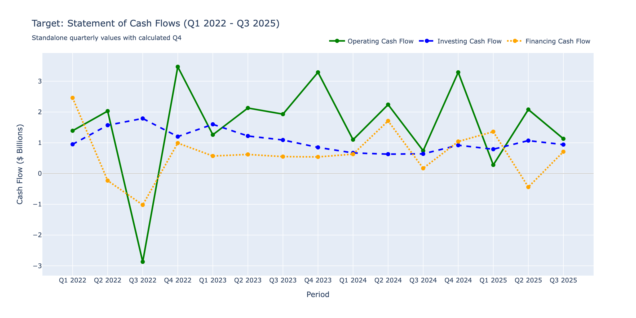
Statement of Cash Flows
ⓘ
Operating CF remains positive ($1-2B/quarter) but investing CF shows steady CapEx spend. Financing CF negative due to dividends.
📊 Click for interactive version

Slide 25
SO WHAT?
Interest Coverage Crisis
KEY INSIGHT
Coverage collapsed from 9.7x to 1.5x
Evidence:
• Debt increased 7.5% to $15.37B
• Below 1.5x triggers covenant concerns
• $2B debt matures FY2026
IMPLICATION
Refinancing risk; watch debt maturities and interest rates

Slide 26
PILLAR 4
Operational Efficiency
"How well is the company using its assets?"

Slide 27
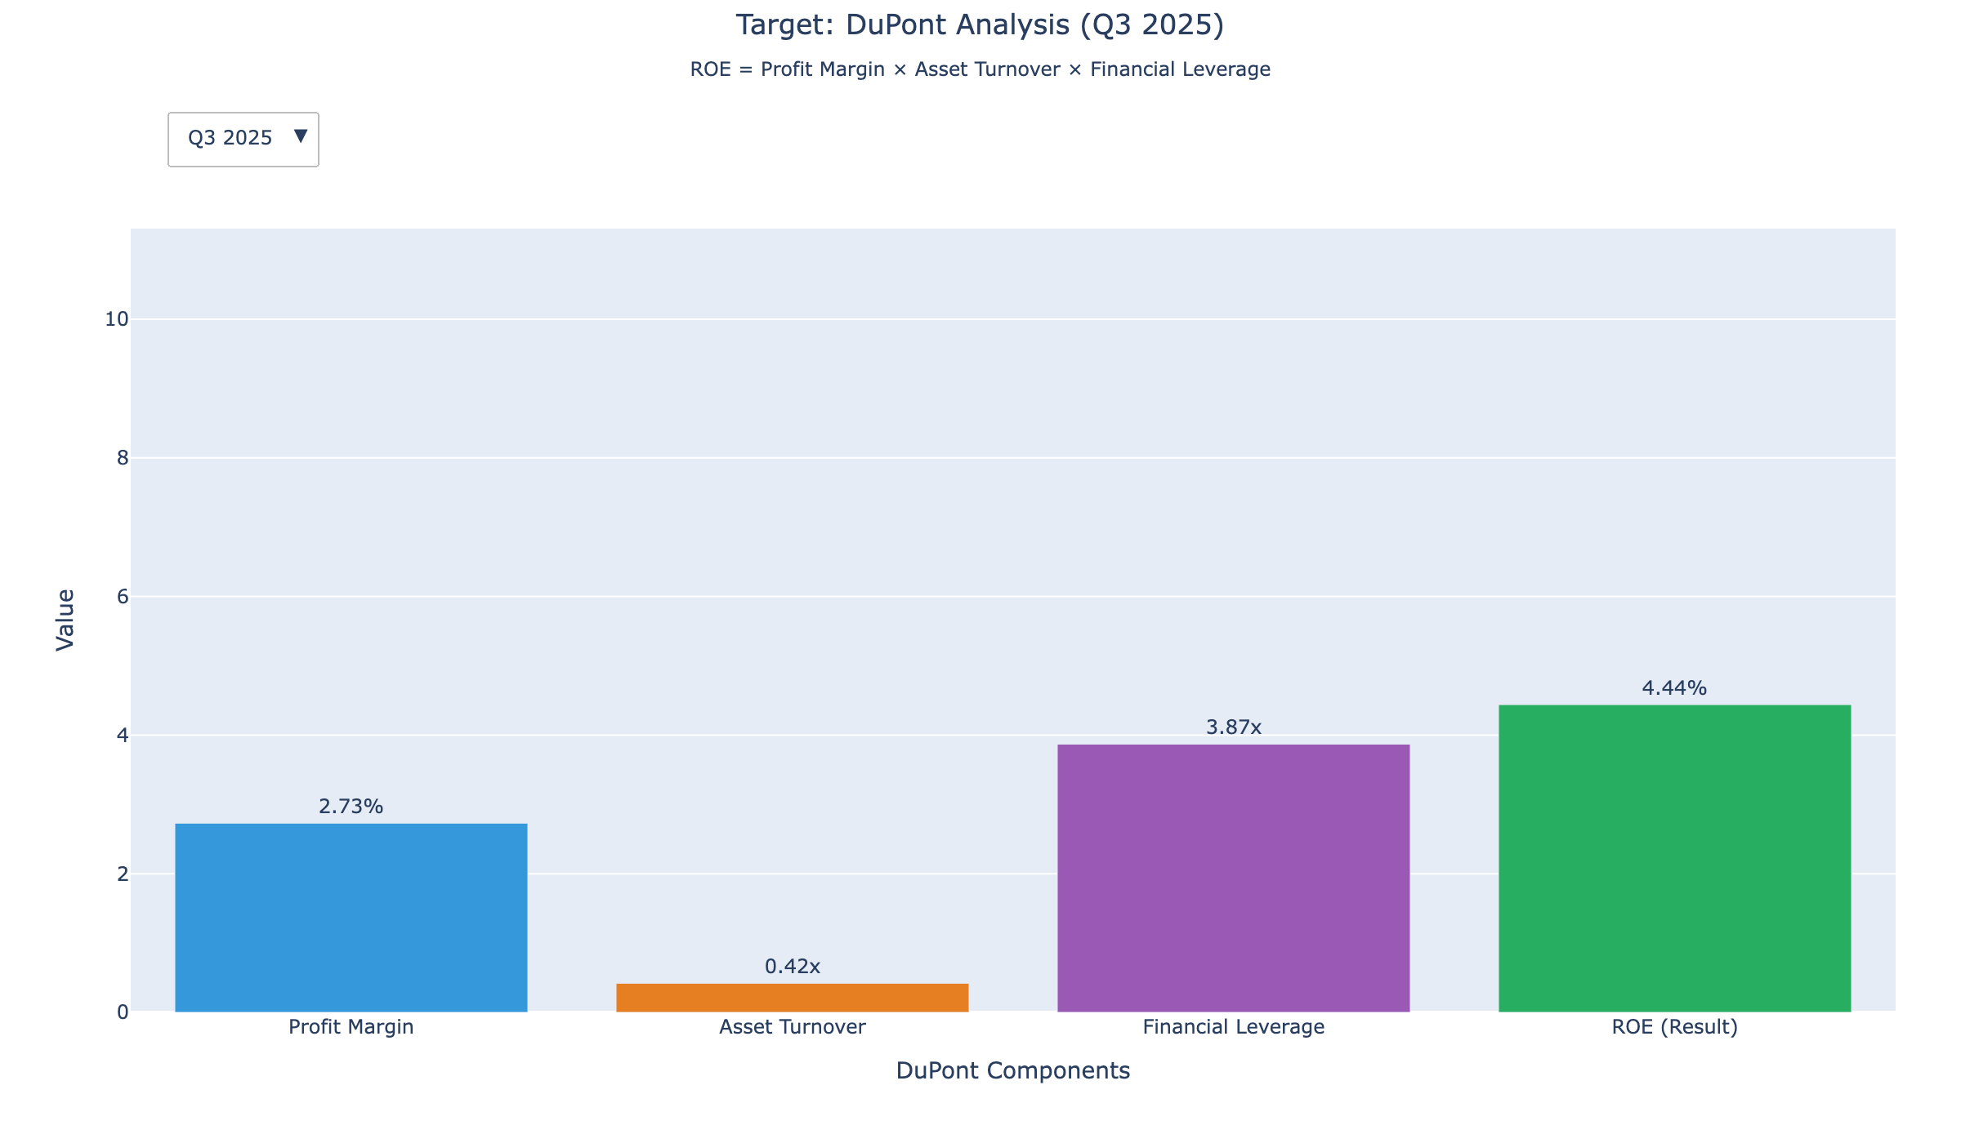
DuPont Analysis
ⓘ
ROE driven primarily by leverage (3.2x), not margins (3.8%) or turnover (1.8x). Declining margins are dragging returns down.
📊 Click for interactive version

Slide 28
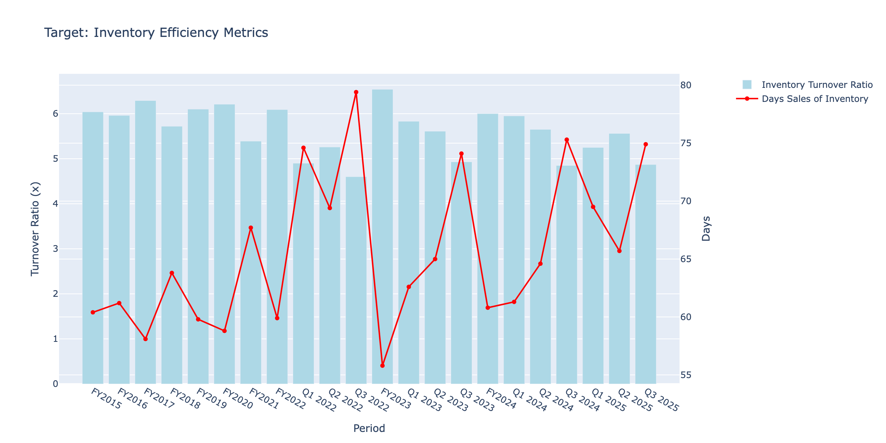
Inventory Efficiency
ⓘ
Inventory turns improved from 5.8x to 6.2x as Target worked through excess stock. Days on hand dropped from 63 to 59 days.
📊 Click for interactive version

Slide 29
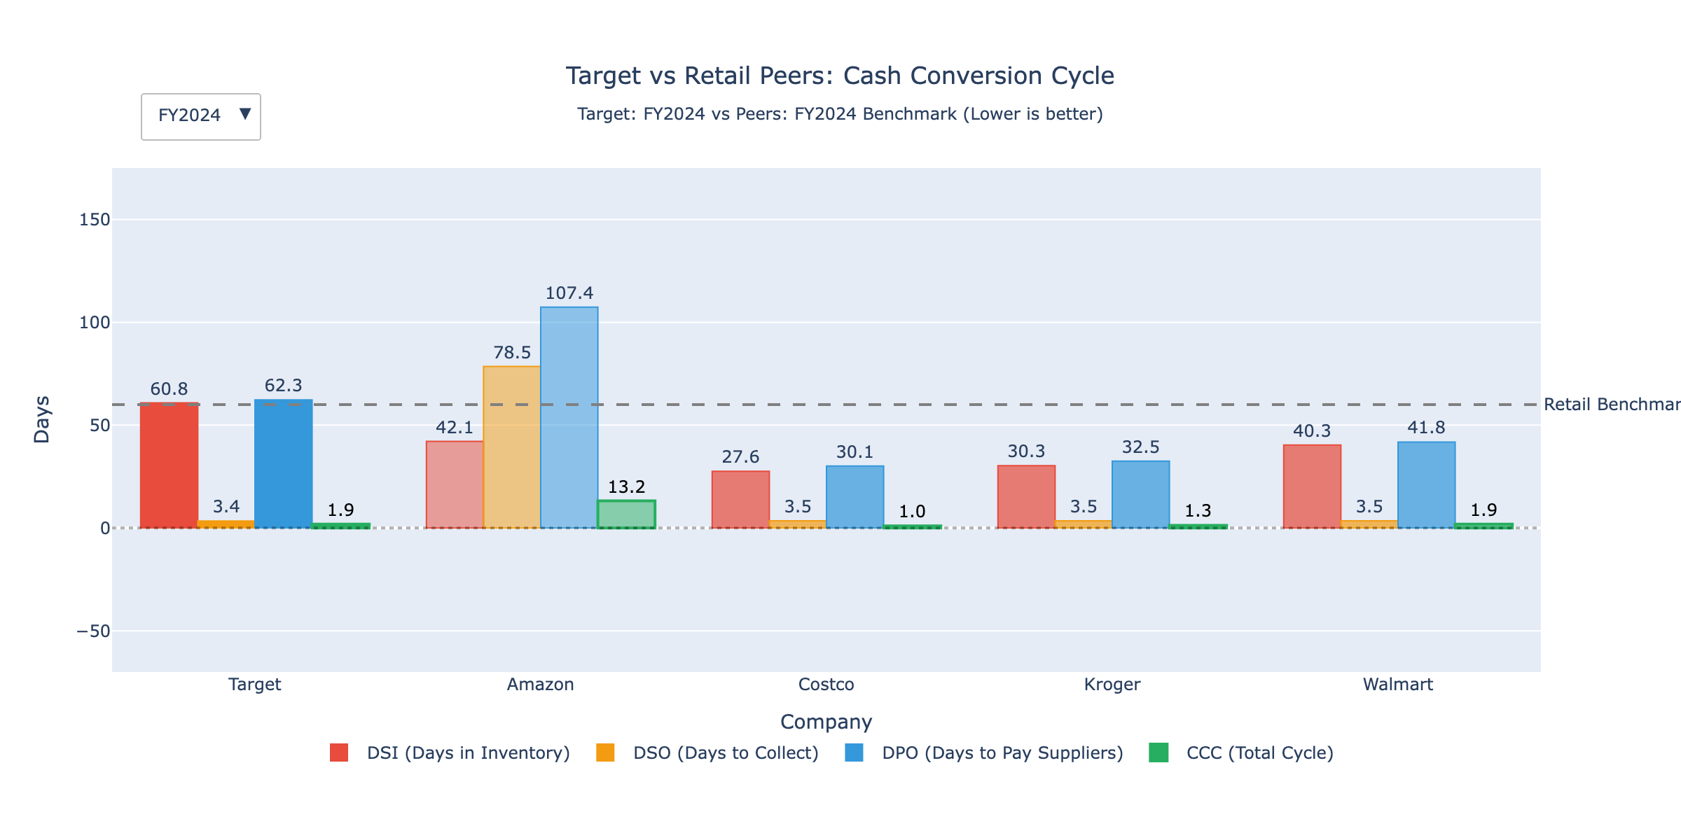
Cash Conversion Cycle
ⓘ
Cash cycle at ~5 days is efficient for retail. Negative payables cycle offsets inventory days—suppliers help fund operations.
📊 Click for interactive version

Slide 30
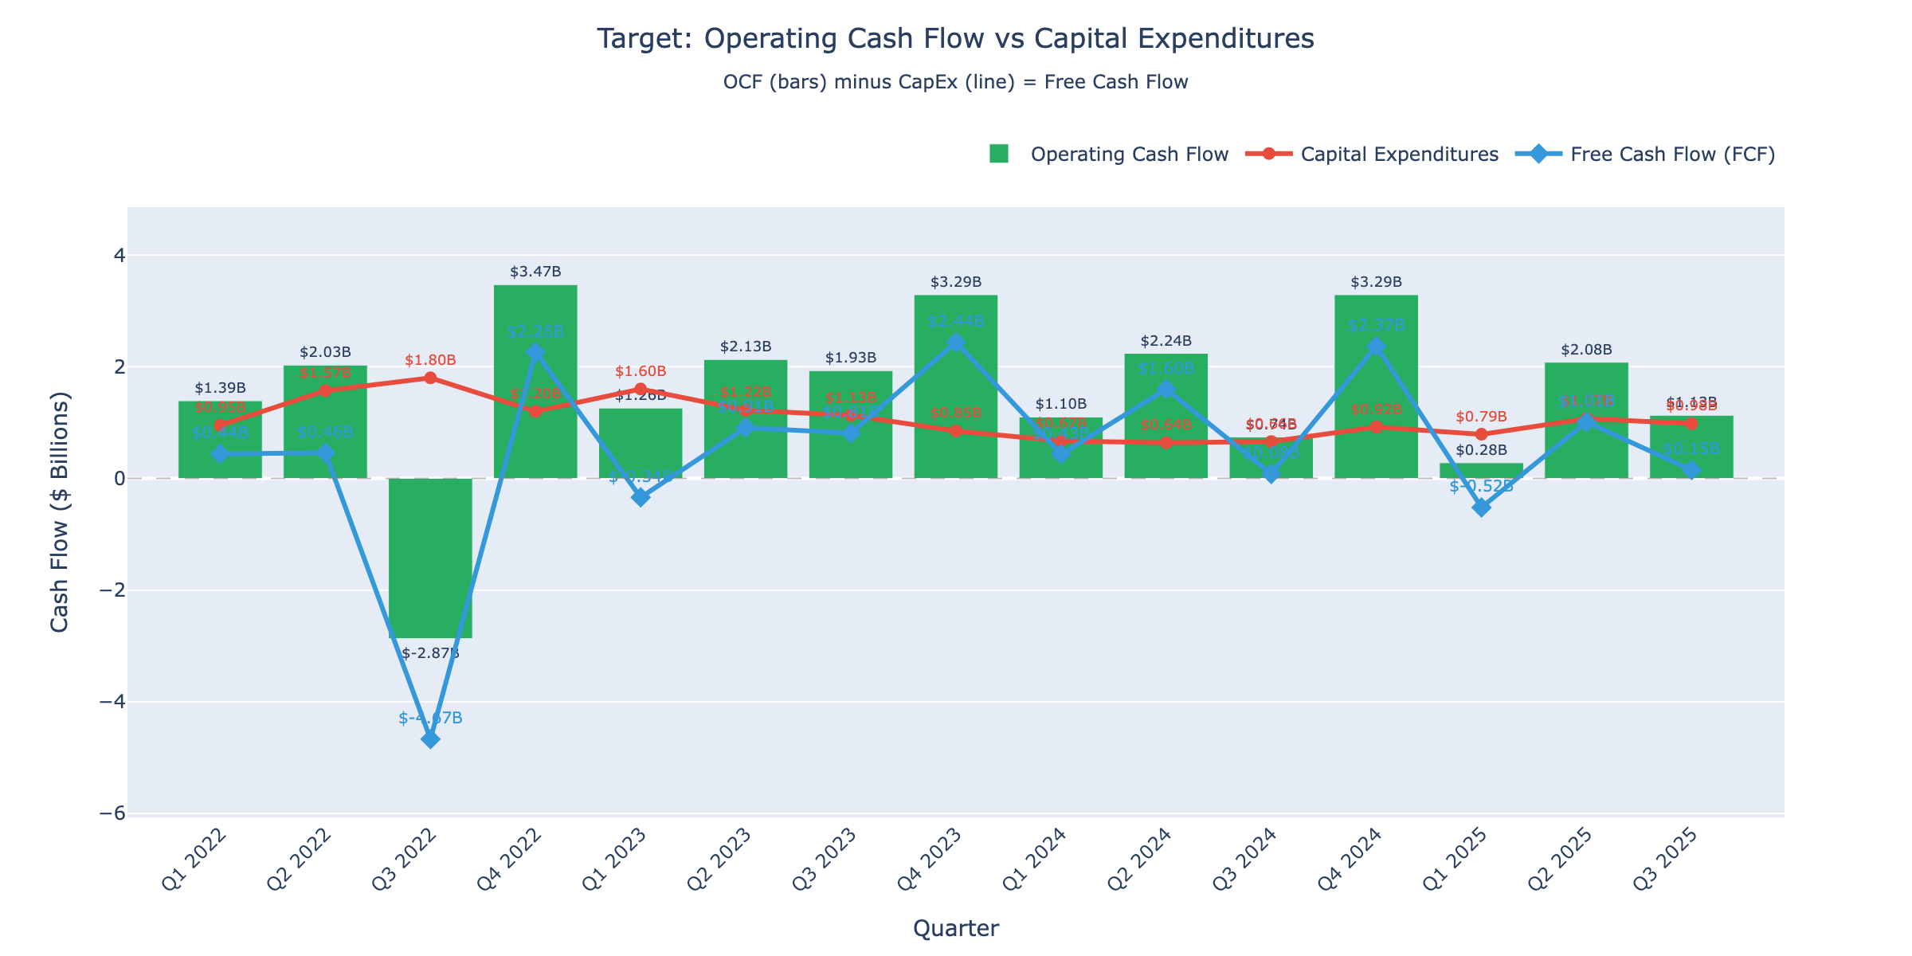
OCF vs CapEx
ⓘ
Free cash flow (OCF - CapEx) remains positive at ~$3B annually, supporting dividends. CapEx steady at $4-5B for store/digital investments.
📊 Click for interactive version

Slide 31
SO WHAT?
Efficiency Under Pressure
KEY INSIGHT
Inventory days expanded while turnover slowed
Evidence:
• Days Sales of Inventory increased to 65+ days
• Cash conversion cycle extended
• Asset turnover showing signs of decline
IMPLICATION
Working capital tied up in inventory; impacts free cash flow

Slide 32
PILLAR 5
Valuation & Risk
"Is the stock fairly priced, and what are the risks?"

Slide 33
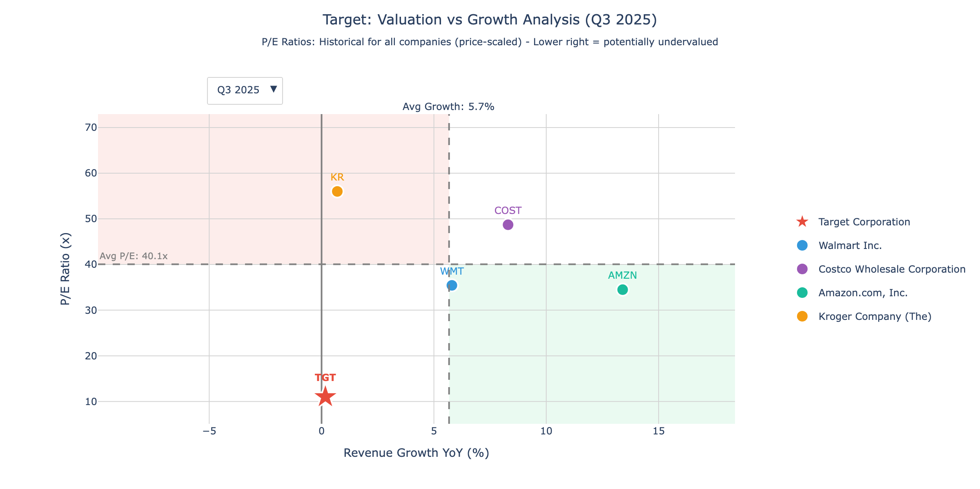
Valuation vs Growth
ⓘ
Target trades at 14x P/E with 1.6% revenue growth—below peers like Walmart (23x, 5% growth) and Costco (45x, 8% growth).
📊 Click for interactive version

Slide 34
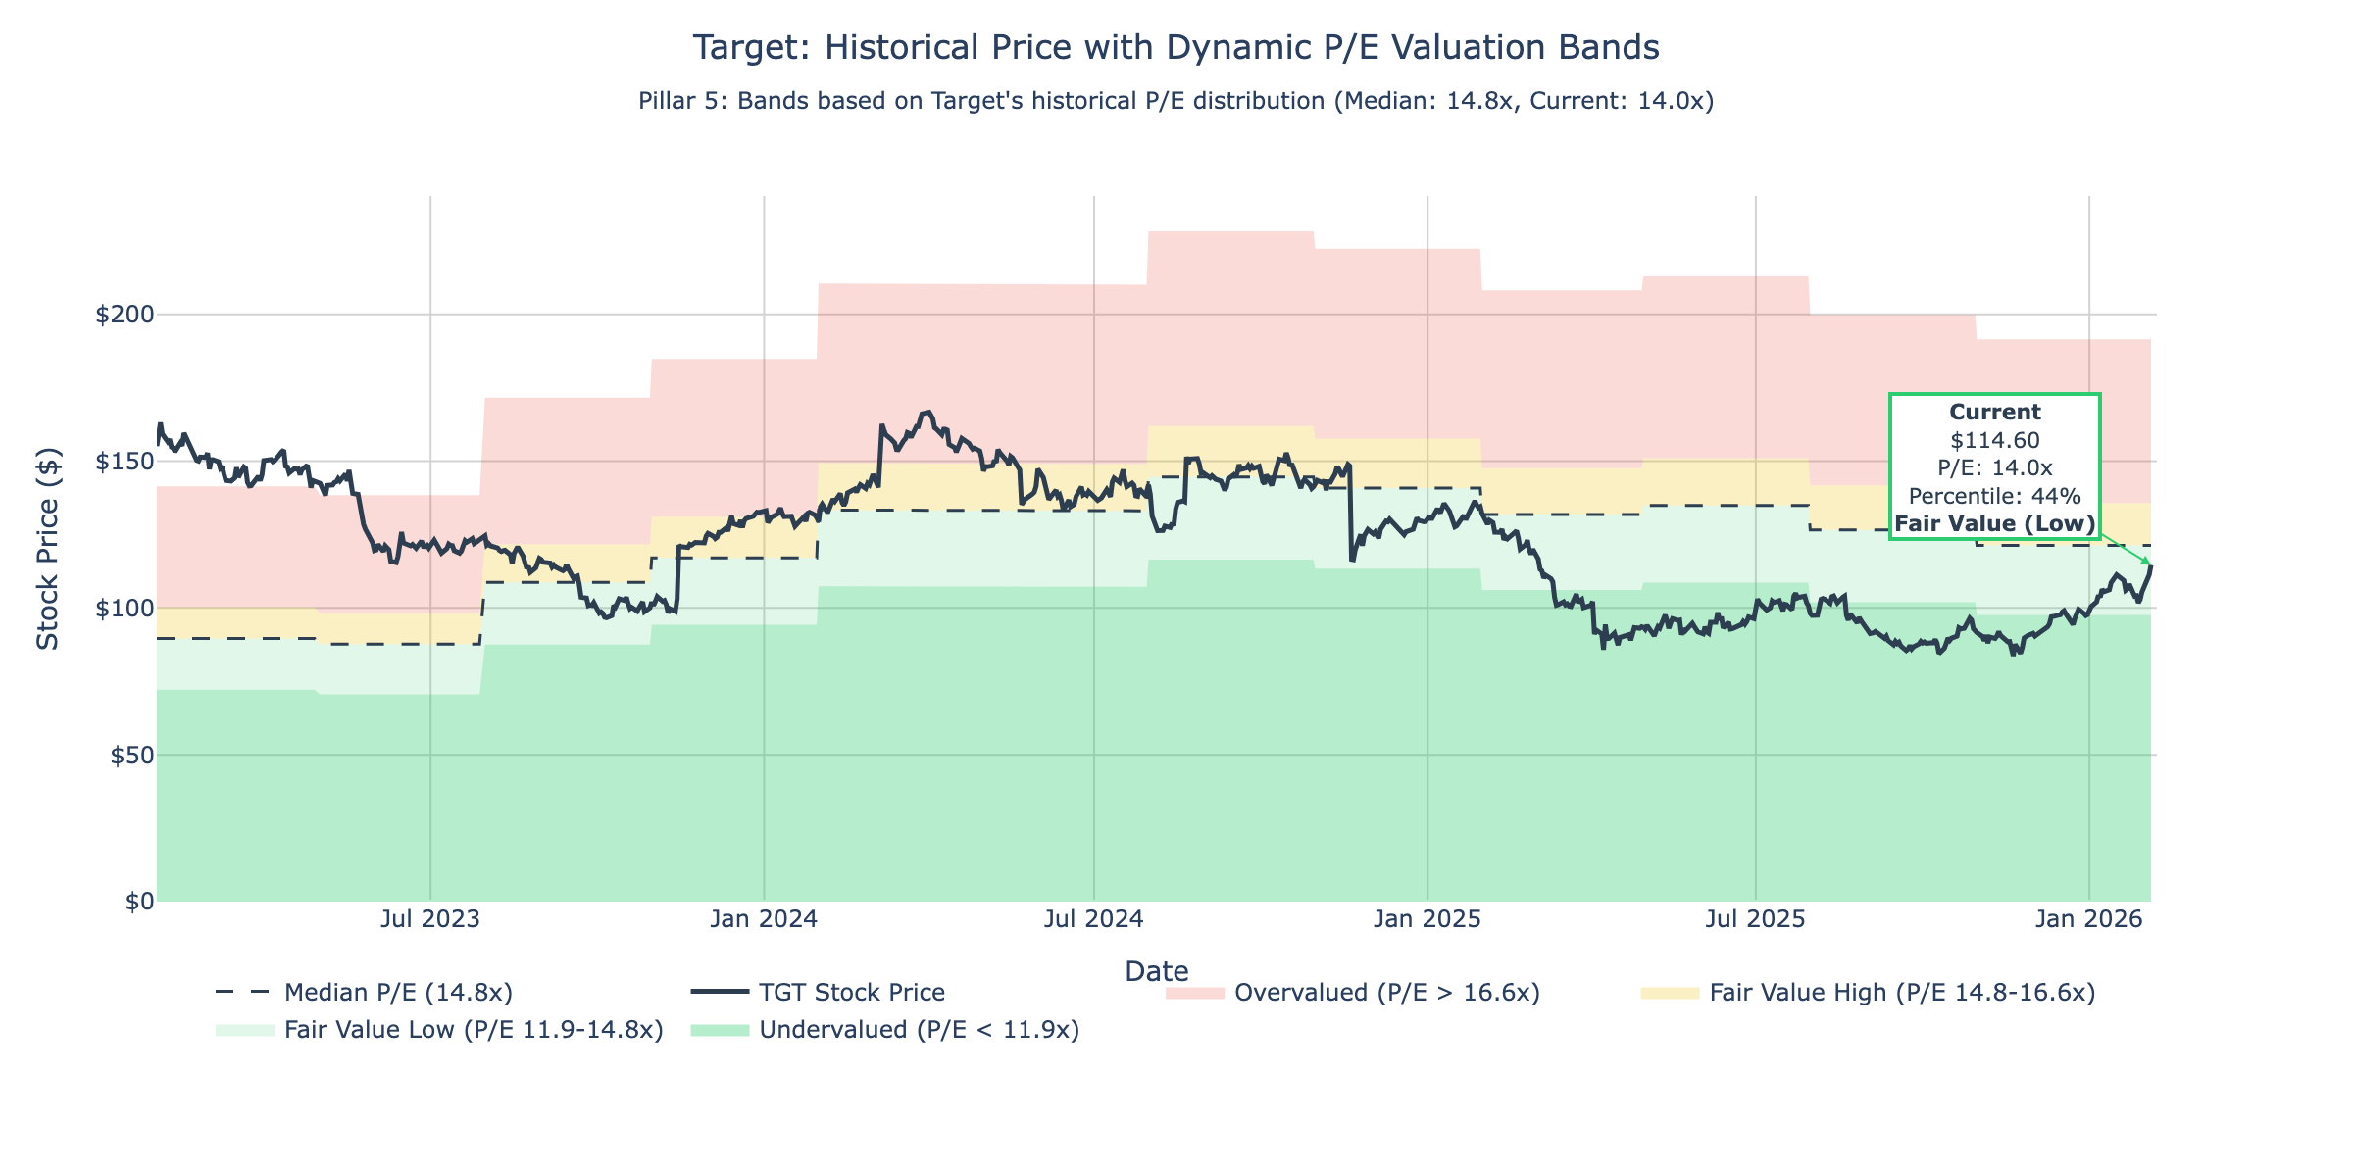
Historical P/E Band
ⓘ
Current P/E of 14x is below the 5-year average of 18x—historically undervalued, but margin concerns may justify discount.
📊 Click for interactive version

Slide 35
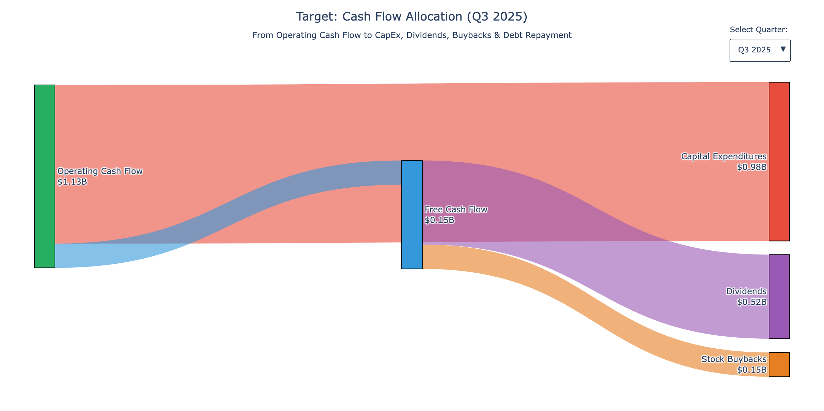
Cash Flow Sankey
ⓘ
~40% of operating CF goes to CapEx, 25% to dividends, 20% to buybacks. Balanced capital allocation despite margin pressure.
📊 Click for interactive version

Slide 36
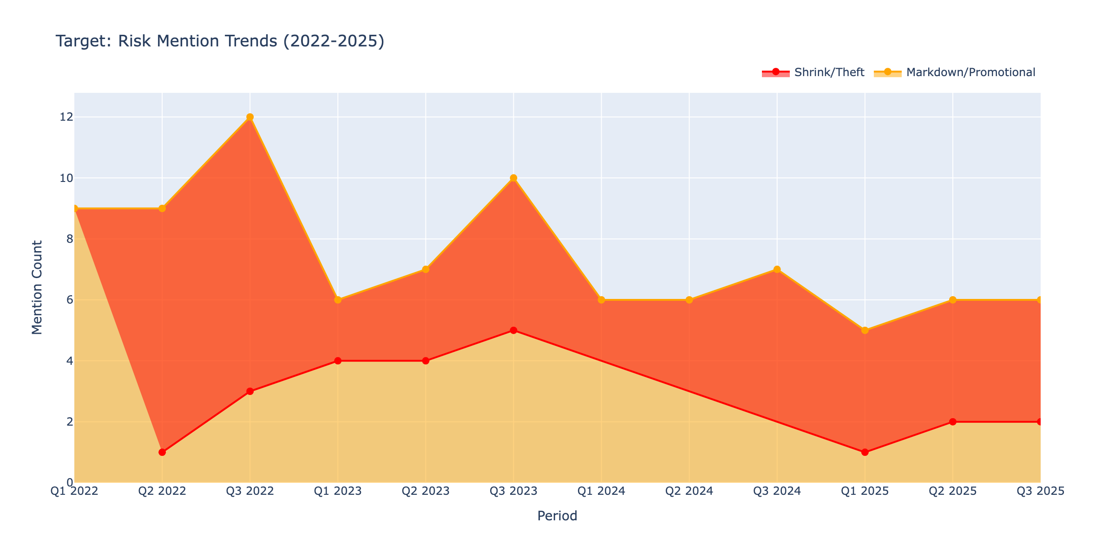
Risk Trends
ⓘ
Shrink/theft mentions increased from 1/period (2020) to 3-4/period (2024-25). Management repeatedly flags this as a margin headwind.
📊 Click for interactive version

Slide 37
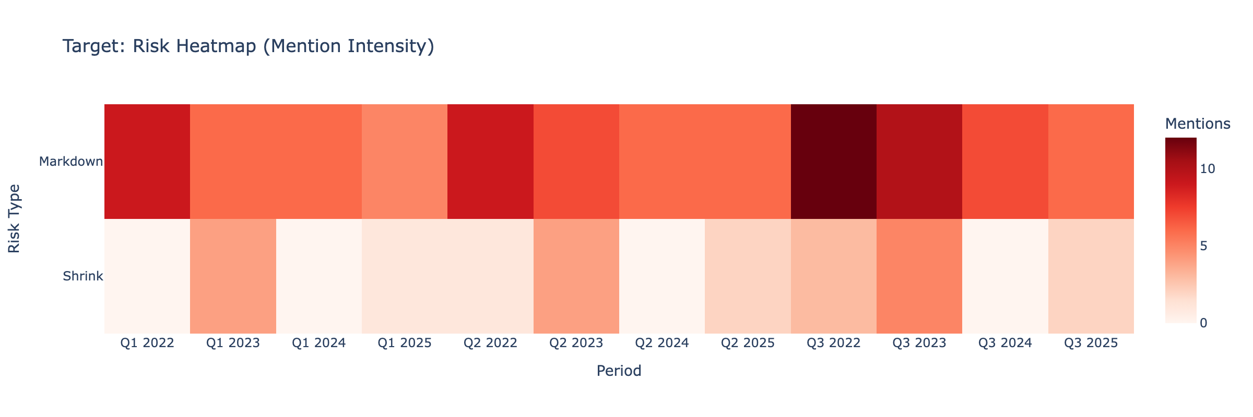
Risk Heatmap
ⓘ
FY2023-Q3 2025 shows elevated risk across all categories. Shrink, markdown, and margin pressure are concurrent concerns.
📊 Click for interactive version

Slide 38
Strategic Conclusion
Recommendation: Hold
Key Strategic Questions to Monitor:
• Margin Recovery: Can Target restore operating margins to 5%+ in FY2025?
• Interest Coverage: Will interest coverage stabilize above 2.0x warning threshold?
• Inventory Management: Can inventory levels normalize without significant markdowns?
• Debt Maturities: How will Target refinance $2B debt maturing in FY2026?
• Competitive Position: Can Target differentiate vs Walmart/Amazon in a slowing consumer environment?
Bottom Line: Margin pressure and elevated risks warrant caution; watch for stabilization

