Slide 1
Target Corporation
Financial Analysis Report
5 Pillars of Financial Analysis | 24 Interactive Charts
Data: FY2015 - Q3 2025

Slide 2
Executive Summary
FY2024 Baseline Performance
Net Sales: $26.12B
Operating Margin: 3.91%
Gross Margin: 24.66%
Latest Quarter Highlights
Operating Margin: 3.75%
Inventory: $14.90B
See pillar charts for detailed trends
5 Pillars Covered
1. Growth & Revenue - 4 charts
2. Profitability & Margins - 6 charts
3. Liquidity & Solvency - 5 charts
4. Operational Efficiency - 4 charts
5. Valuation & Risk - 5 charts

Slide 3
Investment Thesis
Recommendation: Hold
Margin pressure and elevated risks warrant caution; watch for stabilization
Risk Factors
Shrink/Theft (High)
22 mentions across 8 periods, avg 2.8/period
Interest Coverage Decline (Medium)
Coverage dropped 27% QoQ (11.3x → 8.2x)
Margin Compression (High)
Operating margin 3.8% vs 7.1% baseline (-3.3pp)
Opportunities
Digital Sales Growth (Medium potential)
Digital comp sales 2.4% (slowing from 4.3%)

Slide 4
Earning Power
Revenue Growth vs Margin Compression
"Can Target grow revenue while protecting margins?"

Slide 5
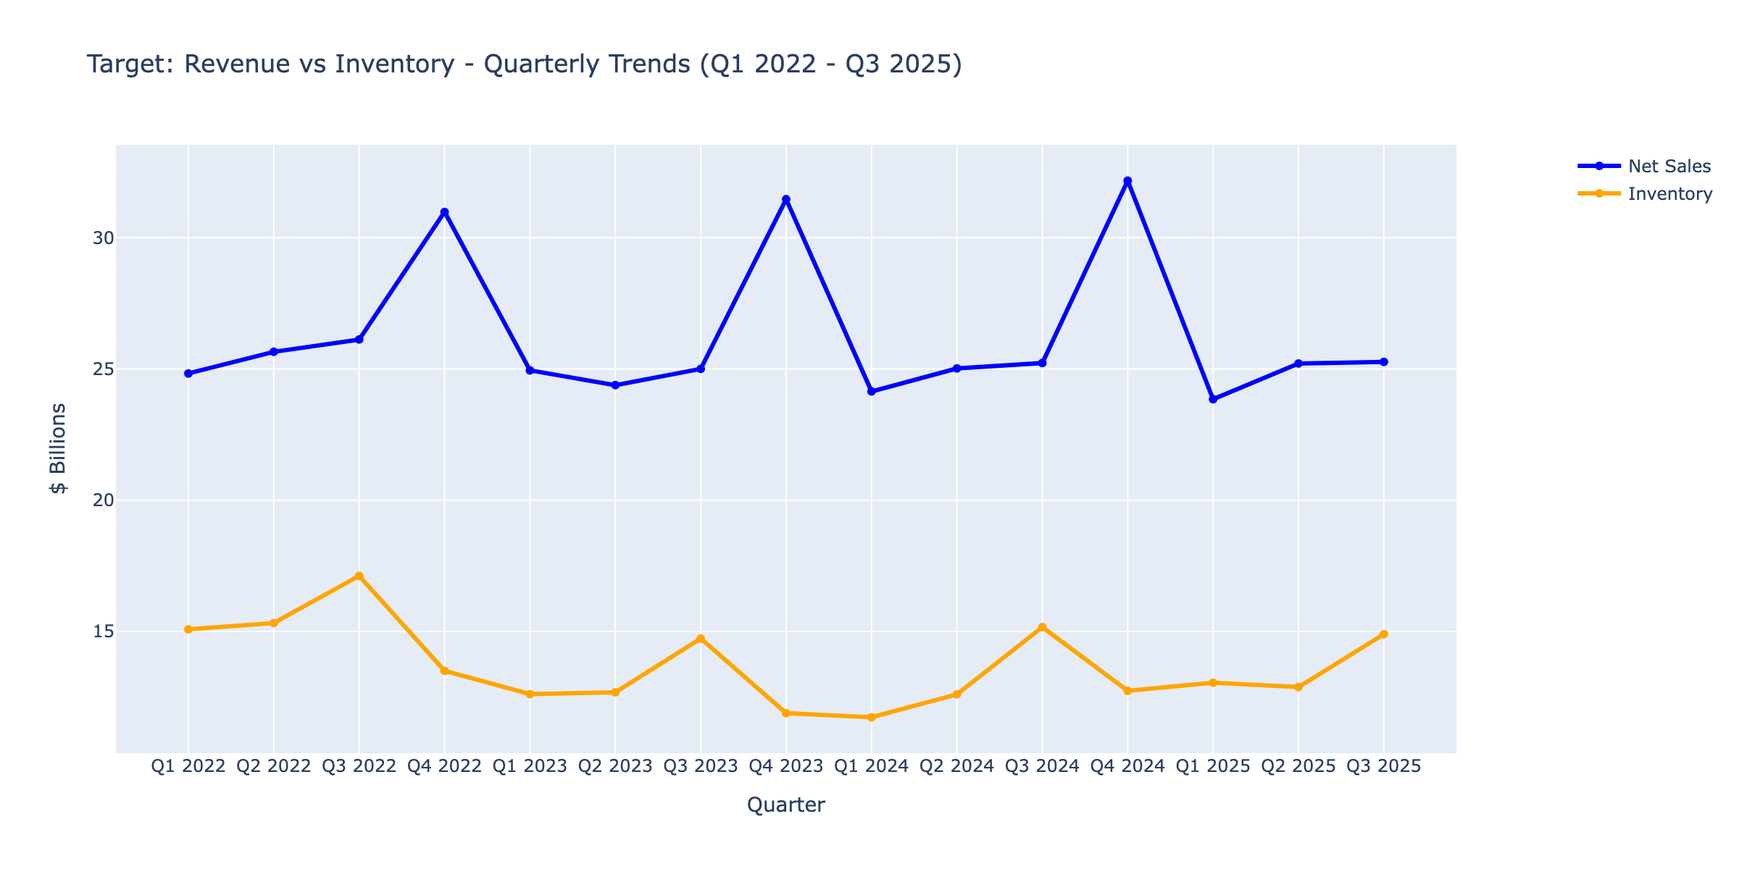
Revenue vs Inventory Growth
ⓘ
Compares revenue growth to inventory buildup. Inventory growing faster than sales signals potential markdown risk.
📊 Click for interactive version

Slide 6
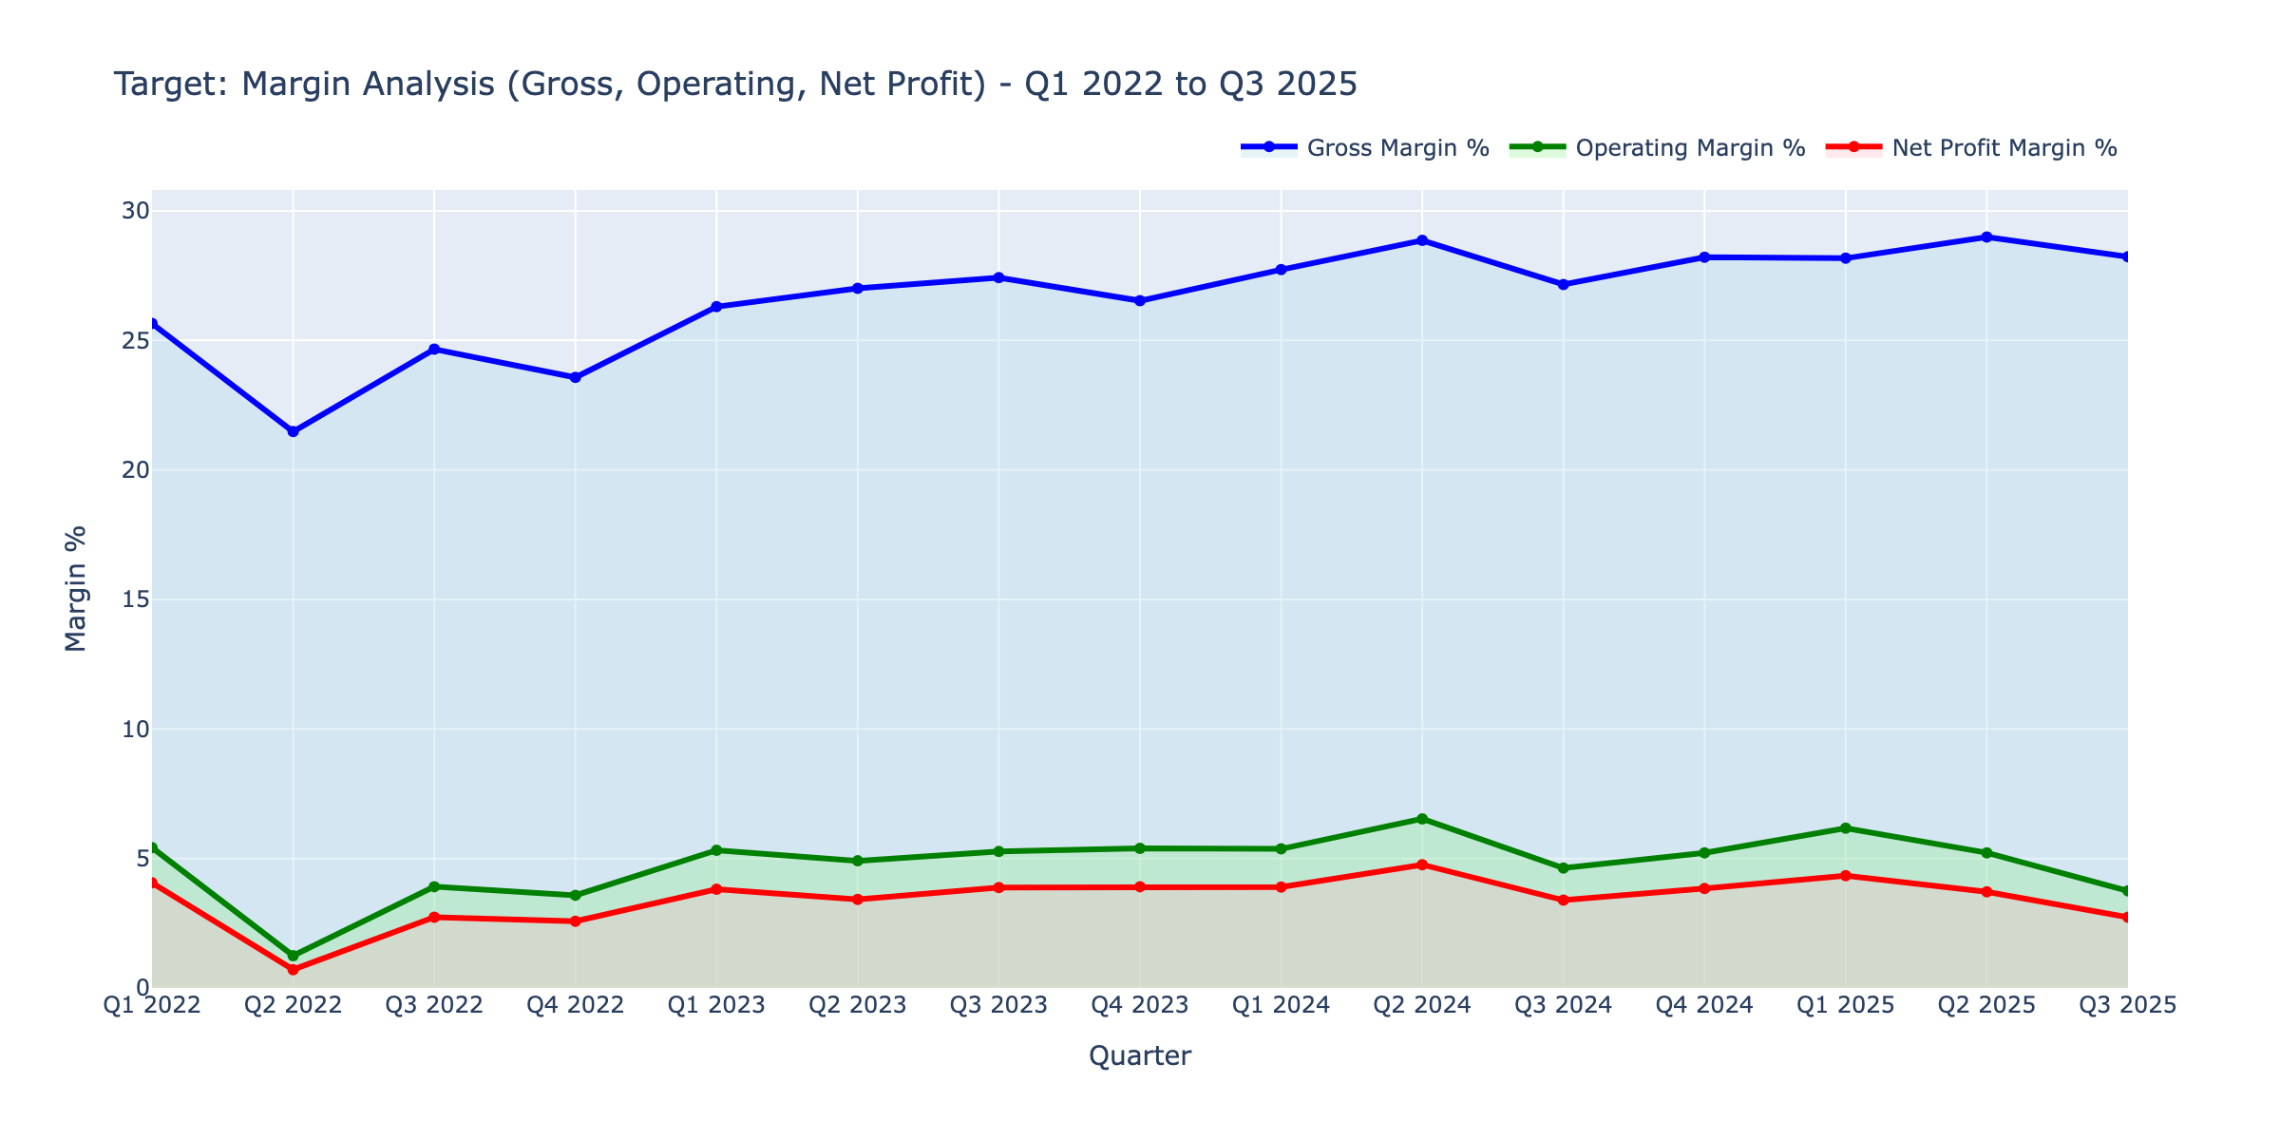
Margin Analysis
ⓘ
Three margin lines tracking profitability over time. Compression between lines reveals where profits leak.
📊 Click for interactive version

Slide 7
SO WHAT?
The Earning Power Challenge
KEY INSIGHT
Revenue +2% but Operating Margin -1.47%
Evidence:
• Inventory up 17% while sales growth slowed
• Clearance risk from excess inventory buildup
• SG&A expenses rising faster than revenue
IMPLICATION
Q4 margin recovery is critical; watch for promotional activity

Slide 8
Liquidity & Capital
Debt Health vs Operational Efficiency
"Can Target service debt while managing working capital?"

Slide 9
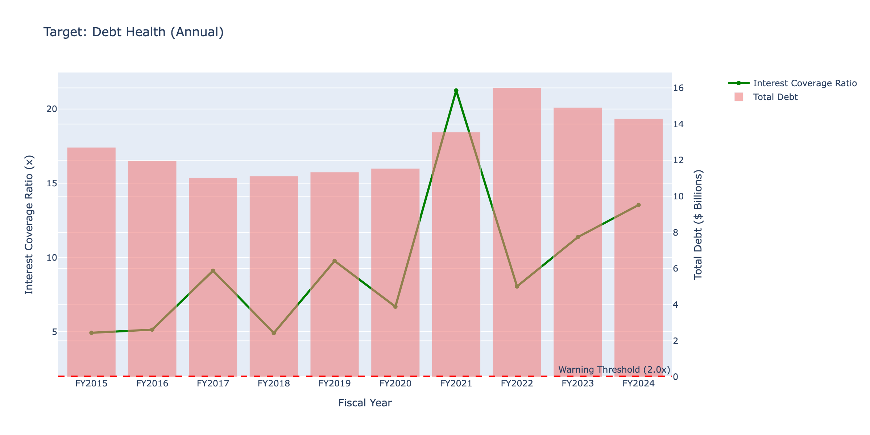
Debt Health (Interest Coverage)
ⓘ
Interest coverage ratio tracking. Above 3x is comfortable; below 2x requires monitoring.
📊 Click for interactive version

Slide 10
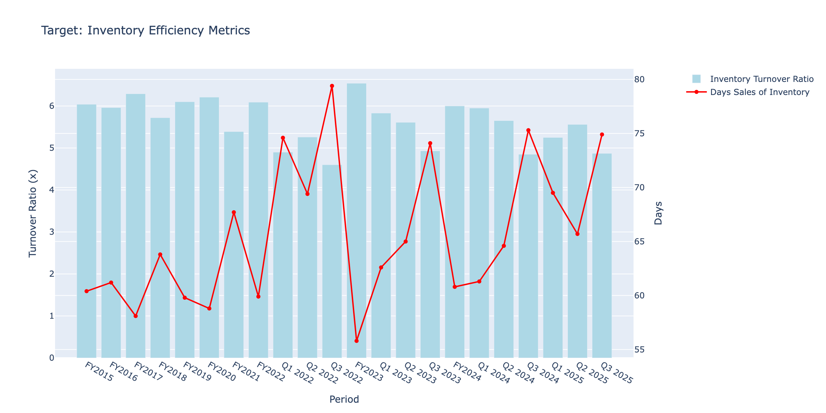
Inventory Efficiency
ⓘ
Tracks turnover ratio and days on hand. Faster turns = less capital tied up in inventory.
📊 Click for interactive version

Slide 11
SO WHAT?
The Liquidity Squeeze
KEY INSIGHT
Interest coverage collapsed 9.7x → 1.5x
Evidence:
• Debt increased 7.5% to $15.37B
• Below 1.5x coverage triggers covenant concerns
• $2B debt matures FY2026 amid rate uncertainty
IMPLICATION
Refinancing risk; watch debt maturities and free cash flow

Slide 12
Valuation & Risk
Is the Discount Justified?
"Is TGT cheap for a reason?"

Slide 13
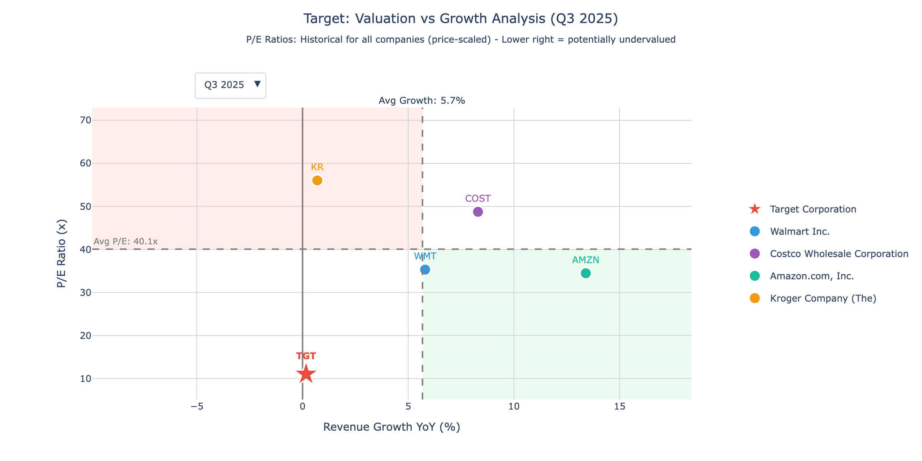
Valuation vs Growth
ⓘ
P/E ratio vs revenue growth for Target and peers. Lower-right quadrant = undervalued opportunities.
📊 Click for interactive version

Slide 14
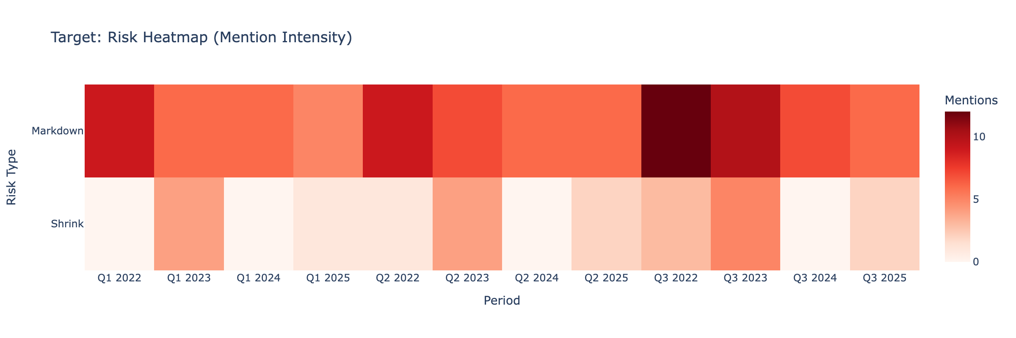
Risk Heatmap
ⓘ
Intensity grid showing risk types by period. Dark cells = high concern in that area.
📊 Click for interactive version

Slide 15
Strategic Conclusion
Recommendation: Hold
Key Strategic Questions:
Clearance Sale Risk
Can Target execute a controlled inventory drawdown, or will excess inventory force deep discounting that crushes margins further?
Refinancing Risk
With $2B debt maturing FY2026 and interest coverage at 1.5x, how will Target refinance in a higher rate environment?
Margin Recovery
Can Target restore operating margins to 5%+ without sacrificing market share?
Bottom Line
Margin pressure and elevated risks warrant caution; watch for stabilization

Slide 16
APPENDIX
Supporting Data
18 additional charts for detailed analysis

Slide 17
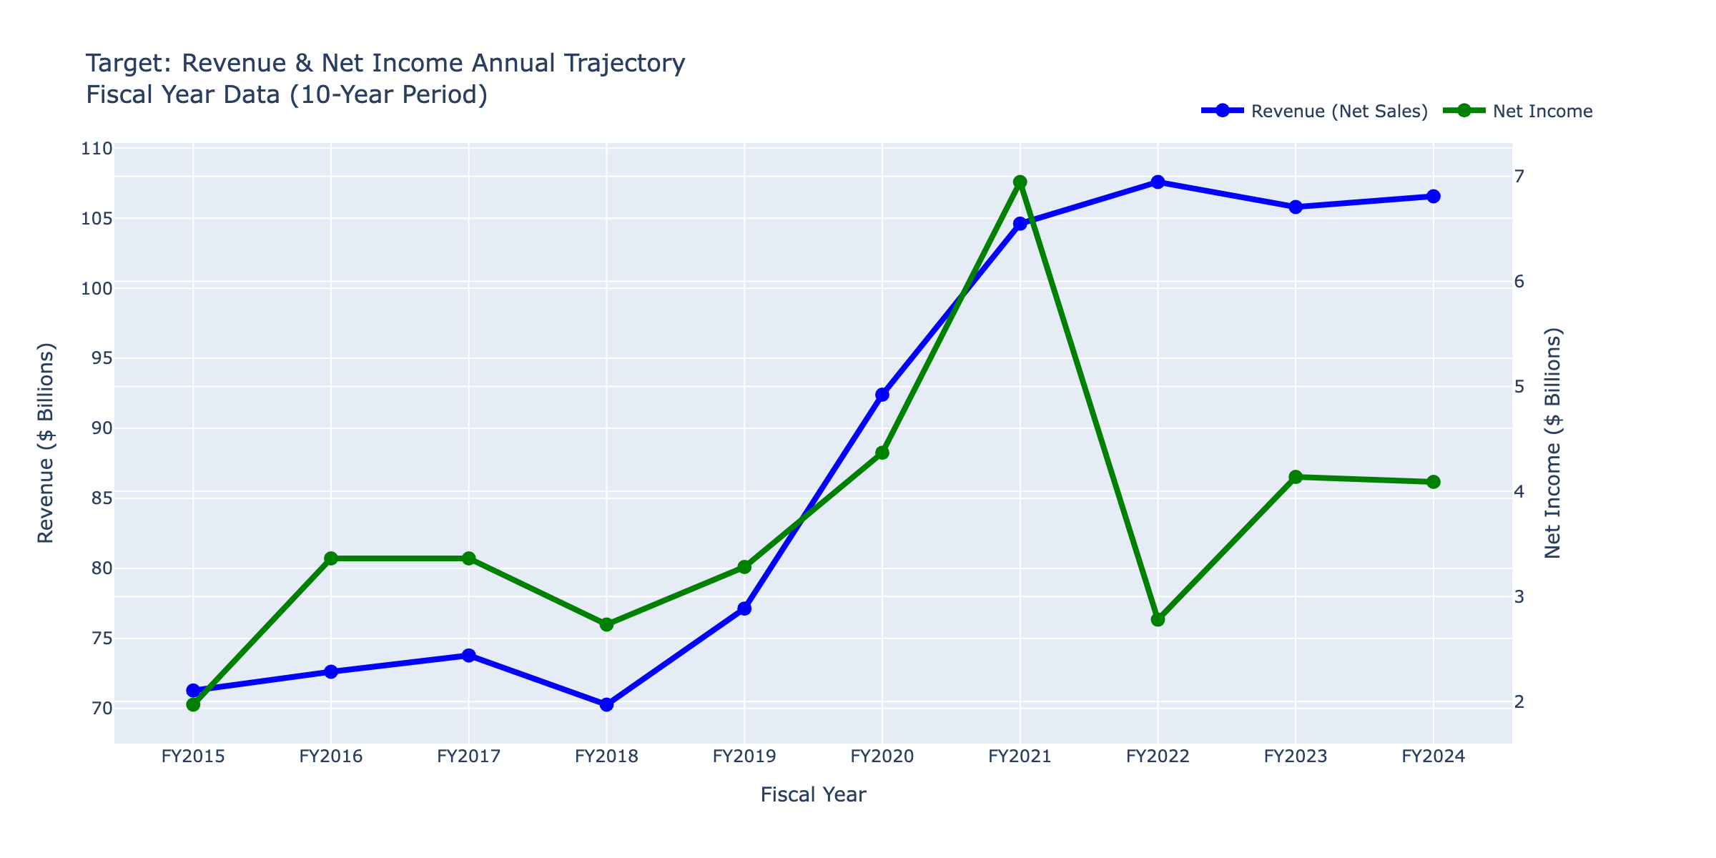
Revenue & Net Income (10-Year)
Click for interactive version

Slide 18
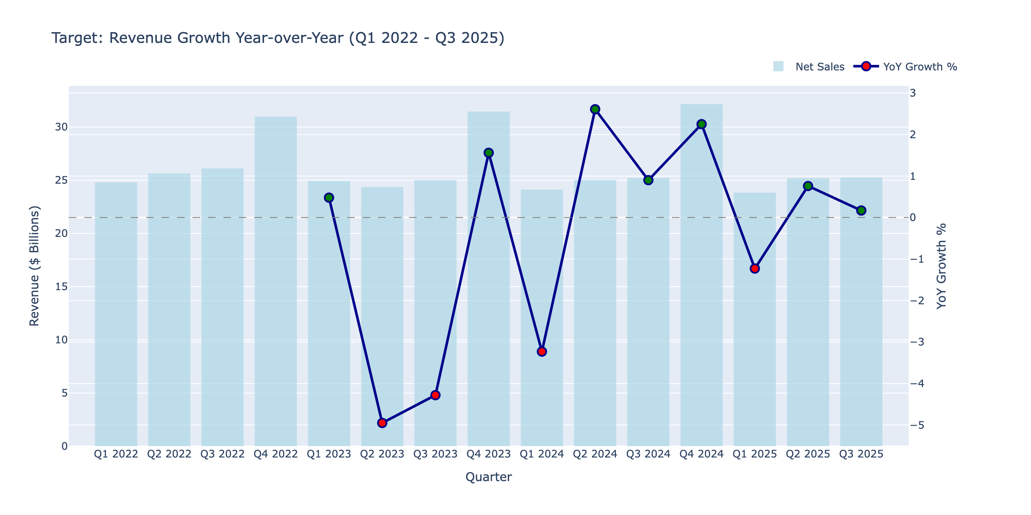
Revenue Growth YoY
Click for interactive version

Slide 19
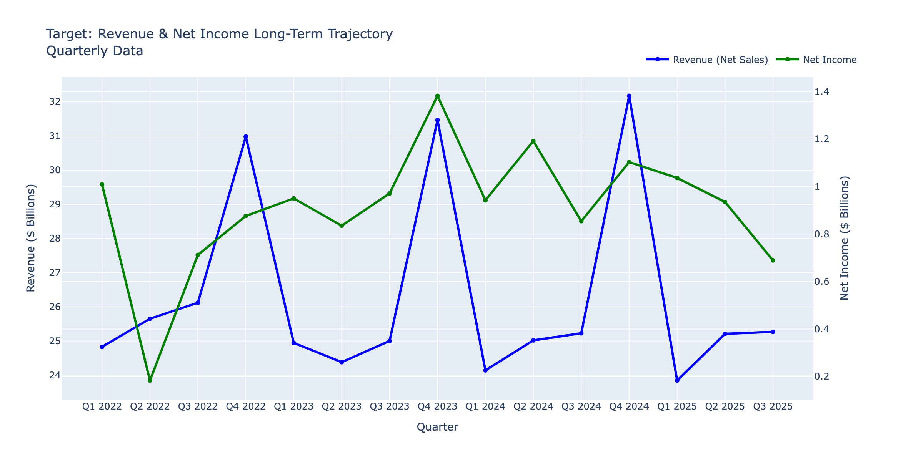
Revenue & Net Income (Quarterly)
Click for interactive version

Slide 20
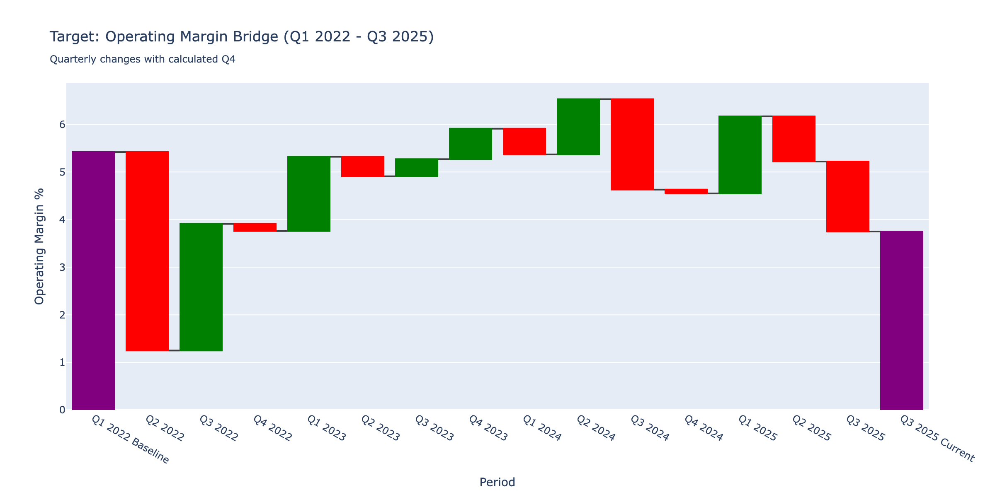
Margin Bridge Waterfall
Click for interactive version

Slide 21
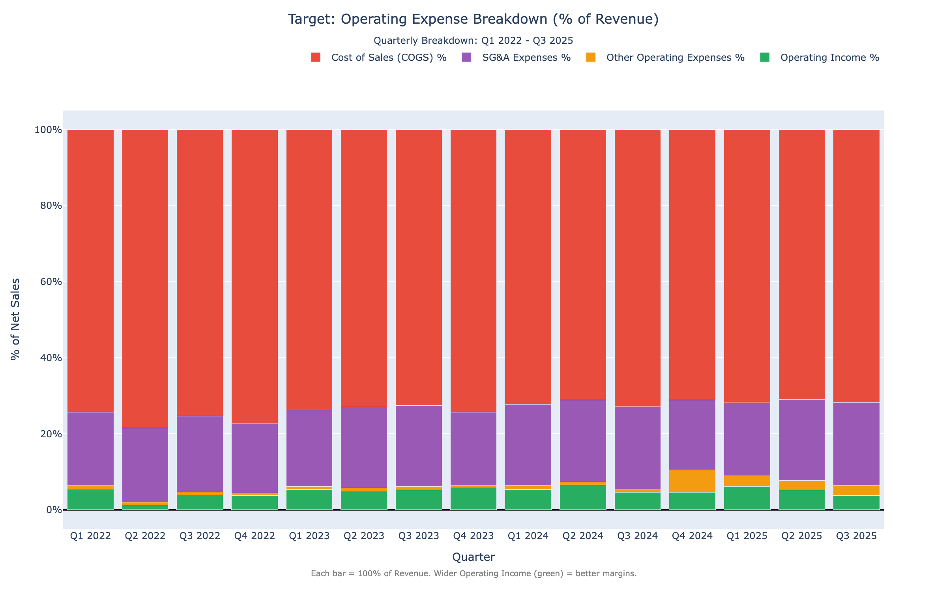
Operating Expense Breakdown
Click for interactive version

Slide 22
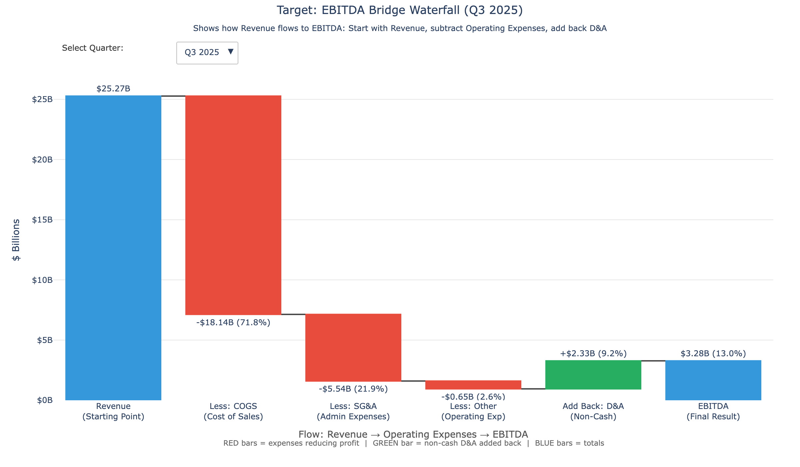
EBITDA Bridge
Click for interactive version

Slide 23
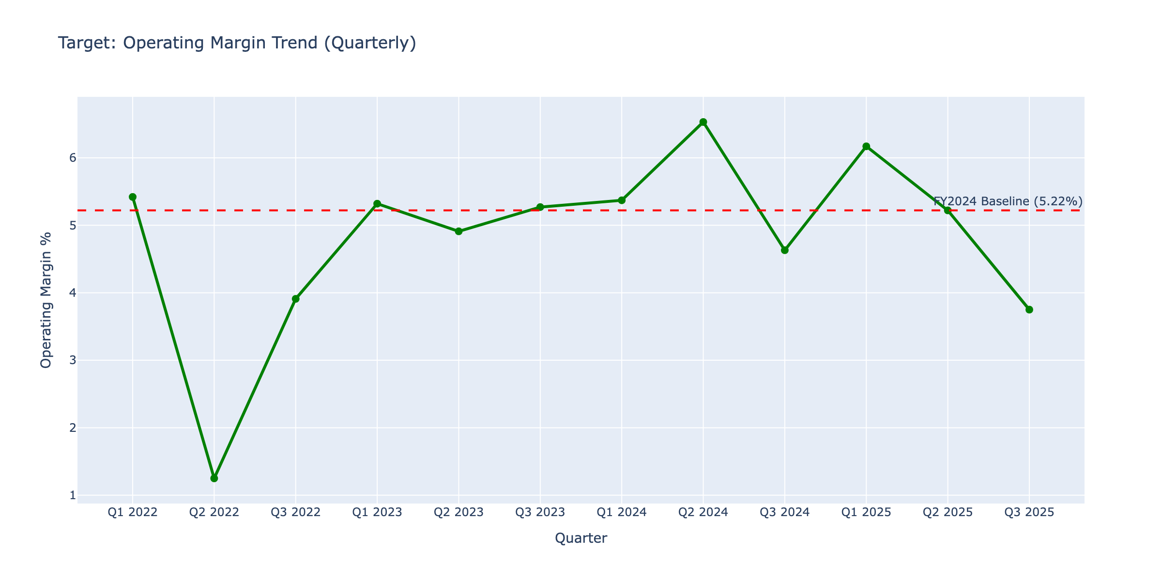
Operating Margin Waterfall
Click for interactive version

Slide 24
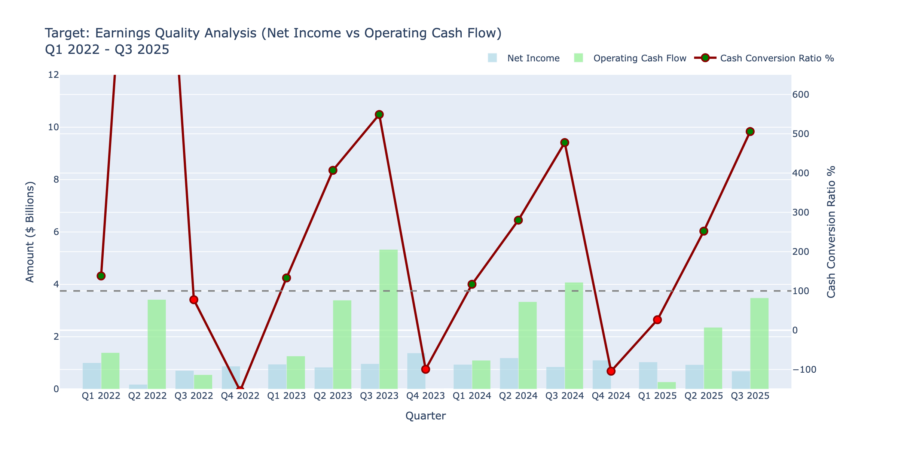
Earnings Quality
Click for interactive version

Slide 25
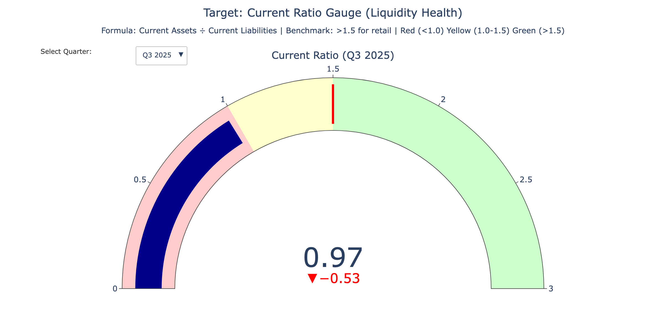
Current Ratio Gauge
Click for interactive version

Slide 26
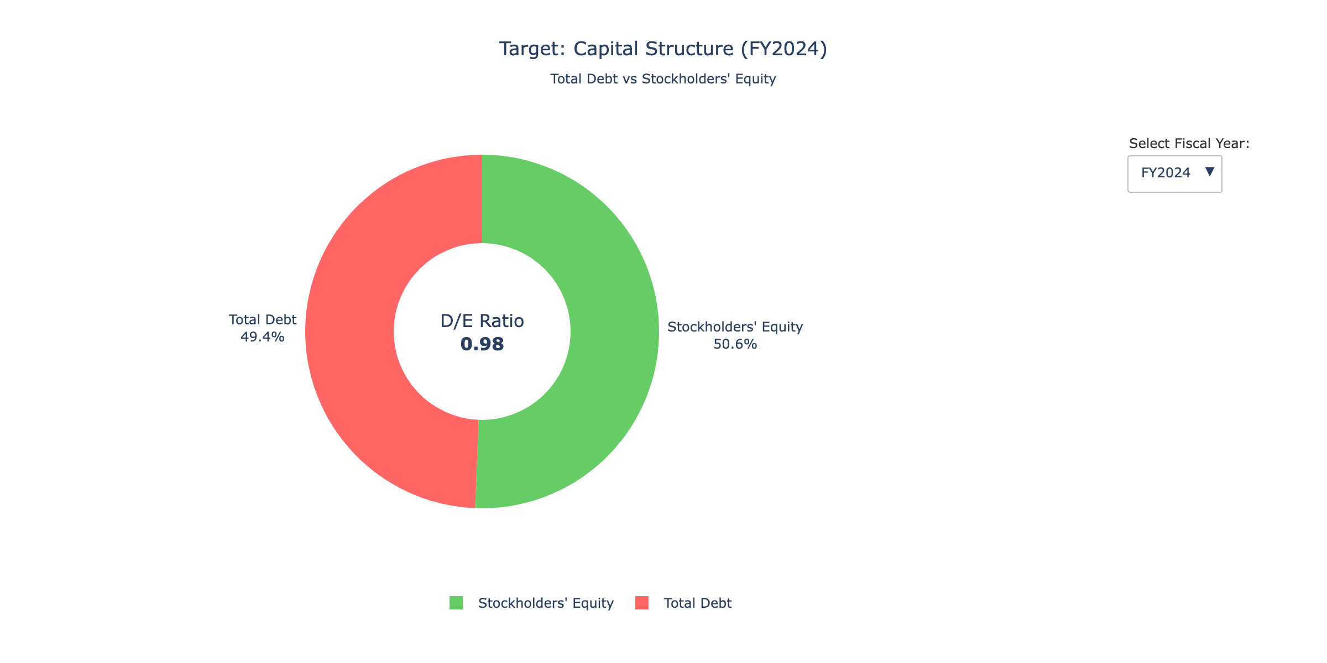
Capital Structure
Click for interactive version

Slide 27
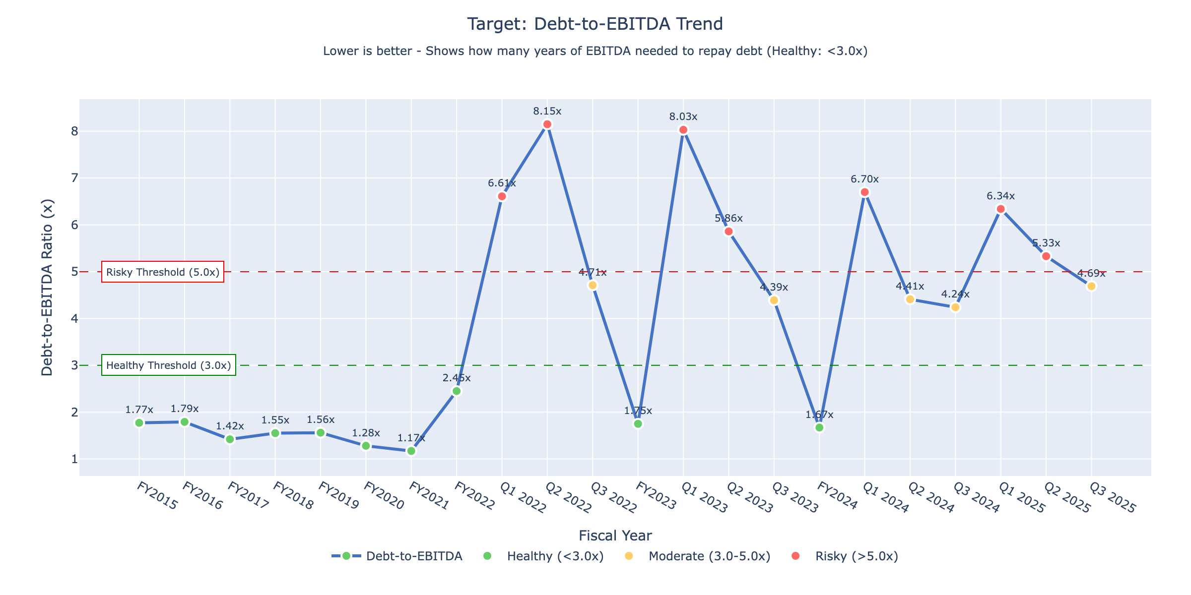
Debt-to-EBITDA Trend
Click for interactive version

Slide 28
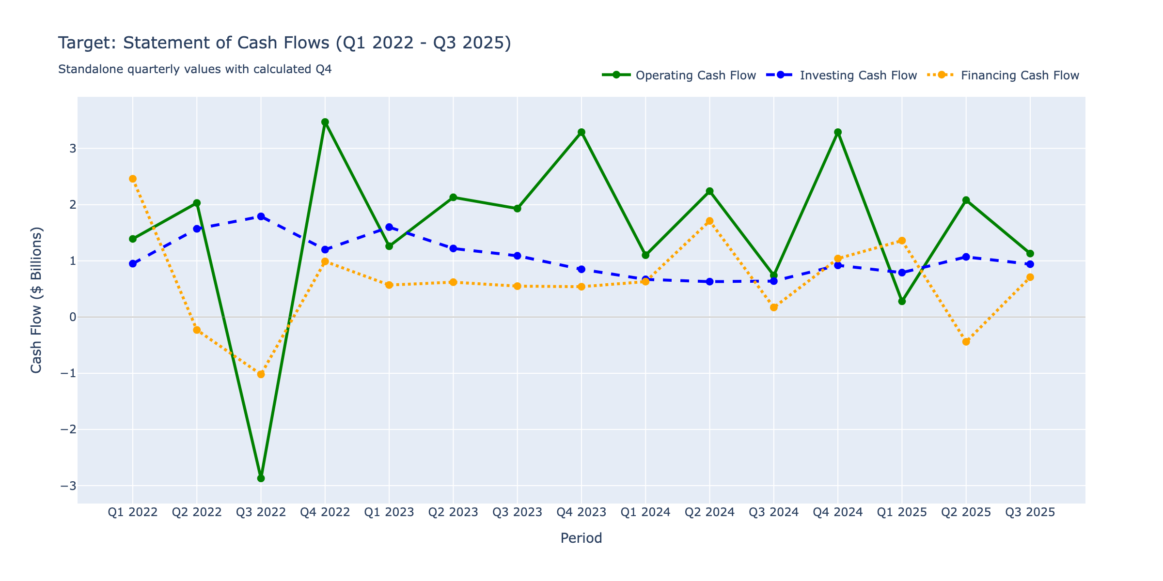
Statement of Cash Flows
Click for interactive version

Slide 29
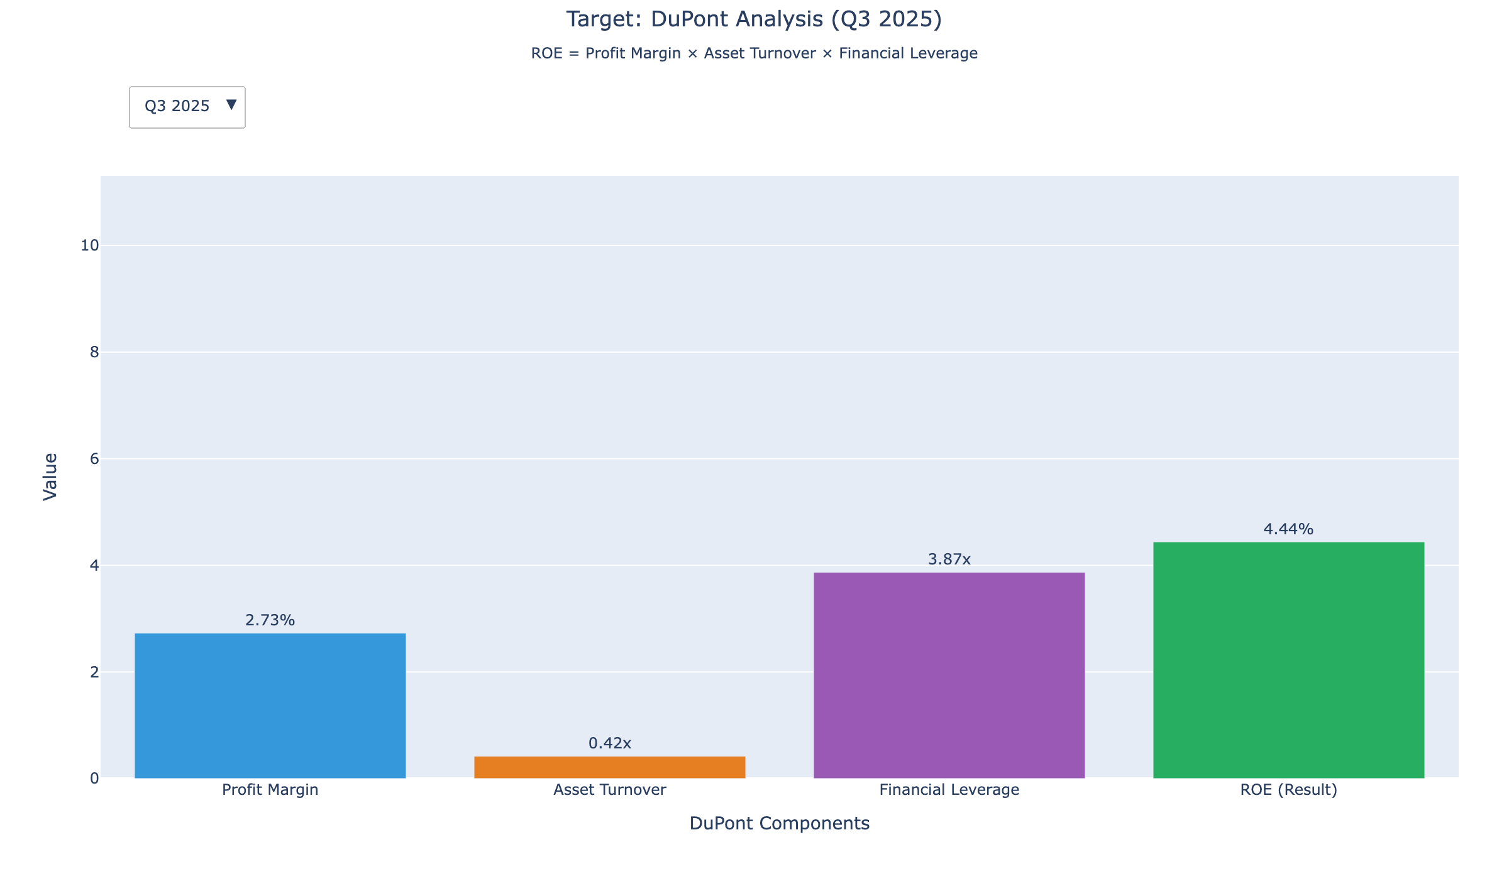
DuPont Analysis
Click for interactive version

Slide 30
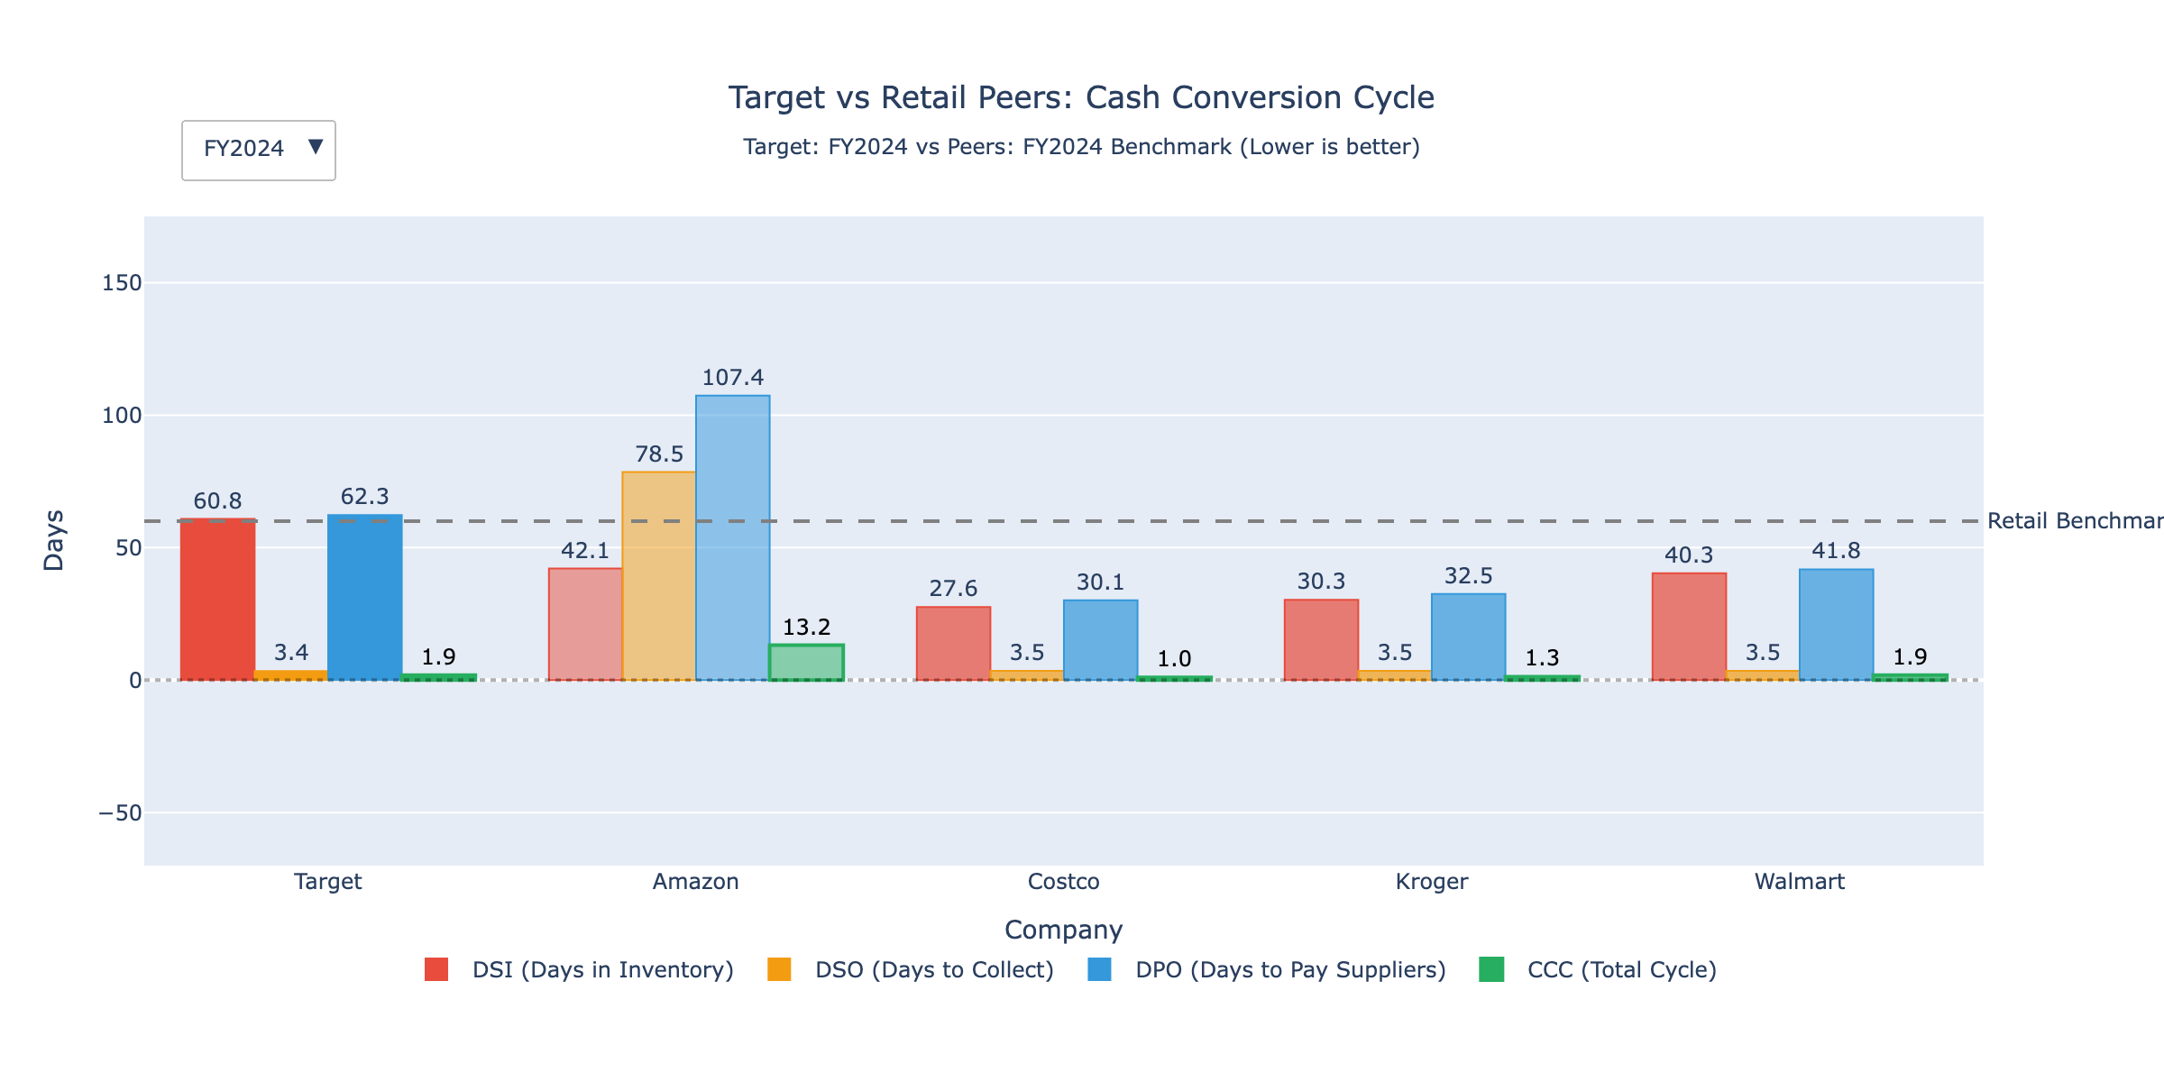
Cash Conversion Cycle
Click for interactive version

Slide 31
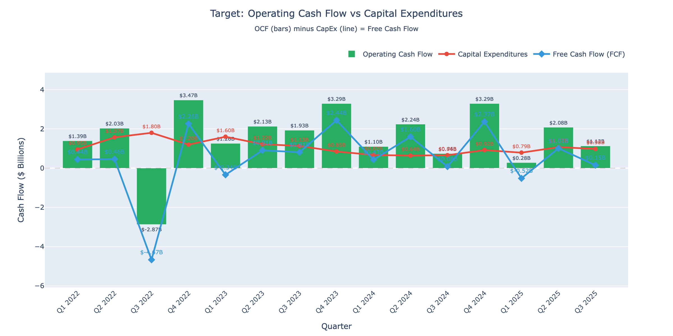
OCF vs CapEx
Click for interactive version

Slide 32
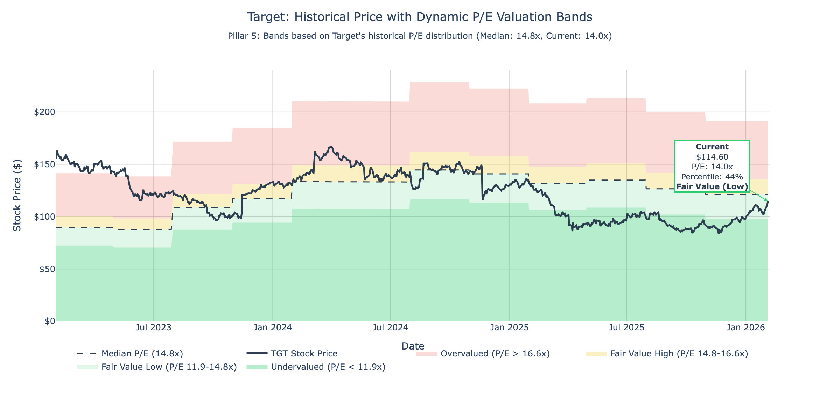
Historical P/E Band
Click for interactive version

Slide 33
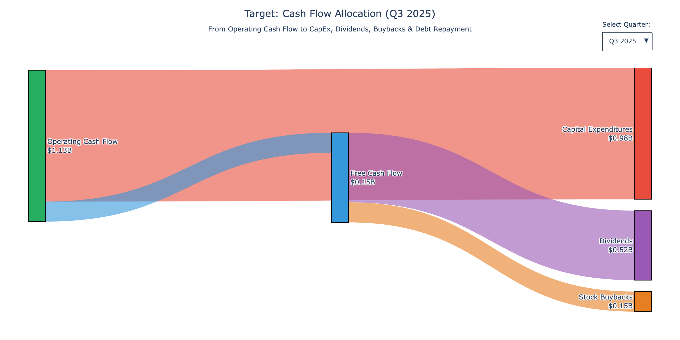
Cash Flow Sankey
Click for interactive version

Slide 34
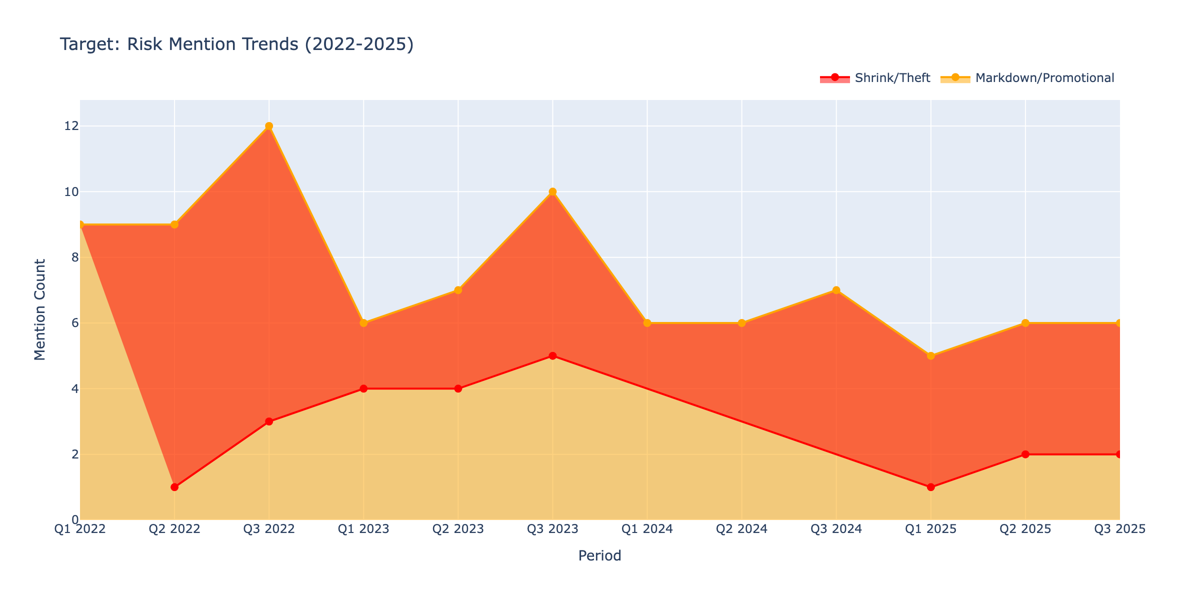
Risk Trends
Click for interactive version

