Slide 1

Emotional Recognition
TDDE70

Slide 2
Problem Formulation
The objective of this study is to explore the challenges associated with constructing deep neural networks capable of detecting human faces in images containing none, one or several human faces and classifying their emotional state.
Face detection
Emotional Classification

Slide 3
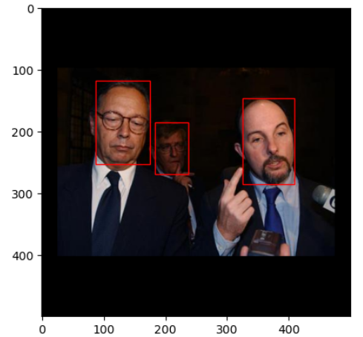
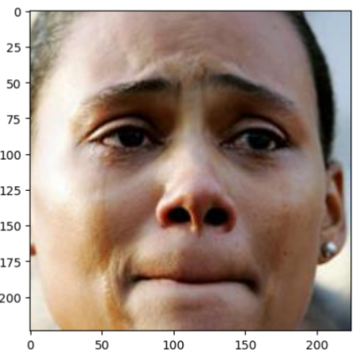
Datasets
AffectNet
Face Detection Dataset and Benchmark
One face per image
Emotional labels, 8 classes
400k samples (used subset ~16k)
Inbalanced dataset → Data augmentation
Varying number of faces
Coordinates of the bounding boxes
Different sizes → Re-scaling and Paddling
3k sampels
Patches for training and validation
Patches created imbalance

Slide 4
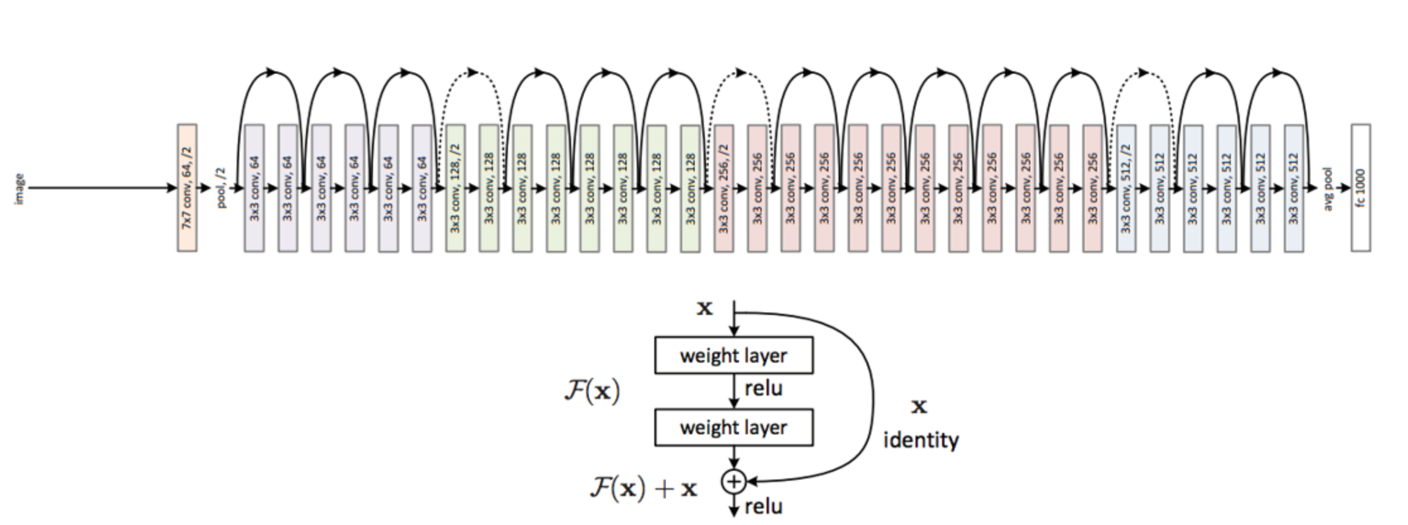
ResNet-50

Slide 5
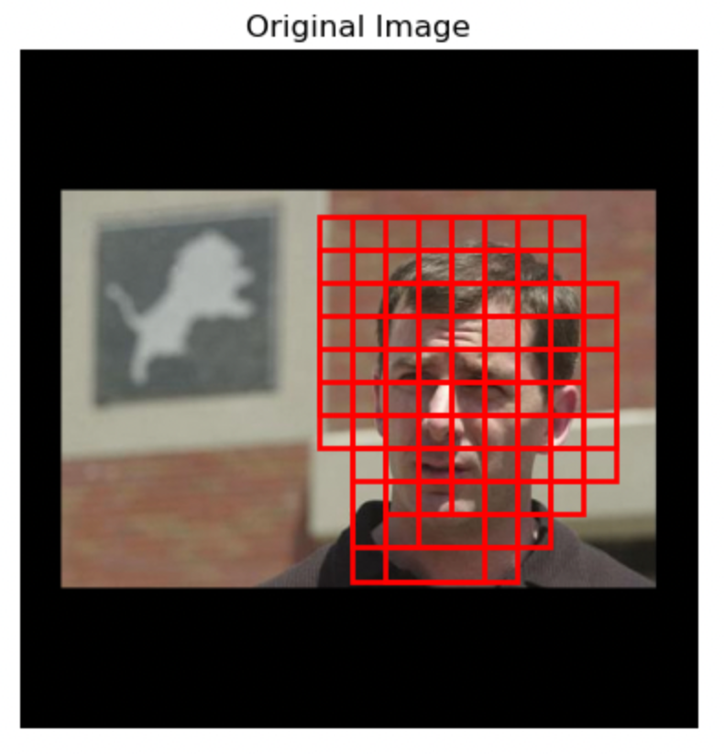
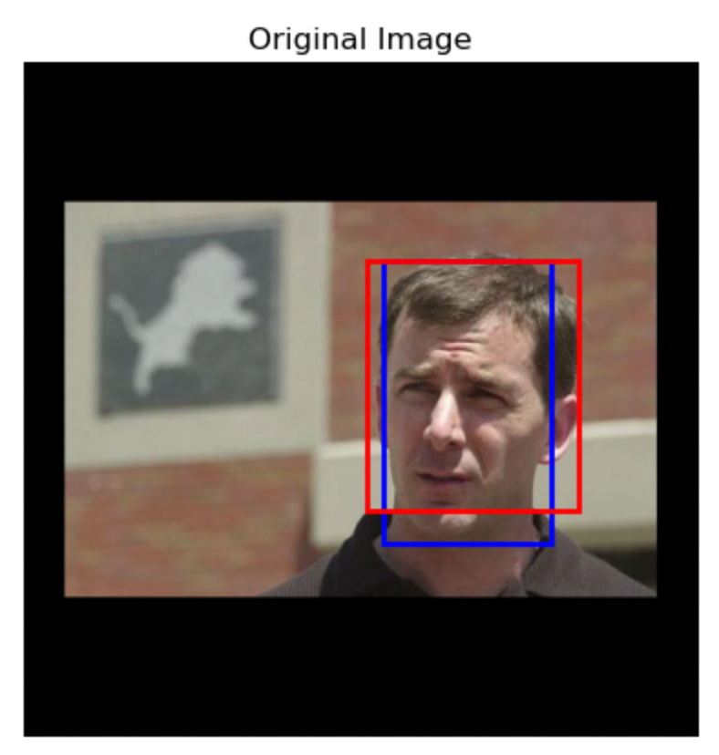
Face detection
Simple CNN
Mature model
Conv2
Batchnorm
Activation
Linear
Cross-entropy loss
Could not learn the pattern
A weighted loss did not improve the model
ResNet-50, frozen layers
Linear
Activation
Heat-map to bounding boxes, threshold
Cross-entropy loss
SGD

Slide 6
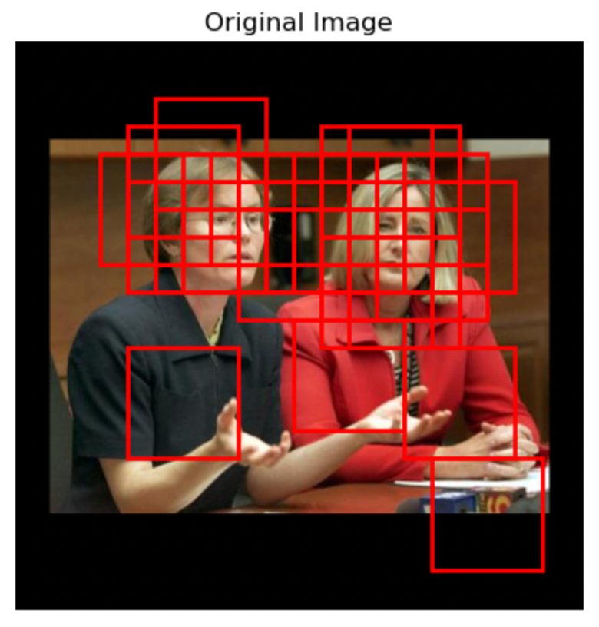
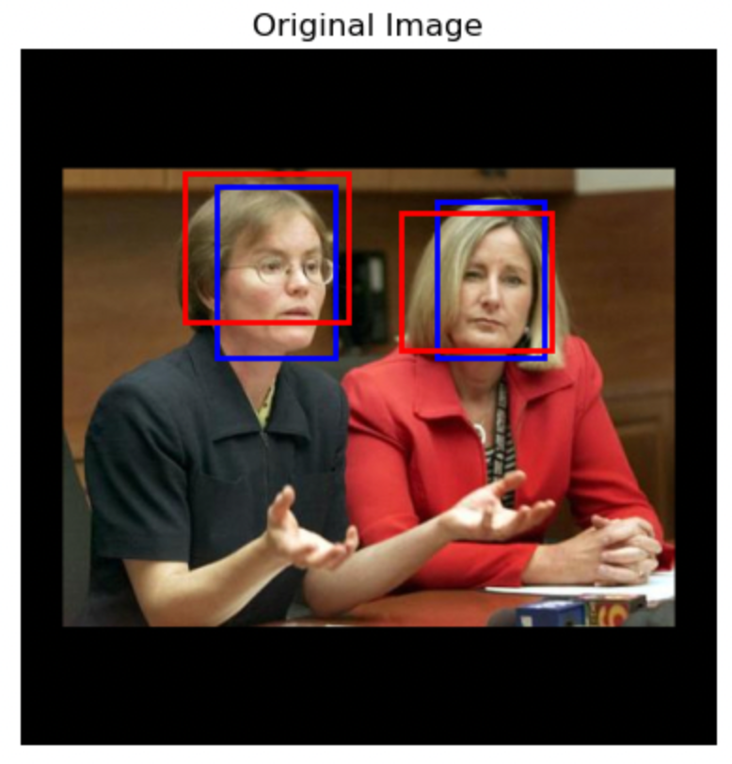
Face detection Results
Patch size : 100px x 100px
Patch stride:
100 for training and removed negatives to create balance
25 for testning
A patch classifies as a face if at least 60% of the patch overlaps with a bounding box
Validation accuracy 90%
True
 | Face | No Face
Face | 0.78 | 0.09
No Face | 0.22 | 0.91
Predicted

Slide 7
Emotion classification
Simple CNN
Mature model
Stacked convolutional layers
Abandoned quickly as it did not perform well
Utilizing the ResNet50 model as backbone
Dropout, batchnorm, activation, linear
Outputs a probability tensor (softmaxed)
Trained with SGD as Adam failed to converge

Slide 8
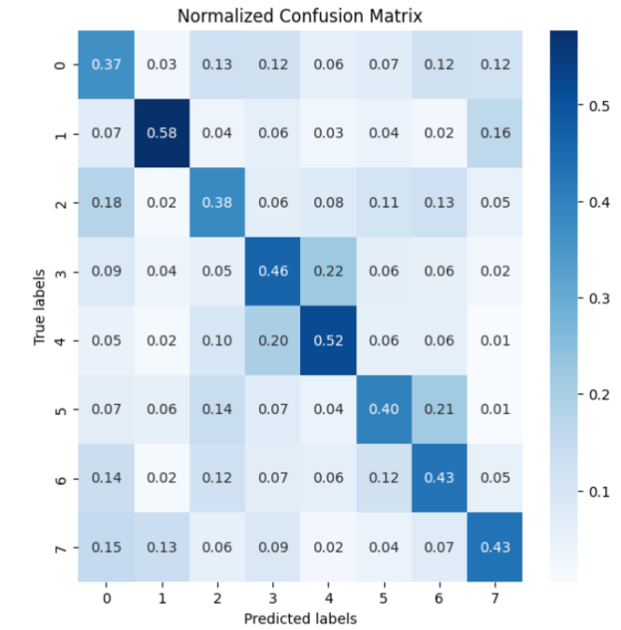
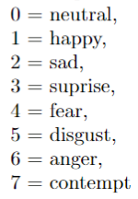
Emotion classifier Results
Validation accuracy: 41,6%
Training accuracy 97,3%

Slide 9
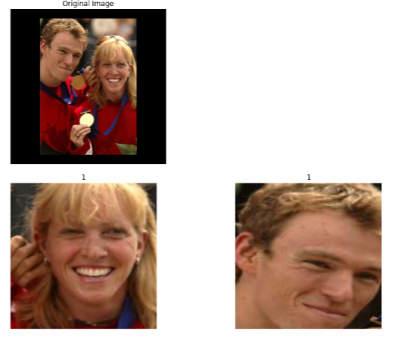
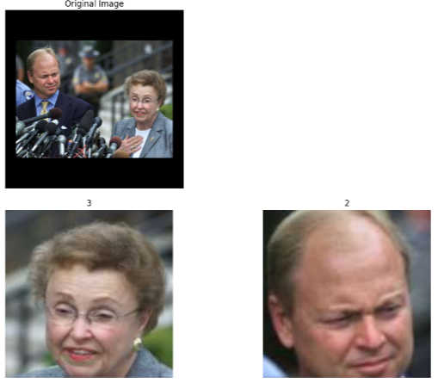
Combined Model
Happy
Happy
Surprise
Sad

Slide 10
Discussion
Time consuming to prepare data
Transfer learning → Combats computational constraints
Difficult to determine emotional states
Hardware limits dataset size

Slide 11
Possible improvements
Face detection
Emotion recognition
Creating image pyramids → capture different face sizes
Having a model that allows us to have a loss function on the final output – not just patches
Using a network better for face detection like:
Yolo-v8
MTCNN
Increase training data subset size
Use of more advanced models
Facial landmark localization model

Slide 12

Tack

