Slide 1

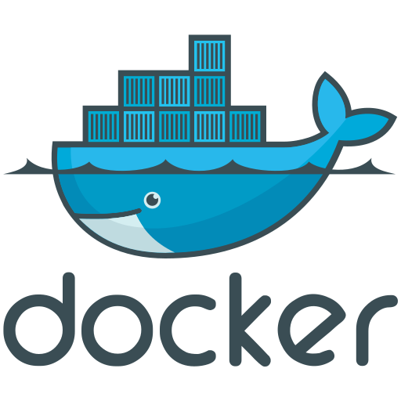


GitHub CI Pipeline – Maven & Docker
$ maven clean
$ maven install
Maven&Docker
Setup Java JDK 11
Setup MySQL
Maven Clean
Maven Build
Create a new Docker Network
Build with Docker Compose
Stop MySQL
$ docker network create spring-net
$ docker-compose build
Run Containers with Docker Compose
Job Complete
$ docker-compose up

Slide 2

GitHub CI Pipeline – Flutter
$ flutter pub get
$ flutter build apk --debug
Build APK
GitHub Flutter Setup
Build Flutter with APK
APK Complete
$ flutter pub get
$ flutter build web
Build Web
GitHub Flutter Setup
Build Flutter with Web
Web Complete

