Slide 1
Customers Like You
Product recommendations and customer groups
DS5020 Mini-Project 1
Notes:
Speaker: Alex Rees, Data Engineer. Time: 20 seconds.
Sarah Okafor, our Head of E-Commerce, asked for two things: an also-bought box on product pages, refreshed overnight and better than best sellers, and one simple picture of our customer groups for marketing. We cover the data, the model, the groups and the risks.
Source: Chen, D. (2012). Online Retail II [Dataset]. UCI Machine Learning Repository. https://doi.org/10.24432/C5CG6D. Licence CC BY 4.0.

Slide 2
Training data and a novel-purchase test
Training: 1 Dec 2009 to 9 Oct 2011
Test: 9 Oct 2011 to 9 Dec 2011
1,067,371 invoice lines, 802,634 after cleaning
684,071 training lines before the cutoff
5,473 x 3,687 customers by products
97.9% of cells are empty
Cell value: log(1 + total quantity)
Products need at least 10 training buyers
Last two months, held out before any fitting
72,919 invoice lines of new-to-customer products
45,644 repeat-purchase lines left out
1,913 of 2,308 customers scored (82.9%)
2,555 of 2,849 test products in catalogue (89.7%)
70.7% of new customer-product pairs scored
Source: UCI Online Retail II (Chen, 2012), https://doi.org/10.24432/C5CG6D, CC BY 4.0. Counts from reports/matrix_report.json and reports/results.json.
Notes:
Speaker: Alex Rees, Data Engineer. Time: 70 seconds.
Our data is the UCI Online Retail II log, 1,067,371 invoice lines from December 2009 to December 2011. I removed cancellations, non-positive quantities and prices, non-product codes and lines without a customer ID, leaving 802,634.
The test is the last two months, from 9 Oct 2011. Targets are products new to that customer: 72,919 invoice lines, with 45,644 repeat-purchase lines left out. The 684,071 earlier lines are training data.
The matrix uses training lines only: log of one plus total quantity, and products with at least 10 training buyers. That gives 5,473 customers by 3,687 products, 97.9% empty. Coverage on the right counts customers, distinct products and new pairs separately.
I built the original cleaning, split, matrix and first exploratory SVD. The completed package reruns these steps from the raw file with python build_matrix.py.
Source: Chen, D. (2012). Online Retail II [Dataset]. UCI Machine Learning Repository. https://doi.org/10.24432/C5CG6D. Licence CC BY 4.0.
Source: reports/cleaning_log.csv, reports/split_log.csv, reports/matrix_report.json.

Slide 3
Rank 100 and the compression tradeoff
k = 100 was fixed from this training curve before any test result
Relative reconstruction error: 72.7%
Dense table: 161.4 MB
Sparse matrix storage: 4.99 MB
Model factors: 7.33 MB
22 times smaller than dense, but larger than sparse
Source: separate TruncatedSVD fits on the training matrix, reports/svd_curve.csv. Error = ||A - A_k|| / ||A|| (Frobenius). MB = 1,000,000 bytes.
Notes:
Speaker: Jiaxiao Chen, ML Engineer. Time: 55 seconds.
I chose Truncated SVD because it works on the sparse matrix directly. The chart shows relative reconstruction error on training data: the Frobenius norm of the matrix minus its rank-k approximation, divided by the norm of the matrix. It describes how roughly we approximate the log-transformed purchase patterns, not a share of purchases kept. It falls from 87.6% at 10 components to 72.7% at 100.
k = 100 came from Alex's original exploratory training curve and was fixed before any test result. It keeps the factors under our 10 MB target: 7.33 MB, 22 times less than the dense table, but more than the 4.99 MB sparse matrix storage.
Source: reports/svd_curve.csv, reports/results.json (matrix and svd sections).

Slide 4
PCA and SVD on the same matrix
Measure | PCA | Truncated SVD
Components (k) | 100 | 100
Fit time | 0.190 s | 0.186 s
Peak memory during fit | 202 MB | 211 MB
Stored factors | 7.36 MB (with mean) | 7.33 MB
Variance explained or error | 44.8% explained, 72.7% error | 72.7% relative error
Hit rate at 10 | 22.9% (438/1,913) | 23.2% (444/1,913)
Best-seller hit rate at 10 | 17.4% (333/1,913) | 17.4% (333/1,913)
Component 1 meaning | Overall buying volume (r = 0.68) | Overall buying volume (r = 0.69)
Both beat best sellers. SVD minus PCA: 0.3 points (95% interval -0.1 to 0.7), no established difference.
Source: reports/comparison.csv. Hit rates use the same 1,913 test customers with history and at least one new-to-them catalogue product.
Notes:
Speaker: Jiaxiao Chen, ML Engineer. Time: 70 seconds.
I ran PCA on the same matrix with the same 100 components and seed. It centres implicitly, so it describes differences from the average customer.
All hit rates use the same 1,913 customers. A hit means at least one product they had never bought before is in their top 10, excluding what they already bought. SVD scored 23.2%, PCA 22.9% and best sellers 17.4%. SVD beat best sellers by 5.8 points, paired 95% interval 3.4 to 8.3. SVD and PCA are 0.3 points apart and the interval includes zero, so this test does not establish a difference.
Fit time is the median of five single-thread runs. Peak memory covers a whole fresh process, sampled every millisecond. PCA's size includes its mean vector.
In both, component one means overall buying volume, correlation 0.69 and 0.68 with log total quantity.
Source: reports/comparison.csv, reports/results.json. Timings measured on an Apple M4 Mac (10 logical CPUs).

Slide 5
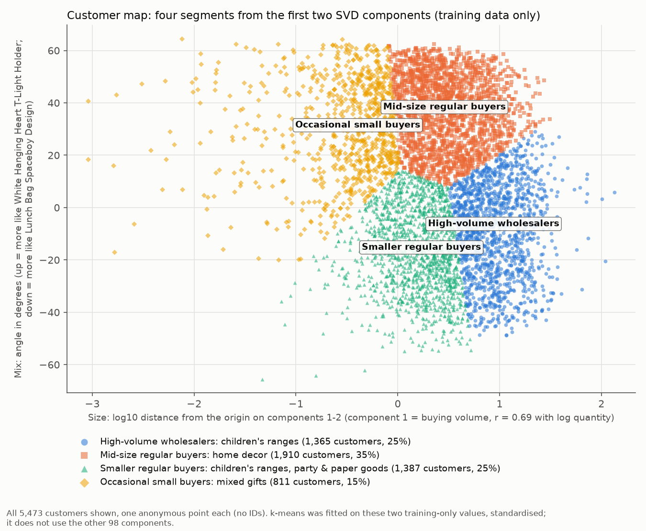
Customer groups for marketing
High-volume wholesalers: children's ranges
UK 85%. Example: Dolly girl beaker
Mid-size regular buyers: home decor
UK 97%. Example: White pearl beaded heart, small
Smaller regular buyers: children's ranges, party & paper goods
UK 86%. Example: Nurse's bag soft toy
Occasional small buyers: mixed gifts
UK 98%. Example: Antique silver tea glass engraved
Source: reports/segments.csv and figures/customer_map.png, training data only. UK = share of the group's customers.
Notes:
Speaker: Jiaxiao Chen, ML Engineer. Time: 50 seconds.
The map plots each customer's size, the log10 distance from the origin on components one and two, against mix, the angle between them in degrees. All 5,473 customers are visible. k-means grouped customers on these two values, standardised, into four groups, seed 42, 20 restarts. Training data only, and only two of the 100 components. Component one tracks buying volume, so size partly reflects order size.
Names come from each group's common and distinctive products, with one example each on the right. All groups are mainly UK-based, 85.5% to 97.7% of customers, and some have a larger overseas share. Marketing should test them.
Source: reports/segments.csv, reports/segment_profiles.json, figures/customer_map.png.

Slide 6
Pilot and coverage
What the test showed
Next steps
SVD top 10: 23.2% of customers had a hit, against 17.4% for best sellers
From the prepared table, fit and top 10 for all 3,687 products: 0.707 s
Purchase value: raw count 12.9%, 1/0 24.9%, log 23.2%. Log was fixed before testing.
A/B pilot on product pages against best sellers
Best sellers for new products and those with under 10 buyers
Personalised lists only for customers with history
Marketing checks the group names before campaigns
Track coverage: 70.7% of new customer-product pairs scored
Source: reports/results.json, reports/sensitivity.csv. Times measured on an Apple M4 Mac (10 logical CPUs). An offline hit rate does not prove extra sales.
Notes:
Speaker: Jiaxiao Chen, ML Engineer. Time: 35 seconds.
We recommend a pilot: SVD beat best sellers, 23.2% against 17.4%. From the prepared purchase table, the fit and all-product neighbour lists took 0.707 s; raw-data cleaning is extra. By purchase value: raw count 12.9%, 1/0 24.9% and log 23.2%. 1/0 scored slightly higher, but log was fixed before testing, so we kept it.
Product pages can serve new customers; personalised lists need history, and new products need best sellers. Alex would own the data refresh, and I the refit and coverage checks.
Source: reports/results.json (nightly and sensitivity sections), reports/sensitivity.csv.

