Slide 1
Проект
Выполнил
Куратор
Guitar Tuner
Савельев Александр
Ванясин Никита

Slide 2
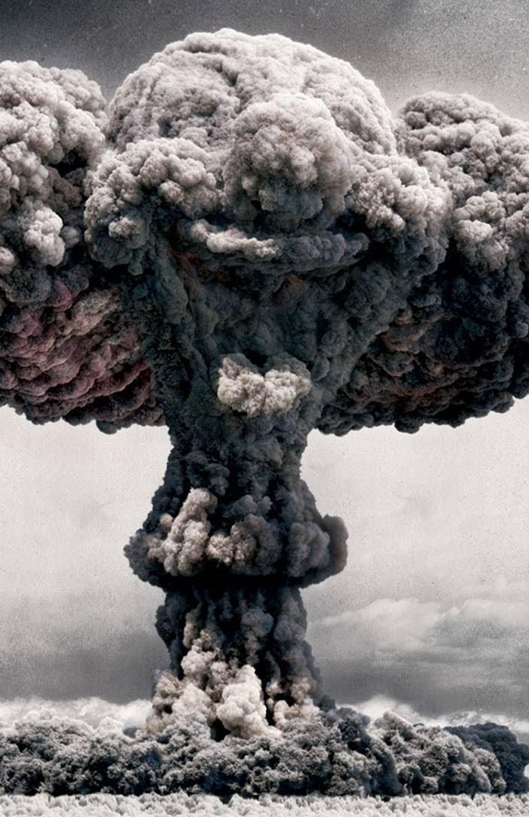
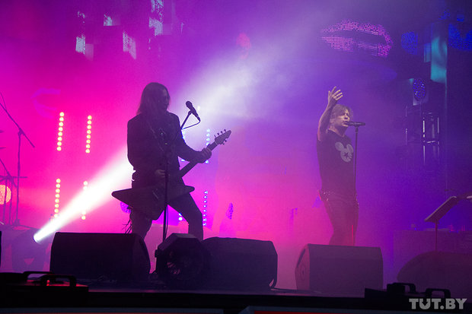


Slide 3
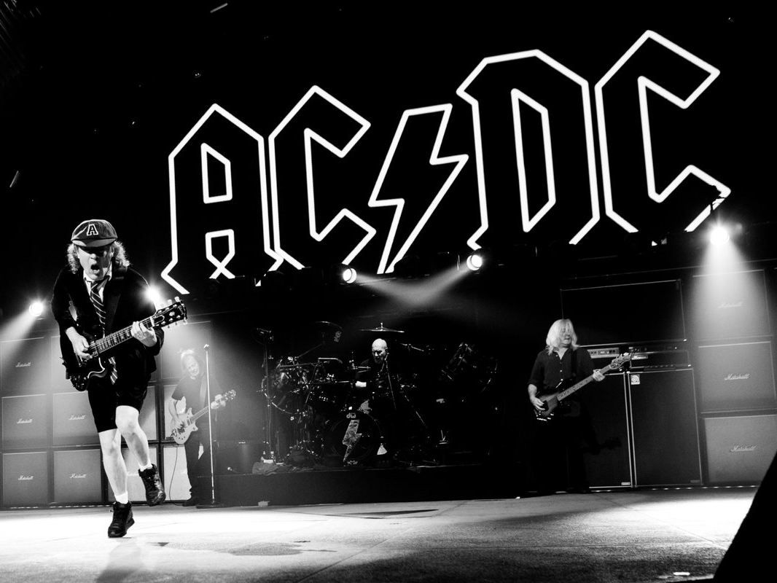

Slide 4
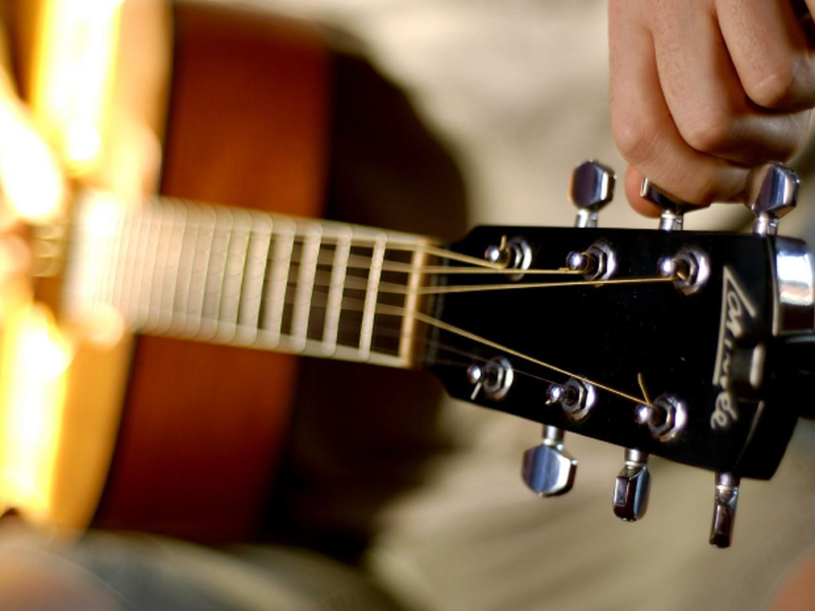

Slide 5
Guitar Tuner

Slide 6
View
Model
Controller

Slide 7
Написать тест
Повторить
Прошел
Проходит ли написанный тест?
Написать код
Не прошел
Не проходят
Проходят ли все тесты?
Проходят
Почистить код

Slide 8
Tuner
Fork
Settings

Slide 9
Line2d.swift
Scale.swift
TunerController.swift
Tuner.swift
Microphone.swift
ForkController.swift
PageController.swift
Fork.swift
Settings.swift
SettingsController.swift

Slide 10
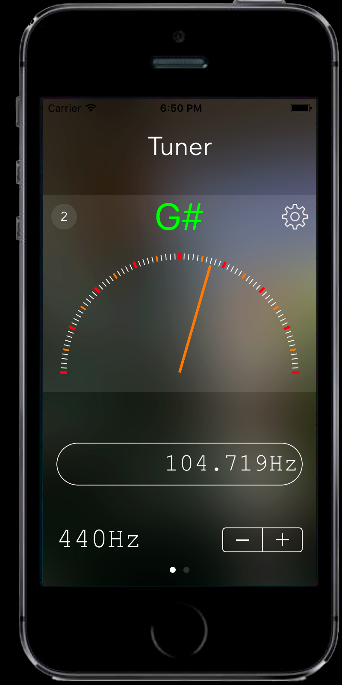
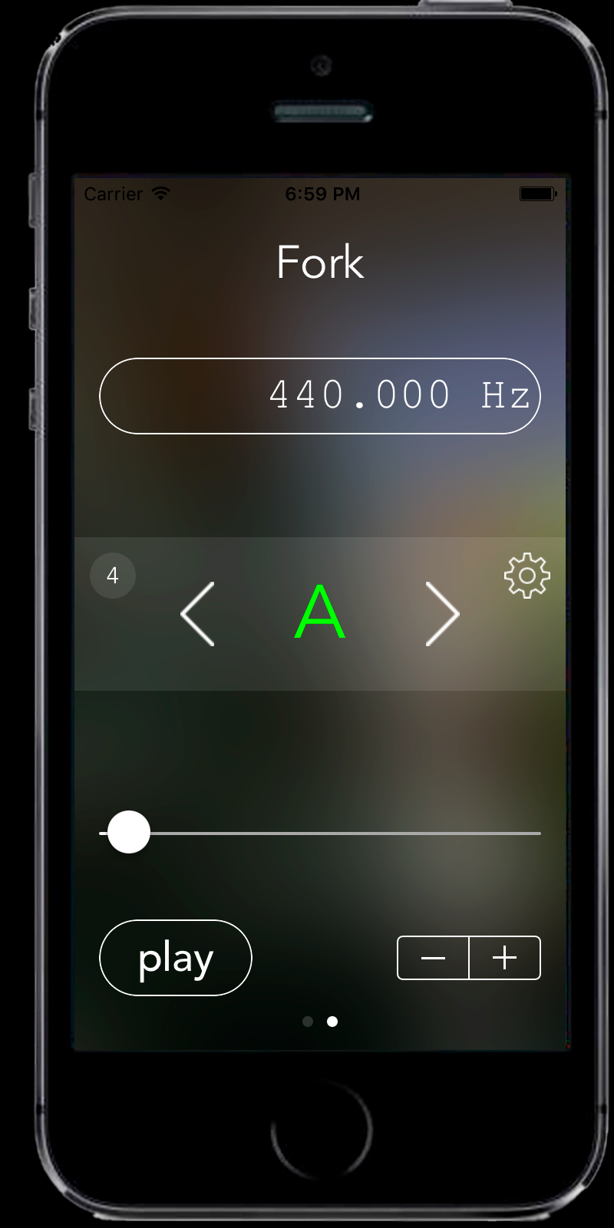
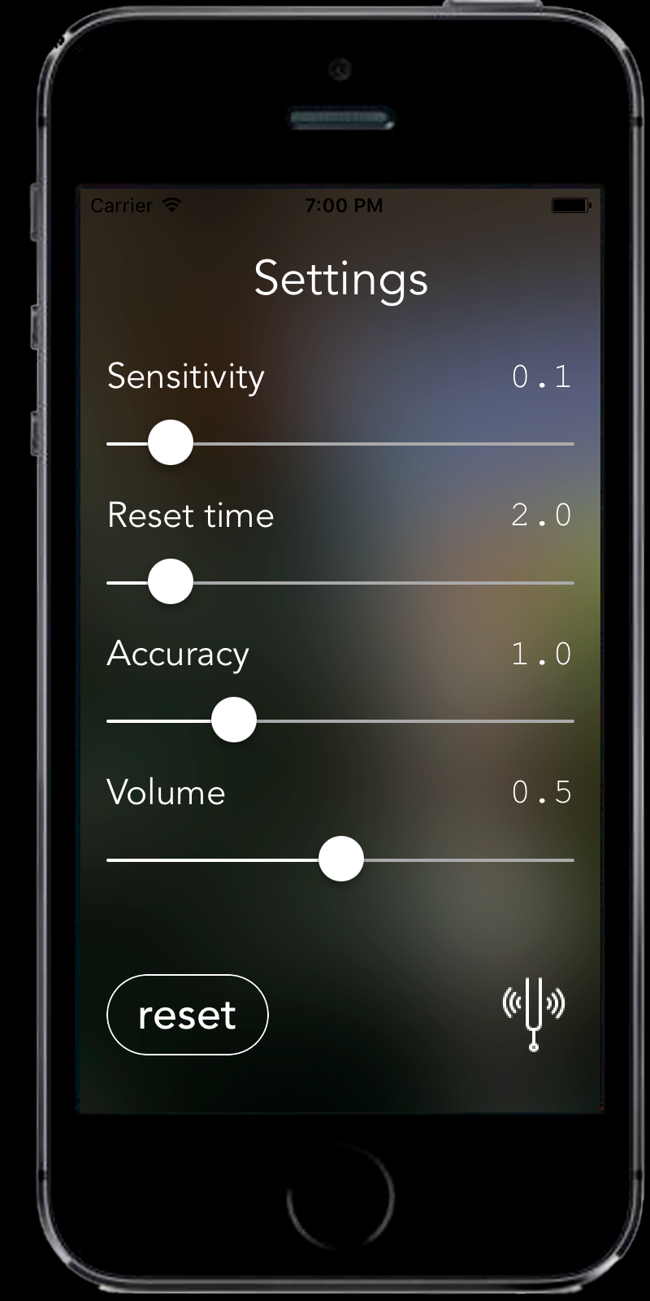

Slide 11
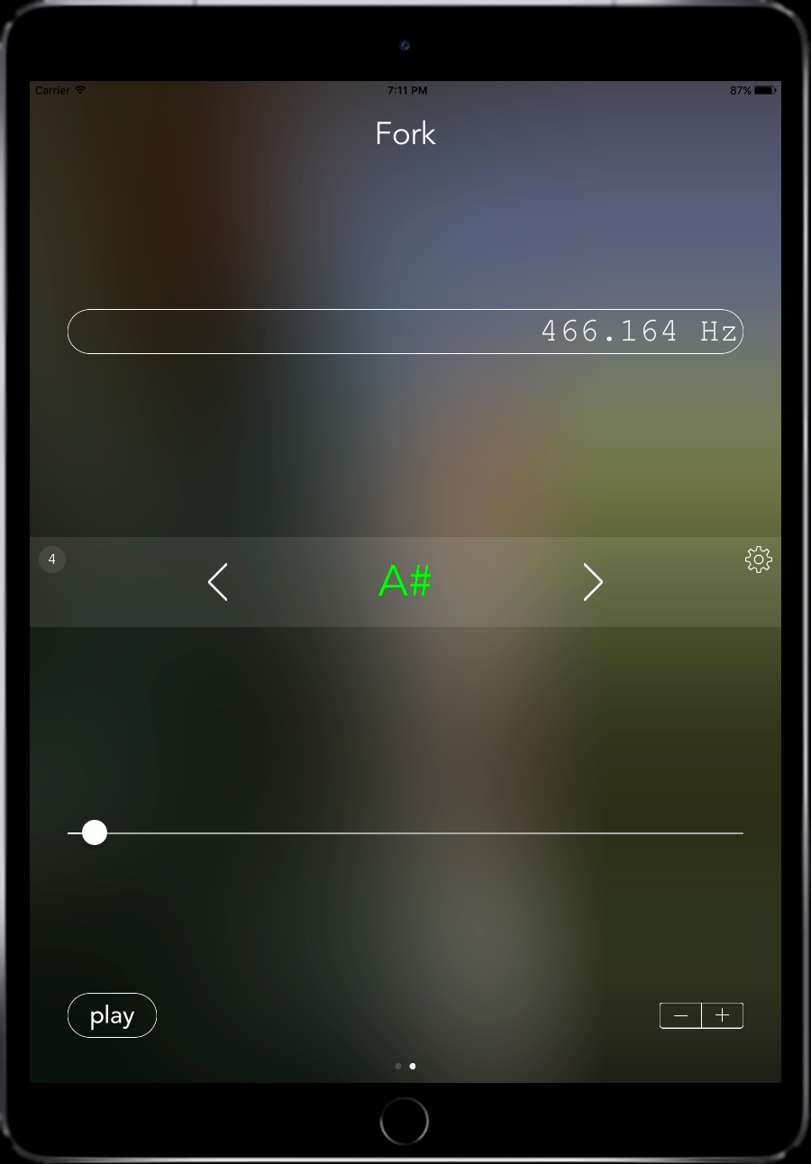
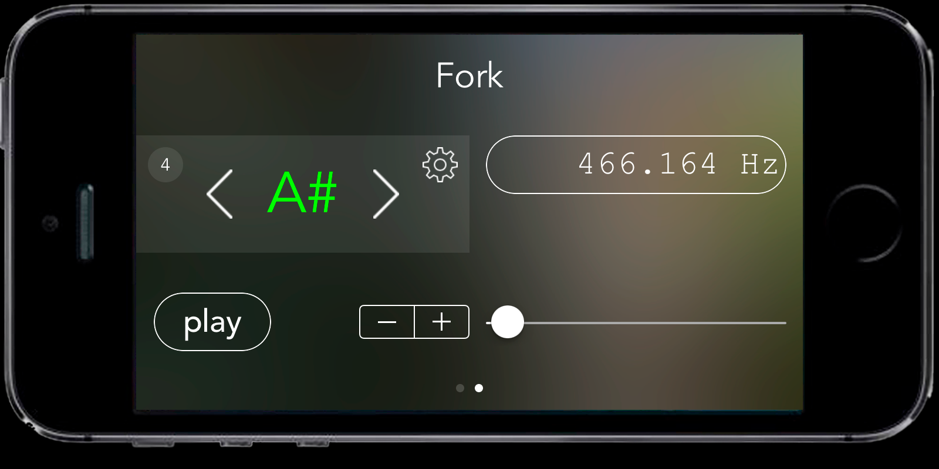

Slide 12
Swift 3
Xcode 8
AudioKit
UIKit
ООП
TDD

Slide 13
Основной цикл тюнера
override func viewDidLoad() {
super.viewDidLoad()
microphone.start()
Timer.scheduledTimer(timeInterval: updateInterval,
target: self,
selector: #selector(TunerController.listen),
userInfo: nil,
repeats: true)
resetUI()
}

Slide 14
Инициализация массива частот
class var noteFrequencies: [Double] {
// f[i] = f0 * 2^(i/12)
// f0 is note A frequency (base note)
var noteFrequenciesArray = [Double]()
let firstNoteFromBase = -57
let lastNoteFromBase = 62
let notesInOctave = 12.0
for i in firstNoteFromBase ... lastNoteFromBase {
noteFrequenciesArray.append( baseFrequency * pow(2, Double(i) / notesInOctave) )
}
return noteFrequenciesArray
}

Slide 15
Поиск ноты
private func updateNoteNumber() {
var nextElement = Tuner.maxNoteNumber
var prevElement = Tuner.minNoteNumber
var currElement = nextElement / 2
if frequency < Tuner.noteFrequencies[Tuner.minNoteNumber] {
noteNumber = Tuner.minNoteNumber
}
if frequency > Tuner.noteFrequencies[nextElement] {
noteNumber = nextElement
}
while ( nextElement - prevElement > 1 ) {
if frequency > Tuner.noteFrequencies[currElement] {
prevElement = currElement
} else {
nextElement = currElement
}
currElement = prevElement + (nextElement - prevElement) / 2
}
let prevElementInterval = -Tuner.noteFrequencies[prevElement] + frequency
let nextElementInterval = Tuner.noteFrequencies[nextElement] - frequency
noteNumber = prevElementInterval > nextElementInterval ? nextElement : prevElement
}

Slide 16
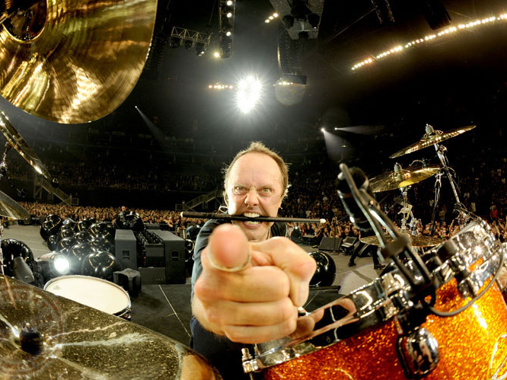
Вопросы

