Slide 1
留学申请经验分享
Minghao Sun (孙铭浩)
Veterinary Medicine 1801 (动医1801)
April 10, 2024

Slide 2
Offers and Rejections
Rejections:
Yale U, Health Informatics, MS
California Institute of Technology, Computational Biology PhD
Duke CBB, PhD
Brown U, CS
JHU * 4 PhD all failed
UC Berkeley, Computational Biology PhD
UCLA, Bioinformatics, PhD
UMich - Ann Arbor, Bioinformatics
University of North Carolina at Chapel Hill, Computer Science PhD
UCSD, DS76?
USC, BME PhD
CMU, BME PhD
USC, Computational Biology, PhD
GaTech, Bioinformatics全家桶, all failed
University of Wisconsin - Madison 全家桶, 全聚德
Michigan State University, Bioinformatics, PhD
UMass, Bioinformatics, PhD
NUS, Public Health, PhD
NUS, BME, PhD
Duke BME, PhD
Duke-NUS Medical School, PhD - QBM
NUS, Cancer Science Institute, PhD
…
Withdraw:
Columbia University, Data Science
Rice U, DS
NYU Courant Computer Science
Other Good Programs:
New York University, Tandon & Courant, Computer Science
UChicago, MPCS
Cornell, Animal Sciences (?) PhD
Johns Hopkins 全家桶
DVM公派...
PhD Offers:
Pennsylvania State University, Computational Biology, PhD
University of California, San Diego, Bioinformatics, PhD
National University of Singapore, Integrative Sciences and Engineering Programme (ISEP), PhD
National University of Singapore, Pharmacy, PhD
National University of Singapore, School of Medicine, PhD
MS Offers:
University of Southern California, Computer Science
University of Southern California, Artificial Intelligence
Carnegie Mellon University, Computational Biology
University of Texas at Austin, Computer Science
GaTech, Computer Science
Pennsylvania University, MCIT
UIUC, Computer Science

Slide 3
Educational Background
Major: Veterinary Medicine
Dual Major: Statistics
Minor: Computer Science
GPA: 89.23 (3.92/4.00) (total credits: 270+)
Research:
First Authored * 2 (Instructor: 贺津)
Other Rankings in Research Papers * N
Other Research Experience
Competition: Kaggle, Bronze Medal * 3
Internship: Animal Hospital, TA, Alibaba Group, Quant

Slide 4
Orientation
Target:
U.S., Singapore
Why Not U.K. and HK?
Why Not Canada?
Information Resource:
一亩三分地，知乎，小红薯
飞跃手册(CS, Statistics, Economics, Medicine)
Quora
留学中介

Slide 5
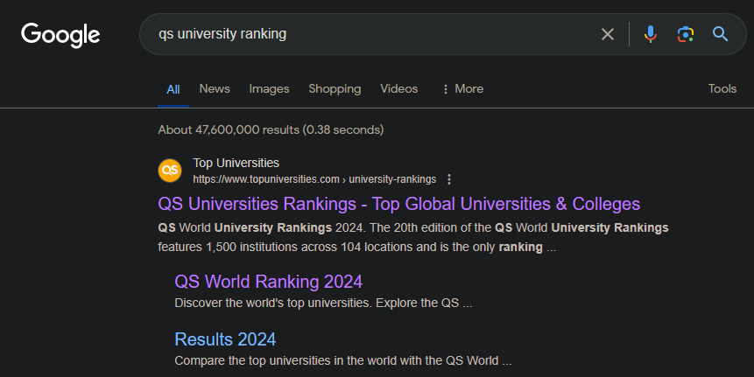
Orientation
usnews: https://www.usnews.com/best-colleges/rankings/national-universities
QS: https://www.topuniversities.com/university-rankings

Slide 6
Materials Preparation
GPA (MS or PhD? Major Changing Prerequisites?)
Language (TOEFL, IELTS, Duolingo & GRE?) (U.S., SG, U.K.)
CV (Resume)
Personal Statement or Statement of Purpose (tailored)
Research Proposal (U.K., Singapore)
Other Online Questions (e.g., extracurricular activities, volunteering...)
Recommendations (养鱼)
PhD Interviews

Slide 7
Personal Statement
Must be Personal
Diversity
Motivation (and your efforts)
Match
Include Educational & Research Experience

Slide 8
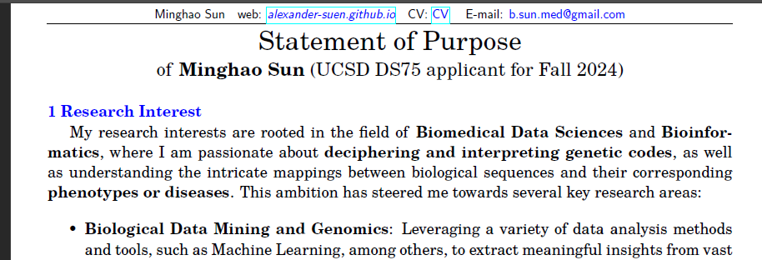
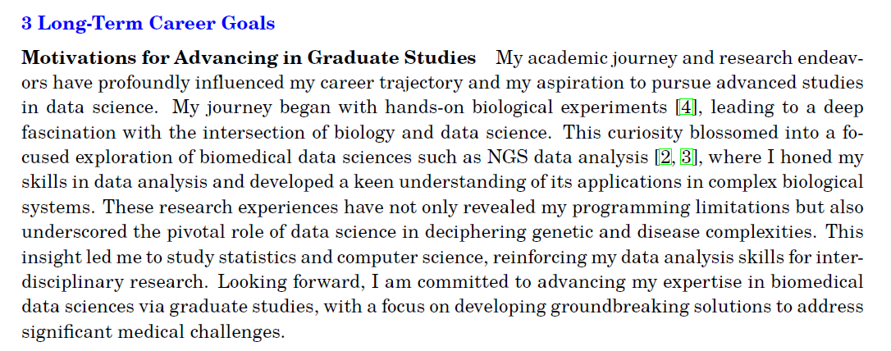

Slide 9
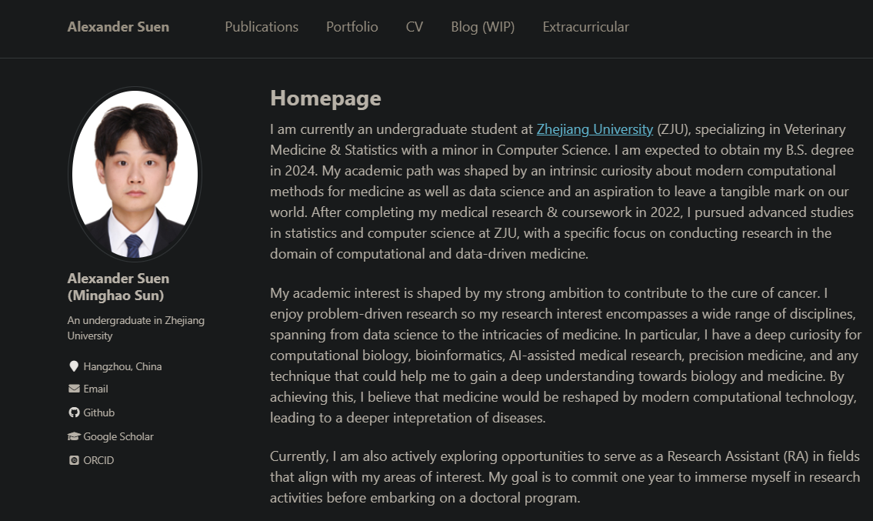

Slide 10
PhD Interviews
Be familiar with all your materials.
Look DIRECTLY at the camera. DO NOT read.
Professor Interview:
Specific Research Questions. E.g., Why xxx model? How to optimize? What do you think of xxx research? What did you do in xxx project?
Hard to Predict.
Committee Interview:
There will be some template questions. E.g., long-term goal, why this program.
Some interviewers may ask the questions that you’re not familiar.
Smile

Slide 11
For Major Changing Students
Computer Science / Data Science:
Prerequisites: Data Structure, Algorithm Analysis, Discrete Mathematics, Computer Networks, Computer Organization, Database, Operating System, Automata...
Competitions and Related Internship (Bonus)
Biostatistics / Bioinformatics:
Prerequisites: Calculus, Linear Algebra, Probability, Mathematical Statistics, Data Structure, Algorithm, Programming (R/Python)
Finance / Marketing / Quant:
Prerequisites: Math, Programming...
Related Internship

Slide 12
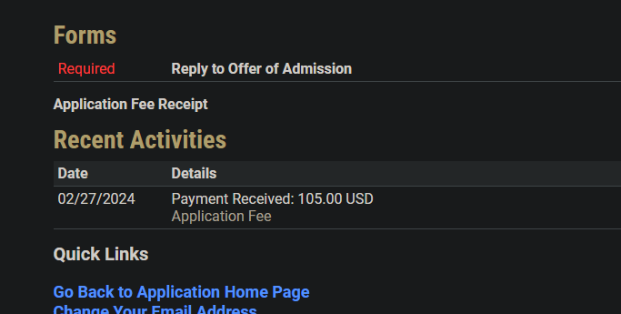
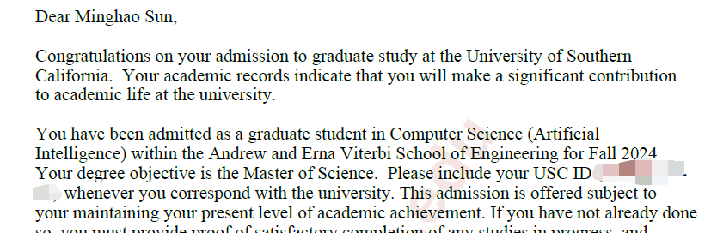
Offer Acceptance & Rejection

Slide 13
留学中介
Time Saving
Cost Performance?
Information
学长/学姐推荐(16&18级)
大中介避雷
Don’t Place All Your Hopes on Anyone Else!

Slide 14
Why Study Abroad?
Major Changing
Higher PhD salaries and environments
可以速通
We’re still young. Permission to try.
See a bigger world. 人赚不到认知之外的钱
Higher salaries, less 9-9-6
Will studying abroad (or working abroad) help you to achieve your goal?

Slide 15

Ask me Anything
WeChat: vxid_artanis062
These materials will be accessible on cc98.org later.

