Slide 1
Alexander Vasilopoulos
Olist Ecommerce Analytics
A Power BI all-round view of sales, deliveries, customers, regions and marketing insights across 98,000 orders from 2016 to 2018
Power BI · DAX · Power Query · Data Modeling
Notes:
Welcome the audience and state the one-line goal: turning raw order data into decisions Olist could actually act on. ~30 seconds.

Slide 2
AGENDA
What to expect
01
The project
Dataset, framework and key questions
02
Sales and customers
Revenue, top categories and customer regions
03
Delivery and customer satisfaction
Impact of delivery delays
04
Marketing & seller analysis
Marketing leads and seller KPIs under the microscope
05
Conclusion
Recommendations and conclusions
2
Notes:
Quickly preview the five sections so the audience knows the shape of the talk. Don't linger — 30 seconds.

Slide 3
The project
Olist: anonymized data from a real Brazilian marketplace business
Olist connects small businesses with large marketplaces across Brazil. This dataset covers roughly 98,000 orders from 2016 to 2018 and includes orders, products, customers, sellers, reviews and payments – plus a marketing funnel for leads that led to orders.
Power BI – report structure
1
Executive Overview
2
Sales & Products
3
Customers & Region
Guiding question
“Where does Olist win customers, where does it lose them, and which marketing leads are actually worth investing in?”
4
Delivery & Logistics
5
Marketing Analysis
6
Drillthrough detail
3
Notes:
Explain the dataset briefly: real anonymized marketplace data, 2016-2018, multiple relational tables. Read the guiding question aloud — it frames everything that follows. ~1 minute.

Slide 4
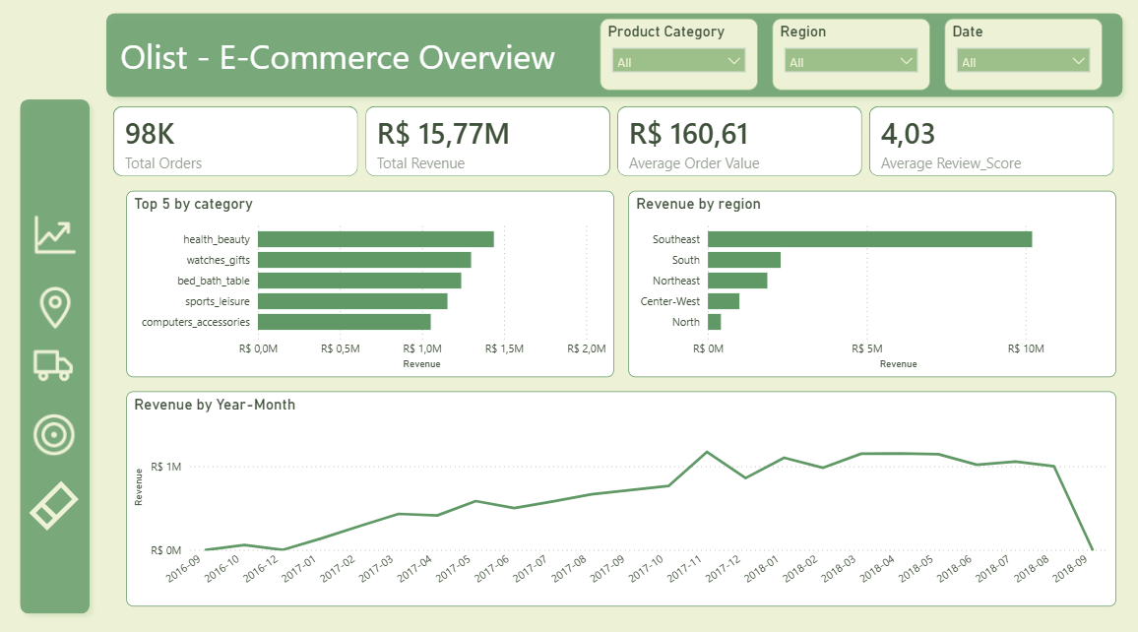
The project – dashboard overview
The company at a glance
- Dashboard teaser -
4
Notes:
Anchor the audience with the headline numbers before diving into detail. Point out the revenue dip at the very end is a partial-month data artifact, not a business collapse — shows attention to data quality. ~1.5 minutes.

Slide 5
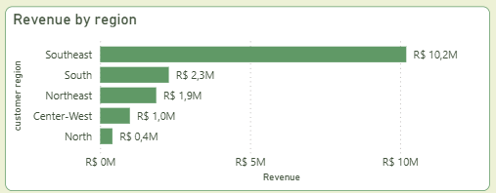
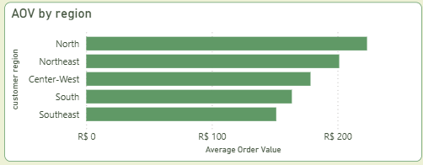
Sales and customers
Where does the revenue come from?
- The Southeast alone generates about 67% of total revenue – owing to high population density on the one hand and better logistics on the other
- Despite having the lowest volume, the North region has the highest average order value, probably due to higher freight costs on long-distance shipments
97%
of customers order only once
Only 2.9% of the 96,000 customers came back — growth here is
driven almost entirely by new-customer acquisition, not by retention.
5
Notes:
Southeast dominance and the 97% one-time-buyer stat are the two soundbites here. Note the North AOV/freight insight briefly. ~1.5 minutes.

Slide 6
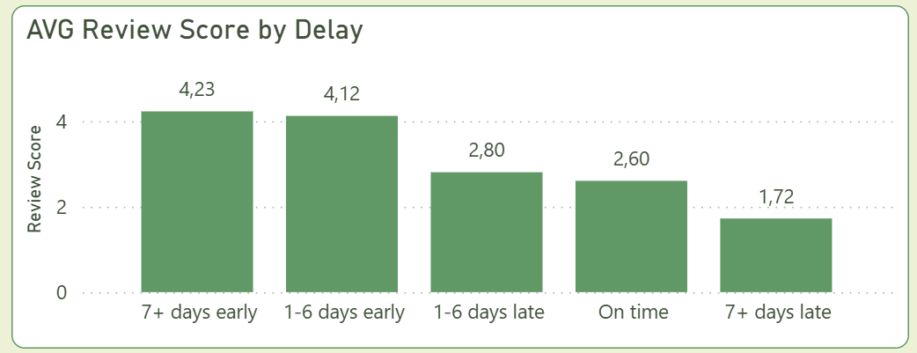
Delivery times
Delivery issues and customer satisfaction
12.4 days
24.4 days
93.2%
6.8%
Average delivery time
Average delivery window to count as “on-time”
On-time
Late
6
Notes:
This is the standout chart of the deck — slow down here. Walk left to right: early delivery, on-time, then the visible drop for late orders. State the number: 7+ days late orders average nearly a full star lower than on-time ones. ~2 minutes.

Slide 7
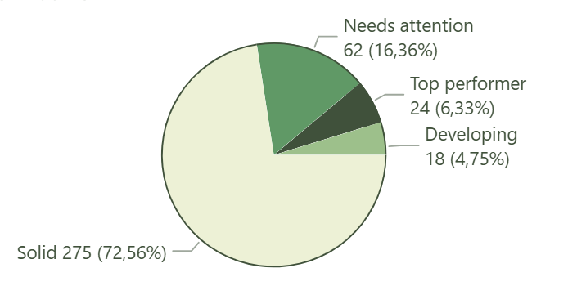
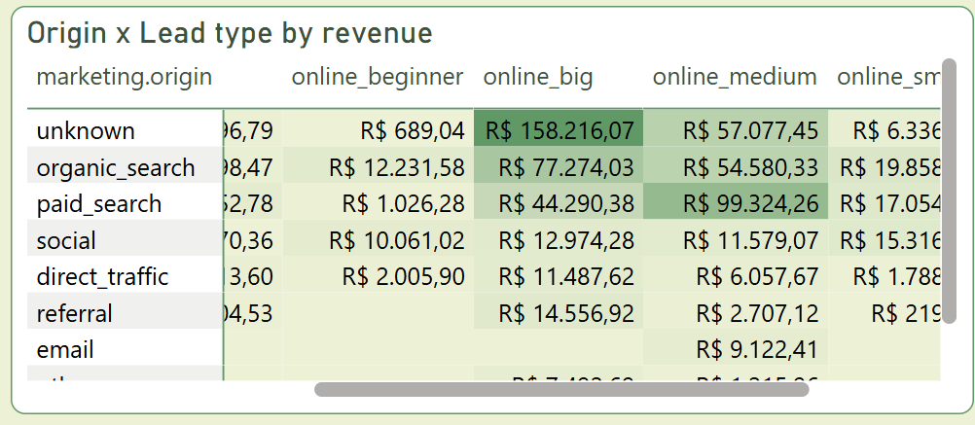
Marketing & seller analysis
Seller scoring
My scoring model: it rates the 379 sellers who went through Olist’s marketing tool, combining revenue, closing speed and order volume into one comparable score.
Seller tier distribution
Origin x Lead type:
- organic search and paid search are the most effective
- ...but many orders have no known origin
Score = weighted combination of revenue, time to close and order volume – calculated relative to the seller average to avoid distortion from outliers.
Maximum score: 9 points.
7
Notes:
This is the most differentiated part of the project — spend real time here. Explain briefly how the score works (revenue + speed + volume, normalized against the average to avoid outlier skew), then land on the organic-search-plus-industry finding and the attribution-gap caveat. ~2.5 minutes.

Slide 8
Conclusion
What Olist can do now
1
Review marketing origin
A large share of high-value leads has no traceable origin.
2
Lean more on organic and paid search
For the industry and large online customer segments, these channels convert leads into revenue fastest and at the greatest scale.
3
Investigate logistics in the North region
The slowest delivery times and a direct link between delays and worse reviews – the biggest lever for improving satisfaction.
4
Develop a customer retention strategy.
A 97% share of one-time buyers points to a purely new-customer base; even a small incentive for repeat purchases compounds quickly.
8
Notes:
Walk through the four recommendations at a steady pace, tying each back to a chart already shown. ~2 minutes.

Slide 9
Thank you for your attention
The complete, interactive report is available to you - by Alexander_Vasilopoulos - Olist_Presentation_EN(.pbix)
Notes:
Thank the audience and open the floor. ~30 seconds.

