Slide 1
Electric Wiring Diagram
Revision 1
Page 2
Ethernet connection
Page 1

Slide 2
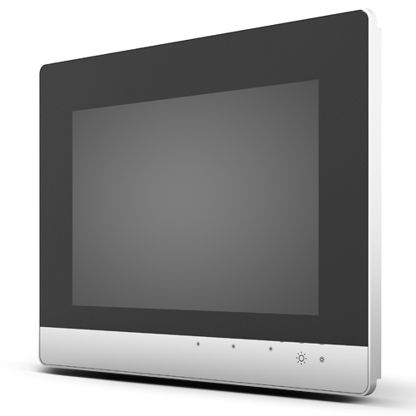
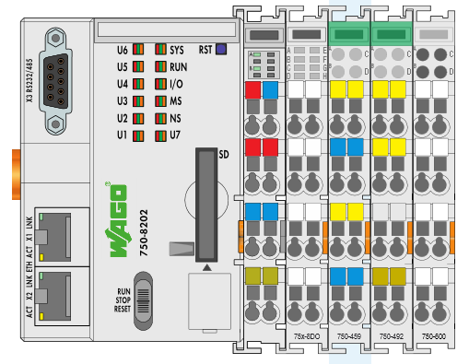

192.168.1.1
192.168.1.20
Revision 1
192.168.1.15
Page 2
Ethernet connection
Page 2

Slide 3
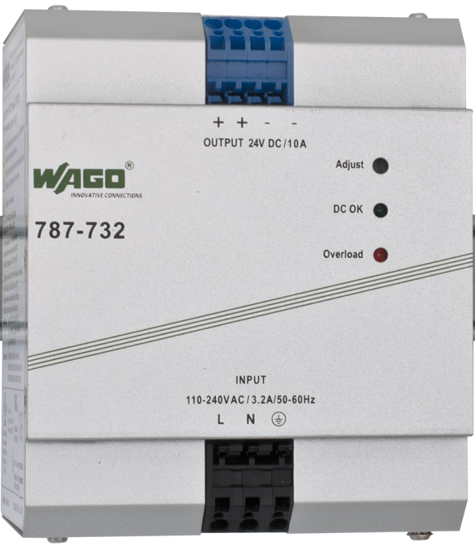
Revision 1
Page 2
PLC Power Supply
Page 3

Slide 4
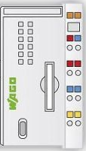

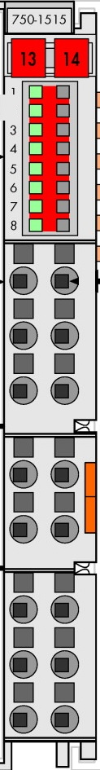

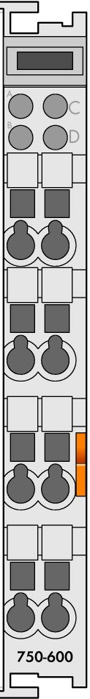
Revision 1
Page 2
PLC Cards
Page 4

Slide 5
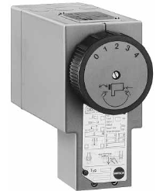
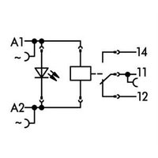
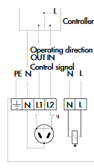
Digital Output Card
Samson Water Control Valve
Relay R1
1
9
220 VAC Terminals
0 VAC Terminals
Ground Terminals
Revision 1
Page 2
Open Water Valve
Page 5

Slide 6
Digital Output Card
Samson Water Control Valve
Relay R2
2
10
220 VAC Terminals
0 VAC Terminals
Ground Terminals
Revision 1
Page 2
Close Water Valve
Page 6

Slide 7

Digital Output Card
Relay R3
Drain Solenoid Valve
3
11
220 VAC Terminals
0 VAC Terminals
L
N
Ground Terminals
Revision 1
Page 2
Open Drain Valve
Page 7

Slide 8
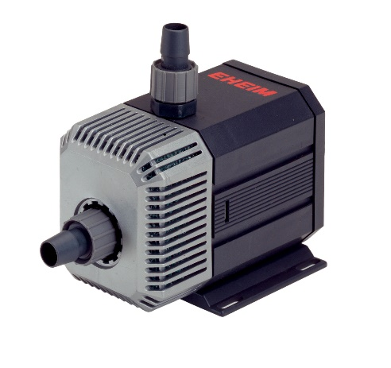
Digital Output Card
Relay R4
Water Pump
220 VAC Terminals
4
12
0 VAC Terminals
L
N
Ground Terminals
Revision 1
Page 2
Start Pump
Page 8

Slide 9


Analog Input Card (0-10 VDC)
Position Potential Divider
1.4 KOhm
DC Power Supply
Revision 1
Page 2
Water Valve Position
Page 9

Slide 10

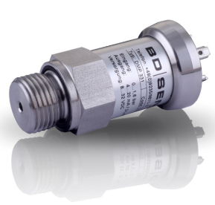
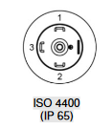
Analog Input Card (4-20 mA)
Water Pressure
Sensor
Revision 1
Page 2
Water Level Meas.
Page 10

