Slide 1
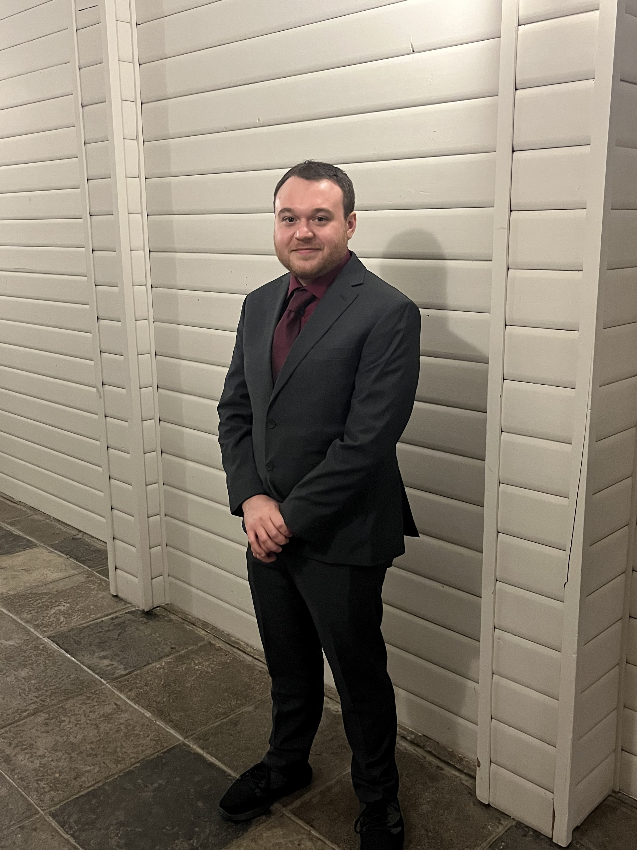
Alexander Peebles
200376601
COMP3025
Mobile and Pervasive Computing – 01
Assignment 3 – To Do App UI

