Slide 1
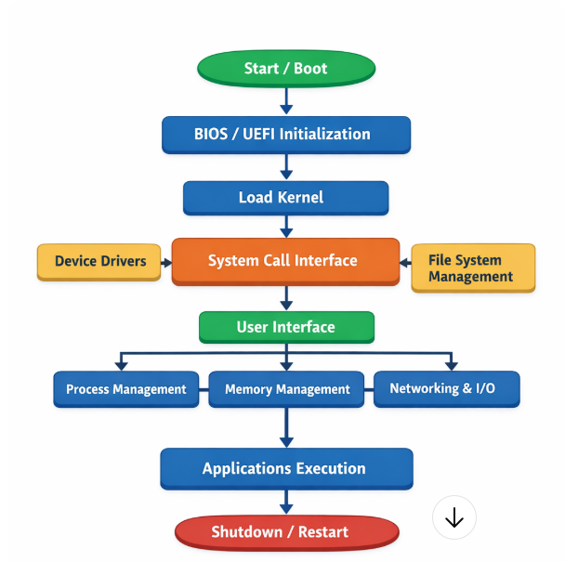
Assignment: Flow Chart: Operating System

Slide 2
“If you were building an app today, what would you do first—write code or understand the users?”

Slide 3
Step 1: Understanding HCI in the SDLC (Big Picture)
What is SDLC?
Software Development Life Cycle (SDLC) is the step-by-step process of creating a system:
Requirements Analysis
Design
Development
Testing
Deployment & Maintenance

Slide 4
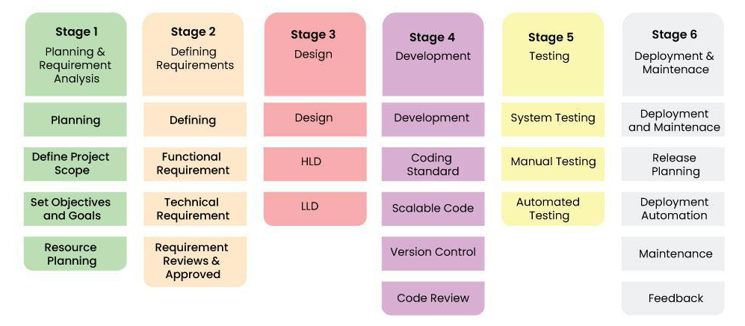
Stages of the Software Development Life Cycle

Slide 5
Software Development Life Cycle Models
Software Development Models are structured frameworks that guide the planning, execution, and delivery of software projects. They define the sequence of development stages, such as requirements, design, coding, testing, and deployment.
Common Models
Waterfall Model
Agile Model
V-Model
Spiral Model
Incremental Model
RAD Model

Slide 6
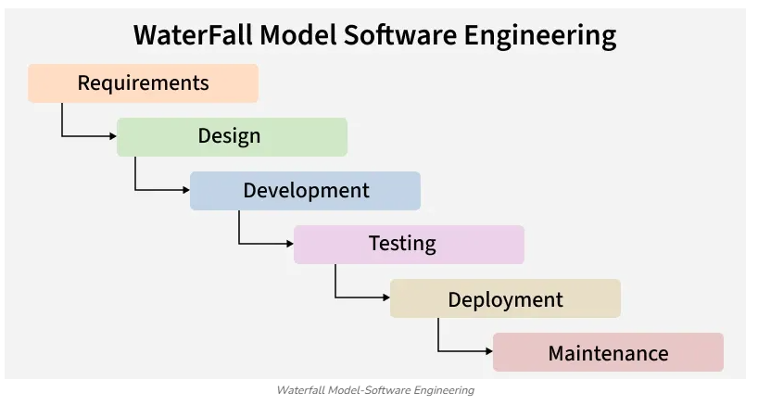

Slide 7
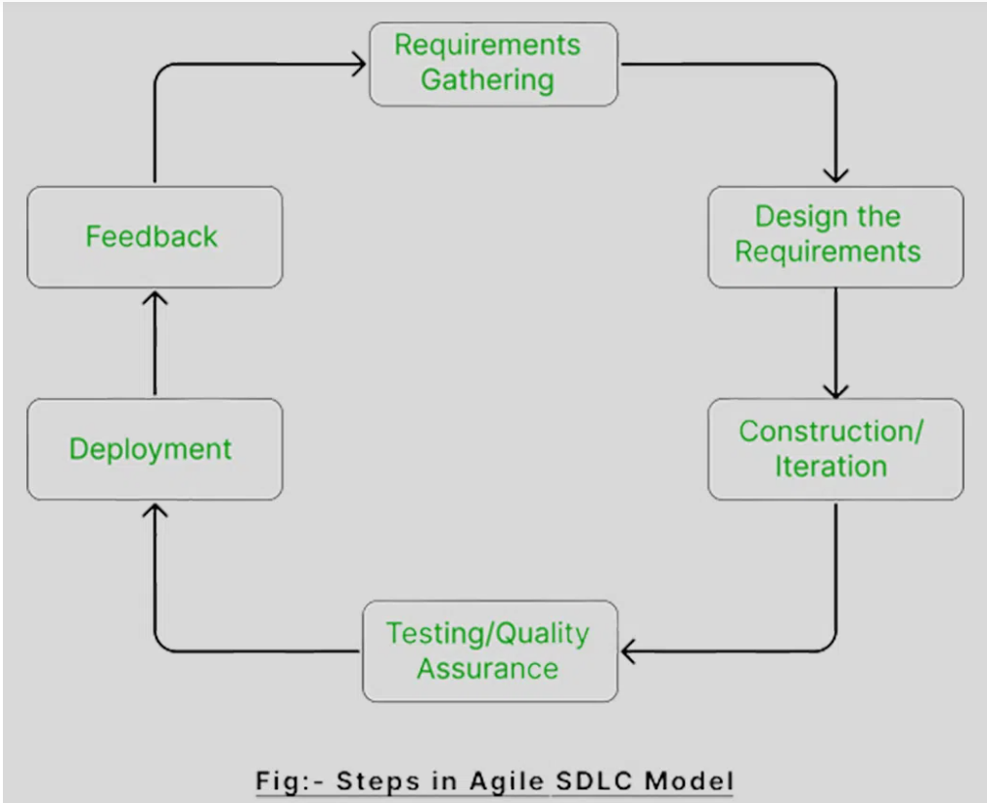

Slide 8
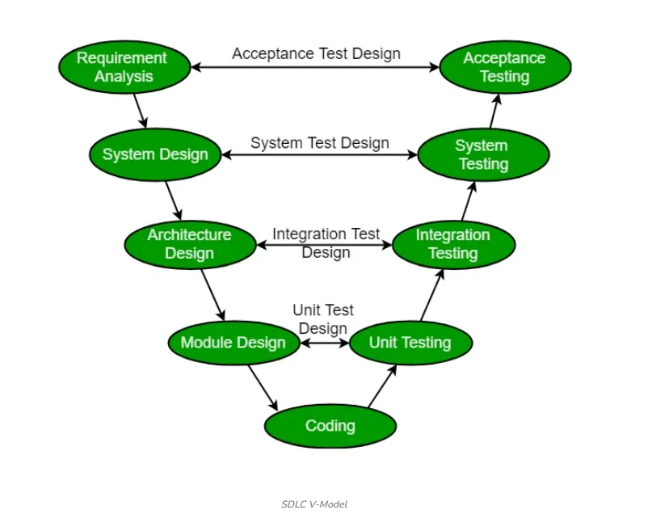

Slide 9
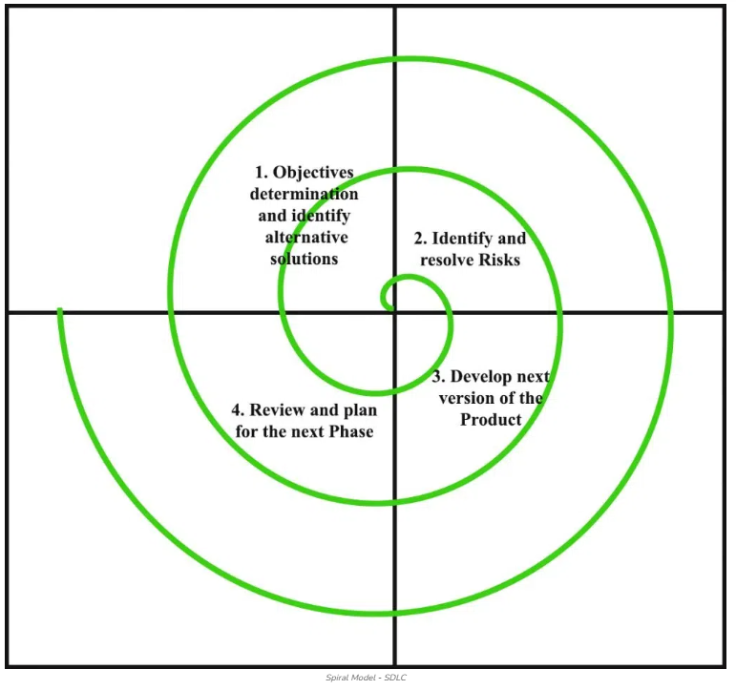

Slide 10
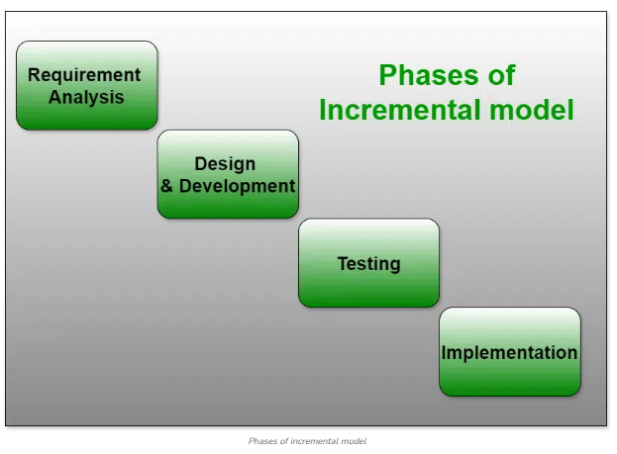

Slide 11
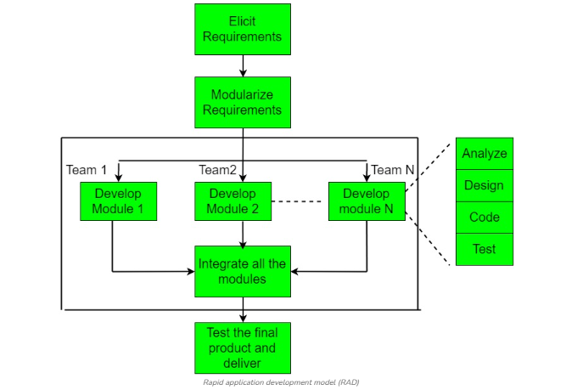

Slide 12
Example: Online Enrollment System
Questions asked:
Who are the users?
What should students be able to do?
Log in
Enroll subjects
View tuition fees
📌 Output of this phase: A list of requirements (functional and usability).

Slide 13
Laboratory Exercise 1: SDLC Application – Case Study (Group Activity)
Objective: Students will apply an SDLC model to a real-world system scenario.
Scenario: Your team is tasked to develop a Student Attendance Monitoring System for your college.
Instructions:
Choose one SDLC model (e.g., Waterfall or Agile).
Apply the chosen model by answering the following:
Requirements: What features are needed?
Design: What will the system look like? (simple diagram or description)
Development: What programming language/tools will be used?
Testing: How will the system be tested?
Deployment & Maintenance: How will it be released and maintained?
Prepare a 5–7 slide presentation.

Slide 14
Expected Output: Group presentation explaining the SDLC application.
Assessment Criteria:
Proper use of SDLC model (40%)
Completeness of phases (30%)
Presentation clarity (20%)
Team participation (10%)

