Slide 1
Human Computer Interaction 2

Slide 2
Course Outcomes (OBE)
CO1: Apply advanced HCI principles in system design
CO2: Evaluate usability and UX of interactive systems
CO3: Design user-centered and accessible interfaces
CO4: Develop prototypes based on user needs

Slide 3
From HCI 1 to HCI 2
HCI 1: Concepts & Principles
HCI 2: Application & Evaluation
Focus on real-world systems used by students

Slide 4
User-Centered Design (UCD)
Understand Users
Specify Requirements
Design Solutions
Evaluate and Improve

Slide 5
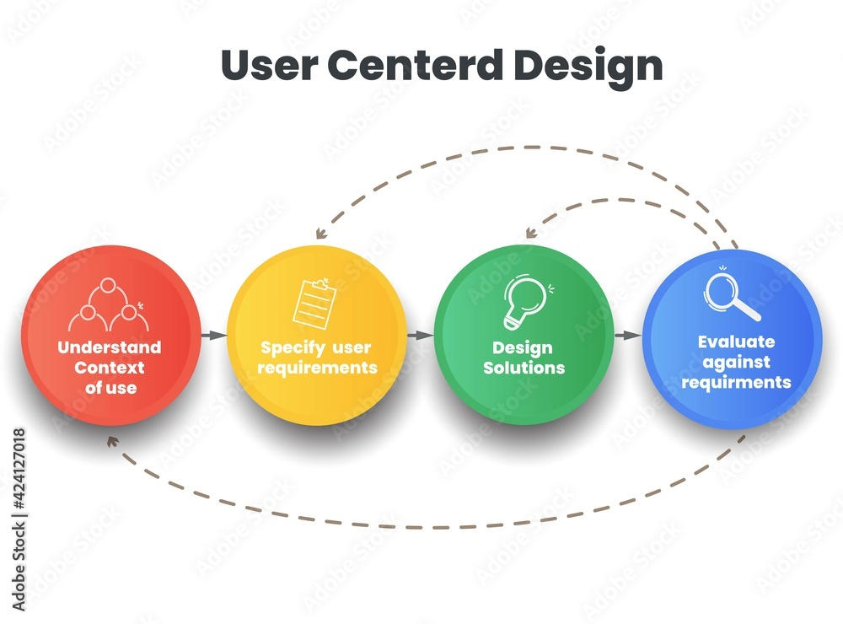
Diagram

Slide 6
UPHSD Example: Student Portal
Users: Students, Faculty, Admin
Tasks: Enrollment, Grades, Clearance
Common Issues: Navigation, Speed, Accessibility

Slide 7
Advanced Interaction Design
Touch & Gesture Interfaces
Menu & Form-Based Interaction
Voice & AI Interaction

Slide 8
Performance Task
Activity: Evaluate a System You Use
Instructions for Students:
1. Choose one system you frequently use (LMS, enrollment system, mobile app, school portal)
2. Analyze it using the 4 HCI steps:
o Who are the users?
o What are their requirements?
o How is the interface designed?
o What problems exist and how can it be improved?
3. Propose at least 3 improvements

