Slide 1
IScheduler2
The wait is over - New generation of calendar app is here

Slide 2
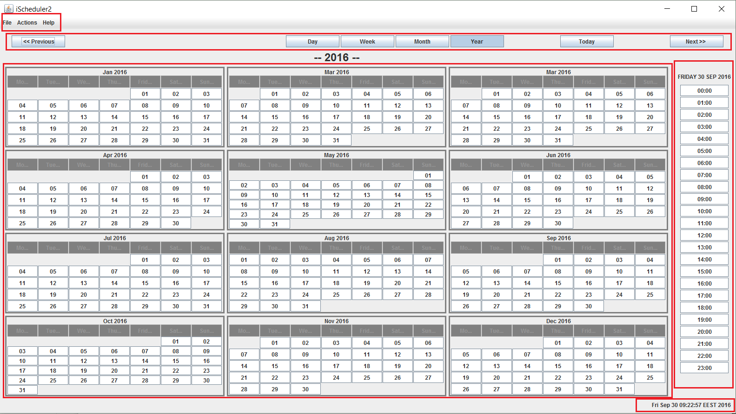
Main window of ischeduler2
Menu bar with Save/Load functions in File
Top bar with naviagation buttons
Access to Day/Week/Month/Year perspective
Table view of the calendar
Quick access to current day events

Slide 3
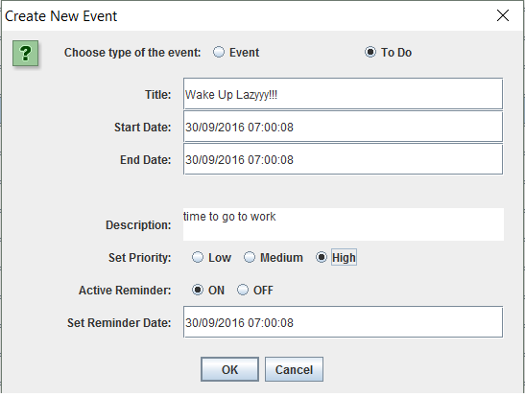
Main window of ischeduler2
Easy access to create a new event with double click on the desired day
Possibility to active reminder that sends you mail to remind of the event ( coming soon )
Cute user friendly access

Slide 4
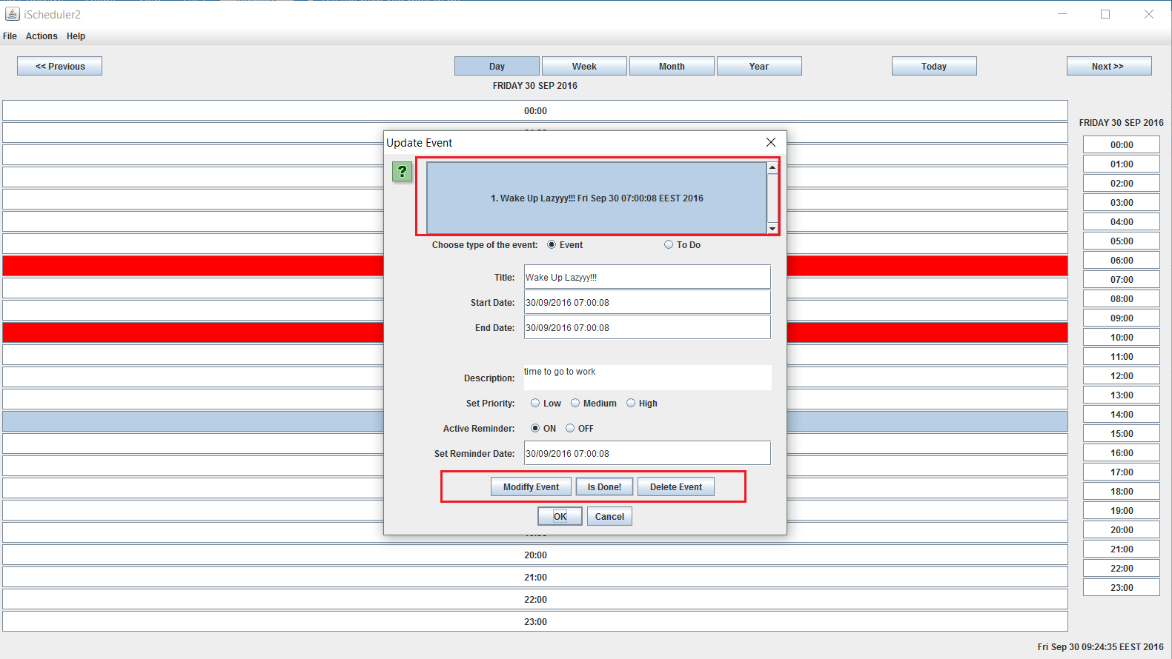
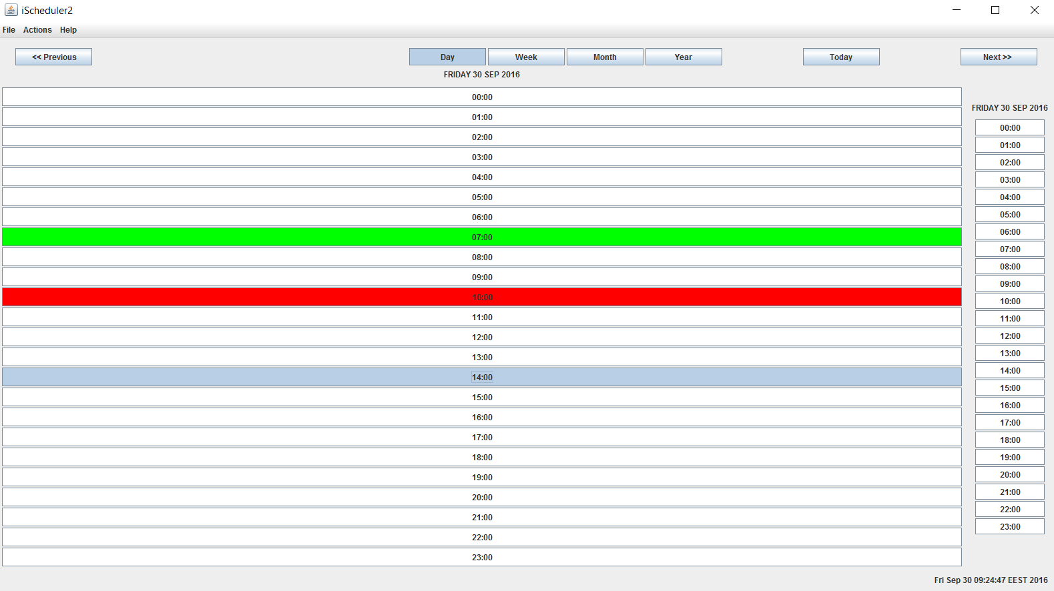
Main window of ischeduler2
Edit event window with a lot a functionality using right click for pop-up window edit event
Cute color scheme - red for active events – green for past events marked “is done”

Slide 5
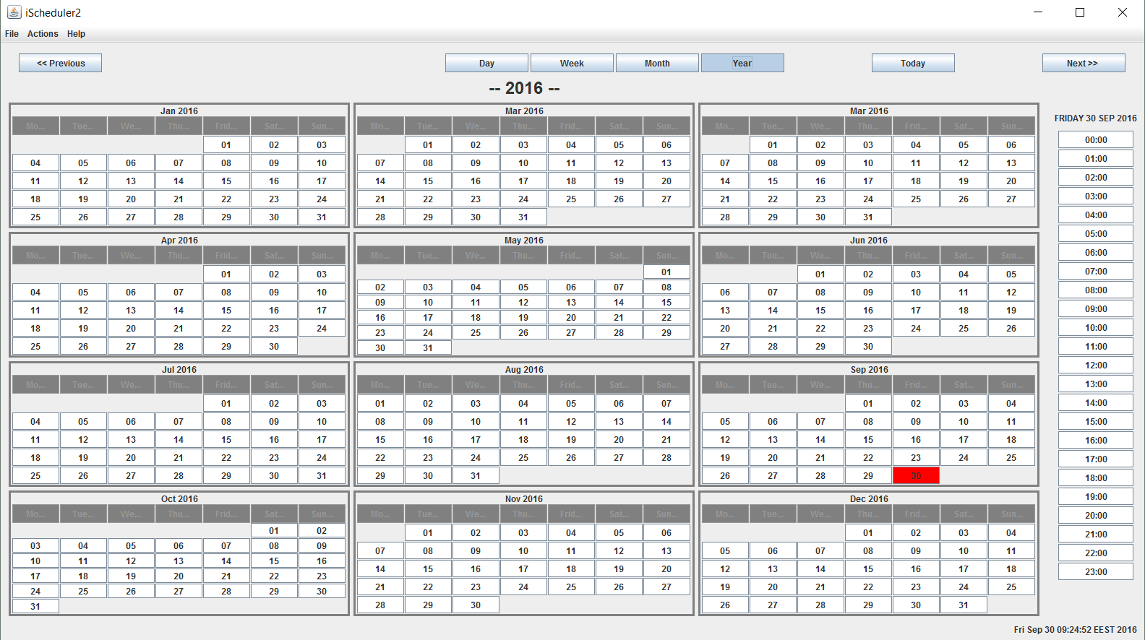
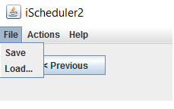
Main window of ischeduler2
The most easiest way to save your events into files for persistence
Using machine code for save into files it’s not like your date is safe, just not human readable

