Slide 1
iScheduler Web App
HTML/CSS/JavaScript

Slide 2
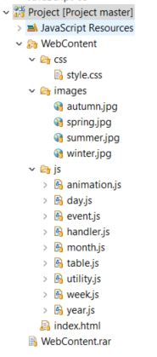
General Presentation
iScheduler has typical structure for Static Web project:
css/style.css
js/*.js
images/*.jpg
index.html
Contains 72% JavaScript code and 12% HTML.
Idea was to create a basic structure in HTML enough flexible to sustain all type of table.

Slide 3
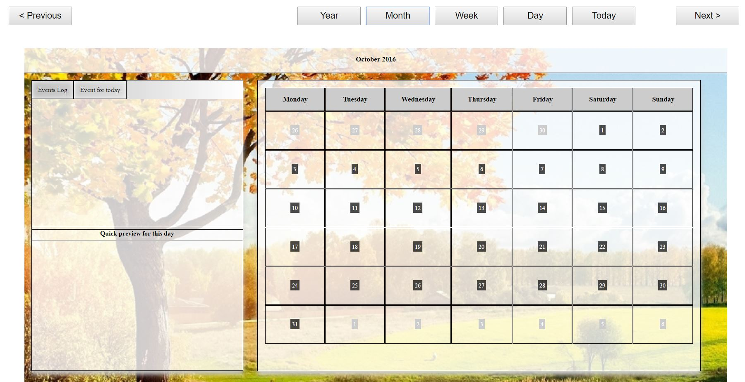
General Presentation
Contains:
Menu bar for switch table
Sidebar for:
Log
Events for selected day
Quick preview on hover the table
Calendar Table
Nice menu for Create/ Edit an event

Slide 4
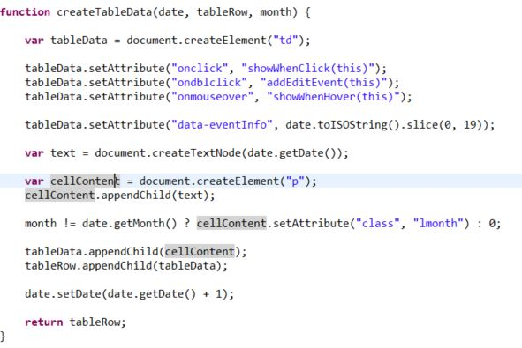
Table Content Development
Calendar Table has a cell for every day in the month with different handlers for Events:
Onclick show enents for selected day;
Ondblclick open an editor to create/edit an event
Onmouseover show a quick preview for that day
For creating an event, we use a custom attribute using HTML5 feature: “data-” and our attribute “eventinfo”

Slide 5
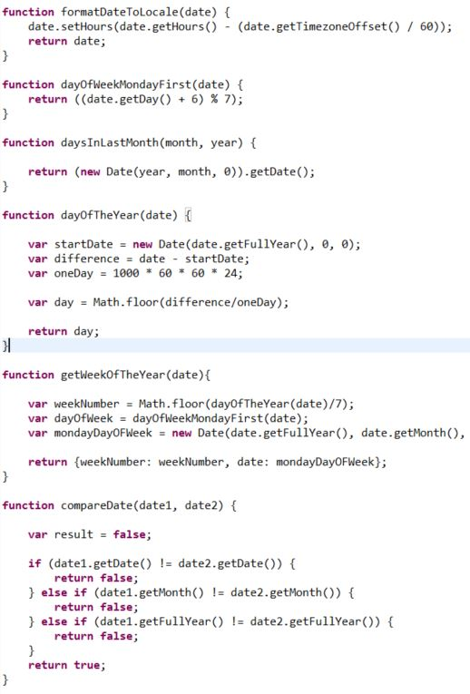
Utility functions
JavaScript has DOM objects with a lot of methods and default functions, but not enough for today’s needs.
One of the options to resolve this kind of problems is to use external libraries prototype.js or apolo.js or frameworks like jQuery.
Or can define one by yourself, like getWeekOfTheYear() which return an inline custom object (I love it :D).
Compare only dates or transform dayOfTheWeek() in Monday first day.

Slide 6
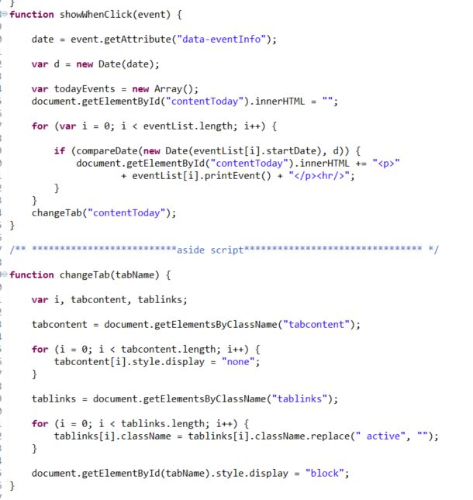
Handlers functions
Using custom attribute to search for events and create content on the page to display them.
And function to display hidden tab content when a button is activated.
Basic concepts of using DOM default elements and JavaScript conditional statements and loops.

Slide 7
Thank you!

