Slide 1

Sprocket Central Pty Ltd
Data analytics approach
Jiarui Xu from KPMG

Slide 2
Agenda
Introduction
Data Exploration
Model Development
Interpretation

Slide 3
Introduction
High Value Customers Identification
Backgrounds and Goals
Sprocket Central Pty Ltd specialises in high-quality bikes and accessories
Aim to optimise resource allocation
1000 new customers targeted
Analysis Approach
RFM analysis and visualisation
Age distributions comparison
Number of cars owned in each state
Bike related purchases Based on Industry

Slide 4
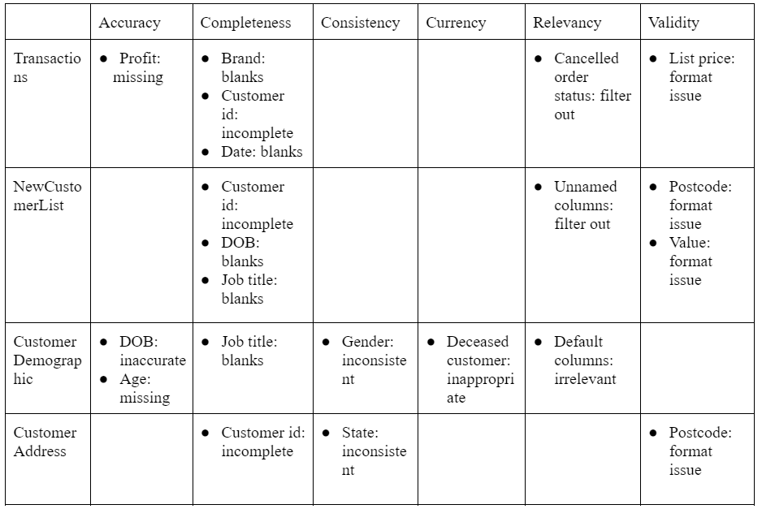
Data Exploration
Data assessment
Data quality issues

Slide 5
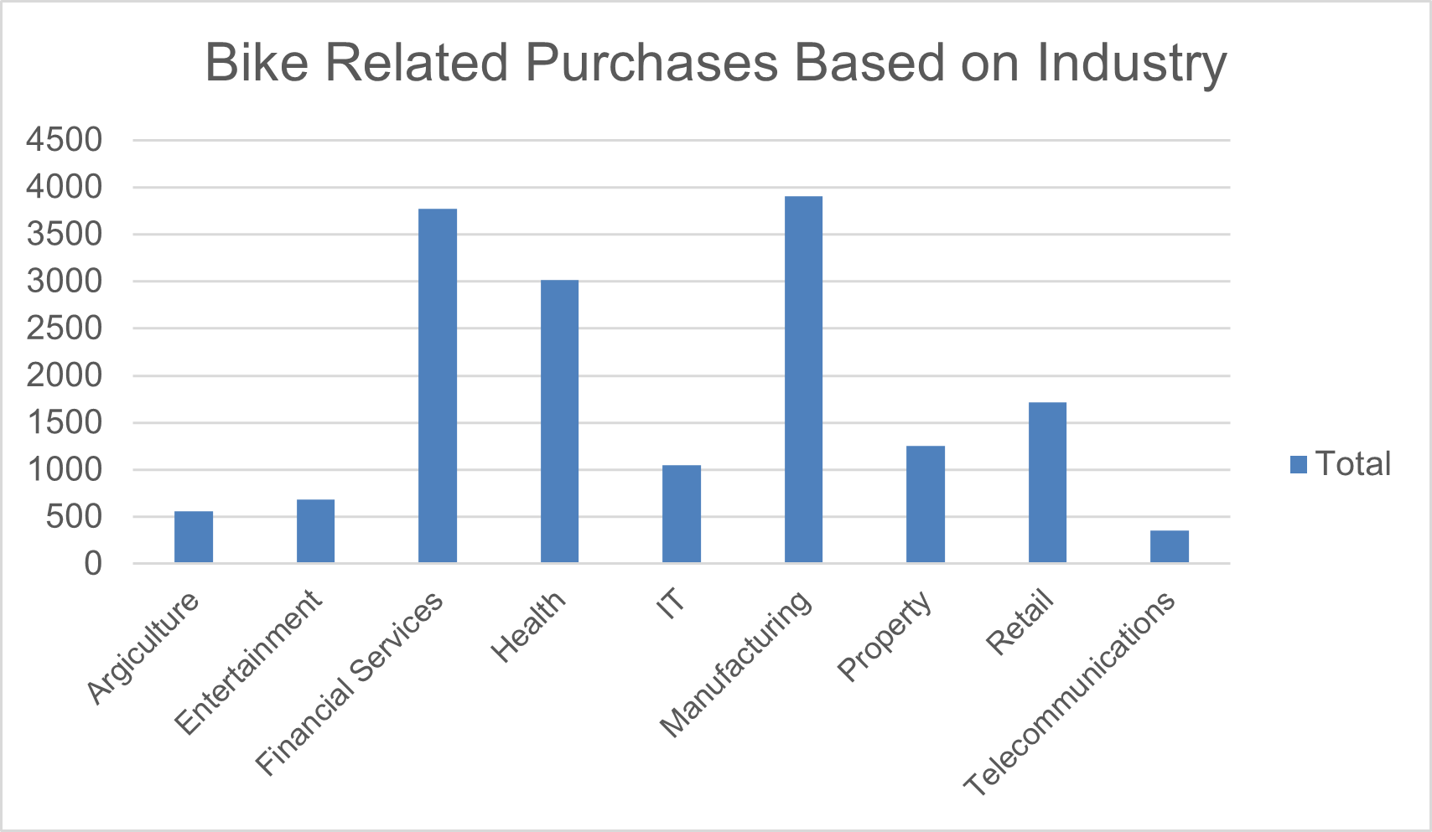
Data Exploration
Bike related purchases based on Industries
Customers in financial services, manufacturing and health are more likely to purchase bike than others

Slide 6
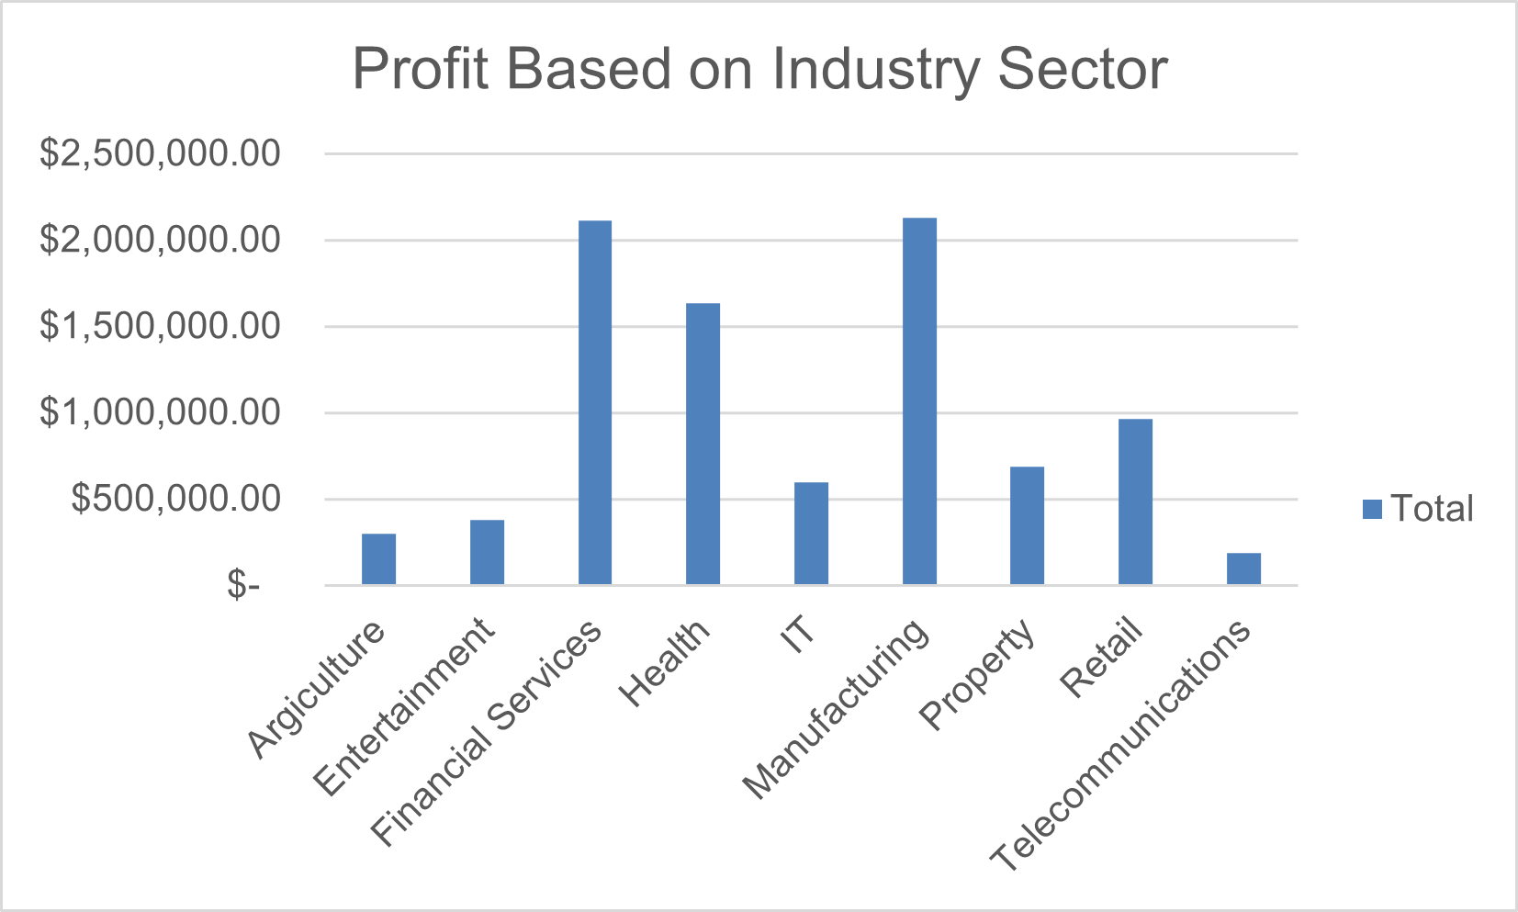
Data Exploration
Profit of different industry sectors
Top 3 highest profit industries: financial services, manufacturing and health
Data contribution is similar to bike purchases
Most industries have profit under 1 million dollars

Slide 7
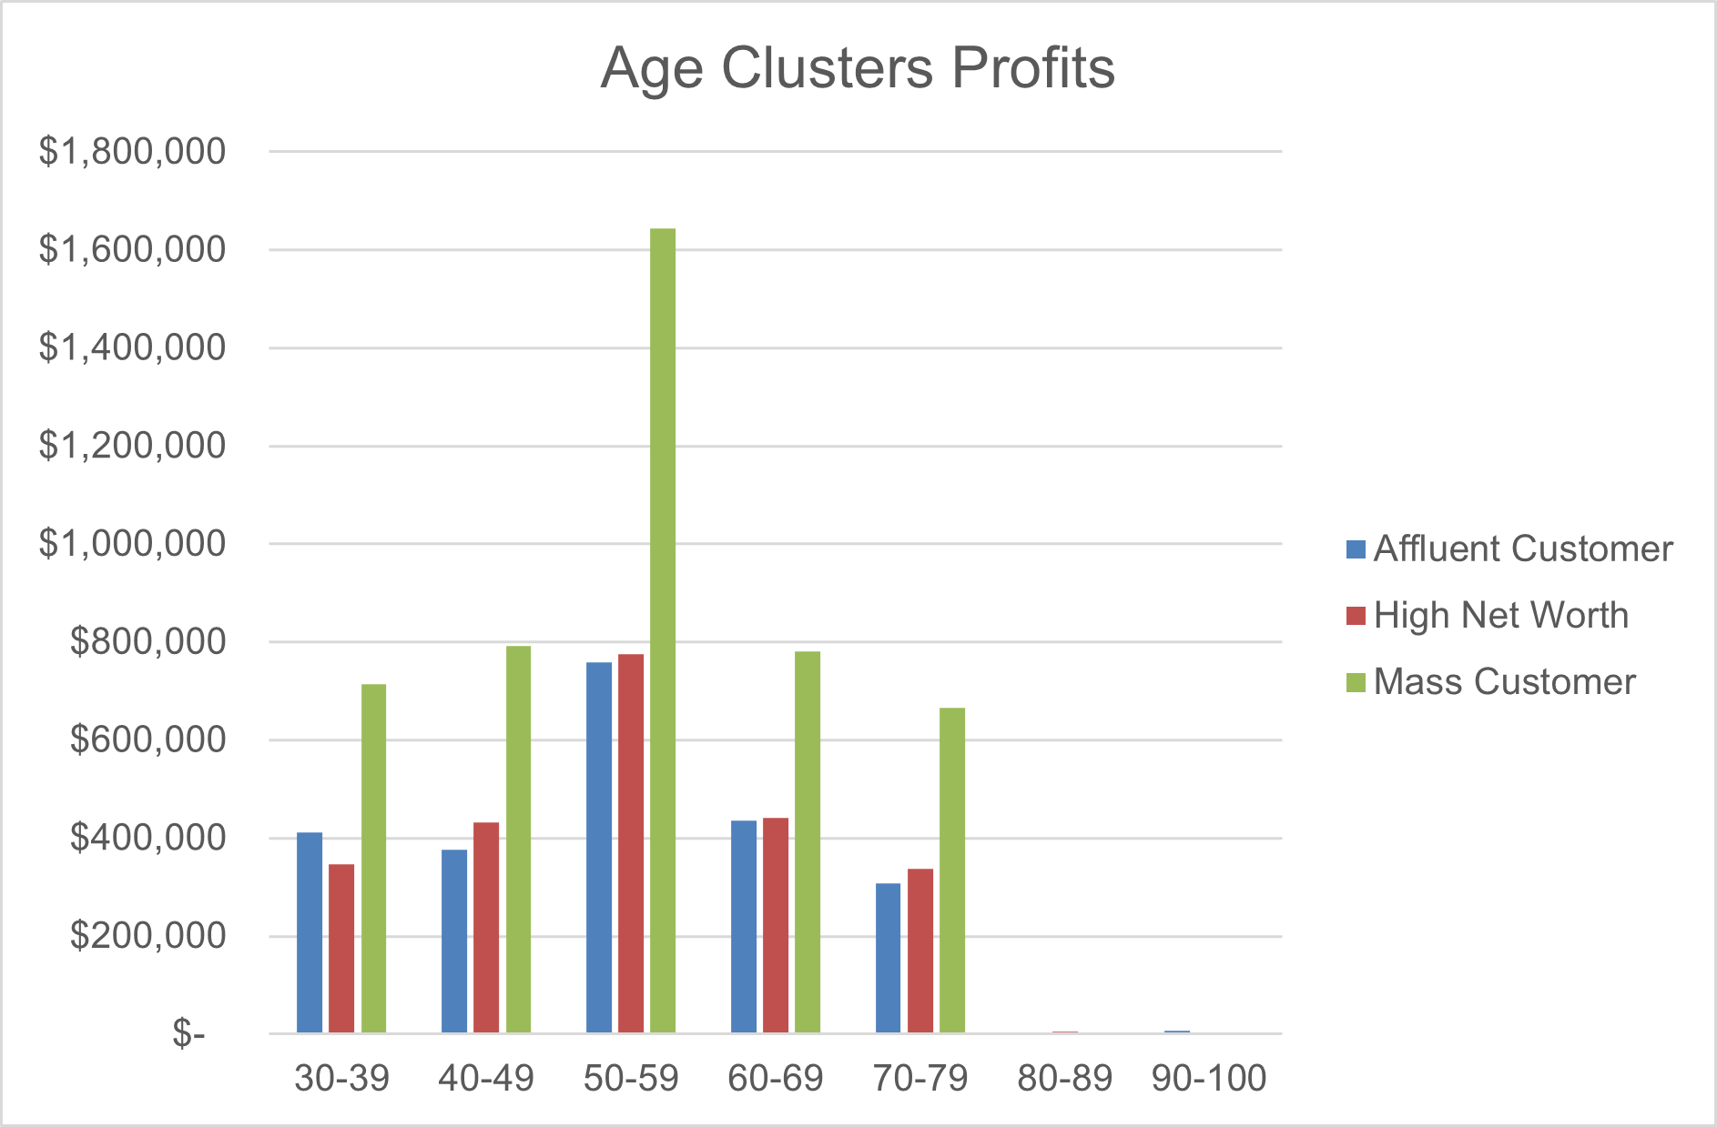
Data Exploration
Profit of wealth segment by ages
Mass customer makes the highest profit among all the age groups
Customer aged between 50-59 have more profit than others
The buying power increases to the peak with aged 50-59 and then shows a decline as people getting older

Slide 8
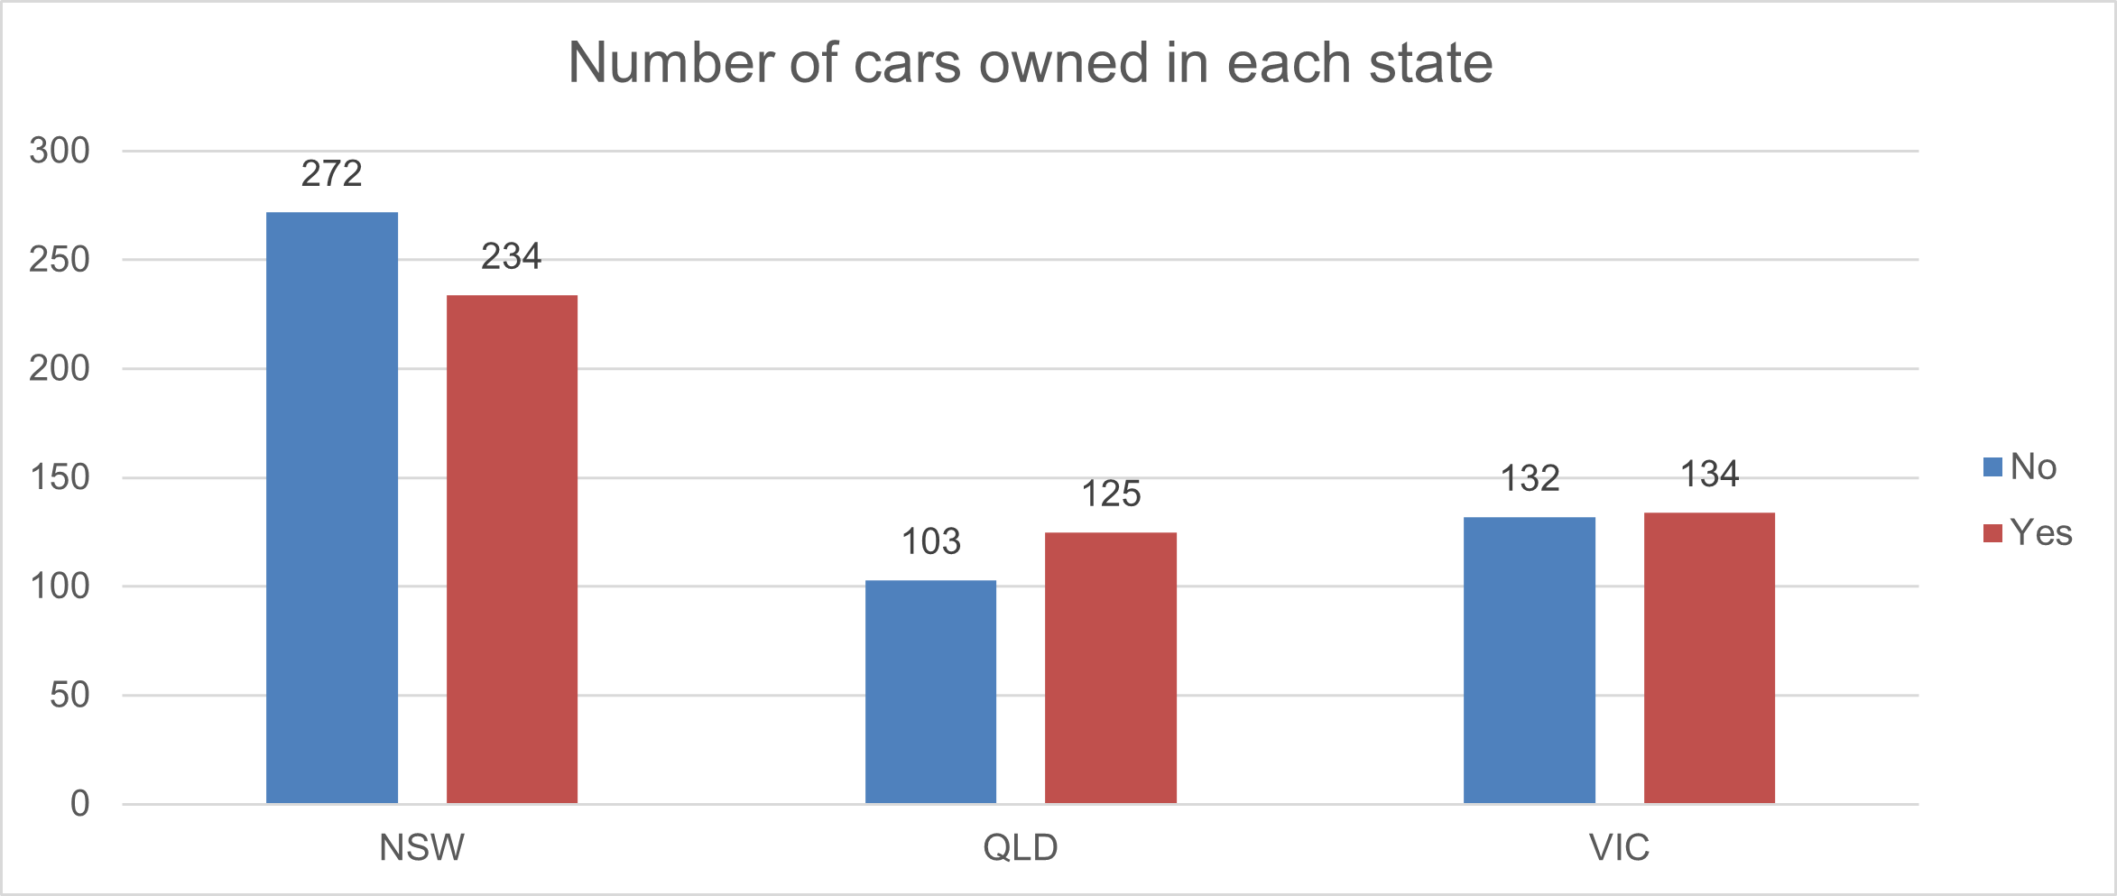
Data Exploration
Number of cars owned in each state
NSW, QLD and VIC could be potential market opportunities for the company
The highest potential can be found in NSW as the number of people who don’t have cars is greater than car owners

Slide 9
Model Development
Customer type classification
The high value customers can be targeted based on these categories:
Working in the Financial services, manufacturing and health industry sector
Aged between 50 and 59
Live in NSW state

Slide 10
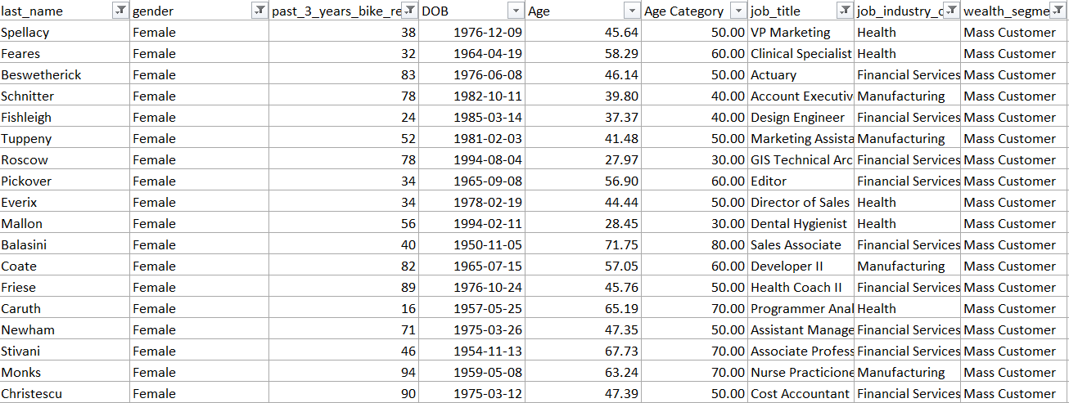
Interpretation
Summary Table for High Value Customers
List of few high value customers from datasets

Slide 11
Thank you

