Slide 1

Computational Physics (PHYS6350)
Lecture 13: Linear algebra and matrices
Linear systems of equations
Gaussian elimination
LU decomposition
Tridiagonal and banded systems
March 2, 2023
Instructor: Volodymyr Vovchenko (vvovchenko@uh.edu)
Course materials: https://github.com/vlvovch/PHYS6350-ComputationalPhysics

Slide 2
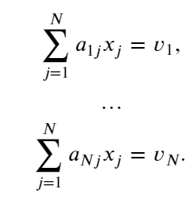

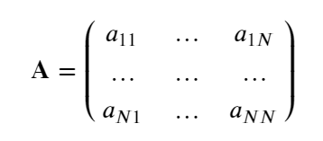
Linear system of equations
Generic problem: solve a system of linear equations
Matrix form:
A unique solution exists if all equations are linearly independent and consistent
Equivalent to condition $\det{A}≠0$
Notes:
The important thing here, however, is that this equation defines how the mean B1 depends on t.
We can thus use this straightforwardly to calculate the higher-order cumulants by taking the derivatives from this equation with respect to t.
And by repeatedly abusing the Faa di Bruno formula for high-order derivatives of composite functions we can calculate the net-baryon cumulants subject to global baryon conservation up to a desired order.
Here I am showing the results for three cumulants ratios, the so-called scaled variance, skewness, and kurtosis, our paper contains explicit results up to order 6.
We obtain the B1 cumulants in terms of the subvolume fraction \alpha and the grand-canonical susceptibilities \chi_B.
This is exactly what we want, as the grand-canonical susceptibilities are the intrinsic properties of the equation of state that we want to probe.
Unsurprisingly, in the limit \alpha goes to zero we obtain the grand-canonical susceptibility ratios.
Let me reiterate again that here I did not assume anything about the equation of state, this result is model-independent.

Slide 3

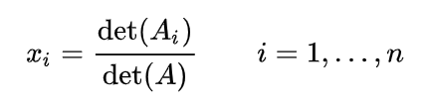
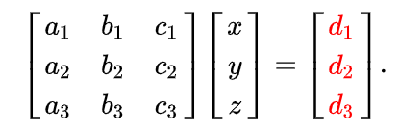
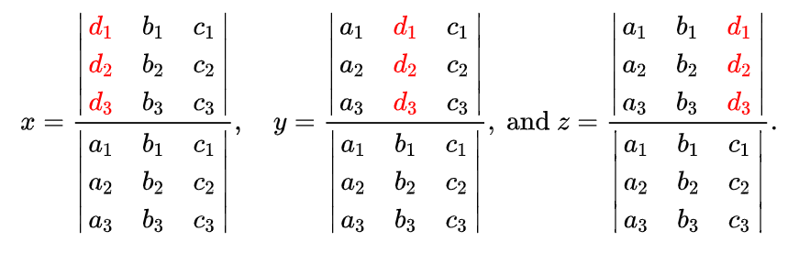
Cramer’s rule
Cramer’s rule:
Solution to reads
where A_{i} is the matrix formed by replacing the i-th column of A by the column vector b.
For example
solved as
Cramer’s rule has theoretical importance but little practical use
Notes:
The important thing here, however, is that this equation defines how the mean B1 depends on t.
We can thus use this straightforwardly to calculate the higher-order cumulants by taking the derivatives from this equation with respect to t.
And by repeatedly abusing the Faa di Bruno formula for high-order derivatives of composite functions we can calculate the net-baryon cumulants subject to global baryon conservation up to a desired order.
Here I am showing the results for three cumulants ratios, the so-called scaled variance, skewness, and kurtosis, our paper contains explicit results up to order 6.
We obtain the B1 cumulants in terms of the subvolume fraction \alpha and the grand-canonical susceptibilities \chi_B.
This is exactly what we want, as the grand-canonical susceptibilities are the intrinsic properties of the equation of state that we want to probe.
Unsurprisingly, in the limit \alpha goes to zero we obtain the grand-canonical susceptibility ratios.
Let me reiterate again that here I did not assume anything about the equation of state, this result is model-independent.

Slide 4
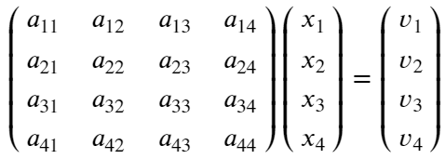
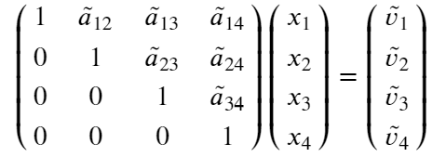
Gaussian elimination
Gaussian elimination is a base procedure for solving systems of linear equations
It is based on iterative transformation of the system of linear equations which preserve the solution (the solution stays equivalent)
The goal is to eliminate all entries in matrix A below the main diagonal
The following two operations preserve the solution:
One can multiply any row by a non-zero number
One can subtract from a given row any other row
Notes:
The important thing here, however, is that this equation defines how the mean B1 depends on t.
We can thus use this straightforwardly to calculate the higher-order cumulants by taking the derivatives from this equation with respect to t.
And by repeatedly abusing the Faa di Bruno formula for high-order derivatives of composite functions we can calculate the net-baryon cumulants subject to global baryon conservation up to a desired order.
Here I am showing the results for three cumulants ratios, the so-called scaled variance, skewness, and kurtosis, our paper contains explicit results up to order 6.
We obtain the B1 cumulants in terms of the subvolume fraction \alpha and the grand-canonical susceptibilities \chi_B.
This is exactly what we want, as the grand-canonical susceptibilities are the intrinsic properties of the equation of state that we want to probe.
Unsurprisingly, in the limit \alpha goes to zero we obtain the grand-canonical susceptibility ratios.
Let me reiterate again that here I did not assume anything about the equation of state, this result is model-independent.

Slide 5

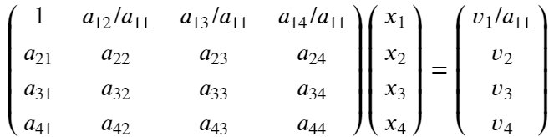
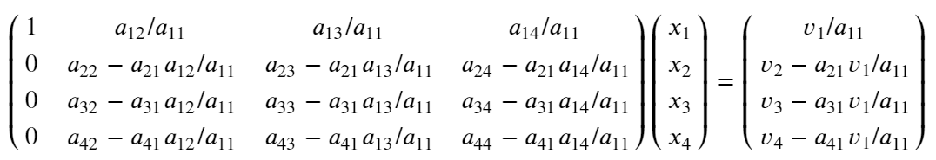
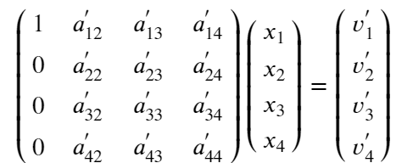
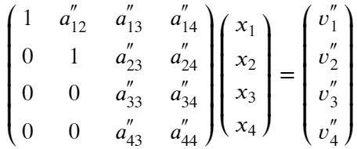
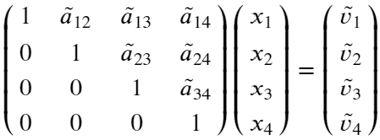
Gaussian elimination
Starting from the first row, divide the row by its diagonal element a₁₁
Make all entries in column 1 below the main diagonal equal to zero by subtracting the first equation from row j with a factor a_{j1}. We get
Repeat steps 1-2 for the 2nd row and column, and then for all others
or
Final result:
Notes:
The important thing here, however, is that this equation defines how the mean B1 depends on t.
We can thus use this straightforwardly to calculate the higher-order cumulants by taking the derivatives from this equation with respect to t.
And by repeatedly abusing the Faa di Bruno formula for high-order derivatives of composite functions we can calculate the net-baryon cumulants subject to global baryon conservation up to a desired order.
Here I am showing the results for three cumulants ratios, the so-called scaled variance, skewness, and kurtosis, our paper contains explicit results up to order 6.
We obtain the B1 cumulants in terms of the subvolume fraction \alpha and the grand-canonical susceptibilities \chi_B.
This is exactly what we want, as the grand-canonical susceptibilities are the intrinsic properties of the equation of state that we want to probe.
Unsurprisingly, in the limit \alpha goes to zero we obtain the grand-canonical susceptibility ratios.
Let me reiterate again that here I did not assume anything about the equation of state, this result is model-independent.

Slide 6
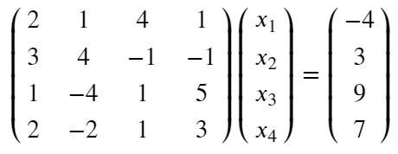
Gaussian elimination
Example: Work out Gaussian elimination for system of equations
Notes:
The important thing here, however, is that this equation defines how the mean B1 depends on t.
We can thus use this straightforwardly to calculate the higher-order cumulants by taking the derivatives from this equation with respect to t.
And by repeatedly abusing the Faa di Bruno formula for high-order derivatives of composite functions we can calculate the net-baryon cumulants subject to global baryon conservation up to a desired order.
Here I am showing the results for three cumulants ratios, the so-called scaled variance, skewness, and kurtosis, our paper contains explicit results up to order 6.
We obtain the B1 cumulants in terms of the subvolume fraction \alpha and the grand-canonical susceptibilities \chi_B.
This is exactly what we want, as the grand-canonical susceptibilities are the intrinsic properties of the equation of state that we want to probe.
Unsurprisingly, in the limit \alpha goes to zero we obtain the grand-canonical susceptibility ratios.
Let me reiterate again that here I did not assume anything about the equation of state, this result is model-independent.

Slide 7
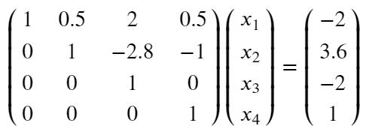
Gaussian elimination
Example: Work out Gaussian elimination for system of equations
The result should be
Notes:
The important thing here, however, is that this equation defines how the mean B1 depends on t.
We can thus use this straightforwardly to calculate the higher-order cumulants by taking the derivatives from this equation with respect to t.
And by repeatedly abusing the Faa di Bruno formula for high-order derivatives of composite functions we can calculate the net-baryon cumulants subject to global baryon conservation up to a desired order.
Here I am showing the results for three cumulants ratios, the so-called scaled variance, skewness, and kurtosis, our paper contains explicit results up to order 6.
We obtain the B1 cumulants in terms of the subvolume fraction \alpha and the grand-canonical susceptibilities \chi_B.
This is exactly what we want, as the grand-canonical susceptibilities are the intrinsic properties of the equation of state that we want to probe.
Unsurprisingly, in the limit \alpha goes to zero we obtain the grand-canonical susceptibility ratios.
Let me reiterate again that here I did not assume anything about the equation of state, this result is model-independent.

Slide 8
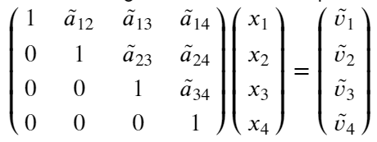
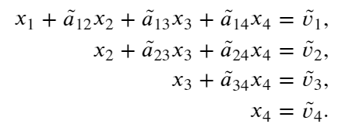
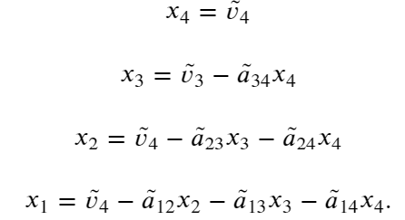
Backsubstitution
After the Gaussian elimination we have the following system of equations
or
The solution now proceeds through backsubstitution, i.e. we go from x₄ to x₁
Notes:
The important thing here, however, is that this equation defines how the mean B1 depends on t.
We can thus use this straightforwardly to calculate the higher-order cumulants by taking the derivatives from this equation with respect to t.
And by repeatedly abusing the Faa di Bruno formula for high-order derivatives of composite functions we can calculate the net-baryon cumulants subject to global baryon conservation up to a desired order.
Here I am showing the results for three cumulants ratios, the so-called scaled variance, skewness, and kurtosis, our paper contains explicit results up to order 6.
We obtain the B1 cumulants in terms of the subvolume fraction \alpha and the grand-canonical susceptibilities \chi_B.
This is exactly what we want, as the grand-canonical susceptibilities are the intrinsic properties of the equation of state that we want to probe.
Unsurprisingly, in the limit \alpha goes to zero we obtain the grand-canonical susceptibility ratios.
Let me reiterate again that here I did not assume anything about the equation of state, this result is model-independent.

Slide 9
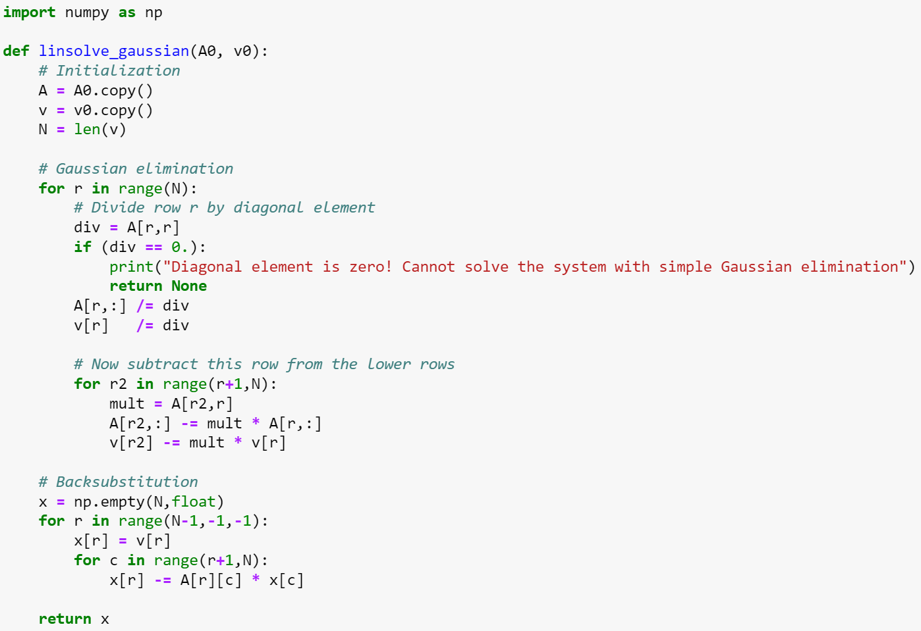
Gaussian elimination: Implementation
Notes:
The important thing here, however, is that this equation defines how the mean B1 depends on t.
We can thus use this straightforwardly to calculate the higher-order cumulants by taking the derivatives from this equation with respect to t.
And by repeatedly abusing the Faa di Bruno formula for high-order derivatives of composite functions we can calculate the net-baryon cumulants subject to global baryon conservation up to a desired order.
Here I am showing the results for three cumulants ratios, the so-called scaled variance, skewness, and kurtosis, our paper contains explicit results up to order 6.
We obtain the B1 cumulants in terms of the subvolume fraction \alpha and the grand-canonical susceptibilities \chi_B.
This is exactly what we want, as the grand-canonical susceptibilities are the intrinsic properties of the equation of state that we want to probe.
Unsurprisingly, in the limit \alpha goes to zero we obtain the grand-canonical susceptibility ratios.
Let me reiterate again that here I did not assume anything about the equation of state, this result is model-independent.

Slide 10
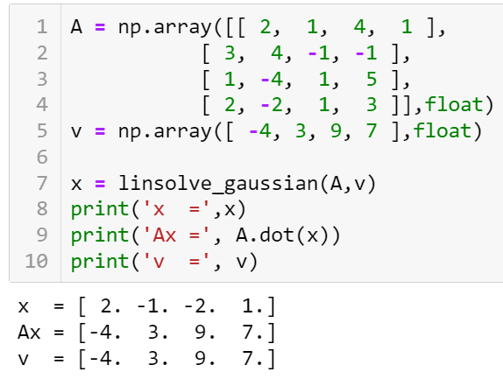
Gaussian elimination: Implementation
Notes:
The important thing here, however, is that this equation defines how the mean B1 depends on t.
We can thus use this straightforwardly to calculate the higher-order cumulants by taking the derivatives from this equation with respect to t.
And by repeatedly abusing the Faa di Bruno formula for high-order derivatives of composite functions we can calculate the net-baryon cumulants subject to global baryon conservation up to a desired order.
Here I am showing the results for three cumulants ratios, the so-called scaled variance, skewness, and kurtosis, our paper contains explicit results up to order 6.
We obtain the B1 cumulants in terms of the subvolume fraction \alpha and the grand-canonical susceptibilities \chi_B.
This is exactly what we want, as the grand-canonical susceptibilities are the intrinsic properties of the equation of state that we want to probe.
Unsurprisingly, in the limit \alpha goes to zero we obtain the grand-canonical susceptibility ratios.
Let me reiterate again that here I did not assume anything about the equation of state, this result is model-independent.

Slide 11
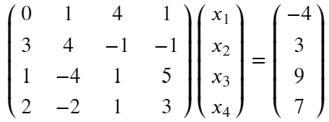
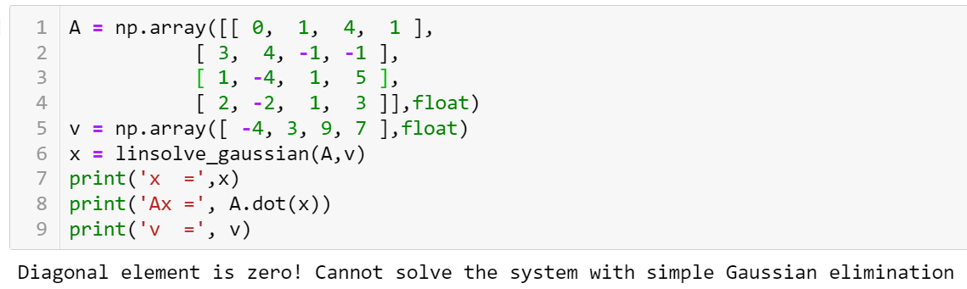
Gaussian elimination: Zero diagonal elements
The trivial implementation of Gaussian elimination will fail if any of the diagonal elements becomes equal to zero in the process of solving
For example:
Notes:
The important thing here, however, is that this equation defines how the mean B1 depends on t.
We can thus use this straightforwardly to calculate the higher-order cumulants by taking the derivatives from this equation with respect to t.
And by repeatedly abusing the Faa di Bruno formula for high-order derivatives of composite functions we can calculate the net-baryon cumulants subject to global baryon conservation up to a desired order.
Here I am showing the results for three cumulants ratios, the so-called scaled variance, skewness, and kurtosis, our paper contains explicit results up to order 6.
We obtain the B1 cumulants in terms of the subvolume fraction \alpha and the grand-canonical susceptibilities \chi_B.
This is exactly what we want, as the grand-canonical susceptibilities are the intrinsic properties of the equation of state that we want to probe.
Unsurprisingly, in the limit \alpha goes to zero we obtain the grand-canonical susceptibility ratios.
Let me reiterate again that here I did not assume anything about the equation of state, this result is model-independent.

Slide 12
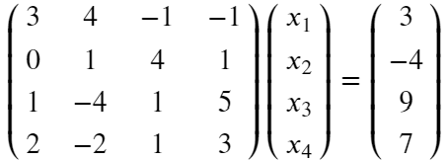
Gaussian elimination: Pivoting
We can simply exchange rows 1 & 2 and avoid the vanishing diagonal element
This is called pivoting, which does not change the solution
The optimal choice of a pivot is the largest element in magnitude (minimizes the round-off error). For numerical stability, pivoting should be performed even when there are no vanishing diagonal elements
Partial pivoting: Exchange rows only
Full pivoting: Exchange both rows and columns (the order of elements in x changes)
Notes:
The important thing here, however, is that this equation defines how the mean B1 depends on t.
We can thus use this straightforwardly to calculate the higher-order cumulants by taking the derivatives from this equation with respect to t.
And by repeatedly abusing the Faa di Bruno formula for high-order derivatives of composite functions we can calculate the net-baryon cumulants subject to global baryon conservation up to a desired order.
Here I am showing the results for three cumulants ratios, the so-called scaled variance, skewness, and kurtosis, our paper contains explicit results up to order 6.
We obtain the B1 cumulants in terms of the subvolume fraction \alpha and the grand-canonical susceptibilities \chi_B.
This is exactly what we want, as the grand-canonical susceptibilities are the intrinsic properties of the equation of state that we want to probe.
Unsurprisingly, in the limit \alpha goes to zero we obtain the grand-canonical susceptibility ratios.
Let me reiterate again that here I did not assume anything about the equation of state, this result is model-independent.

Slide 13
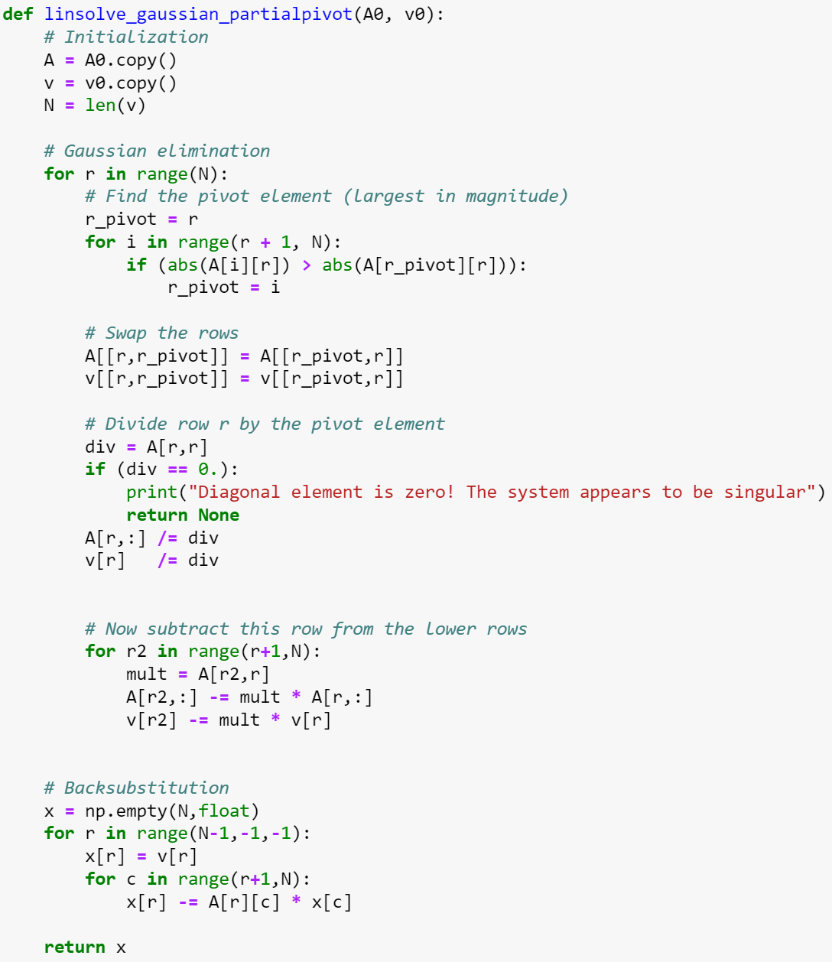
Partial pivoting implementation
Notes:
The important thing here, however, is that this equation defines how the mean B1 depends on t.
We can thus use this straightforwardly to calculate the higher-order cumulants by taking the derivatives from this equation with respect to t.
And by repeatedly abusing the Faa di Bruno formula for high-order derivatives of composite functions we can calculate the net-baryon cumulants subject to global baryon conservation up to a desired order.
Here I am showing the results for three cumulants ratios, the so-called scaled variance, skewness, and kurtosis, our paper contains explicit results up to order 6.
We obtain the B1 cumulants in terms of the subvolume fraction \alpha and the grand-canonical susceptibilities \chi_B.
This is exactly what we want, as the grand-canonical susceptibilities are the intrinsic properties of the equation of state that we want to probe.
Unsurprisingly, in the limit \alpha goes to zero we obtain the grand-canonical susceptibility ratios.
Let me reiterate again that here I did not assume anything about the equation of state, this result is model-independent.

Slide 14
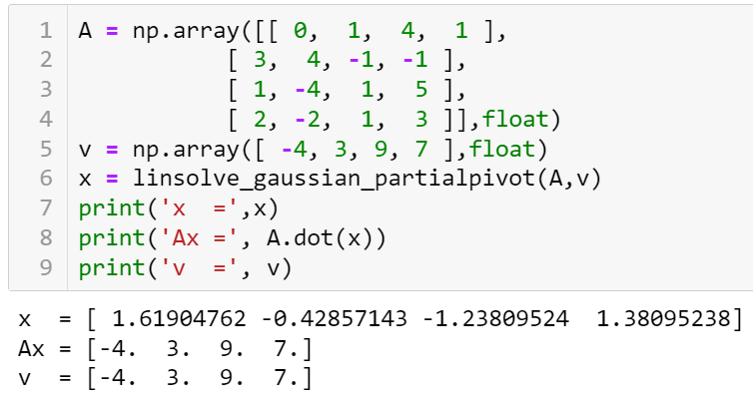
Partial pivoting implementation
Notes:
The important thing here, however, is that this equation defines how the mean B1 depends on t.
We can thus use this straightforwardly to calculate the higher-order cumulants by taking the derivatives from this equation with respect to t.
And by repeatedly abusing the Faa di Bruno formula for high-order derivatives of composite functions we can calculate the net-baryon cumulants subject to global baryon conservation up to a desired order.
Here I am showing the results for three cumulants ratios, the so-called scaled variance, skewness, and kurtosis, our paper contains explicit results up to order 6.
We obtain the B1 cumulants in terms of the subvolume fraction \alpha and the grand-canonical susceptibilities \chi_B.
This is exactly what we want, as the grand-canonical susceptibilities are the intrinsic properties of the equation of state that we want to probe.
Unsurprisingly, in the limit \alpha goes to zero we obtain the grand-canonical susceptibility ratios.
Let me reiterate again that here I did not assume anything about the equation of state, this result is model-independent.

Slide 15
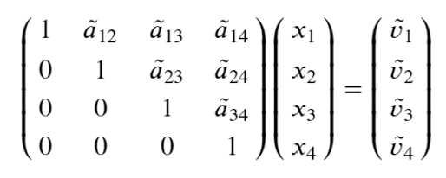


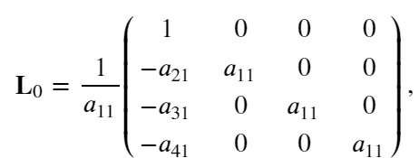
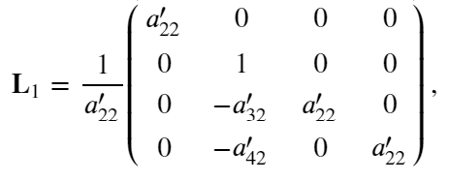
LU decomposition
At the end of Gaussian elimination we have
i.e. our matrix became upper triangular
Discarding pivoting for a moment, all steps of the Gaussian elimination can be represented by matrix multiplication, i.e.
where e.g.
Notes:
The important thing here, however, is that this equation defines how the mean B1 depends on t.
We can thus use this straightforwardly to calculate the higher-order cumulants by taking the derivatives from this equation with respect to t.
And by repeatedly abusing the Faa di Bruno formula for high-order derivatives of composite functions we can calculate the net-baryon cumulants subject to global baryon conservation up to a desired order.
Here I am showing the results for three cumulants ratios, the so-called scaled variance, skewness, and kurtosis, our paper contains explicit results up to order 6.
We obtain the B1 cumulants in terms of the subvolume fraction \alpha and the grand-canonical susceptibilities \chi_B.
This is exactly what we want, as the grand-canonical susceptibilities are the intrinsic properties of the equation of state that we want to probe.
Unsurprisingly, in the limit \alpha goes to zero we obtain the grand-canonical susceptibility ratios.
Let me reiterate again that here I did not assume anything about the equation of state, this result is model-independent.

Slide 16
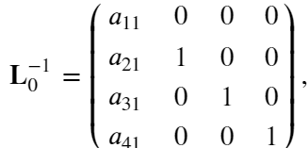
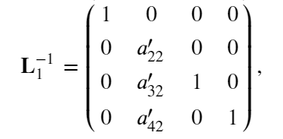
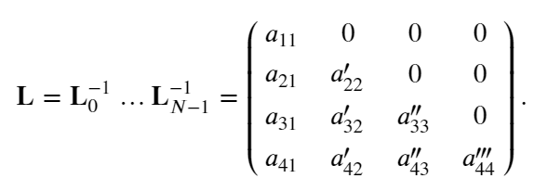

LU decomposition
The matrices L_{i} are lower triangular
Inverses are also lower triangular
Therefore,
where
Notes:
The important thing here, however, is that this equation defines how the mean B1 depends on t.
We can thus use this straightforwardly to calculate the higher-order cumulants by taking the derivatives from this equation with respect to t.
And by repeatedly abusing the Faa di Bruno formula for high-order derivatives of composite functions we can calculate the net-baryon cumulants subject to global baryon conservation up to a desired order.
Here I am showing the results for three cumulants ratios, the so-called scaled variance, skewness, and kurtosis, our paper contains explicit results up to order 6.
We obtain the B1 cumulants in terms of the subvolume fraction \alpha and the grand-canonical susceptibilities \chi_B.
This is exactly what we want, as the grand-canonical susceptibilities are the intrinsic properties of the equation of state that we want to probe.
Unsurprisingly, in the limit \alpha goes to zero we obtain the grand-canonical susceptibility ratios.
Let me reiterate again that here I did not assume anything about the equation of state, this result is model-independent.

Slide 17

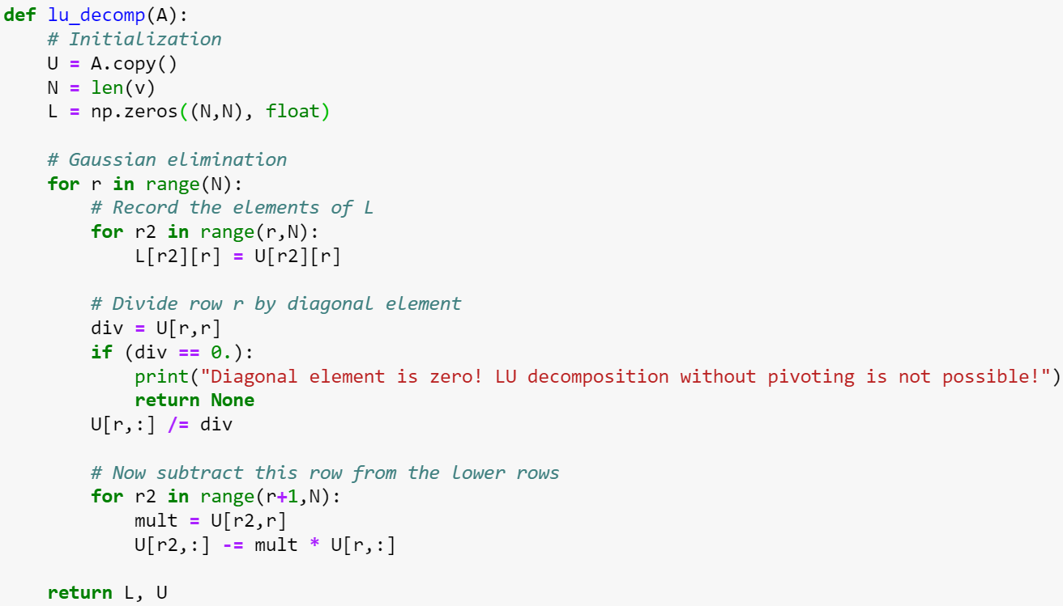
LU decomposition
Notes:
The important thing here, however, is that this equation defines how the mean B1 depends on t.
We can thus use this straightforwardly to calculate the higher-order cumulants by taking the derivatives from this equation with respect to t.
And by repeatedly abusing the Faa di Bruno formula for high-order derivatives of composite functions we can calculate the net-baryon cumulants subject to global baryon conservation up to a desired order.
Here I am showing the results for three cumulants ratios, the so-called scaled variance, skewness, and kurtosis, our paper contains explicit results up to order 6.
We obtain the B1 cumulants in terms of the subvolume fraction \alpha and the grand-canonical susceptibilities \chi_B.
This is exactly what we want, as the grand-canonical susceptibilities are the intrinsic properties of the equation of state that we want to probe.
Unsurprisingly, in the limit \alpha goes to zero we obtain the grand-canonical susceptibility ratios.
Let me reiterate again that here I did not assume anything about the equation of state, this result is model-independent.

Slide 18
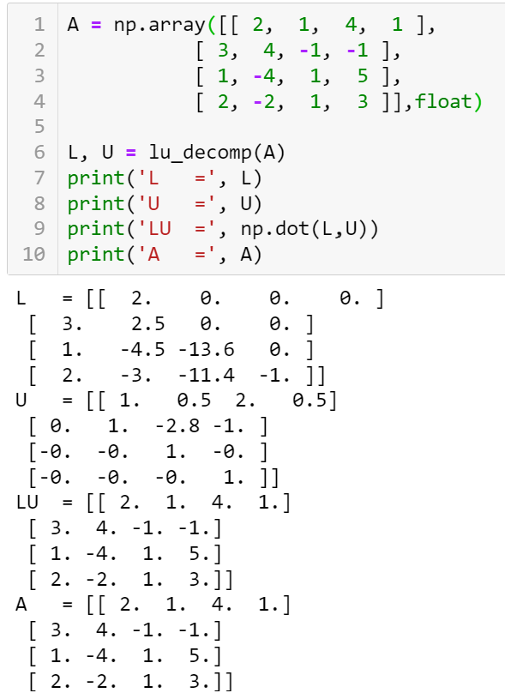
LU decomposition
Notes:
The important thing here, however, is that this equation defines how the mean B1 depends on t.
We can thus use this straightforwardly to calculate the higher-order cumulants by taking the derivatives from this equation with respect to t.
And by repeatedly abusing the Faa di Bruno formula for high-order derivatives of composite functions we can calculate the net-baryon cumulants subject to global baryon conservation up to a desired order.
Here I am showing the results for three cumulants ratios, the so-called scaled variance, skewness, and kurtosis, our paper contains explicit results up to order 6.
We obtain the B1 cumulants in terms of the subvolume fraction \alpha and the grand-canonical susceptibilities \chi_B.
This is exactly what we want, as the grand-canonical susceptibilities are the intrinsic properties of the equation of state that we want to probe.
Unsurprisingly, in the limit \alpha goes to zero we obtain the grand-canonical susceptibility ratios.
Let me reiterate again that here I did not assume anything about the equation of state, this result is model-independent.

Slide 19



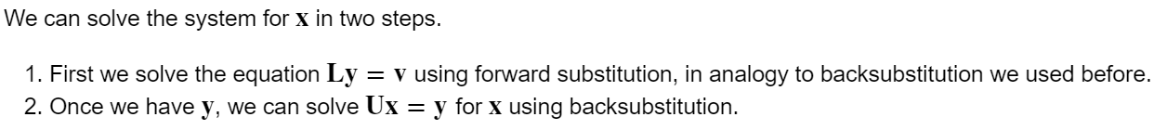
LU decomposition and systems of linear equations
LU decomposition is particularly useful for repeated solution of systems of linear equations
the matrix A stays the same but where the vector v can change.
Indeed the system of equations becomes
Let us define
then
Notes:
The important thing here, however, is that this equation defines how the mean B1 depends on t.
We can thus use this straightforwardly to calculate the higher-order cumulants by taking the derivatives from this equation with respect to t.
And by repeatedly abusing the Faa di Bruno formula for high-order derivatives of composite functions we can calculate the net-baryon cumulants subject to global baryon conservation up to a desired order.
Here I am showing the results for three cumulants ratios, the so-called scaled variance, skewness, and kurtosis, our paper contains explicit results up to order 6.
We obtain the B1 cumulants in terms of the subvolume fraction \alpha and the grand-canonical susceptibilities \chi_B.
This is exactly what we want, as the grand-canonical susceptibilities are the intrinsic properties of the equation of state that we want to probe.
Unsurprisingly, in the limit \alpha goes to zero we obtain the grand-canonical susceptibility ratios.
Let me reiterate again that here I did not assume anything about the equation of state, this result is model-independent.

Slide 20
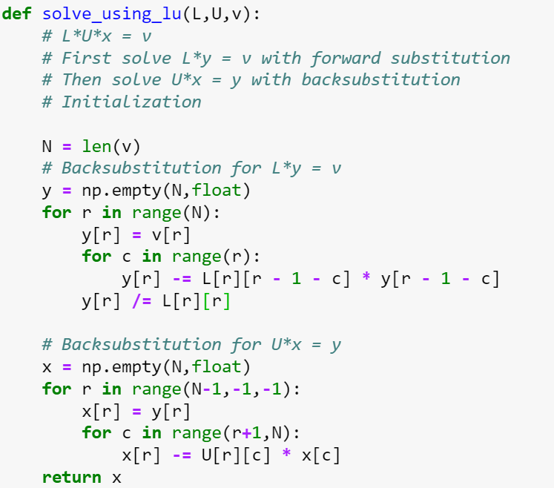
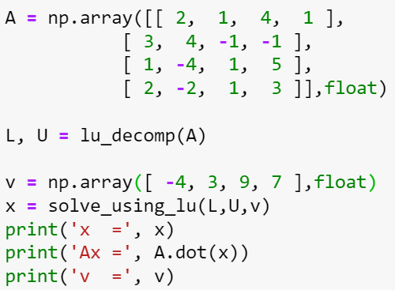
LU decomposition and systems of linear equations
Notes:
The important thing here, however, is that this equation defines how the mean B1 depends on t.
We can thus use this straightforwardly to calculate the higher-order cumulants by taking the derivatives from this equation with respect to t.
And by repeatedly abusing the Faa di Bruno formula for high-order derivatives of composite functions we can calculate the net-baryon cumulants subject to global baryon conservation up to a desired order.
Here I am showing the results for three cumulants ratios, the so-called scaled variance, skewness, and kurtosis, our paper contains explicit results up to order 6.
We obtain the B1 cumulants in terms of the subvolume fraction \alpha and the grand-canonical susceptibilities \chi_B.
This is exactly what we want, as the grand-canonical susceptibilities are the intrinsic properties of the equation of state that we want to probe.
Unsurprisingly, in the limit \alpha goes to zero we obtain the grand-canonical susceptibility ratios.
Let me reiterate again that here I did not assume anything about the equation of state, this result is model-independent.

Slide 21


LU decomposition with pivoting
Not every non-singular matrix allows for LU decomposition because diagonal elements can be zero.
In general case we need to allow the possibility to perform partial pivoting by exchanging the rows of our matrix.
If we do that, what we get the LU-decomposition with pivoting which can be written as
Here P is a row permutation operator.
Solving the system of equations
is also straightforward using forward and backsubstitution passes, except that we have to exchange the rows in the vector v to account for the row swaps that we did.
Notes:
The important thing here, however, is that this equation defines how the mean B1 depends on t.
We can thus use this straightforwardly to calculate the higher-order cumulants by taking the derivatives from this equation with respect to t.
And by repeatedly abusing the Faa di Bruno formula for high-order derivatives of composite functions we can calculate the net-baryon cumulants subject to global baryon conservation up to a desired order.
Here I am showing the results for three cumulants ratios, the so-called scaled variance, skewness, and kurtosis, our paper contains explicit results up to order 6.
We obtain the B1 cumulants in terms of the subvolume fraction \alpha and the grand-canonical susceptibilities \chi_B.
This is exactly what we want, as the grand-canonical susceptibilities are the intrinsic properties of the equation of state that we want to probe.
Unsurprisingly, in the limit \alpha goes to zero we obtain the grand-canonical susceptibility ratios.
Let me reiterate again that here I did not assume anything about the equation of state, this result is model-independent.

Slide 22
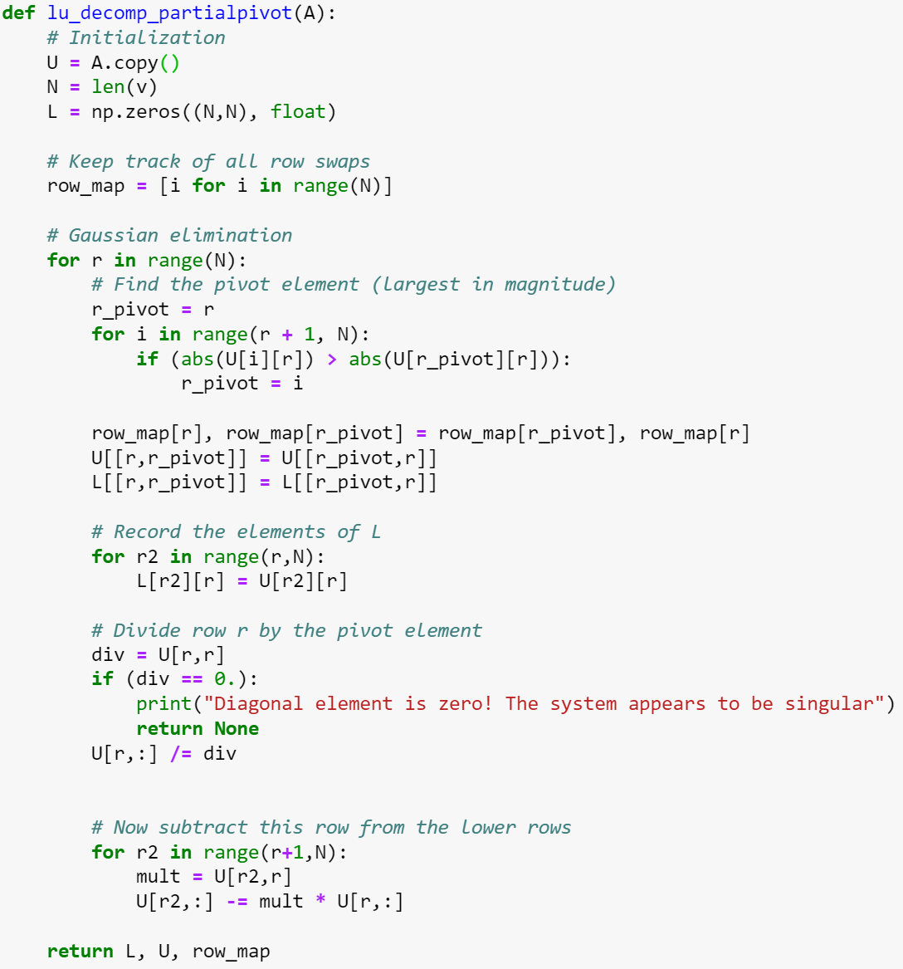
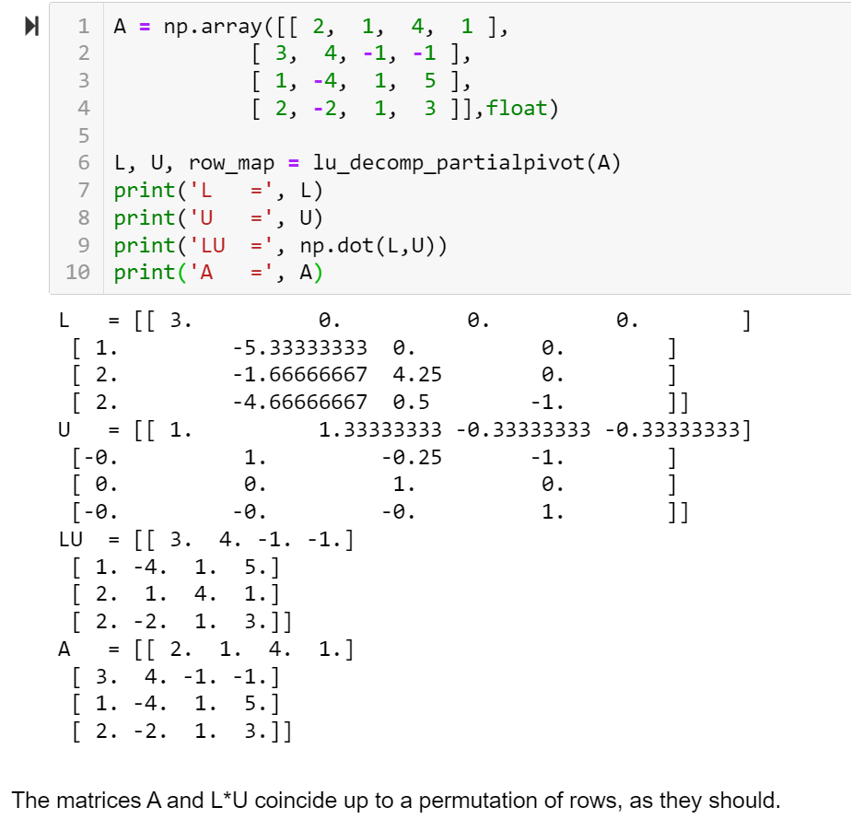
LU decomposition with pivoting
Notes:
The important thing here, however, is that this equation defines how the mean B1 depends on t.
We can thus use this straightforwardly to calculate the higher-order cumulants by taking the derivatives from this equation with respect to t.
And by repeatedly abusing the Faa di Bruno formula for high-order derivatives of composite functions we can calculate the net-baryon cumulants subject to global baryon conservation up to a desired order.
Here I am showing the results for three cumulants ratios, the so-called scaled variance, skewness, and kurtosis, our paper contains explicit results up to order 6.
We obtain the B1 cumulants in terms of the subvolume fraction \alpha and the grand-canonical susceptibilities \chi_B.
This is exactly what we want, as the grand-canonical susceptibilities are the intrinsic properties of the equation of state that we want to probe.
Unsurprisingly, in the limit \alpha goes to zero we obtain the grand-canonical susceptibility ratios.
Let me reiterate again that here I did not assume anything about the equation of state, this result is model-independent.

Slide 23
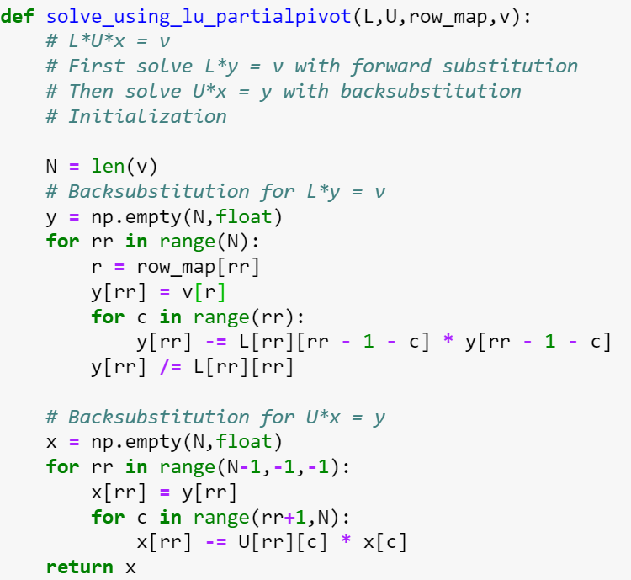
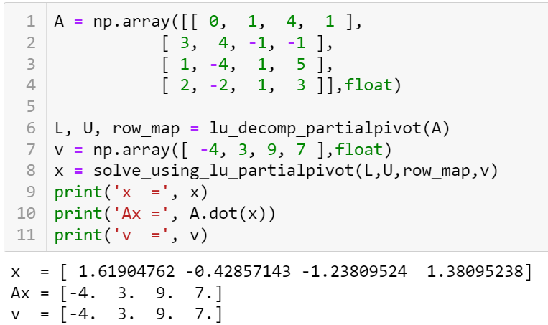
LU decomposition with pivoting
Notes:
The important thing here, however, is that this equation defines how the mean B1 depends on t.
We can thus use this straightforwardly to calculate the higher-order cumulants by taking the derivatives from this equation with respect to t.
And by repeatedly abusing the Faa di Bruno formula for high-order derivatives of composite functions we can calculate the net-baryon cumulants subject to global baryon conservation up to a desired order.
Here I am showing the results for three cumulants ratios, the so-called scaled variance, skewness, and kurtosis, our paper contains explicit results up to order 6.
We obtain the B1 cumulants in terms of the subvolume fraction \alpha and the grand-canonical susceptibilities \chi_B.
This is exactly what we want, as the grand-canonical susceptibilities are the intrinsic properties of the equation of state that we want to probe.
Unsurprisingly, in the limit \alpha goes to zero we obtain the grand-canonical susceptibility ratios.
Let me reiterate again that here I did not assume anything about the equation of state, this result is model-independent.

