Slide 1

Computational Physics (PHYS6350)
Lecture 1: Introduction, Syllabus, Technical Details
January 17, 2023
Instructor: Volodymyr Vovchenko (vvovchenko@uh.edu)

Slide 2
Course description
Description: Simulation of classical and quantum mechanical problems on digital computers using numerical and modern programming techniques.
Topics:
General introduction to scientific programming and visualization.
Numerical solutions to (systems of) non-linear equations.
Numerical integration and differentiation.
Numerical solutions to ordinary and partial differential equations.
Linear algebra and matrices.
Molecular dynamics and Monte Carlo simulations.
Problems from classical, statistical, and quantum mechanics.
Data analysis, processing, and curve fittings.
Introduction to parallel computing. (tentative)
Textbook: No mandatory textbook but recommend Computational Physics by Mark Newman (Some parts of this text are available on the author’s website: http://www-personal.umich.edu/~mejn/cp/index.html)
2

Slide 3
Requirements
A laptop to run where you can write, compile, and run code.
Plotting of the obtained results.
Preferred languages:
Python within Jupyter Notebook (most of the examples will be given in this one)
Pure Python (.py code)
C/C++
Other languages possible with prior approval (e.g. for assignments)
The operating system is up to you, I will use Ubuntu.
Useful links:
Python/Jupyter Notebook: one may use Anaconda distribution https://www.anaconda.com/
C/C++/Python: Visual Studio Code https://code.visualstudio.com/
Plotting: matplotlib (part of Python), gnuplot (http://www.gnuplot.info/)
3

Slide 4
Class schedule
Lecture: TuTh 4 PM – 5:30 PM
+
Lab: Tu 5:30 PM – 7 PM
Instructor: Volodymyr Vovchenko (vvovchenko@uh.edu)
Office Hours: Tuesday 12-1 PM or by appointment (office SR1 629C)
Lecture notes and the solution to sample problems will be posted after each lecture
4

Slide 5
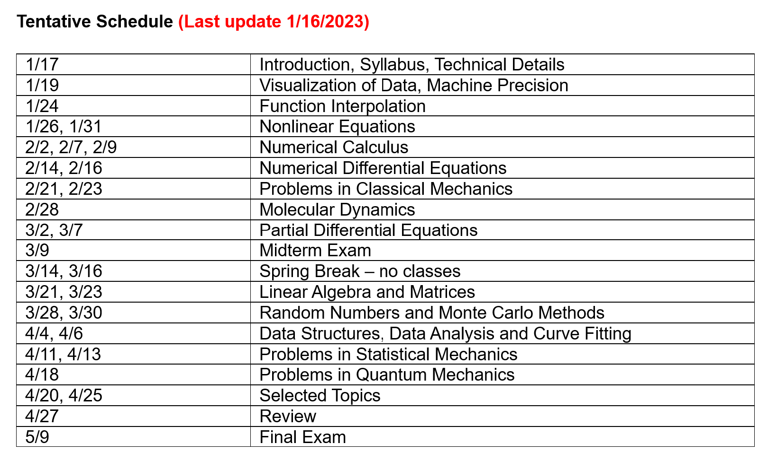
Class schedule II
2/7 and 2/9 virtual (pre-recorded lecture)
5

Slide 6
Grading
Homework (40%)
Every 1-2 weeks, due on Friday of the following week
Should include code and where applicable plot/tabulated output
The instructor may ask to explain how the submitted code works
Final project (20%)
A numerical solution to a problem on a pre-approved topic
Should include both the code and a report
Due on last day of class
Mid-term (15%) and Final (25%)
Multiple choice, short and long answer questions
May include a quick programming exercise
6

