Slide 1

Computational Physics (PHYS6350)
Lecture 2: Data Visualization, Machine Precision
January 19, 2023
Data visualization (plotting with matplotlib as an example)
Accuracy of integer and floating-point number representation
Instructor: Volodymyr Vovchenko (vvovchenko@uh.edu)

Slide 2
Course materials
Apart from Teams, course materials will be maintained and updated on GitHub
https://github.com/vlvovch/PHYS6350-ComputationalPhysics

Slide 3
Data visualization
Line plots
Scatter plots
Contour/density plots (2D data)
References:
Chapter 3 of Computational Physics by Mark Newman
Matplotlib documentation

Slide 4
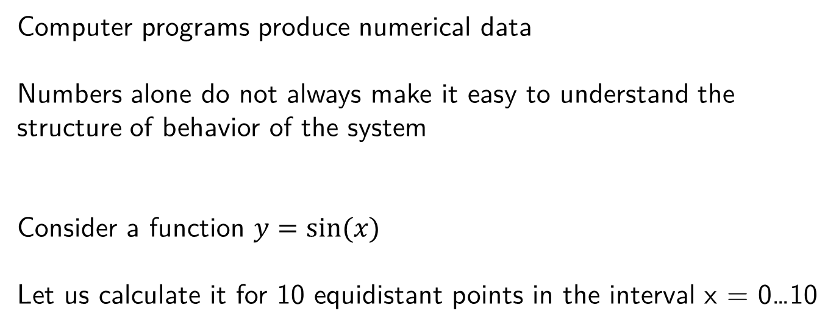
Plotting the data
Computer programs produce numerical data
Numbers alone do not always make it easy to understand the structure of behavior of the system
Consider a function $y=sin⁡(x)$
Let us calculate it for 10 equidistant points in the interval x = 0…10

Slide 5
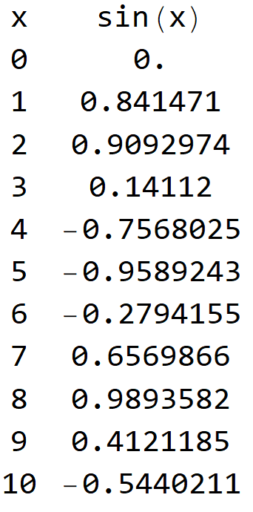
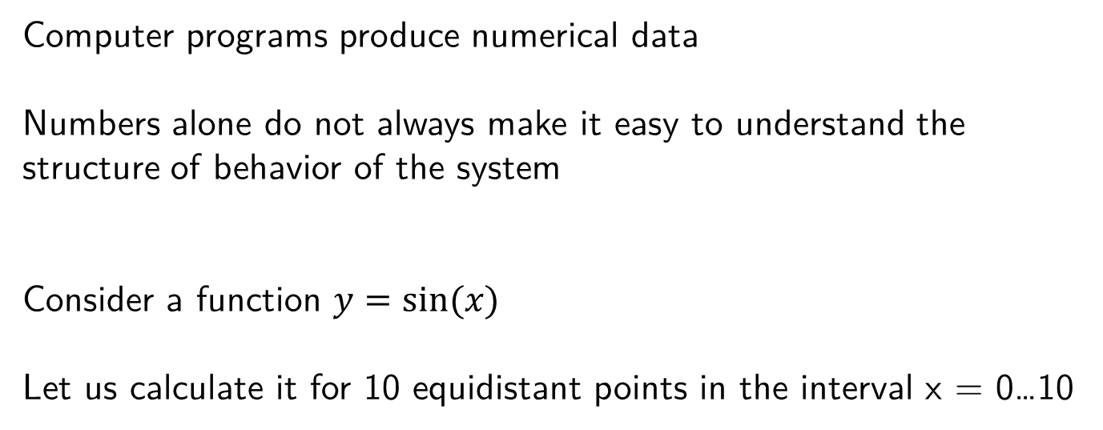
Plotting the data
Computer programs produce numerical data
Numbers alone do not always make it easy to understand the structure of behavior of the system
Consider a function $y=sin⁡(x)$
Let us calculate it for 10 equidistant points in the interval x = 0…10

Slide 6
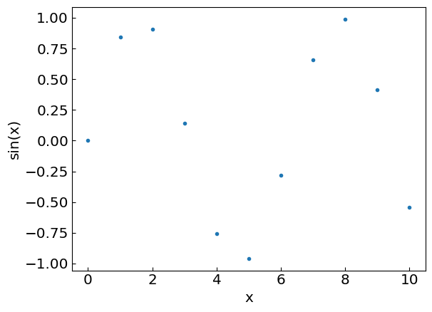
Putting it on a graph
Let us add more points…

Slide 7
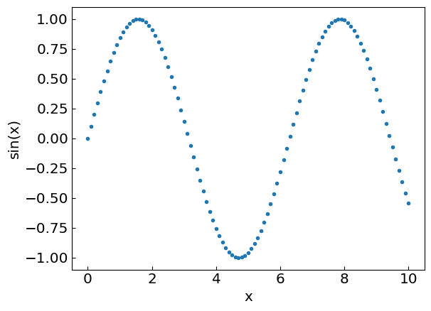
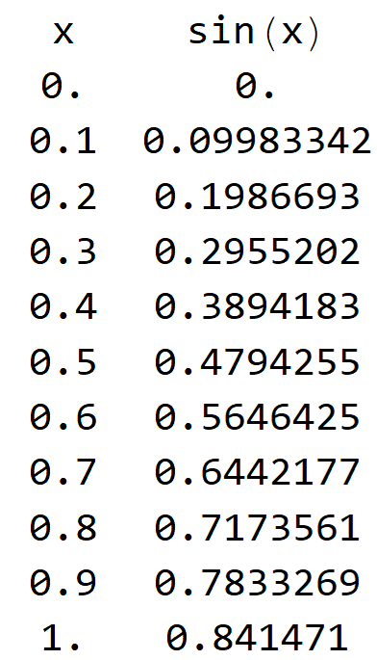
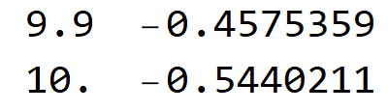
Putting it on a graph
…
Now we have enough points to join them by a smooth line

Slide 8
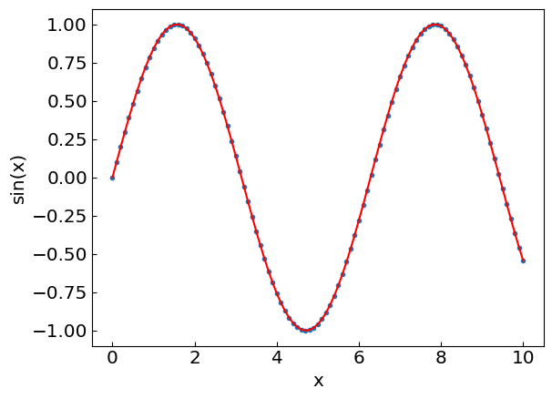
Putting it on a graph
…
Now we have enough points to join them by a smooth line

Slide 9
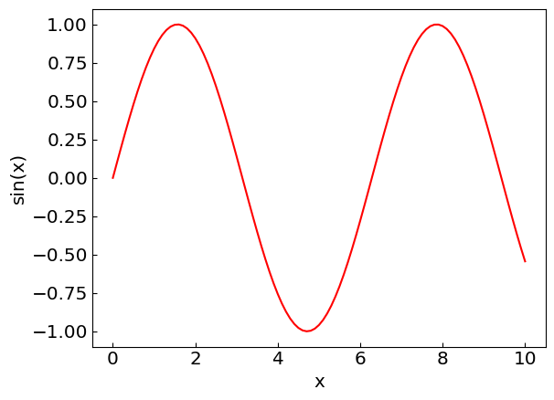
Putting it on a graph
…
Now we have enough points to join them by a smooth line

Slide 10
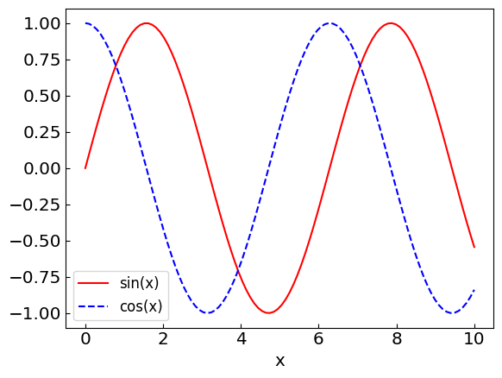
Plot multiple lines to compare functions, profiles, etc.

Slide 11
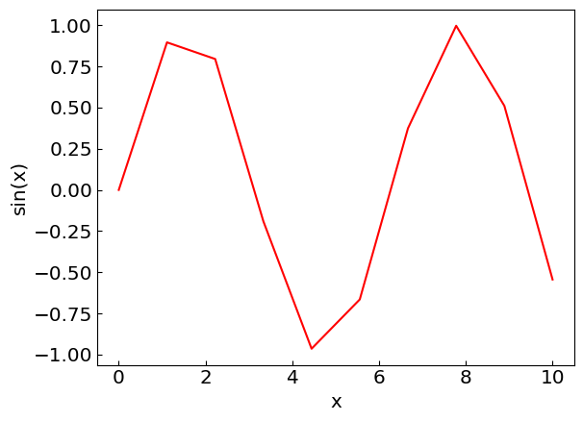
Things to avoid
Insufficient number of data points

Slide 12
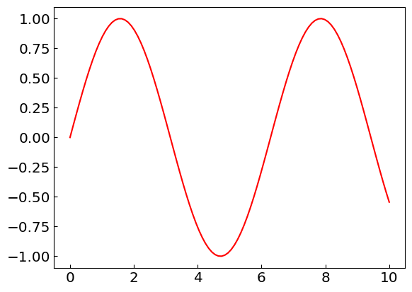
Things to avoid
Unlabeled axes

Slide 13
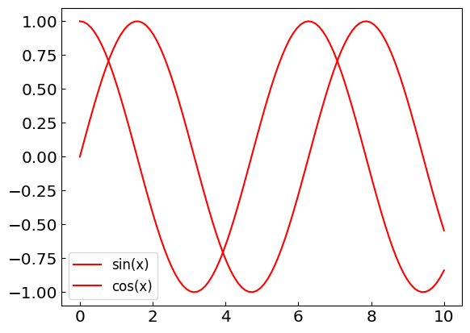
Things to avoid
Indistinguishable line styles

Slide 14
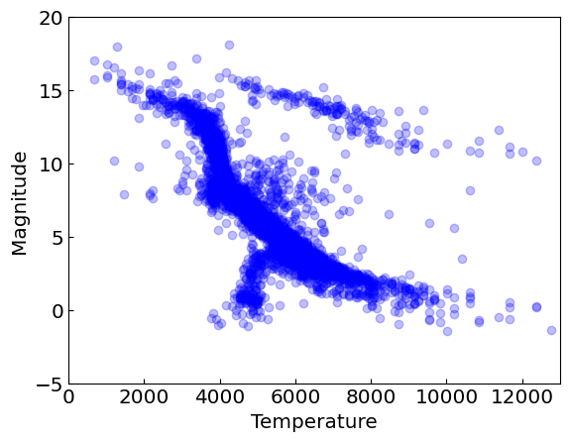
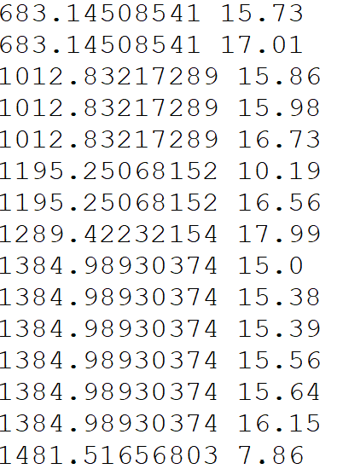
Scatter plots
Not all data points are suitable to be joined by lines
Consider the observations of star surface temperature (= x) and brightness (= y)
…

Slide 15
Errors and accuracy
References:
Chapter 4 of Computational Physics by Mark Newman
Chapter 1.1 of Numerical Recipes Third Edition by W.H. Press et al.

Slide 16
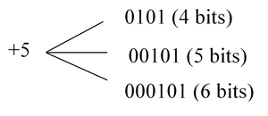

Integer representation
Numbers on a computer are represented by bits
Most typical native formats:
32-bit integer, range −2,147,483,647 (-2³¹) to +2,147,483,647 (2³¹)
64-bit integer, range ~ −10¹⁸ (-2⁶³) to +10¹⁸ (2⁶³)
Python supports natively larger numbers but calculations can become slow
In C++ it is important to avoid under/overflow

Slide 17
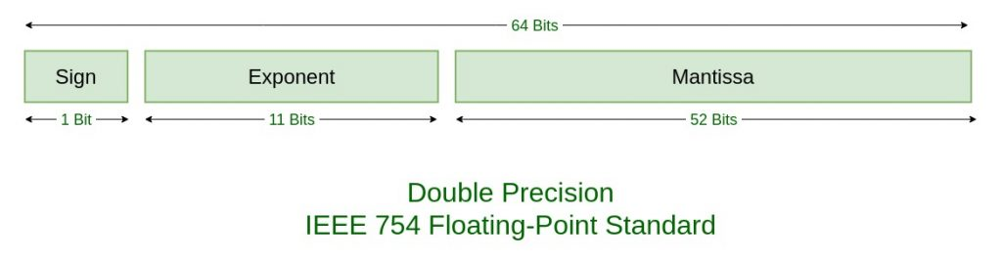

Floating-point number representation
Floating point numbers represented by bit sequences as well
separated into:
Sign S
Exponent E
Mantissa M (significant digits)
Main consequence: Floating-point numbers are not exact!
For example, with 52 bits one can store about 16 decimal digits
Range: from ~ -10³⁰⁸ to 10³⁰⁸ for a 64-bit float

Slide 18

Floating-point number representation
When you write
What it means
for a 64-bit float

Slide 19
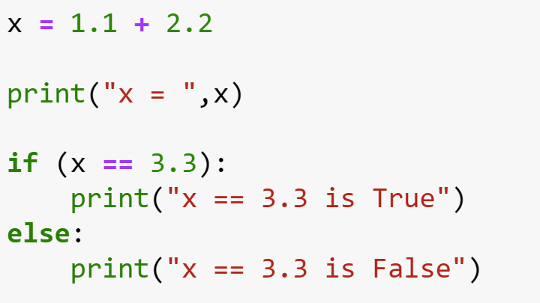
Example: Equality test

Slide 20
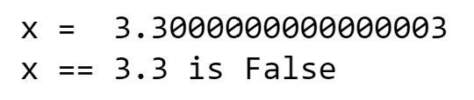
Example: Equality test

Slide 21
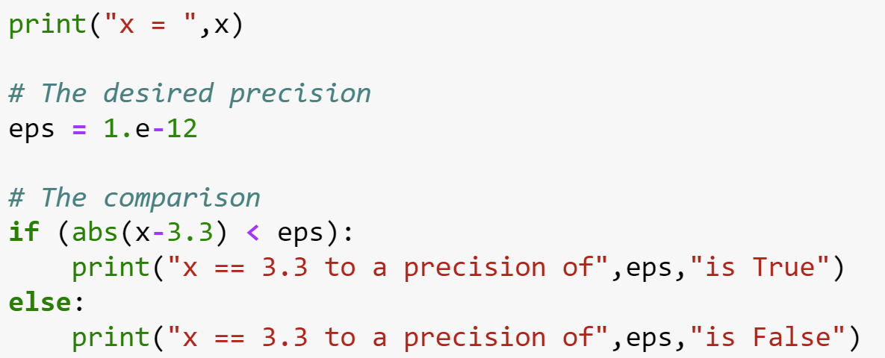
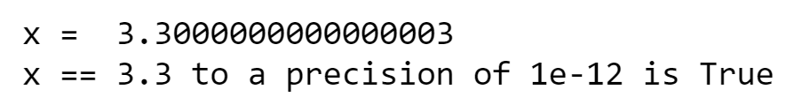
Example: Equality test
Instead you can do

Slide 22
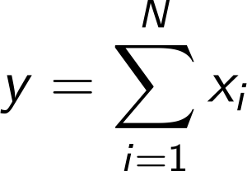
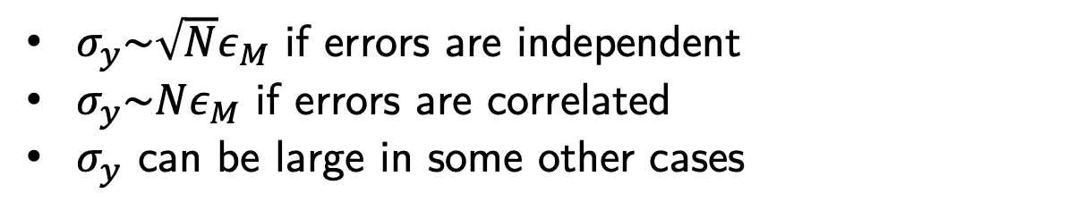
Error accumulation
unavoidable round-off error
Errors also accumulate through arithmetic operations, e.g.
$σ_{y}\sim \sqrt{N}ε_{M}$ if errors are independent
$σ_{y}\sim Nε_{M}$ if errors are correlated
$σ_{y}$ can be large in some other cases

Slide 23
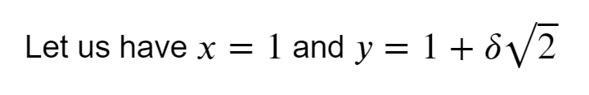
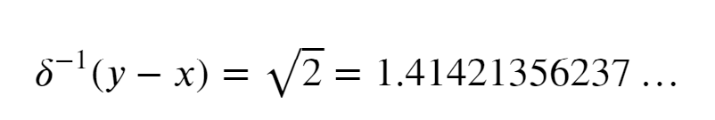
Example: Two large numbers with small difference

Slide 24
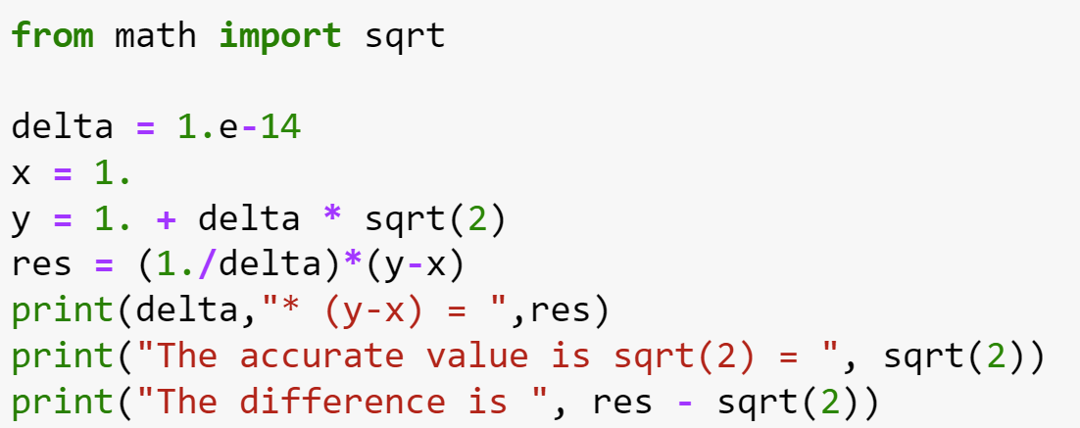
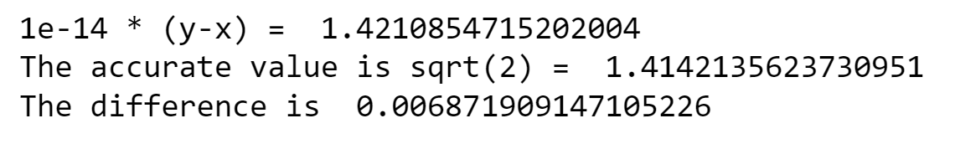
Example: Two large numbers with small difference

Slide 25

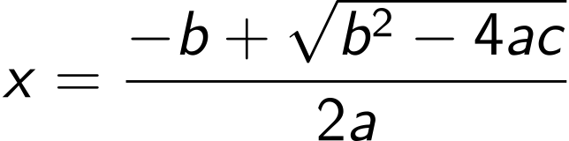
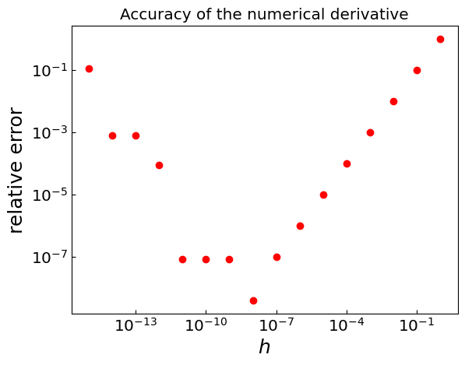
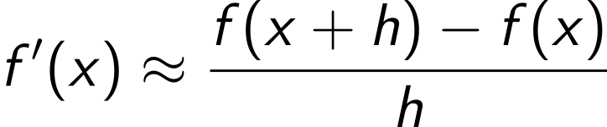
Other examples (see the sample code)
Roots of a quadratic equation with |ac|<<b² (cancellation of two large numbers)
Simple numerical derivative
Sometimes a small h is too small

