Slide 1

Computational Physics (PHYS6350)
Lecture 21: Problems in quantum mechanics
Matrix method for eigenenergies and eigenstates
Time-dependence
April 11, 2023
Instructor: Volodymyr Vovchenko (vvovchenko@uh.edu)
Course materials: https://github.com/vlvovch/PHYS6350-ComputationalPhysics

Slide 2
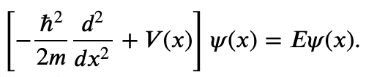

Finding the eigenenergies
Time-independent Schroedinger equation reads
e.g. in a box of length L with boundary conditions
In the case of (an)harmonic oscillator we learned how to use the shooting method to find the eigenenergies by combining a root finder (bisection or secant method) with an ODE integrator (such as RK4).
This involved discretizing the space on a grid.
The problem can also be tackled efficiently by linear algebra methods.

Slide 3
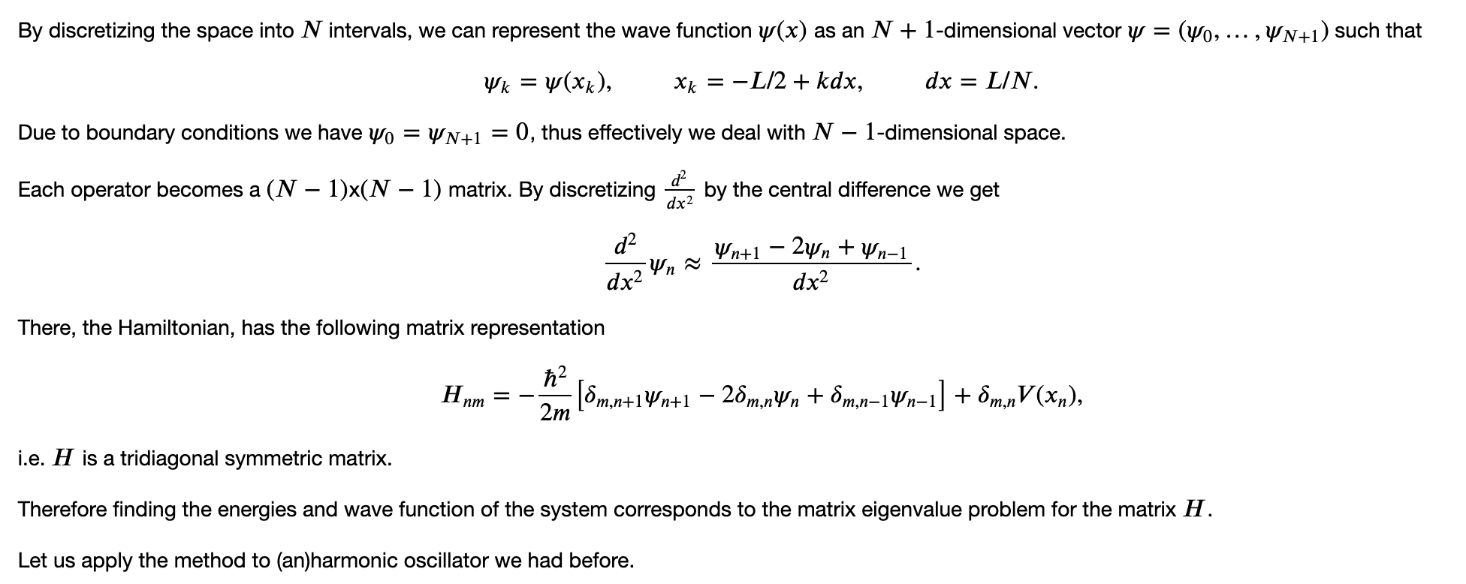
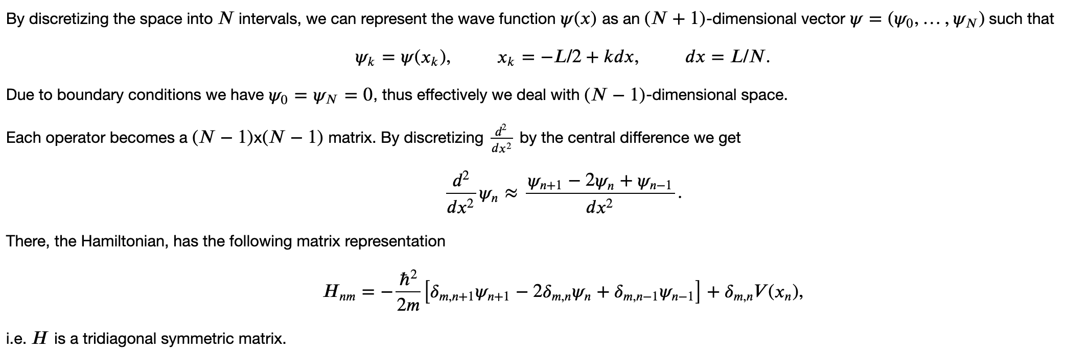
Matrix method for eigenenergies and eigenstates

Slide 4
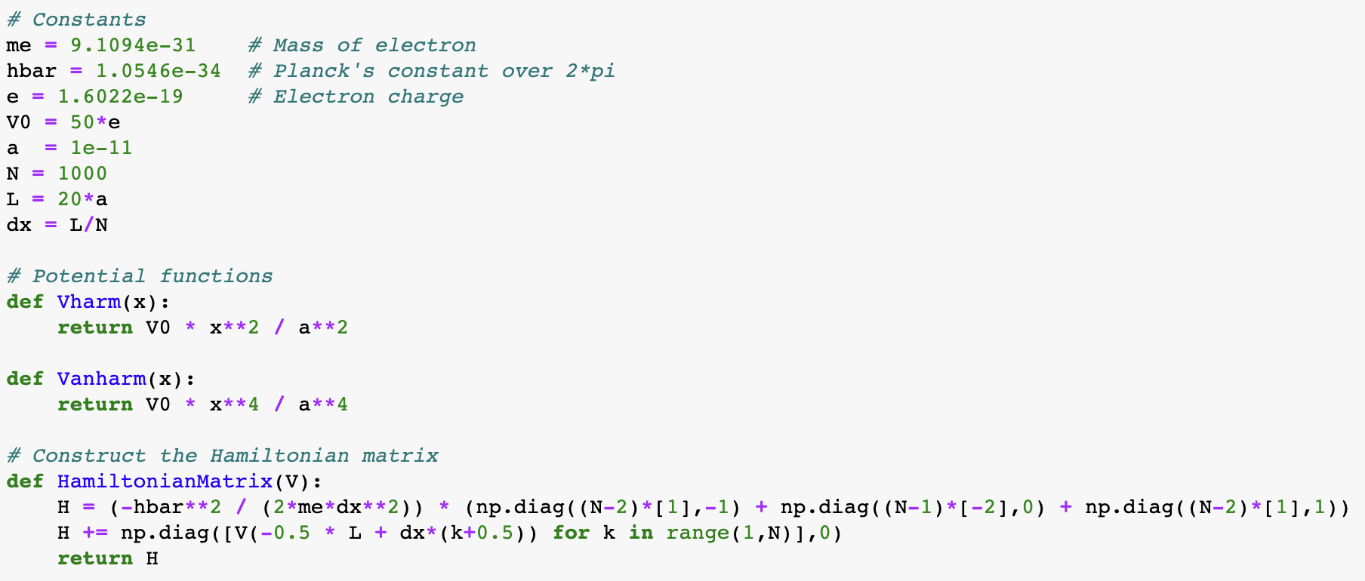
Matrix method

Slide 5
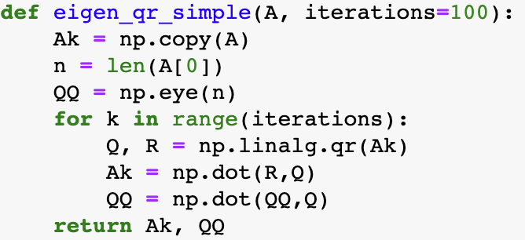
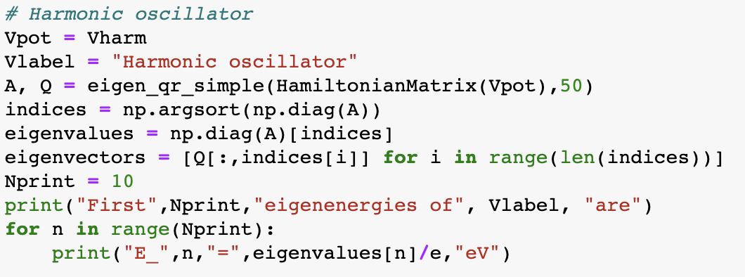
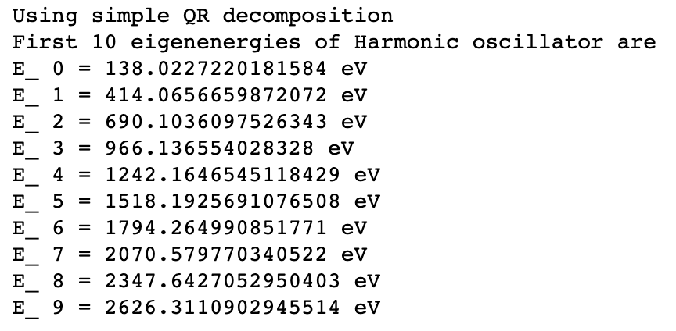
Matrix method for harmonic oscillator
We can use QR decomposition to solve the eigenvalue problem

Slide 6
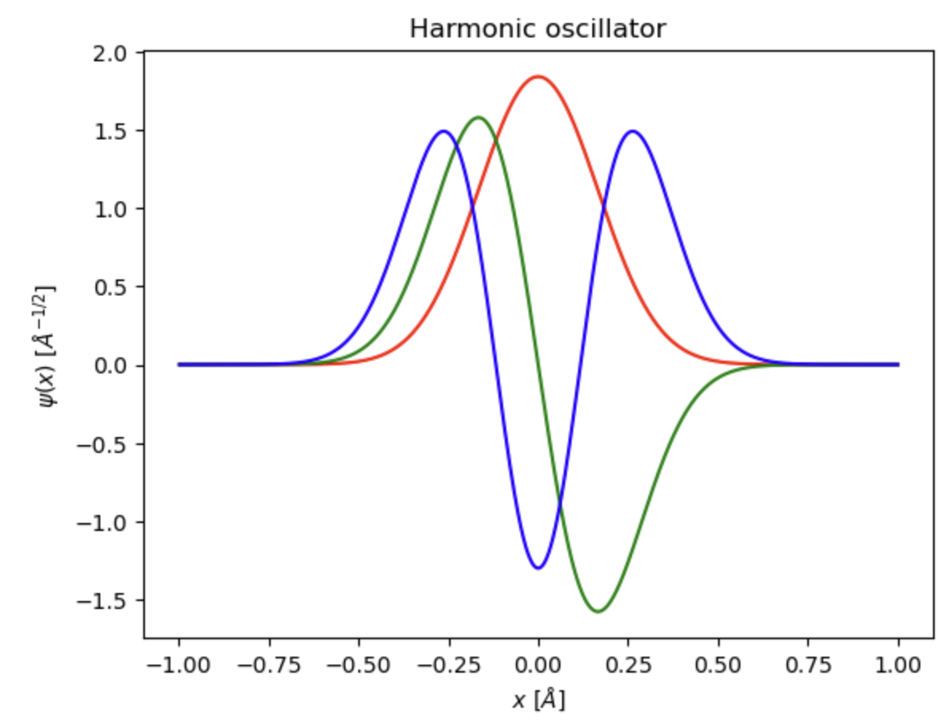
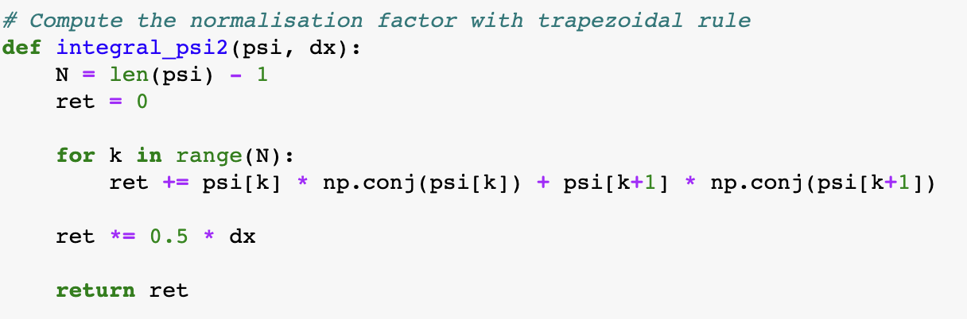
Matrix method for harmonic oscillator
Eigenstates are encoded in the columns of matrix Q
Normalization

Slide 7
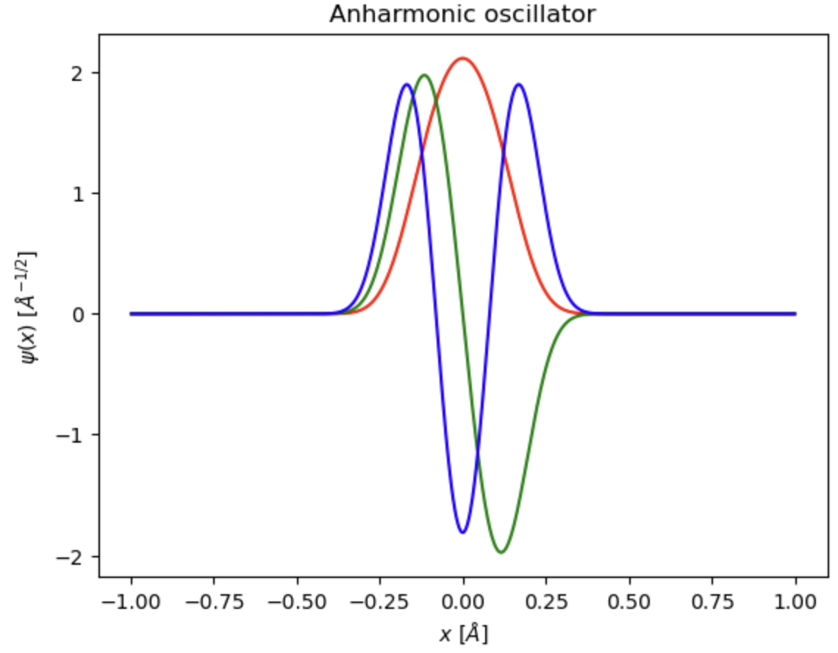
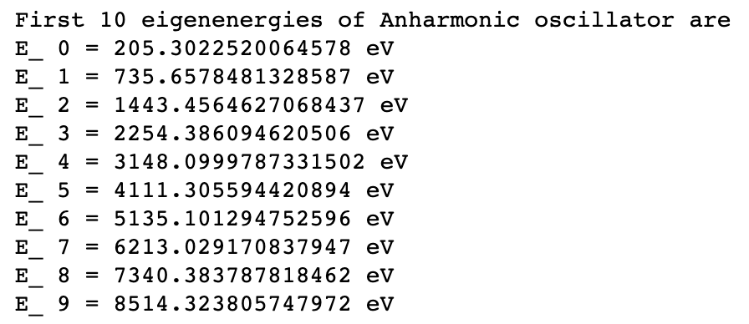
Matrix method for anharmonic oscillator

Slide 8
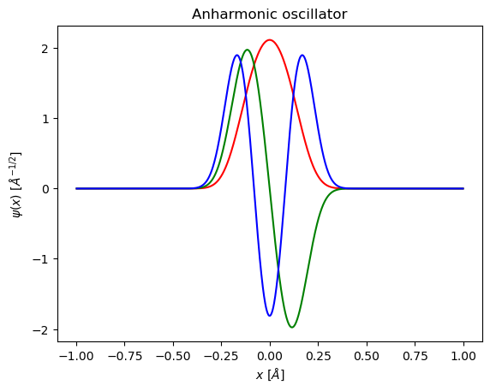
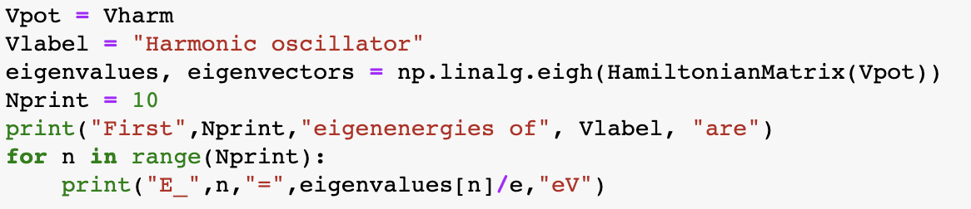

Matrix method
One can also use efficient implementations of the eigenvalue problem in numpy

Slide 9
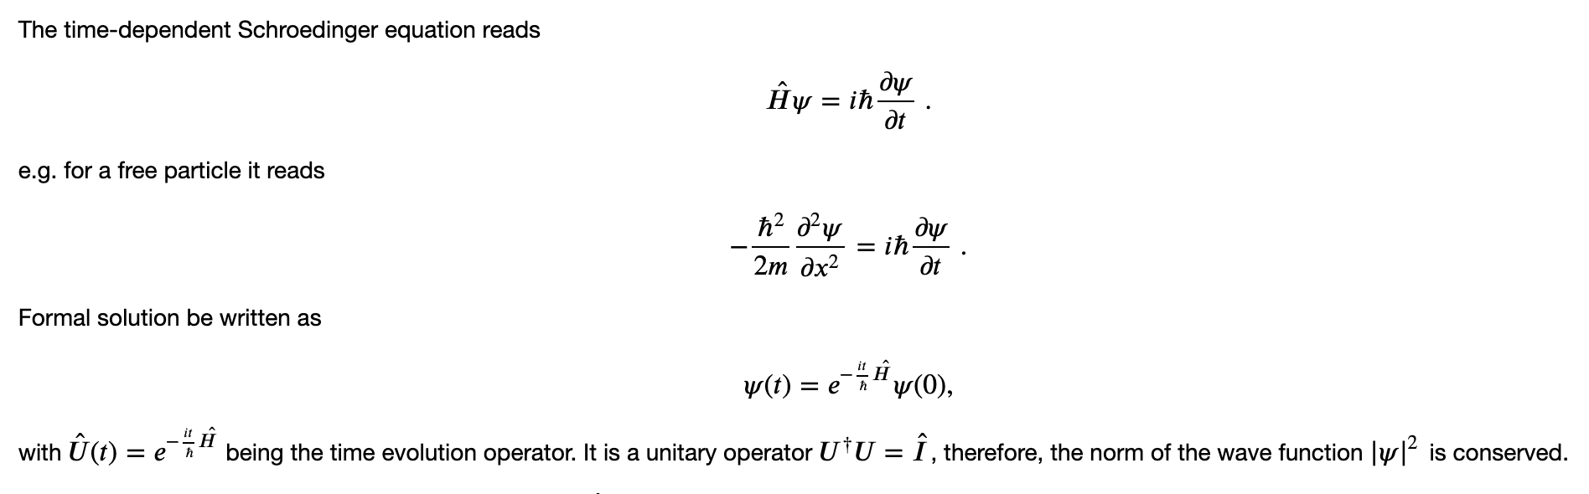
Time-dependent Schroedinger equation

Slide 10
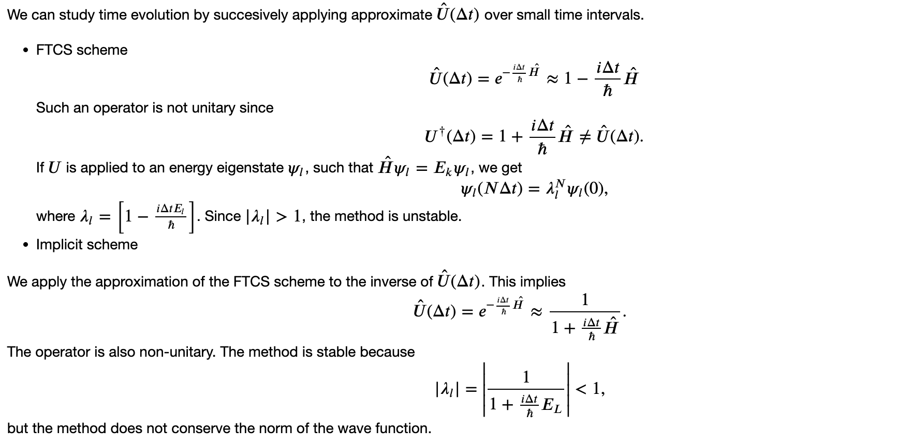
Time integration

Slide 11
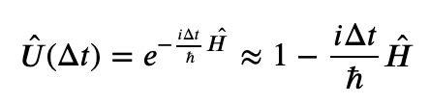
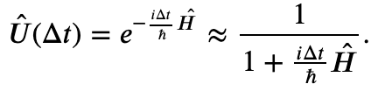
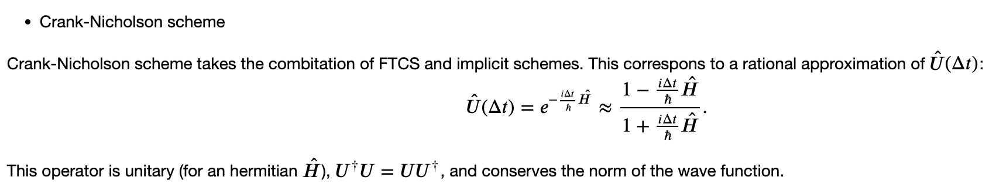
Time integration: Crank-Nicholson scheme
explicit
implicit

Slide 12
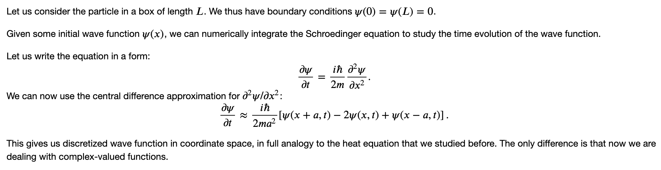

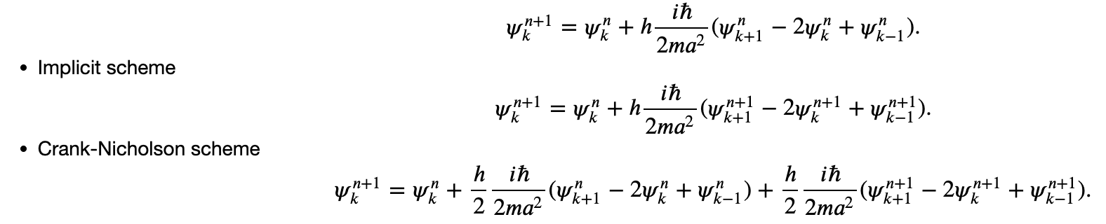
Free particle in a box

Slide 13
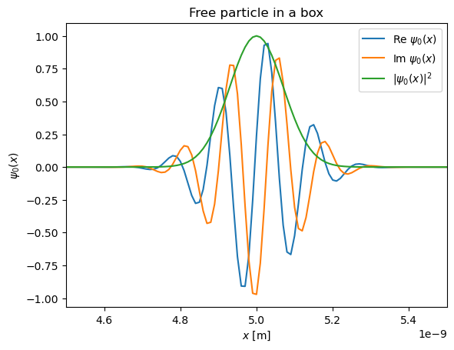
Initial wave function: Gaussian wave packet

Slide 14
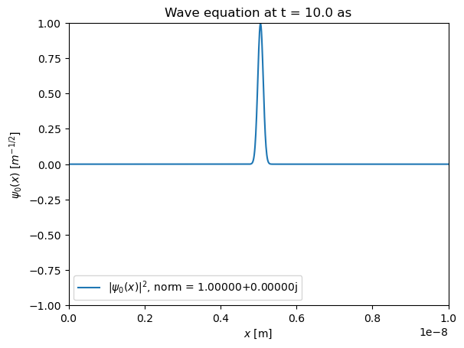
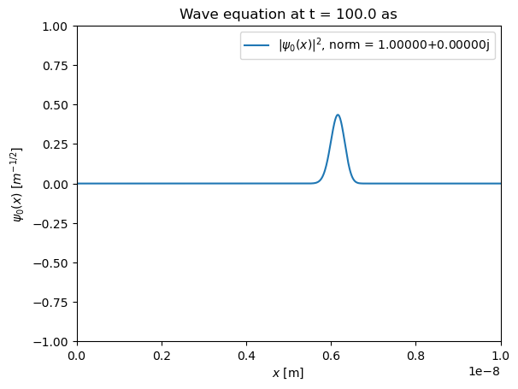
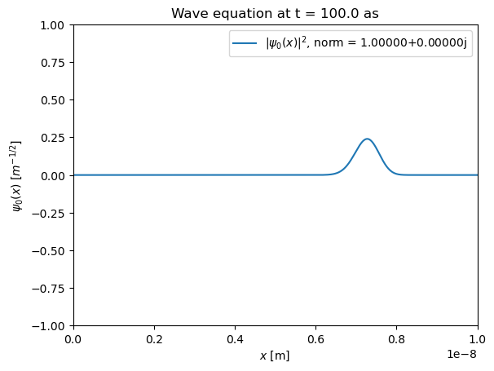
Time evolution
Expanding wave packet (towards plane wave), norm is conserved

