Slide 1

Computational Physics (PHYS6350)
Review and concluding remarks
April 27, 2023
Instructor: Volodymyr Vovchenko (vvovchenko@uh.edu)
Course materials: https://github.com/vlvovch/PHYS6350-ComputationalPhysics

Slide 2
Reminders
The Final Project is due today(!)
So far about 50% have been received
Late submissions: allowed but with an increasing penalty (try to get it in this week)
You are encouraged to submit feedback through Faculty/Course evaluation
https://uh.edu/measurement-evaluation-center/faculty-course-evaluation/student_info/

Slide 3
Grading
Homework (40%) (completed)
Final project (20%)
Mid-term (15%) (completed) and Final (25%)
Multiple choice, short and long answer questions

Slide 4
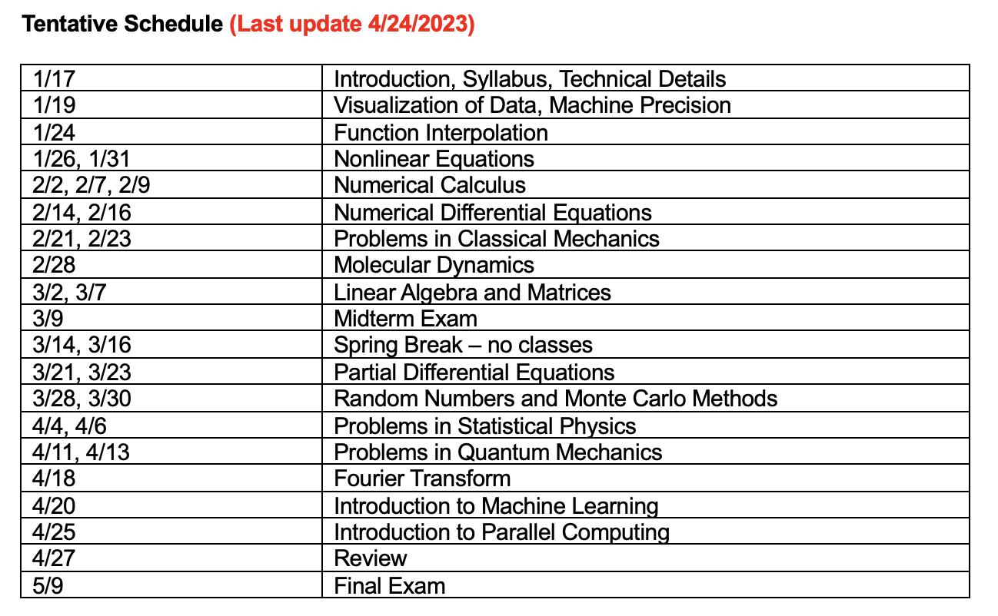
Overview: What we covered

Slide 5
Overview
The course has been focused on concepts used in computational physics, hence
Jupyter notebooks and python
(Re)implementation of many standard routines
Little focus on performance

Slide 6
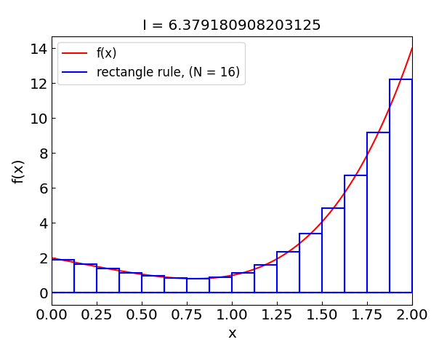
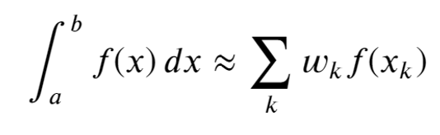
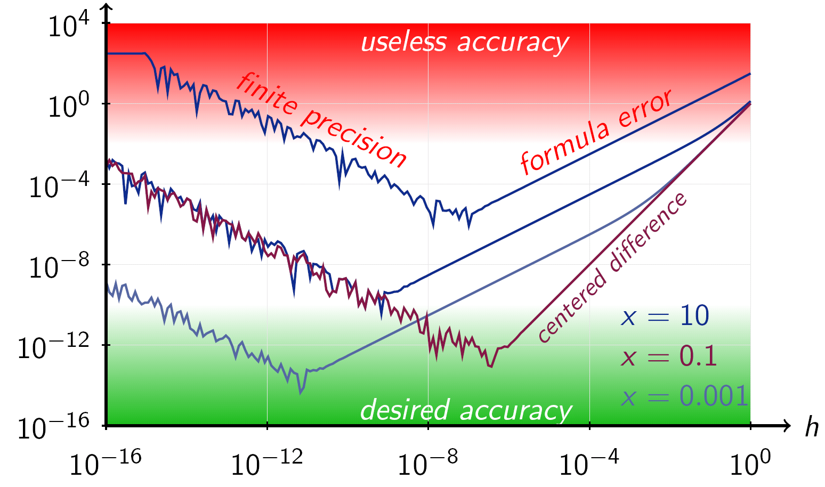
Overview: Numerical integration and differentiation
Numerical integration:
For quick and dirty calculations
Rectangle or trapezoidal rules
For a single and precise calculation
Methods with control over error estimate
E.g. Romberg method
For repeated calculations of the same kind of integral
Gaussian quadratures
Numerical derivatives:
Use central difference schemes
Lower order o.k. in many cases
Beware of round-off error for small h and/or high-order derivatives

Slide 7
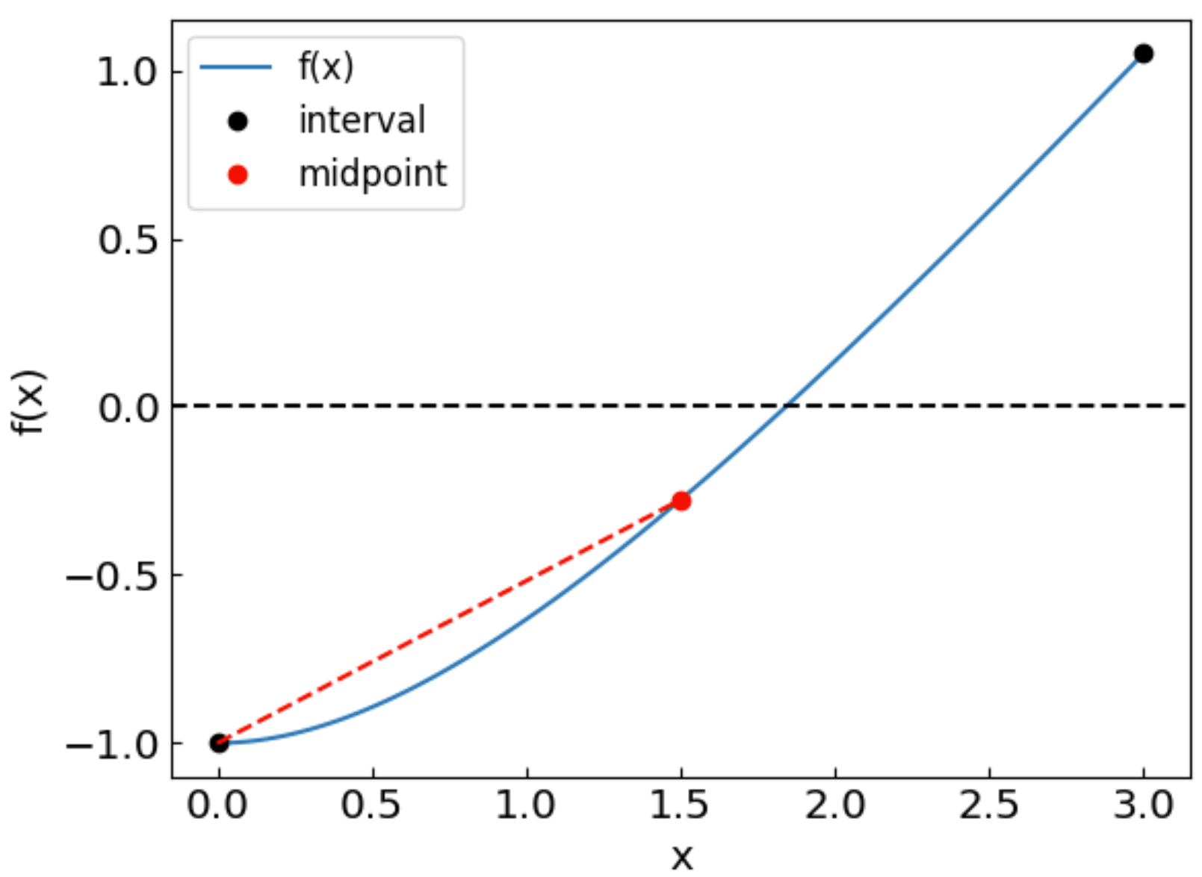

Overview: Non-linear equations
The main methods are
Bisection method
If root is bracketed, guaranteed to converge
Newton-Raphson method (or secant method if cannot compute f’)
Converges fast when the root is nearby
Good to use for refining the root
Systems of non-linear equations
Newton’s method
Fast convergence but requires Jacobian matrix calculation and inversion
Broyden’s method
No need for matrix inversion

Slide 8
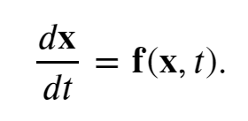

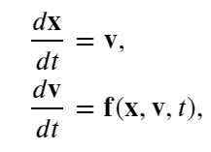
Overview: Ordinary differential equations
Lots of physics problems formulated as systems of ODEs
Good starting point: fourth-order Runge-Kutta (RK4)
If not, use adaptive time step
Time-reversal symmetry and energy conservation
Leap-frog method (e.g. Molecular dynamics)
Bulirsch-Stoer method (control over error)
Systems of ODEs
Same as a single ODE component-by-component
2nd or high-order ODE
Convert to a system of first-order ODEs
Stiff/unstable systems
Use implicit methods

Slide 9

Overview: Linear algebra
Use standard/library routines whenever possible
LU-decomposition
Solve systems of linear eqs. with the same matrix A but varied v
Tri- and band-diagonal systems
Appear often, in particular when discretizing PDEs
Use specific algorithms since they have linear complexity in N
Eigenvalues and eigenvectors
QR algorithm and diagonalization
Eigenvalues only is easier than eigenvalues + eigenvectors
Use standard/library routines

Slide 10

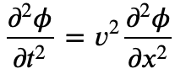
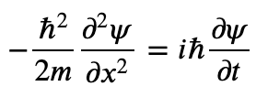
Overview: Partial differential equations
Lots of physics problems formulated as systems of PDEs
Discretization of spatial derivatives
Central difference typically o.k.
Time propagation
Explicit scheme (FTCS)
Often has stability issues
More easily generalized to multiple dimensions
Crank-Nicolson scheme
More stable and conserves the wave amplitude
Implicit, but only involves a tridiagonal system solution
Multiple dimensions are more challenging
Further reading
Finite element method (irregular spatial shapes)
Finite volume method (conservation laws and fluxes)

Slide 11
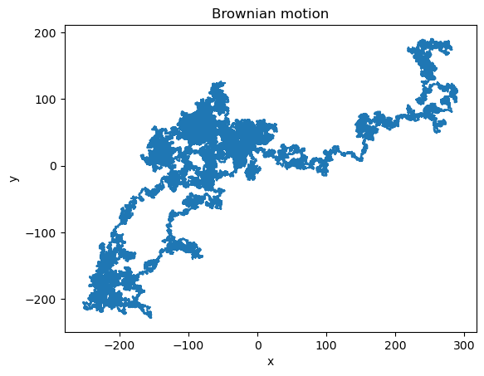
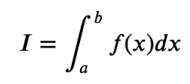
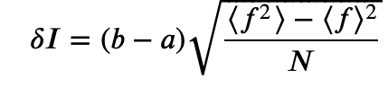
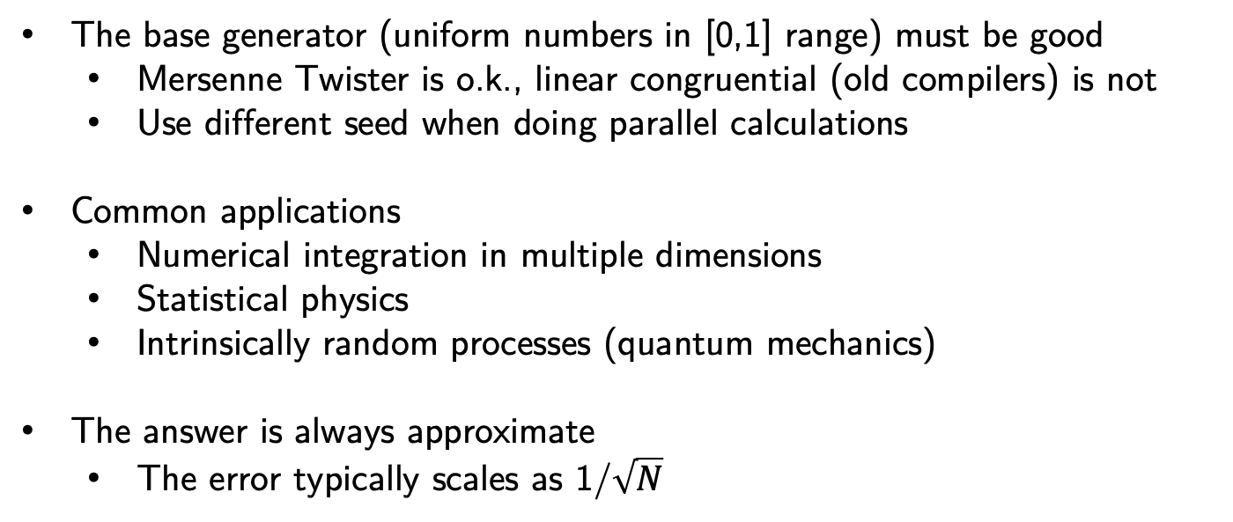
Overview: Random numbers (Monte Carlo method)
Powerful method where other approaches fail (typically when there is a large amount of degrees of freedom involved)
The base generator (uniform numbers in [0,1] range) must be good
Mersenne Twister is o.k., linear congruential (old compilers) is not
Use different seed when doing parallel calculations
Common applications
Numerical integration in multiple dimensions
Statistical physics
Intrinsically random processes (quantum mechanics)
The answer is always approximate
The error typically scales as 1/$\sqrt{N}$

