Slide 1

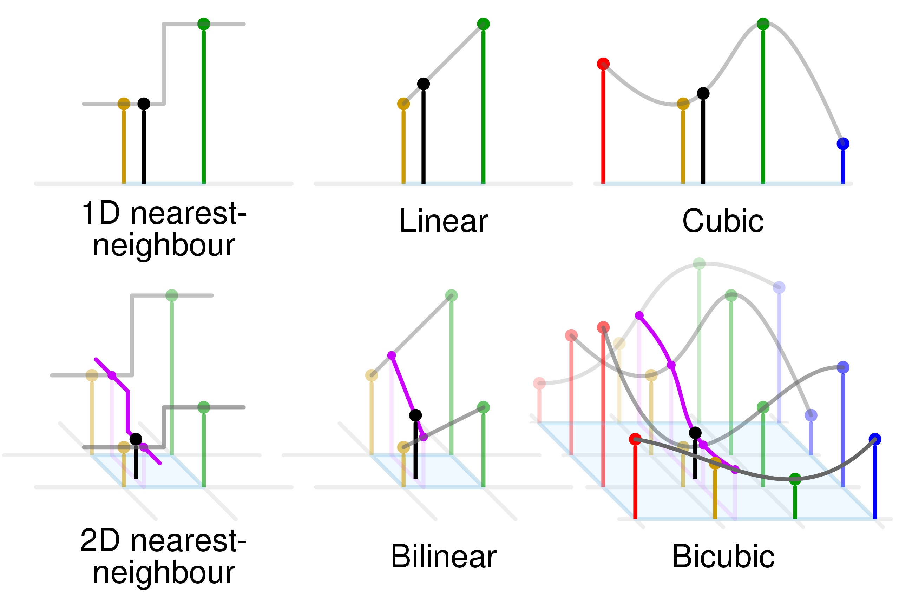
Computational Physics (PHYS6350)
Lecture 3: Interpolation
January 24, 2023
Instructor: Volodymyr Vovchenko (vvovchenko@uh.edu)
Course materials: https://github.com/vlvovch/PHYS6350-ComputationalPhysics

Slide 2
Interpolation
Sometimes we know the value of some function f(x) at a discrete set of points x₀, x_{1,} …, x_{N}, but we do not know how to (easily) calculate its value at arbitrary x
Examples:
Physical measurements
Long numerical calculations
Interpolation is a method to generate new data points from existing data points consisting of two steps:
Fitting the interpolating function to data points
Evaluating the interpolating function at a target point x
References:
Chapter 3 of Numerical Recipes Third Edition by W.H. Press et al.

Slide 3
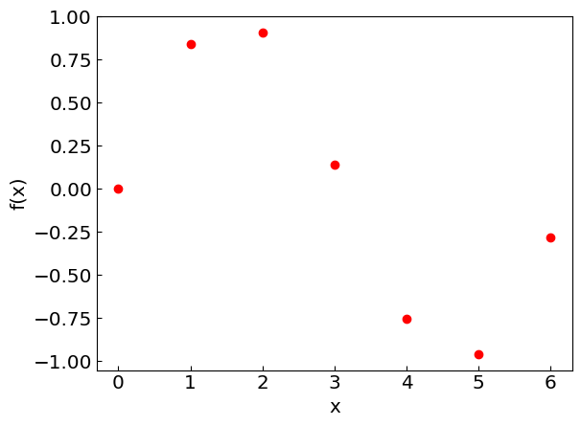
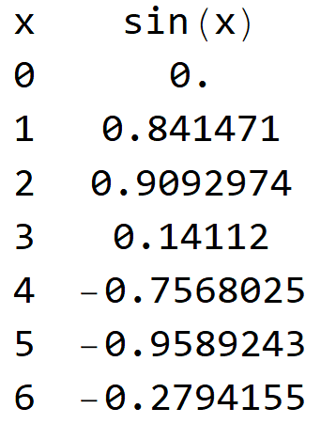
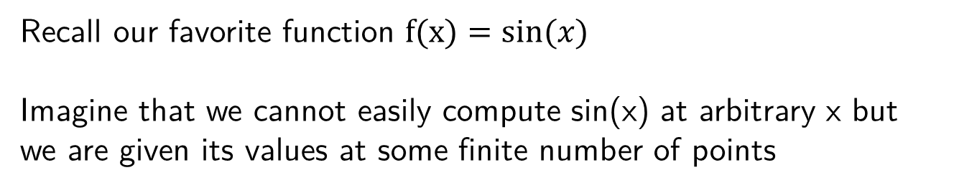
Interpolation
Recall our favorite function $f(x)=sin⁡(x)$
Imagine that we cannot easily compute sin(x) at arbitrary x but we are given its values at some finite number of points
Consider different methods of interpolating the function

Slide 4
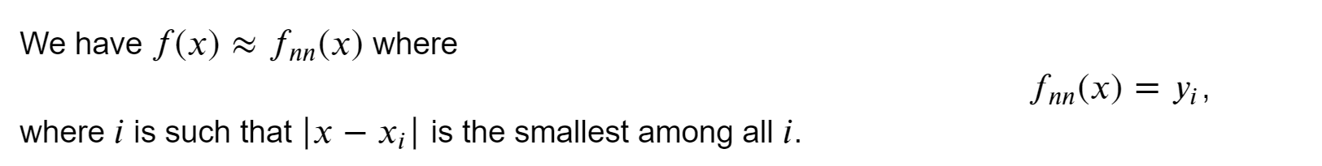
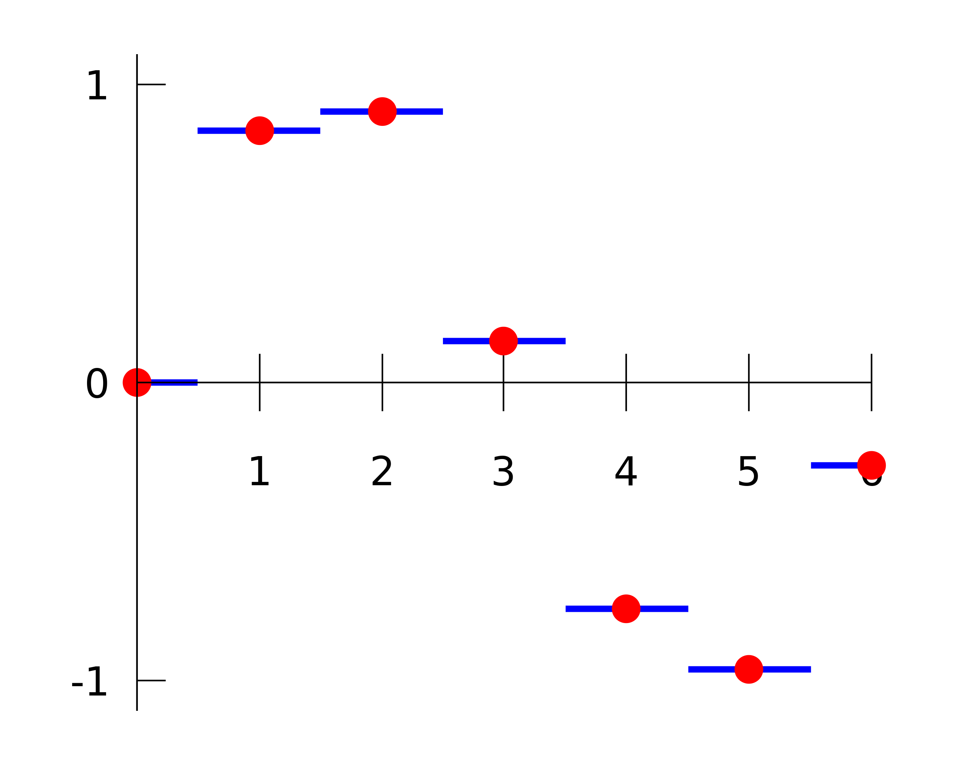
Nearest-neighbor interpolation
Simply assign the value of the closest data point to x, i.e.

Slide 5
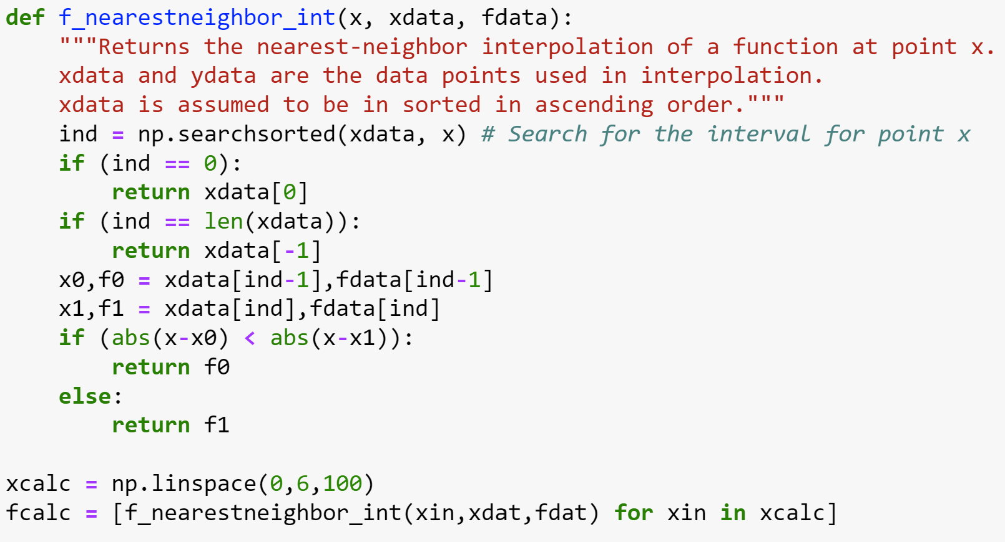
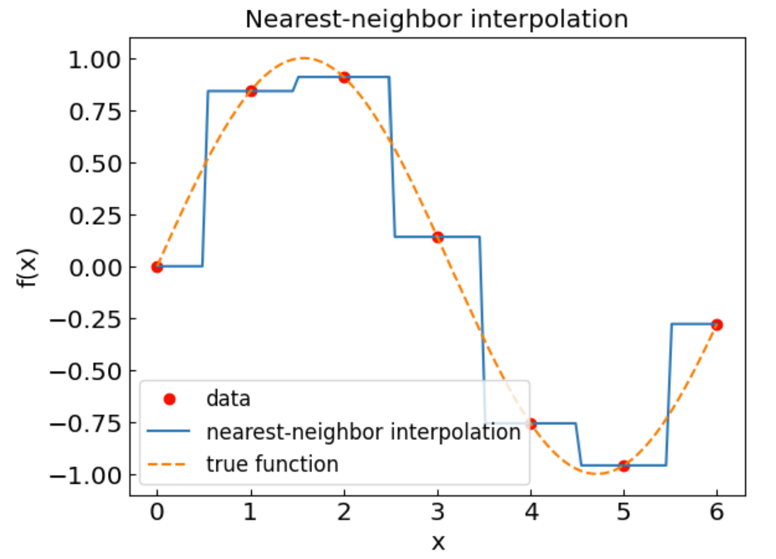
Nearest-neighbor interpolation
In Python:
Advantages:
Very simple
Easy to generalize to multiple dimensions
Disadvantages:
Limited accuracy
Better & easy options available

Slide 6
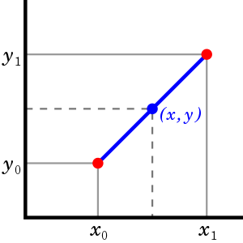
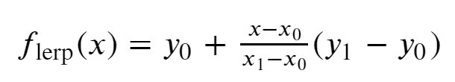
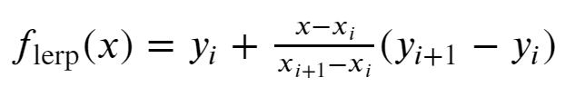
Linear interpolation
Let us have the data points (x₀,y₀) and (x₁,y₁)
Linear interpolant is a straight line between these points
Use it to calculate the function value at any x in-between
For a larger set of points x₀ < x₁ < … < x_{N}, find the interval (x_{i}, x_{i+1}) enveloping x and use the linear interpolant formula
Credit: Wikipedia

Slide 7
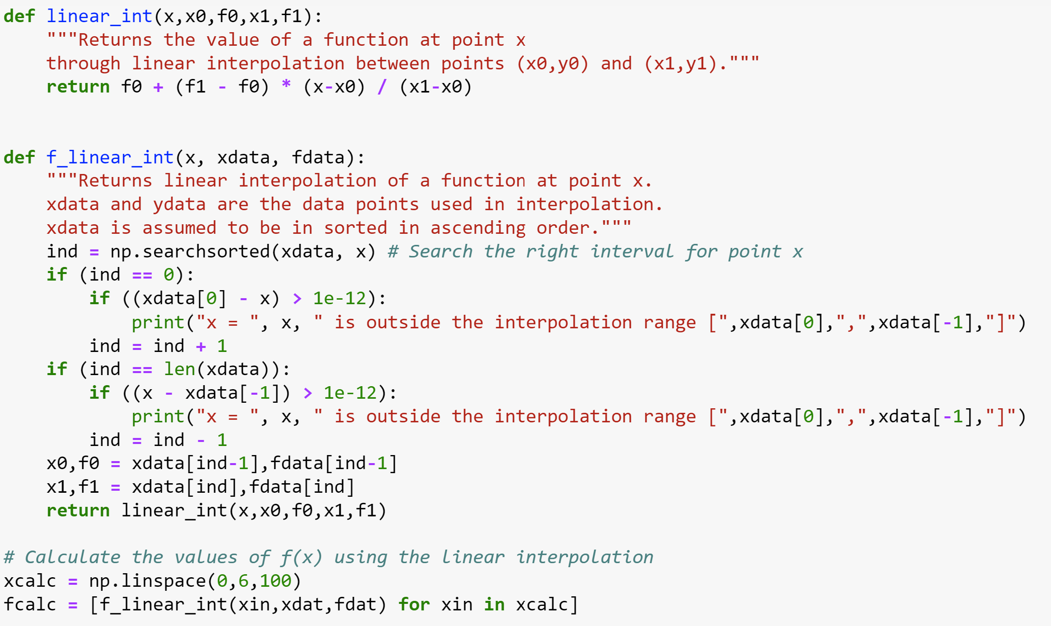
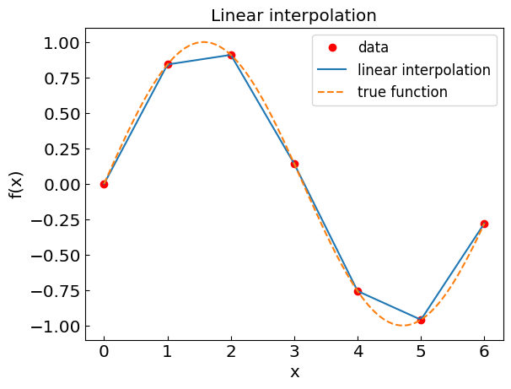
Linear interpolation
In Python:
Advantages:
Simple, and generalizes to multiple dimensions
More accurate than nearest-neighbor appr.
Disadvantages:
Limited accuracy compared to polynomials
Not good for derivatives

Slide 8
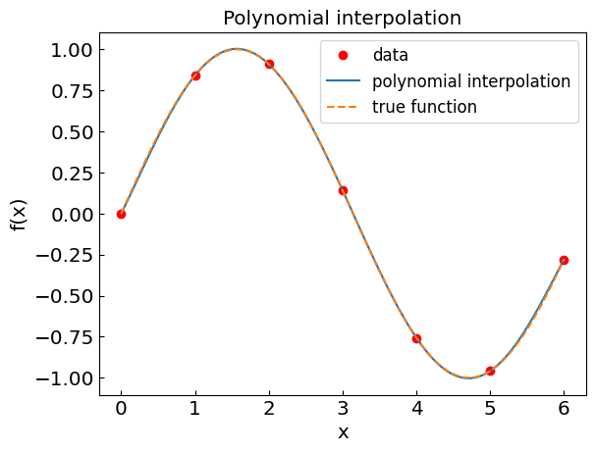
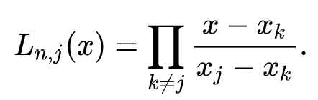

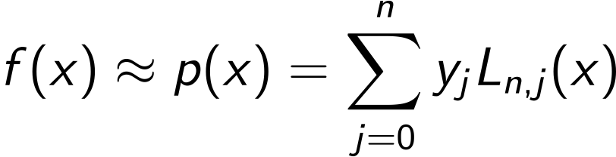
Polynomial interpolation (Lagrange form)
Theorem: There exists a unique polynomial of order n that interpolates through n+1 data points (x₀,y₀), (x₁,y₁), …, (x_{n},y_{n})
How to build such a polynomial?
Consider Lagrange basis functions:
Easy to see that for x=x_{k} one has
Therefore:

Slide 9

Polynomial interpolation
For our example f(x) = sin(x)
one obtains
In practice, the Lagrange form is more stable with respect to round-off errors

Slide 10
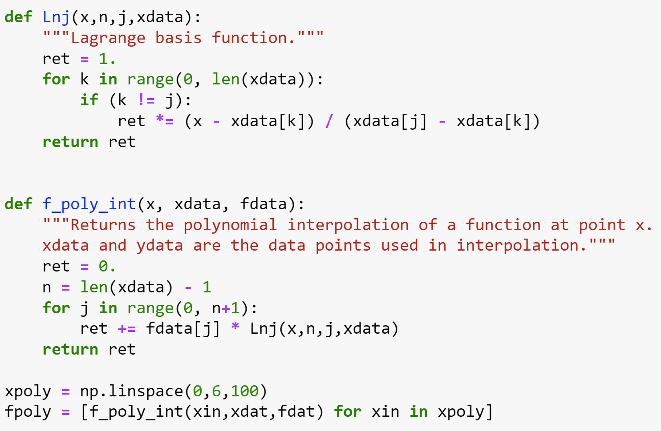
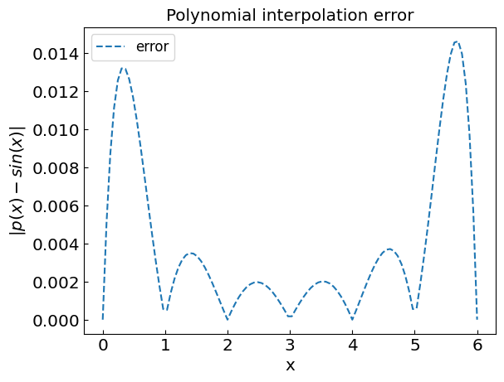
Polynomial interpolation
In Python:

Slide 11
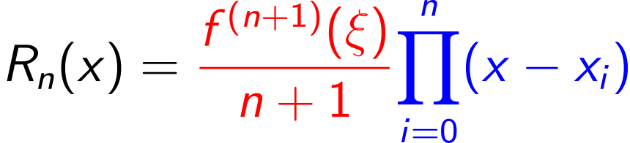
Polynomial interpolation: Errors and artefacts
Truncation errors
Round-off errors
Especially for high-order polynomials
Truncation errors can be a problem if
High-order derivatives f^{(n+1)}(x) of the function are significant
The choice of nodes leads to a large value of the product factor
Runge phenomenon: Oscillation at the edges of the interval which gets worse as the interpolation order is increased

Slide 12
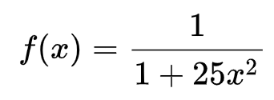
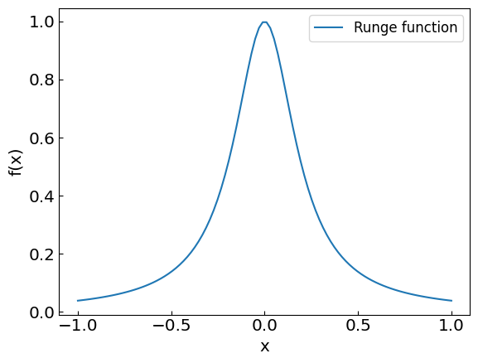
Polynomial interpolation: Runge phenomenon
Consider the Runge function:
Let us do polynomial interpolation using equidistant nodes

Slide 13
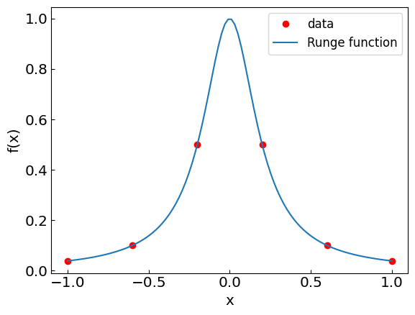
Polynomial interpolation: Runge phenomenon

Slide 14
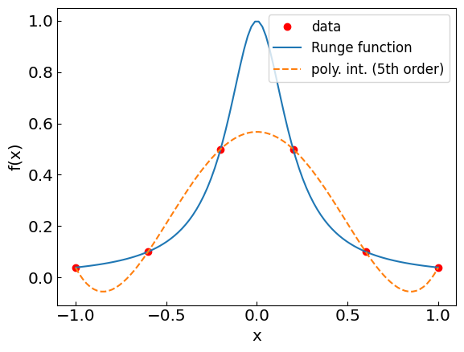
Polynomial interpolation: Runge phenomenon

Slide 15
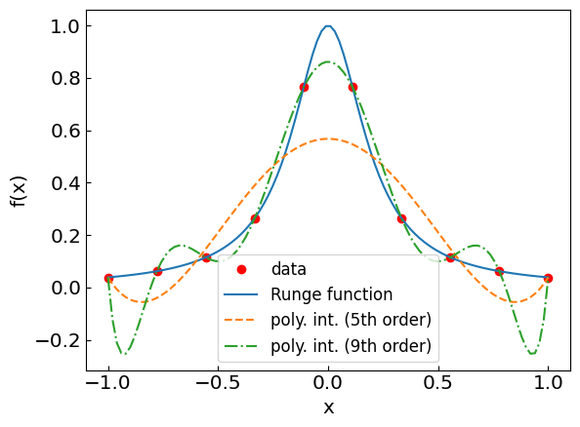
Polynomial interpolation: Runge phenomenon

Slide 16
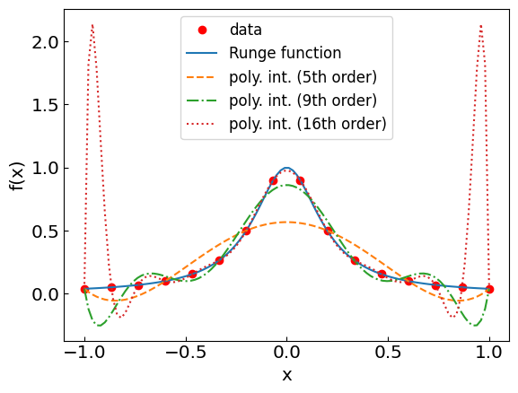
Polynomial interpolation: Runge phenomenon
We have a real problem at the edges!

Slide 17
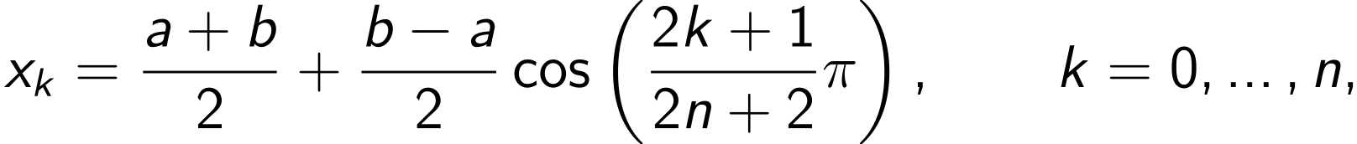
Polynomial interpolation: Chebyshev nodes
Recall the truncation error
So far, we used the equidistant nodes:
Can we choose the nodes x_{i} differently to minimize the product factor? Yes!
Chebyshev nodes:

Slide 18
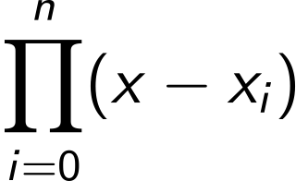
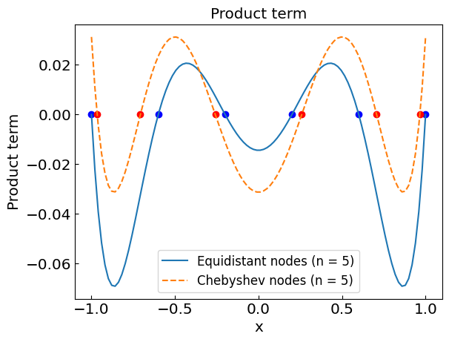
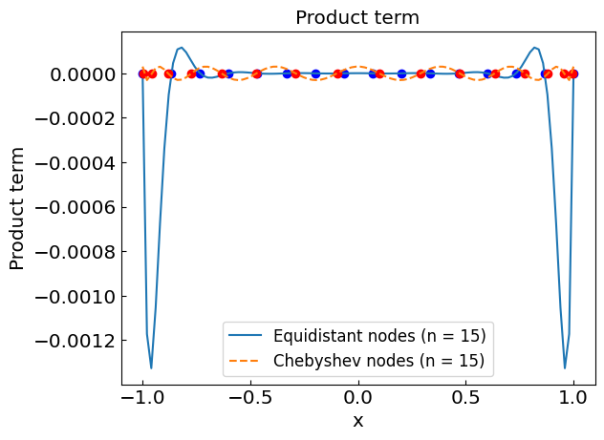
Equidistant vs Chebyshev nodes
Plot as a function of x for different number of nodes n on a (-1,1) interval

Slide 19
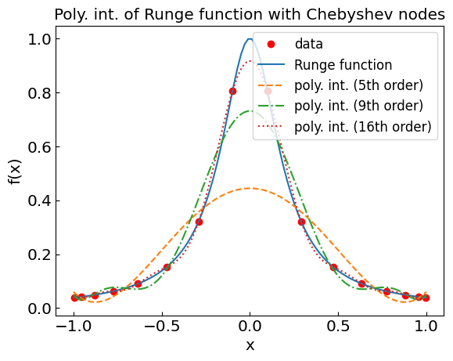
Back to the Runge function: Chebyshev nodes

Slide 20
Polynomial interpolation: Summary
Advantages:
Generally more accurate than the linear interpolation
Derivatives are continuous
Can be used for numerical integration and differential equations
Disadvantages:
Implementation not so simple
Artefacts possible (such as large oscillations between nodes)
Polynomials of large order susceptible to round-off errors
Not easily generalized to multiple dimensions

Slide 21
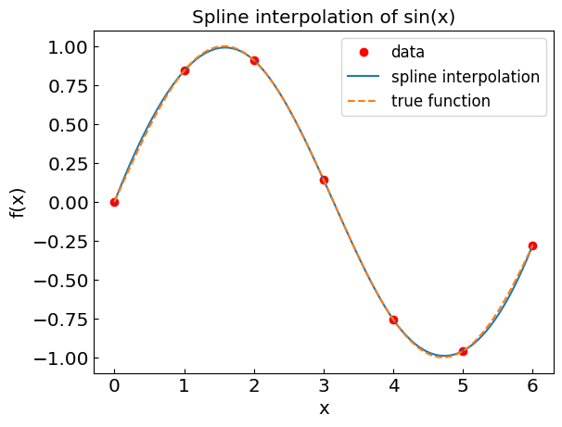
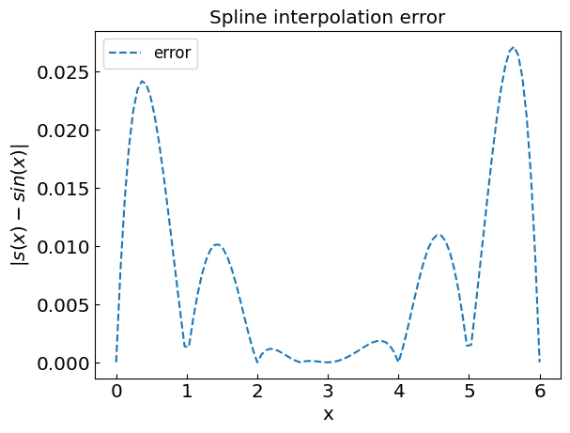
Spline interpolation
Connect each pair of nodes by a cubic polynomial
4n coefficients a_{i}, b_{i}, c_{i}, d_{i} determined from
n+1 data points
continuity of first and second derivatives at nodes
Boundary conditions for first derivative
Advantages:
More accurate than linear interpolation
Derivatives are continuous
Avoids issues with polynomials of high degree
Disadvantages:
Implementation not so simple
Artefacts like large oscillations between nodes are possible

Slide 22
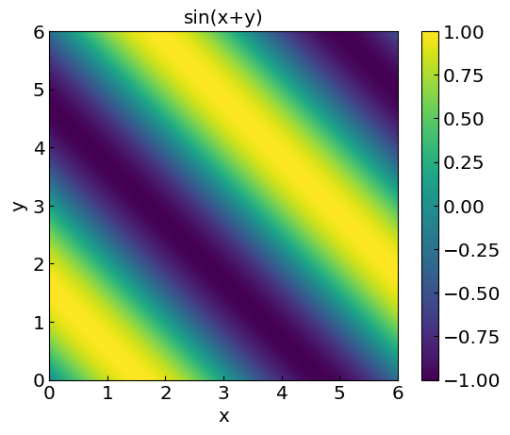
Multiple dimensions
Functions of more than one variable, e.g. f(x,y) = sin(x+y)
Data points: (x_{i},y_{i},f_{i})
Main methods:
Nearest-neighbor
Successive 1D interpolations

Slide 23
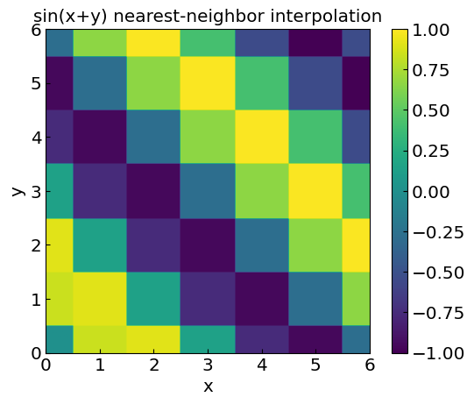
2D nearest-neighbor
2D nearest-neighbor:
Simply assign the value of the closest data point to (x,y) in the plane
Consider f(x,y) = sin(x+y)
Data points at integer values x,y=0,1,…6 (regular grid)

Slide 24
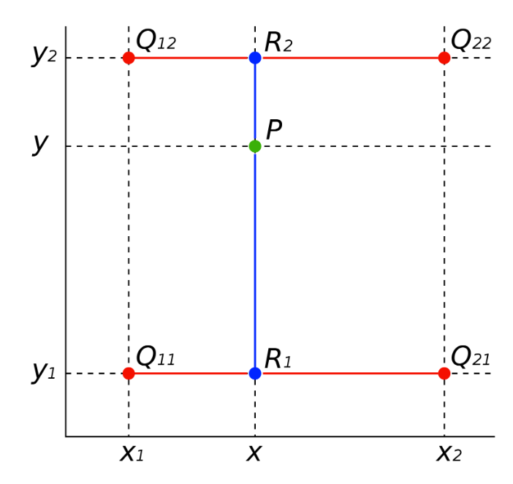
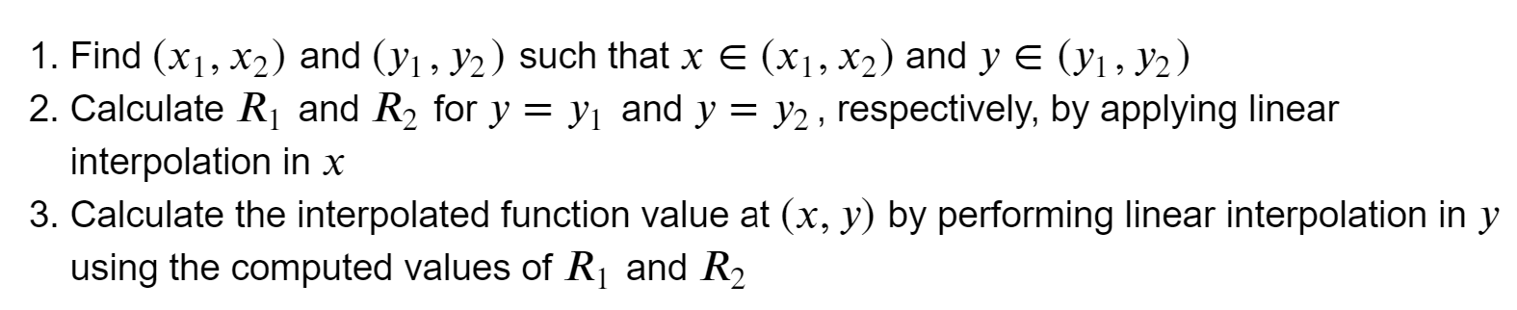
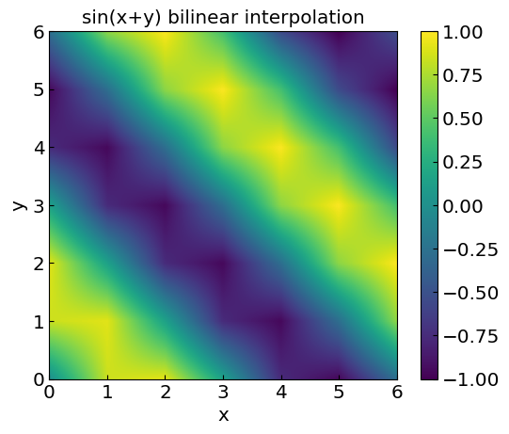
Bilinear interpolation
Bilinear interpolation: apply linear interpolation twice

