Slide 1

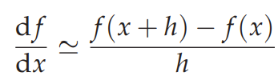
Computational Physics (PHYS6350)
Lecture 8: Numerical Derivatives
February 9, 2023
Instructor: Volodymyr Vovchenko (vvovchenko@uh.edu)
Course materials: https://github.com/vlvovch/PHYS6350-ComputationalPhysics

Slide 2
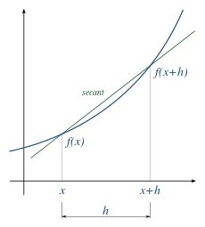
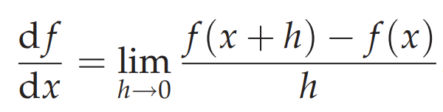
Numerical differentiation
Generic problem: evaluate
We need numerical differentiation when
Function f is known at a discrete set of points
Too expensive/cumbersome to do directly
E.g. when f(x) itself is a solution to a complex web of non-linear equations, calculating f’(x) explicitly will require rewriting all the equations
References:
Chapter 5 of Computational Physics by Mark Newman

Slide 3
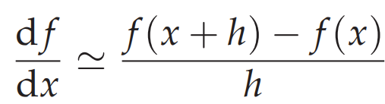
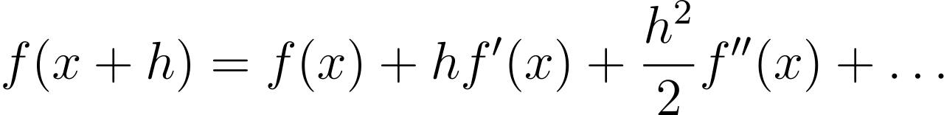
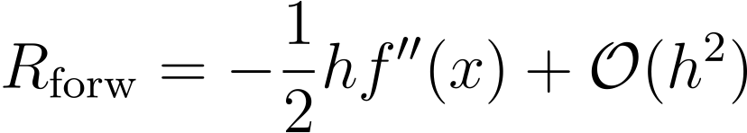
Forward difference
Simply approximate
by
where h is finite
Taylor theorem:
gives the approximation error estimate of

Slide 4
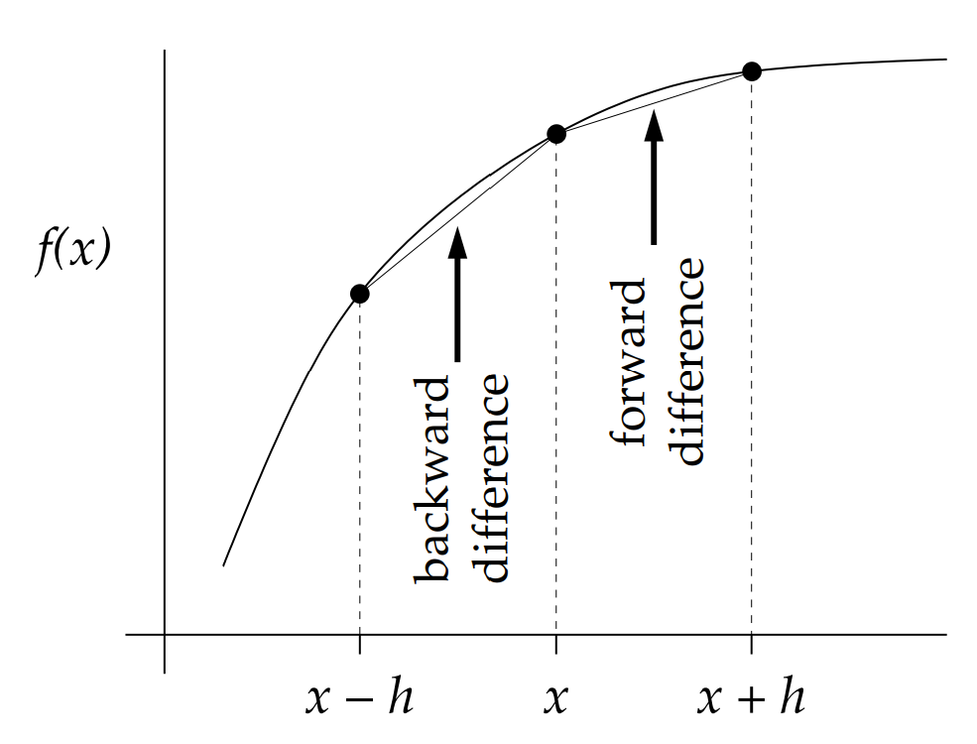
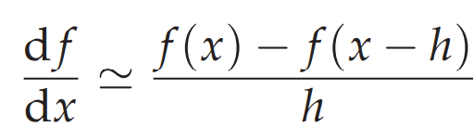
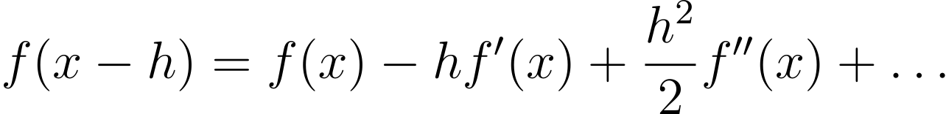
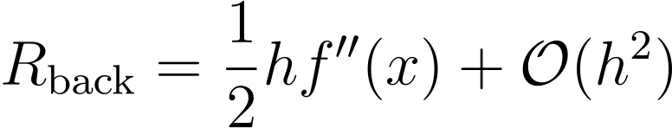
Backward difference
Backward difference
Taylor theorem:
gives the approximation error estimate of

Slide 5
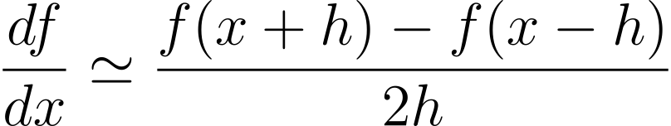
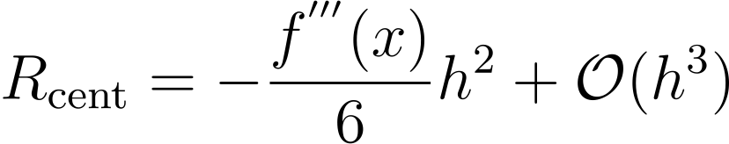
Central difference
Recall the forward and backward difference and their errors
Taking the average of the two cancels out the O(h) error term
central difference
Error estimate:

Slide 6
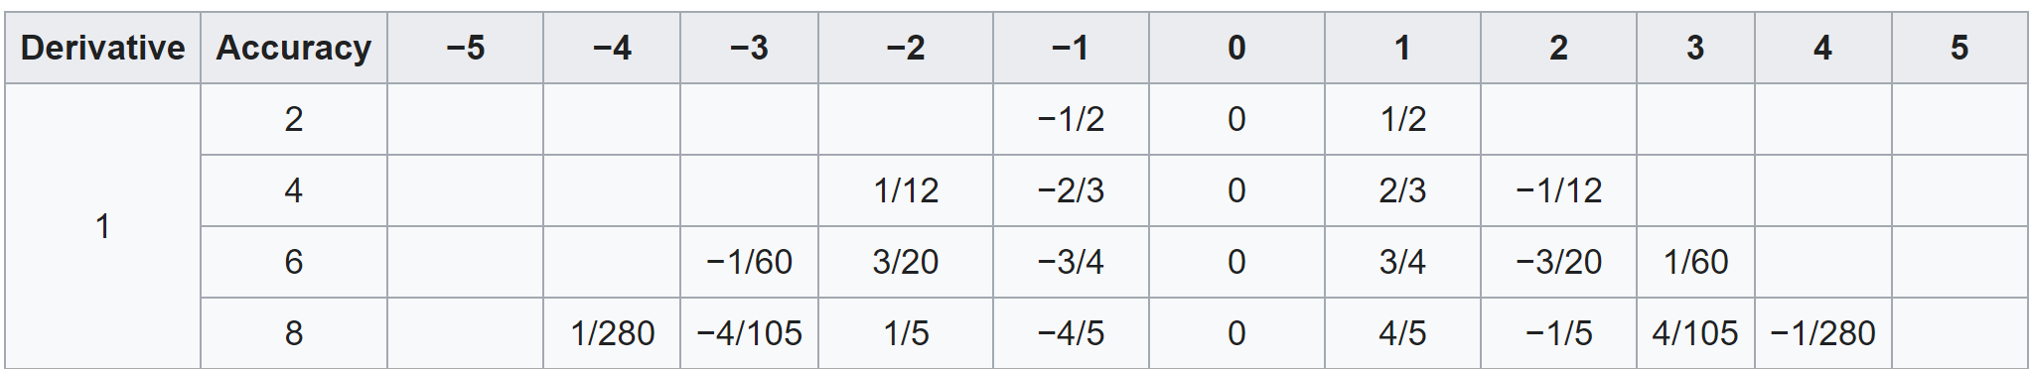
High-order central difference
To improve the approximation error use more than two function evaluations, e.g.
Determine A,B,C,D,E using Taylor expansion to cancel all terms up to h⁴
High-order terms:

Slide 7
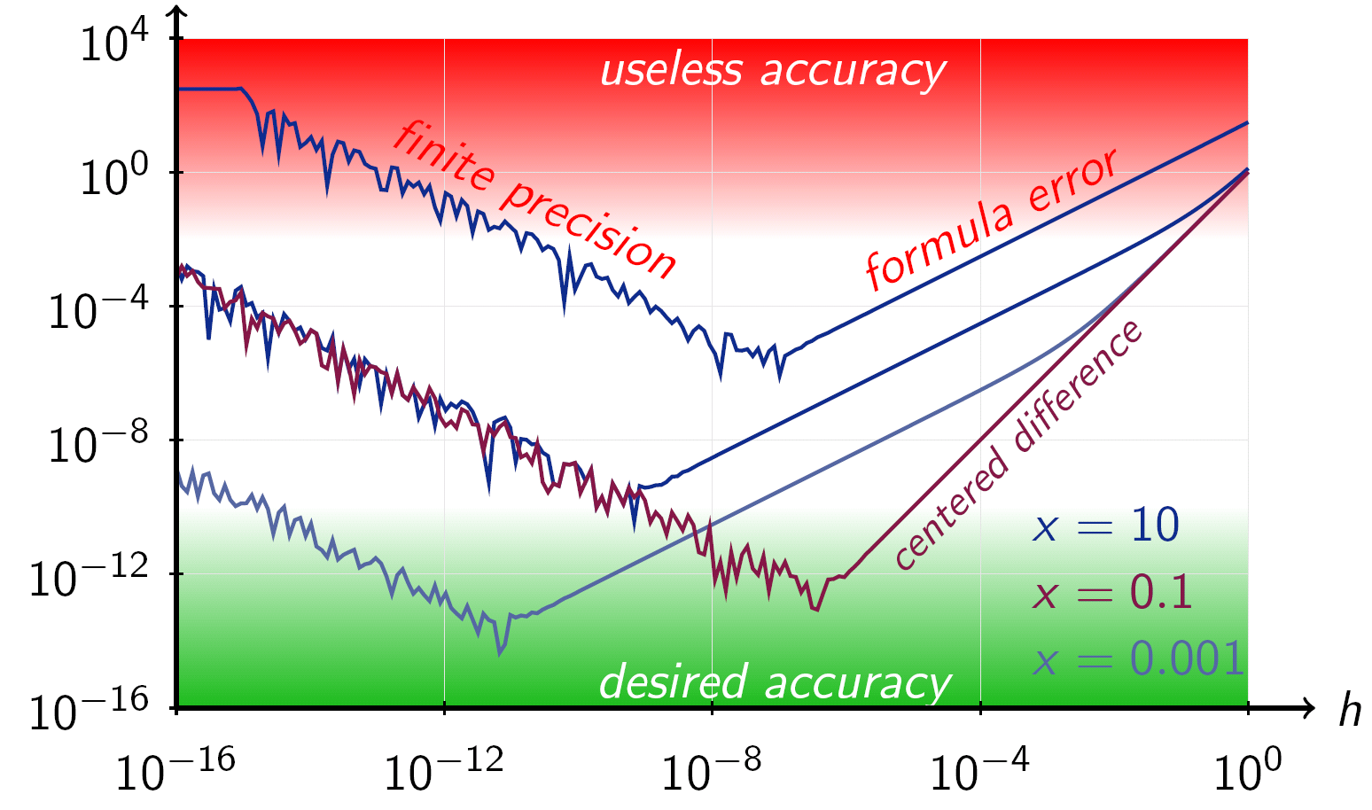
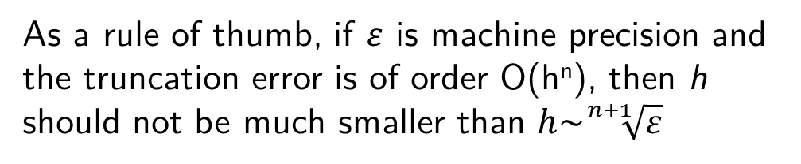
Balancing truncation and round-off errors
If h is too small, round-off errors become important
cannot distinguish x and x+h and/or f(x+h) and f(x) with enough accuracy
As a rule of thumb, if $ε$ is machine precision and the truncation error is of order O(h^{n}), then h should not be much smaller than $h\sim \sqrt[n+1]{ε}$
Credit: Wikipedia
The higher the finite difference order is, the larger h should be

Slide 8
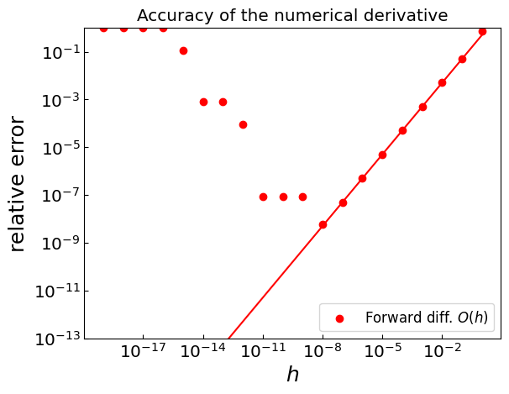
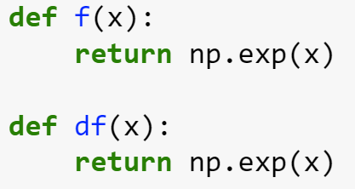

Balancing truncation and round-off errors
Let f(x) = exp(x)
Calculate the derivatives at x = 0
Forward difference O(h):
Optimal $h\sim \sqrt[2]{{10}^{−16}}\sim {10}^{−8}$

Slide 9
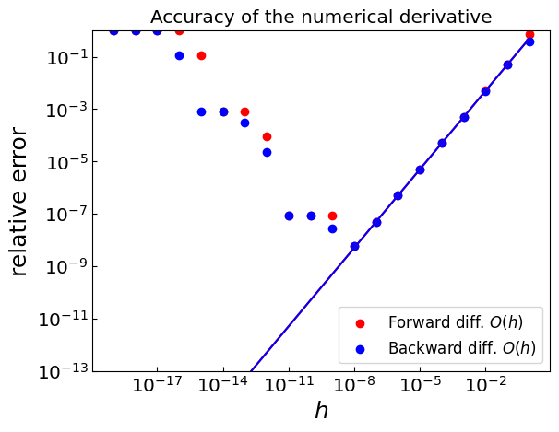
Balancing truncation and round-off errors
Let f(x) = exp(x)
Calculate the derivatives at x = 0
Backward difference O(h):
Optimal $h\sim \sqrt[2]{{10}^{−16}}\sim {10}^{−8}$

Slide 10
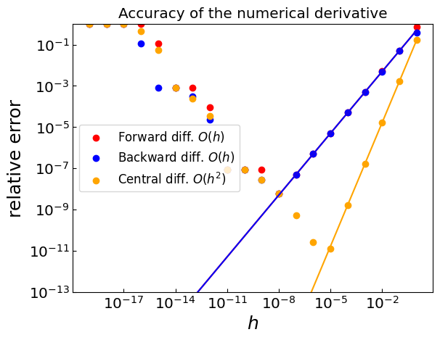

Balancing truncation and round-off errors
Let f(x) = exp(x)
Calculate the derivatives at x = 0
Central difference O(h²):
Optimal $h\sim \sqrt[3]{{10}^{−16}}\sim {10}^{−5}$

Slide 11
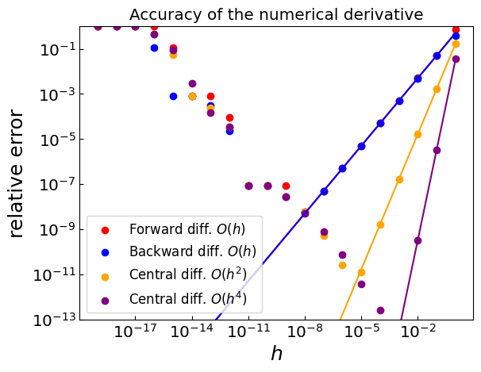

Balancing truncation and round-off errors
Let f(x) = exp(x)
Calculate the derivatives at x = 0
Central difference O(h⁴):
Optimal $h\sim \sqrt[5]{{10}^{−16}}\sim {10}^{−3}$

Slide 12
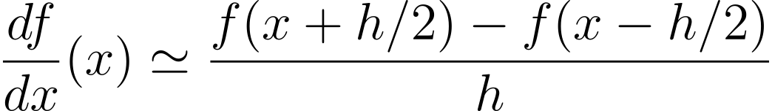
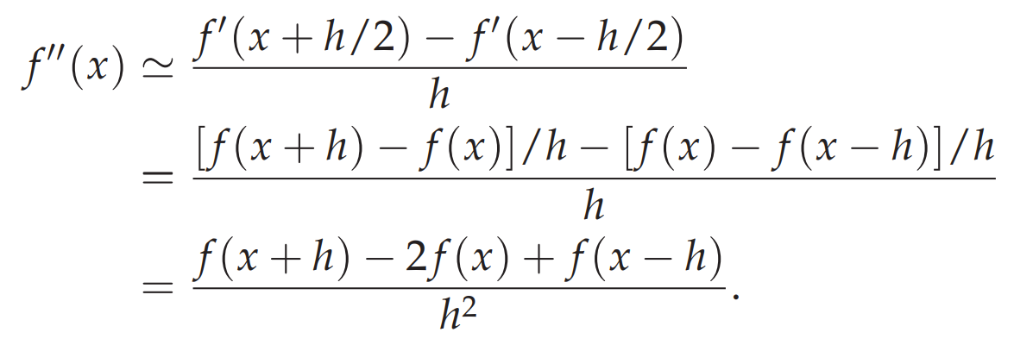
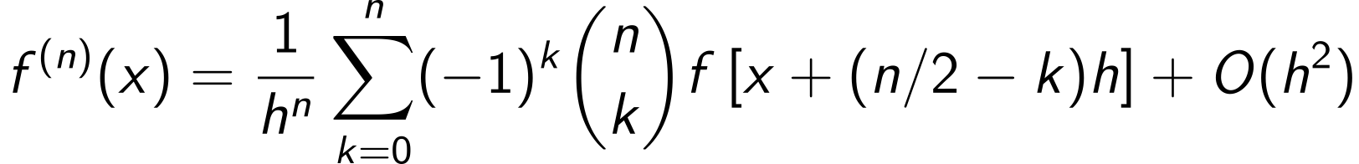
High-order derivatives
Central difference
Now apply the central difference again to f’(x+h/2) and f’(x-h/2)
General formula (to order h)

Slide 13

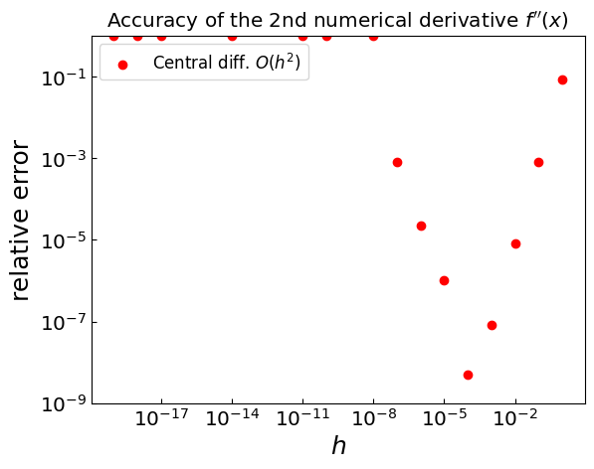
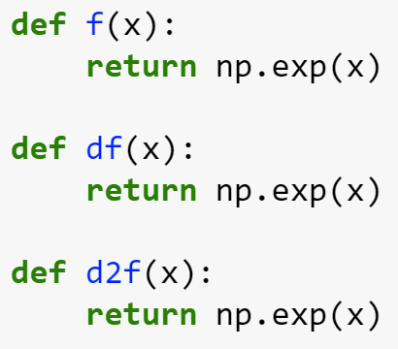

Second derivative
f(x) = exp(x)
Optimal $h\sim \sqrt[4]{{10}^{−16}}\sim {10}^{−4}$

Slide 14
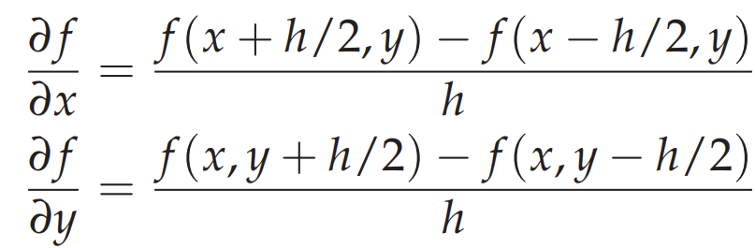

Partial derivatives
Let us have f(x,y)
Use central difference to calculate first-order derivatives
Reapply the central difference to calculate

Slide 15
Summary: Numerical differentiation
Forward/backward differences
Useful when we are given a grid of function values
Have limited accuracy (linear in h)
Central difference
More precise than forward/backward differences (quadratic in h)
Gives f’(x) estimate at the midpoint of function evaluation points
Higher-order formulas are obtained by using more than two function evaluations
Can be used when limited number of function evaluations available
Straightforwardly extendable to high-order and partial derivatives
Balance between truncation and round-off error must be respected
h should not be taken too small

Slide 16
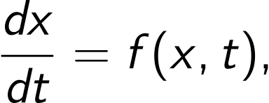

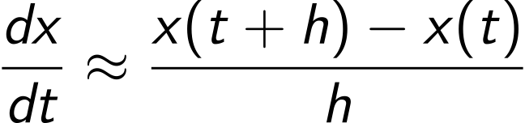
Numerical derivative and ordinary differential equations
Ordinary differential equation
with initial condition
Use the forward difference to approximate dx/dt
gives the Euler method of solving the equation for x(t)

