Slide 1

Computational Physics (PHYS6350)
Lecture 14: Linear algebra and matrices: Part II
Matrix inversion
Tri- and band-diagonal systems
QR decomposition
Eigenvalue problem
March 7, 2023
Instructor: Volodymyr Vovchenko (vvovchenko@uh.edu)
Course materials: https://github.com/vlvovch/PHYS6350-ComputationalPhysics

Slide 2



Matrix inversion
Inverse of matrix A, if it exists, satisfies
Let us denote the columns of the inverse matrix A⁻¹ by x_{k}, i.e. A⁻¹=(x₁,…,x_{n})
The vectors x_{k} satisfy the following N systems of non-linear equations
where
Since the matrix A is always the same, these systems can be efficiently solved with LU-decomposition to find all x_{k} and thus the inverse matrix A⁻¹
Complexity: 1 LU-decomposition O(N³) + N backsubstitutions [each O(N²)] ~ O(N³)
Notes:
The important thing here, however, is that this equation defines how the mean B1 depends on t.
We can thus use this straightforwardly to calculate the higher-order cumulants by taking the derivatives from this equation with respect to t.
And by repeatedly abusing the Faa di Bruno formula for high-order derivatives of composite functions we can calculate the net-baryon cumulants subject to global baryon conservation up to a desired order.
Here I am showing the results for three cumulants ratios, the so-called scaled variance, skewness, and kurtosis, our paper contains explicit results up to order 6.
We obtain the B1 cumulants in terms of the subvolume fraction \alpha and the grand-canonical susceptibilities \chi_B.
This is exactly what we want, as the grand-canonical susceptibilities are the intrinsic properties of the equation of state that we want to probe.
Unsurprisingly, in the limit \alpha goes to zero we obtain the grand-canonical susceptibility ratios.
Let me reiterate again that here I did not assume anything about the equation of state, this result is model-independent.

Slide 3
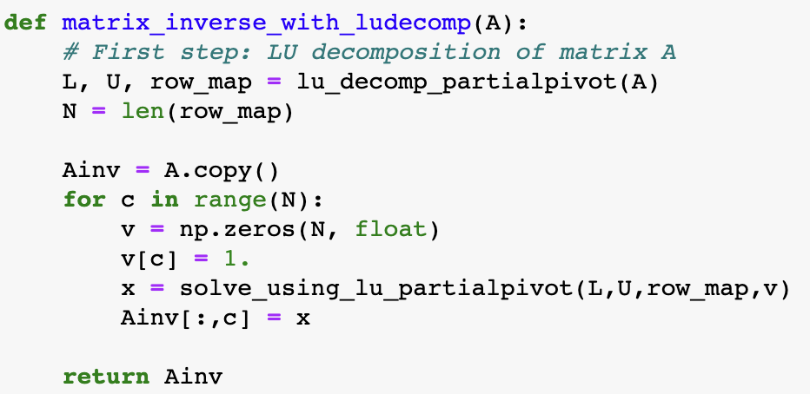
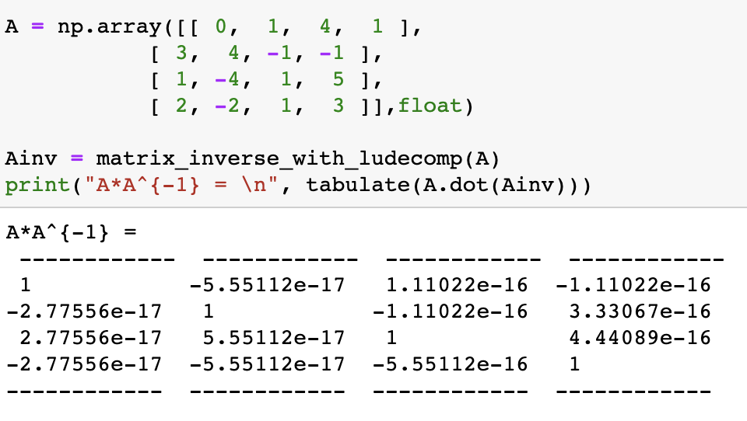
Matrix inversion
Notes:
The important thing here, however, is that this equation defines how the mean B1 depends on t.
We can thus use this straightforwardly to calculate the higher-order cumulants by taking the derivatives from this equation with respect to t.
And by repeatedly abusing the Faa di Bruno formula for high-order derivatives of composite functions we can calculate the net-baryon cumulants subject to global baryon conservation up to a desired order.
Here I am showing the results for three cumulants ratios, the so-called scaled variance, skewness, and kurtosis, our paper contains explicit results up to order 6.
We obtain the B1 cumulants in terms of the subvolume fraction \alpha and the grand-canonical susceptibilities \chi_B.
This is exactly what we want, as the grand-canonical susceptibilities are the intrinsic properties of the equation of state that we want to probe.
Unsurprisingly, in the limit \alpha goes to zero we obtain the grand-canonical susceptibility ratios.
Let me reiterate again that here I did not assume anything about the equation of state, this result is model-independent.

Slide 4
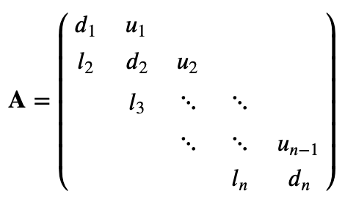
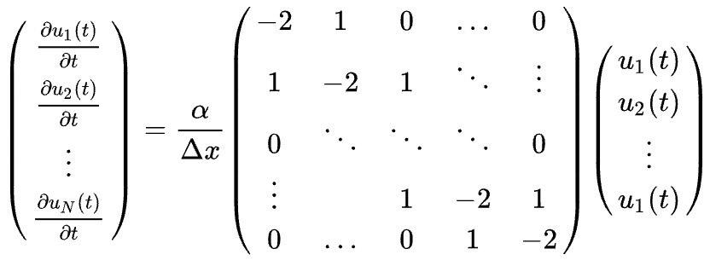
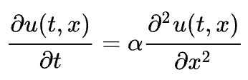
Tridiagonal systems
Tridiagonal system of equation is a special case when the matrix A is tridiagonal
Tridiagonal systems of linear equations often appear in physics, e.g.
Nearest-neighbor interaction (linear chain of springs)
Finite differences applied to partial differential equations (heat equation)
Notes:
The important thing here, however, is that this equation defines how the mean B1 depends on t.
We can thus use this straightforwardly to calculate the higher-order cumulants by taking the derivatives from this equation with respect to t.
And by repeatedly abusing the Faa di Bruno formula for high-order derivatives of composite functions we can calculate the net-baryon cumulants subject to global baryon conservation up to a desired order.
Here I am showing the results for three cumulants ratios, the so-called scaled variance, skewness, and kurtosis, our paper contains explicit results up to order 6.
We obtain the B1 cumulants in terms of the subvolume fraction \alpha and the grand-canonical susceptibilities \chi_B.
This is exactly what we want, as the grand-canonical susceptibilities are the intrinsic properties of the equation of state that we want to probe.
Unsurprisingly, in the limit \alpha goes to zero we obtain the grand-canonical susceptibility ratios.
Let me reiterate again that here I did not assume anything about the equation of state, this result is model-independent.

Slide 5

Solving tridiagonal systems
Tridiagonal system can be solved in linear time [O(N)] with Gaussian elimination
At each step need to subtract only one row below the current one, and at most two elements
Backsubstitution step: subtract only single element from the upper superdiagonal
Notes:
The important thing here, however, is that this equation defines how the mean B1 depends on t.
We can thus use this straightforwardly to calculate the higher-order cumulants by taking the derivatives from this equation with respect to t.
And by repeatedly abusing the Faa di Bruno formula for high-order derivatives of composite functions we can calculate the net-baryon cumulants subject to global baryon conservation up to a desired order.
Here I am showing the results for three cumulants ratios, the so-called scaled variance, skewness, and kurtosis, our paper contains explicit results up to order 6.
We obtain the B1 cumulants in terms of the subvolume fraction \alpha and the grand-canonical susceptibilities \chi_B.
This is exactly what we want, as the grand-canonical susceptibilities are the intrinsic properties of the equation of state that we want to probe.
Unsurprisingly, in the limit \alpha goes to zero we obtain the grand-canonical susceptibility ratios.
Let me reiterate again that here I did not assume anything about the equation of state, this result is model-independent.

Slide 6
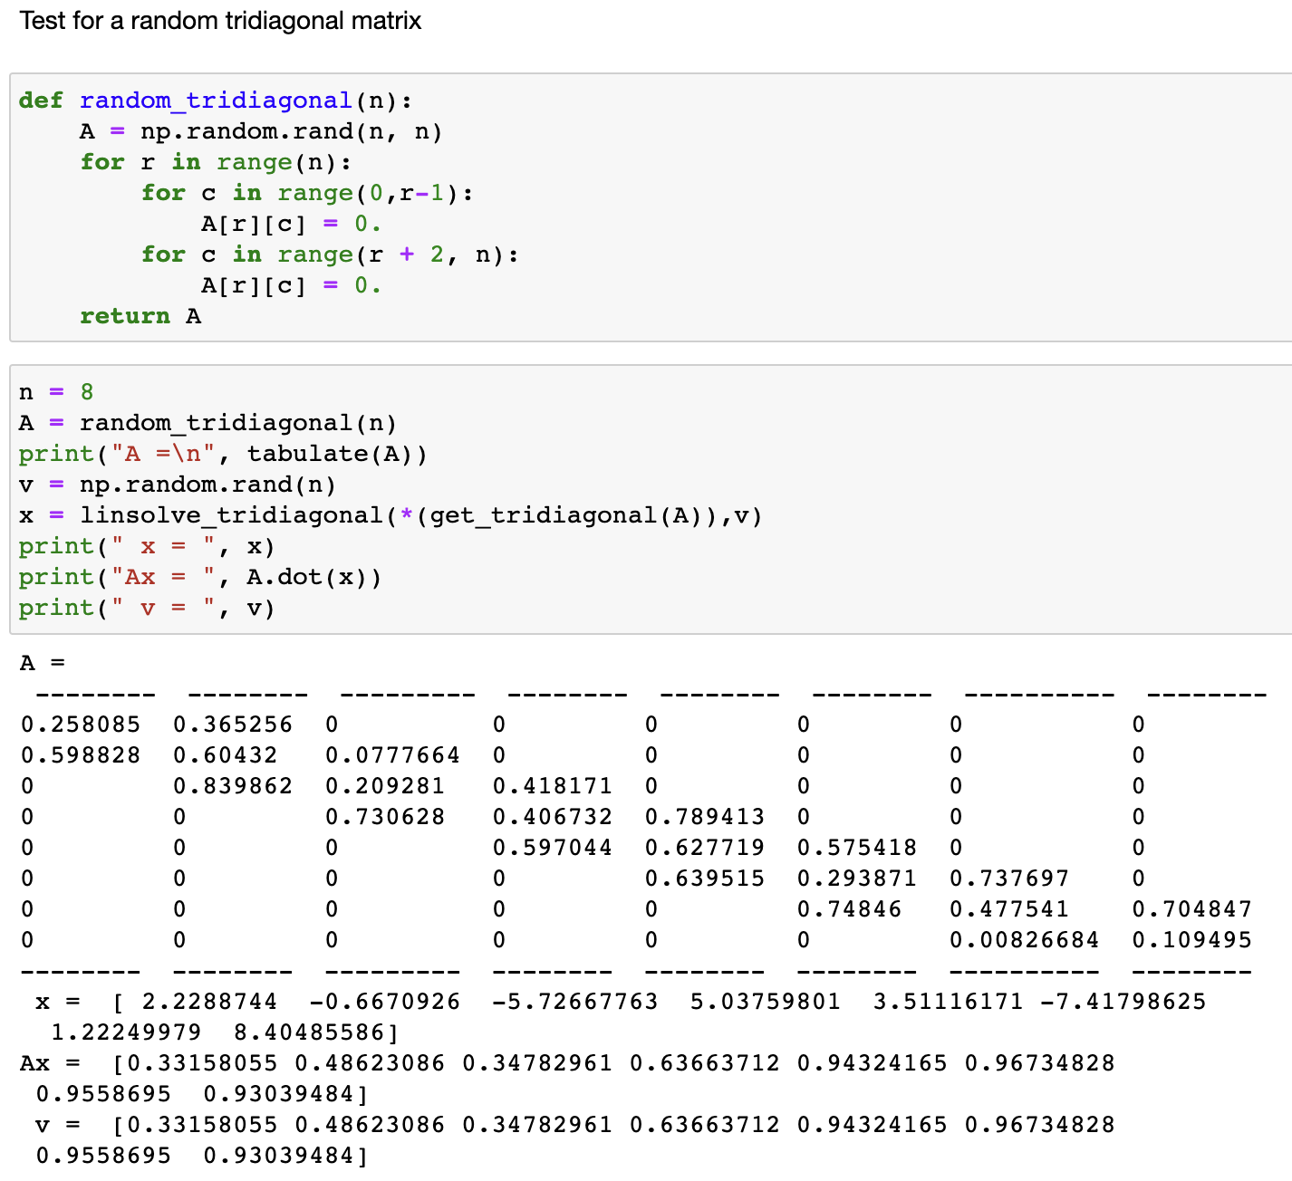
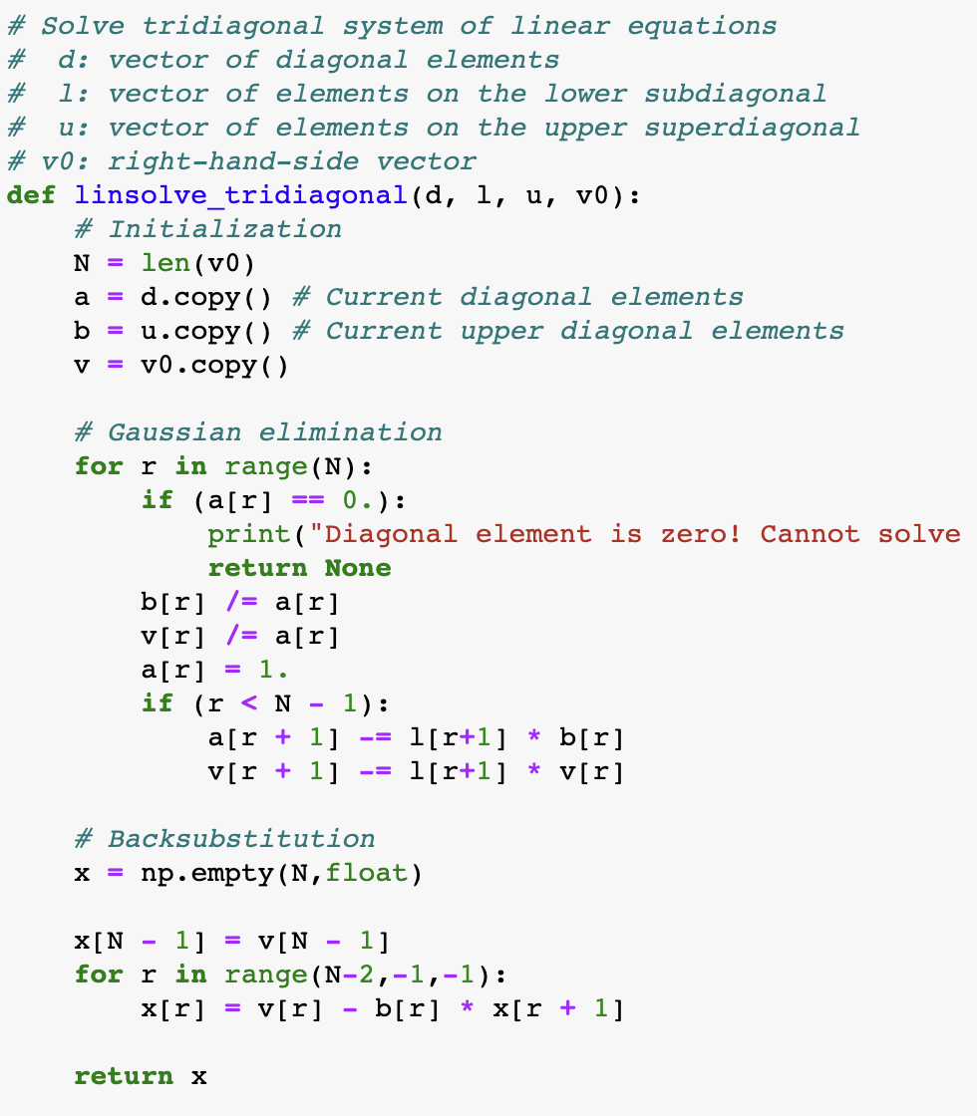
Solving tridiagonal systems
Notes:
The important thing here, however, is that this equation defines how the mean B1 depends on t.
We can thus use this straightforwardly to calculate the higher-order cumulants by taking the derivatives from this equation with respect to t.
And by repeatedly abusing the Faa di Bruno formula for high-order derivatives of composite functions we can calculate the net-baryon cumulants subject to global baryon conservation up to a desired order.
Here I am showing the results for three cumulants ratios, the so-called scaled variance, skewness, and kurtosis, our paper contains explicit results up to order 6.
We obtain the B1 cumulants in terms of the subvolume fraction \alpha and the grand-canonical susceptibilities \chi_B.
This is exactly what we want, as the grand-canonical susceptibilities are the intrinsic properties of the equation of state that we want to probe.
Unsurprisingly, in the limit \alpha goes to zero we obtain the grand-canonical susceptibility ratios.
Let me reiterate again that here I did not assume anything about the equation of state, this result is model-independent.

Slide 7
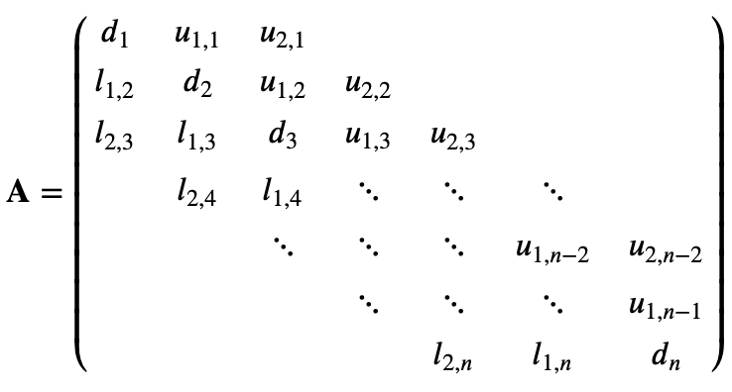
Band-diagonal systems
Band-diagonal system: in each row
at most m_{lower} non-zero elements to the left of the main diagonal
at most m_{upper} non-zero elements to the right of the main diagonal
Generalization of tridiagonal systems (m_{lower} = m_{upper} =1)
Nearest-neighbor interaction (linear chain of springs)
Finite differences applied to partial differential equations (heat equation)
Notes:
The important thing here, however, is that this equation defines how the mean B1 depends on t.
We can thus use this straightforwardly to calculate the higher-order cumulants by taking the derivatives from this equation with respect to t.
And by repeatedly abusing the Faa di Bruno formula for high-order derivatives of composite functions we can calculate the net-baryon cumulants subject to global baryon conservation up to a desired order.
Here I am showing the results for three cumulants ratios, the so-called scaled variance, skewness, and kurtosis, our paper contains explicit results up to order 6.
We obtain the B1 cumulants in terms of the subvolume fraction \alpha and the grand-canonical susceptibilities \chi_B.
This is exactly what we want, as the grand-canonical susceptibilities are the intrinsic properties of the equation of state that we want to probe.
Unsurprisingly, in the limit \alpha goes to zero we obtain the grand-canonical susceptibility ratios.
Let me reiterate again that here I did not assume anything about the equation of state, this result is model-independent.

Slide 8
Solving band-diagonal systems
Solving band-diagonal system proceeds also through Gaussian elimination
At each step one has to normalize m_{upper}+1 elements in the current row, then subtract the current row from at most m_{lower} rows below it. O(N x m_{upper} x m_{lower})
Backsubstitution step: in each row subtract up to m_{upper} elements to the right from the main diagonal. O(N x m_{upper})
Overall complexity: O(N x m_{upper} x m_{lower})
Notes:
The important thing here, however, is that this equation defines how the mean B1 depends on t.
We can thus use this straightforwardly to calculate the higher-order cumulants by taking the derivatives from this equation with respect to t.
And by repeatedly abusing the Faa di Bruno formula for high-order derivatives of composite functions we can calculate the net-baryon cumulants subject to global baryon conservation up to a desired order.
Here I am showing the results for three cumulants ratios, the so-called scaled variance, skewness, and kurtosis, our paper contains explicit results up to order 6.
We obtain the B1 cumulants in terms of the subvolume fraction \alpha and the grand-canonical susceptibilities \chi_B.
This is exactly what we want, as the grand-canonical susceptibilities are the intrinsic properties of the equation of state that we want to probe.
Unsurprisingly, in the limit \alpha goes to zero we obtain the grand-canonical susceptibility ratios.
Let me reiterate again that here I did not assume anything about the equation of state, this result is model-independent.

Slide 9
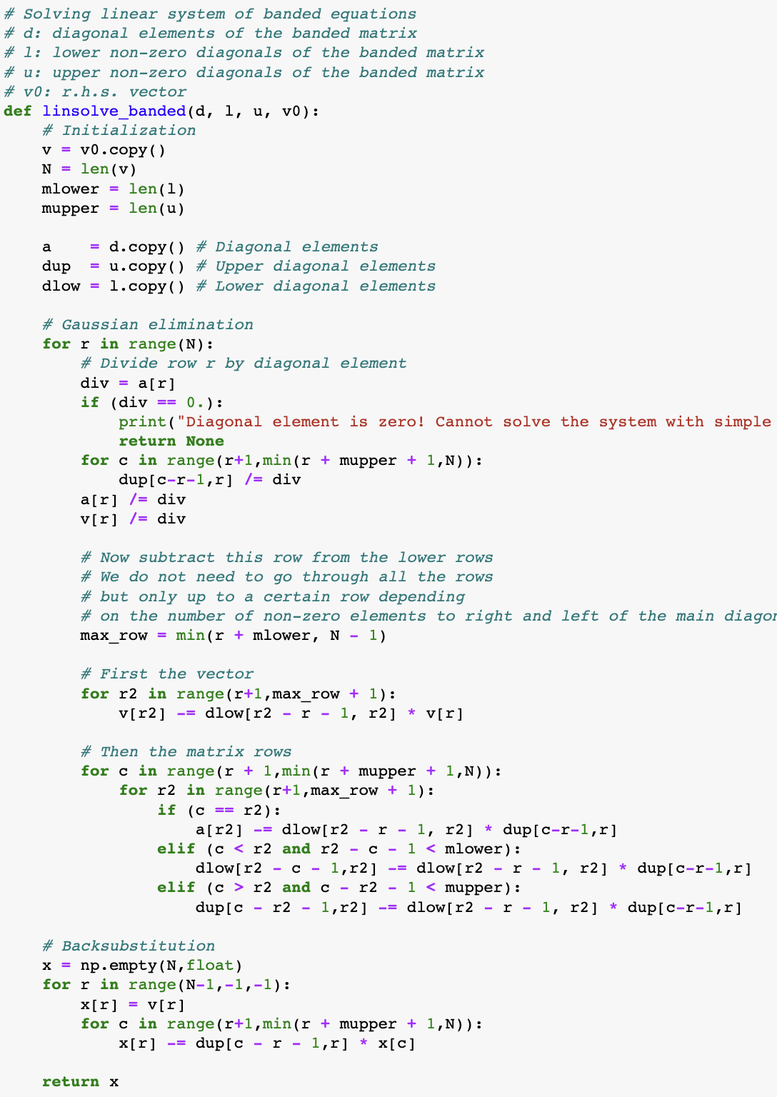
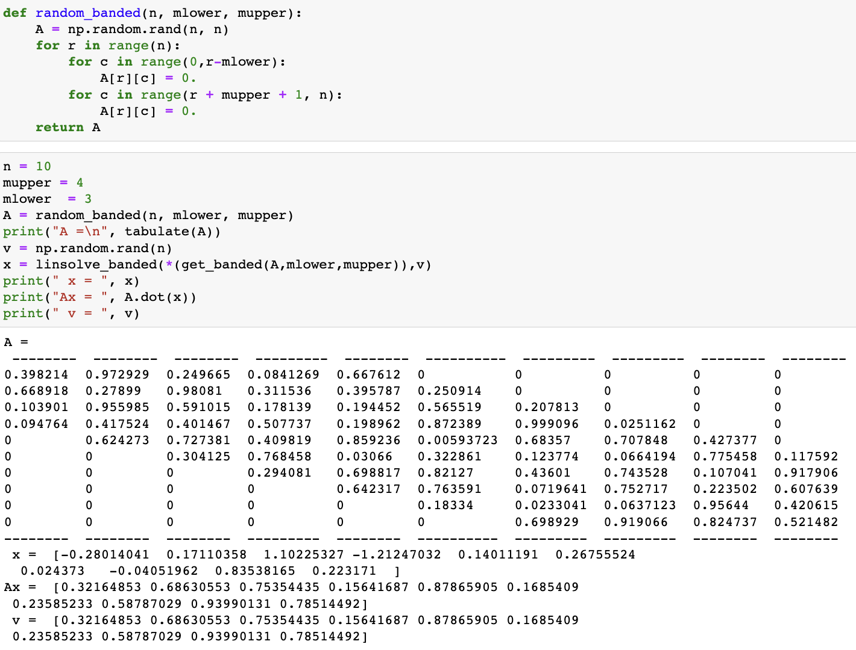
Solving band-diagonal systems
Notes:
The important thing here, however, is that this equation defines how the mean B1 depends on t.
We can thus use this straightforwardly to calculate the higher-order cumulants by taking the derivatives from this equation with respect to t.
And by repeatedly abusing the Faa di Bruno formula for high-order derivatives of composite functions we can calculate the net-baryon cumulants subject to global baryon conservation up to a desired order.
Here I am showing the results for three cumulants ratios, the so-called scaled variance, skewness, and kurtosis, our paper contains explicit results up to order 6.
We obtain the B1 cumulants in terms of the subvolume fraction \alpha and the grand-canonical susceptibilities \chi_B.
This is exactly what we want, as the grand-canonical susceptibilities are the intrinsic properties of the equation of state that we want to probe.
Unsurprisingly, in the limit \alpha goes to zero we obtain the grand-canonical susceptibility ratios.
Let me reiterate again that here I did not assume anything about the equation of state, this result is model-independent.

Slide 10

QR decomposition*
Any real square matrix A permits a decomposition
where
Q is orthogonal, Q⁻¹=Q^{T}, and thus, Q^{T}Q = I
R is upper diagonal
There are many algorithms for constructing the QR decomposition, from simple Gram-Schimdt process to more involved methods using Householder transformation and Givens rotations. These are readily implemented in linear algebra packages.
*Has nothing to do with QR codes
Notes:
The important thing here, however, is that this equation defines how the mean B1 depends on t.
We can thus use this straightforwardly to calculate the higher-order cumulants by taking the derivatives from this equation with respect to t.
And by repeatedly abusing the Faa di Bruno formula for high-order derivatives of composite functions we can calculate the net-baryon cumulants subject to global baryon conservation up to a desired order.
Here I am showing the results for three cumulants ratios, the so-called scaled variance, skewness, and kurtosis, our paper contains explicit results up to order 6.
We obtain the B1 cumulants in terms of the subvolume fraction \alpha and the grand-canonical susceptibilities \chi_B.
This is exactly what we want, as the grand-canonical susceptibilities are the intrinsic properties of the equation of state that we want to probe.
Unsurprisingly, in the limit \alpha goes to zero we obtain the grand-canonical susceptibility ratios.
Let me reiterate again that here I did not assume anything about the equation of state, this result is model-independent.

Slide 11



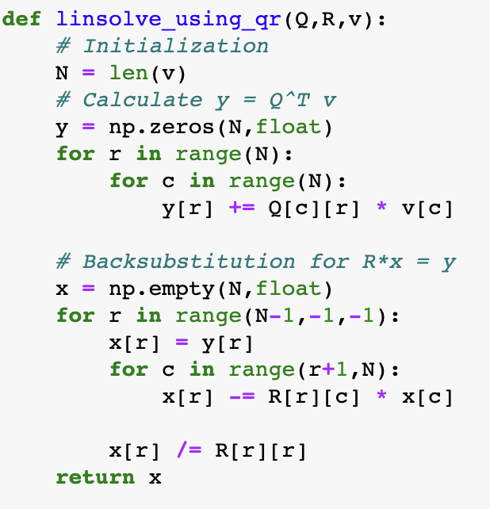
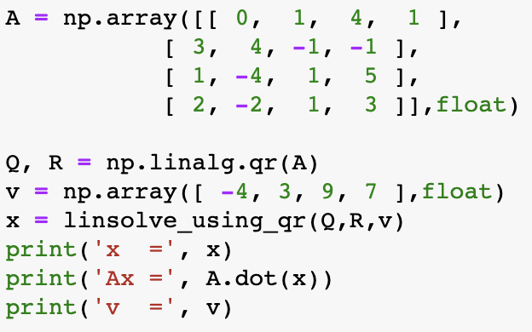
QR decomposition and systems of linear equations
System of linear equations
If A = QR we can rewrite the system as
Multiplying each side of the equation by Q^{T}, we have
The matrix R is upper triangular, thus, the system can solved using backsubstitution.
Notes:
The important thing here, however, is that this equation defines how the mean B1 depends on t.
We can thus use this straightforwardly to calculate the higher-order cumulants by taking the derivatives from this equation with respect to t.
And by repeatedly abusing the Faa di Bruno formula for high-order derivatives of composite functions we can calculate the net-baryon cumulants subject to global baryon conservation up to a desired order.
Here I am showing the results for three cumulants ratios, the so-called scaled variance, skewness, and kurtosis, our paper contains explicit results up to order 6.
We obtain the B1 cumulants in terms of the subvolume fraction \alpha and the grand-canonical susceptibilities \chi_B.
This is exactly what we want, as the grand-canonical susceptibilities are the intrinsic properties of the equation of state that we want to probe.
Unsurprisingly, in the limit \alpha goes to zero we obtain the grand-canonical susceptibility ratios.
Let me reiterate again that here I did not assume anything about the equation of state, this result is model-independent.

Slide 12



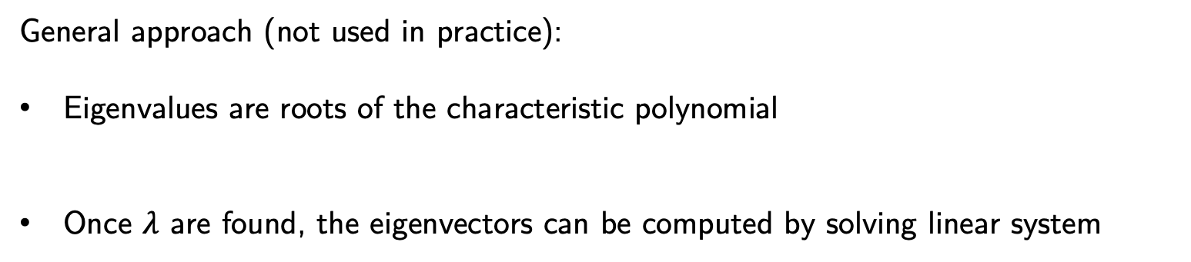
Eigenvalue problem
A common matrix problem in physics is the calculation of eigenvalues and eigenvectors of a matrix (e.g. classical and quantum mechanics).
The eigenvalue problem corresponds to the equation
Here $λ$ are the eigenvalues and v are the eigenvectors
General approach (not used in practice):
Eigenvalues are roots of the characteristic polynomial
Once $λ$ are found, the eigenvectors can be computed by solving linear system
Notes:
The important thing here, however, is that this equation defines how the mean B1 depends on t.
We can thus use this straightforwardly to calculate the higher-order cumulants by taking the derivatives from this equation with respect to t.
And by repeatedly abusing the Faa di Bruno formula for high-order derivatives of composite functions we can calculate the net-baryon cumulants subject to global baryon conservation up to a desired order.
Here I am showing the results for three cumulants ratios, the so-called scaled variance, skewness, and kurtosis, our paper contains explicit results up to order 6.
We obtain the B1 cumulants in terms of the subvolume fraction \alpha and the grand-canonical susceptibilities \chi_B.
This is exactly what we want, as the grand-canonical susceptibilities are the intrinsic properties of the equation of state that we want to probe.
Unsurprisingly, in the limit \alpha goes to zero we obtain the grand-canonical susceptibility ratios.
Let me reiterate again that here I did not assume anything about the equation of state, this result is model-independent.

Slide 13

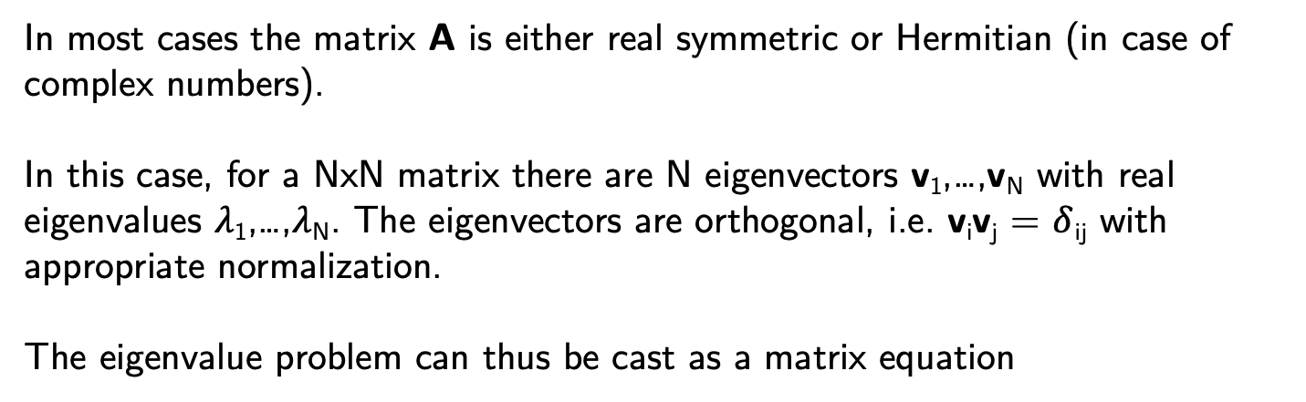
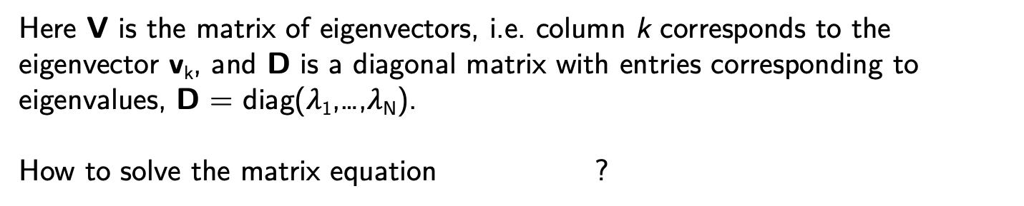
Eigenvalue problem
In most cases the matrix A is either real symmetric or Hermitian (in case of complex numbers).
In this case, for a NxN matrix there are N eigenvectors v₁,…,v_{N} with real eigenvalues $λ$₁,…,$λ$_{N}. The eigenvectors are orthogonal, i.e. v_{i}v_{j} = $δ$_{ij} with appropriate normalization.
The eigenvalue problem can thus be cast as a matrix equation
Here V is the matrix of eigenvectors, i.e. column k corresponds to the eigenvector v_{k}, and D is a diagonal matrix with entries corresponding to eigenvalues, D = diag($λ$₁,…,$λ$_{N}).
How to solve the matrix equation ?
Notes:
The important thing here, however, is that this equation defines how the mean B1 depends on t.
We can thus use this straightforwardly to calculate the higher-order cumulants by taking the derivatives from this equation with respect to t.
And by repeatedly abusing the Faa di Bruno formula for high-order derivatives of composite functions we can calculate the net-baryon cumulants subject to global baryon conservation up to a desired order.
Here I am showing the results for three cumulants ratios, the so-called scaled variance, skewness, and kurtosis, our paper contains explicit results up to order 6.
We obtain the B1 cumulants in terms of the subvolume fraction \alpha and the grand-canonical susceptibilities \chi_B.
This is exactly what we want, as the grand-canonical susceptibilities are the intrinsic properties of the equation of state that we want to probe.
Unsurprisingly, in the limit \alpha goes to zero we obtain the grand-canonical susceptibility ratios.
Let me reiterate again that here I did not assume anything about the equation of state, this result is model-independent.

Slide 14
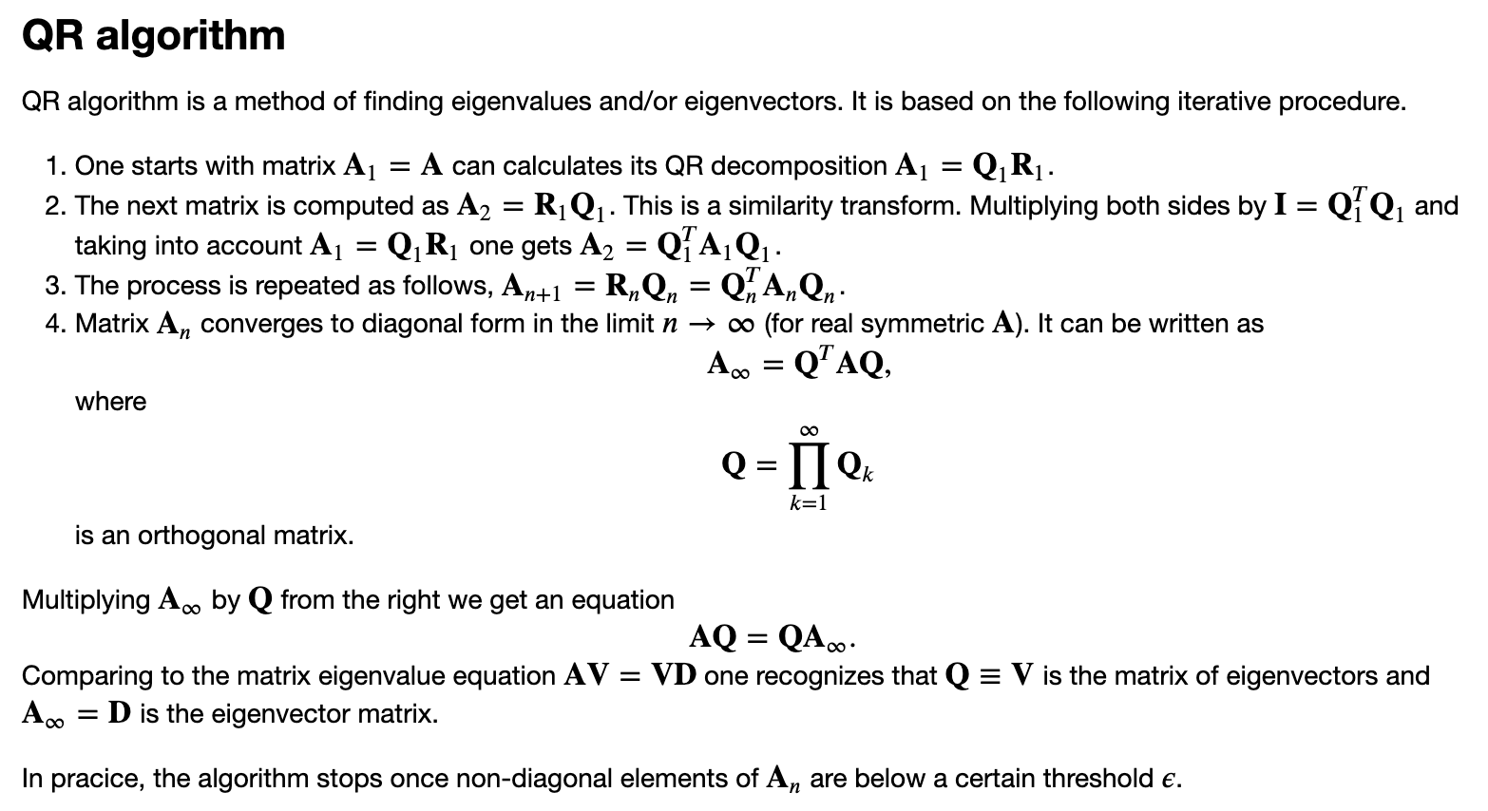
QR algorithm
Notes:
The important thing here, however, is that this equation defines how the mean B1 depends on t.
We can thus use this straightforwardly to calculate the higher-order cumulants by taking the derivatives from this equation with respect to t.
And by repeatedly abusing the Faa di Bruno formula for high-order derivatives of composite functions we can calculate the net-baryon cumulants subject to global baryon conservation up to a desired order.
Here I am showing the results for three cumulants ratios, the so-called scaled variance, skewness, and kurtosis, our paper contains explicit results up to order 6.
We obtain the B1 cumulants in terms of the subvolume fraction \alpha and the grand-canonical susceptibilities \chi_B.
This is exactly what we want, as the grand-canonical susceptibilities are the intrinsic properties of the equation of state that we want to probe.
Unsurprisingly, in the limit \alpha goes to zero we obtain the grand-canonical susceptibility ratios.
Let me reiterate again that here I did not assume anything about the equation of state, this result is model-independent.

Slide 15
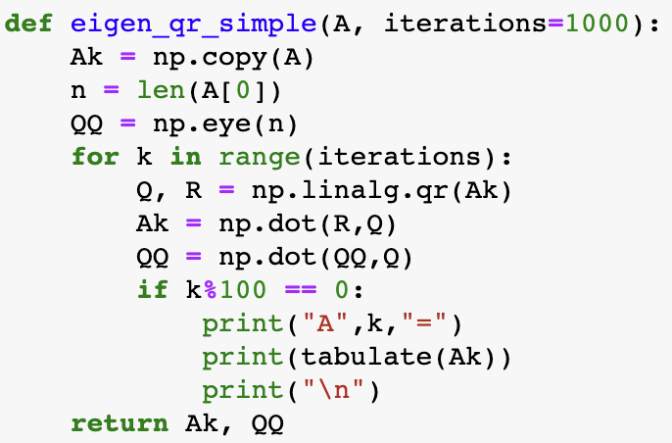
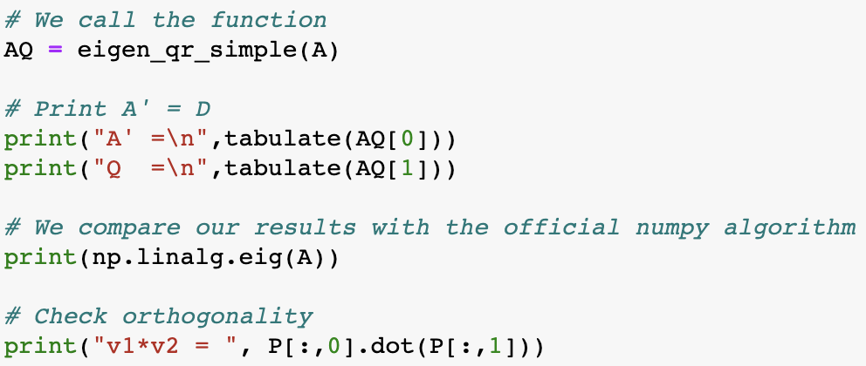
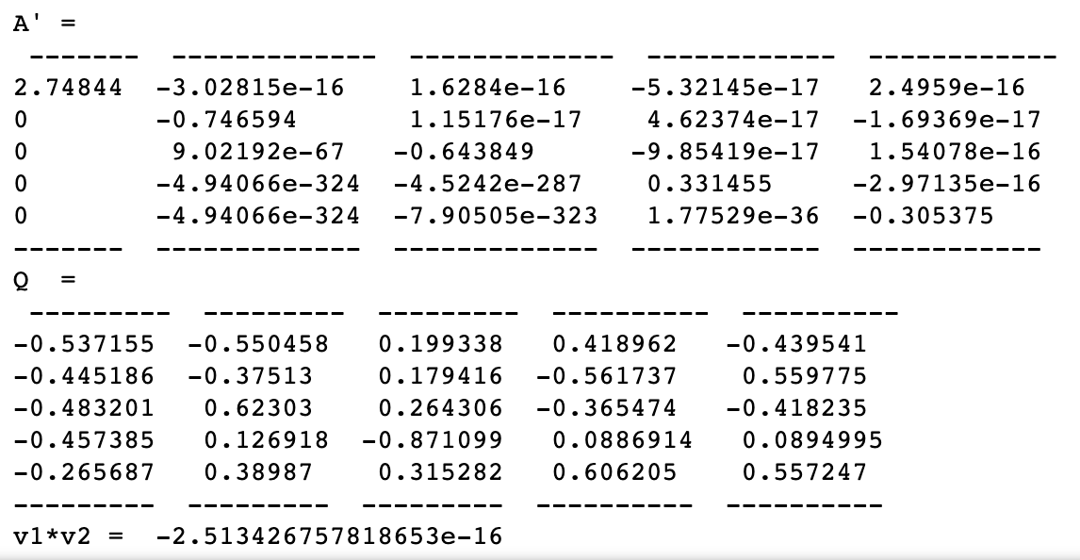
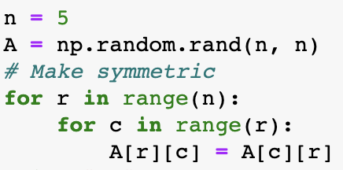
QR algorithm
Notes:
The important thing here, however, is that this equation defines how the mean B1 depends on t.
We can thus use this straightforwardly to calculate the higher-order cumulants by taking the derivatives from this equation with respect to t.
And by repeatedly abusing the Faa di Bruno formula for high-order derivatives of composite functions we can calculate the net-baryon cumulants subject to global baryon conservation up to a desired order.
Here I am showing the results for three cumulants ratios, the so-called scaled variance, skewness, and kurtosis, our paper contains explicit results up to order 6.
We obtain the B1 cumulants in terms of the subvolume fraction \alpha and the grand-canonical susceptibilities \chi_B.
This is exactly what we want, as the grand-canonical susceptibilities are the intrinsic properties of the equation of state that we want to probe.
Unsurprisingly, in the limit \alpha goes to zero we obtain the grand-canonical susceptibility ratios.
Let me reiterate again that here I did not assume anything about the equation of state, this result is model-independent.

