Slide 1
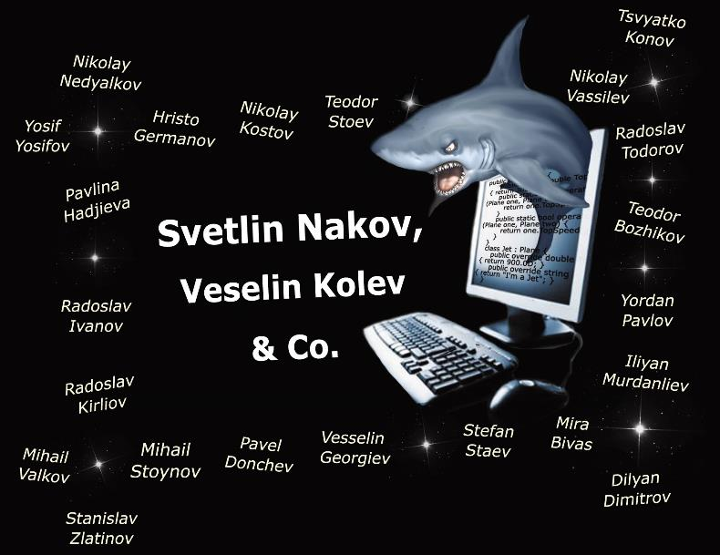




100% free!
Videos
Slides
Mind Maps

Slide 2
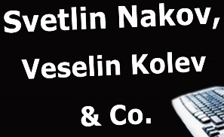

100% free e-book!
Book
Videos
Slides
Mind Maps

Slide 3


Videos
Slides
Mind Maps

