Slide 1
Final Project For Telerik School Academy
Created By Team Mink with members:
Alexander Yordanov
Boyan Hristov

Slide 2
Content
What is the main problem the application solves?
What solution BeautifulFeed provides?
Routes
News feed route
Posts route
Videos route
Statuses route
Pages route
Active Points

Slide 3
What is the main problem the application solves?
Everyone is spending too much time on Facebook
The users don’t know what they really want to see
The users are constantly scrolling through the news feed in search for an interesting post
The news feed can’t be organized

Slide 4
What solution BeautifulFeed provides?
The application can provide you the most interesting posts first
You can review statuses only from your friends
You can check your favourite pages and their posts
You can even browse through videos only

Slide 5


News Feed Route

Slide 6
News feed route
Browse through videos from Facebook, Youtube, Vbox, Vimeo and more.
They are posted by your friends and the pages you’ve liked.

Slide 7
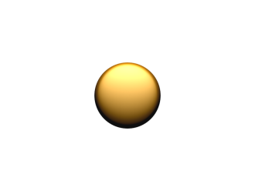

Active Points

Slide 8
Active Points
They are stored when the user likes, comments on or shares a post.
They can sort the user’s news feed and show the most interesting posts first
We store them in our database

Slide 9
Thanks for watching!
Благодарим ви за вниманието!
Danke für die Aufmerksamkeit!

