Slide 1
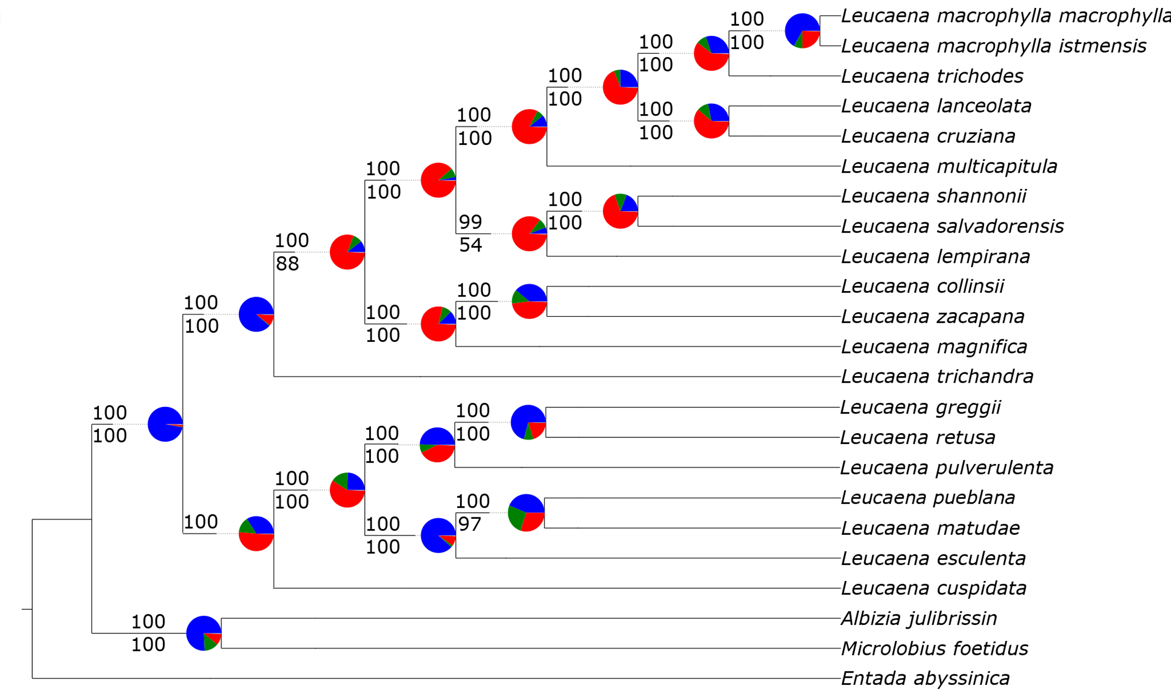
Concordant gene trees
lla
Top alternative bipartition
Conflicting gene trees
Clade 1
Clade 3
Clade 2

