Slide 1
TMS99105 SBC Memory Map
0000-F000
Application Memory
RAM
D800-E33C
BDOS
BDOS.A99
E600-EE2E
FDC BIOS
MONITOR.A99
F000-FFFF
DEBUG Monitor
TIMON.A99
ROM

Slide 2
3 ¼ FDD
RS232
TMS99105 SBC
PC Power
Supply

Slide 3
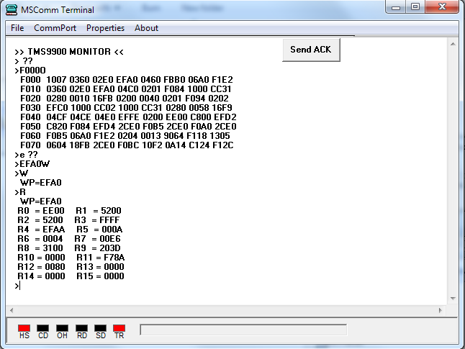

Slide 4
2732 EPROM
0000H
E000H
Mapped out and filled with FFH
0800H
F000H
SBC Address Space
ROM Address Space
DEBUG Monitor
HIGH Byte
LOW Byte
1000H
FFFFH

Slide 5
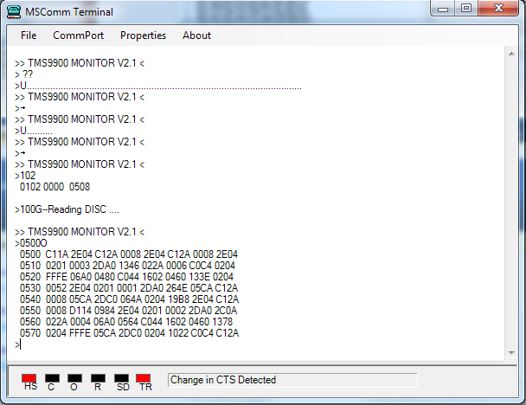
Reading in MONITOR.H99
Reading in READSEC.H99
Specify Track 5, Sector 8
Dumping Buffer at 0500H

