Slide 1

An Introduction to HPC and Scientific Computing
Lecture seven: An introduction to the CUDA programming language.
Karel Adámek
Oxford e-Research Centre,
Department of Engineering Science

Slide 2
Overview
In this lecture we will learn about:
What is CUDA?
The basics of writing a GPU accelerated code.
Parallelisation in CUDA.
How to map data in CUDA to GPU hardware.
What is the NVIDIA visual profiler (nvvp)?

Slide 3
What is CUDA
General purpose computing on GPU
or GPGPU means that GPU can be used for computations as well as for graphics. First introduced into GPU to improve image quality.
Heterogeneous computing
refers to systems which use different kinds of processor architectures to achieve higher performance or energy efficiency. Different architectures are better suited for different tasks.
API
is “application programming interface” and in this case it is a piece of software which simplifies communication with the GPU.
Is abbreviation for “Compute Unified Device Architecture”
Language based on C/C++
Exposes GPU parallel capabilities for general purpose computing, while retaining high performance
Enables heterogeneous computations and programming
API allows to manage GPUs and their memory (allocate, copy, free)
Fortran is supported as well

Slide 4
Where is CUDA
What do you need?
NVIDIA driver
CUDA toolkit
What do you get?
Driver is a low-level software that controls the graphics card
Toolkit:
nvcc CUDA compiler
Nsight IDE plugin for Eclipse or Visual Studio
nvvp - profiling tools
cuda-gdb - debugging tools
several libraries (cuFFT, cuBLAS, cuRAND, ... )
SDK:
lots of demonstration examples
some error-checking utilities
not officially supported by NVIDIA
almost no documentation

Slide 5
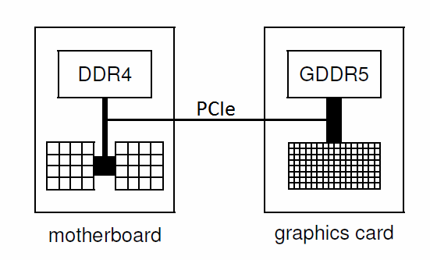
Hardware perspective
A typical node (computer) configuration is to have a CPU communicating with one or more GPUs through PCIe.
In general
CPU (host) has lower bandwidth to memory, less cores but much more memory available.
GPU (device) has higher bandwidth, many more cores, less memory.
CPU is optimized to minimize latency, ideal for command and control and some computations.
GPU is optimized for throughput, ideal for data parallel computations.
PCIe
is a bus connecting the host and device, it has the potential to be a problem:
CPU bandwidth: ~300GB/s
GPU bandwidth: ~900GB/s
PCIe bandwidth: ~16GB/s

Slide 6
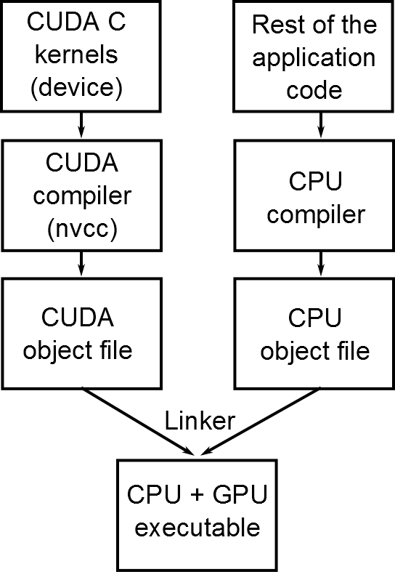
How this affects us?
Code is divided into host part and device part (both can be in one file)
Any device code must be in the form of a CUDA kernel
Host code constitutes the rest of the application
Host operations include: memory management, host<->device interactions, computations
Device operations are parallel computations

Slide 7
‘Hello world’ in CUDA
CPU code for fancy ‘Hello world’
GPU code for ‘Hello world’
#include <stdio.h>
#include <stdlib.h>
void helloworld(void) {
printf("Hello world!\n");
}
int main(void) {
helloworld();
return (0);
}
#include <stdio.h>
#include <stdlib.h>
// we have to include few more things
#include <cuda.h>
#include <cuda_runtime.h>
#include <cuda_runtime_api.h>
__global__ void helloworld_GPU(void){
printf("Hello world!\n");
}
int main(void) {
// run CUDA kernel
helloworld_GPU<<<1,1>>>();
return (0);
}
GPU does things bit differently:
The function helloworld_GPU is special function which is run on GPU and it is called kernel.
Before we launch any GPU kernel it needs to be configured. This is done by <<< ... >>> syntax.
Run CUDA kernel

Slide 8
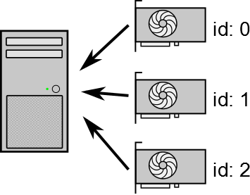
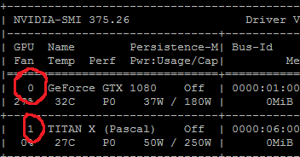
‘Hello world’ in CUDA – device initialisation
Before we can run our code we have to initialize the device first!
GPU code for ‘Hello world’
#include <stdio.h>
#include <stdlib.h>
// we have to include few more things
#include <cuda.h>
#include <cuda_runtime.h>
#include <cuda_runtime_api.h>
__global__ void helloworld_GPU(void){
printf("Hello world!\n");
}
int main(void) {
// initiate GPU
int deviceid = 0; // using GPU with id 0
int devCount;
// gets number of GPU available
cudaGetDeviceCount(&devCount);
// check if we have enough GPUs
if(deviceid<devCount) {
// tell CUDA that we want to use GPU 0
cudaSetDevice(deviceid);
}
else return(1);
// run CUDA kernel
helloworld_GPU<<<1,1>>>();
return (0);
}
A node (or PC) can have more then one GPU. That is why each GPU has its id.
In our code we want to use GPU with id 0.
How to get information about what GPU are available? Run nvidia-smi on linux.

Slide 9
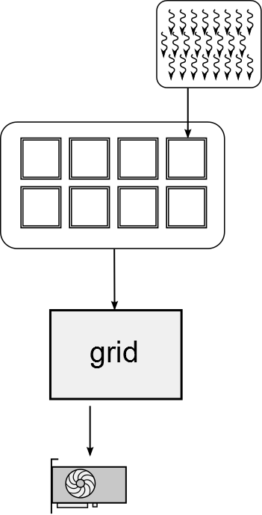
Expressing parallelism in CUDA
Kernel is a set of instructions executed by a single thread, i,.e. something like a serial code for CPU written in C.
To achieve parallelism and good performance on GPUs we have to launch a lot of these threads. Each thread executed same kernel.
We can control how many threads execute our kernel by setting up a grid.
Each kernel has its own grid.
The hierarchy of threads:
Threads are finest in granularity
Blocks contain threads which can cooperate with each other
Size of the block is limited to 1024 threads by architecture
Because 1024 is not enough threads for GPU we create identical blocks to increase parallelism, i.e. increase number of threads
A set of threads is called a thread block or block
A set of identical blocks is called grid
Grid contain all threads which execute our kernel.

Slide 10
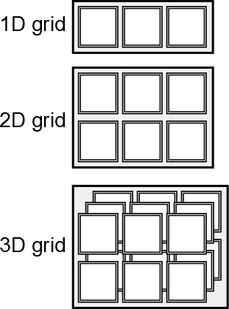
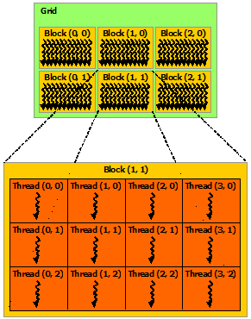
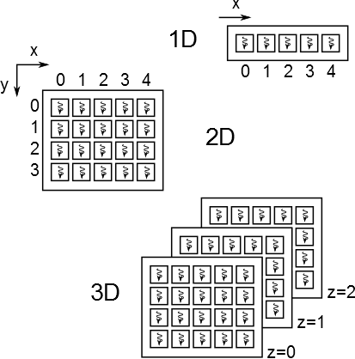
Linking threads (blocks) and data
We can launch a lots of threads, doing the same thing. But how do we point them to different data?
By using their coordinates in three dimensions
Every block has three dimensional coordinate within its grid and,
Every thread from a block has three dimensional coordinate within that block.
Each thread has access to pre-set three dimensional variables:
threadIdx
blockIdx
blockDim
gridDim
Using these we can assign work for each thread.
Example of a grid
Values of preset variable for this thread are:
threadIdx.x = 2
threadIdx.y = 1
threadIdx.z = 0
blockDim.x = 4
blockDim.y = 3
blockDim.z = 1
gridDim.x = 3
gridDim.y = 2
gridDim.z = 1

Slide 11
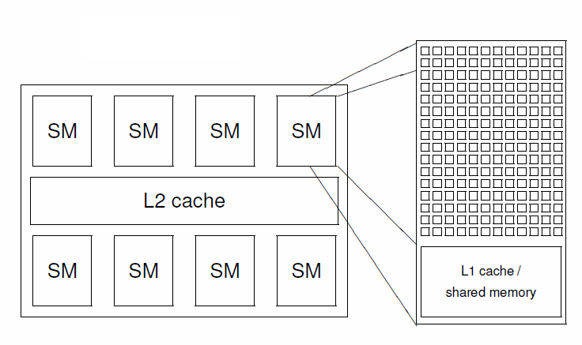
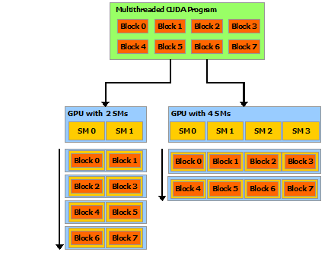
Mapping grid onto hardware
Grid is an abstraction. We cannot control what is executed where on a hardware level.
Threads:
Threads are executed in groups of 32 called warps. (SIMD units have 32 lanes)
Only threads from the same block can cooperate with each other efficiently.
Blocks:
A single block execute on a single SM, blocks do not migrate.
All concurrently running blocks on the same SM share its resources. Utilization of these resources is summarized in occupancy.
GPU is based on latency hiding, in order to hide threads/blocks which are waiting for resources GPU needs a lot of them lined up. Spawn as many threads/blocks as possible.
How blocks are mapped to SMs is not decided by us. This also ensures scalability across different GPUs.

Slide 12
CUDA kernel - definition
CUDA kernel is C-like function, that is, when called, its executed on many threads in parallel.
Kernel is defined by __global__ declaration specifier. Kernel is executed by each thread from CUDA grid in parallel.
Kernel must return void. Kernel cannot communicate with host directly, only through device memory.
Kernel is written from a point of view of a single thread, i.e. like serial code on CPU. However threads can access shared resources with all dangers that it entails in a parallel environment.
Kernel can call function which are executed on the device.
Grid for given kernel is specified by <<<...>>> execution configuration syntax.
// Example of kernel definition
__global__ void my_kernel(args){
int a = 1; // variable local to the thread
for()...; // C-like syntax
if()...;
sqrt = sqrt(2); // special functions
C = A + B; // math
}
// Example of kernel definition
// for vector addition
__global__ void vector_add(
float *d_C, float *d_A, float *d_B
){
int index;
d_C[index] = d_A[index] + d_B[index];
}

Slide 13
CUDA kernel - execution
// Example of kernel definition
// for vector addition
__global__ void vector_add(
float *d_C, float *d_A, float *d_B
){
int index = ...;
d_C[index] = d_A[index] + d_B[index];
}
// Example of simplest configuration (using int
// instead of dim3 and omitting optional parameters
int nBlocks = 1;
int nThreads = 100;
Vector_add<<< nBlocks, nThreads >>>(d_C, d_A, d_B);
// Example of 2D configuration, omitting optional
// parameters
dim3 Gd(2, 2, 1);//unused dimension is set to 1
dim3 Bd(32, 4, 1);
Vector_add<<< Gd, Bd >>>(d_C, d_A, d_B);
// Example of 3D configuration, omitting optional
// parameters
dim3 Gd(2, 2, 2); // unused dimension must be 1
dim3 Bd(32, 4, 4);
Vector_add<<< Gd, Bd >>>(d_C, d_A, d_B);
Execution configuration syntax:
Required:
Gd is number of blocks in three dimensions in the grid.
Bd is number of threads in three dimension per block.
Both could be int for one dimensional case.
Optional (not discussed in this lecture):
Ns is size of shared memory in bytes
S is CUDA stream
// Kernel definition
__global__ void my_kernel(args);
// dim3 is three component vector
dim3 Gd(Gx,Gy,Gz);
dim3 Bd;
Bd.x = Bx; Bd.y = By; Bd.z = Bz;
size_t Ns;
cudaStream_t S;
my_kernel<<< Gd, Bd, Ns, S >>>(args);

Slide 14
Function calls in CUDA
CPU code for fancy ‘Hello world’
Examples of functions in CUDA
#include <stdio.h>
#include <stdlib.h>
void helloworld(void) {
printf("Hello world!\n");
}
int main(void) {
helloworld();
return (0);
}
//
// __device__
// Executed on the device,
// callable from the device only,
// cannot be combined with __global__.
__device__ helloworld(void){
printf("Hello world!\n");
}
// __host__
// Executed on the host,
// callable from the host only,
// cannot be combined with __global__.
__host__ helloworld_host(void){
printf("Hello world!\n");
}
// Executed on the host when called by the host
// and on the device if called from device.
// Does not serve as a kernel, cannot be called
// from host and execute on the device.
__host__ __device__ helloworld_both(void){
printf("Hello world!\n");
}
__global__ defines a CUDA kernel cannot be combined with others declarations.
__device__ defines function resident on the device and callable from device only.
__host__ defines function resident on the host and callable from host only. It is a default, but must be mentioned if combined with __device__.

Slide 15
Scheduling – order of execution
Blocks and threads (warps) are scheduled for execution when resources they need become available.
There is no guaranteed order of execution.
Threads within a block can be executed concurrently
Blocks from one grid can be executed concurrently
Grids on different GPU can be executed concurrently
Only means of cooperation (reasonable) is among threads from the same block. These threads can:
Access shared resources – shared memory
Synchronize – synchronization means that it is guaranteed that all threads had finish their instructions before synchronization point. This does not mean there is guaranteed order of execution before or after synchronization.
Warps are executed in lock step, i.e. all 32 threads from one warp are executing same instruction. This is only partially true with new Volta architecture.

Slide 16
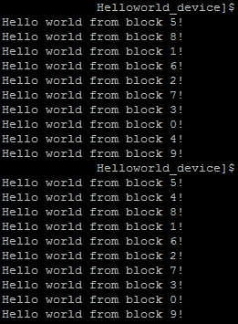
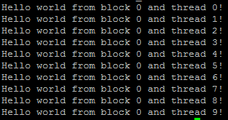
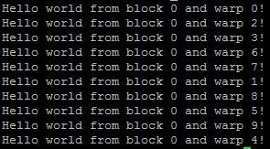
Scheduling – ‘Hello world’ example
Blocks
Threads from one warp
Warps

Slide 17
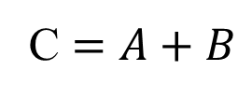

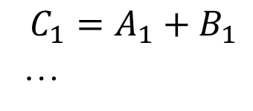

Vector addition example
What is vector addition?
Where A, B, C are vectors of length n. If we rewrite this by elements we get
We can map this to threads for example like this:
Thread 0 calculates C0
Thread 1 calculates C1
…
Thread n calculates Cn
We can map the problem also like this:
Thread 0 calculates elements from C0 to Cm-1
Thread 1 calculates elements from Cm to C2m-1
Thread 2 calculates elements from C2m to C3m-1
…
Thread n/m calculates from Cn-m to Cn
Yet another way of mapping the problem is:
Threads 0 to 31 (a warp) would calculate elements from C0 to Cm*32-1 with step 32
Threads 32 to 63 (next warp) would calculate elements from Cm*32 to C2m*32 with step 32
…
Do these mappings differ in any way beside the way we map them?
C $=A+B$
$$C_{0}=A_{0}+B_{0}$$
$$C_{1}=A_{1}+B_{1}$$
…
$$C_{n}=A_{n}+B_{n}$$
On vector addition we will demonstrate typical processing flow of the GPU code.

Slide 18
Processing flow of GPU accelerated code
host code for vector addition
#include <stdio.h>
#include <stdlib.h>
#include <cuda.h>
#include <cuda_runtime.h>
#include <cuda_runtime_api.h>
int main(void) {
// What we want to calculate is C = A + B, where
// A, B, C are vectors of size N
size_t N = 1; // scalar
float *h_A, *h_B, *h_C;
// allocate host memory
h_A = (float*) malloc(N*sizeof(float));
h_B = (float*) malloc(N*sizeof(float));
h_C = (float*) malloc(N*sizeof(float));
// initiate host data
for(size_t f=0; f<N; f++) {
h_A[f] = f + 1.0f;
h_B[f] = f + 1.0f;
h_C[f] = 0;
}
...
}
Initiate host – declare variables, allocate memory on the host, load data
Initiate device - allocate memory, set environment variables
Transfer data to device
Run GPU kernel
Transfer data back to host

Slide 19
Processing flow of GPU accelerated code
host code for vector addition
#include <stdio.h>
#include <stdlib.h>
#include <cuda.h>
#include <cuda_runtime.h>
#include <cuda_runtime_api.h>
int main(void) {
// What we want to calculate is C = A + B, where
// A, B, C are vectors of size N
size_t N = 1; // scalar
float *h_A=NULL, *h_B=NULL, *h_C=NULL;
// allocate host memory
h_A = (float*) malloc(N*sizeof(float));
h_B = (float*) malloc(N*sizeof(float));
h_C = (float*) malloc(N*sizeof(float));
if(h_A==NULL || h_B==NULL || h_C==NULL)
return(1);
// initiate host data
for(size_t f=0; f<N; f++) {
h_A[f] = f + 1.0;
h_B[f] = f + 1.0;
h_C[f] = 0;
}
...
}
Initiate host – declare variables, allocate memory on the host, load data
Initiate device - allocate memory, set environment variables
Transfer data to device
Run GPU kernel
Transfer data back to host
With added error checking. NULL is one way of saying the pointer is empty. If memory cannot by initialized pointer is returned empty (handed).

Slide 20
Processing flow of GPU accelerated code
host code for vector addition
...
int main(void) {
...
// initiate GPU
int deviceid = 0;
int devCount;
cudaGetDeviceCount(&devCount);
if(deviceid<devCount) cudaSetDevice(deviceid);
else return(1);
// define device variables
float *d_A, *d_B, *d_C;
// allocate memory on the device
cudaMalloc(&d_A, N*sizeof(float));
cudaMalloc(&d_B, N*sizeof(float));
cudaMalloc(&d_C, N*sizeof(float));
...
}
Initiate host – declare variables, allocate memory on the host, load data
Initiate device - allocate memory, set environment variables
Transfer data to device
Run GPU kernel
Transfer data back to host

Slide 21
Processing flow of GPU accelerated code
host code for vector addition
...
int main(void) {
...
// initiate GPU
int deviceid = 0;
int devCount;
cudaGetDeviceCount(&devCount);
if(deviceid<devCount) cudaSetDevice(deviceid);
else return(1);
// define device variables
float *d_A, *d_B, *d_C;
// allocate memory on the device
cudaError_t err_code;
err_code = cudaMalloc(&d_A, N*sizeof(float));
if(err_code!=cudaSuccess) return(1);
err_code = cudaMalloc(&d_B, N*sizeof(float));
if(err_code!=cudaSuccess) return(1);
err_code = cudaMalloc(&d_C, N*sizeof(float));
if(err_code!=cudaSuccess) return(1);
cudaMemset(d_C, 0, N*sizeof(float));
...
}
Initiate host – declare variables, allocate memory on the host, load data
Initiate device - allocate memory, set environment variables
Transfer data to device
Run GPU kernel
Transfer data back to host
With added error checking. The cudaError_t is variable type for storing result of CUDA calls. If the call was successful it returns cudaSuccess.

Slide 22
Processing flow of GPU accelerated code
host code for vector addition
...
int main(void) {
...
// transfer data from host to device
cudaMemcpy(d_A, h_A, N*sizeof(float),
cudaMemcpyHostToDevice);
cudaMemcpy(d_B, h_B, N*sizeof(float),
cudaMemcpyHostToDevice);
// run CUDA kernel for vector add
vector_add<<<1,1>>>(d_C, d_A, d_B);
// transfer result to host
cudaMemcpy(h_C, d_C, N*sizeof(float),
cudaMemcpyDeviceToHost);
// free memory on the host and the device
cudaFree(d_A);
cudaFree(d_B);
cudaFree(d_C);
free(h_A);
free(h_B);
free(h_C);
return(0);
}
Initiate host – declare variables, allocate memory on the host, load data
Initiate device - allocate memory, set environment variables
Transfer data to device
Run GPU kernel
Transfer data back to host
Clean up
We are launching kernel on grid containing one thread. Not very parallel of us.

Slide 23
Processing flow of GPU accelerated code
Kernel for vector addition
Initiate host – declare variables, allocate memory on the host, load data
Initiate device - allocate memory, set environment variables
Transfer data to device
Run GPU kernel
Transfer data back to host
Clean up
// kernel definition for vector addition
__global__ void vector_add(
float *d_C, float *d_A, float *d_B
){
int index=blockIdx.x*blockDim.x + threadIdx.x;
d_C[index] = d_A[index] + d_B[index];
}
We use pre-set variables we have discussed before (here in red) to calculate which data thread should work with.

Slide 24
Unified memory
host code for vector addition
int main(void) {
// initiate GPU
...
// Declare variables
size_t N = 1;
float *A, *B, *C;
// allocate unified memory
cudaMallocManaged(&A, N*sizeof(float));
cudaMallocManaged(&B, N*sizeof(float));
cudaMallocManaged(&C, N*sizeof(float));
// initiate host data
for(size_t f=0; f<N; f++) ...
// run CUDA kernel for vector add
vector_add<<<1,1>>>(C, A, B);
// Wait for GPU to finish before
// accessing on the host
cudaDeviceSynchronize();
// free memory on the host and the device
cudaFree(A);
cudaFree(B);
cudaFree(C);
return(0);
}
Data can be accessed using a one pointer on the host and as well as on the device.
Advantages:
Unified memory simplifies CUDA code as you do not have to explicitly move data to where they are needed. There is one allocation and one deallocation.
Simplifies usage of data structures.
Disadvantages:
Loosing control – there might be unwanted copies. Like array C which we set on the host to zero.
Hiding bottlenecks from view

Slide 25

Indexing – 1D vector addition
Each thread has access to pre-set three dimensional variables:
threadIdx
blockIdx
blockDim
gridDim
Using these we can assign work for each thread.
Example of vector addition:
Input is 1D array of floats
float *A;
If we launch vector_add kernel like this:
vector_add<<<N/5,5>>>(…)
For N=100 grid will have 20 blocks each with 5 threads.
Indexing data like this:
int index=blockIdx.x*blockDim.x + threadIdx.x;
Assign 0th block to first 5 elements, 2nd block to next 5 elements (starting with 5th element) and so on.
// Example of kernel definition
// for vector addition
__global__ void vector_add(
float *d_C, float *d_A, float *d_B
){
int index=blockIdx.x*blockDim.x + threadIdx.x;
// index has different value for each thread
// for 0th block, 3rd thread index=3
// for 1st block, 3rd thread index=8
// ...
d_C[index] = d_A[index] + d_B[index];
}

Slide 26
Two other ways of doing vector addition
Indexing data will be similar.
The difference between two other ways of mapping vector addition onto a GPU is that a single thread is processing m elements but with different step size.
The step size is important because it determines if threads are accessing memory in coalesced or uncoalesced manner.
We say that threads from one warp (threads which are next to each other 0, 1, 2, …) has coalesced memory access, if they are accessing data which are next to each other.
This is because memory delivers data in chunks of N bytes. We call these chunks cachelines. Every time a thread requests data, surrounding data comes along with it, even if we do not used them. If we can process these data as well we have them for ‘free’.
#define M 32
// Kernel definition for vector addition where
// thread access data with step 1
__global__ void vector_add_step1(
float *d_C, float *d_A, float *d_B
){
for(int f=0; f<M; f++){
int index=M*blockIdx.x*blockDim.x +
M*threadIdx.x + f;
d_C[index] = d_A[index] + d_B[index];
}
}
// Kernel definition for vector addition where
// thread access data with step blockDim.x
__global__ void vector_add_stepbig(
float *d_C, float *d_A, float *d_B
){
for(int f=0; f<M; f++){
int index=M*blockIdx.x*blockDim.x + threadIdx.x
+ f*blockDim.x;
d_C[index] = d_A[index] + d_B[index];
}
}
// kernel configuration is same for both
vector_add_*<<<N/(M*M),M>>>(...)

Slide 27
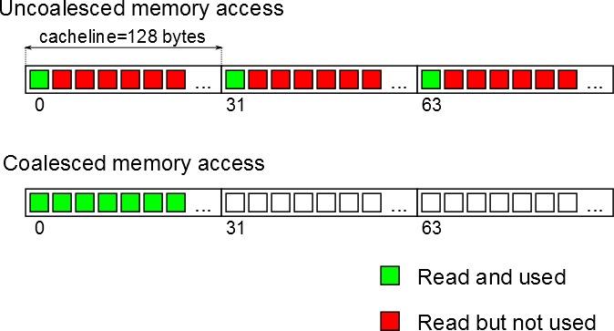
Performance difference
On NVIDIA GTX 1080 for N=67 M points
Uncoalesced memory access execution time: 28.77 ms
Coalesced memory access execution time: 2.29 ms
Speed up 12x
Data are read from memory in blocks of 128 bytes (32 floats), even if we request one value all others are delivered anyway. Coalesced memory access is better because it uses these ‘free’ values.

Slide 28
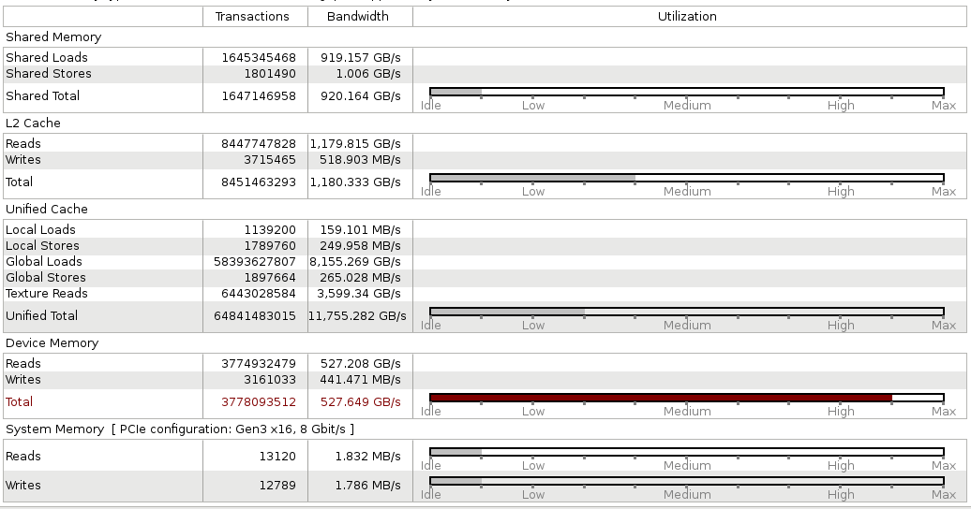
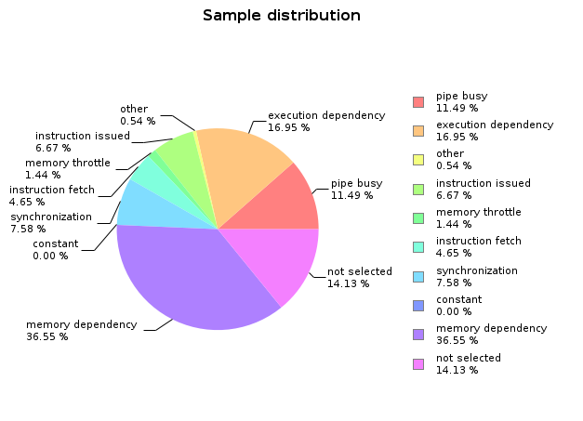
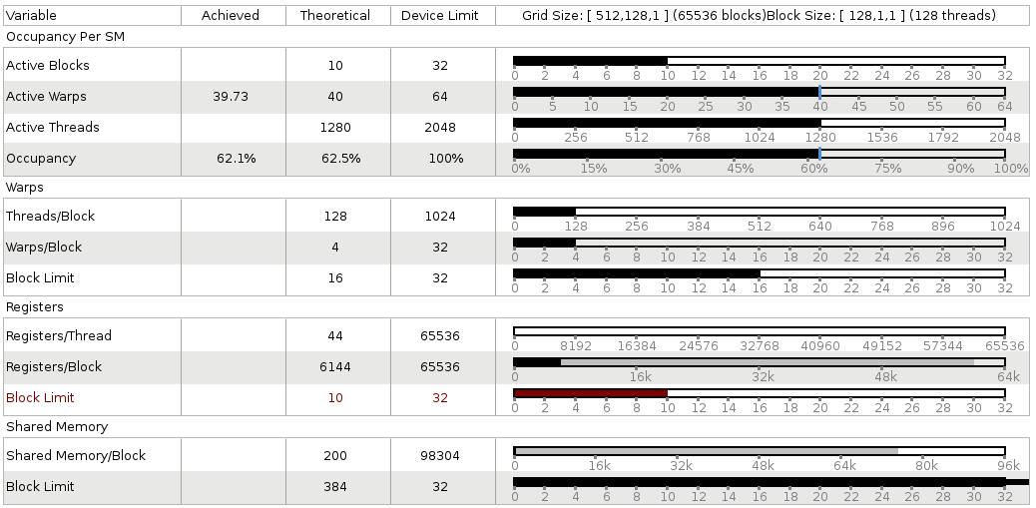
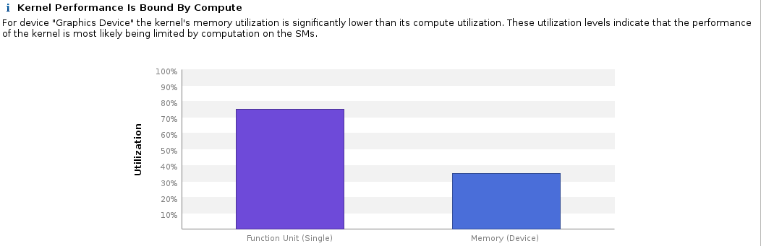
Visual profiler - nvvp
Great tool for evaluating performance bottlenecks. It provides you with graphical interface in which you can explore performance of your code.
Compute bound or memory bound?
Occupancy calculation
Memory bandwidth utilisation
Compute utilisation
Stall reasons

Slide 29
What have we learnt?
How to write a basic code with GPU kernels.
Basics of how to use Unified memory or manage memory ourselves.
How to launch kernels using blocks and threads.
Basics of how to use blocks and threads ids to map data to threads.
That NVIDIA visual profiler is a good thing to have.

Slide 30
Further reading
CUDA Toolkit Documentation (https://docs.nvidia.com/cuda/index.html )
NVIDIA whitepapers (https://images.nvidia.com/content/pdf/tesla/whitepaper/pascal-architecture-whitepaper.pdf, https://images.nvidia.com/content/volta-architecture/pdf/volta-architecture-whitepaper.pdf )
Code samples from SDK

Slide 31
In the next lecture…
<A synopsis of the next lecture>

Slide 32

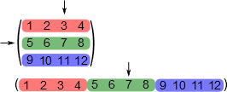
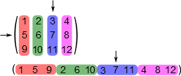
Linearisation (flattening) of an array
Matrix
int nRows=3;
int nColumn=4;
float M[nRows][nColumns];
M[1][2]==7;
// numbers from rows are next to each other
float M[nRows*nColumns];
M[1*nColumns + 2] == 7;
// numbers from columns are next to each other
float M[nRows*nColumns];
M[2*nRows + 1] == 7;
Row major format
Column major format

Slide 33
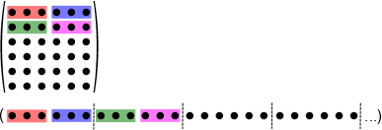
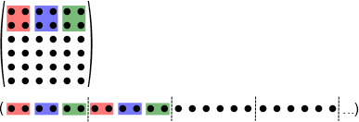
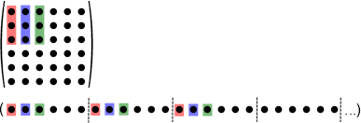
Indexing – 2D matrix addition
dim3 nBlocks, nThreads;
// N columns, M rows
int N, M;
// linear indexing = we ignore that it is a matrix
int index=blockIdx.x*blockDim.x + threadIdx.x;
int nThreads=3;
matrix_add<<<(N*M)/nThreads, nThreads>>>(...)
// 2D indexing, we selecting sub-matrices
int index_x = blockIdx.x*blockDim.x + threadIdx.x;
int index_y = blockIdx.y*blockDim.y + threadIdx.y;
int index = index_y*N + index_x;
dim3 nThreads(2,2,1);
dim3 nBlocks;
nBlocks.x = N/nThreads.x;
nBlocks.y = M/nThreads.y;
nBlocks.z = 1;
matrix_add<<< nBlocks, nThreads>>>(...)
// reading row major as column major
int index_x = blockIdx.x*blockDim.x + threadIdx.x;
int index_y = blockIdx.y*blockDim.y + threadIdx.y;
int index = index_y*N + index_x;
dim3 nThreads(1,3,1);
...

Slide 34
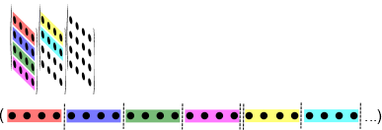
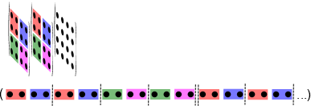
Indexing – 3D tensor addition
dim3 nBlocks, nThreads;
// N columns, M rows, K matrices
int N, M, K;
// linear indexing = we ignore that it is a tensor
int index=blockIdx.x*blockDim.x + threadIdx.x;
int nThreads=4;
matrix_add<<<(N*M*K)/nThreads, nThreads>>>(...)
// 3D indexing, we selecting sub-tensors
int index_x = blockIdx.x*blockDim.x + threadIdx.x;
int index_y = blockIdx.y*blockDim.y + threadIdx.y;
int index_z = blockIdx.z*blockDim.z + threadIdx.z;
int index = index_z*N*M + index_y*N + index_x;
dim3 nThreads(2,2,2);
dim3 nBlocks;
nBlocks.x = N/nThreads.x;
nBlocks.y = M/nThreads.y;
nBlocks.z = K/nThreads.z;
matrix_add<<< nBlocks, nThreads>>>(...)
// getting coordinates x,y,z from linear index
int z = index%(N*M);
int y = (index – z*N*M)%N;
int x = index – z*N*M – y*N;
Why use anything else then linear indexing?
Because getting coordinates x,y,z from linear index when you need them is a pain.

Slide 35
Dealing with arbitrary size data
// kernel for tensor addition
__global__ void vector_add(float *d_C, float *d_A, float *d_B, int N, int M, int K){
int index_x = blockIdx.x*blockDim.x + threadIdx.x;
int index_y = blockIdx.y*blockDim.y + threadIdx.y;
int index_z = blockIdx.z*blockDim.z + threadIdx.z;
int index = index_z*N*M + index_y*N + index_x;
// since number of blocks is rounded up some
// threads might read or write outside allocated
// memory. We have to check the boundaries.
if(index_x < N && index_y < M && index_z < K)
d_C[index] = d_A[index] + d_B[index];
}
int N=113, M=113, K=113;
dim3 nThreads(32,4,4);
dim3 nBlocks;
// round number of blocks up
nBlocks.x = (N+nThreads.x-1)/nThreads.x;
nBlocks.y = (M+nThreads.y-1)/nThreads.y;
nBlocks.z = (K+nThreads.z-1)/nThreads.z;
Tensor_add<<<nBlocks, nThreads>>>(...);
What if we have data which are not multiple of our number of threads?
Round number of blocks up
Inside kernel check is threads are reading or writing inside allocated memory
It depends on indexing scheme used

Slide 36
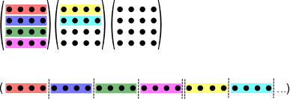
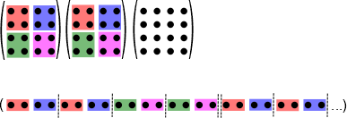
Indexing – 3D tensor addition
dim3 nBlocks, nThreads;
// N columns, M rows, K matrices
int N, M, K;
// linear indexing = we ignore that it is a tensor
int index=blockIdx.x*blockDim.x + threadIdx.x;
int nThreads=4;
matrix_add<<<(N*M*K)/nThreads, nThreads>>>(...)
// 3D indexing, we selecting sub-tensors
int index_x = blockIdx.x*blockDim.x + threadIdx.x;
int index_y = blockIdx.y*blockDim.y + threadIdx.y;
int index_z = blockIdx.z*blockDim.z + threadIdx.z;
int index = index_z*N*M + index_y*N + index_x;
dim3 nThreads(2,2,2);
dim3 nBlocks;
nBlocks.x = N/nThreads.x;
nBlocks.y = M/nThreads.y;
nBlocks.z = K/nThreads.z;
matrix_add<<< nBlocks, nThreads>>>(...)
// getting coordinates x,y,z from linear index
int z = index%(N*M);
int y = (index – z*N*M)%N;
int x = index – z*N*M – y*N;
Why use anything else then linear indexing?
Because getting coordinates x,y,z from linear index when you need them is a pain.

