Slide 1

An Introduction to HPC and Scientific Computing
Lecture <number>: <Title>
<Your Name>
Oxford e-Research Centre,
Department of Engineering Science

Slide 2
Overview
In this lecture we will learn about:
<overview>

Slide 3
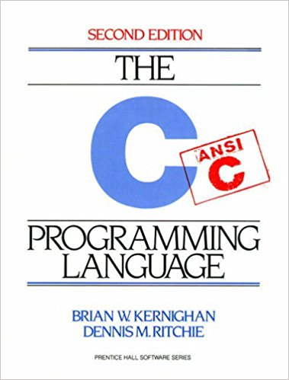
Example slide
The C programming language was devised by Dennis Ritchie at Bell labs in 1972 (yes, it’s predecessor was B!).
C is a high-level programming language, meaning that it is possible to express several pages of machine code in just a few lines of C code.
Other examples of high-level languages are BASIC, C++, FORTRAN and Pascal. They are so called because they are closer to human language than machine languages.

Slide 4
What have we learnt?
<recap>

Slide 5
Further reading

Slide 6
In the next lecture…
<A synopsis of the next lecture>

