Slide 1

An Introduction to HPC and Scientific Computing
Lecture two: Introduction to the C programming language
Wes Armour
Oxford e-Research Centre,
Department of Engineering Science

Slide 2
Overview
In this lecture you will learn about:
High level computer languages.
The basic components of a C computer program.
How data is stored on a computer.
The difference between statements and expressions.
What operators and functions are.
How to control basic input and output.
Finally how to write a basic C program.

Slide 3
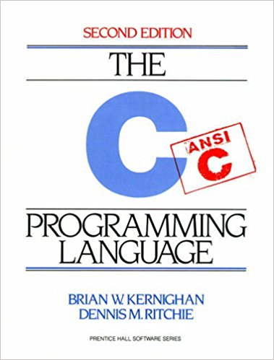
A brief introduction
The C programming language was devised by Dennis Ritchie at Bell labs in 1972 (yes, it’s predecessor was B!).
C is a high-level programming language, meaning that it is possible to express several pages of machine code in just a few lines of C code.
Other examples of high-level languages are BASIC, C++, Fortran and Pascal. They are so called because they are closer to human language than machine languages.

Slide 4
A brief introduction
int square(int num) {
return num * num;
}
push rbp #2.21
mov rbp, rsp #2.21
sub rsp, 16 #2.21
mov DWORD PTR [-16+rbp], edi #2.21
mov eax, DWORD PTR [-16+rbp] #3.18
imul eax, DWORD PTR [-16+rbp] #3.18
leave #3.18
ret #3.18
01110000011010001010100100100101001000111111111111010101111001110010101010101001111111111110101010010101010101010101010101001010101010100101
HLL
Such high-level languages allow a programmer to write programs that are independent of particular types of computer. This is called portability.
Portability can aided by using an agreed standard when writing your program (such as C99).
A compiler (such as gcc or icc) is used to convert your high-level language program into machine code that can be executed on a computer.
Assembly
Code
Machine
Code
https://godbolt.org/

Slide 5
The components of a C program
All C programs have some common elements.
The #include directive tells the compiler to include other files stored on your HDD into your C program. These files will include information that does not change between programs that your program can use. On the right we include the standard input and output library.
The main() function is the only component that has to be included in every C program. It is followed by a pair of braces: { }
The return() statement returns values from a function. Within the main() function is can be used to tell the operating system (in our case Linux) whether our code completed successfully.
#include <stdio.h>
int main() {
return(0);
}

Slide 6
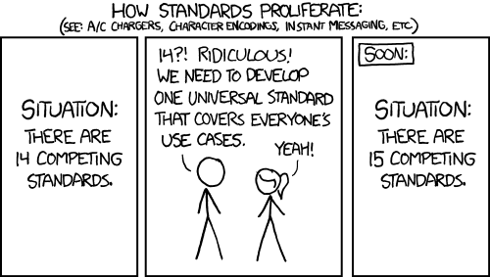

The C standard library
The C programing language has a rich set of tools that you can use in your code to make it portable and easer to write.
Using these tools that are contained in the C standard library will save you time, effort and make your code more understandable to others.
https://xkcd.com/927/

Slide 7
Standard header files
Name | Description
<assert.h> | Contains the assert macro, used to assist with detecting logical errors and other types of bug in debugging versions of a program.
<complex.h> | A set of functions for manipulating complex numbers.
<errno.h> | For testing error codes reported by library functions.
<math.h> | Defines common mathematical functions.
<stdbool.h> | Defines a boolean data type.
<stdio.h> | Defines core input and output functions
<stdlib.h> | Defines numeric conversion functions, pseudo-random numbers generation functions, memory allocation, process control functions
<string.h> | Defines string handling functions.
<time.h> | Defines date and time handling functions
The list on the right describes some of the more common header files.
These are included into your code in the same way as we included the standard input/output header, using the #include directive.
These tools can save you lots of time, for example you could use the random number generator included in <stdlib.h> rather than writing your own.

Slide 8
Storing data
Our previous example program didn’t do anything though. To make this more useful we need to store and manipulate data.
A computer stores data as strings of zeros and ones: 100101111001…
The smallest element of data storage on a computer is a bit, it can be two things, a zero or a one.
Eight bits combine to produce a byte. If each bit in a byte can be either a zero or a one then a byte can represent:
2 x 2 x 2 x 2 x 2 x 2 x 2 x 2 = 2⁸ = 256
unique “things”. For example these “things” could be the numbers from -128 to 127.
In the C language this would be called a char variable.
#include <stdio.h>
int main() {
char x;
return(0);
}

Slide 9
Variables and Constants
The C language has different numeric data types that you can use in your program depending on what type of number you need to store or manipulate.
This is useful for many reasons. For example if our program only operates on small numbers (-128 to 127) then we can use a char which takes up a single byte of memory rather than using a long integer that might take 4 bytes or 8 bytes of memory space.
Along with this we might want to work on decimal numbers. In C real numbers are stored as floating point variables, these have a fractional part. Integers are stored as integer numbers and have no fractional part.
Variables with more bytes require more computational operations to manipulate them, so this will slow your program execution down.
Data Type | Keyword | Minimum Bytes Required | Minimum Range
Character | char | 1 | –128 to 127
Short integer | short | 2 | –32767 to 32767
Integer | int | 4 | –2,147,483,647 to 2,147,438,647
Long integer | long | 4 | –2,147,483,647 to 2,147,438,647
Unsigned character | unsigned char | 1 | 0 to 255
Unsigned short integer | unsigned short | 2 | 0 to 65535
Unsigned integer | unsigned int | 4 | 0 to 4,294,967,295
Unsigned long integer | unsigned long | 4 | 0 to 4,294,967,295
Single-precision floating-point | float | 4 | 1.2E–38 to 3.4E38
Double-precision floating-point | double | 8 | 2.2E–308 to 1.8E308

Slide 10
Variables and Constants
The amount of bytes needed to store any particular numeric data type in memory can vary between computer architectures.
C provides a useful function sizeof() to determine this.
Numeric data types can either be a variable or a constant in your C program.
Variables and literal constants can change during your program execution, symbolic constants cannot.
Literal constants are defined by assigning a number to the constant:
float radius = 10;
A symbolic constant can be defined using two methods. The first is by using #define, the other by using the const keyword.
const float radius = 10;
#include <stdio.h>
#define PI 3.14
int main() {
float radius = 10.0;
float area;
area = PI * radius * radius;
return(0);
}

Slide 11
Statements
A statement in C is a command that instructs the computer to do something.
An example of a statement is:
area = PI * radius * radius;
This tells the computer to multiply PI by radius and the multiply the results of this by radius again.
The result of the multiplications is then assigned to the variable area
All statements in C are terminated with a semi-colon and all white space (tabs, spaces and blank lines) are ignored by the compiler (apart from within a string – more later).
This allows for lots of freedom in formatting you C program, however to ensure that your code is easy to work with and reusable by others it is important to ensure that it is easy to read and understand.
area = PI * radius * radius;
Is equivalent to
area =
PI *
radius
* radius
;

Slide 12
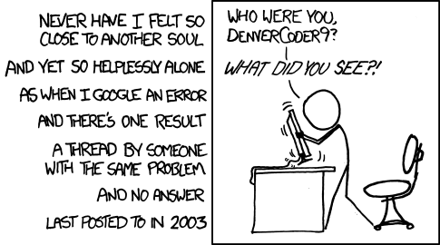
Comments
To ensure that your code is easy to read and understand it’s important to write your code in a readable and maintainable way.
Adding comments to your code will help others understand your code when they come to work on it. A comment is text that you or other programmers can read but is ignored by the compiler. A good code has more comments than source code.
// starts a single line comment
/* Starts a multiline comments and is ended by */
https://xkcd.com/979/

Slide 13
Naming
/* This is a C program that
calculates the area of a circle.
Written by Wes
wes.armour@eng.ox.ac.uk
06/05/18
*/
//Include standard IO library
#include <stdio.h>
// Define a symbolic constant, pi.
#define PI 3.14
// The main body of the program
int main() {
// Define variables
float radius = 10.0;
float area;
// Calculate the area
area = PI * radius * radius;
return(0);
}
Using variable names that are meaningful is a useful thing to do, for example:
area = PI * radius * radius;
is easy to understand, whereas
one = c * two * two;
tells us less about what you want your code to achieve. Take time to name variables in a meaningful and intuitive way.

Slide 14

Expressions
An expression in C is any statement that evaluates to a numeric value. In the most basic form this could just be our previous example of using a symbolic constant, PI
We use the assignment operator (=) to assign the result of our expression to a variable:
variable = expression;
https://www.freepik.com/free-photos-vectors/people
Created by Ddraw - Freepik.com

Slide 15
Expressions
However statements can become complicated very quickly. Consider summing the area of three circles:
a = p*a*a+p*b*b+p*c*c;
When trying to evaluate the above where does the computer start with such an expression? What stops the computer evaluating a+p first?
Several things can help us ensure that we get the computer to do the right thing, separating our expression, using brackets and operator precedence.
#include <stdio.h>
#define PI 3.14
int main() {
float radius_one = 5.0;
float radius_two = 10.0;
float radius_three = 15.0;
float area_one, area_two, area_three;
float total_area;
area_one = PI * radius_one * radius_one;
area_two = PI * radius_two * radius_two;
area_three = PI * radius_three * radius_three;
total_area = area_one + area_two + area_three;
return(0);
}

Slide 16
Operators
An operator in C is a symbol that instructs the computer to perform an operation on an operand.
Precedence tells the computer which operation should be performed first in an expression. Returning to our example of calculation the area of a circle:
area = PI * radius * radius;
We see that multiply (*) has a precedence of 3, whereas assignment (=) has a lower precedence of 7, meaning multiplication is carried out then the assignment.
The order in which the multiplication is carried out is determined by the Associativity of multiplication. We see that this is Left-to-right. So the order would be:
(PI * radius) * radius
Precedence | Operator | Description | Associativity
1 | ++ | Postfix increment | Left-to-right
 | -- | Postfix decrement
 | () | Function call
2 | ++ | Prefix increment | Right-to-left
 | -- | Prefix decrement
 | sizeof | Size-of
3 | * | Multiplication | Left-to-right
 | / | Division
 | % | Modulo (remainder)
4 | + | Addition | Left-to-right
 | - | Subtraction
5 | < | Less than | Left-to-right
 | <= | Less than or equal to
 | > | Greater than
 | >= | Greater than or equal to
6 | == | Equal to | Left-to-right
 | != | Not equal to
7 | = | Direct assignment | Right-to-left
 | += | Assignment by sum
 | -= | Assignment by difference
 | *= | Assignment by product
 | /= | Assignment by quotient

Slide 17
Functions
#include <stdio.h>
#define PI 3.14
float area_of_circle(float radius);
int main() {
float radius_one = 5.0;
float radius_two = 10.0;
float radius_three = 15.0;
float area_one, area_two, area_three;
float total_area;
area_one = area_of_circle(radius_one);
area_two = area_of_circle(radius_two);
area_three = area_of_circle(radius_three);
total_area = area_one + area_two + area_three;
return(0);
}
float area_of_circle(float radius) {
float area = PI * radius * radius;
return area;
}
A function is an independent piece of C code that performs a specific task. The function may or may not return a value to the calling code. For example it might calculate the area of a circle, or it might print a message to the screen.
A function has a unique name
A function is independent of other parts of your code, so it is self contained.
A function performs a specific task in your code.
A function may or may not have a return value.
On the right we see how we can use a function in our example code that calculates and sums the area of three circles.

Slide 18
Functions
Looking at our example in a little more detail.
float area_of_circle(float radius);
Is the function prototype this tells the compiler that a function called area_of_circle will be used later in the code and it will take a float as an argument and return a float.
We then see the function being called to calculate area_one, area_two and area_three.
Finally outside of the main() { } function we see the function definition. The first line is the function header and this is exactly the same as the function prototype (without the semicolon). It defines the functions name, the parameter list (variables and their types that are passed to the function by the calling code), whether it returns a value (in this case the return type is a float) and then what it does.
#include <stdio.h>
#define PI 3.14
float area_of_circle(float radius);
int main() {
float radius_one = 5.0;
float radius_two = 10.0;
float radius_three = 15.0;
float area_one, area_two, area_three;
float total_area;
area_one = area_of_circle(radius_one);
area_two = area_of_circle(radius_two);
area_three = area_of_circle(radius_three);
total_area = area_one + area_two + area_three;
return(0);
}
float area_of_circle(float radius) {
float area = PI * radius * radius;
return area;
}

Slide 19
Arrays
Our previous example code could be come very cumbersome and difficult to maintain if we wanted to calculate the area of thousands of circles.
C has arrays to help with this. An array is a indexed group of data storage, all of the same type.
C arrays are indexed from 0 to n-1, where n is the number of elements in the array.
An array is defined in the following way:
float radius[3];
Here we define an array called radius that has 3 elements. It can be initialised using braces.
float radius[3] = {5, 10, 15};
#include <stdio.h>
#define PI 3.14
float area_of_circle(float radius);
int main() {
float radius[3] = {5.0, 10.0, 15.0};
float area[3];
float total_area;
area[0] = area_of_circle(radius[0]);
area[1] = area_of_circle(radius[1]);
area[2] = area_of_circle(radius[2]);
total_area = area[0] + area[1] + area[2];
return(0);
}
float area_of_circle(float radius) {
float area = PI * radius * radius;
return area;
}

Slide 20
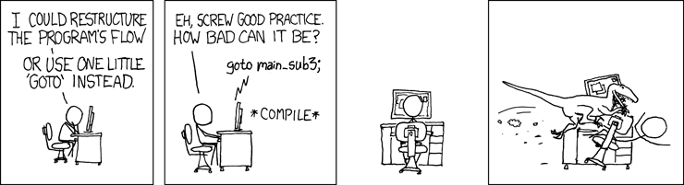
Program control
To solve a particular problem your C program might need to take different execution paths. These might depend on different inputs.
For example we could construct a program that calculates the area or circumference of a circle depending on what the user requests.
C has various statements that give the programmer control over the flow of execution in their program. However it’s important to use these sensibly and not create unmaintainable “spaghetti” code.
https://xkcd.com/292/

Slide 21
Relational operators
The C language has a set of relational operators that are used to compare expressions.
For example we could check to see if our radius is less than or equal to 10:
radius <= 10.0
If our radius is less than or equal to 10 the above expression evaluates to true (represented by 1).
If our radius is greater than 10 then the above expression evaluates to false (represented by 0).
Precedence | Operator | Description | Associativity
5 | < | Less than | Left-to-right
 | <= | Less than or equal to
 | > | Greater than
 | >= | Greater than or equal to
6 | == | Equal to | Left-to-right
 | != | Not equal to

Slide 22
Logical operators
What if we need to compare more than one expression at the same time?
C has logical operators to help with this.
Logical operators allow us to combine two or more relational expressions into one single expression.
For example we could check to see if our radius is greater than 5 and less than or equal to 10:
radius > 5.0 && radius <= 10.0
Precedence | Operator | Description | Associativity
2 | ! | Logical NOT | Right-to-left
11 | && | Logical AND | Left-to-right
12 | || | Logical OR | Left-to-right

Slide 23
Program control – if statement
#include <stdio.h>
#define PI 3.14
int main() {
float radius = 10.0;
float area;
if(radius <= 10.0) {
area = PI * radius * radius;
}
return(0);
}
The if statement evaluates an expression, if the expression evaluates to true (1) then the code following the if statement executes.
An example on the left checks to see if we have a radius less than our equal to 10, if we do then it calculates the area of a circle.

Slide 24
Program control – if statement
The if statement also has an else clause. The else clause executes when the expression evaluated by the if statement evaluates to false.
An example of this is given on the right. Here we see that when we have a radius less than or equal to 10.0 our code calculates the area of a circle. For a radius greater than 10. the code calculates the circumference. In this example radius = 11.0, so the code would calculate the circumference.
The example on the right is binary in the sense that the result gives two different outcomes dependent on whether our expression is true or false. This can be expanded to give many different outcomes by using else if (see practical 1).
#include <stdio.h>
#define PI 3.14
int main() {
float radius = 11.0;
float area;
float circumference;
if(radius <= 10.0) {
area = PI * radius * radius;
} else {
circumference = 2.0 * PI * radius;
}
return(0);
}

Slide 25
Program control – for statement
#include <stdio.h>
#define PI 3.14
float area_of_circle(float radius);
int main() {
int i;
float radius[3] = {5.0, 10.0, 15.0};
float area[3];
float total_area;
for(i=0; i<3; i++) {
area[i] = area_of_circle(radius[i]);
}
total_area = 0.0;
for(i=0; i<3; i++) {
total_area += area[i];
}
return(0);
}
float area_of_circle(float radius) {
float area = PI * radius * radius;
return area;
}
The for statement (often called the for loop) executes a block of statements a certain number of defined times. It has the following structure:
for(start point; relational expression; increment)
statement;
Our example on the right executes as follows:
start point is an integer index that is set to zero (i = 0).
The relational expression is evaluated, our index i is less than 3 (i<3) so the condition is true (if this evaluates to false the for loop terminates).
Statement then executes (e.g. the area of a circle is calculate).
Next the index i is incremented by one (i++) and execution returns to step 2.

Slide 26
Program control – for statement
The diagram on the right represents the for loop as a flow diagram.
Consider the following for loop:
for(A; B; C)
D;
The initial starting point A is evaluated.
Then the relational condition B is evaluated.
If B evaluates to true then statement D is executed. If B evaluates to false then the for loop ends.
Once statement D has executed, the increment C is evaluated.
The loop then returns to evaluating the relational condition B.
Start
A
B
True
D
False
C
End

Slide 27
Program control – while statement
#include <stdio.h>
#define PI 3.14
float area_of_circle(float radius);
int main() {
int i;
float radius[3] = {5.0, 10.0, 15.0};
float area[3];
float total_area;
i=0;
while(i<3) {
area[i] = area_of_circle(radius[i]);
i++;
}
total_area = 0.0;
for(i=0; i<3; i++) {
total_area += area[i];
}
return(0);
}
float area_of_circle(float radius) {
float area = PI * radius * radius;
return area;
}
The while statement (often called the while loop) executes a block of statements while a certain condition is true. It has the following structure:
while(relational expression)
statement;
Our example on the right executes as follows:
We fist set our integer index i to zero (i = 0).
The relational expression is evaluated, our index i is less than 3 (i<3) so the condition is true (if this evaluates to false the while loop terminates).
Statement then executes (e.g. the area of a circle is calculate).
Next the index i is incremented by one (i++) and execution returns to step 2.

Slide 28
Program control – while statement
The diagram on the right represents the while loop as a flow diagram.
Consider the following while loop:
while(A)
B;
The relational condition A is evaluated.
If A evaluates to true then statement B is executed. If A evaluates to false then the while loop ends.
Once statement B has executed, the loop evaluates relational condition A again.
Start
A
True
B
False
End

Slide 29
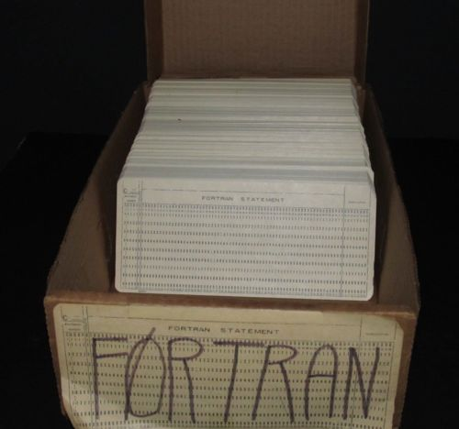
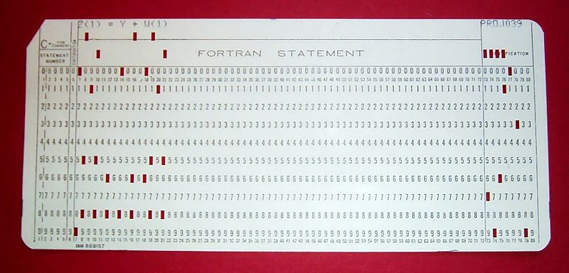
Inputs and Outputs
Many years ago computers were programmed using a series of punch cards (right)!
Fortunately the C language has many functions to help with input and output.
In this lecture we will look at two commonly used functions.
To print information out to the screen we will use printf()
To read information from the keyboard we will use scanf()
These are contained in the stdio.h library.
Arnold Reinhold https://commons.wikimedia.org/wiki/File:FortranCardPROJ039.agr.jpg

Slide 30
Inputs and Outputs
To format input and output C uses conversion specifiers and escape sequences.
The use of these will become clear in the following slides.
Escape sequence | Description
\b | Backspace
\n | Newline
\t | Horizontal Tab
\v | Vertical Tab
\\ | Backslash
\' | Single quotation mark
\" | Double quotation mark
\? | Question mark
Conversion specifier | Type converted | Description
%c | char | char single character
%d | int | signed integer
%ld | long int | long signed integer
%f | float, double | float or double signed decimal
%s | char[] | sequence of characters
%u | int | unsigned integer
%lu | long int | long unsigned integer

Slide 31
Inputs and Outputs - printf
#include <stdio.h>
#define PI 3.14
float area_of_circle(float radius);
int main() {
int i;
float radius[3] = {5.0, 10.0, 15.0};
float area[3];
float total_area;
i=0;
while(i<3) {
area[i] = area_of_circle(radius[i]);
i++;
}
total_area = 0.0;
for(i=0; i<3; i++) {
total_area += area[i];
}
printf(“\nTotal area is:\t%f\n”, total_area);
return(0);
}
float area_of_circle(float radius) {
float area = PI * radius * radius;
return area;
}
The keen eyed amongst you will have noticed an issue with our example program. Although we calculate a sum of areas of circles, we never actually get the result out of our program.
We can do this using the printf() statement. In our example program on the right you can see that we’ve added a printf() statement.
It works as follows…

Slide 32
Inputs and Outputs - printf
#include <stdio.h>
#define PI 3.14
float area_of_circle(float radius);
int main() {
int i;
float radius[3] = {5.0, 10.0, 15.0};
float area[3];
float total_area;
i=0;
while(i<3) {
area[i] = area_of_circle(radius[i]);
i++;
}
total_area = 0.0;
for(i=0; i<3; i++) {
total_area += area[i];
}
printf(“\nTotal area is:\t%f\n”, total_area);
return(0);
}
float area_of_circle(float radius) {
float area = PI * radius * radius;
return area;
}
We tell printf to print a string to the monitor:
“\nTotal area is:\t%f\n”
We start a new line using the “\n” escape sequence.
We the print the characters “Total area is:”
We use a tab to neatly separate our words from our output number using the “\t” escape sequence.
We use the conversation specifier for a float “%f” to output a float.
We tell printf that the float to output is total_area

Slide 33
Inputs and Outputs - scanf
#include <stdio.h>
#define PI 3.14
float area_of_circle(float radius);
int main() {
int i=0;
float radius[3];
float area[3];
float total_area;
printf(“\nEnter three radii:\t”);
scanf(“%f %f %f”, &radius[0], &radius[1], &radius[2]);
while(i<3) {
area[i] = area_of_circle(radius[i]);
i++;
}
total_area = 0.0;
for(i=0; i<3; i++) {
total_area += area[i];
}
printf(“\nTotal area is:\t%f\n”, total_area);
return(0);
}
float area_of_circle(float radius) {
float area = PI * radius * radius;
return area;
}
You will have also noticed that we hardcode the radii into our code {5.0,10.0,15.0}
So if we wanted to use different radii we would need to change these values in our source code and then recompile. That’s not very efficient or portable.
We can use the scanf() statement to read three different values, meaning our code will work for any combination of radii.

Slide 34
Inputs and Outputs - scanf
#include <stdio.h>
#define PI 3.14
float area_of_circle(float radius);
int main() {
int i=0;
float radius[3];
float area[3];
float total_area;
printf(“\nEnter three radii:\t”);
scanf(“%f %f %f”, &radius[0], &radius[1], &radius[2])
while(i<3) {
area[i] = area_of_circle(radius[i]);
i++;
}
total_area = 0.0;
for(i=0; i<3; i++) {
total_area += area[i];
}
printf(“\nTotal area is:\t%f\n”, total_area);
return(0);
}
float area_of_circle(float radius) {
float area = PI * radius * radius;
return area;
}
The example code on the right uses the scanf() statement to read three floats into our code and then uses these values to calculate our total area as before.
Once we execute our code it will print the message “Enter three radii:” to the monitor and then wait at the scanf() statement for the user to enter three values and press return.
scanf() reads the three values entered by the user and stores them in radius[0], radius[1] and radius[2] respectively.

Slide 35

What have we learnt?
In this lecture you have learnt about the basic building blocks of a C program.
You have learnt about standard libraries, expressions and statements.
We have covered how data is stored on a computer and how it is represented in C.
You have learnt about functions, operators, both logical and relational and program control.
Finally we covered the basics of input and output.
You should now be in a position to write your own C program.

Slide 36
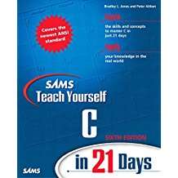
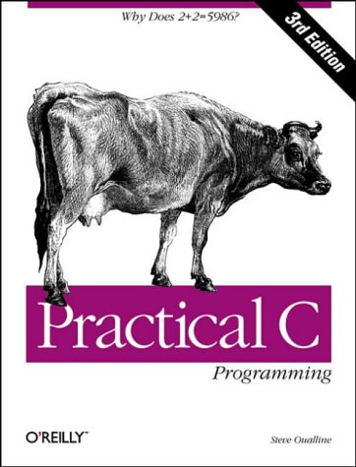
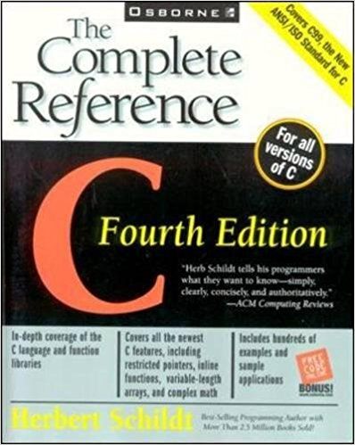
Further reading
http://www.learn-c.org/
https://www.cprogramming.com/tutorial/c-tutorial.html
https://www.gnu.org/software/gnu-c-manual/gnu-c-manual.html

Slide 37

In the next lecture…
In the next lecture you will learn about the Linux operating system and how to use it. You’ll get to know compilers, what they do and how to use them. You’ll also learn about build systems, what they are, how to use them and how they can make the life of a programmer easier.

