Slide 1

An Introduction to HPC and Scientific Computing
Lecture three: Introduction to Linux, compilers and build systems
Ian Bush
Oxford e-Research Centre,
Department of Engineering Science

Slide 2
Overview
In this short lecture we will learn about:
Linux
Compilers and make
A little bit about Arcus-b – the machine that we will do the practicals on
Batch Systems

Slide 3
Linux
Linux is the operating system (OS) that the vast majority of supercomputers use
Derived ultimately from Unix
For us, that controls how we interact with the machine
You are probably more used to Microsoft Windows or OS X on a Mac
Windows and Macs tend to stress the graphical user interface
But note under the hood OS X is also derived from Unix
While Linux does have an extensive GUI most people work at the command line
So instead of pointing at and clicking things you type commands in a terminal at a prompt

Slide 4
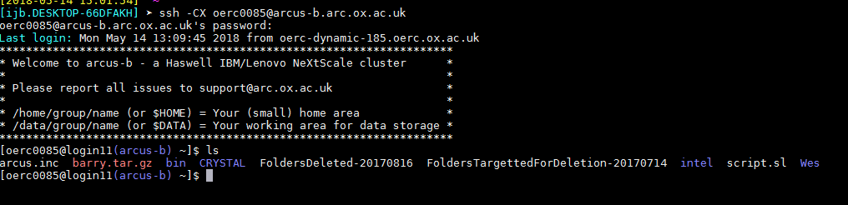
Logging onto Arcus-b
You log onto a remote system using the ssh command
We will do the practicals on arcus-b, the University’s central compute cluster run by ARC
Here I log onto arcus-b and show the ls command which lists the files in my home directory
Note here I am using mobaxterm - the software I recommend for use on Windows systems

Slide 5
Computing – You only learn by doing it
You only really learn this stuff by doing it
Hence rather than go through all of numerous command in Linux there is a worksheet which will be part of the practical where you will learn what you need
However it’s worth noting that the Unix, and hence Linux, philosophy is a bit different from that found in Windows
In Unix you have a large number of relatively simple tools which can easily be chained together to do something quite complicated
This is flexible and can do many things, but can take a while to learn
Under Windows you tend to have one big tool that does complicated things
Great and easy to use if you want to do what it can do
But not great once you stray outside those bounds
Anyway, we’ll learn Linux by doing it!

Slide 6
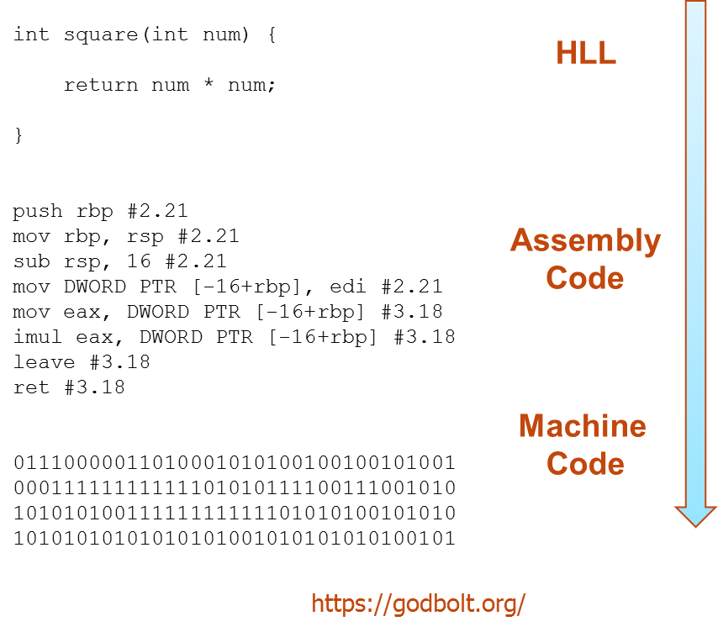
Using Compilers
As you learnt earlier a compiler converts a High-level language such as C into the machine code that the computer understands
Let’s look a little more at that and how it works under Linux

Slide 7
There is No One True Compiler
There are many compilers available under Linux
The most commonly used are
gcc – The Gnu Compiler
Truly free, comes with every Linux
icc – The Intel Compiler
Commercial (i.e. costs money), not always available, but generally produces executables that run faster than those from the Gnu compiler

Slide 8
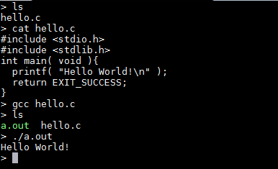
Using A Compiler Under Linux
Note
You should always end your C file names with .c – confusion will occur if you do not!
The default name for an executable under Linux is a.out
You run an executable by using its name

Slide 9
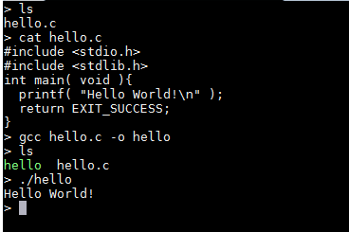
Compilers with Flags
Compilers can take many flags which alter how they behave
Here we make the executable have a more sensible name
In the practical we will see more examples of this

Slide 10
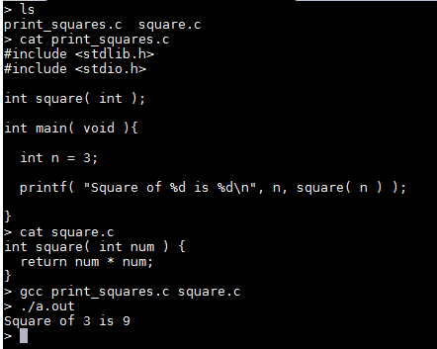
Programs in Multiple Files
Note a program need not be all in one file:

Slide 11
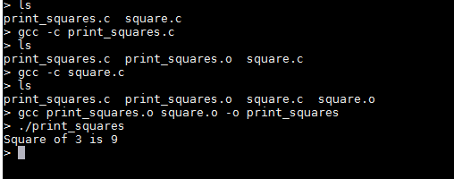
Compiling and Linking
Note there are actually two phases in this process
We first compile each file to a corresponding object file
Thus each source file has a corresponding object file
Then all the object files are linked together to produce the executable
By default both are done
The –c flag can be used to force only the compilation stage

Slide 12
Compiling and Linking
Why is this useful?
Let’s pretend we have a program in 100 different files
We now compile all those 100 files and link the resulting object files together to produce an executable
We now change just one of the source files
Without the 2 stage system we would have to recompile everything
But now we can just compile the one source file that has chaned to a new object file, and then relink that with the existing 99 old ones to produce a new executable
This can save a lot of time in a big program!
It is so useful there is a special utility called make that takes advantage of this
We don’t need to know much about make as we will provide the makefiles for all the exercises
We mainly need to know how to use it

Slide 13
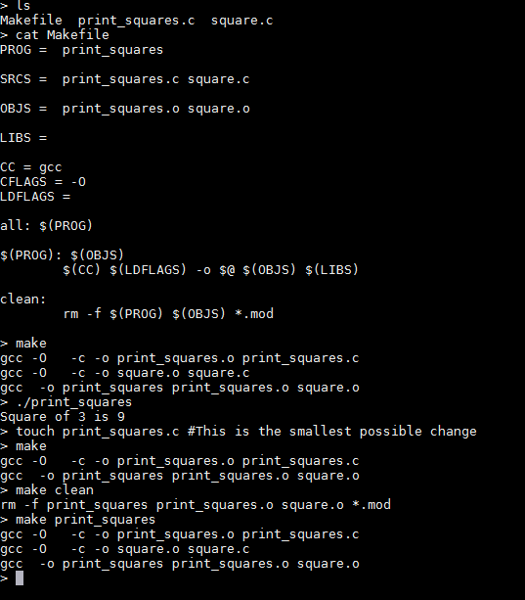
Using make
Note how the Makefile contains a set of rules that make interprets
Don’t worry, we will always provide this!
Note how it also automatically works out what files need to be compiled and only compiles them
Also make clean is very common – clean up and leave the files as they were before any compilation occurred

Slide 14
Arcus-b
Arcus-b is the cluster we are running on
It is the main central cluster for the University, consisting of around 400 nodes, each with 16 cores and at least 64 Gbytes of memory
Remember 16 cores per node mean that the 64 Gbytes on a node is shared by the 16 cores
Important for OpenMP later on – OpenMP on arcus-b is restricted to at most 16 cores
Important to know about for 2 reasons
We need to know how to manage the software environment via the module system
We need to know how to access those 400 nodes via the batch system

Slide 15
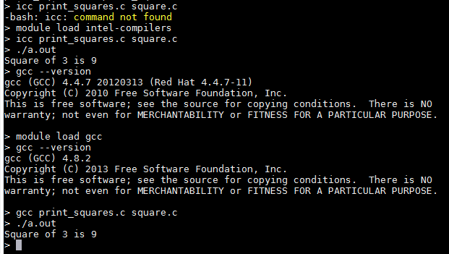
Arcus-b Software Environment
You gain access to software via the module system
module load gives access to the software
module avail lists what is available
module list lists what is currently loaded
module purge removes everything – often useful to start from a blank sheet to avoid confusion

Slide 16
Batch Systems
Like most clusters on arcus-b you don’t log onto the nodes that do the computation
Instead you log onto the login nodes and there do you editing, compiling, file managing etc.
And when you are ready to do the computation you send the jobs to the compute nodes via the batch system
What this means is you must specify what resources you require
Typically number of nodes (for us always 1) and time, possibly memory
And the batch system will send you job to an appropriate (set of) nodes once the resources become available
Remember the system is shared
You may have to wait
And remember these nodes are NOT connected (by default) to you screen and keyboard
Lots of batch systems, Arcus-b uses something called SLURM

Slide 17
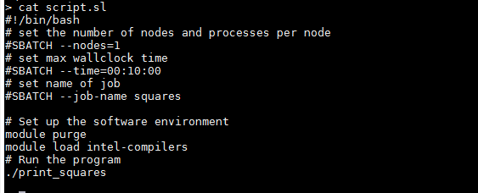
A SLURM Batch Script
Resources we need to reserve
1 node for 10 minutes
Commands to run on the resources once they become available

Slide 18
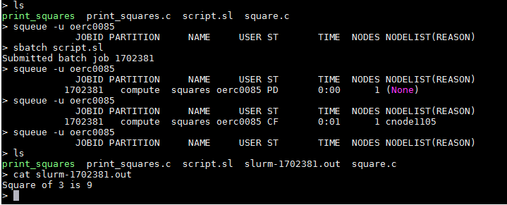
Using the Batch System
Don’t worry! We will provide the batch scripts, you just need to know
How to use them with sbatch, squeue and scancel
The basics of modifying them (e.g. new commands, or longer time)

Slide 19
Much, MUCH more in the Practical
We’ve gone through this all very quickly
Don’t worry if it’s still a bit unclear, you only really learn by doing it
And next is the practical where we will go through all this in a lot more detail

Slide 20
What have we learnt?
Linux is the OS most supercomputers use
You interact with it via the command line
There are many compilers, we will use the Gnu and Intel ones
Compilation is really two phases, compilation to an object file, and then linking the object files together to produce the executable
The make utility can take advantage of this to speed up compilation, especially for large projects
Arcus-b is the cluster we will use
It has 16 cores per node
The software environment is managed via the module system
Access to the compute nodes is via the batch system

Slide 21
Further reading

Slide 22
In the next lecture…
<A synopsis of the next lecture>

