Slide 1

An Introduction to HPC and Scientific Computing
Lecture six: How to multi-task on CPUs using OpenMP.
Oxford e-Research Centre,
Department of Engineering Science

Slide 2
Overview
In this lecture we will learn about:
The Basic Idea Behind Parallelism
What OpenMP is
How to divide work amongst threads
How to synchronise threads
How to go about parallelising a simple program with OpenMP

Slide 3
Parallelism – How to do we split up the work?
Scenario: the serial application developed by a researcher takes too long to run on a desktop! Parallel processing can shorten the run-time if the application is re-programmed
to expose parallelism in the workload (in algorithms and data) and
to assign the parallel portions of the workload to different workers (processors)
Analogy: shorten the time it takes to build an entire row of houses by:
dividing the work into parts that can be carried out in parallel and
scheduling different (teams of) workers to work on these parts concurrently.
Perfect (linear) scaling is the holy grail:
execution time is inversely proportional with the number of processors
by analogy: halve the building time by employing double the number of workers
in practice, scaling is not linear but can be close enough

Slide 4
Many ways to parallelise
Consider the row of houses analogy
One could hire one man for each house
Or you could hire a brickie, a roofer, a plumber, an electrician etc.
The second obviously requires more communication between the workers
They have to coordinate their activities
Can’t put a roof on the house before you have built the walls
But the second also doesn’t require every person to know everything about how to build a house
The required knowledge is split across many people
Another possibility is a hybrid approach
Hire N brickies, N roofers, N plumbers, N electricians
And form N teams each of which works on 1/N^{th} of the houses

Slide 5
Parallelism – A maths example
Consider adding two vectors:
a_{i}=b_{i}+c_{i}
The operations required for each value of i are independent from any other value
Thus for parallelism we require independent operations
An alternative way of putting it is that we can perform the operations in any order
Slightly less obviously we also require independent data
Consider the apparently very similar a_{i}=b_{i}+a_{i-1}
Can’t calculate a_{i} until has been a_{i-1} calculated

Slide 6
Parallelism – Communication and Synchronisation
Now consider a dot product
a=∑b_{i}×c_{i}
If we want to parallelise it we could give a subset of the indices to each process or thread and form the local contribution to a
And then sum together all the local contributions to form the final answer
This last phase requires the processes or threads to work together
i.e. they are no longer totally independent
They need to communicate with each other
If one finishes before the others it will have to wait for them
Very typical way parallelism work inside real codes
Period of independent iterations
Followed by them coordinating the local results into a global one

Slide 7
Parallel Scaling
Consider the time to solution for our dot product.
Let our vectors be of order N and let us have P threads or processes
The time to compute the local sum will be proportional to N/P
A decreasing function of the number of threads
The time to synchronise and is more complicated
But it will be an increasing function of the number of threads
and independent of N
A deeper analysis shows a suitable model is Log(P)
Thus our model is t(P) = αN/P + βlog(P)
We want t to be a decreasing function of P, thus we want the first term to be important
Thus parallelism is most efficient
For large N
For small P
And using too many threads may cause your program to slow down!

Slide 8
Measuring Scalability – Speed Up
S = t(1)/t(P)

Slide 9
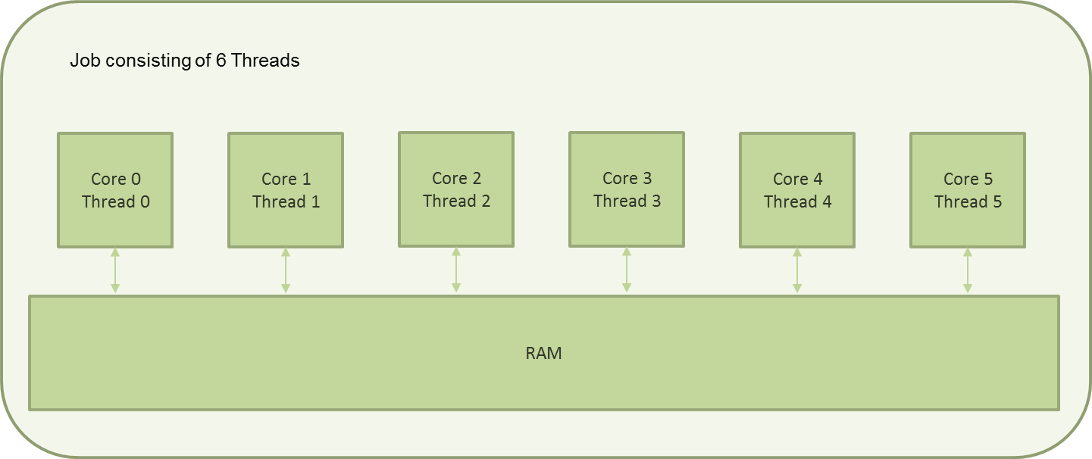
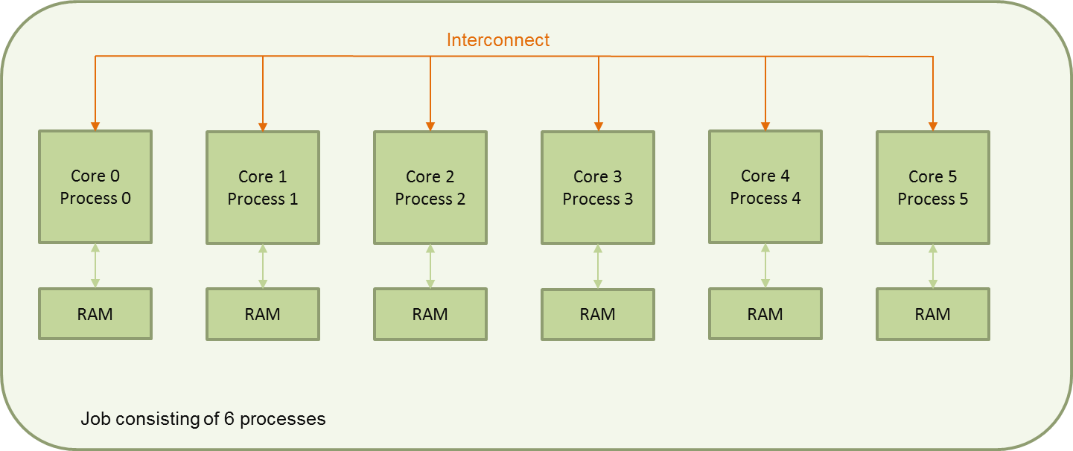
Parallelising Scientific Programs
Two main methods
Shared memory programming
Each of the cores can see all of the memory
This is generally done via OpenMP, and is what we will cover
Generally limited to a single node
16 Cores on the ARC machine
Distributed memory programming
Each of the cores can only see part of the memory
If one core wants data from another core’s memory it will have to use the interconnect
Can use an unlimited number of cores
Generally done via MPI
We don’t cover it here but there are free ARC and ARCHER courses
Hybrids of the two are possible and are used

Slide 10
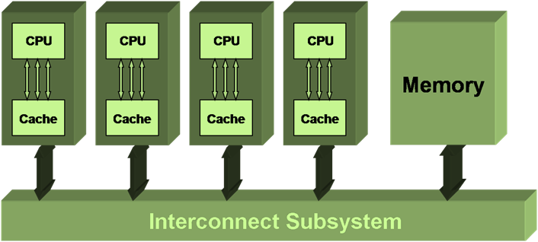
Shared memory model
Represents computing on a multi-processor architecture which links multiple (identical) CPUs to a single unified main memory;
Uses a shared-memory programming model, with data that can be shared between processors
Also called SMP, Symmetric Multi-Processor systems (for historical reasons)

Slide 11
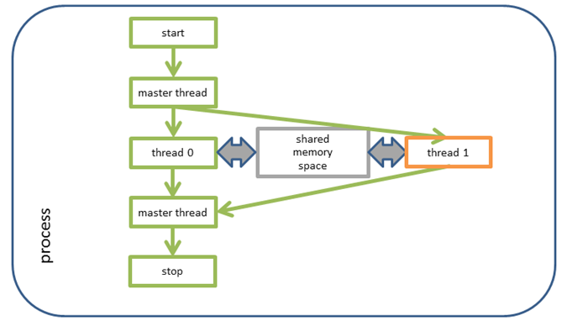
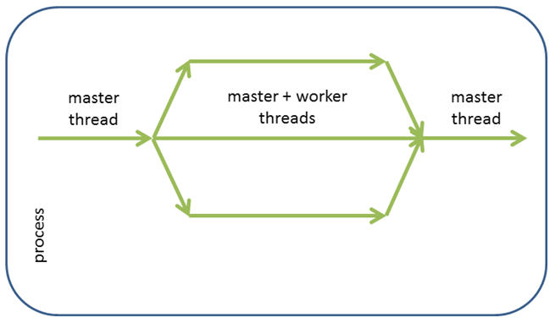
Processes and Threads
In shared-memory computing, an application is a single process, which can manage a number of threads:
the process is also the master thread
the master thread can spawn/destroy other threads (fork/join strategy)

Slide 12
Thread programming
Explicit, low-level thread programming:
start several threads and explicitly tell each what to do
tedious, difficult to write and difficult to maintain
standards not universal (POSIX pthreads, Windows threads)
may be suited to task parallelism
High-level programming using the OpenMP API:
instruct the compiler what can be done in parallel and let it do the tedious stuff
threads are generated automatically at runtime and scheduled by the OS
standard supported by a large number of compilers and operating systems
by design, suited to data parallelism

Slide 13
OpenMP Status
OpenMP specification is an agreement between industrial vendors and users and not a formal standard.
Version 2.5 (May 2005)
Version 3.0 (May 2008)
Version 3.1 (July 2011)
Currently this is probably the most common implementation you will meet
Version 4.0 (July 2013)

Slide 14
The OpenMP API
OpenMP is
An API for portable and scalable shared memory programming
Defined and supported by a group of major vendors
Supported by most compilers for Fortran, C, C++
OpenMP programming is
Standardised parallelism (fine-grained – loops, coarse-grain – regions)
If careful usable as serial code (threading ignored by serial compilation)
OpenMP API components:
Compiler directives
Runtime library routines
Environment variables

Slide 15
OpenMP “Hello World” in C
#include <stdio.h>
#include <stdlib.h>
#include "omp.h"
int main( void ) {
int my_thread;
/* Scope the variables and create the threads */
#pragma omp parallel default( none ) private( my_thread )
{
my_thread = omp_get_thread_num();
printf( "Hello from thread %d\n", my_thread );
}
return EXIT_SUCCESS;
}
$ gcc -fopenmp -O -std=c89 -Wall -Wextra -pedantic hello.c -o hello
$ export OMP_NUM_THREADS=5
$ ./hello
Hello from thread 2
Hello from thread 4
Hello from thread 3
Hello from thread 0
Hello from thread 1
$ export OMP_NUM_THREADS=3
$ ./hello
Hello from thread 0
Hello from thread 2
Hello from thread 1

Slide 16
Running In Batch
#!/bin/bash
# set the number of nodes, which is always 1 for OpenMP codes
#SBATCH --nodes=1
# set number of cores per node -- grab the whole node (why?)
#SBATCH --ntasks-per-node=16
# set max wallclock time
#SBATCH --time=00:10:00
# set name of job
#SBATCH --job-name hello
# Set up the software environment
module purge
module load intel-compilers
# set the number of threads we will use
export OMP_NUM_THREADS=5
# run the OpenMP program
./my_prog

Slide 17
A More Complex Example
#include <stdlib.h>
#define N 50
int main( void ) {
double a[ N ], b[ N ], c[ N ];
int i;
for( i = 0; i < N; i++ ) {
b[ i ] = ( (double) rand() ) / RAND_MAX;
c[ i ] = ( (double) rand() ) / RAND_MAX;
}
/* Scope the variables for the parallel region and create the threads */
#pragma omp parallel default( none ) shared( a, b, c ) private( i )
{
/* A work sharing directive */
#pragma omp for
for( i = 0; i < N; i++ ) {
a[ i ] = b[ i ] + c [ i ];
}
}
return EXIT_SUCCESS;
}

Slide 18
Scoping and Work Sharing
So there are two main steps
Create the threads with a parallel directive and at that point “scope” the variables.
default none forces you to scope all the variables – USE THIS.
Variables can be one of
Shared – each thread can access the variable
Private – each thread has its own, unique copy
Note thread creation is expensive.
Once the threads are created you split the work up between them with a “work sharing” directive
Without a work sharing directive all threads will do exactly the same thing on the same data!
You can have as many work sharing constructs as you want within a parallel region
As thread creation is expensive exploit this – don’t create threads every time you need to share work, reuse the threads as many times as you can!

Slide 19
Problems Of Sharing Data
Shared variables makes writing parallel code easy
But what happens if multiple threads are trying to update (the same part of) a shared variable at the same time?
The result is not well defined!
And will probably vary from run to run!
This is called a “race condition” and OpenMP does NOTHING by default to protect you from them
So if multiple threads need to access a shared variable you will need to synchronize the threads somehow
Rule of thumb: If a shared variable is on the left hand side of an = sign it is time to stop and think about thread synchronisation
Race conditions are very easy to write and very hard to debug! Be careful!
To fully cover this subject we need to have discussed the OpenMP memory model, which is well beyond what we have time to cover here.

Slide 20
Synchronising Threads
So how can we synchronise threads?
OpenMP provides a number of mechanisms. Here we will cover
Barrier: a given thread can only proceed once all threads have reached the barrier
Important: By default there is an implicit barrier at the end of each worksharing construct
Critical region: Only 1 thread can be executing codes within a critical region. All other threads must wait at the start until the thread executing the region has exited it
Reduction: Combining multiple private values into a single shared value

Slide 21
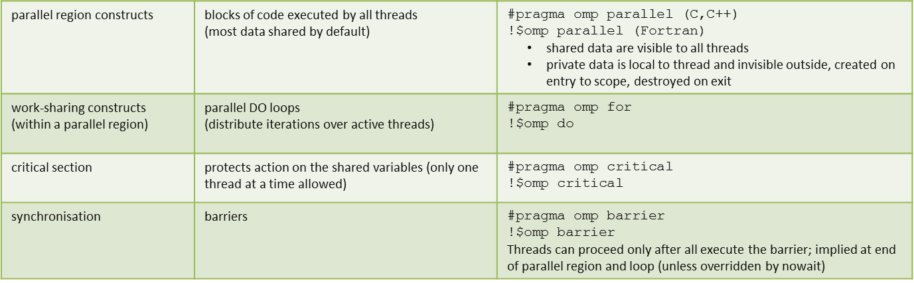
Summary: OpenMP Directives So Far

Slide 22
Bringing It Together – A More Complex Example
Thread 1
z = 0
for i = 1 to n/2
z = z + x_{i} * y_{i}
end for
[ w = w + z ]
< barrier >
for i = 1 to n/2
y_{i} = y_{i} - w * x_{i}
end for
Thread 2
z = 0
for i = n/2+1 to n
z = z + x_{i} * y_{i}
end for
[ w = w + z ]
< barrier >
for i = n/2+1 to n
y_{i} = y_{i} - w * x_{i}
end for
Thread 1
z = 0
for i = 1 to n/2
z = z + x_{i} * y_{i}
end for
w = w + z
for i = 1 to n/2
y_{i} = y_{i} - w * x_{i}
end for
Thread 1
z = 0
for i = 1 to n/2
z = z + x_{i} * y_{i}
end for
[ w = w + z ]
< barrier >
for i = 1 to n/2
y_{i} = y_{i} - w * x_{i}
end for
Thread 1
z = 0
for i = 1 to n/2
z = z + x_{i} * y_{i}
end for
for i = 1 to n/2
y_{i} = y_{i} - z * x_{i}
end for
Thread 1
z = 0
for i = 1 to n/2
z = z + x_{i} * y_{i}
end for
for i = 1 to n/2
y_{i} = y_{i} - z * x_{i}
end for
Thread 1
z = 0
for i = 1 to n/2
z = z + x_{i} * y_{i}
end for
for i = 1 to n/2
y_{i} = y_{i} - z * x_{i}
end for
Thread 1
z = 0
for i = 1 to n/2
z = z + x_{i} * y_{i}
end for
for i = 1 to n/2
y_{i} = y_{i} - z * x_{i}
end for
Thread 1
z = 0
for i = 1 to n/2
z = z + x_{i} * y_{i}
end for
w = w + z
for i = 1 to n/2
y_{i} = y_{i} - w * x_{i}
end for
Thread 1
z = 0
for i = 1 to n/2
z = z + x_{i} * y_{i}
end for
[ w = w + z ]
for i = 1 to n/2
y_{i} = y_{i} - w * x_{i}
end for
Thread 1
z = 0
for i = 1 to n/2
z = z + x_{i} * y_{i}
end for
[ w = w + z ]
for i = 1 to n/2
y_{i} = y_{i} - w * x_{i}
end for
Serial Code
z = 0
for i = 1 to n
z = z + x_{i} * y_{i}
end for
for i = 1 to n
y_{i} = y_{i} - z * x_{i}
end for
Thread 2
z = 0
for i = n/2+1 to n
z = z + x_{i} * y_{i}
end for
w = w + z
for i = n/2+1 to n
y_{i} = y_{i} - w * x_{i}
end for
Thread 2
z = 0
for i = n/2+1 to n
z = z + x_{i} * y_{i}
end for
[ w = w + z ]
< barrier >
for i = n/2+1 to n
y_{i} = y_{i} - w * x_{i}
end for
Thread 2
z = 0
for i = n/2+1 to n
z = z + x_{i} * y_{i}
end for
for i = n/2+1 to n
y_{i} = y_{i} - z * x_{i}
end for
Thread 2
z = 0
for i = n/2+1 to n
z = z + x_{i} * y_{i}
end for
for i = n/2+1 to n
y_{i} = y_{i} - z * x_{i}
end for
Thread 2
z = 0
for i = n/2+1 to n
z = z + x_{i} * y_{i}
end for
for i = n/2+1 to n
y_{i} = y_{i} - z * x_{i}
end for
Thread 2
z = 0
for i = n/2+1 to n
z = z + x_{i} * y_{i}
end for
for i = n/2+1 to n
y_{i} = y_{i} - z * x_{i}
end for
Thread 2
z = 0
for i = n/2+1 to n
z = z + x_{i} * y_{i}
end for
w = w + z
for i = n/2+1 to n
y_{i} = y_{i} - w * x_{i}
end for
Thread 2
z = 0
for i = n/2+1 to n
z = z + x_{i} * y_{i}
end for
[ w = w + z ]
for i = n/2+1 to n
y_{i} = y_{i} - w * x_{i}
end for
Task:
Orthogonalise 2 NORMALIZED vectors x and y on 2 threads.
There are several problems to watch out for.
Thread 2
z = 0
for i = n/2+1 to n
z = z + x_{i} * y_{i}
end for
[ w = w + z ]
for i = n/2+1 to n
y_{i} = y_{i} - w * x_{i}
end for
Problem
i and z are updated by both threads (race condition)
This now works!
Problem
z has now different values in the two threads
Problem
A thread may finish before the other has updated w
Problem
w may not have the correct value (race condition)
Solution
Make a global w
Accumulate z in w
Solution
Protect [ … ] the update of w
(Only one thread at a time)
Solution
Synchronise the process (barrier)
Solution
make i and z private

Slide 23
OpenMP program example
Update (Critical Section)
Define a parallel region
Parallel Loop
Parallel Loop
Wait for all Threads (Barrier)
Fortran
C
w = 0.0
!OMP PARALLEL SHARED(n,w,x,y), &
!OMP PRIVATE (i,z)
z = 0.0
!OMP DO
DO i = 1, n
z = z + x(i)*y(i)
END DO
!OMP END DO
!OMP CRITICAL
w = w + z
!OMP END CRITICAL
!OMP BARRIER
!OMP DO
DO i = 1, n
y(i) = y(i) – w*x(i)
END DO
!OMP END DO
!END PARALLEL
w = 0.0;
#pragma omp parallel shared (n,w,x,y) \
private(i,z)
{
z = 0.0;
#pragma omp for
for (i=0; i<n; i++) {
z = z + x[i]*y[i];
}
#pragma omp critical
{
w = w + z;
}
#pragma omp barrier
#pragma omp for
for (i=0; i<n; i++) {
y(i) = y(i) – w*x(i);
}
}

Slide 24
OpenMP program example
w = 0.0;
#pragma omp parallel shared (n,w,x,y) \
private(i,z)
{
z = 0.0;
#pragma omp for
for (i=0; i<n; i++) {
z = z + x[i]*y[i];
}
#pragma omp critical
{
w = w + z;
}
#pragma omp barrier
#pragma omp for
for (i=0; i<n; i++) {
y[i] = y[i] – w*x[i];
}
}
Serial code
Spawn threads
Same code
Do loop
Each thread execute
a different set of loop iterations
Only one thread at a time can execute this
Barrier
All threads synchronise
Do loop
Each thread execute
a different set of loop iterations
Destroy threads
Serial code

Slide 25
Reductions
In the above example we are adding up the value of the private z's across all threads to produce a shared value in w
So we are reducing many values to a single one via the + operator
This is so common that reduction operations are supplied directly by OpenMP
And if it is applicable reductions should be used rather than critical as it will be faster
Critical is all purpose, reduction is the precision tool
Reductions can be applied to whole parallel regions or parallel do/for work share constructs
In the latter the reduction variable should be shared

Slide 26
w = 0.0;
#pragma omp parallel shared (n,w,x,y) \
private(i)
{
#pragma omp for reduction(+:w)
for (i=0; i<n; i++) {
w = w + x[i]*y[i];
}
#pragma omp for
for (i=0; i<n; i++) {
y[i] = y[i] – w*x[i];
}
}
$ cat reg.c
#include <stdio.h>
#include <stdlib.h>
int main( void ) {
int num_threads;
num_threads = 0;
#pragma omp parallel default( none )\
reduction( +:num_threads )
{
num_threads = 1;
}
printf( "Number of threads used is"
"%d\n", num_threads );
return EXIT_SUCCESS;
}
$ gcc -std=c89 -Wall -Wextra -pedantic –O -fopenmp reg.c –lm
$ export OMP_NUM_THREADS=4
$ ./a.out
Number of threads used is 4
$ export OMP_NUM_THREADS=7
$ ./a.out
Number of threads used is 7

Slide 27
Reduction Operators
C/C++ Syntax: reduction (operator : list)
Where
operator is one of: + * - & ^ | && ||
In OpenMP 3.1 and later the following are also allowed: min max

Slide 28
More OpenMP
There is much more in OpenMP
More run time library routines
Inquiry, timers, locks …
More work share directives
Sections, work share, task …
More synchronisation directives
atomic, flush …
More environment variables than you can imagine
We have only scratched the surface here
ARC courses
ARCHER Courses

Slide 29
OpenMP: best practices
thread creation / destruction can be expensive, so threads should be re-used
maximise parallel loops (large loops has more opportunities for reuse of cached data)
avoid parallel regions in inner loops (aim for the coarsest data parallelism)
minimise the number of times parallel regions are entered/exited
example: parallel inner loop moved to parallel outer region
# initial
for (n=0;n<NN;n++)
#pragma omp parallel private(m)
#pragma omp for
for (m=0;m<MM;m++)
# improved
#pragma omp parallel private (n,m)
for (n=0;n<NN;n++)
# pragma omp for
for (m=0;m<MM;m++)

Slide 30
OpenMP: best practices
Do not overuse synchronisation and explicit barriers
Remember every workshare construct by default has an implicit barrier on exit – this is normally enough
Scope all your variables and use default(none)
Think carefully about potential race conditions
Remember – a shared variable on the left hand side of an = should start alarm bells ringing

Slide 31
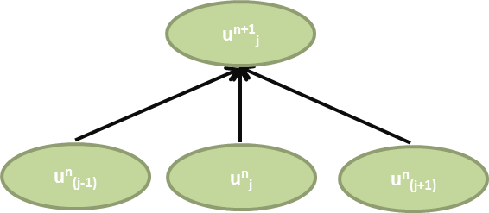
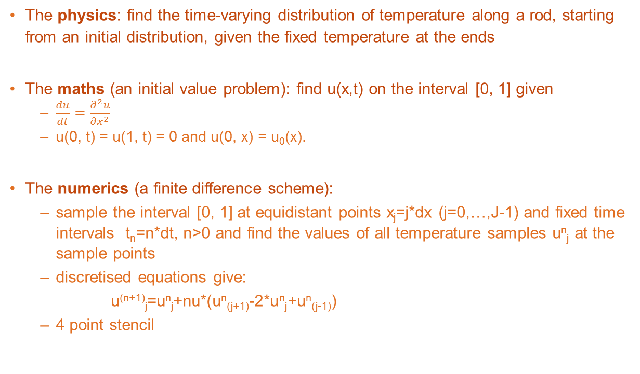
Example – The 1D Heat Equation
The physics: find the time-varying distribution of temperature along a rod, starting from an initial distribution, given the fixed temperature at the ends
The maths (an initial value problem): find u(x,t) on the interval [0, 1] given
$\frac{du}{dt}=\frac{∂^{2}u}{{∂x}^{2}}$
u(0, t) = u(1, t) = 0 and u(0, x) = u₀(x).
The numerics (a finite difference scheme):
sample the interval [0, 1] at equidistant points x_{j}=j*dx (j=0,…,J-1) and fixed time intervals t_{n}=n*dt, n>0 and find the values of all temperature samples u^{n}_{j} at the sample points
discretised equations give:
u^{(n+1)}_{j}=u^{n}_{j}+nu*(u^{n}_{(j+1)}-2*u^{n}_{j}+u^{n}_{(j-1)})
4 point stencil

Slide 32
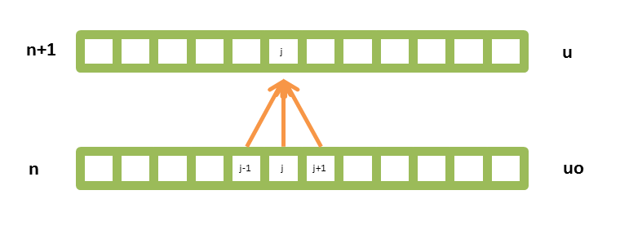
Example: 1D Heat Equation
The core of the program is to use two vectors u and uo (u “old”).
At every time step,
copy u into uo (not efficient but simple to understand)
apply the finite difference scheme (the 4 point stencil)
apply boundary conditions: u₁=u_{J}=0

Slide 33
Example – 1D Heat Equation
// boundary conditions
u[0] = 0.0; uo[0] = 0.0;
u[J-1] = 0.0; uo[J–1] = 0.0;
// time loop
for (n=0; n<n_time_steps; n++) {
// store solution
for (j=1; j<J-1; j++) {
uo[j] = u[j];
}
// finite difference scheme
for (j=1; j<J-1; j++) {
u[j] = uo[j] + nu*(uo[j-1]-2.0*uo[j]+uo[j+1]);
}
}

Slide 34
Problem: 1D heat equation in Parallel – The Easy Way
// time loop
for (t=0; t<n_time_steps; t++) {
// store solution
for (j=1; j<n-1; j++) {
uo[j] = u[j];
}
// finite difference scheme
for (j=1; j<n-1; j++) {
u[j] = uo[j] +
nu*(uo[j-1]-2.0*uo[j]+uo[j+1]);
}
}
// time loop
for (t=0; t<n_time_steps; t++) {
// store solution
#pragma omp parallel shared(n,u,uo,J) private(j)
{
#pragma omp for
for (j=1; j<n-1; j++) {
uo[j] = u[j];
}
}
// finite difference scheme
#pragma omp parallel shared(n,u,uo,nu,J) private(j)
{
#pragma omp for
for (j=1; j<n-1; j++) {
u[j] = uo[j] +
nu*(uo[j-1]-2.0*uo[j]+uo[j+1]);
}
}
}

Slide 35
Problem: 1D Heat Equation in Parallel – The Better Way
// time loop
for (t=0; t<n_time_steps; t++) {
// store solution
#pragma omp parallel shared(n,u,uo,J) private(j)
{
#pragma omp for
for (j=1; j<n-1; j++) {
uo[j] = u[j];
}
}
// finite difference scheme
#pragma omp parallel shared(n,u,uo,nu,J) private(j)
{
#pragma omp for
for (j=1; j<n-1; j++) {
u[j] = uo[j] +
nu*(uo[j-1]-2.0*uo[j]+uo[j+1]);
}
}
}
// time loop
# pragma omp parallel default( none ) \
shared(n,n_time_steps,u,uo,nu,) \
private(t,j)
{
for (t=0; t<n_time_steps; t++) {
// store solution
# pragma omp for
for (j=1; j<n-1; j++) {
uo[j] = u[j];
}
// finite difference scheme
# pragma omp for
for (j=1; j<n-1; j++) {
u[j] = uo[j] +
nu*(uo[j-1]-2.0*uo[j]+uo[j+1]);
}
}
}

Slide 36
What have we learnt?
We have learnt
The basic ideas behind parallelism
How OpenMP implements the shared memory programming model
How to create threads with #pragma omp parallel
How to scope variables
How to share the work between the threads with #pragma omp for
How to synchronise the threads with barriers, critical regions and reductions
How to parallelise a small but realistic program

Slide 37
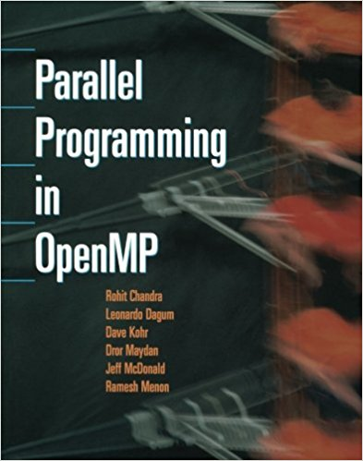
Further learning
The best way to learn OpenMP is to go on a longer course. Two free possibilities are
The courses run here in Oxford by the Advanced Research Computing Service
http://www.arc.ox.ac.uk/content/training
https://oxford.imparando.com/accessplan/LMSPortal/UI/Page/Courses/book.aspx?courseid=HP014 is the direct link to the OpenMP course
Courses run by the national supercomputing service, ARCHER
http://www.archer.ac.uk/training/
Unfortunately there are no books I know of that I can totally recommend
Probably the best is Parallel Programming in OpenMP by Chandra et al.
But it is a bit old now

Slide 38
In the next lecture…
<A synopsis of first CUDA lecture>
Need to see lecture before I can fill this in!

