Slide 1

An Introduction to HPC and Scientific Computing
Lecture five: A deeper dive into C programming
Wes Armour
Oxford e-Research Centre,
Department of Engineering Science

Slide 2
Overview
In this lecture you will learn about:
More on arrays.
Multidimensional arrays.
An introduction to pointers.
Characters and strings.
Variable scope.
Advanced program control.
How to work with files.
Dynamic memory allocation.

Slide 3
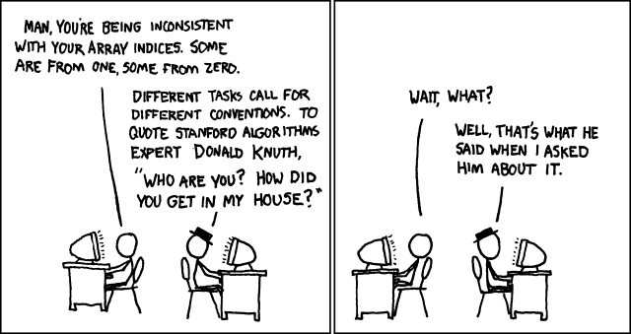

Using Arrays
In lecture two we presented the concept of an array and how to use them. Now let’s look a them in some more detail. What characterises an array.
An array is a collection of data storage locations.
An array hold data all of the same type.
Each storage location is called an array element.
C arrays are indexed from 0 to n-1, where n is the number of elements in the array.
Arrays can be initilaised using braces:
int array[3] = {1,3,5};
As demonstrated in our first practical arrays are a useful way to organise variables in your program.
https://xkcd.com/163/

Slide 4
Using Arrays – single dimensional
In practical one we used an array called radius to hold different values for the radius of a circle. This can be represented schematically below.
We have a contiguous collection of array elements, starting at zero, increasing to n-1, all holding a single value.
array[0] holds the integer value 5, array[1] holds the integer value 10, up to array[n-1] which holds the integer value 11.
int array[n]
5
10
15
…
11
array[0]
array[n-1]

Slide 5
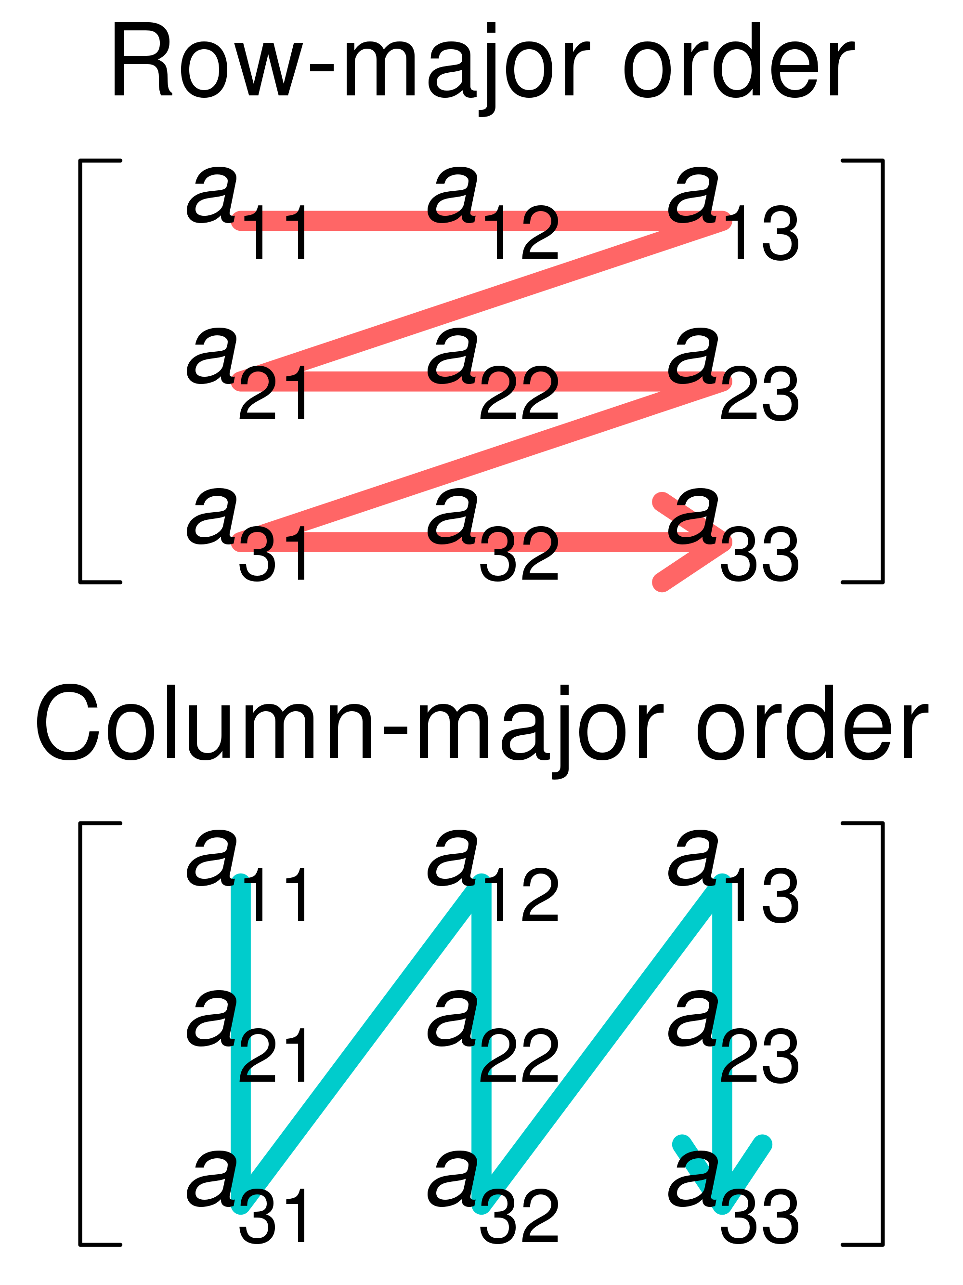
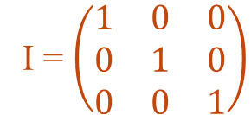
Using Arrays – multidimensional
We can see that arrays can be very useful in helping us create compact and easy to read code. But what about if we want to store something that has more than a single dimension?
Fortunately C has the concept of multidimensional arrays. Using these we can store an entity that has any dimension.
Lets consider the 3x3 identity matrix (right). We can store this as a 2D array which we declare as:
int identity[3][3]
In C this would tell the compiler to create a linear contiguous area in memory to hold 3x3 = 9 ints.
C uses row-major ordering. What does this mean?
I = $\left(\begin{matrix}1 & 0 & 0 \\ 0 & 1 & 0 \\ 0 & 0 & 1\end{matrix}\right)$
By Cmglee [CC BY-SA 4.0 (https://creativecommons.org/licenses/by-sa/4.0) or GFDL (http://www.gnu.org/copyleft/fdl.html)], from Wikimedia Commons

Slide 6
Using Arrays – multidimensional
Row-major ordering means that consecutive elements within a row reside next to each other in memory. Rows are then stored (in order) in memory consecutively.
Lets return to our example of the 3x3 identity matrix (below). We see the first element of the first row is stored first, followed by the second element of the first row, and so on. Then the first element of the second row is stored, followed by the second element of the second row etc.
int identity[3][3]
1
0
0
0
1
0
0
0
1
…
…
array[0][0]
array[1][1]
array[2][3]
array[0][m]
array[1][m]
array[2][m]

Slide 7
Using Arrays – initialising multidimensional arrays
How do we initialise these arrays in our code?
Previously we showed that a one dimensional array can be initialised as follows:
int array[3] = {1,3,5};
We can initialise a 2D array in the following way:
int identity[3][3] = {{1,0,0},
{0,1,0},
{0,0,1}};
This can be generalised. For example below is the initialisation for a 3D array which has dimensions p x q x r (I’ve omitted actual values in an attempt to make this clearer).
int array[p][q][r] = {{{},{},{}},
{{},{},{}},
{{},{},{}}};

Slide 8
Using Arrays – using multidimensional arrays
#include <stdio.h>
#include <stdlib.h>
int main() {
const int n_rows = 3;
const int n_cols = 3;
int random[n_cols][n_rows];
for(int col=0; col<n_cols; col++) {
for(int row=0; row<n_rows; row++) {
random[col][row]=rand();
}
}
printf(“\n\n”);
for(int col=0; col<n_cols; col++) {
for(int row=0; row<n_rows; row++) {
printf(“%d\t\t”, random[col][row]);
}
printf(“\n);
}
return(0);
}
Finally how do we used these arrays in our code? The code on the right gives an example of how we initialise a matrix with random numbers.
To do this we use the random number generator called rand(). This is a function that returns a random integer between 0 and RAND_MAX (where RAND_MAX is at least 32767). It has the function prototype:
int rand(void);
which is included in stdlib.h

Slide 9
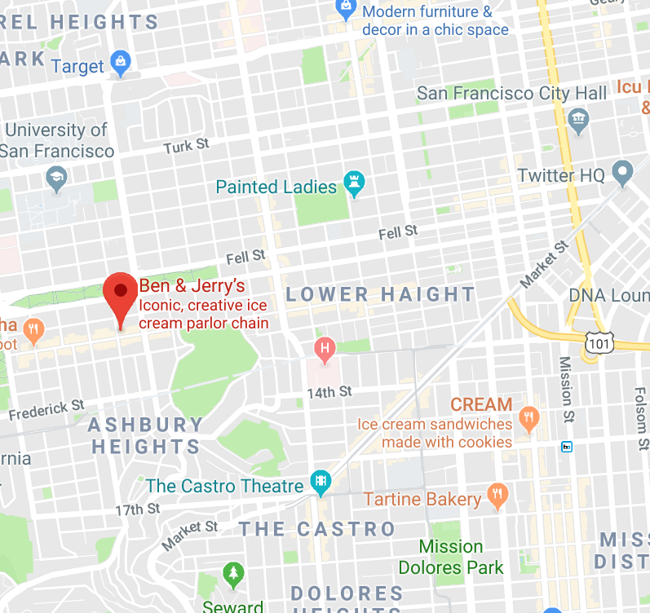
Understanding pointers - memory locations
Our previous example of arrays depicted a computers memory (RAM) as a sequence of linear, contiguous storage elements. We looked at how data items are stored in each element.
But how does a computer know in which element the data it wants to access is stored? For example how does it know where identity[0][0] is located?
This problem is overcome just as it would be in the real world. Each memory location is given a unique address. This is a simplified view of the actual mechanics of how memory is addressed, however it is sufficient for our needs.

Slide 10
Understanding pointers – addressing memory
Lets go back to our previous description of an integer array.
But now lets add an address. I’ve chosen to add an integer address where the beginning element our array which is array[0] has address 100
(again this is simplified, but its sufficient to understand pointers).
Schematically this is represented on the right.
int array[n]
5
10
15
…
11
Address
100
101
102
…
100+(n-1)
array[0]
array[n-1]

Slide 11

Understanding pointers – creating a pointer
The next thing to note is that each address is a number and so can be treated like any other number in C.
If we know the address of array[0] then we could create another variable to store this address.
Lets work through the process for doing this over the next few slides.

Slide 12
Understanding pointers – creating a pointer
int array[5]
As before we declare our integer array, let’s declare space for 5 integers (so n=5)
5
…
11
Address
98
99
100
…
100+(5-1)
array[0]
array[4]

Slide 13
Understanding pointers – creating a pointer
int array[5]
Next we declare a variable (called ptr_array) that happens to live at address 98.
At this point it is uninitialized, so its value is undetermined.
?
5
…
11
Address
98
99
100
…
100+(5-1)
ptr_array
array[0]
array[4]

Slide 14
Understanding pointers – creating a pointer
int array[5]
Now we store the address of array[0] in the variable ptr_array
Because ptr_array contains the address of array[0] it points to where array is stored in memory.
100
5
…
11
Address
98
99
100
…
100+(5-1)
ptr_array
array[0]
array[4]
Hence ptr_array is a pointer to array

Slide 15
Understanding pointers – using pointers
To work with pointers we need to know about two operators. These are:
The indirection operator *
The address-of operator &
To understand these operators lets return to our simple example of calculating the area of a circle.
We declare a pointer to type float by:
float *ptr_radius;
The indirection operator tells the compiler that ptr_radius is a pointer to type float and not a variable of type float.
#include <stdio.h>
#define PI 3.14
int main() {
float radius = 10.0;
float area;
float *ptr_radius;
area = PI * radius * radius;
return(0);
}

Slide 16
Understanding pointers – using pointers
#include <stdio.h>
#define PI 3.14
int main() {
float radius = 10.0;
float *ptr_radius;
float area;
area = PI * radius * radius;
printf(“\nArea:\t%f”, area);
area = 0;
ptr_radius = &radius;
area = PI * (*ptr_radius) * (*ptr_radius);
printf(“\nArea with pointer:\t%f”, area);
return(0);
}
To initialise the pointer (set it to point to something) we use the address-of operator:
ptr_radius = &radius;
This tells the compiler to take the address of the variable radius and store it in the pointer ptr_radius
The code on the right shows how this works and tests the results of using a pointer.

Slide 17
Understanding pointers – using pointers
We can use arithmetic on pointers, just like we can any other numbers.
A schematic demonstrating this is given below.
We also have increment: ptr_radius++;
and decrement operators: ptr_radius--;
Finally we can pass pointers as arguments to functions:
float area_of_circle(float *ptr_radius);
5
10
15
…
11
array[0]
*(array+0)
array[1]
*(array+1)
array[2]
*(array+2)
array[n-1]
*(array+n-1)

Slide 18
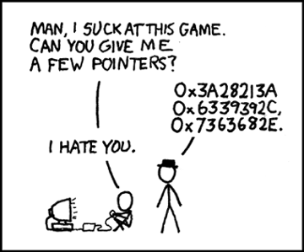
Understanding pointers
Pointers are (arguably) the most difficult concept in C to understand. However they are a powerful tool that can be used to write versatile and concise code. They also provide a flexible method for data manipulation.
In “Practical examples using the C programming language” we will look at the uses of pointers in more detail.
https://xkcd.com/138/

Slide 19
Characters and Strings
C uses the char variable to store characters and strings.
C uses ASCII encoding to turn integer numbers into characters. An example of this is given on the right.
C decides whether a char holds a character or a number depending on the context of its use.
#include <stdio.h>
int main() {
char one = 70;
char two = ‘q’;
printf(“\nOne as a character:\t%c”, one);
printf(“\nOne as a number:\t%d”, one);
printf(“\nTwo as a character:\t%c”, two);
printf(“\nTwo as a number:\t%d”, two);
return(0);
}
https://en.wikipedia.org/wiki/ASCII

Slide 20
Characters and Strings
C uses arrays of char variables to store strings.
Stings are terminated with the null character which is represented by \0
So a string that has seven characters needs an array of eight elements to store it.
The code on the right gives an example of this and demonstrates two ways to initialise a character array with a string.
Recall the conversion specifier for a string is %s
#include <stdio.h>
int main() {
char one[5] = {‘H’,’a’,’r’,’d’};
char two[5] = “Easy”;
printf(“\nString one:\t%s”, one);
printf(“\nString two:\t%s”, two);
return(0);
}

Slide 21
Characters and Strings
#include <stdio.h>
int main() {
char one[] = {‘H’,’a’,’r’,’d’};
char *two = “Easy”;
printf(“\nString one:\t%s”, one);
printf(“\nString two:\t%s”, two);
return(0);
}
You can also allocate storage space for your string at compile time. To do this use one of the two ways demonstrated in the code on the right.

Slide 22
Characters and Strings
For a user to interact with your program they need to be able to pass it input. C has two methods to read strings from the keyboard.
The first is the gets() function. This simply reads all input to the keyboard until a user presses the Enter key.
The second is the scanf() function, this requires the programmer to specify the format of the input using conversion specifiers.
Both methods are demonstrated in the code on the right.
#include <stdio.h>
int main() {
char one[256];
char two[256];
char three[256];
int count;
printf(“\nType some text and press Enter:\n”);
gets(one);
printf(“\nYou typed:\t%s”, one);
printf(“\nType two words and press Enter:\n”);
count = scanf(“%s%s”, &two &three);
printf(“\nYou enterd %d words:\t%d”, count);
printf(“\nYour words are: %s and %s”, two, three);
return(0);
}

Slide 23
Variable scope – Global variables
Variable scope refers to the extent to which different parts of your C program can “see” a variable that you declare.
The concept of scope allows a programmer to truly separate out (structure) their code into independent self contained routines or functions.
Doing this helps reduce bugs in code and makes for more reusable code. For example if a variable can only be seen by the function that is operating on it another function cannot mistakenly corrupt its value.
In some instances it is desirable to share a variable amongst the whole code. This can be done with the extern keyword.
#include <stdio.h>
void print_number(void);
float one = 3.0;
int main() {
extern float one;
print_number(void);
return(0);
}
void print_number(void) {
extern float one;
printf(“\nYour number is:\t%f\n”, one);
}

Slide 24
Variable scope – Local variables
External variables are sometimes called global variables. Their scope is the whole program, so main() and any other functions() that you define.
This is opposite to local variables. A local variable is defined within a function. As such its scope is within the function (remember main() is a function and so we can have local variables in main()).
Local variables are automatic, meaning they are created when the function is called and destroyed when it exits. So an automatic variable doesn’t retain its value in between function calls.
To remember the value of a variable between function calls we can use the static keyword.
#include <stdio.h>
void print_number(int x);
int main() {
for(int x=0; x<3; x++) {
print_number(x);
}
return(0);
}
void print_number(int x) {
static int y = 0;
printf(“\nx,y are:\t%d %df\n”, x, y);
y--;
}

Slide 25
Advanced program control
#include <stdio.h>
void print_number(int x);
int main() {
for(int x=0; x<5; x++) {
print_number(x);
if(x == 2) break;
}
int x = 0;
while(1) {
if(x == 3) {
break;
}
print_number(x);
x++;
}
return(0);
}
void print_number(int x) {
static int y = 0;
printf(“\nx,y are:\t%d %df\n”, x, y);
y--;
}
C provides some additional tools for advanced program control.
Three of the most useful are:
break
continue
switch
Both break and continue provide additional control within loops. They are used within the body of a for() or while() loop, additionally break can be used in a switch statement.
The switch statement takes an argument and then executes code based on this.

Slide 26
Advanced program control
#include <stdio.h>
void print_number(int x);
int main() {
int choice;
printf(“\nEnter a choice: 1,2 or 3 to exit: “);
scanf(“%d”, &choice);
switch(choice) {
case 1:
printf(“You entered 1”);
break;
case 2:
printf(“You entered 3”);
break;
case 3:
printf(“You entered 3. Exiting.”);
exit(0);
}
return(0);
}
The switch statement is useful when you want to compare a value against a list of known values. An example might be allowable responses for input. More general comparisons are done by if as we saw previously.
An example of how the switch statement can be used is given on the right.

Slide 27
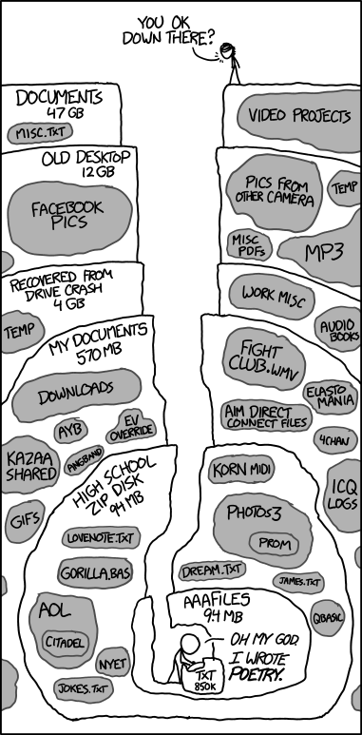
Using files
C provides a number of different tools for interacting with files stored on your computer.
In this lecture we’ll cover four basic functions for this.
fopen()
fclose()
fprintf()
fscanf()
https://xkcd.com/1360/

Slide 28
Using files – fopen and fclose
The code on the right declares a pointer to type FILE. Then two char arrays are declared to hold a file name and a mode.
The file name is the name of the file you want to use and the path to it.
We use gets() to read strings from the keyboard and store these in our char arrays.
We then use fopen() to try and open the requested file. If the file opens successfully then the pointer fp is initialised. If not the pointer is set to NULL and we print an error.
Finally we close the file using the fclose() statement.
#include <stdio.h>
int main() {
FILE *fp;
char filename[200], mode[4];
printf(“\nEnter your file: “);
gets(filename);
printf(“\nEnter a file mode: “);
gets(mode);
if((fp=fopen(filename, mode)) != NULL) {
printf(“\nOpened %s in mode %s”, filename, mode);
} else {
printf(“\nERROR: File not recognised”);
}
fclose(fp);
return(0);
}

Slide 29
Using files – fopen and fclose
Mode | Meaning | Return value from fopen if the file:
 |  | Exists | Doesn’t exist
r | Reading | – | NULL
w | Writing | Overwrite if file exists | Create new file
a | Append | New data is appended at the end of file | Create new file
r+ | Reading + Writing | New data is written at the beginning of the file overwriting existing data | Create new file
w+ | Reading + Writing | Overwrite if file exists | Create new file
a+ | Reading + Appending | New data is appended at the end of file | Create new file
In the previous slide we introduce the concept of opening a file in different modes.
The table on the right outlines different modes and the and the associated return value of fopen()

Slide 30
Using files – fprintf and fscanf
#include <stdio.h>
int main() {
FILE *fp;
char filename[200], mode[4];
int index[10], square[10];
printf(“\nEnter your file: “), gets(filename);
printf(“\nEnter a file mode: “), gets(mode);
if((fp=fopen(filename, mode)) == NULL) exit(1);
for(int i=0; i<10; i++) {
fprintf(fp, “%d %d”, i, i*i);
}
fclose(fp);
fp=fopen(filename, mode);
for(int i=0; i<10; i++) {
fscanf(fp, “%d %d”, &index[i], &square[i]);
}
for(int i=0; i<10; i++) {
fprintf(fp, “%d %d”, i-index[i],(i*i)-squared[i]);
}
return(0);
}
The code on the right gives examples of using the fprintf()and fscanf() functions (it’s a bit squashed).
We open a file as before (note the bad coding practice, the code fails silently if fopen() fails).
We use fprintf() to print 10 numbers and their squares to a file. Note how fprintf() works like printf()
We close the file and reopen it.
We then use fscanf() to read in our outputted numbers.
Finally we perform a difference of these and print out to screen.

Slide 31
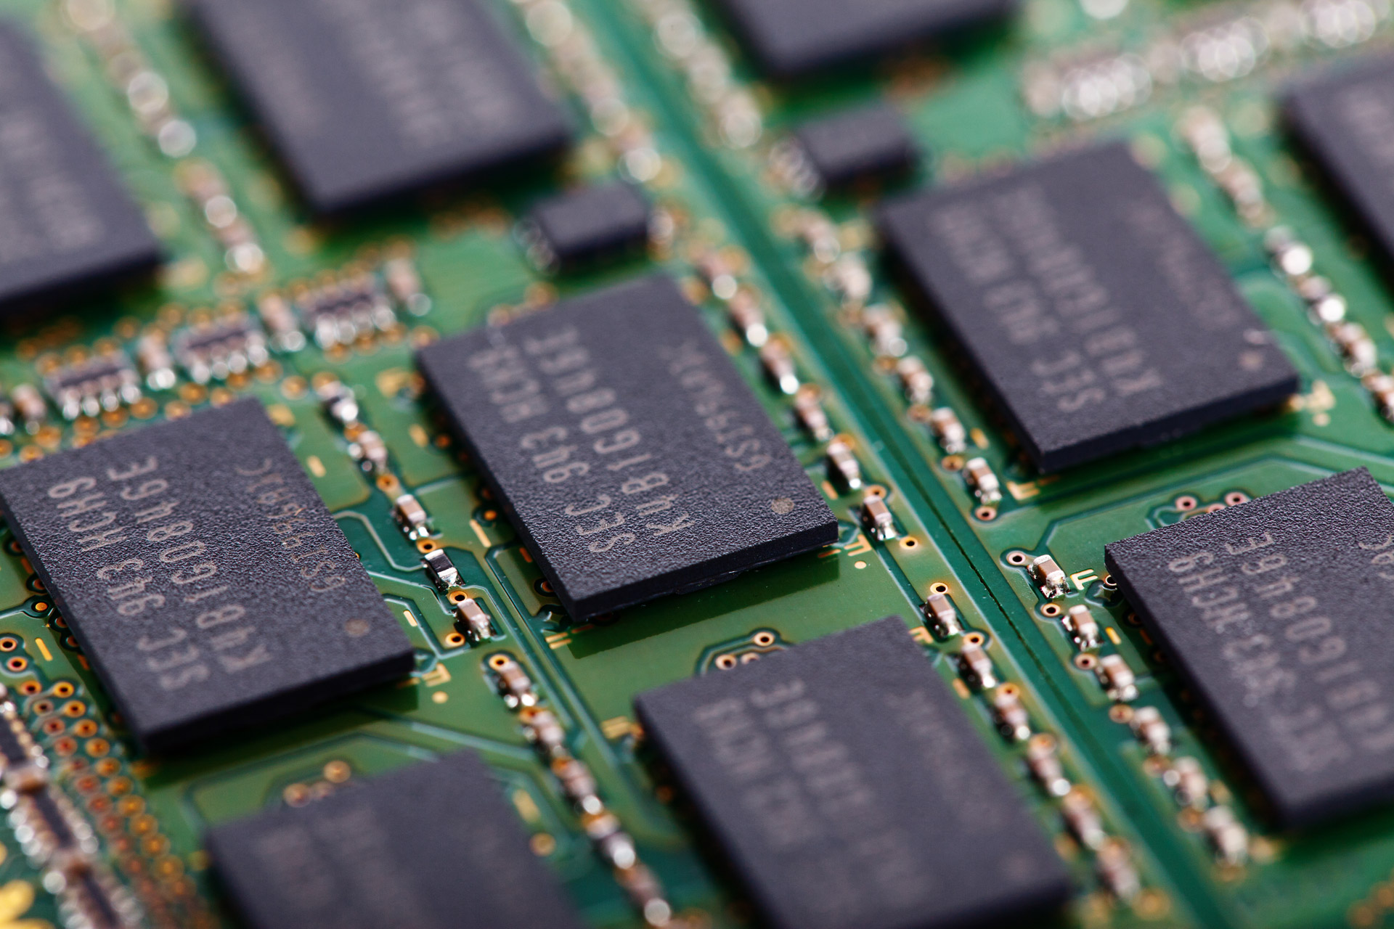
Working with memory
Up until now all of our example codes have allocated static memory.
By this we mean that when we write our code we declare how much memory we need for particular variables or arrays.
However there might be instances where we don’t know how much memory we need until we run the code. For example we might want to read a file into our code that is updated on a daily basis, the files length might be different on different days.
C provides a process for allocating memory at runtime. This is called dynamic memory allocation.
https://en.wikipedia.org/wiki/C_dynamic_memory_allocation

Slide 32
Working with memory
Lets return to our example code from Lecture two. We can modify this code so that is askes the user how many areas they want to calculate and then dynamically allocates memory for them.
We start by declaring two pointers:
float *radius;
We then use scanf() to get the number of circles the user wants to work with.
We then use malloc() to allocate the memory that we need.
After this we use scanf() to get the radii from the user.
This time we accumulate directly to total_area
Finally we free()our allocated memory.
#include <stdio.h>
#include <stdlib.h>
#define PI 3.14
float area_of_circle(float radius);
int main() {
int i=0, number_of_circles=0;
float *radius;
float total_area=0;
printf(“\nEnter the number of circles to calculate:\t”);
scanf(“%d”, &number_of_circles);
radius=(float *)malloc(number_of_circles*sizeof(float));
printf(“\nEnter the radii:\n”);
for(i=0; i<number_of_circles; i++) scanf(“%f”, &radius[i]);
i=0;
while(i<number_of_circles) {
total_area += area_of_circle(radius[i]);
i++;
}
printf(“\nTotal area is:\t%f\n”, total_area);
free(radius);
free(area);
return(0);
}
float area_of_circle(float radius) {
float area = PI * radius * radius;
return area;
}

Slide 33
Working with memory – malloc()
Lets take a closer look at malloc()
Both malloc()and free() are defined in stdlib.h, so this must be included into your code to use them.
The function prototype for malloc() is:
void *malloc(size_t num);
size_t is an unsigned integral type and is used to represent the size of an object in bytes. The return type of the sizeof() operator is size_t
malloc() will return NULL if num bytes cannot be allocated (for example the computer doesn’t have enough memory space left)
memory
malloc(size)
allocation

Slide 34


Working with memory – free()
Once we’ve finished working with the memory that we’ve allocated using malloc() we should free it so that it can be used again.
This is done using the free() function. Its function prototype is:
void free(void *ptr);
Calling free() releases the memory that is pointed to by ptr

Slide 35
Working with memory – multidimensional arrays
int ** identity;
int num_rows = 3;
int num_cols = 3;
// To allocate
identity = (int **)malloc(num_rows * sizeof(int*));
for(int i=0; i<num_rows; i++) {
identity[i] = (int *)malloc(num_cols * sizeof(int));
}
// To free
for(int i=0; i<num_rows; i++) {
free(identity[i]);
}
free(identity);
Finally lets return to our identity matrix.
int identity[3][3]
How can we allocate memory for this using malloc()?
The code snippet on the right shows how to do this and then free the allocated memory using free()

Slide 36
Working with memory – multidimensional arrays
identity
**int
Schematically this can be represented by the diagram on the right.
We begin by allocating a double pointer to type int** This in turn points to an array of pointers of type int*
We then point each of these at a single dimensional array of type int.
identity[0]
Identity[1]
Identity[2]
*int
identity[0][0]
identity[1][0]
identity[2][0]
identity[0][1]
identity[1][1]
identity[2][1]
int
identity[0][2]
identity[1][2]
identity[2][2]

Slide 37

What have we learnt?
In this lecture you have learnt about some of the advanced features of the C programing language.
We have covered multidimensional arrays, pointers and characters and strings.
You have learnt about variable scope, some of the functions that provide advanced program control and how to work with files.
Finally we have covered the basics of dynamic memory allocation.
You should now be in a position to write your own advanced C program.

Slide 38
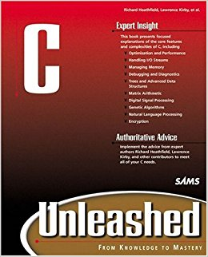
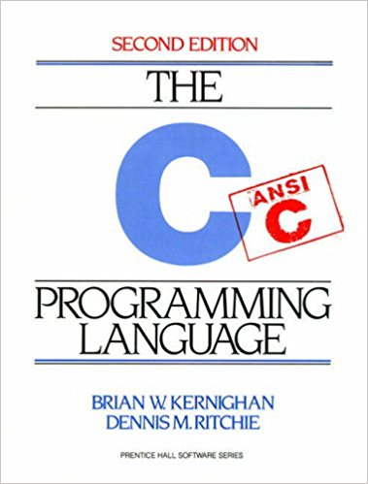
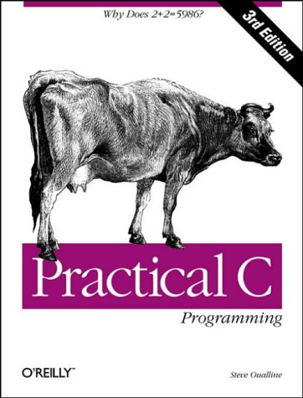
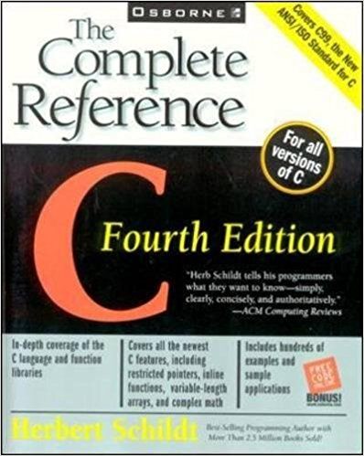
Further reading
http://www.learn-c.org/
https://www.cprogramming.com/tutorial/c-tutorial.html
https://www.gnu.org/software/gnu-c-manual/gnu-c-manual.html

Slide 39

In the next lecture…
In the next lecture you will learn about multi-tasking on CPUs using OpenMP. You will learn about parallelism and concurrency. You will get to know OpenMP and how to use it to share work across cores in a CPU and across CPUs in a server.

