Slide 1

An Introduction to HPC and Scientific Computing
Lecture 4: Using repositories and good coding practices.
Ian Bush
Oxford e-Research Centre,
Department of Engineering Science

Slide 2
Overview
In this lecture we will learn about:
The elements of good practice in writing code
Some of the tools that will help us write good code
The very basics of Revision Control

Slide 3
What Do We Want Out of Good Software
Portable
Works everywhere, for an appropriate value of everywhere
Maintainable
Easy to work with
Easy to fix
Ideally extensible as well
Reliable
Does the job as expected
Few bugs
Efficient
Fast enough – note the word enough!
Usable
People can use it to get their work done

Slide 4
Portability
Standards are one of the main ways to help ensure your code will work in as many places as possible
C standards:
C89
C99
C2011
The compiler is a great tool to help you with standards compliance
Note by default few compilers are standard compliant
They have non-portable extensions
In fact the compiler is a very useful tool in general through programming, learn to use it!

Slide 5
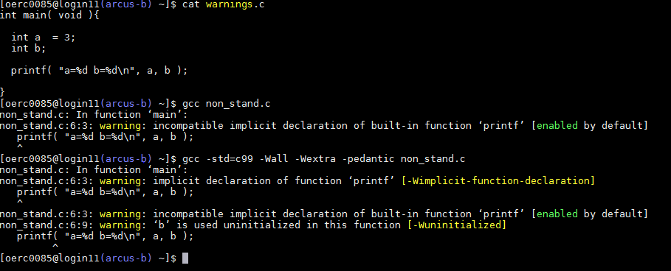
Using the Compiler
If it generates a warning fix it
Use flags on the compiler to generate warning about any dodgy code!

Slide 6
Maintainable
You WILL want to modify your code
You WON’T remember what it did 6 months after you wrote it
However if you put a bit of effort in when you first write it you can save a lot of effort when you come back to it

Slide 7
Think before you start!
Before you write anything think about how you will structure your program
What functions will you need
What inputs does it require
What outputs does it provide
What data structures will you require
Especially for larger projects a bit of careful thought at the beginning can save a lot of thought in the end

Slide 8
Comments And Self Documenting Code
Comments should be useful
Good comment:
// Update the charge density
Bad comment
i++; // Increment i
Code should as far as is possible be self-documenting
Use meaningful variable and function names
Call variables by what they are, not how they are to be used
Use white space to break the code into logical blocks
float calc_circle_area( const float r ){
/* This function calculates
the area of a circle of radius r */
float area;
const float pi = 3.1415927;
area = pi * r * r;
return area;
}

Slide 9
Indent your Code
Indentation helps you identify where control structures (for,if etc.) start and end
It also help you identify which curly brace corresponds to which control structure
Your Editor should help you do this
And don’t use tabs to do it!
for( i=0; i<10; i++ ){
for( j=0; j<10; j++ ){
a[ i ][ j ] = i + j;
}
b[ i ] = a[ i ][ 0 ]
}

Slide 10
Have A (Basic) Naming Convention
Use similar names throughout for your code for variables and functions that do similar things
You probably don’t realise it, but you already will have assumed that i and j are int’s, and are going to be variables to loop over arrays
Another one is that variables starting with an n refer to the number of something
Also commonly used is variables with is in the name refer to binary decisions
for( i=0; i<10; i++ ){
for( j=0; j<10; j++ ){
a[ i ][ j ] = i + j;
}
b[ i ] = a[ i ][ 0 ]
}
is_zero = c == 0;

Slide 11
Be Consistent in your Code
There is no one true way to ident code
There is no one true variable naming convention
It is much more important for a given project to pick a reasonable one and then BE CONSISTENT
One code I work with calls all temporary variables after characters from Lord of the Rings
I’m not saying it’s best practice to call all your variables bilbo and frodo
All I am saying is it is fine as long as you are consistent in doing this!

Slide 12
KISS - Keep it Simple, Stupid
A real line submitted to Stackoverflow
sfs=(n*vs)**2/1.49**2*((20+2*ys)/20/ys)**(4/3)
v(j,i+1)=4.905*(sqrt(sqrt(ys)*s0**2*dt**2-2*sqrt(ys)*s0*dt*(sfs*dt-0.1019368*(vs-3.13209195*sqrt(ys)))
+sfs**2*sqrt(ys)*dt**2-0.2038736*sfs*(vs-3.132092*sqrt(ys))*sqrt(ys)*dt+0.0065092*(q((i+1)*dt)+1.596377*
(vs**2-6.2641839*vs*sqrt(ys)+9.81*ys)*sqrt(ys)))+ys^(1/4)*(s0*dt-sfs*dt+0.101937*(vs-3.132092*sqrt(ys))))
/ys**(1/4)

Slide 13
KISS and Functions
Break large blocks of code into multiple functions
Ideally each function should be no more than “1 page long”
As you can see it all in one go
Use a consistent naming convention for functions
A common one is “verb-noun”
E.g. Calculate_Potential_Energy
float calc_circle_area( const float r ){
/* This function calculates
the area of a circle of radius r */
float area;
const float pi = 3.1415927;
area = pi * r * r;
return area;
}

Slide 14
Wherever Possible Keep Functions Pure
A Pure function is one whose result depends purely on the values of the parameters supplied to it
float calc_circle_area( const float r ){
/* This function calculates
the area of a circle of radius r */
float area;
const float pi = 3.1415927;
area = pi * r * r;
return area;
}

Slide 15
Impure Functions Are Difficult to Debug; Avoid Global Variables
Imagine the function to the right is causing problems
You would have to work out the value of magic, and it is a global variable it could be set anywhere in the code
The related lesson here is avoid global variables
If you you do use global variables
Keep them to a minimum
Best keep them constant, e.g. pi is fine as a global
At worst set once in a well defined place and never again modified, only read
float calc_something( float s ){
float result;
if( magic == 0 ) {
result = 3;
}
else {
result = another_function();
}
return result;
}

Slide 16
Pure Functions are Easy To Develop and test
A function that is pure is easy to test
Simply write a main program that calls it with an appropriate set of parameters
This makes it easy to develop
Make all your functions pure, write a testing program, test it to hell and back, move to developing the next function
Such an approach is called unit testing
Unit testing frameworks exist to help with this
float calc_circle_area( const float r ){
/* This function calculates
the area of a circle of radius r */
float area;
const float pi = 3.1415927;
area = pi * r * r;
return area;
}

Slide 17
A Good way to Learn Maintainability
Look at open source codes and see what works!
Example in the practical

Slide 18
Reliability
Cutting down on the number of bugs you learn by experience
But we have seen some techniques so far
Use the compiler to check your code as thoroughly as possible
Keep your functions pure and simple so they can be thoroughly tested before incorporation into the larger project
Also check the return values of functions to check that actually worked
E.g. fopen
E.g. malloc
However there are other tools you can use to help you with bugs
The compiler
Debuggers

Slide 19
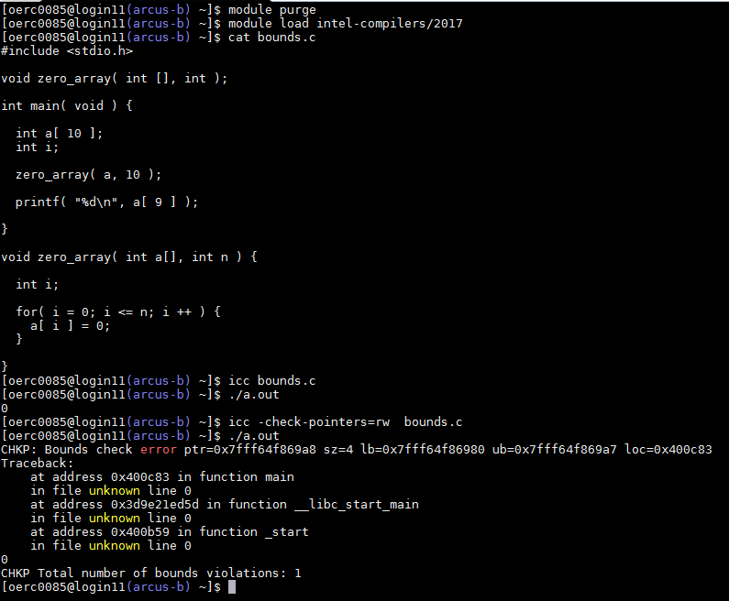
Run Time Checks with the Compiler
If you have access to a recent version of the Intel Compiler (2017 or later)

Slide 20
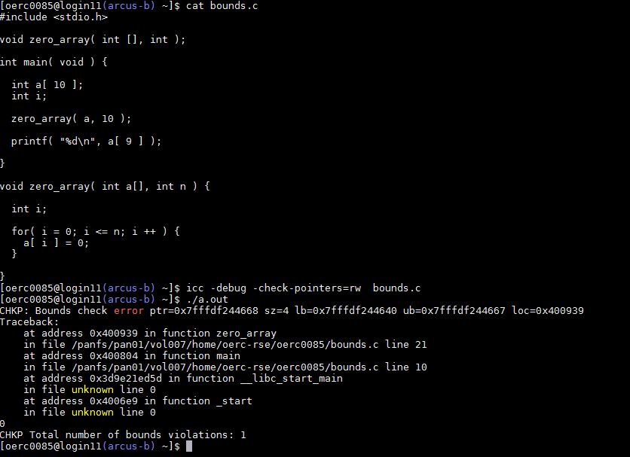
More Useful Run Time Checks
So we got the compiler to tell us there is a problem
Good but with a bit more work we can do better!
We can get it to tell us exactly where the problem is
Getting array and pointer indexing wrong is an incredibly common error, I strongly suggest you use it whenever developing code
Civilised languages have had this feature for decades …
Also note here I am using icc, earlier I used gcc
When developing use many compilers, they have different diagnostic capabilities

Slide 21
More Complex Bugs
For more complex bugs you can use a debugger
E.g. gdb
Not sufficient time to cover here but should be aware of them
Can use them for many things, including
Work out while a program has crashed
While running pause the program at a specified point
While running enquire the value of variables
While running modify the value of variables
Run the program a single line at a time (step through the code)
Pause the program if a given variable is modified
Do all the above run time checks dependent on a condition
And many more

Slide 22
Efficiency
We don’t really have time to address efficiency here
But note I said “fast enough”
If over night is good enough 4 hours or 8 hours makes no difference
But the weather forecast has to be there by tomorrow!
You can use a profiler to look at efficiency problems
gprof is a simple free one, and you will look at nvvp in the CUDA exercises
But remember if you get the wrong answer it doesn’t matter how fast it runs
Get it right and then, and only then, get it fast
Correctness trumps efficiency every time, too many people forget this

Slide 23
Usability
If your program doesn’t solve the problem it is supposed to solve it’s not much use
Similarly if it does but you can’t work out to use it, again it is not much use!
Some thought should go into how a human interacts with a program
Inputs and how outputs will be handled
Small projects files are enough, but for many programs at some point a GUI becomes desirable
Larger projects, certainly ones with more than one person involved, should be documented
Again there are tools to help
E.g. see Doxygen

Slide 24
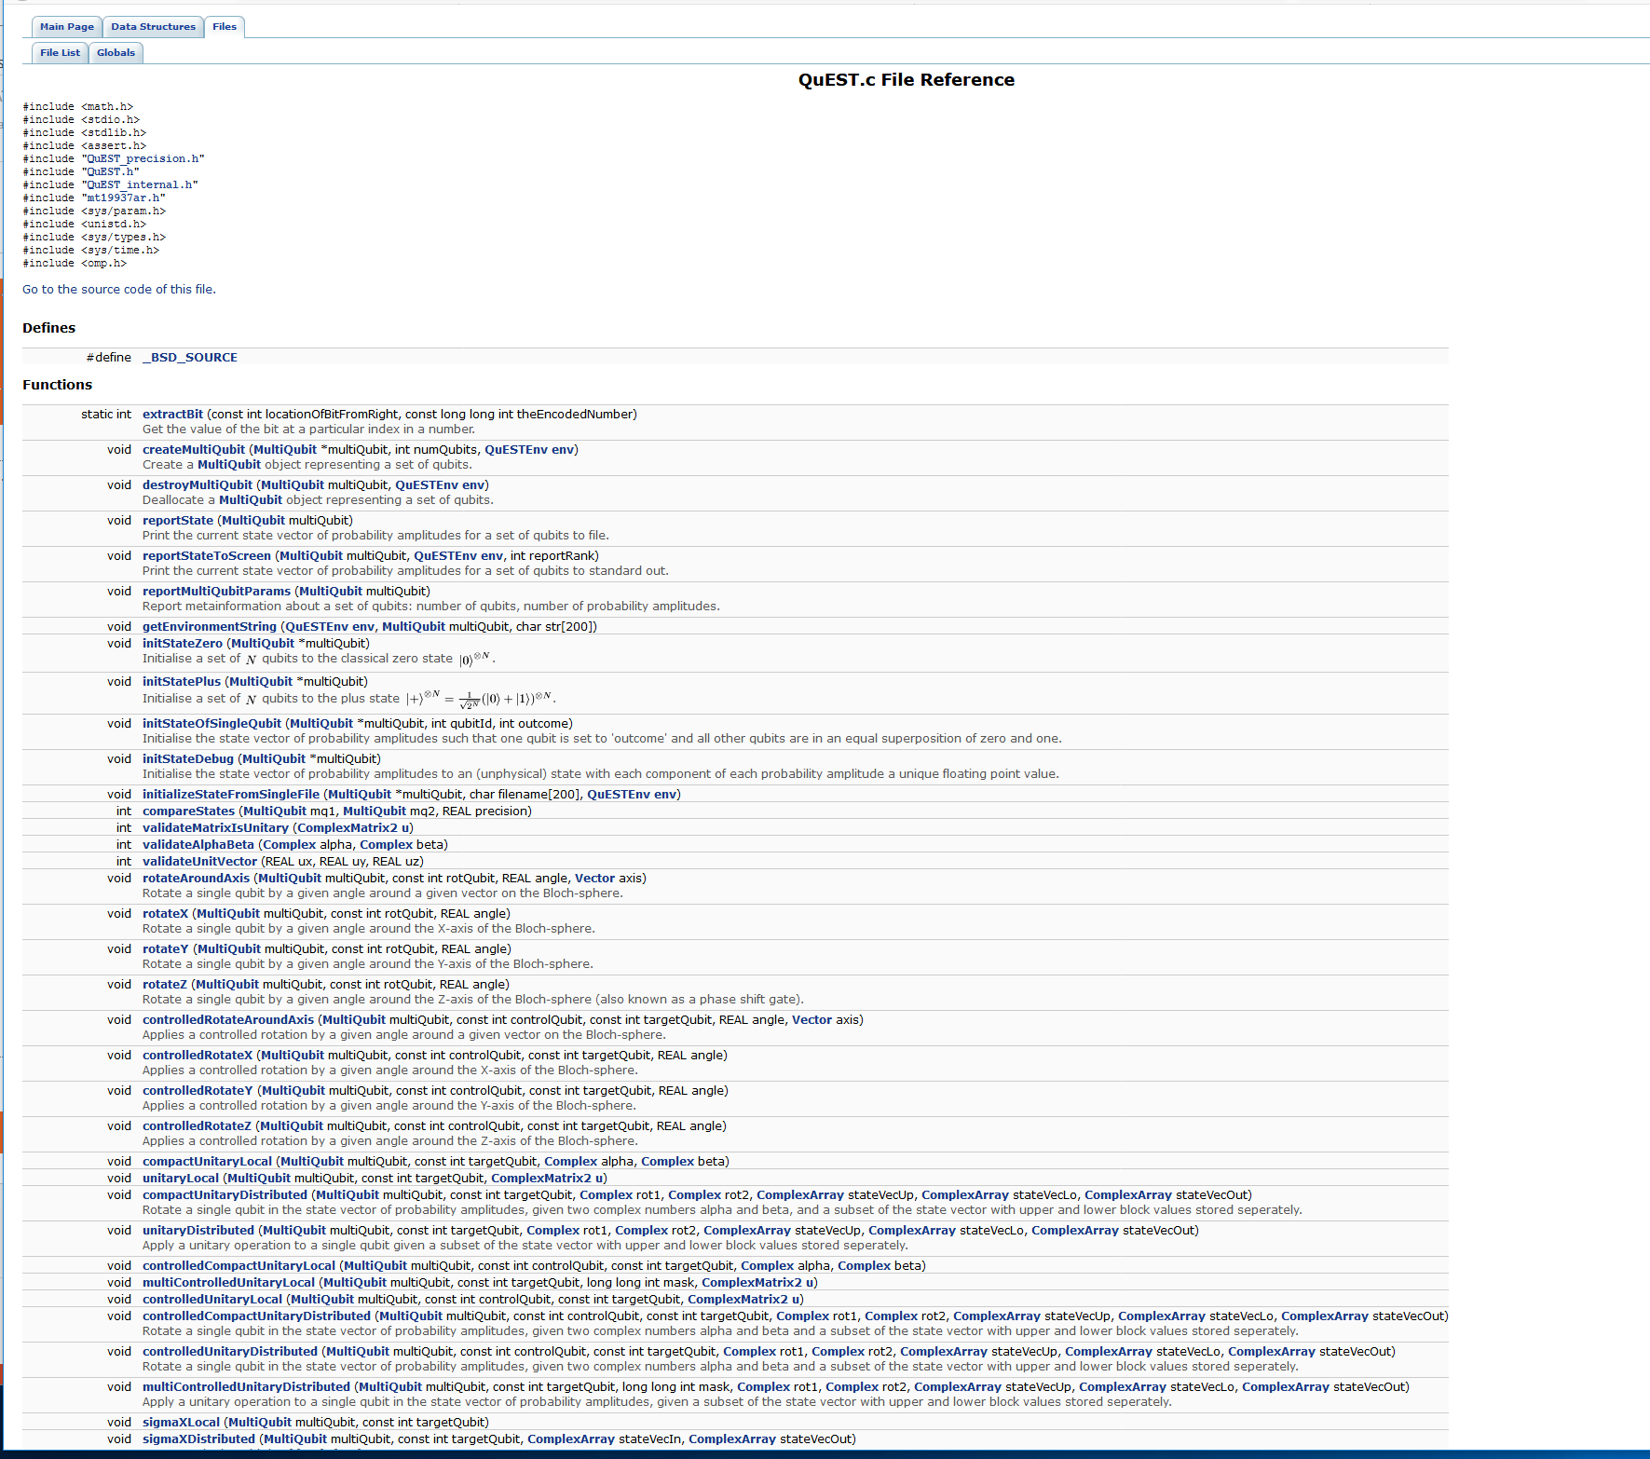
Doxygen

Slide 25
A Summary of Development Tools
Editors e.g. emacs, nano
Useful for consistent code layout, and can help find some bugs via e.g. syntax highlighting
Compilers e.g. gcc, icc
Standard conformance, bug detection at both compile and run time
Unit testing frameworks, many free ones for C e.g. Check
Check correctness during development cycle
Debuggers e.g. gdb, idb, Totalview, ddt
Find bugs either post mortem or at run time
Profilers e.g. gprof, Scalasca, Paraver
Diagnose efficiency issues
Documentation e.g. Doxygen
Automatically generate documentation from the comments in your code
What Else?
IDE’s (integrated development environments) bring a lot of these together e.g. Eclipse
But less popular in the Linux world than Windows – philosophical reasons I suspect
Revision Control Systems – we’ll have a quick look at this
a.k.a. Version Control
Continuous Integration (CI) – a quick word once we have done Revision Control

Slide 26
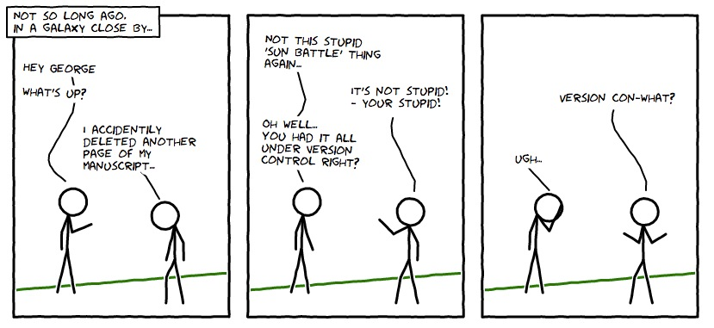
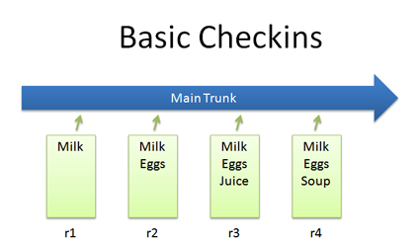
Revision Control Systems (1)
Imagine you are working on a piece of software
It’s working and then you make some changes
It’s now not working
E.g. you are doing this after the pub. Number one tip: software development and beer don’t mix!
Wouldn’t it be nice if you could go back to the version that worked and start again?
Ideally tomorrow morning
Revision control systems allow you to do this by keeping a complete history of all versions of the software project
https://betterexplained.com/articles/a-visual-guide-to-version-control/

Slide 27
Revision Control Systems (2)
Imagine the project has got so complex that it is not just you working on it
It would be nice to have a tool that kept track of the most up to date version which is the union of all the teams changes
You don’t want to be emailing versions of files around – people will lose track and everybody will end up with a subtly different version of the code
It would also be nice to have a tool that helps you merge the various changes together
And identify where the work of one member of the team conflicts with the work of another
Revision control systems help you do that

Slide 28
Revision Control systems (3)
You now want to release the software to the public
How are people to get the code from you
If somebody reports a bug how are you to know what version of the code it relates to?
Revision control can help with this as well!
Release tags

Slide 29
Revision Control Systems (4)
What if somebody in the project wants to do something very experimental
Or there are multiple developments which need to go on, and the best way to work would be to each development to be worked upon as independently as possible from any other one
Or you want to be able to merge bug fixes into a given release, but have a separate version of the code which is being developed for the next release?
Revision control systems can help with this!
Branches

Slide 30
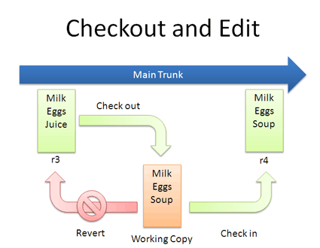
Revision Control Systems
The basic idea
The current version and history of the project is held in a repository
When you want to work on the code you check out a copy of the code
You do your work on the working copy
Once you are happy with your work you check it back into the repository

Slide 31
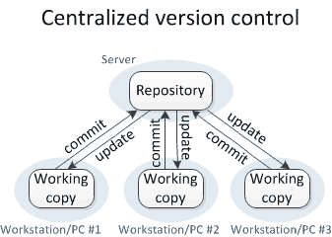
Centralised Revision Control Systems
Note the repository could be accessible by just you, or members of a team
The simplest model is a centralised version control system
https://blog.inf.ed.ac.uk/sapm/2014/02/14/if-you-are-not-using-a-version-control-system-start-doing-it-now/

Slide 32
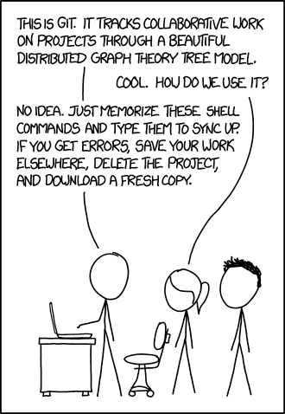
Git
Many Revision Control systems
Mercurial, subversion …
I think I have used 7 different ones over the years
Admittedly all more or less the same for the level of use needed here
Git is probably the most commonly used nowadays
Even if myself I’m not that fond of it …

Slide 33
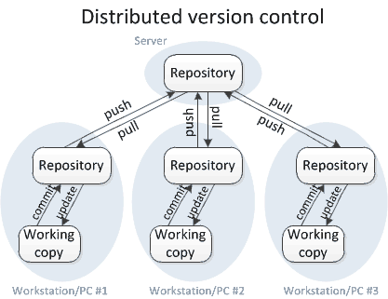
Git Model
Git has a slightly more complicated model
It is a distributed revision control system
Definite advantage in having own local repository to work with, and then a shared external repository
One of the reasons git is popular is there are many places to store the shared repository, e.g. github, which also makes it easy to distribute code
See the practical

Slide 34
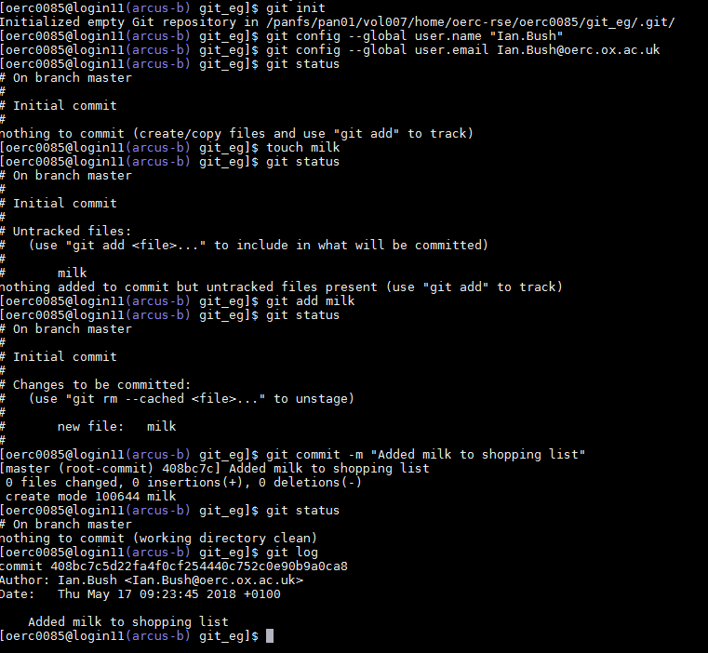
Git – a few basic commands
git init – initialise a local repository
git add – add a file to the staging area
git commit – check all changes held in the staging area into the repository
git status – what is the current status of the directory, staging area and repository?

Slide 35
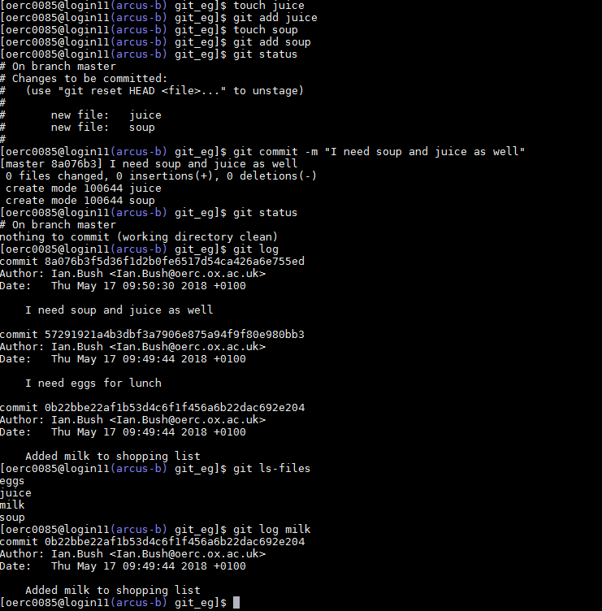
git ls-files – list the files in my repository
git log – history of repository, or a given file

Slide 36
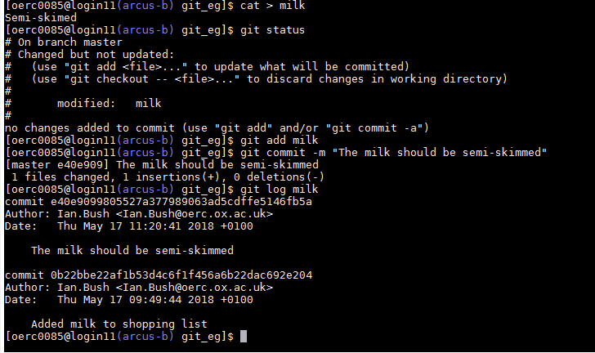
Updated files:

Slide 37
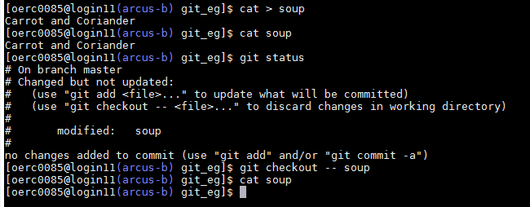
Whoops!
If you realise you have made a mistake – git checkout

Slide 38
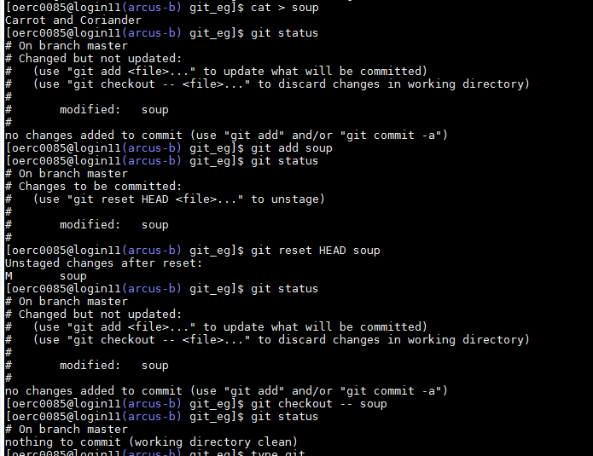
Whoops And I’ve Added It!
To remove it from the staging area git reset HEAD

Slide 39
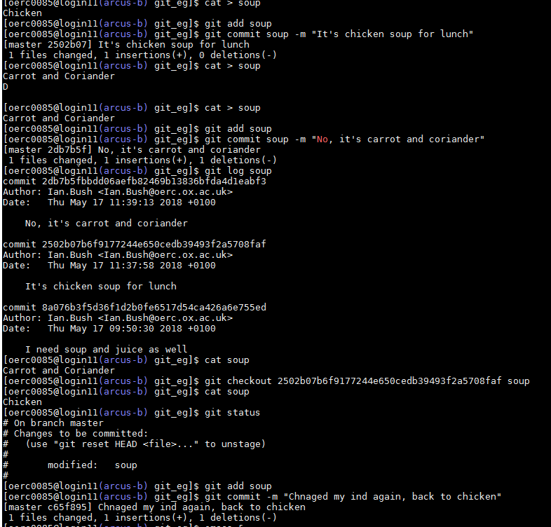
Whoops and I’ve Comitted It!
git checkout can also be used to get back old versions

Slide 40
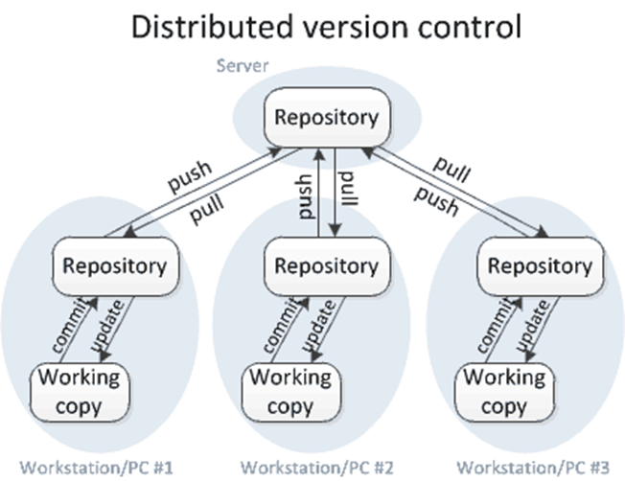
Remote repository
We’ve looked at add, commit and checkout to deal with the local repository
Where you store your changes
In git there is also the global repository
Where the team as a whole stores their changes
push, pull and clone are used to access those
Will look at briefly during the practicals

Slide 41
Continuous Integration (CI) tools
How do we make sure the code in the repository is reliable (and maybe efficient)?
Continuous integration tools automate testing of the software by, at regular intervals, checking out the current version of the repository, running tests as specified by the development team, and reporting and problems encountered
It’s possible to run these tests on different platforms to check portatbility
It’s possible to include efficiency tests in the suite
Serious software projects really should use this!
Jenkins is probably the most widely used CI tool

Slide 42
A Final Word About your Software: Stick A Licence On it!
If you are going to give out your software to somebody else I strongly recommend you put a licence on it to protect yourself and make sure you get recognition
What is allowed may depend on departmental policy – check!
Common simple, open source ones:
BSD - https://en.wikipedia.org/wiki/BSD_licenses
MIT - https://en.wikipedia.org/wiki/MIT_License

Slide 43
What have we learnt?
We have learnt about
The very basics of writing good quality code
The names, and in some cases basic use, of some of the tools that software developers use
A bit about revision control
The existence of software licences

Slide 44
Further reading
You only learn this stuff by doing it!
But some suggestions:
ARC and Archer provide a number of courses, some of which cover some of the material covered here
Consider attending one of the Software Carpentry courses
https://software-carpentry.org/
https://www.software.ac.uk/software-carpentry
A few introductions to revision control and git:
https://blog.inf.ed.ac.uk/sapm/2014/02/14/if-you-are-not-using-a-version-control-system-start-doing-it-now/
https://betterexplained.com/articles/a-visual-guide-to-version-control/
https://try.github.io/levels/1/challenges/1 - we’ll look at this in the practicals
https://git-scm.com/book/en/v2 - an on line book on git
http://www-cs-students.stanford.edu/%7Eblynn/gitmagic/ - another book on git

Slide 45
In the next lecture…
We shall look further into C!

