Slide 1





PDF
Images
OCR Extract
Find Linkages
Extract Linkages
Verify Data
Export Data

Slide 2
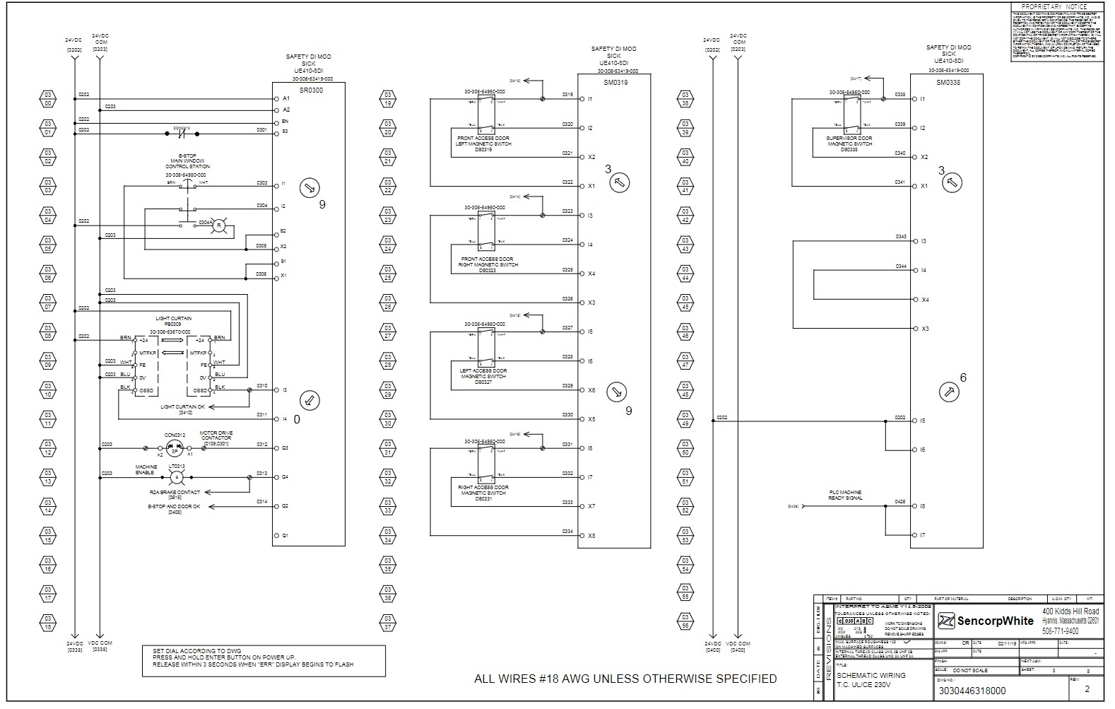

Slide 4
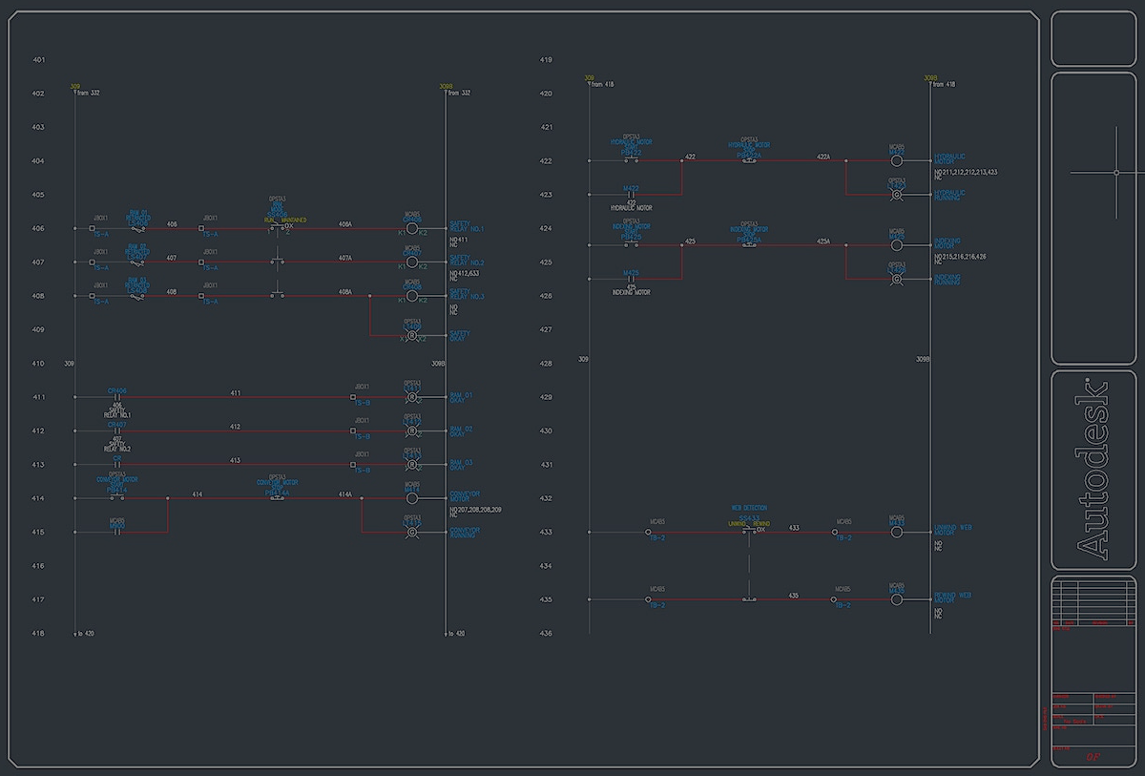
Notes:
https://www.google.com/url?sa=i&url=https%3A%2F%2Fwww.autodesk.com%2Fuk%2Fproducts%2Fautocad-electrical%2Ffeatures.electrical-schematic-design&psig=AOvVaw0uuYwmpHEPgoq8scpHpcqi&ust=1734956457803000&source=images&cd=vfe&opi=89978449&ved=0CBcQjhxqFwoTCMiC9NKuu4oDFQAAAAAdAAAAABAP
Image address: https://www.autodesk.com/content/dam/autodesk/www/products/autocad/fy21/toolsets/autocad-electrical/images/autocad-electrical-toolset-large-1920x1050.jpg

Slide 5
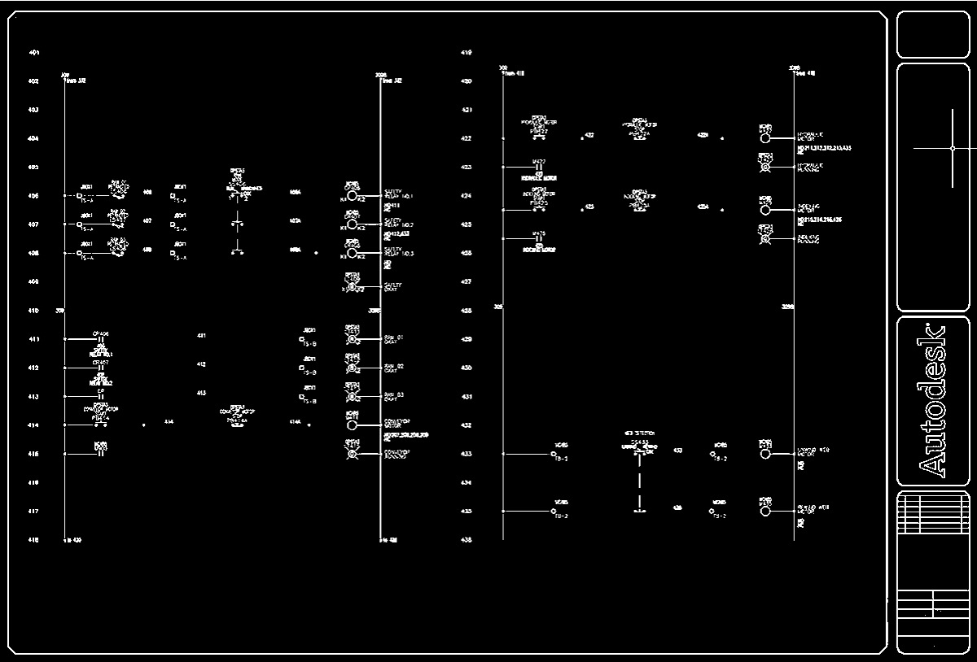

Slide 6
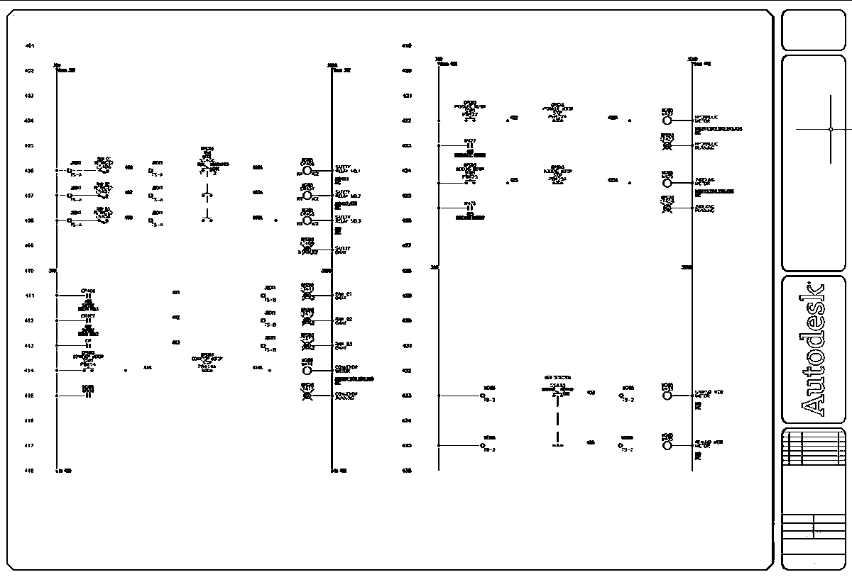

Slide 7
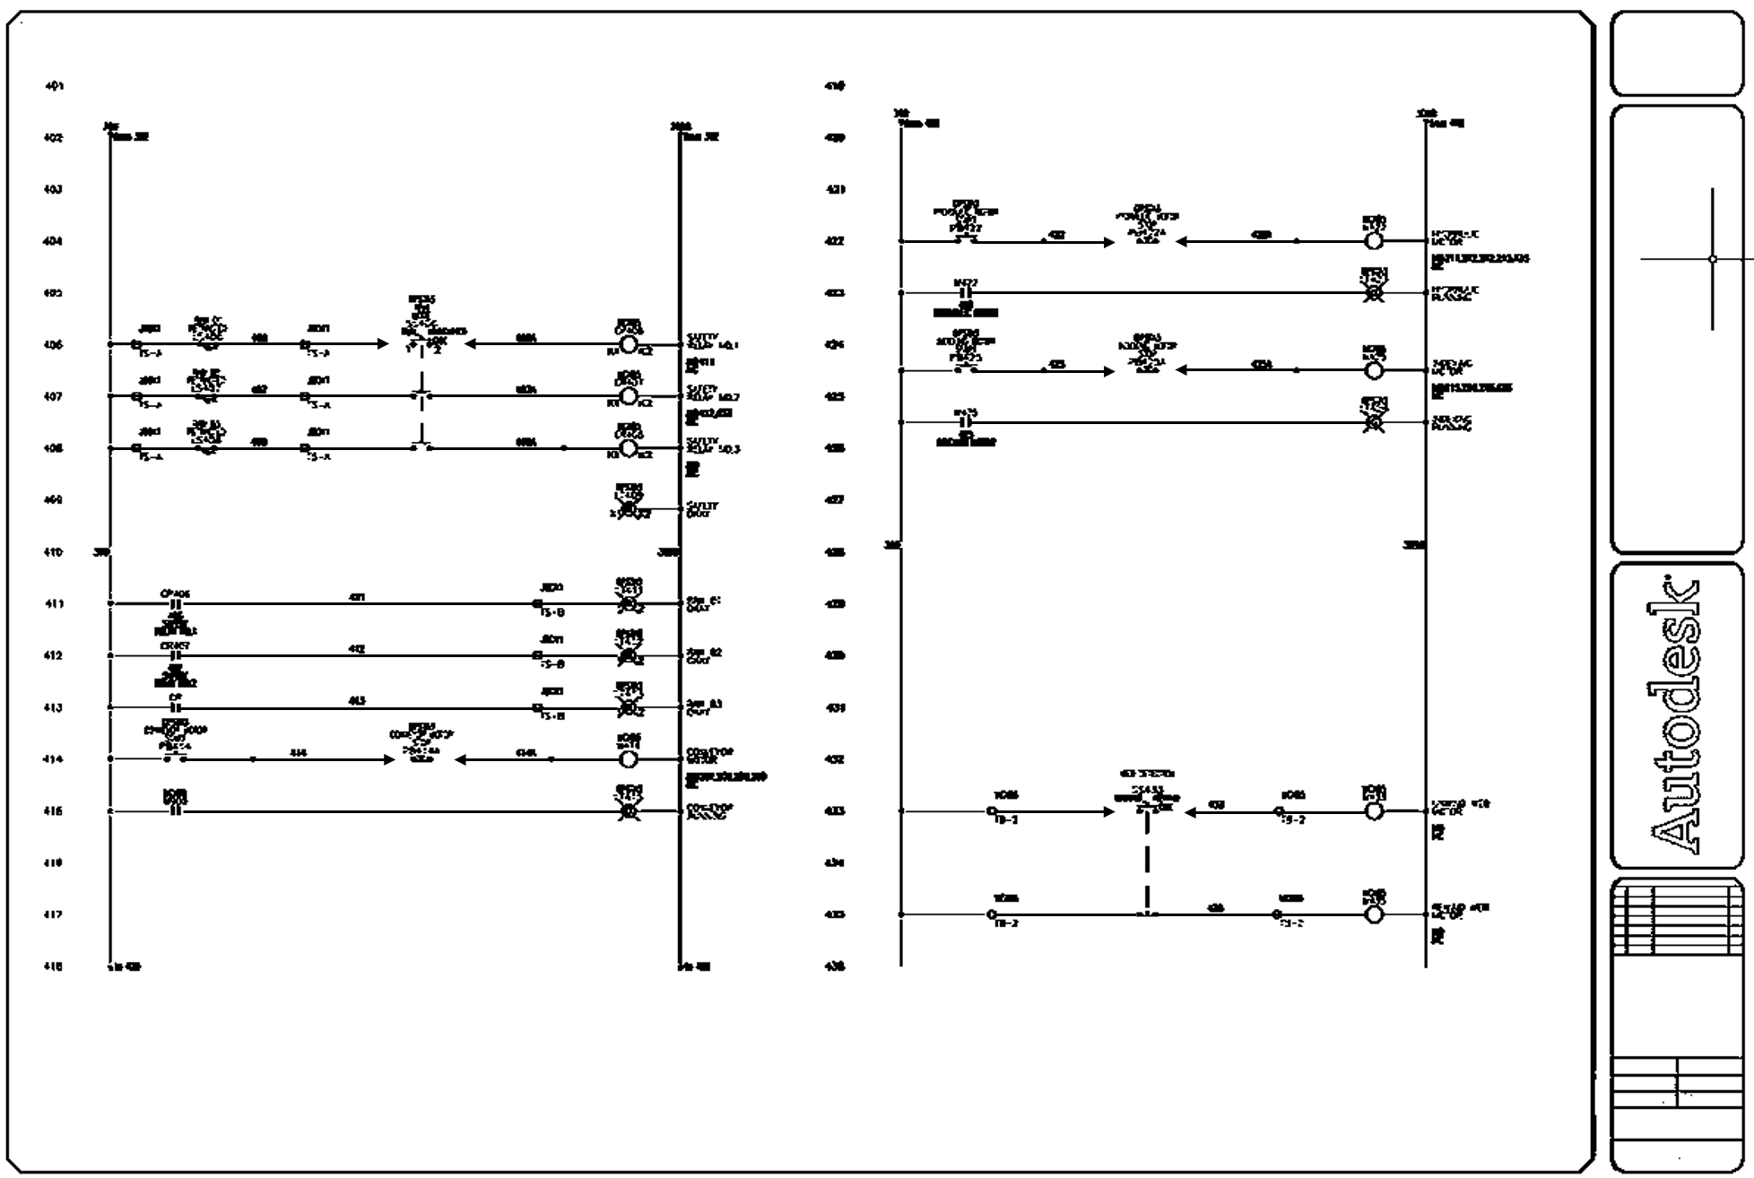

Slide 9
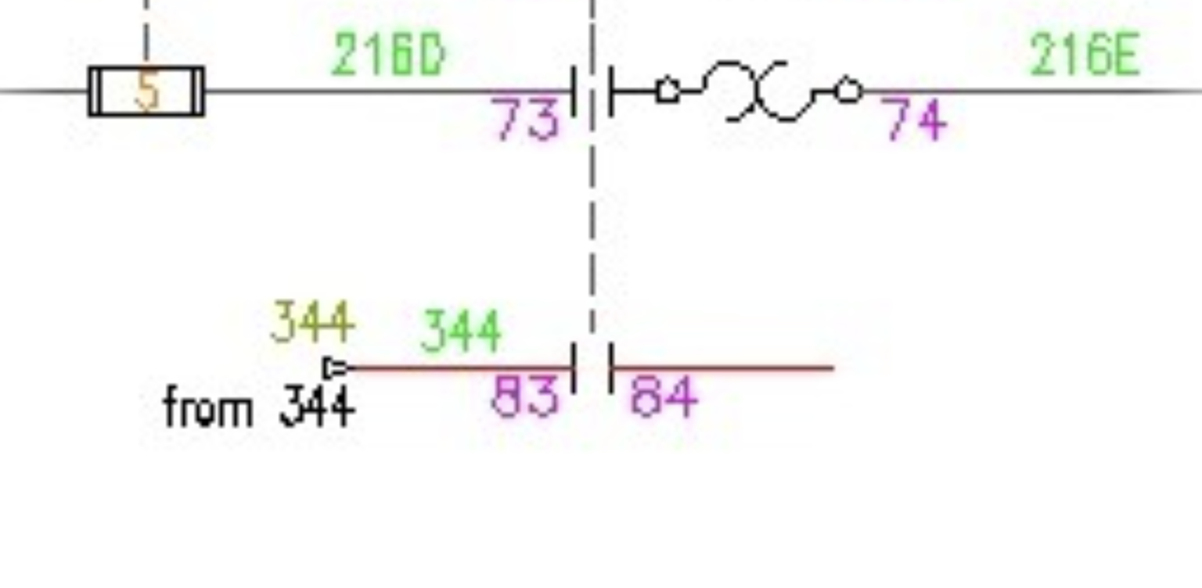
Notes:
https://www.google.com/url?sa=i&url=https%3A%2F%2Fwww.autodesk.com%2Flearn%2Fondemand%2Fmodule%2Fautocad-electrical-essentials-3-schematic-wiring%2Funit%2F75gSG9J0EKERIaOG6mLfbm&psig=AOvVaw3jhmRP88cUKqXBhNkt14JW&ust=1734963799869000&source=images&cd=vfe&opi=89978449&ved=0CBcQjhxqFwoTCKDU6_7Ju4oDFQAAAAAdAAAAABAJ
Image address: https://files.upskill-dev.autodesk.com/public/CSO_Content/IMAGES/MEE-AE0003_1610993128_71.jpg

