Slide 1

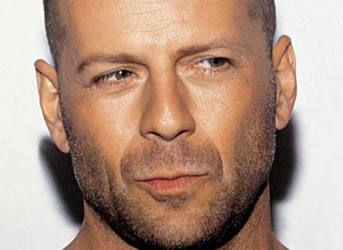
Things I learnt last Christmas
John McClane
Firestarter at Nakatomi Inc
@John____McClane

Slide 2
Welcome to this template
Feel free to change anything.
Try not to put too much on each slide.
You don’t have to follow the 10/20/30 rule.
Just be brief
And break the subject into multiple slides.

Slide 3
Guidelines
This template is just a recommendation. Feel free to use your own design.
The slide format is 1024 × 768 (4/3)
Fonts:
Ubuntu (title)
Open Sans (body)
Source Code Pro (er, code)

Slide 4
We love seeing code
var msg = [
'Yippee ki-yay, motherfucker',
'Now I have a machine gun, HO, HO, HO',
'You throw quite a party. I didn\'t realize they celebrated Christmas in Japan.'
];
console.group('Pearls of wisdom');
for (var a = 0; a < 10; a++) {
console.log(msg[Math.floor(Math.random() * msg.length)]);
}
console.groupEnd();

Slide 5
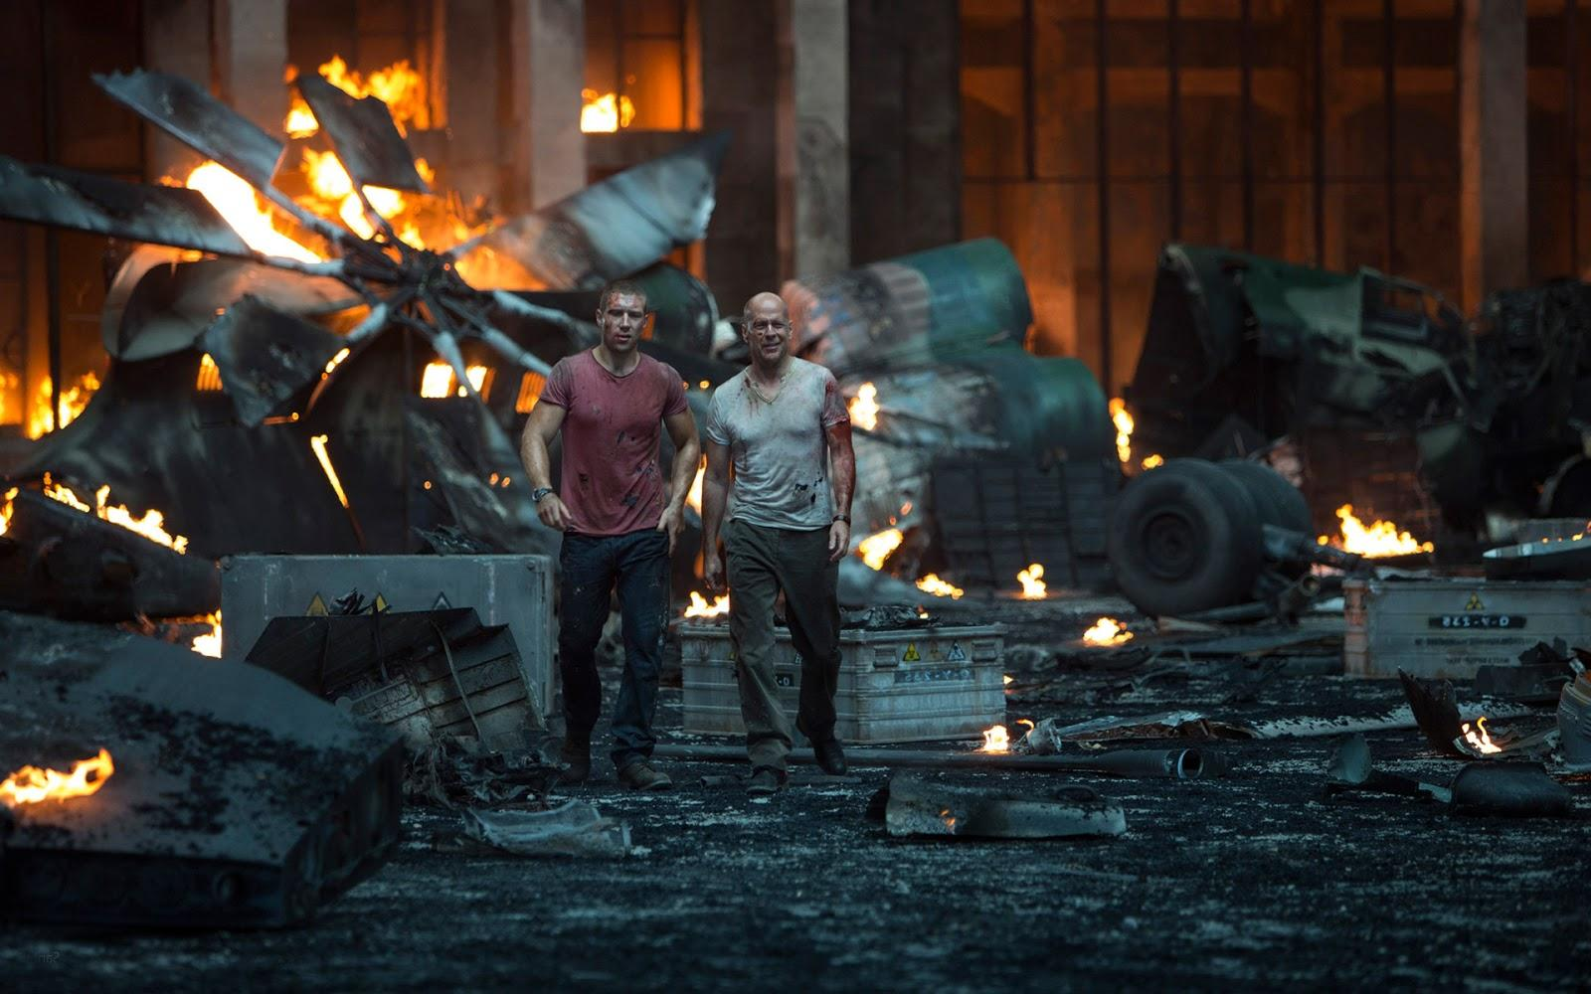
TESTING
BEFORE DEPLOYING IS
OVERRATED
Die Hard is © 20th Century Fox
Notes:
Always reference your source and try to use authorized materials. In other words, don’t do this.

Slide 6
Now it’s your turn
Grab that keyboard and start blowing brains out.
Remember: this template is also available online.

