Slide 1
ARI2129 - Principles of CV
Gamma Correction &
Tone Mapping
Alexander Busuttil Cazac, Nicholai Camilleri, Sarah Demanuele, Zack Haber & Reuben Mifsud

Slide 2
Introduction to
Gamma Correction
CRT Displays
Near-Logarithmic Perception of Light
Notes:
mention analogy:
0→10 vs 90→100 volume

Slide 3
“If cameras store light linearly, but our eyes perceive it logarithmically, how do we store an image that actually looks natural to a human?”

Slide 4
The Solution
Camera
Linear
Light
Gamma Encoding
Storage/
Display
Gamma Decoding
Human Eye
Notes:
Encode (γ=0.45)
Decode (γ=2.2)

Slide 5
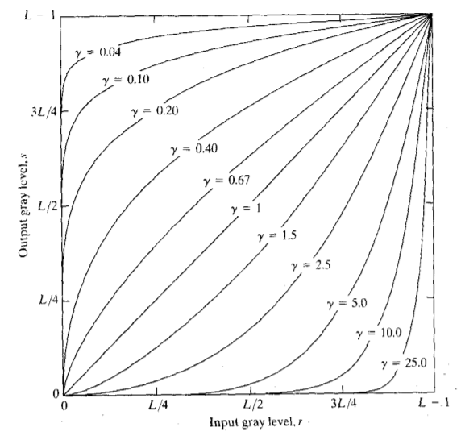
ɣ
s = C · r
Notes:
to mention while explaining:
s = output pixel value
r = input pixel value (normalised between 0 and 1)
C = a positive scaling constant, typically set to 1 for standard use
ɣ = the exponent that controls the shape of the transformation
γ < 1: Brightens → stretches shadows, compresses highlights. Curve bows upwards. Applied during encoding (camera → file)
γ > 1: Darkens → compress shadows, stretches highlights. Curve bows downwards. Applied during decoding (file → display)
γ = 1: Identity → no change. Reduces to s = C · r

Slide 6
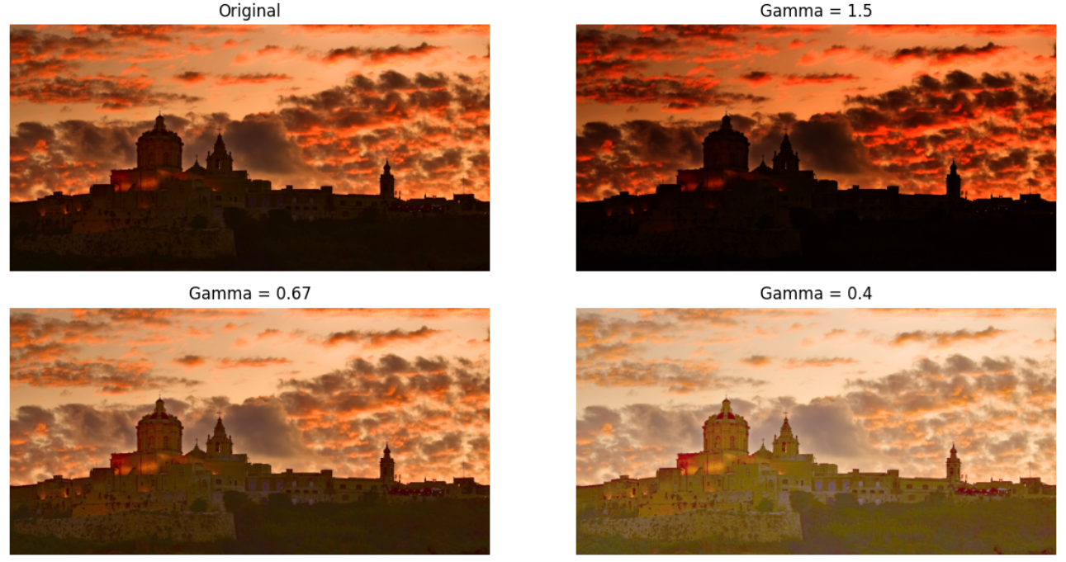
SIMULATOR

Slide 7
Dynamic Range
1
The span between the darkest and brightest values a system can simultaneously capture or display
Introduction to Tone Mapping
2
Low Dynamic Range
An image format with a limited brightness range
High Dynamic Range
3
An image format that stores a wider range of brightness values

Slide 8
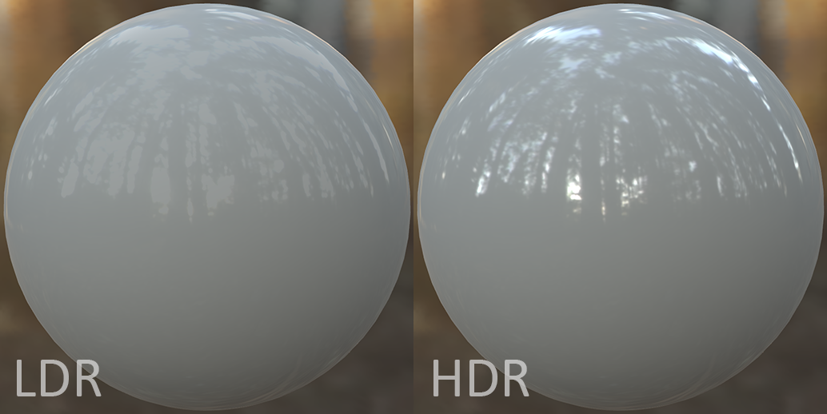

Slide 9
“If an image was captured in HDR, how can we display it on an LDR screen while maintaining the overall quality of the original image?”

Slide 10
What?
Remapping HDR (thousands of nits) → LDR (~100 nits) while preserving perceived detail
Why?
Tone
Mapping
Clipping
Crushing
Tone mapping prevents both
How?
A Tone Mapping Operator (TMO) applies a non-linear curve to luminance values:
Preserves detail
Compresses highlights without clipping
Common operators: Reinhard · ACES Filmic · Hable (Uncharted 2)
Notes:
Clipping — bright areas forced to pure white → highlight detail lost
Crushing — dark areas forced to solid black → shadow detail lost

Slide 11
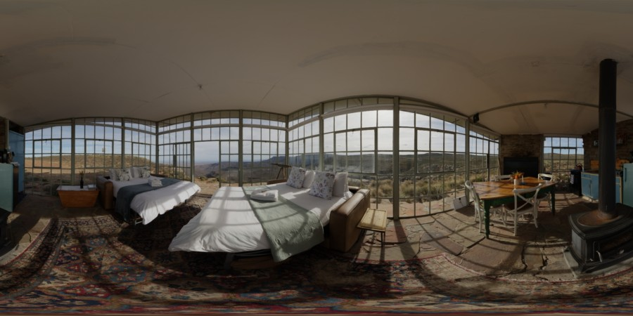
SIMULATOR

Slide 12
01
Photography & Camera
02
Advertising & Marketing
Real-World Applications
03
Radiographic Imaging
04
Video Games
05
Display Hardware

Slide 13
Limitations & Failure Cases
Problem
blurry edge detection
double gamma
dark areas amplified
colour desaturation
When
local tone mapping
post-production
HDR video
global operators
Effect
glowing edges
washed-out image
grain in dark areas
unrealistic colours
01
02
03
04

Slide 14
When not to use
Alternatives
Gamma Correction
Mid-pipeline rendering
Image already gamma encoded
Gamma Correction
Perceptual Quantiser
Linear Workflow with colour management
Tone Mapping
Content is already SDR
If the display natively supports the full HDR range
Tone Mapping
Exposure fusion
Local adaptation with spatial awareness
Notes:
Mid-pipeline rendering → apply at final output only, never during lighting/colour calculations or it corrupts the math
Already gamma encoded image (non-RAW) → re-encoding double-corrects → washed out result
Already LDR content → no HDR to compress → unnecessarily degrades image
Native HDR display → preserve HDR data as-is → display handles it natively
PQ (Perceptual Quantizer) → HDR-specific transfer function → models actual human vision research → used in HDR10 & Dolby Vision
Linear workflow → OpenColourIO → stay in linear light throughout → single calibrated display transform at the very end
Exposure Fusion → multiple LDR shots at different exposures → blend best-exposed regions directly → no HDR file ever created
Local Adaptation → spatially aware → each pixel mapped based on surrounding neighbourhood → preserves local contrast better than global curve

