Slide 1
Sentence Compression Using
Emoji Summarization
📄🗜➡️😆
Alex Day and Chris Mankos
Client: Dr. Soo Kim

Slide 2
Overview
Introduction
Problem Statement
Importance of Emoji Summarization
Related Work
Composition of N-grams for Emoji Translation
Sentence Compositions
N-Gram → Emoji Comparison
Translation Scoring
Summary Generation
Improvements to the Algorithm
Dependency Tree/TF-IDF
Sentiment
Conclusion
Results
Future work
Notes:
Chris
During the course of this talk we will cover three broad topics
An introduction to what we are doing, why we are doing it, and what has been done before
An explanation of how we accomplished our project goals
Some results and conclusions from our algorithm

Slide 3
Problem Statement
Research Question: Can we effectively summarize sentences using emojis through the use of vector embeddings to produce meaningful results?
Not a complete one-to-one mapping of words to emojis
Capture ‘essence’ of several words
Some examples of what we would like:
My dog can run so fast → 🐕🏃💨
I’m thinking that this computer has a virus → 🤔🖥️🦠
Notes:
Alex
Our project is in a sub-domain of Machine Learning, Natural Language Processing or NLP. This domain is focused on the interaction between computers and human-understandable language. Some of the projects from this domain that you might be familiar with include spoken-language understanding and emoji prediction when you’re texting. Our question that we are trying to answer in this domain is as follows {ON SCREEN}. We aim to do this WITHOUT using a one-to-one mapping of every word to a single emoji, rather we aim to capture the essence of several words within just one emoji. These are some examples of what we would like to see our algorithm produce.

Slide 4
Importance of an Emoji Summary
Improve Emoji understanding
Facilitate communication across language
🐶 is a dog to both a French and English speaker
Crossroads for different NLP ideas
Summarization
Translation
Understanding
Notes:
Alex
This project may not seem important at first, it might seem like research for research’s sake. However there are two main reasons that this is an important question. First, we are improving the methods that computers can use to understand emojis. While we are, in this project, going from english to emoji. We are still generating an internal representation of the emoji that the computer can understand, we will touch on that later. This project also has applications with communication across language barriers, both actual language-barriers (such as speaking a different language) or more hard-to-understand barriers like learning disabilities. This is also an application of three diferent areas within NLP, which is always informative as it gives insight into concrete applications of prior research

Slide 5
Related Work
Embeddings
Word2Vec
Sent2Vec
Emoji2Vec
Direct word → emoji mappings
https://decodeemoji.com
https://meowni.ca/emoji-translate/
Emoji Dick
Translation of Moby Dick into Emojis
Text Summarization (our earlier work)
TF-IDF
TextRank
Notes:
Alex
In terms of previous work that can also be separated into two catagories. The previous work that we are building on, and previous work that aims to do the same thing we do in a different way. In terms of the work we are building on that can be broadly classified as embedding. This will be explained more later but it is basically a technology that is used to facilitate machine understanding of words, sentences, or emojis. In terms of projects with similar goals as ours there are two. The first are programs that use a direct one to one mapping to create an emoji translation. And the second is Emoji Dick. Emoji Dick was an effort to utilize humans to translate the book Moby Dick into emojis. This was done using an Amazon service that lets you farm out menial tasks to human workers.
Are “Direct word -> emoji mappings” previous work in a relevant sense? We’re specifically not doing what they do.
Also removed sentiment from ‘sentiment embeddings’ since it was a little misleading imo (there’s much more going on and they don’t even do sentiment well), but if it is the technical term, put it back
Alex

Slide 6
Composition of N-Grams for Emoji Translation (CoNET)
CoNET is a combination of machine learning and natural language processing (NLP) techniques that can produce a series of emojis when given a variable length input sentence
Algorithm is split into separate parts
Sentence compositions
N-Gram → emoji comparison
Translation scoring
Summary generation
Notes:
CONFETY
Chris

Slide 7
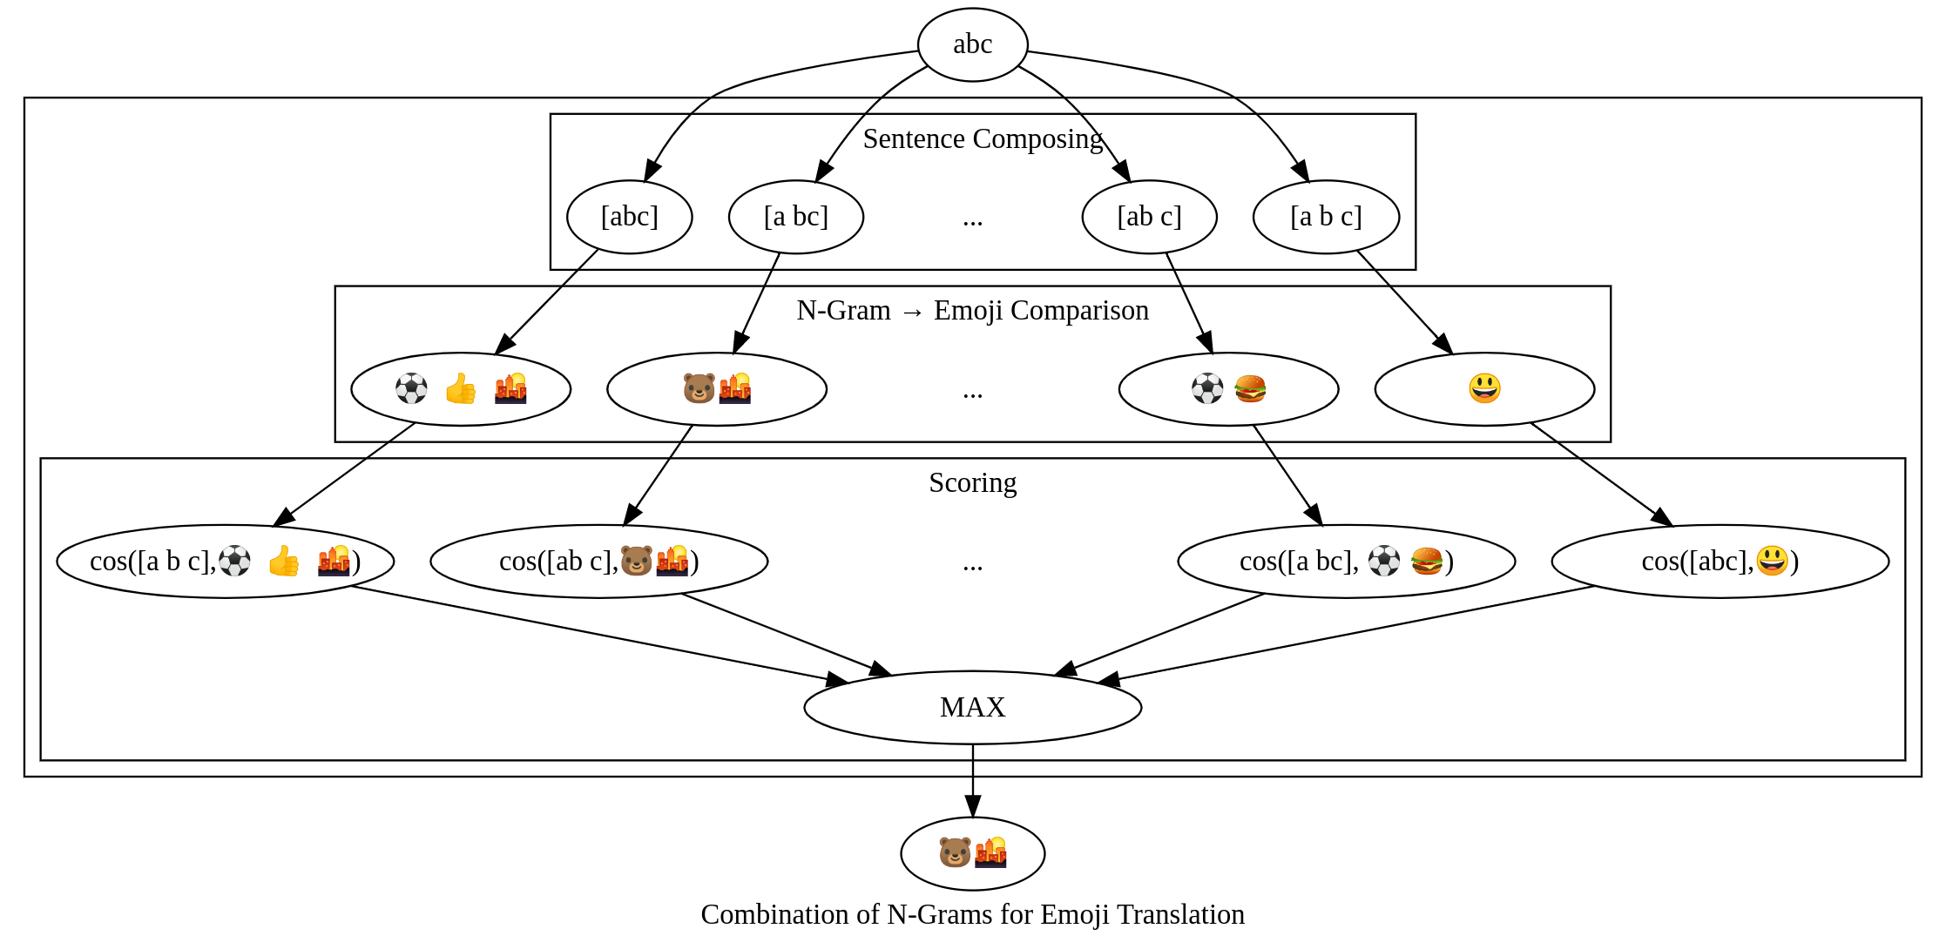
High-Level Algorithm Architecture
Notes:
Chris

Slide 8
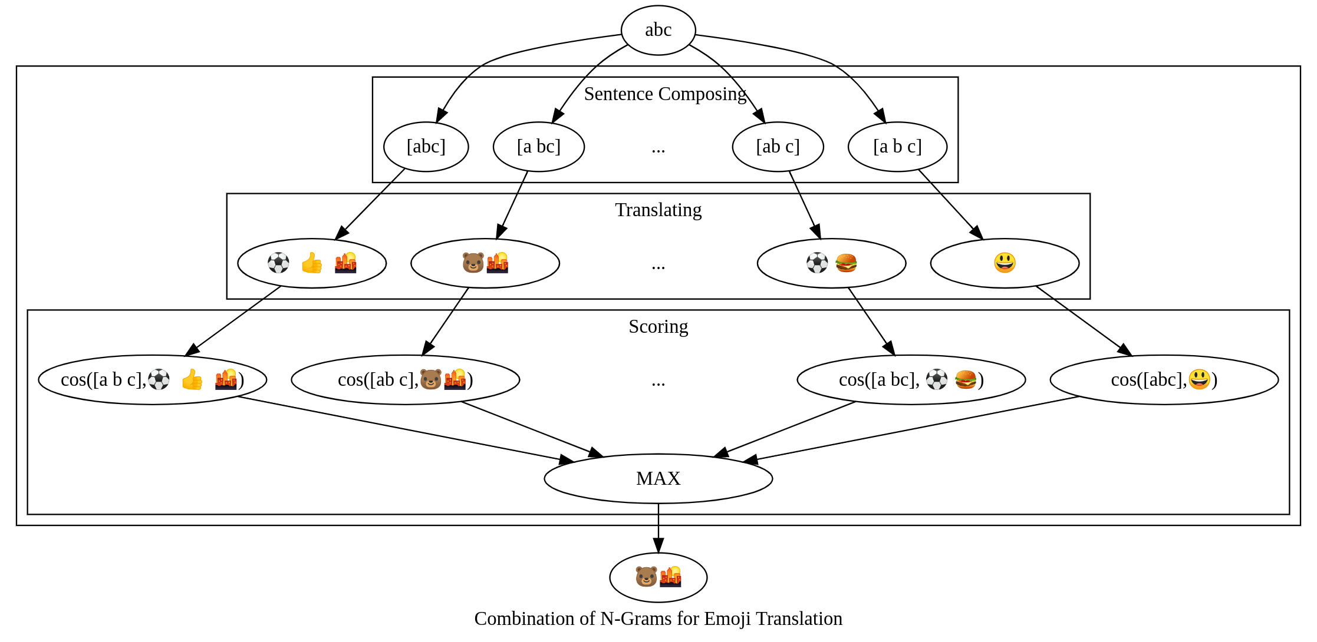
High-Level Algorithm Architecture
Notes:
Chris

Slide 9
Sentence Compositions
An n-gram is a variable length sequence of contiguous words, normally in the context of a larger phrase or sentence.
A sentence can be represented by a sequence of n-grams
Ex: The sentence “The dog bit me very hard” has the n-grams:
“The dog bit”, “me”, “very hard”
We will refer to a sequence of n-grams as the n-gram sequence, and an individual n-gram in the sequence as an n-gram
The simplest way to partition a sentence is to do so exhaustively
Ex: For the sentence “The dog bit me very hard” we check all sequences of n-grams:
Assumption: there must exist some optimal n-gram sequence that generates the best summary
Notes:
Chris

Slide 10
High-Level Algorithm Architecture
Notes:
Alex

Slide 11
N-Gram→ Emoji Comparison
Need a way to translate an n-gram (eg. “the dog”) to an emoji (eg. 🐕) that is not just a one-to-one mapping from word to emoji
What is an emoji?
Just a mapping over a description:
🐕 → Dog, Puppy, Doggo
🌎→Earth, Home, North and South America
The dataset we are using for emojis contains a list of emojis each with one or more descriptions
We can use something called vector embeddings to translate both an n-gram and an emoji description into a vector
Notes:
Alex
Now we need a way to go from an n-gram within a sequence to an emoji. The goal is to take some n-gram sequence and produce an emoji sequence with each emoji representing one n-gram.To do this we need to step back and think what an emoji actually is. In all reality an emoji is just a representation of a description. For example {EXAMPLES}. With this in mind we can just think of going from n-gram to a similar n-gram. We do this using vector embeddings.
Alex

Slide 12
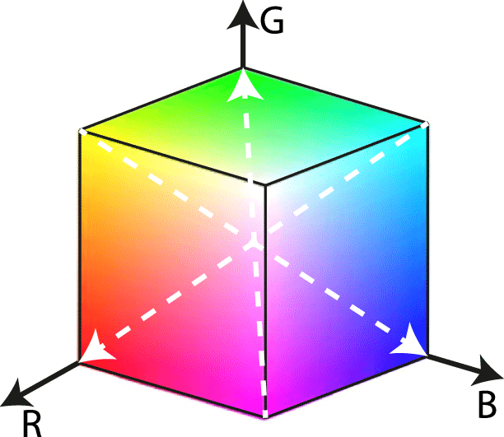
Embeddings Explained using Colors
Colors can be mapped into three-dimensional space using a vector of 3 numbers representing red, green, and blue
Colors as specific points
Purple → [1, 0, 1]
Orange → [1, 0.5, 0]
Adding colors together
Red + Blue = Purple
[1, 0, 0] + [0, 0, 1] = [1, 0, 1]
Notes:
Alex
Embeddings are just a mapping from some object (text, or in this case colors) into space. For example you can map colors into three-d space very simply by assigning the X, Y, and Z axis to a saturation of either Red, Green, or Blue. So in this diagram purple is at 1,0,1, and orange is at 1, 0.5, 0. With this in mind you can perform simple vector additiona nd it works just like you would expect

Slide 13
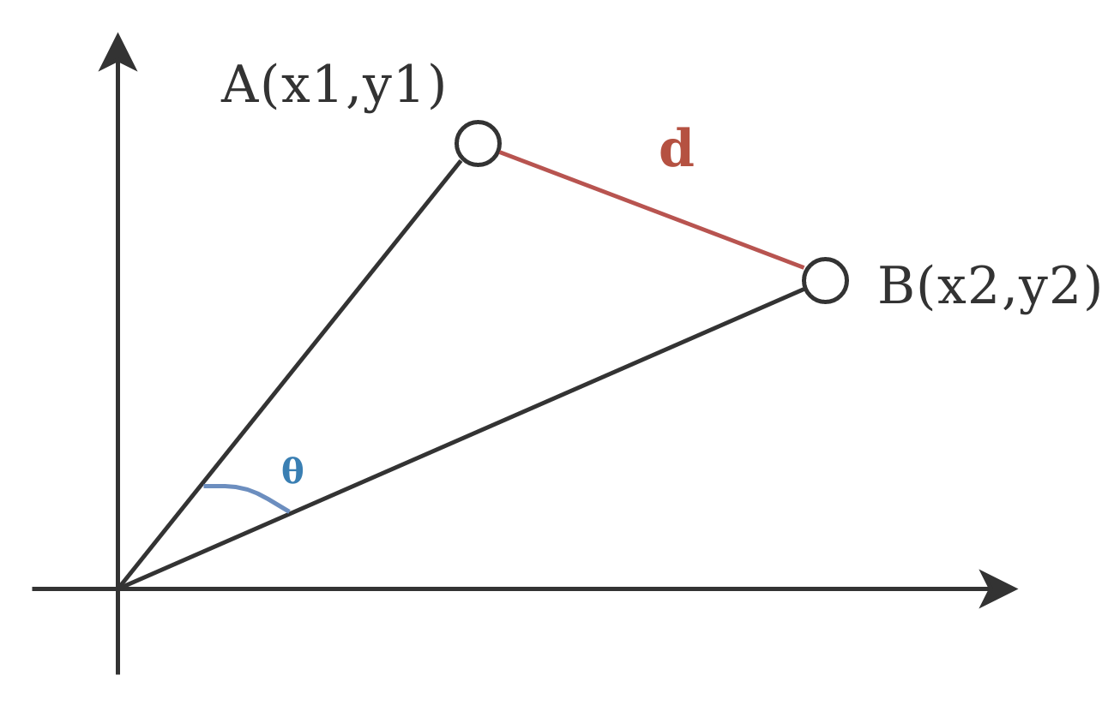
Embeddings Explained using Colors Continued...
We can also use this idea to compare points in the color space
Similarity Metrics
Euclidean Distance is the line distance between two points (d)
Cosine Difference is 1 - the cosine of the measure of the angle from the origin between two points (Θ)
Determining color difference
cos(Purple, Orange) = 0.04
cos(Red, Blue) = 1
Closest Vectors (Vectors with lowest difference)
closest(Red) = {Scarlet, Lipstick Red, …}
Notes:
Alex
Using embeddings you can also compare points. In normal 2d or 3d space a common comparison metric is euclidean distance. This is the distance of the straight line between any two points. However with words mapped to high-dimensional space it becomes easier to calculate and work with the cosine similarity. This is not true of all high-dimension space, but because of the sparcity of the space and of the vectors themselves cosine is better for NLP tasks.

Slide 14
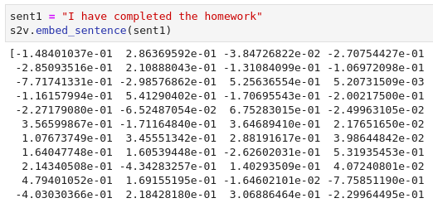
N-Gram→ Emoji Comparison Continued...
Sent2Vec
Sentence vectorization technique
Translates a sentence, phrase, or word into a 700-long vector with elements from -1 - 1
Embeds the semantic meaning of the sentence into a machine readable format
...
Notes:
Alex
To do the actual vectorization we use something called Sent2Vec. Sent2vec gives us a vector of 700 elements when given a phrase. This vector represents the phrase in space and we can perform the same caculations as we did with colors.

Slide 15
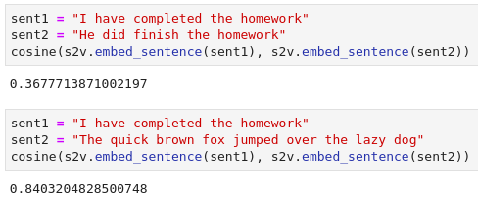
N-Gram→ Emoji Comparison Continued...
Sent2Vec
Sentence vectorization technique
Translates a sentence, phrase, or word into a 700-long vector with elements from -1 - 1
Embeds the semantic meaning of the sentence into a machine readable format
Notes:
Alex
For example, the most pertinent calculation is cosine differnece (0 is very similar). It is clear to see with these examples that sent2vec works well for what we will use it for.

Slide 16
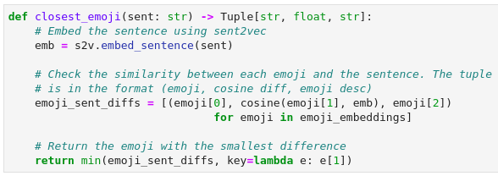
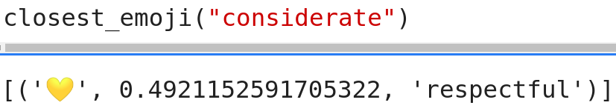
N-Gram→ Emoji Comparison Continued...
To find the closest emoji to a vector the following function is executed:
We can now query our dataset like this:
Notes:
Alex
So now we need to find a close emoji to a given sentence. We do this in three steps, and some magic python list comprehension.
First things first this function is called closest_emoji, it takes in a sentence as a string, and returns a tuple that contains an emoji and then the cosine difference between the two n-grams (description and input)
The first thing we do in the function is embed the sentence using sent2vec. This gives us the 700-dimensional vector
Then we search through all of the pre-embedded emojis to calculate the difference between the input and each emoji description
Then we reutnr the emoji, its cosine difference, and its description with the smallest cosine differense
Alex

Slide 17
High-Level Algorithm Architecture
Notes:
Chris

Slide 18
Translation Scoring
We score a sentence based on the sum of its parts. Meaning that the sentence’s score as a whole is an average of the cosine similarity of the n-gram → emoji pairs that make up that summary.
🐩🎽💨
N-grams → “the dog” “runs” “fast”
Emoji-grams → “dog” “run” “fast”
Cosine Similarity → 0.96, 1.0, 1.0
Average Cosine Similarity → 0.9844
💭💾🐛
N_grams → “i think that this” “computer” “has a virus”
Emoji-grams → “think” “computer” “virus”
Cosine Similarity → 0.52, 1.0, 0.79
Average Cosine Similarity → 0.231
Notes:
Chris
The next part of our algorithm is scoring of a translation. A translation is scored based on the score of its parts. The score of a whole sentence is just the average of all the cosine similarities. We have experimented with different metrics but this one is the one that has given us the most consistent results.
New scoring: sum(weight*distance)/sum(weight)

Slide 19
Summary Generation
Given a sentence, S, to summarize
Split S into every possible n-gram sequence, call that list of sequences N
For every sequence in N:
For every n-gram in sequence
Find closest emoji and add that to the summary
Score sequence
Return sequence in N with highest score
Notes:
Chris
Now that we have all of the constituent parts we can begin talking about a high level algoritihm. The general flow is as follows. Given some sentence, S, that needs to be summarized. Split S up into all of the sequences of n-grams. For each sequence of n-grams determine the closest emoji for each n-gram and then score that translation. The emoji summary is then the summary generated with the highest average cosine similarity.

Slide 20
Summary Generation
Notes:
Chris
Now that we have all of the constituent parts we can begin talking about a high level algoritihm. The general flow is as follows. Given some sentence, S, that needs to be summarized. Split S up into all of the sequences of n-grams. For each sequence of n-grams determine the closest emoji for each n-gram and then score that translation. The emoji summary is then the summary generated with the highest average cosine similarity.

Slide 21
Drawbacks with this implementation
Computationally expensive
Every word doubles the number of compositions to look at
2^{n-1} total compositions to consider, where n is the sentence length
Words are variably impactful
‘The’, ‘a’, ‘but’, and other similar words
Little to no context
🐶🌭🐶
“A dog eats a treat while another dog watches.”
“A dog steals the food of the dog.”
“A dog shares his snack with a dog.”
Notes:
Chris

Slide 22
Addressing the issues
Computationally expensive
Don’t look at every possible combination
The natural parts of speech offer an intuitive approach to grouping a sentence
Variable importance of words
Maybe if we could weigh the relative importance of words, we could more fairly score…?
Inspiration from the automatic text summarization techniques that we considered years ago
Context
More important for human translators
Sentiment analysis - the feeling of a sentence - as an initial attempt
Notes:
Chris

Slide 23
High-Level Algorithm Architecture
Notes:
Chris

Slide 24
Tf-idf to high level considerations go here
Made a mistake and need to fix it. Fixing other end first before I write.

Slide 25
High-Level Algorithm Architecture
Notes:
Chris

Slide 26
Smart Dependency Tree N-Gram Generation
Sentences can be turned into a tree-like structure based on the syntactic dependencies.
Given that tree we can collapse it down to produce the n-grams from all the remaining nodes
We collapse based on two rules:
If there is a node-to-node relationship with only one child we combine them
If there are two or more leafs on the same level we combine them
Pros
Faster than the exhaustive search
Uses contextual information from the sentence to generate the n-grams
Cons
Relies on proper part of speech tagging
Notes:
Alex

Slide 27
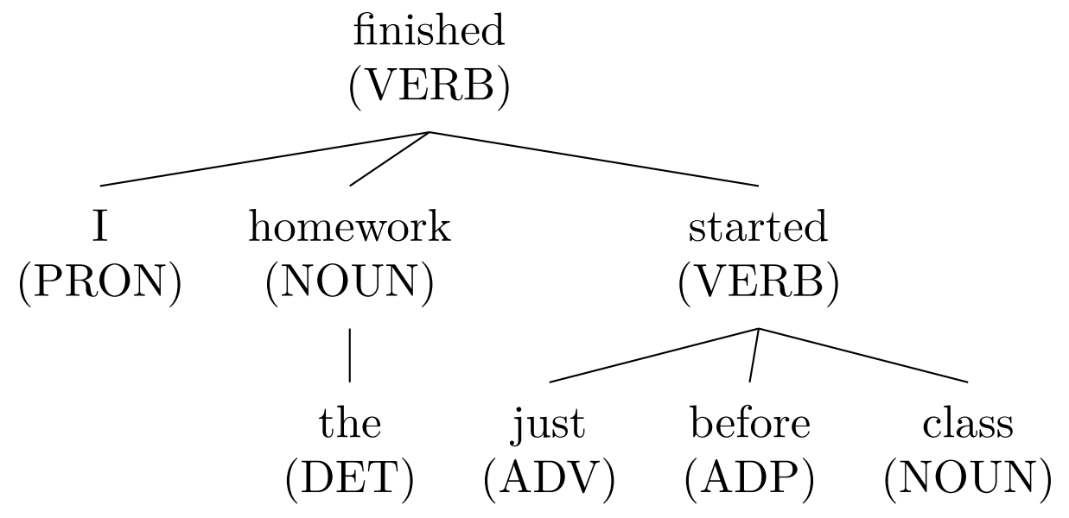
Dependency Trees
“I finished the homework just before the class started.”
Notes:
Alex

Slide 28
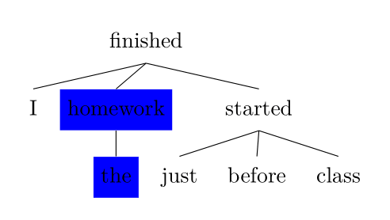
Child Collapse
Notes:
Alex

Slide 29
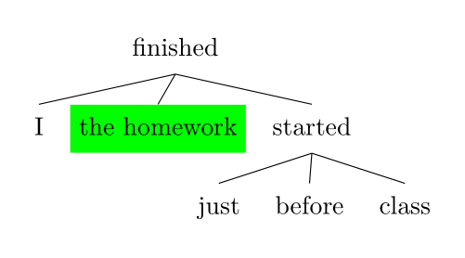
Child Collapse Continued...
Notes:
Alex

Slide 30
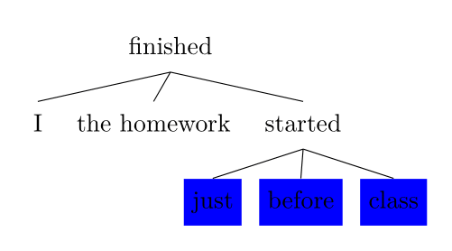
Neighbor Collapse...
Notes:
Alex

Slide 31
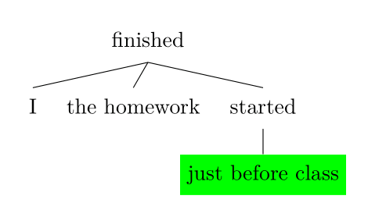
Neighbor Collapse Continued...
Notes:
Alex

Slide 32
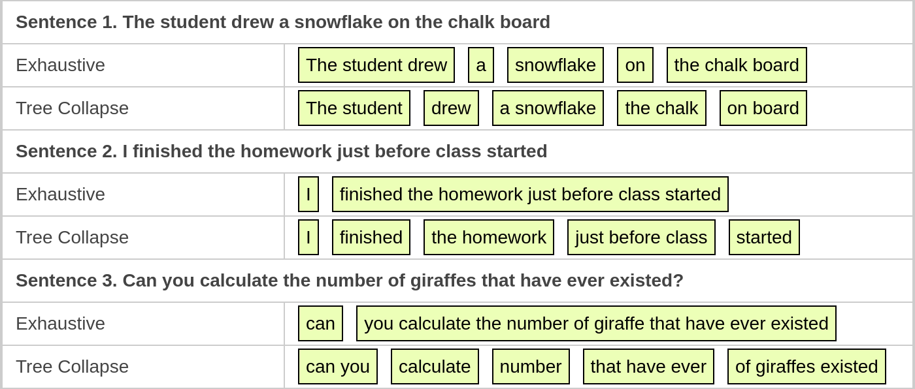
Smart Dependency Tree N-Gram Generation Continued...
Notes:
Alex
This is a comparison of the results as compared to our first exhaustive n-gram sequence generator. There are three sentences and each sentence has the n-gram sequence that had the highest scoring translation and then

Slide 33
High-Level Algorithm Architecture
Notes:
Chris

Slide 34
Sentiment
Initially, just a table
Score a sentence using TextBlob
Pull an emoji from a table
Iteration 2:
Use twitter’s API to find tweets containing each emoji
Run each tweet through TextBlob
Find the mean and standard deviation of each emoji
Run the target sentence through TextBlob
Find the nearest emoji
(Negative) Polarity (Positive)
😡 | 😐 | 😂
😟 | 😶 | 🙂
👎 | ⚖ | 👍
(Opinion)
Subjectivity
(Fact)
Notes:
Chris

Slide 35
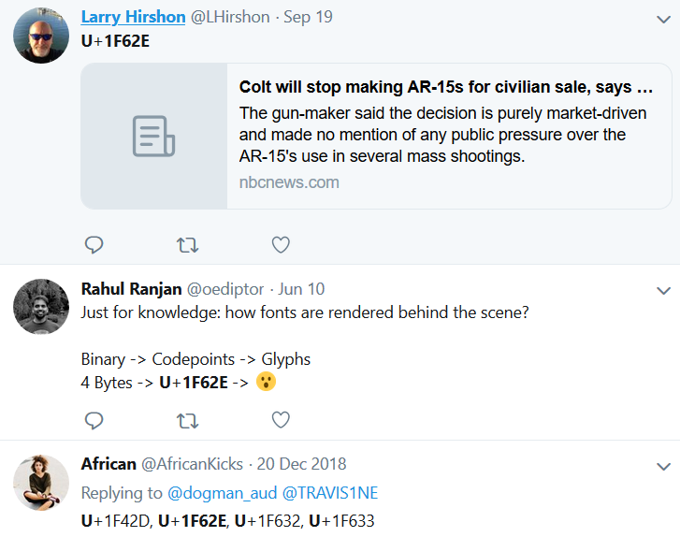
Issues
Dataset
Size (Twitter API rate limit)
Query structure issues
Searching for “U+1F62E” (😮)
Not always in tweet
Can only search so far back
😷 results in many Hong-Kong related tweets
Notes:
Chris

Slide 36
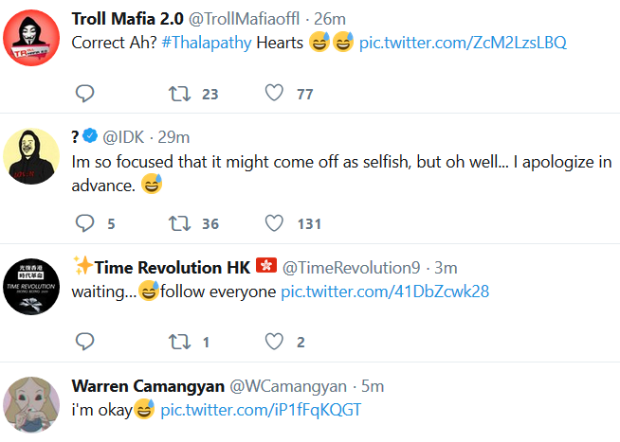
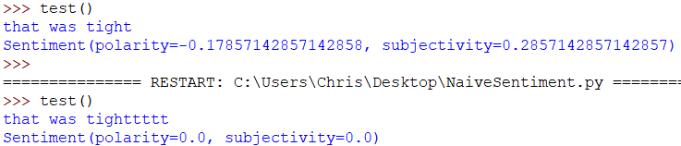
Issues Continued
Preprocessing is a different beast
“Current mood: ”
Spelling, punctuation
Notes:
Chris

Slide 37
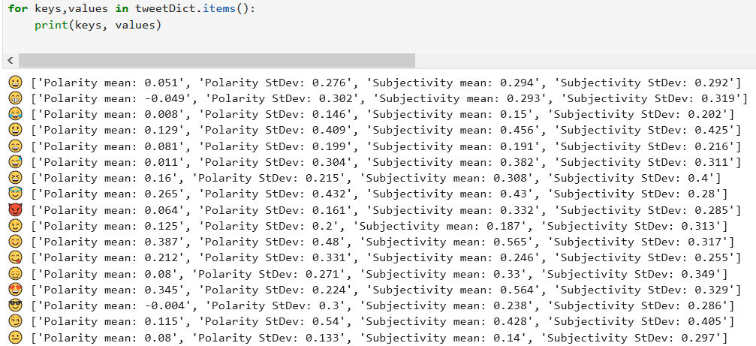
TextBlob conclusion
More data
Better preprocessing
Maybe categorical data analysis combined with with a better dataset (Kaggle)
Notes:
Chris

Slide 38
Testing
Testing this algorithm proved to be difficult as there are no explicit metrics to measure what we want to do.
While machine translation is a common task it is almost never done without some sort of testing data
Because of time constraints and lack of data we could not rely on the same metrics
Testing: Iteration 1:
Run each emoji through Emoji2Vec’s nearest word and build a ‘sentence’ to compare cosine distances with the original sentence
Testing: Iteration 2:
Enhance iteration 1 with frequency analysis and POS tagging in order to suggest nearest POS instead
Notes:
Alex

Slide 39
Results (Exhaustive Splitting)
Input Sentence | Output Emojis | Score
The dog runs fast | 🐩🎽💨 | 0.984
The child was in love with the cat | 👶😚🐾 | 0.824
They are playing christmas music from the bell tower | 🎴🎄🎻⏰🏰 | 0.893
I think that this computer has a virus | 💭💾🐛 | 0.769
I have to wear my headphones to run in the race | 🎩🎧🎽🏁 | 0.960
The company Apple makes both cell phones and computers | 🍏📱💾 | 0.903
Notes:
Alex

Slide 40
Results (Smart Dependency Tree Splitting)
Input Sentence | Output Emojis | Score
The dog runs fast | 🎽🐩 | 0.663
The child was in love with the cat | 👶🚯🐾 | 0.629
They are playing christmas music from the bell tower | 🚯🎴🎄🏰 | 0.706
I think that this computer has a virus | 👤💭💯💾🐛 | 0.822
I have to wear my headphones to run in the race | 👤🔬🚯🎩🎧🎽🏁 | 0.668
The company Apple makes both cell phones and computers | 🍏🚯📞📱 | 0.590
Notes:
Alex
Something of note: The no littering emoji is translated directly to CAN so it is very close to most non-semantic words (must, have, could, that this, etc.). The dependency tree does split the sentence into its constituent parts well. The sentence is definitely better chunked but these are not good emoji chunks. This might be something we can improve with the dataset but it could also be a fatal flaw in the dependency tree idea.

Slide 41
Future Work
Improved dataset
The dataset is the main influence on the “readability” of the generated summaries.
The dataset we have is aimed at word vectorization rather than sentence vectorization
Each n-gram is currently independent of every other n-gram in the sequence
By checking before and ahead and using that to influence the decision it may lead to better results. This is a proven technique used by Recurrent Neural Networks.
Improve Testing Metrics
Translate emojis back into a sentence and calculate distance from the input sentence
One n-gram can have multiple emojis all with the same similarity. We need some way of determining the closest “closest” emoji.
Maybe by considering the emoji’s other keywords as well
Notes:
Alex

Slide 42
Demo
Notes:
Chris

Slide 43
Questions?
Notes:
Chris

Slide 44
TF-IDF
A way to score the relative importance of a word (term) in a given sentence (document)
Two parts
TF -> Term Frequency: How often a word shows up in the document
Motivation: The more often a word shows up, the more important it is to the document
Number of times a word shows up in the document
IDF -> Inverse Document Frequency: How often a word shows up in all of the documents
Motivation: The more things a word shows up in, the less important it is to a single document
log(|corpus|/term
TF-IDF(term, document, corpus) = TF(term, document) x IDF(term, corpus)
Notes:
Chris

Slide 45

Estimating n-grams with TF-IDF
TF-IDF typically considers individual words
Sometimes trained on bigrams or trigrams, but not often much more than that
Taking 10,000 words as an estimation of the size of a vocabulary, and taking 10 as a cap on the length of a sentence we’re summarizing, we’d have in the neighborhood of 10⁴⁰ possible sentences.
Even with discarding a significant fraction as invalid (grammatically incorrect) sentences, still too many n-grams to consider
Notes:
Chris
Not just looking at 10-grams, but 9-grams, 8-grams, …, bigrams, and unigrams as well.
So summation

Slide 46
Steps
Find TF-IDF scores of each word in the sentence to translate
When prompted for an n-gram, calculate n-gram frequency (how many times it shows up in the sentence) and estimate inverse document frequency (by multiplying the document frequency of the terms making up the n-gram and the chances that they’ll be in that order)
Score each composition by multiplying the tf-idf weight of each n-gram with the uncertainty score calculated by cosine difference

Slide 47
High level considerations
Consider a bigram
Pool of ‘words’ to select from is much larger - would expect frequency of [AB] to be smaller overall
Document frequency should be way down
Bigrams should score better
Hugely variable based on training corpus
Some were sentences and others were full blown books
Assumptions made on word frequencies
“The dog runs fast”
I looked at datasets of SMS spam/ham, Jeopardy! questions, Canadian Parliament transcriptions, and they heavily impacted the weights.
Notes:
Chris

