Slide 1
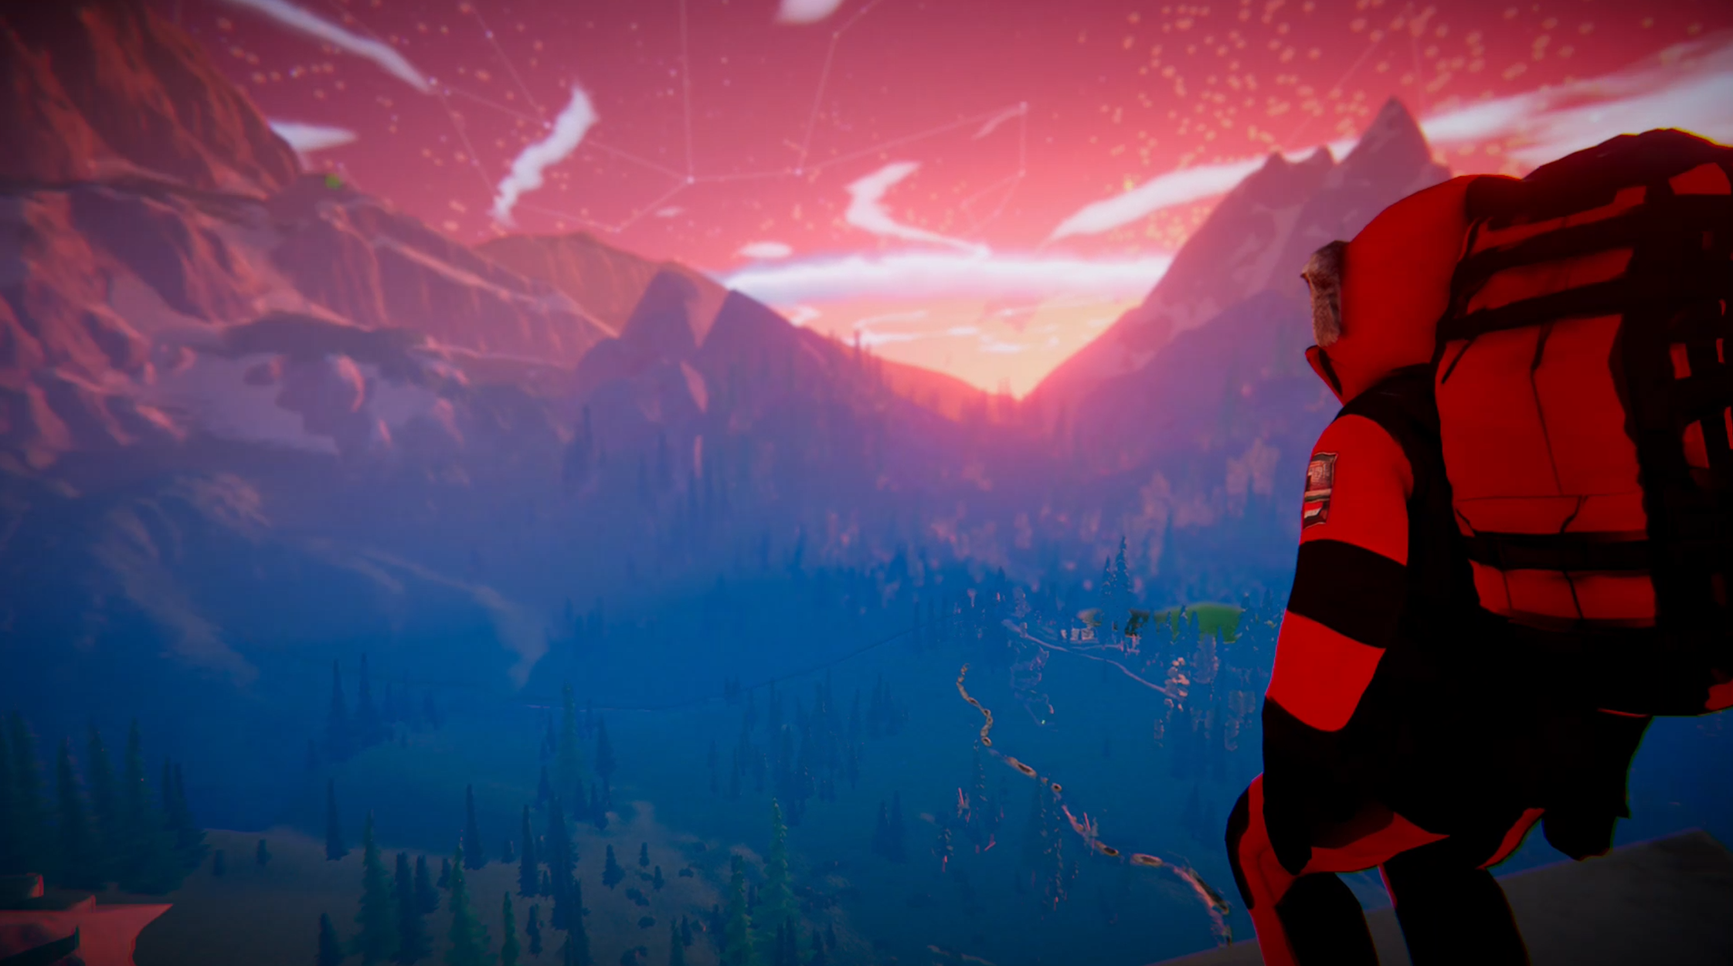
COVER
BERG
A first-person co-op climbing adventure set on the Zugspitze. Players climb together on a shared mountain server, where route choice, weather, oxygen, cold, stamina and rope safety define the outcome of each expedition.
Concept Development Deck for FFF Bayern High Concept 2.0
PC
12+
PLATFORM
AUDIENCE
PC
casual co-op players
Berg | Concept Development Deck | FFF Bayern High Concept 2.0
01

Slide 2
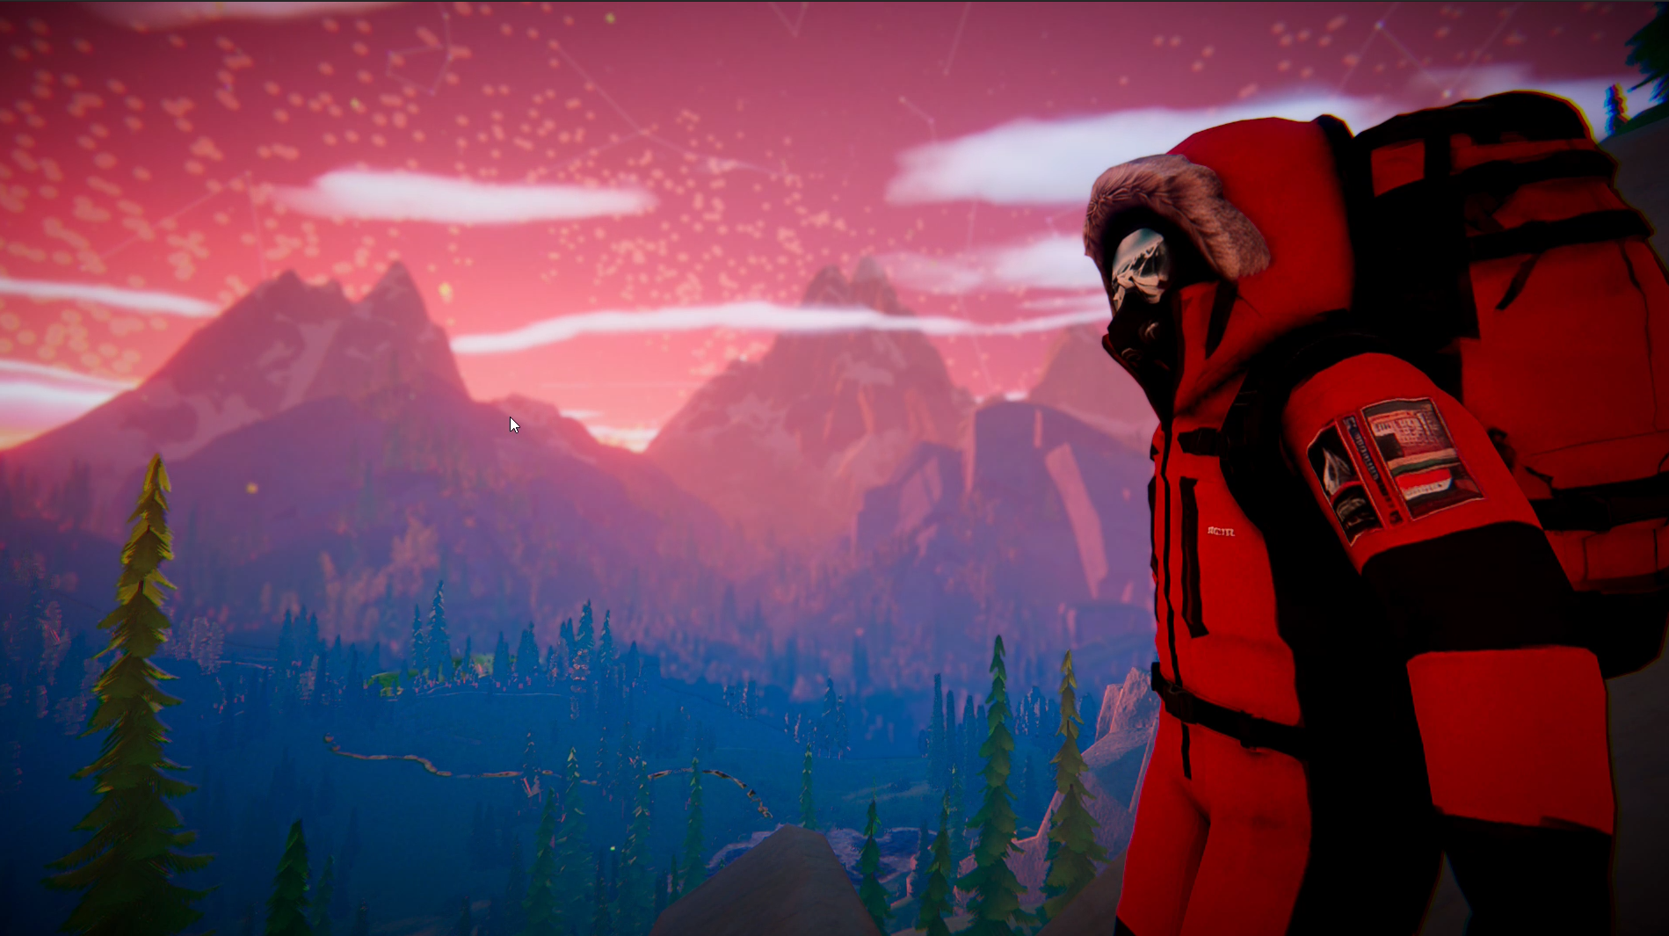
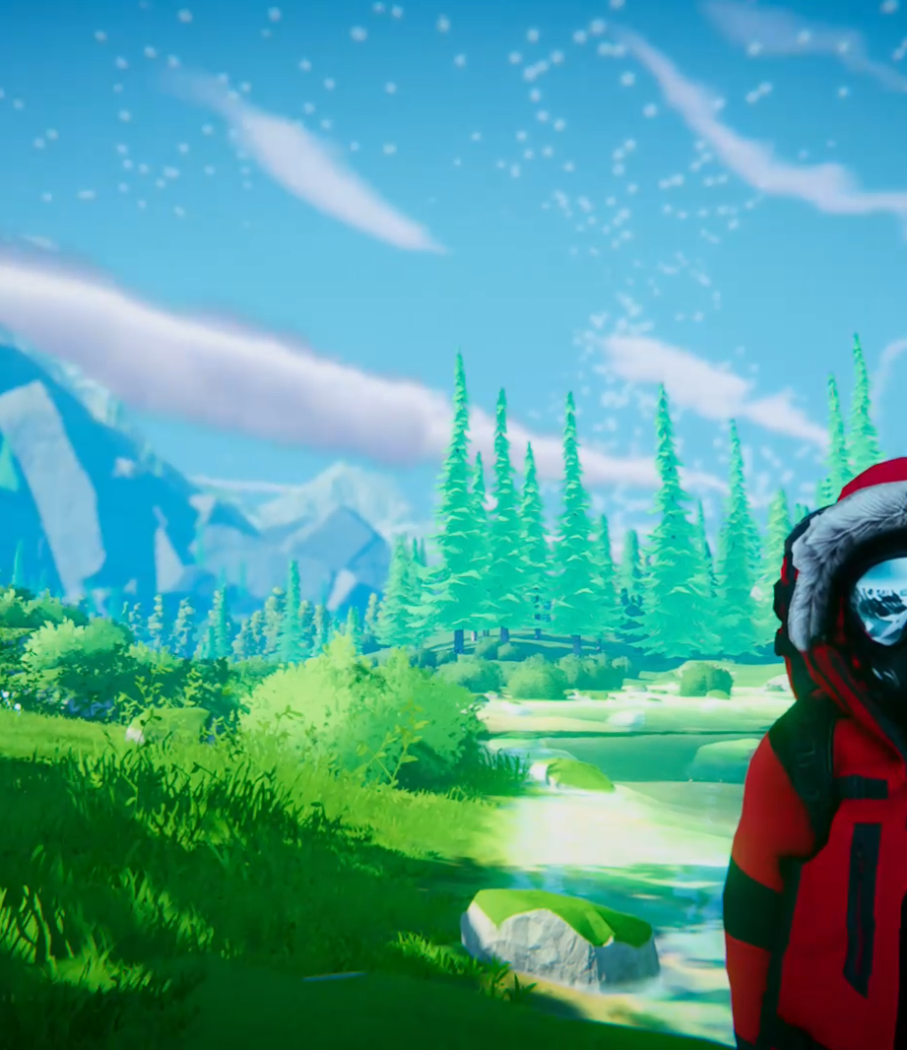
ELEVATOR PITCH
A grounded co-op climbing adventure set on the Zugspitze.
BERG is a first-person co-op game about reaching the summit in modern alpine conditions. Players start at the base of the mountain, choose routes, deliver supplies, complete tasks and climb upward while overcoming environmental obstacles.
The core interaction is simple and readable: control each hand, manage grip, secure the rope, monitor oxygen and keep moving. Depth comes from route choice, weather pressure, oxygen management, cold exposure and the presence of other players on the same mountain.
Key points
USK 6/12
60+ min
Zugspitze setting
TARGET RATING
SESSION TARGET
Friends-first co-op
USK 6/12
60+ minutes
Mood target
Readable alpine pressure
Grounded, atmospheric and accessible
Berg | Concept Development Deck | FFF Bayern High Concept 2.0
02

Slide 3
MOMENT-TO-MOMENT LOOP
The climb is built around clear physical decisions.
BERG translates climbing into a readable gameplay loop. Players read the route, climb by moving each hand separately, attach themselves to rope anchors and monitor their body state under changing alpine conditions.
01 — Read the route
02 — Move each hand
03 — Attach to anchors
04 — Monitor body state
Players follow marked climbing lines, evaluate the next section and choose when to continue, rest or change approach.
Separate left and right hand inputs create the core climbing rhythm.
Players secure themselves to fixed rope points to reduce fall risk and create safer progress.
Cold, oxygen and stamina affect movement speed, grip reliability and recovery.
Failure model
Weather pressure
Fall, ragdoll, freeze, recover. Mistakes do not delete the run. Players can lose time, position and route progress, but return to a recoverable state or respawn from the checkpoint.
Changing weather supports longer 60+ minute attempts. Strong wind can interfere with movement and drown out voice chat. Snowstorms reduce visibility and can separate players, creating tense moments where teammates must call out to find each other again.
Berg | Concept Development Deck | FFF Bayern High Concept 2.0
03

Slide 4
MOUNTAIN STRUCTURE
One mountain, multiple routes to the same summit.
All players start at the base of the mountain. The mountain contains several rope-marked routes that all lead toward the same summit, but each route creates a different risk profile. At the beginning, only one route is clearly available. As players progress, they unlock new routes and learn which lines are safer, faster or more demanding under specific conditions.
NPC tasks give players practical goals during the climb. Completing tasks rewards currency that can be spent on better oxygen tanks, improved hand stamina, longer ropes, winch-based rope tools, radios and other climbing gadgets.
Route logic
There is one main checkpoint in the middle of the mountain. It reduces frustration while preserving the feeling of one continuous climb.
Base → route choice → middle checkpoint → summit push
Quest examples
Deliver an oxygen tank to an intermediate camp
Deliver supplies to a high-altitude tent camp
Bring down an NPC suffering from altitude sickness
Evacuate climbers stranded on the route
Berg | Concept Development Deck | FFF Bayern High Concept 2.0
04

Slide 5
SIMULATION PILLARS
Realism is expressed through readable gameplay systems.
BERG should feel grounded and atmospheric without becoming a hardcore climbing simulator. The player has a clear HUD for important survival and movement indicators, while the mountain systems directly affect moment-to-moment decisions.
SYSTEM
PLAYER-FACING INFORMATION
GAMEPLAY EFFECT
Wind speed / direction
Wind strength, direction and exposed route sections
Pushes players sideways, makes some sections harder and can increase fall risk
Cold and snow
Temperature drop, snowstorm intensity and exposure
Slows movement, increases pressure to rest or reach shelter
Snowstorm visibility
Reduced visibility in bad weather
Players can lose sight of teammates and must communicate to regroup
Voice distance
Proximity voice affected by distance and weather
Strong wind and snowstorms make communication harder
Oxygen
Tank amount and thin-air pressure
Lower oxygen makes stamina drain faster during vertical climbs
Hand stamina
Separate grip stamina for climbing actions
Forces pauses, safer route choices and better timing
Berg | Concept Development Deck | FFF Bayern High Concept 2.0
05

Slide 6
SOCIAL MOUNTAIN
Multiplayer turns the mountain into a shared expedition space.
Up to 100
ONLINE PLAYERS
public server ambition, to be validated during prototyping.
BERG is not limited to a closed four-player party. The concept is built around a cloud-hosted Photon server where multiple teams share the same mountain, cross paths on routes, hear nearby players through distance-based voice chat and create organic rescue, supply and cooperation moments.
Unity + Photon
TECHNICAL DIRECTION
Unity + Photon
Public base
Route traffic
Emergent help
Summit stories / leaderboard
Players gather, choose routes, accept tasks and form groups.
Teams cross each other on easier and more technical climbing lines.
Supplies, rescue actions and rope support become social interactions.
The server records who reached the summit and under which conditions.
Communication
Design intent
Distance-based voice chat
Global text chat
A public mountain where other players become part of the expedition pressure, not just background population.
Berg | Concept Development Deck | FFF Bayern High Concept 2.0
06

Slide 7
PROGRESSION AND RETENTION
Replayability comes from upgrades, harder routes and shared stories.
BERG is designed around repeated attempts to reach the summit under different conditions. Players improve their equipment, unlock more demanding routes and return to the mountain with different friends to experience new failures, rescues and summit stories.
Progression
Retention
Business model
Better oxygen tanks
Try a harder route
Premium Steam
Buy once, invite friends, climb the mountain.
Improved hand stamina
Return with another group
Longer ropes
Recover from failed attempts
Radios and climbing gadgets
Create memorable co-op moments
New route access
Reach the summit under different conditions
Berg | Concept Development Deck | FFF Bayern High Concept 2.0
07

Slide 8
MARKET POSITION
Climbing games show clear demand, but PC still has room for a grounded social alpine title.
BERG is positioned between PEAK and more realistic Roblox climbing experiences such as K2 Climbing Simulator. The goal is a dedicated premium PC product, not a mod or platform-limited experience.
PEAK
BERG
Roblox K2 Climbing Simulator
A strong reference for social climbing with broad streamer-friendly readability. Its tone is closer to fantasy, friendslop and comedy than to an atmospheric climbing simulation.
A dedicated premium PC climbing adventure set in the Bavarian Alps. BERG focuses on grounded atmosphere, route planning, weather pressure, proximity voice and shared-server expeditions.
A proof that players respond to climb-to-summit progression and public mountain status. Roblox shows the demand, while BERG translates the appeal into a dedicated PC Steam product.
BERG difference
BERG combines PEAK's social readability with K2's climb-to-summit progression, then moves both toward a grounded PC Steam experience: Zugspitze setting, weather pressure, proximity voice and shared-server expeditions.
Berg | Concept Development Deck | FFF Bayern High Concept 2.0
08

Slide 9
FFF BAYERN CONCEPT PHASE
The goal is to make BERG ready for further production funding.
The High Concept 2.0 phase is focused on clarifying the design, market positioning, technical scope and visual direction before moving into production.
High Concept 2.0
Additional concept-phase deliverables
Bavarian relevance
A polished English concept deck and written design thesis for FFF follow-up evaluation.
GDD 1.0
The Zugspitze and the German Alps give the project a clear local cultural and geographic anchor.
Financial plan
Cost plan for a future prototype funding application
Generative AI disclosure
AI may be used as an ideation aid during concept work. Final application material should clearly label the role of AI and remain under human creative direction.
Berg | Concept Development Deck | FFF Bayern High Concept 2.0
09

Slide 10
TEAM AND ASK
ZweiBier Indie can turn a focused concept grant into a fundable production package.
Dreadway
Munich
Applicants: Aleksandr Varko - ZweiBier Indie, Munich. The production team is intentionally small and focused: Aleksandr Varko leads programming, multiplayer systems and producing. PMB Interactive contributes art direction, visual concepts and level design — backed by 20+ years of game development experience, 50+ published titles and awards including the Apple Design Award and the Deutscher Computerspielpreis.
TRACK RECORD
LOCATION
Shipped commercial Steam reference
Home-based Bavarian development
PC Steam
High Concept 2.0
Aleksandr Varko
Matthias Baudrexl
Programming, multiplayer systems and producing
Founder PMB Interactive UG; PMB Interactive contributes art direction, visual concepts and level design
TARGET
NEXT GATE
Premium multiplayer release path
Design, market, technical scope and art package
Request
20 000 euro
BERG
A realistic social climbing adventure set on the Zugspitze.
Berg | Aleksandr Varko / ZweiBier Indie | FFF Bayern
10

