Slide 1
Databases and Visual Studio (part I)

Slide 2
Creating a database in Visual Studio
We can use Visual Studio as a DBMS
First steps:
Create a local database (is physically located on your PC)
Create tables, row, etc. by using a given database script

Slide 3
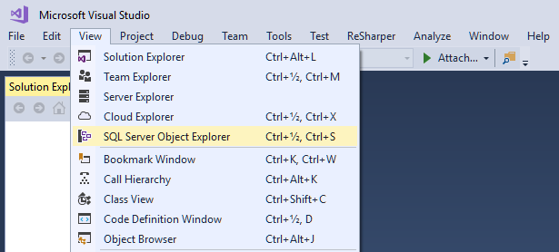

Slide 4
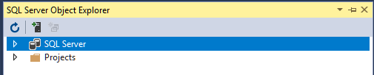
A database runs on a database server (found under SQL Server)

Slide 5
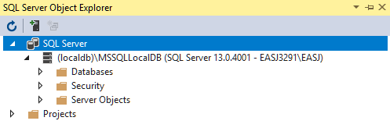
This is a built-in database server called (localdb)

Slide 6
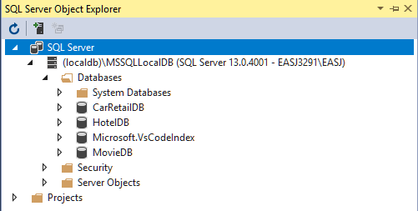
You probably don’t have all these databases (yet ☺)

Slide 7
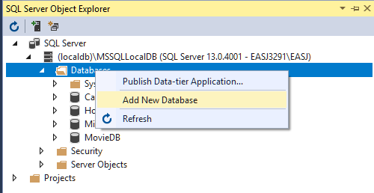
Right-click on Databases, and choose Add New Database

Slide 8
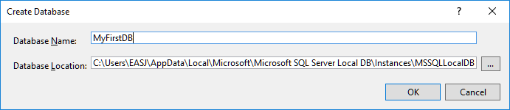

Slide 9
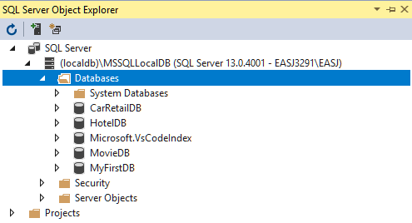

Slide 10
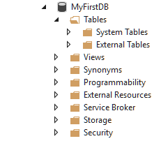

Slide 11
Creating a database in Visual Studio
We have created a (local) database called MyFirstDB
The database does not contain any (user-defined) tables yet
Table definitions can be created manually (later), or by running a database script
A script generally just contains SQL code, which may e.g.
Create a number of tables
Enter a number of rows into the tables

Slide 12
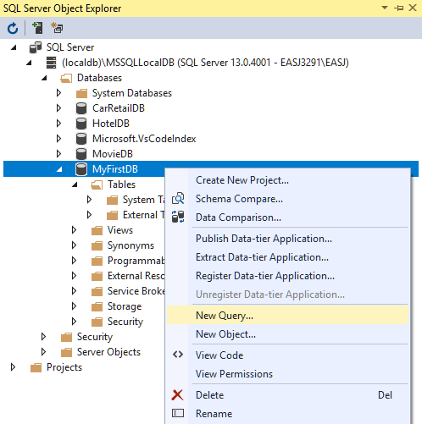
Right-click on MyFirstDB, and choose New Ouery…

Slide 13
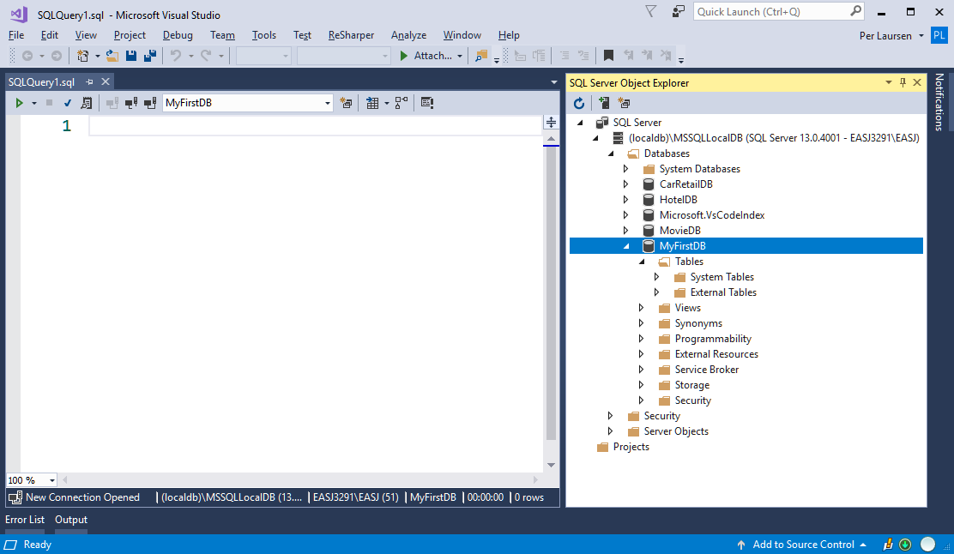
This opens a Query window

Slide 14
Here you can write SQL directly, or copy SQL from a given script

Slide 15
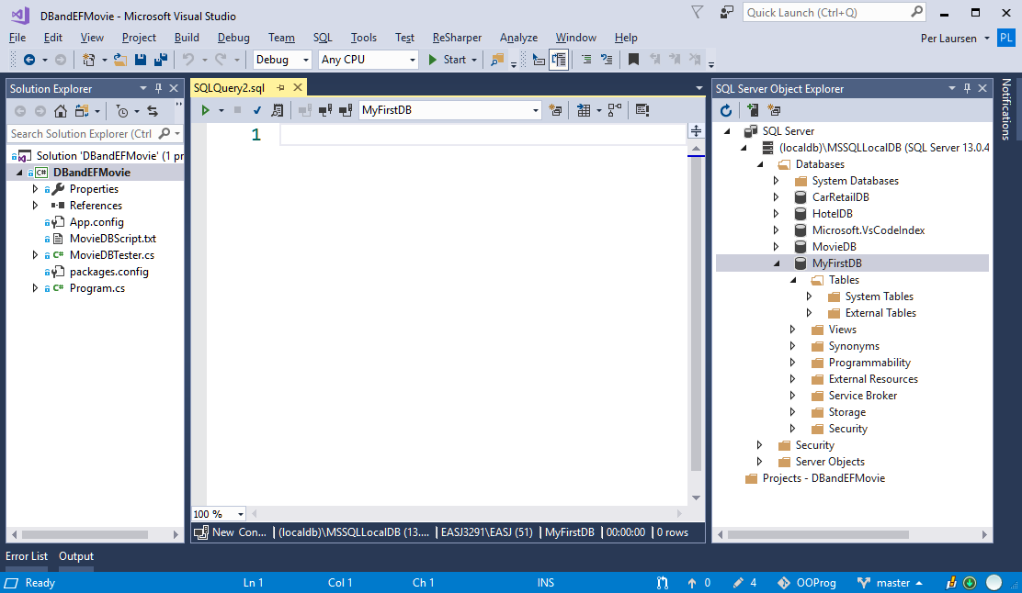
Example: Script included in exercise project, as a simple text file

Slide 16
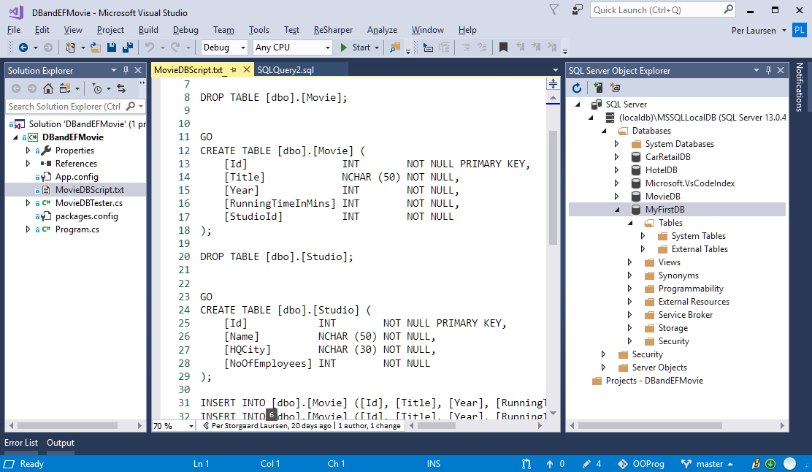
Copy content from text file into Query window

Slide 17
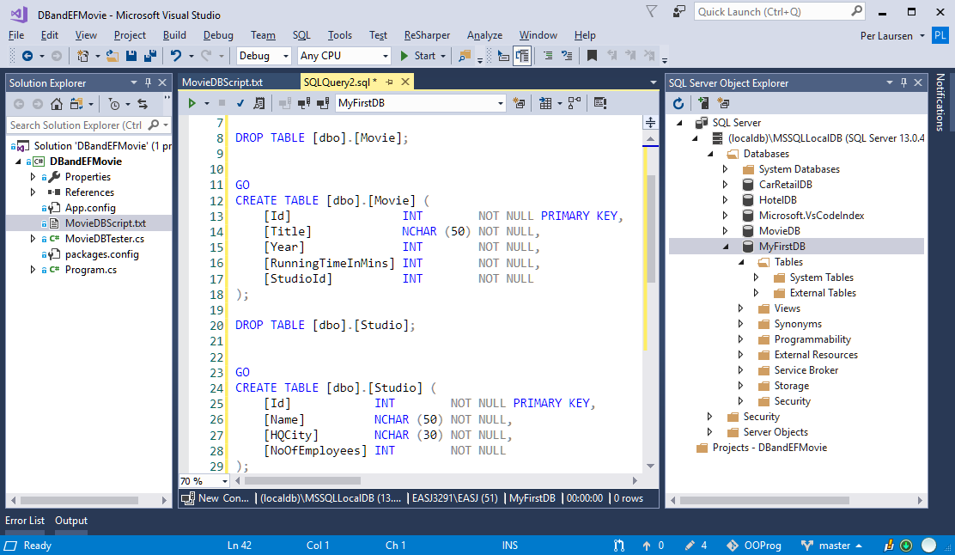

Slide 18
NOT THIS ONE!!! ☺
Run script by clicking the small green triangle

Slide 19
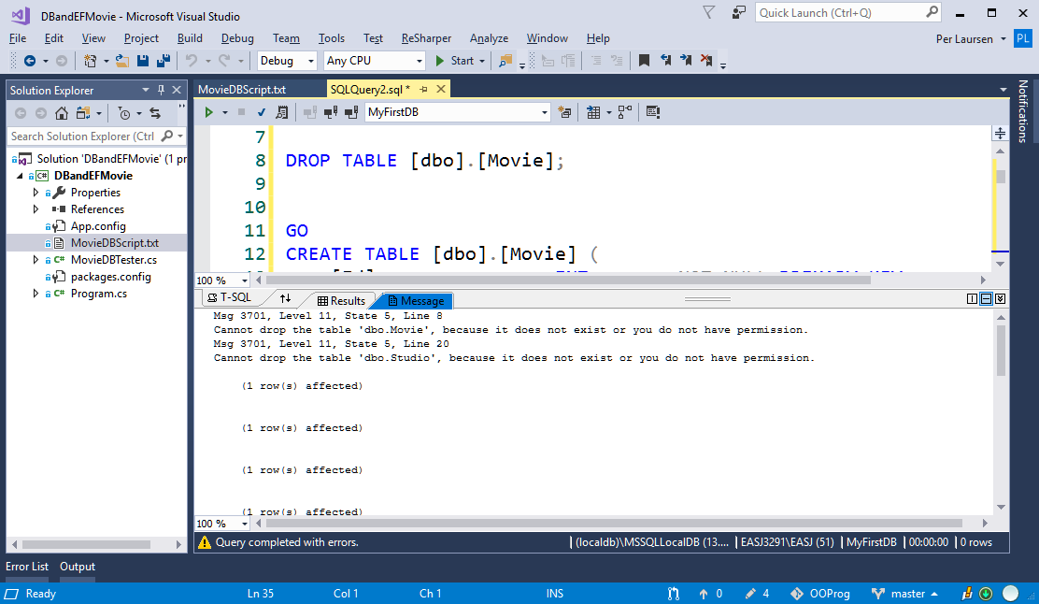
Don’t panic if some errors are reported when running the script ☺

Slide 20
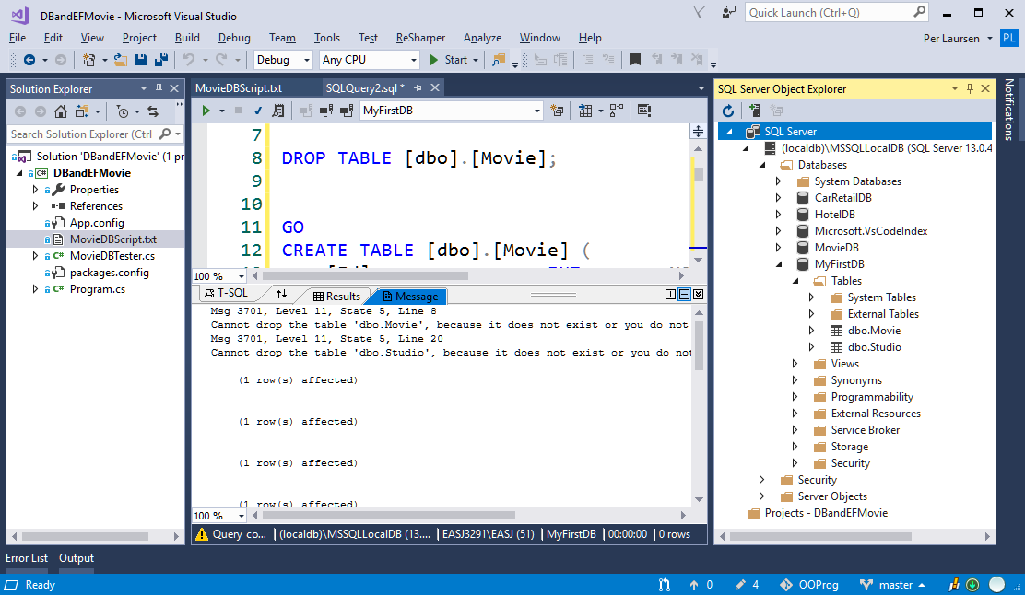
Now click the Refresh button…
…two new tables have been added to MyFirstDB ☺

Slide 21
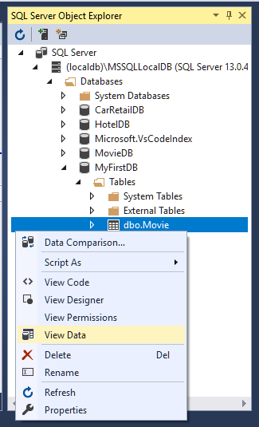
Right-click on Movie table, and choose View Data

Slide 22
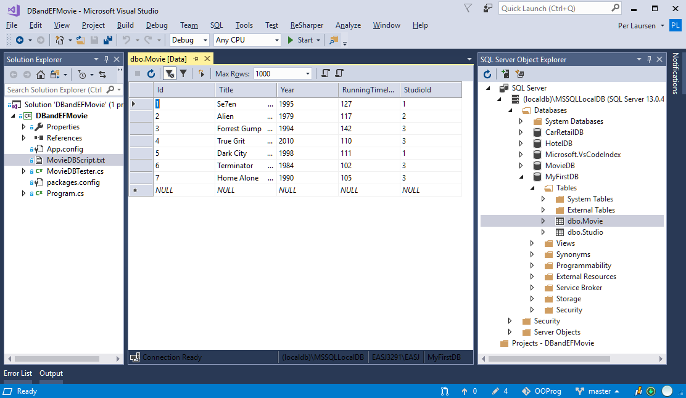
The Movie table contains 7 rows

Slide 23
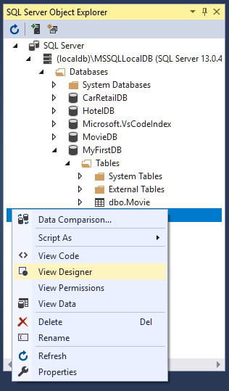
Right-click on Movie table, and choose View Designer

Slide 24
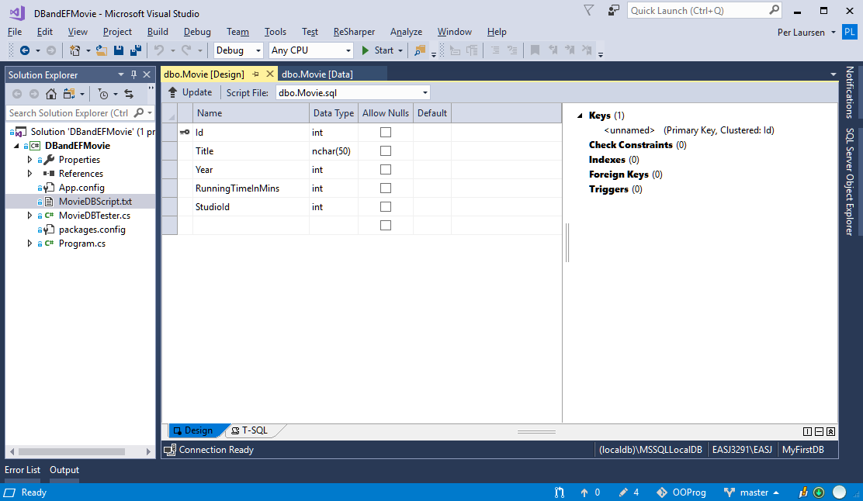
Column definitions for Movie table (designer mode)

Slide 25
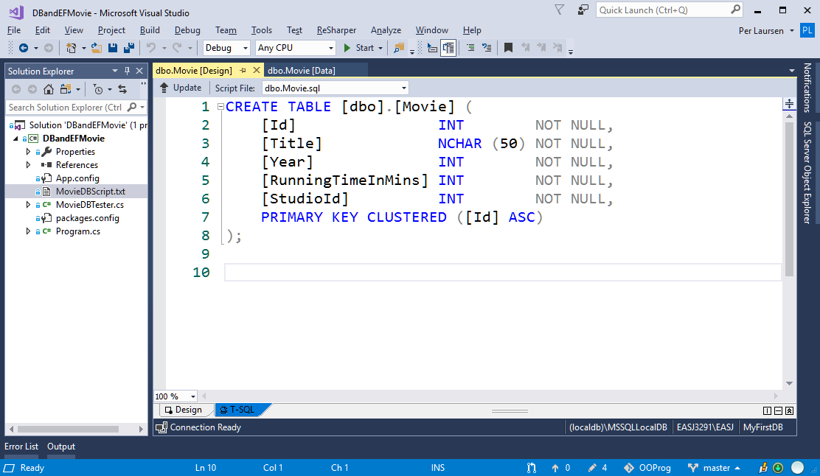
Column definitions for Movie table (”raw” SQL code)

Slide 26
Creating a database in Visual Studio
We can now
Create a new database
Run a given script on the database
Next steps are
Execute queries on a database
Define tables manually

